Slide 1
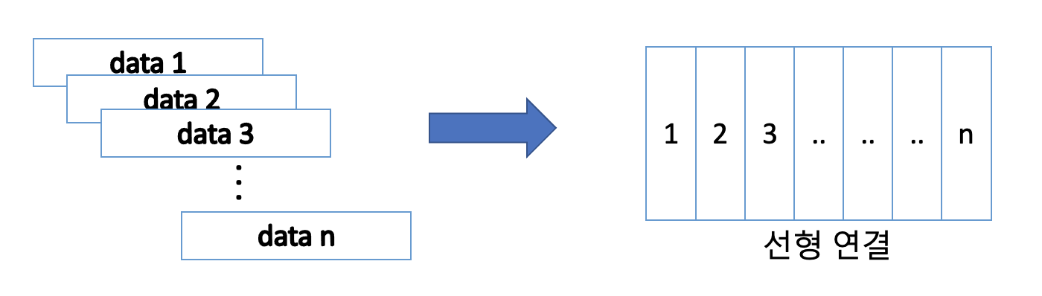

Slide 2
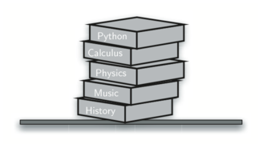

Slide 3
8.4
Top
True
“dog”
4
Base

Slide 4
8.4
4th
1st
True
2nd
3rd
“dog”
2nd
3rd
4
1st
4th
8.4
True
“dog”
4
4
“dog”
True
8.4
Original Order
Reversed Order

Slide 5
Most recent open matches first close
( ( ) ( ( ) ) ( ) )
First open may wait until last close

Slide 6
1
Push remainders
Pop remainders
1
1
233//2=116 rem=1
0
116//2=58 rem=0
1
29//2=14 rem=1
14//2=7 rem=0
0
7//2 = 3 rem = 1
0
3//2=1 rem=1
1//2=0 rem=1
1

Slide 7
( A + ( B * C ) )

Slide 8
( A + ( B * C ) )

Slide 9
(A+B) * C – (D-E) * (F+G)
(((A+B) * C) – ((D-E) * (F+G)))
Prefix
Postfix
-*+ABC*-DE+FG
AB+C*DE-FG+*-

Slide 10
A*B+C*D
A
*
B
+
C
*
D
*
*
*
*
*
*
+
+
+
+
+
+
A
B
*
C
D
*
+
AB*CD*+

Slide 11
Left to Right Evaluation
4
5
6
*
+
push
Pop twice and
push
push
do math
Pop twice and
6
do math
5
5
30
4
4
4
4
34

Slide 12
7
8
+
3
2
+
/
2
8
3
3
5
7
7
15
15
15
15
3

Slide 13
rear
8.4
True
“dog”
4
front
Items

Slide 14
Bill
Pass to next person
After 5 passes,
Brad is eliminated
Brad
David
Until predefined counting constant
And so on
Kent
Susan
Jane

Slide 15
rear
Brad
Kent
Jane
Susan
David
Bill
front
Go to the rear
(Pass the potato)
enqueue
dequeue
rear
Bill
Brad
Kent
Jane
Susan
David
front

Slide 16
17
31
26
54
93
77

Slide 17
17
31 (End)
26
Head
54
93
77

