Slide 1
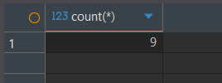
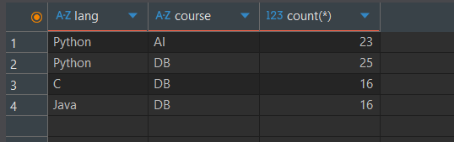
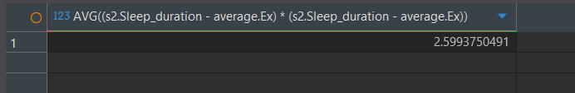
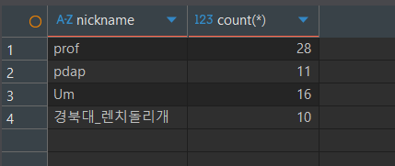

Problem Number | Your Solution (SQL) | Captured Result
Problem1 | select count(*) from new_student s where s.mbti_type like '___J' and exists (select * from favorite_course f where f.nickname = s.nickname and f.course = 'OS')
Problem2 | select p.lang, f.course, count(*) from preferred_pl p, favorite_course f where p.nickname = f.nickname group by p.lang, f.course having count(*) >= 15
Problem3 | with average as (select AVG(s1.Sleep_duration) as Ex from student s1) select AVG((s2.Sleep_duration - average.Ex) * (s2.Sleep_duration - average.Ex)) from student s2, average
Problem4 | with union_friend as ((select * from friend_info f1) union (select f2.friend_nickname, f2.nickname from friend_info f2)) select u.nickname , count(*) from union_friend u group by u.nickname having count(*) >= 8
Problem5 | select count(s.nickname) from new_student s where not exists (select * from favorite_course fc where s.nickname = fc.nickname and fc.course is null) and not exists (select * from favorite_food ff where ff.nickname = s.nickname and ff.food is null) and not exists (select * from preferred_pl pp where pp.nickname = s.nickname and pp.lang is null)

