Slide 3










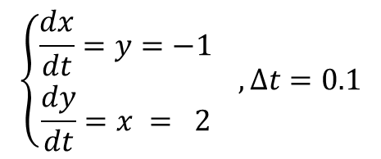

$\left(x,y\right)=\left(2, −1\right)$에서
$$y$$
$$\left\{\begin{aligned}\frac{dx}{dt}=y=−1 \\ \frac{dy}{dt}=x = 2\end{aligned}\right. , Δt=0.1$$
$$0$$
$$1$$
$$2$$
$$x$$
$$−1$$
$$\left(1.9, −0.8\right)$$
$$\frac{dy}{dt}Δt$$
$$\left(2, −1\right)$$
$$\frac{dx}{dt}Δt$$

Slide 6

$$\left[\begin{matrix}0 & 1 \\ 1 & 0\end{matrix}\right]$$
행렬을 통한
선형변환

Slide 10
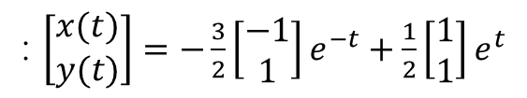





$t=1.$2
$t=0.$9
$t=0.$6
$$t=0.3$$
$$t=0$$
: $\left[\begin{matrix}x(t) \\ y(t)\end{matrix}\right]=−\frac{3}{2}\left[\begin{matrix}−1 \\ 1\end{matrix}\right]e^{−t}+\frac{1}{2}\left[\begin{matrix}1 \\ 1\end{matrix}\right]e^{t}$

