Slide 1
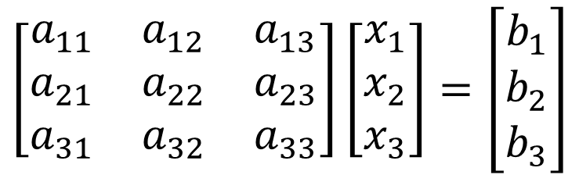

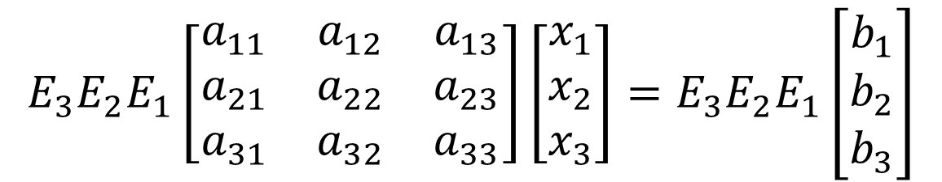
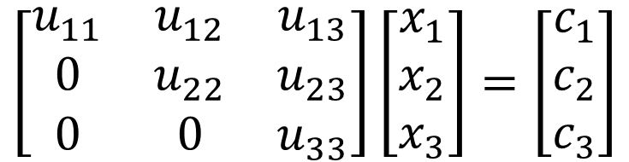

$$Ax=b$$
$$Ux=c$$
$$\left[\begin{matrix}a_{11} & a_{12} & a_{13} \\ a_{21} & a_{22} & a_{23} \\ a_{31} & a_{32} & a_{33}\end{matrix}\right]\left[\begin{matrix}x_{1} \\ x_{2} \\ x_{3}\end{matrix}\right]=\left[\begin{matrix}b_{1} \\ b_{2} \\ b_{3}\end{matrix}\right]$$
$$\left[\begin{matrix}u_{11} & u_{12} & u_{13} \\ 0 & u_{22} & u_{23} \\ 0 & 0 & u_{33}\end{matrix}\right]\left[\begin{matrix}x_{1} \\ x_{2} \\ x_{3}\end{matrix}\right]=\left[\begin{matrix}c_{1} \\ c_{2} \\ c_{3}\end{matrix}\right]$$
Basic Row Operations
$$E_{3}E_{2}E_{1}\left[\begin{matrix}a_{11} & a_{12} & a_{13} \\ a_{21} & a_{22} & a_{23} \\ a_{31} & a_{32} & a_{33}\end{matrix}\right]\left[\begin{matrix}x_{1} \\ x_{2} \\ x_{3}\end{matrix}\right]=E_{3}E_{2}E_{1}\left[\begin{matrix}b_{1} \\ b_{2} \\ b_{3}\end{matrix}\right]$$

Slide 2
▲
-
-
-
-
-
-
-
0
▲
-
-
-
-
-
-
0
0
▲
-
-
-
-
-
0
0
0
▲
-
-
-
-
0
0
0
0
0
0
▲
-
0
0
0
0
0
0
0
0

Slide 3
Pivots
▲
-
-
-
-
-
-
-
0
▲
-
-
-
-
-
-
0
0
▲
-
-
-
-
-
0
0
0
▲
-
-
-
-
0
0
0
0
0
0
▲
-
0
0
0
0
0
0
0
0

Slide 4
1
0
0
0
-
-
0
-
:Pivots
0
1
0
0
-
-
0
-
0
0
1
0
-
-
0
-
0
0
0
1
-
-
0
-
0
0
0
0
0
0
1
-
0
0
0
0
0
0
0
0

Slide 5



$$y=−2x−1$$
$$y=x+1$$
$$y=3x−2$$

Slide 6



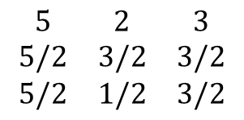



$$\begin{matrix}5 & 2 & 3 \\ 5/2 & 3/2 & 3/2 \\ 5/2 & 1/2 & 3/2\end{matrix}$$
← $r_{3}$
-
←$1/2 r_{1}$
-
←$1/2 r_{2}$
$$0$$
$$0$$
$$0$$

