Slide 1



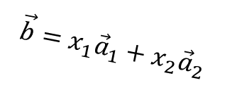
$$\vec{b}={x_{1}\vec{a}}_{1}+x_{2}{\vec{a}}_{2}$$
$$\vec{b}$$
$${\vec{a}}_{2}$$
$${\vec{a}}_{1}$$
Col(A)

Slide 2





$$\vec{b}$$
$$\vec{e}=\vec{b}−\vec{p}$$
Col(A)
$${\vec{a}}_{2}$$
$$p=A\hat{x}$$
$${\vec{a}}_{1}$$

