Slide 1
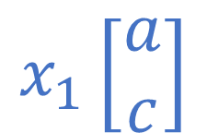

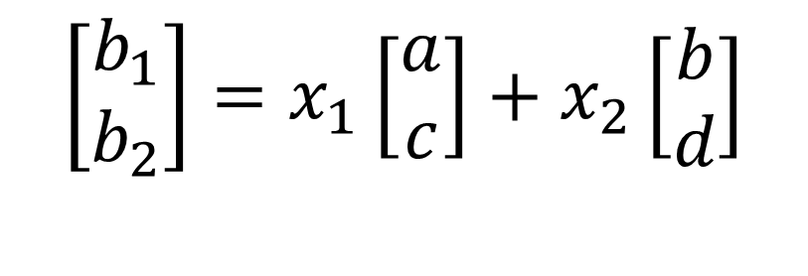


$$\left[\begin{matrix}b_{1} \\ b_{2}\end{matrix}\right]=x_{1}\left[\begin{matrix}a \\ c\end{matrix}\right]+x_{2}\left[\begin{matrix}b \\ d\end{matrix}\right]$$
$$x_{2}\left[\begin{matrix}b \\ d\end{matrix}\right]$$
$$\left[\begin{matrix}b \\ d\end{matrix}\right]$$
$$\left[\begin{matrix}a \\ c\end{matrix}\right]$$
$$x_{1}\left[\begin{matrix}a \\ c\end{matrix}\right]$$

Slide 2
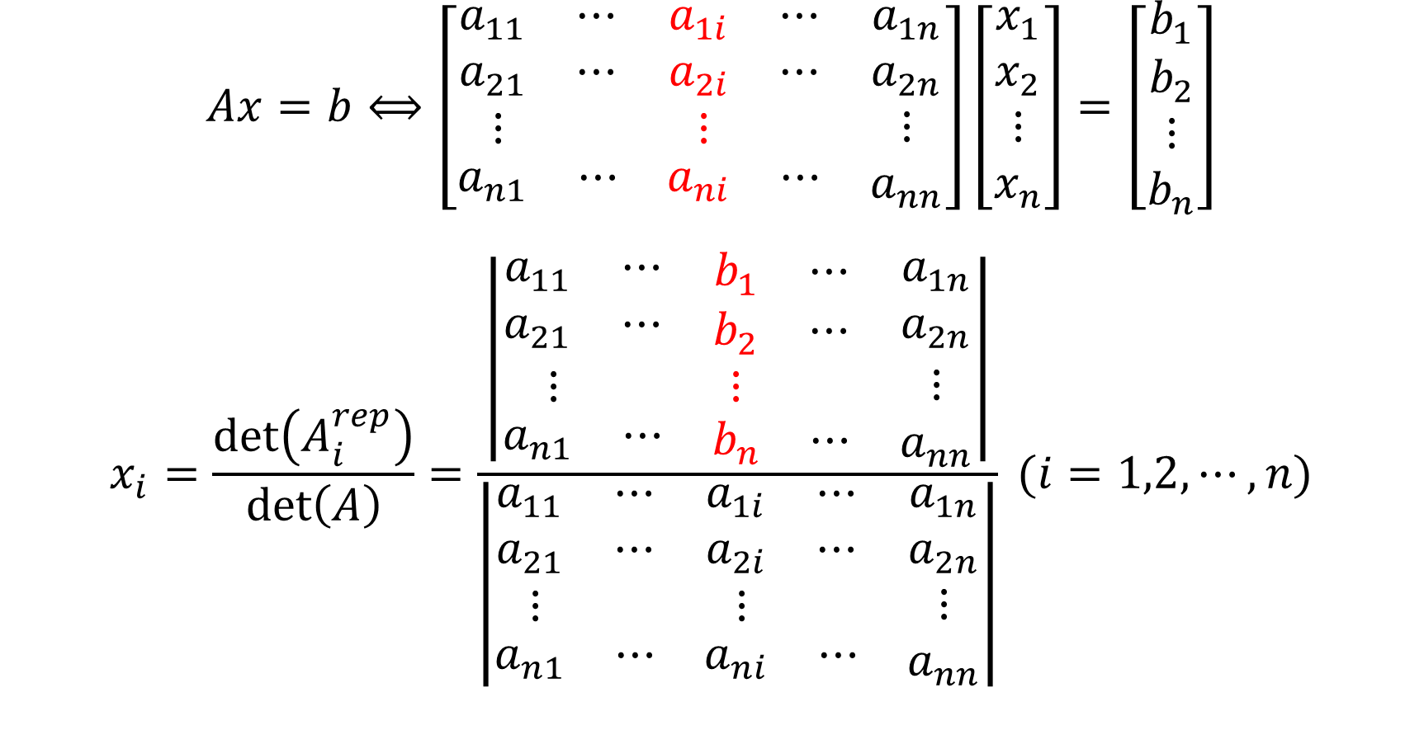
$$Ax=b⟺\left[\begin{matrix}\begin{matrix}a_{11} & ⋯ \\ a_{21} & ⋯\end{matrix} & \begin{matrix}a_{1i} & ⋯ \\ a_{2i} & ⋯\end{matrix} & \begin{matrix}a_{1n} \\ a_{2n}\end{matrix} \\ \begin{matrix}⋮ & \end{matrix} & \begin{matrix}⋮ & \end{matrix} & ⋮ \\ \begin{matrix}a_{n1} & ⋯\end{matrix} & \begin{matrix}a_{ni} & ⋯\end{matrix} & a_{nn}\end{matrix}\right]\left[\begin{matrix}\begin{matrix}x_{1} \\ x_{2}\end{matrix} \\ \begin{matrix}⋮ \\ x_{n}\end{matrix}\end{matrix}\right]=\left[\begin{matrix}\begin{matrix}b_{1} \\ b_{2}\end{matrix} \\ \begin{matrix}⋮ \\ b_{n}\end{matrix}\end{matrix}\right]$$
$$x_{i}=\frac{\det\left(A_{i}^{rep}\right)}{\det\left(A\right)}=\frac{\left|\begin{matrix}\begin{matrix}a_{11} & ⋯ \\ a_{21} & ⋯\end{matrix} & \begin{matrix}b_{1} & ⋯ \\ b_{2} & ⋯\end{matrix} & \begin{matrix}a_{1n} \\ a_{2n}\end{matrix} \\ \begin{matrix}⋮ & \end{matrix} & \begin{matrix}⋮ & \end{matrix} & ⋮ \\ \begin{matrix}a_{n1} & ⋯\end{matrix} & \begin{matrix}b_{n} & ⋯\end{matrix} & a_{nn}\end{matrix}\right|}{\left|\begin{matrix}\begin{matrix}a_{11} & ⋯ \\ a_{21} & ⋯\end{matrix} & \begin{matrix}a_{1i} & ⋯ \\ a_{2i} & ⋯\end{matrix} & \begin{matrix}a_{1n} \\ a_{2n}\end{matrix} \\ \begin{matrix}⋮ & \end{matrix} & \begin{matrix}⋮ & \end{matrix} & ⋮ \\ \begin{matrix}a_{n1} & ⋯\end{matrix} & \begin{matrix}a_{ni} & ⋯\end{matrix} & a_{nn}\end{matrix}\right|} (i=1,2,⋯,n)$$

Slide 3






$$x_{2}\left[\begin{matrix}b \\ d\end{matrix}\right]$$
$$\left[\begin{matrix}b_{1} \\ b_{2}\end{matrix}\right]$$
$$\det\left(\left[\begin{matrix}a & b \\ c & d\end{matrix}\right]\right)$$
$$\left[\begin{matrix}b \\ d\end{matrix}\right]$$
$$\left[\begin{matrix}a \\ c\end{matrix}\right]$$
$$x_{1}\left[\begin{matrix}a \\ c\end{matrix}\right]$$

Slide 4

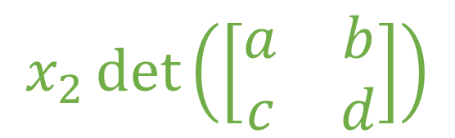




$$x_{2}\det\left(\left[\begin{matrix}a & b \\ c & d\end{matrix}\right]\right)$$
$$x_{2}\left[\begin{matrix}b \\ d\end{matrix}\right]$$
$$\left[\begin{matrix}b_{1} \\ b_{2}\end{matrix}\right]$$
$$\left[\begin{matrix}b \\ d\end{matrix}\right]$$
$$\left[\begin{matrix}a \\ c\end{matrix}\right]$$
$$x_{1}\left[\begin{matrix}a \\ c\end{matrix}\right]$$

Slide 5



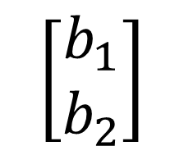


$$\left[\begin{matrix}b_{1} \\ b_{2}\end{matrix}\right]$$
$$x_{2}\left[\begin{matrix}b \\ d\end{matrix}\right]$$
$$\left[\begin{matrix}b \\ d\end{matrix}\right]$$
$$\det\left(\left[\begin{matrix}a & b_{1} \\ c & b_{2}\end{matrix}\right]\right)$$
$$\left[\begin{matrix}a \\ c\end{matrix}\right]$$
$$x_{1}\left[\begin{matrix}a \\ c\end{matrix}\right]$$

