Slide 1
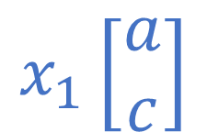

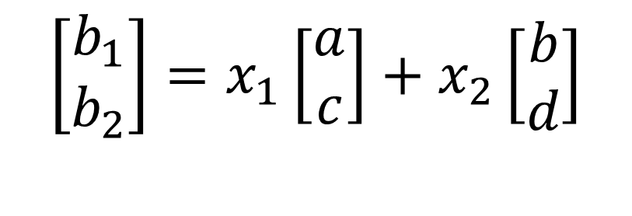


$$\left[\begin{matrix}b_{1} \\ b_{2}\end{matrix}\right]=x_{1}\left[\begin{matrix}a \\ c\end{matrix}\right]+x_{2}\left[\begin{matrix}b \\ d\end{matrix}\right]$$
$$x_{2}\left[\begin{matrix}b \\ d\end{matrix}\right]$$
$$\left[\begin{matrix}b \\ d\end{matrix}\right]$$
$$\left[\begin{matrix}a \\ c\end{matrix}\right]$$
$$x_{1}\left[\begin{matrix}a \\ c\end{matrix}\right]$$

Slide 2






$$x_{2}\left[\begin{matrix}b \\ d\end{matrix}\right]$$
$$\left[\begin{matrix}b_{1} \\ b_{2}\end{matrix}\right]$$
$$\det\left(\left[\begin{matrix}a & b \\ c & d\end{matrix}\right]\right)$$
$$\left[\begin{matrix}b \\ d\end{matrix}\right]$$
$$\left[\begin{matrix}a \\ c\end{matrix}\right]$$
$$x_{1}\left[\begin{matrix}a \\ c\end{matrix}\right]$$

Slide 3






$$x_{2}\det\left(\left[\begin{matrix}a & b \\ c & d\end{matrix}\right]\right)$$
$$x_{2}\left[\begin{matrix}b \\ d\end{matrix}\right]$$
$$\left[\begin{matrix}b_{1} \\ b_{2}\end{matrix}\right]$$
$$\left[\begin{matrix}b \\ d\end{matrix}\right]$$
$$\left[\begin{matrix}a \\ c\end{matrix}\right]$$
$$x_{1}\left[\begin{matrix}a \\ c\end{matrix}\right]$$

Slide 4



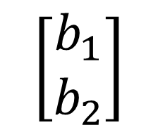


$$\left[\begin{matrix}b_{1} \\ b_{2}\end{matrix}\right]$$
$$x_{2}\left[\begin{matrix}b \\ d\end{matrix}\right]$$
$$\left[\begin{matrix}b \\ d\end{matrix}\right]$$
$$\det\left(\left[\begin{matrix}a & b_{1} \\ c & b_{2}\end{matrix}\right]\right)$$
$$\left[\begin{matrix}a \\ c\end{matrix}\right]$$
$$x_{1}\left[\begin{matrix}a \\ c\end{matrix}\right]$$

