Slide 1
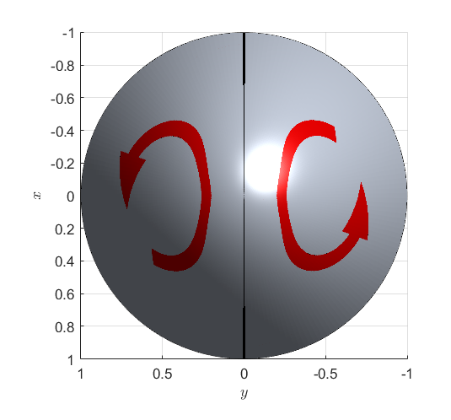


$$C_{1}$$
$$C_{2}$$

