Slide 1
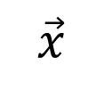

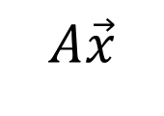
$$A$$
$$\vec{x}$$
$$A\vec{x}$$
Another
matrix
vector
matrix

