Slide 1


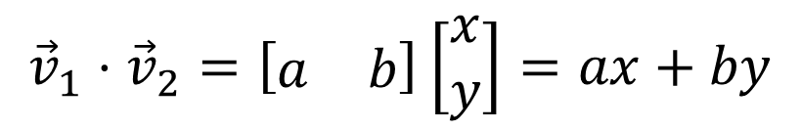
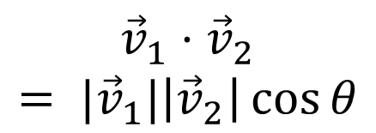


$${\vec{v}}_{2}$$
why?
$${\vec{v}}_{1}⋅{\vec{v}}_{2}=\left[\begin{matrix}a & b\end{matrix}\right]\left[\begin{matrix}x \\ y\end{matrix}\right]=ax+by$$
$$θ$$
$${\vec{v}}_{1}$$
$$\left|{\vec{v}}_{2}\right|\cos{θ}$$
$${\vec{v}}_{1}⋅{\vec{v}}_{2}= |{\vec{v}}_{1}|\left|{\vec{v}}_{2}\right|\cos{θ}$$

Slide 2
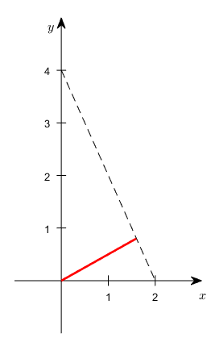



$$\sqrt{2^{2}+4^{2}}$$
$$d$$
$$0$$

