Slide 1
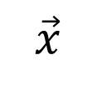

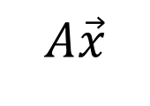
$$A$$
$$\vec{x}$$
$$A\vec{x}$$
Another
vector
vector
matrix

