Slide 1
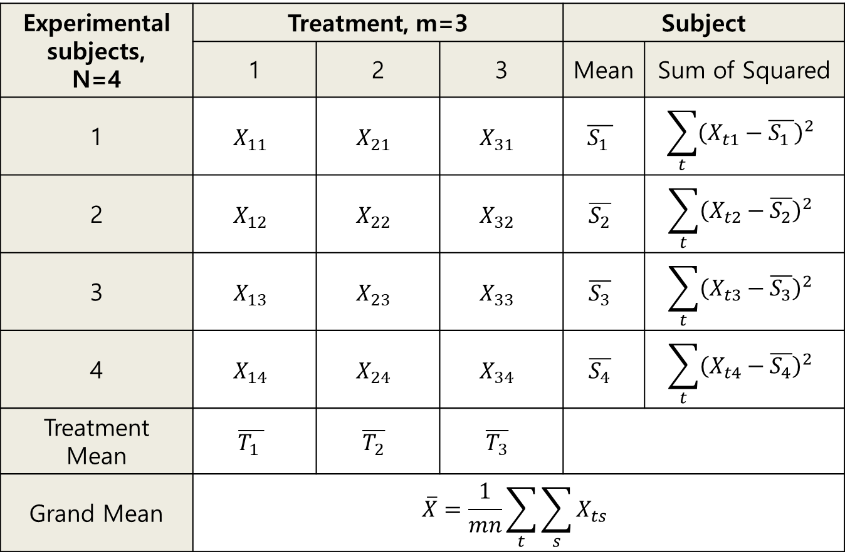
Experimental subjects, N=4 | Treatment, m=3 |  |  | Subject
 | 1 | 2 | 3 | Mean | Sum of Squared
1 | $$X_{11}$$ | $$X_{21}$$ | $$X_{31}$$ | $$\overline{S_{1 }}$$ | $$\sum_{t}{{\left(X_{t1}−\overline{S_{1 }}\right)}^{2}}$$
2 | $$X_{12}$$ | $$X_{22}$$ | $$X_{32}$$ | $$\overline{S_{2}}$$ | $$\sum_{t}{{\left(X_{t2}−\overline{S_{2}}\right)}^{2}}$$
3 | $$X_{13}$$ | $$X_{23}$$ | $$X_{33}$$ | $$\overline{S_{3}}$$ | $$\sum_{t}{{\left(X_{t3}−\overline{S_{3}}\right)}^{2}}$$
4 | $$X_{14}$$ | $$X_{24}$$ | $$X_{34}$$ | $$\overline{S_{4}}$$ | $$\sum_{t}{{\left(X_{t4}−\overline{S_{4}}\right)}^{2}}$$
Treatment Mean | $$\overline{T_{1 }}$$ | $$\overline{T_{2}}$$ | $$\overline{T_{3}}$$
Grand Mean | $$\overline{X}=\frac{1}{mn}\sum_{t}{\sum_{s}{X_{ts}}}$$

