Slide 1
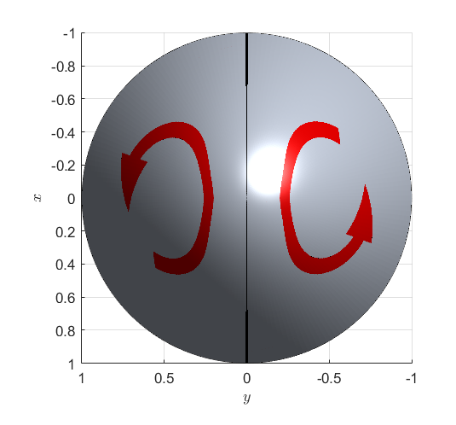


$$C_{1}$$
$$C_{2}$$

Slide 2
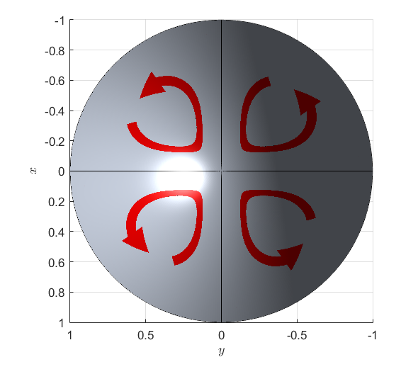




$$C_{1}$$
$$C_{2}$$
$$C_{3}$$
$$C_{4}$$

Slide 3


$${넓이: S}_{k}$$

Slide 4
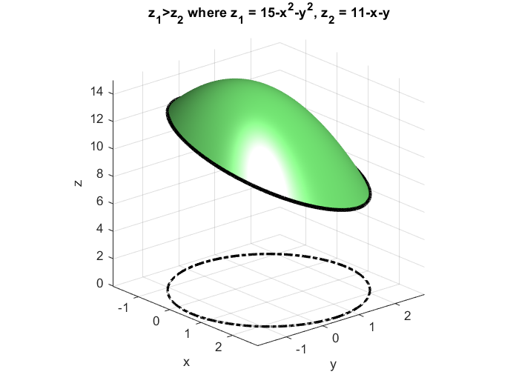


$$S$$
치역: 곡면
정의역(Domain)
$$D$$

