Slide 1
Data Structure
BST VISUALIZATION
Using JAVA FX
HyeonSeo Park
HyeonYeong Seo
JinSoo Park

Slide 2
UML
Compare the input node and existing node
Check whether the element is in the tree
Insert a new node
Delete a node
Check if iterator has more elements
Move the current node to the next point
Remove the current node from the tree
Remove all the node in the tree
+compareTo( ): void
+search( E ): boolean
+insert( E ): boolean
+delete( E ): boolean
+hasNext( ): boolean
+next( ): E
+remove( ): void
+clear( ): void

Slide 3
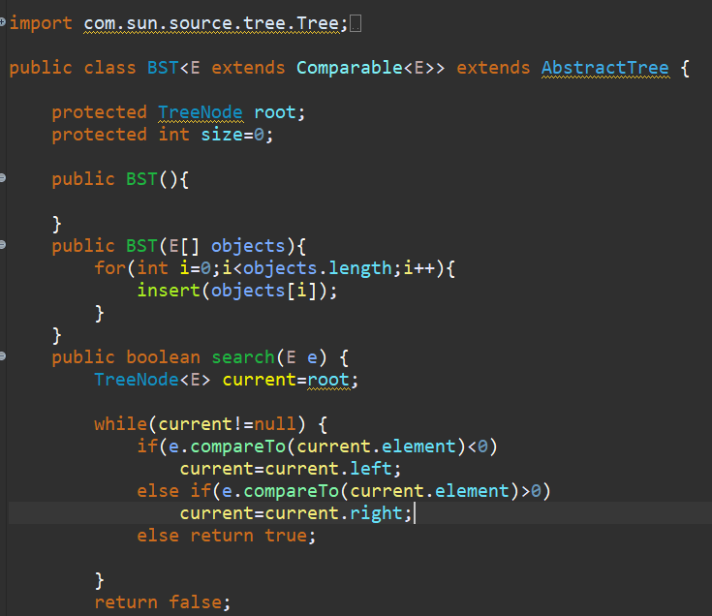
BST Class
CONTENTS
-Create a default binary tree.
-A binary tree comes from an array of objects.
01
01
02
Returns true if the element is in the tree.
<Searching Process>
Starting from the root node, then it goes down to the left side and right side of the root.
If there doesn’t exist the element, return False.

Slide 4
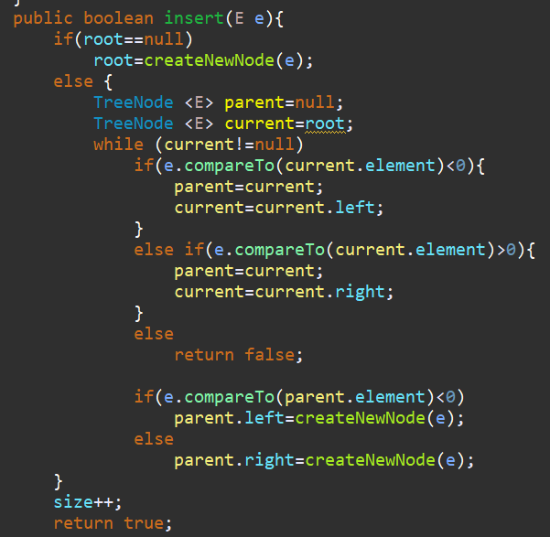
BST Class
CONTENTS
Insert element into the binary tree
-Create a new root.
-Place the parent node and compare the new node with it.
01
01
If new node is less than current node, it is located in left side.
If new node is greater than current node, it is located in right side.
02
Note
-duplicated node is rejected.
-after inserting, size of tree becomes +1

Slide 5
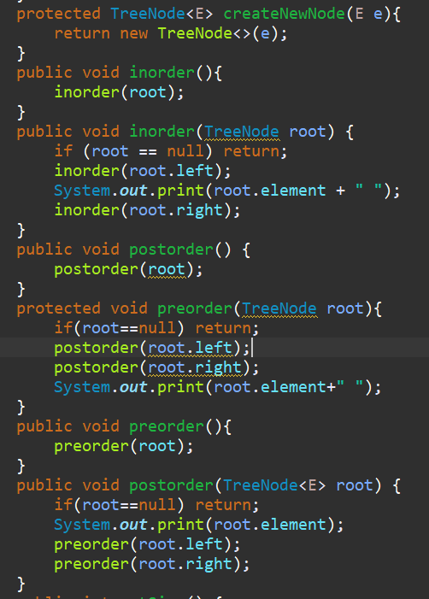
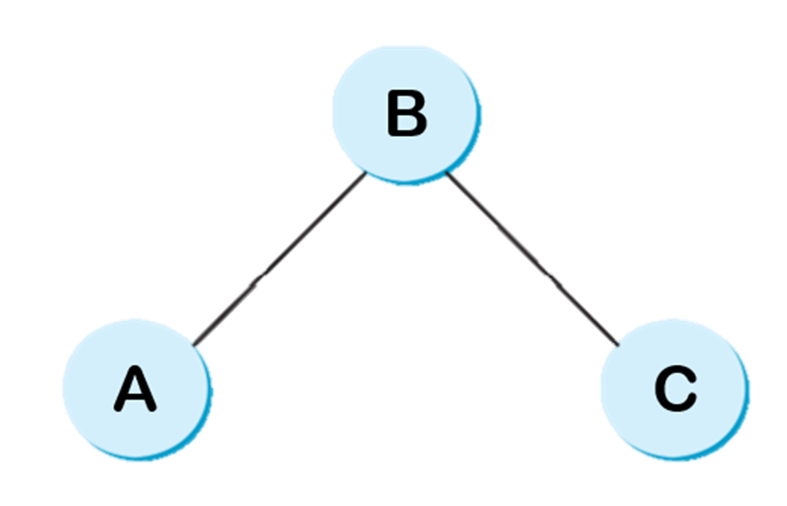
BST Class
CONTENTS
Traversal
-Inoder traversal
A-B-C
-Preorder traversal
B-A-C
-Postorder traversal
A-C-B
01
01
Note
-we set the algorithm with this notion.

Slide 6
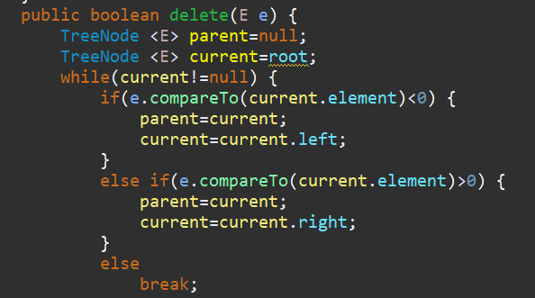
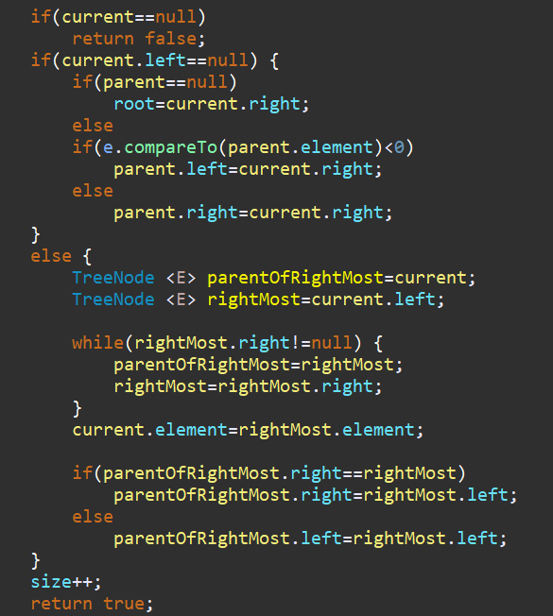
BST Class
CONTENTS
Delete element from the binary tree
-Place the node to be deleted and its parent node.
-Element is in the tree pointed at by current
01
01
If element isn’t in the tree, return false.
If left side is empty, connect to the right.
02
If the node has left child node, put the rightmost one in the left subtree. That is, replace the element in current by the rightmost one.
03

Slide 7
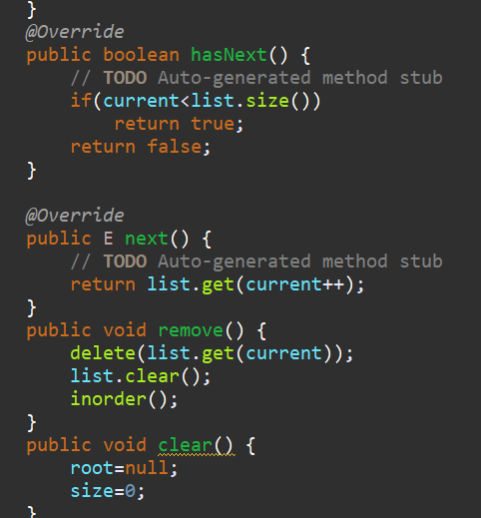
Iterators Class
CONTENTS
Iterator makes traversing in tree in a uniform way
-hasNext : return true if iterator has more elements and check if the current node is in the tree.
01
01
-next : return the next element and move current node to point to the next node.
02
01
-remove : remove the current node from the tree and current node doesn’t have to be changed.
03

Slide 8
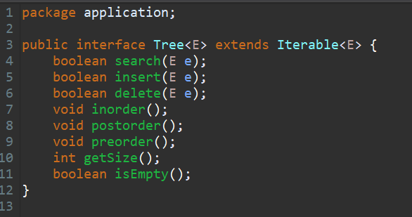
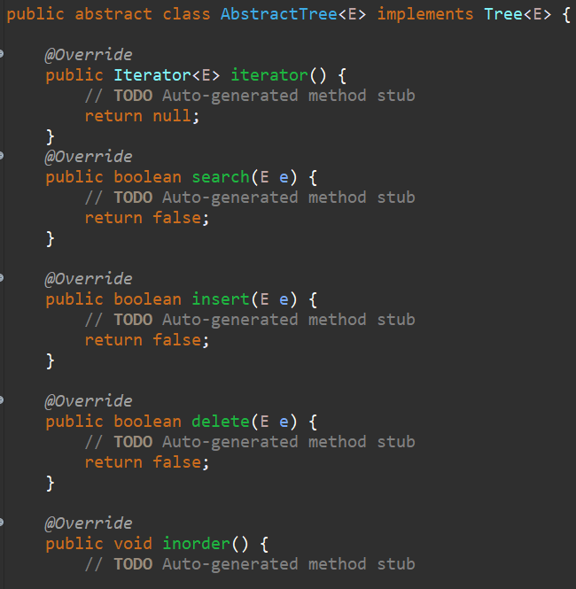
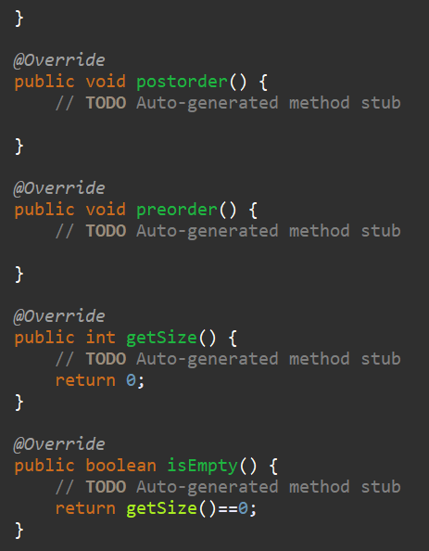
Tree interface & AbstractTree Class
Tree interface defines the operation in binary search tree.
AbstractTree Class implements Tree interface.
CONTENTS
01

Slide 9
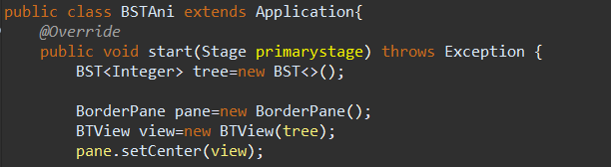
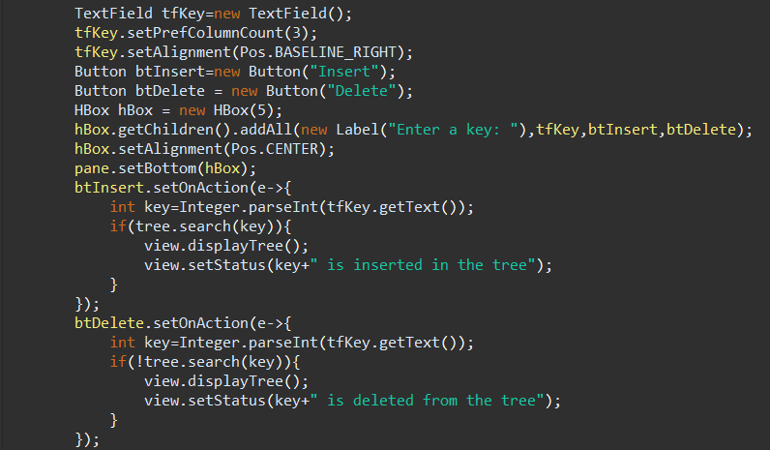
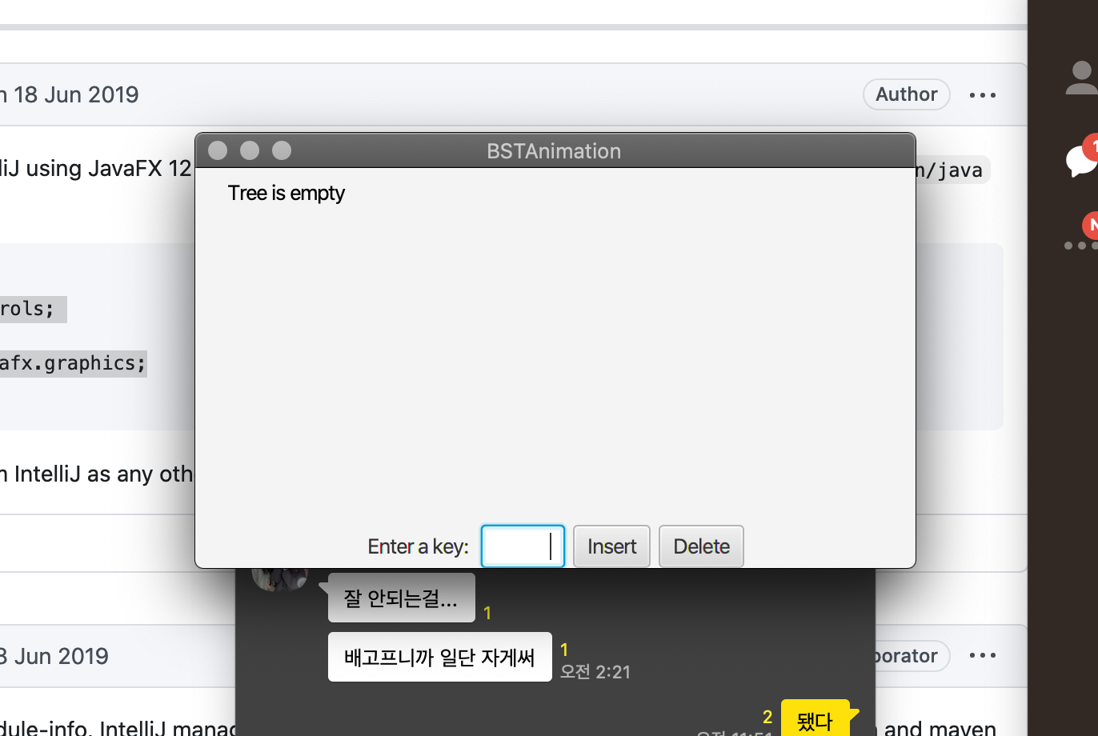
BST Animation
CONTENTS
Buttons
-Create a tree that consists of integer type data
-Create a view (BTView)
01
BTView
-Create a box to enter a key
-Generate the statements to notice that show the status of BST after being successfully processed
01
02
-btInsert - The integer data put in variable ‘key’ is inserted in the tree. After that, it shows the status of the completed tree.
-btDelete - The data in ‘key’ is deleted from the tree. After that, it shows the status of the completed tree.
02

Slide 10

BST Animation
CONTENTS
Display
- Create a scene and place the pane in the stage
01
01
-Set the stage title
-Place the scene in the stage
-Display the stage
02

Slide 11
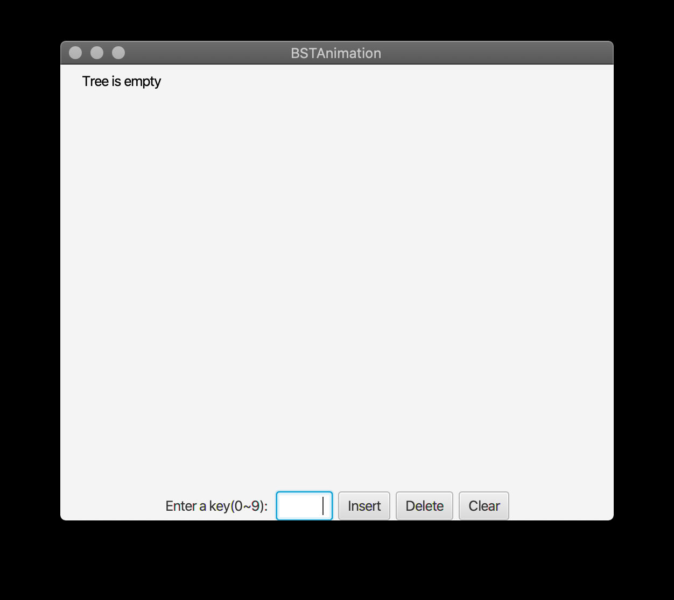
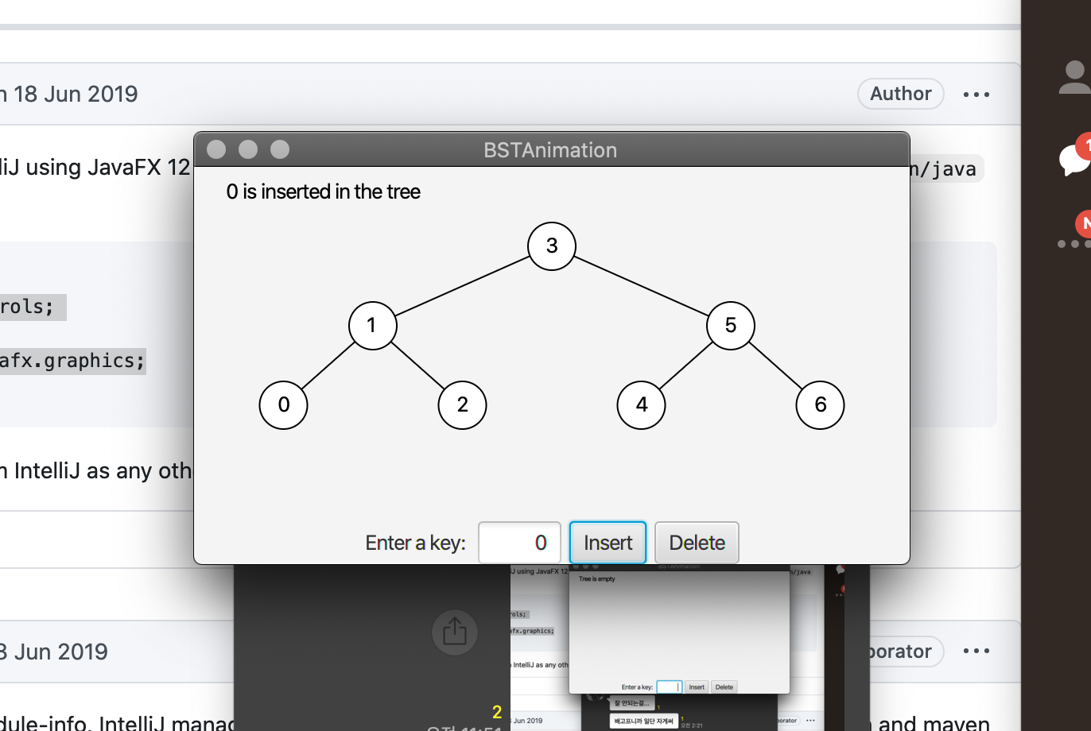
Final Result Screen!
Initial Screen (When tree is empty)
After inserting some nodes 0~9/ deleting 7,8,9
User’s
Manual
Input a node to insert and delete
After inputting the node in the box, select the button
Reset the system

Slide 12
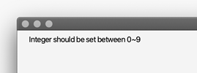
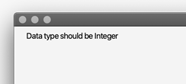
Final Result Screen!
Our system can be processed with great robustness with some notice about input types!!

Slide 13
Thank you

