Slide 1
ITM 19102090 Hyunseo Park
Memory Hierarchy Simulator
ITM 19102092 Hyeonyeong Seo

Slide 2
Contents
Memory Hierarchy
Memory Hierarchy Simulator
Development Environment
Hardware
Software
Code Explanation
Result

Slide 3
Memory Hierarchy
~ 1KB, 0.3 ns
L0
Registers
Fast expensive memory,
Smaller in sizes
L1 Cache
(SRAM)
L1
1~256KB, 1.1~10 ns
L2
L2 Cache
(SRAM)
256KB~1MB, 10~20 ns
L3
L3 Cache
(SRAM)
1~8MB, 20~40 ns
L4
Main Memory
(DRAM)
8MB~32GB, 40~80 ns
Slow cheap memory,
bigger in sizes
L5
Local secondary storage
(local disks)
~200GB~1TB, ~0.1ms
L6
Remote secondary storage
(distributed file systems
2~5TB, ~3ms

Slide 4
Memory Hierarchy

Slide 5
Memory Hierarchy Simulator
Goal
To make multiple arrays in each cache & main memory
To show result which proves that arrays are in the right place
Way to achieve goal
Make multiple sizes of arrays that deal with each cache level & main memory
Make memory hierarchy simulator that shows access time(ns)
to each cache level 1,2,3 & main memory

Slide 6
Development Environment – Hardware
MacBook Pro 18 | Cache size per core | # of core | Total cache size
L1 Cache | 64KB | 6 | 384 KB
L2 Cache | 256KB | 6 | 1536 KB
L3 Cache | NA | NA | 9 MB
Main memory | NA | NA | 16 GB

Slide 7


Development Environment – Software
C++
Visual Studio

Slide 8





Code Explanation – TimeChecker()
Main header – Chrono
Header for accurate time measurement
Time variables – struct timespec
Structure holding an interval broken down into seconds and nanoseconds
Time measurement method
clock_gettime : get the time of the clock
tv_sec : seconds
tv_nsec : nanoseconds
Target result – nanoseconds

Slide 9

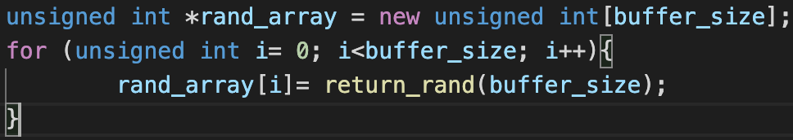
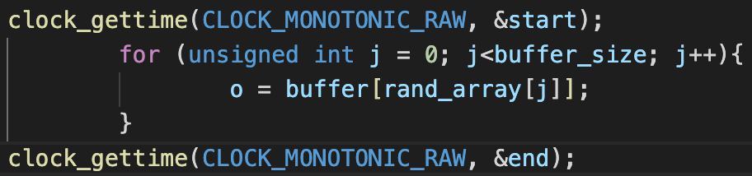
Code Explanation – Arrays
Size of arrays
Array
Array access
To set size of array in int main()
To fill out array with random values
return_rand() is the class that makes
random numbers lower than
buffer size
Set string data type filled with ‘a’,
buffer_size times
Access to rand_array buffer_size times
Get rand_array’s jth values,
and bring buffer’s value by those

Slide 10
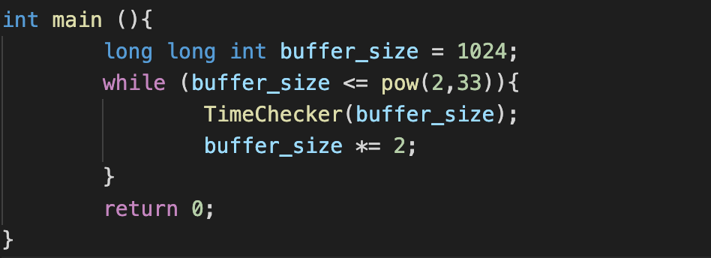
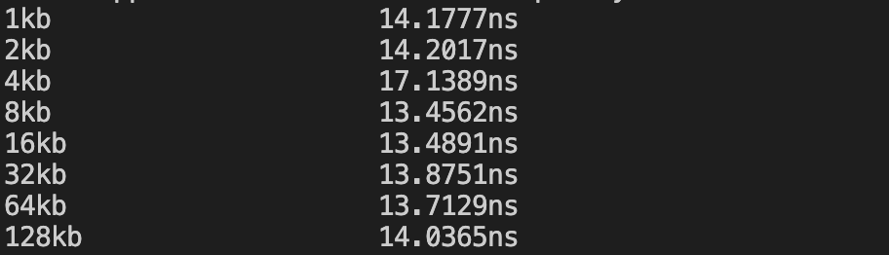
Code Explanation – int main()
Main code
Output
Start from 1KB
End in 2 GB

Slide 11
Result
Time(ns)
L1 Cache
L2 Cache
L3 Cache
Main memory

Slide 12
Compare Results
Time(ns)
=> Shows that arrays are in the right place

Slide 13
ITM 19102090 Hyunseo Park
Thank You!
ITM 19102092 Hyeonyeong Seo

