Slide 1
Computer System assignment1
19102092 HyeonYeong. Seo

Slide 2
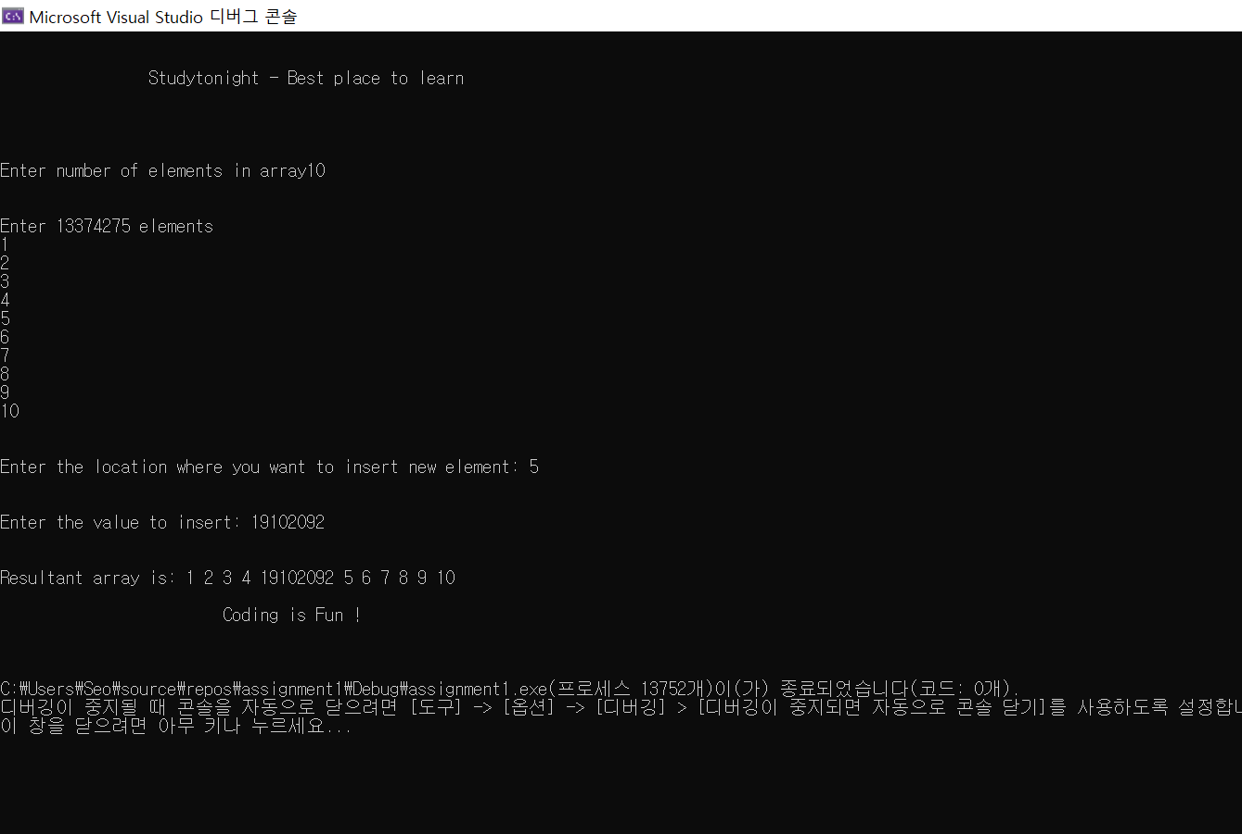
#1 captured output

Slide 3
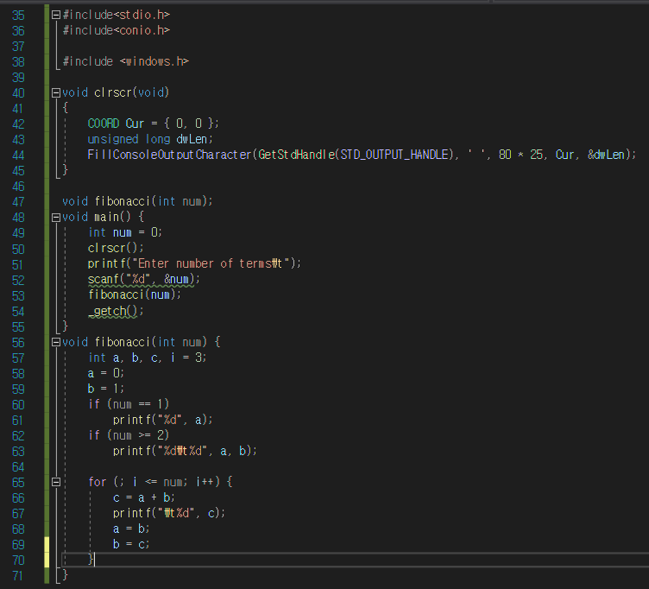
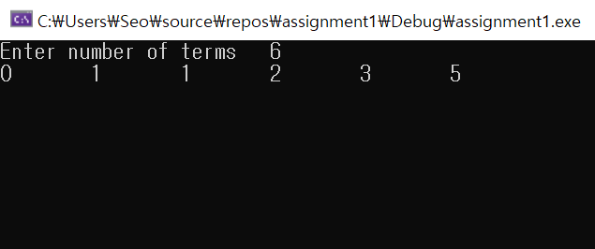
#2 source code

Slide 4
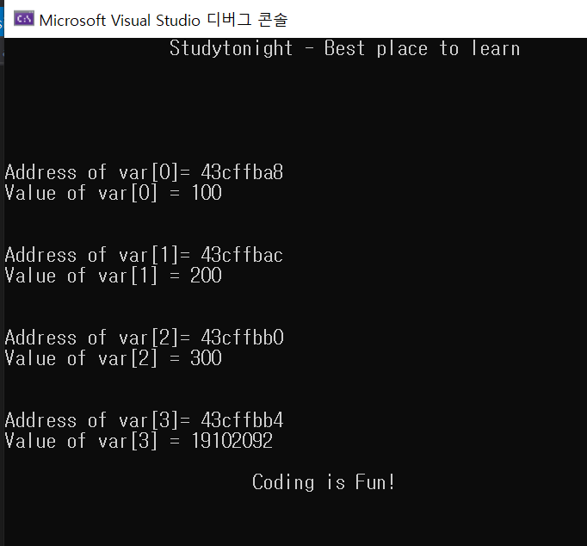
#3 captured output

