Slide 1

기능시험 절차서
SimpleChat1
프로젝트
회 사 명 :Gkes
검수 일자 : 2022년 7월 20 일
시 험 자 : Dhe yeong (인)
검 수 자 : (인)
연 락 처 :

Slide 2
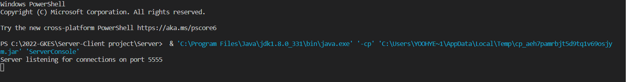
Server startup check with default arguments
김성회
SimpleChat1
Server 실행 시 출력 값 확인
Server
Server startup check with default argument (2001)
Server 표시 출력 및 포트 5555 수신 확인
At the console, enter: java EchoServer.
Expected result:
The server reports that it is listening for clients by displaying the following messages:
Server listening for clients on port 5555.
The server console awaits for user input.
[실행 결과 화면 캡쳐하여 추가]

Slide 3
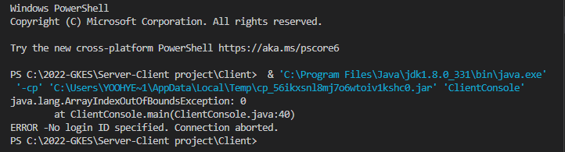
김성회
SimpleChat1
Client 실행 시 출력 값 확인
Client
Client Start up without a login (2002)
Client 종료 오류 메시지 출력
Instructions:
At the console, enter: java Client Console.
Expected result:
The client reports it cannot connect without a login by displaying:
ERROR – No login ID specified. Connection aborted.
The client terminates.

Slide 4

connection with default arguments
김성회
SimpleChat1
Client 실행 시 출력 값 확인
Client
Client startup check with a loging and without a server(2003)
Client 종료 오류 메시지 출력
Instructions:
At the console, enter: java ClientConsole<loginID> where loginID is the name you wish to be identified by.
Expected results:
The client report it cannot connect to a server by displaying:
Cannot open connection. Awaiting command
The client waits for user input.

Slide 5
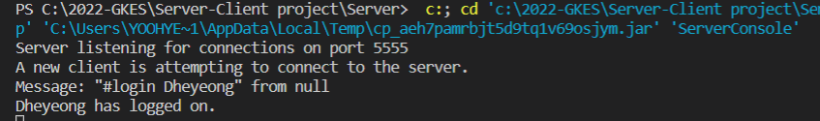

김성회
SimpleChat1
Client 실행 시 출력 값 확인
Client
Client connection with default arguments(2004)
Client 종료 오류 메시지 출력
Instructions:
Start a server(Testcase 2001, instruction 1)
On a different console on the same computer, start a client.
Expected results:
The server displays the following messages in sequence:
A new client is attempting to connect to the server.
Message received#login<loginID> from null.
<loginID> has logged on
The client displays message similar to the following: <loginID> has logged on.
The client and the server wait for user input.

Slide 6
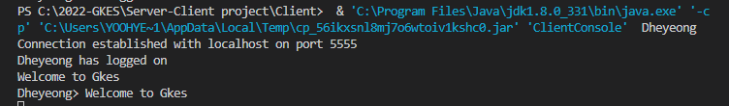
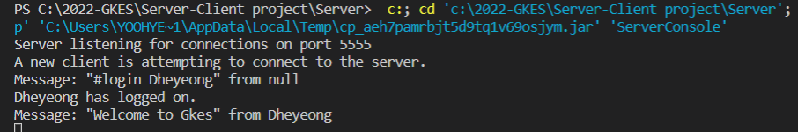
.
김성회
SimpleChat1
Client 실행 시 출력 값 확인
Client
Client Data transfer and data echo(2005)
Client 종료 오류 메시지 출력
Start a server and a client on the same computer and connect using the default arguments (Testcase 2004 instruction ).
Once connected , type in data on the client console and press ENTER.
Expected results:
The message is echoed on the client side, but is preceded by the sender’s loginID and the greater than symbol(">”)
The server displays a message similar to the following:
Message received: <user input> from<loginID>

Slide 7
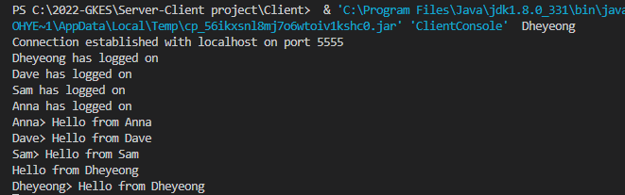
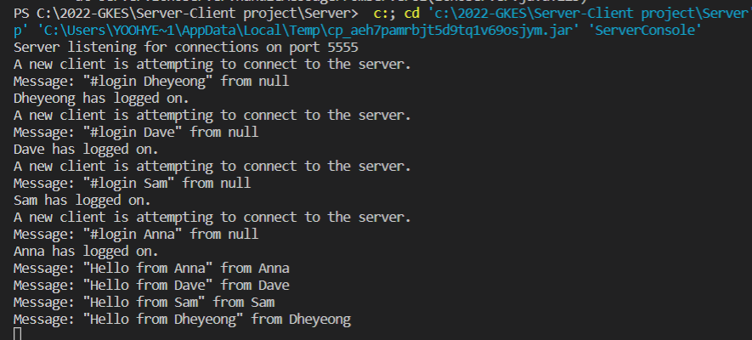
.
김성회
SimpleChat1
Client 실행 시 출력 값 확인
Client
Multiple local connections(2006)
Client 종료 오류 메시지 출력
Start a server and multiple clients with different loginIDs and connect them to the server using default arguments. (Testcase 2005 instructions
Start typing on all the client consoles and the server console, pressing ENTER to send each message.
Expected results:
All client messages are echoed as in Testcase 2005
All messages from the server console are echoed on the server console and to all clients, but are preceeded by "SERVER MESSAGE> ".

Slide 8
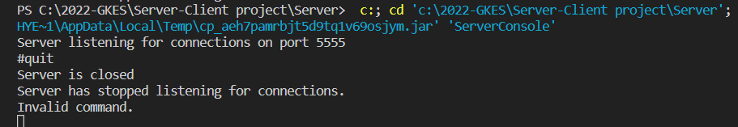
김성회
SimpleChat1
Client 실행 시 출력 값 확인
Client
Server termination command Check(2007)
Client 종료 오류 메시지 출력
Start a server (Testcase 2001 instruction 1) using default arguments.
Type "#quit" into the server's console.
Expected results:
The server quits.

Slide 9
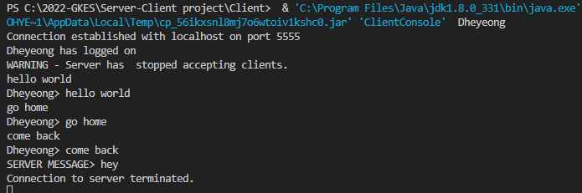
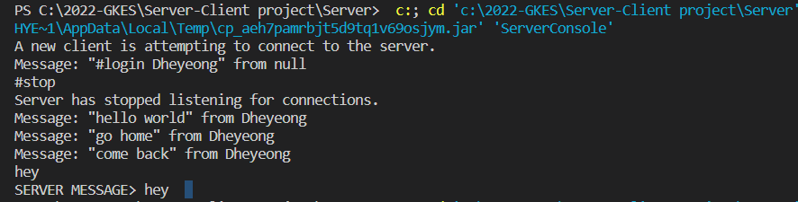
김성회
SimpleChat1
Client 실행 시 출력 값 확인
Client
Server stop check(2008)
Client 종료 오류 메시지 출력
Start a server (Testcase 2001, instruction 1).
Connect a client to the server(Testcase 2004).
Type “#stop” into the server’s console.
Type in a message on the client and send it.
Attempt to connect other clients.
Restart the server.
Expected result:
The server displays:
Server has stopped listening for connections.
The client displays:
WARNING – Server has stopped listening for connections.
Data echoing still works normally.
Attempting to connect other clients will hang the console as these new connections are put on backlog until the max backlog(default of 10) is reached.
Restarting the server will cause the backlogged clients to connect properly.

Slide 10
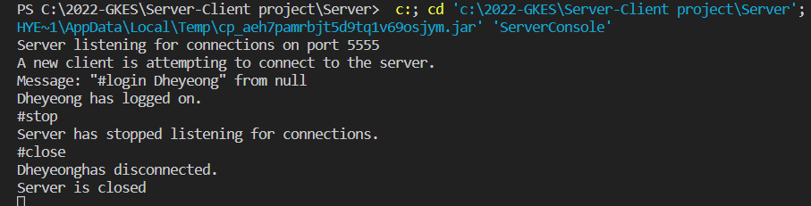
김성회
SimpleChat1
Client 실행 시 출력 값 확인
Client
Server close command check(2009)
Client 종료 오류 메시지 출력
Start a server and connect a client to it.
Stop the server by using the “#stop” command.
Type “#close” into the server’s console.
Expected result:
The server displays in sequence:
Server has stopped listening for connections.<loginID> has disconnected.
The client displays:
WARNING – Server has stopped listening for connections. SERVER SHUTTING DOWN DISCONNECTING. Abnormal termination of connection. And the waits for input.
Data echoing still works normally.
Attempting to connect other clients will hang the console as these new connections are put on backlog until the max backlog(default of 10) is reached.
Restarting the server will cause the backlogged clients to connect properly.

Slide 11

김성회
SimpleChat1
Client 실행 시 출력 값 확인
Client
Client termination command check(2010)
Client 종료 오류 메시지 출력
Start a client (Testcase 2002, instruction 1).
Type “#quit” into the client’s console.
Expected result:
Client terminates.

Slide 12
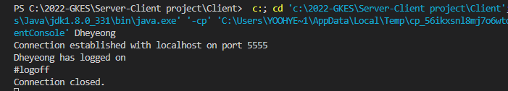
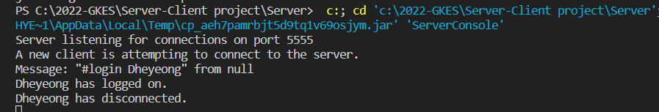
김성회
SimpleChat1
Client 실행 시 출력 값 확인
Client
Client logoff check(2011)
Client 종료 오류 메시지 출력
Start a server (Testcase 1001, instruction 1), and the connect a single local client on this server.
Type “#logoff” into this client console.
Expected result:
Client disconnects and displays
Connection closed. (Under NT, it will display Abormal termination of connection.)

Slide 13
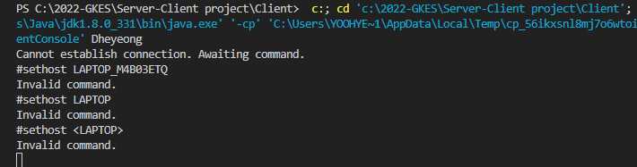
김성회
SimpleChat1
Client 실행 시 출력 값 확인
Client
Client host and port setup command(2012)
Client 종료 오류 메시지 출력
Starta client but no servers and attempt to connect using default arguments.
At the client’s console type “#sethost <newhost>” where <newhost> is the name of a computer on the network
At the client’s console type “setport 1234”
Expected result:
The client displays
Host set to: <newhost>.
Port set to: 1234

Slide 14
김성회
SimpleChat1
Client 실행 시 출력 값 확인
Client
Starting a server on a non default port(2013)
Client 종료 오류 메시지 출력
Start a server by typing java ServerConsole 1234.
Expected result:
The server displays
Server listening for connections on port 1234.

Slide 15
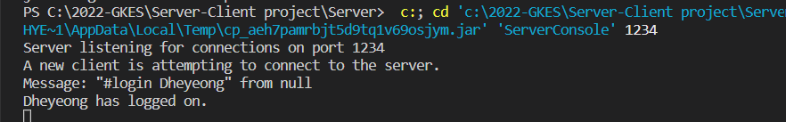

김성회
SimpleChat1
Client 실행 시 출력 값 확인
Client
Starting a server on a non default host or port(2014)
Client 종료 오류 메시지 출력
Start a server by typing java ServerConsole 1234.
On a different computer, start a client by typing “java ClientCOnsole<loginID> <host> 1234” replacing the parameters by appropriate values.
Expected result:
The connection occurs normally.

Slide 16
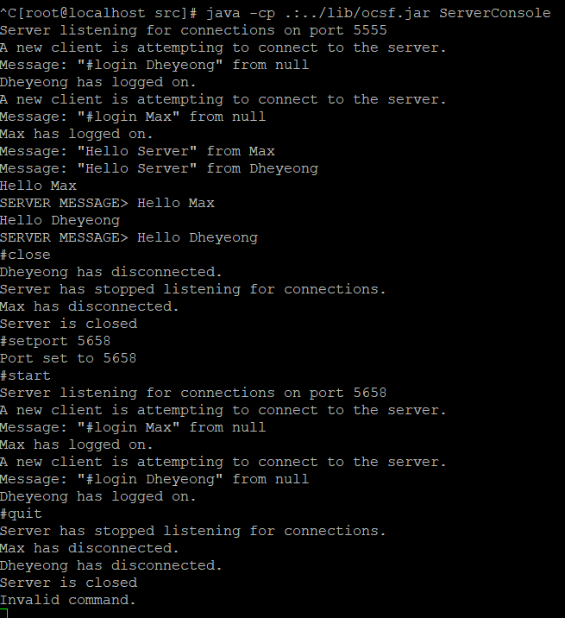
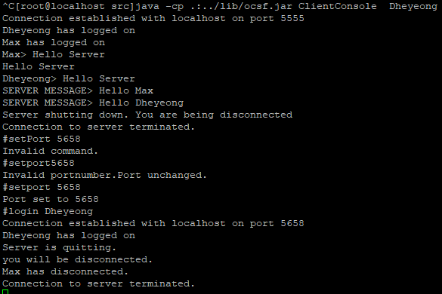
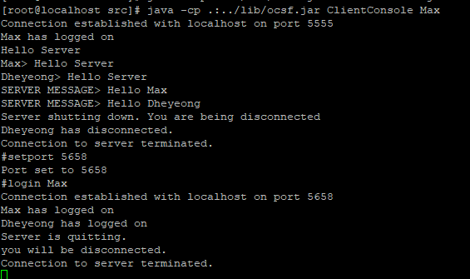
김성회
SimpleChat1
Client 실행 시 출력 값 확인
Client
Multiple remote clients disconnections and reconnections(2015)
Client 종료 오류 메시지 출력
Start a server (Testcase 2001, instruction 1)
On a different computers, start clients (1 or 2 per computer) and connect them to the server.
Exchange data.
Close the server using the #close command.
Change the server’s port by typing “#setport <Newport>”
Restart the server using the #start command.
Change the ports of each clients using the #setPort command.
Reconnect the clients to the server by using the #login<loginID> command
Close the server by using the #quit command.
Expected result:
The first set of connections occur normally.
When the server is closed, all clients are disconnected.
The server displays the following message when the #setport command is used: port set to:<Newport>
The server restarts and displays: Server listening for connections on port <Newport>.
The clients change port as in Testcase 2012.
The clients reconnect normally.
The clients are disconnected when the server quits.

Slide 17
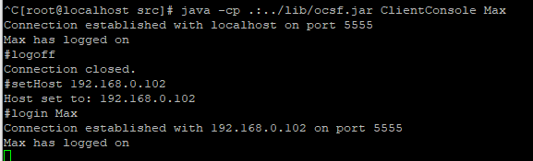
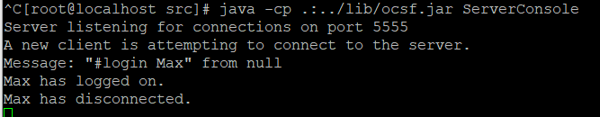
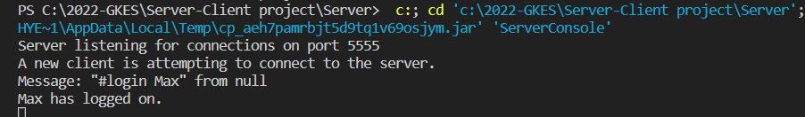
김성회
SimpleChat1
Client 실행 시 출력 값 확인
Client
Client changing hosts(2016)
Client 종료 오류 메시지 출력
On two different computers, start servers on the default port.
On a different computer, start a client and connect it to one of the two servers.
Logoff from that server using the #logoff command.
4. Change the host name by using the #sethost<otherhost> where <otherhost> is the name of the other computer on the network.
Log on to this new host using the #login<loginID> command.
Expected result:
The two servers start up normally.
The client connects to the first server normally.
When the client disconnects it displays Connection closed
When the client disconnects, the server displays:<loginID> has disconnected.
The client changes host as in Testcase 2012.
The client reconnects normally as in testcase 2015.

Slide 18
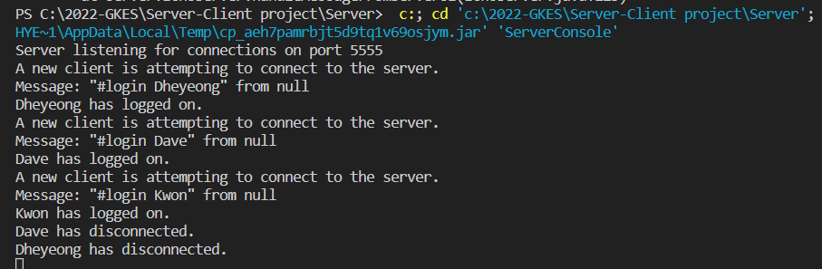
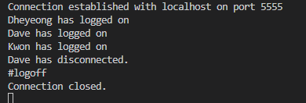
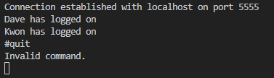

김성회
SimpleChat1
Client 실행 시 출력 값 확인
Client
Client quitting or logging off a server displays: (2017)
Client 종료 오류 메시지 출력
Start a server and connect multiple(At least 3) clients.
In on client’s console, type “#quit”.
In a second client’s console, type “#logoff”
Expected result:
In both cases, all remaining clients and the server get the following message: <loginID> has disconnected.
The clients display:
Connection closed.

