Slide 1

Do the Dash
Eduthon
2022
NOW YOU
SEE ME
NOW YOU
SEE ME
NOW YOU
SEE ME
NOW YOU
SEE ME

Slide 2


Table of Contents
NOW YOU SEE ME
Socket Programming
Subject
Q&A

Slide 3
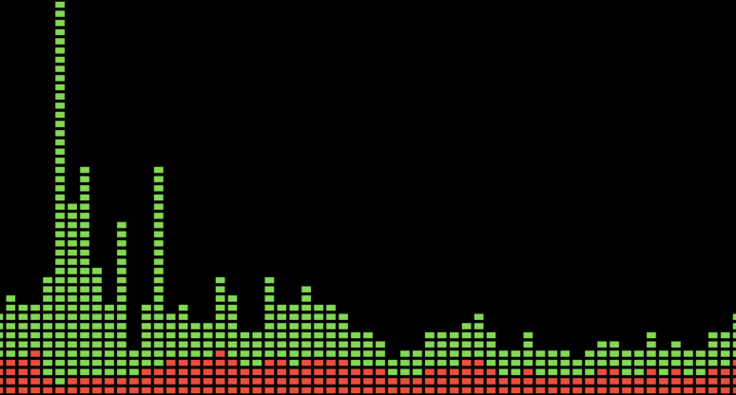
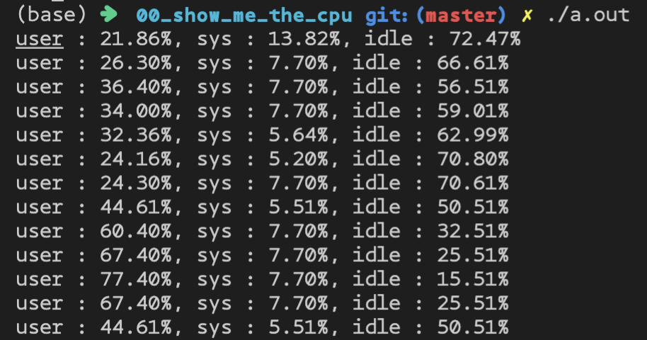


What is “Now you see me”?

Slide 4
TCP
UDP
Reliable
Socket Programming
Speed
Secure
Broadcast
Ordered
Customizing

Slide 5
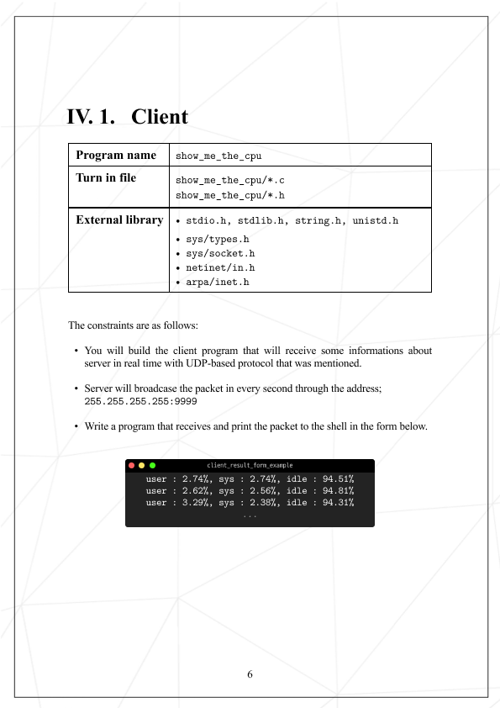
Subject: Show me the cpu

Slide 6
Subject: Now you see me

Slide 7
Bonuses! AWESOME

Slide 8
Q&A

