Slide 1
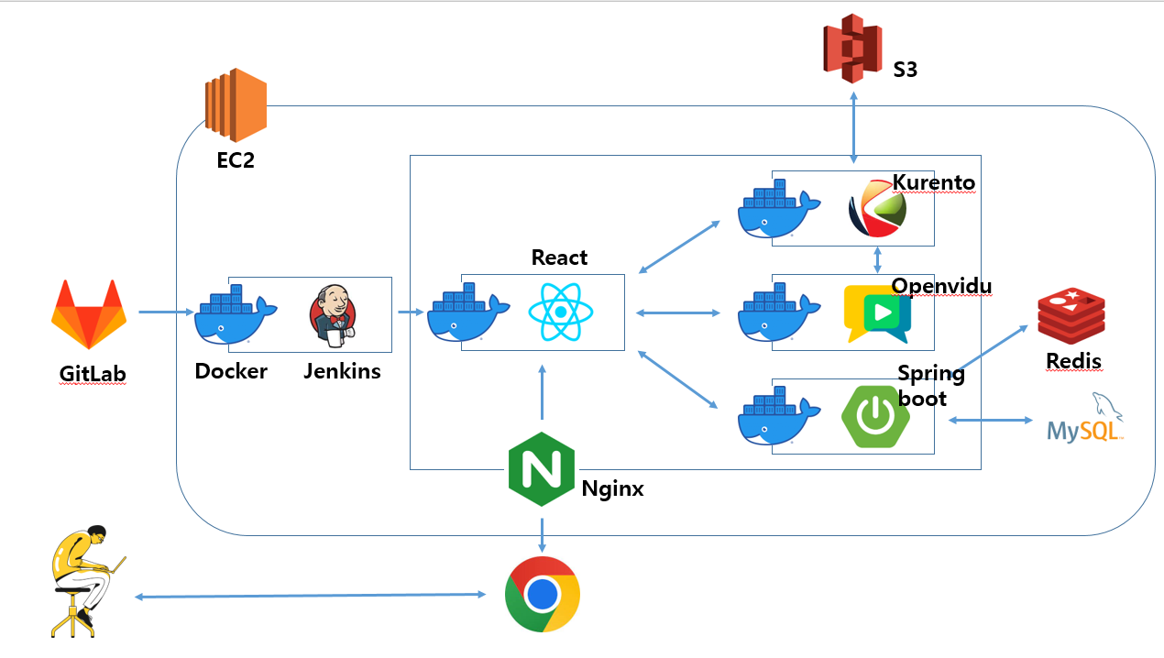














S3
EC2
Kurento
React
Openvidu
Docker
Jenkins
Spring
boot
Redis
GitLab
Nginx

