Slide 1
AGENDA
Continuous Integration & Deployment Components
Need for Unified DevOps Dashboard
Promoting the use of Open source Software
Target Audience: Developers, Leads & Managers
How are we contributing to this project?
Demo of the Hygieia Dashboard for DevOps

Slide 2

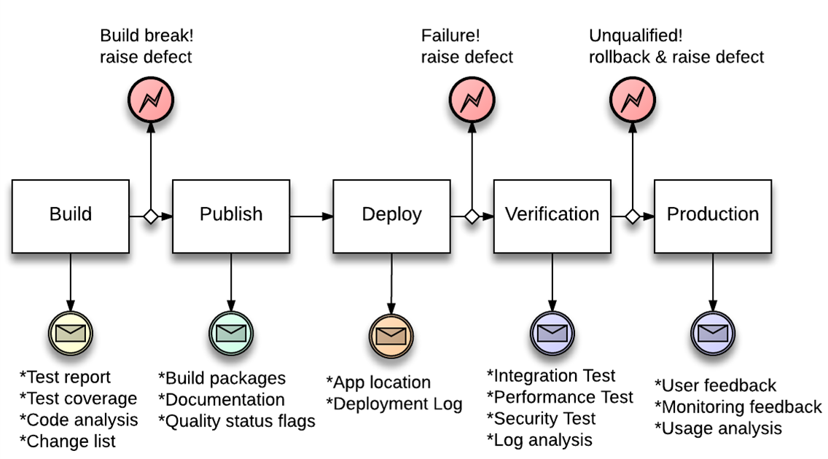
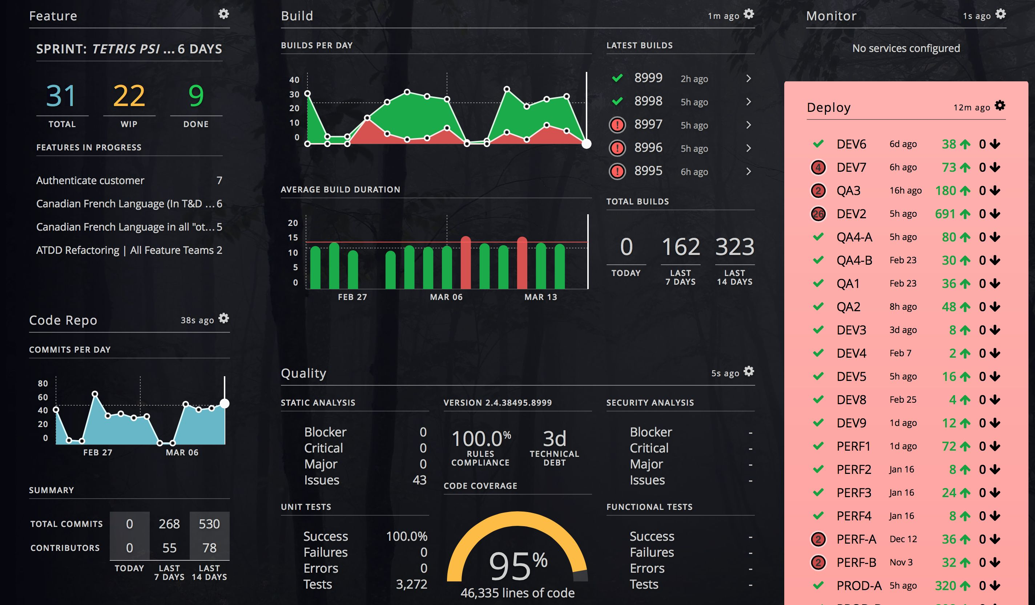
Problem Statement / Project Idea
1
Automate Development Environment Setup using DevOps Tool Chain
Continuous Performance Measurement & Visualization using SiteSpeed, Jmeter, and Jenkins – in the Deployment Pipeline
2
3
Unified DevOps Dashboard
Continuous Performance Monitoring
Continuous Build & Deploy Monitoring
Missing Piece
1
2
3
Missing Piece
Missing Piece
Development
Unified Dashboard
* Automate environments
* Open source tools
* Save time and resources

Slide 3


DevOps Dashboard Architecture
Jira
Lifecycle Management
Collector
Git / Stash / Subversion
Code Repository
Collector
Jenkins
Build & Deploy
Collector
REST API Layer
Dashboard UI Layer
Fortify
SonarQube
Collector
Deployment
Collector
Performance Monitoring
Collector
ChatOps
Collector

Slide 4
Installing the DevOps Dashboard
You can follow below steps to install & operationalize the DevOps dashboard for your application or install it in a central location and all the teams can create dashboard for their own branch/project.
Step 1
Step 2
Step 3
Step 4
Build Hygieia project using Maven from GitHub
Install Mongo DB for the Hygieia API data store
Run the collectors with properties to connect to CI tools
Setup the Dashboard widgets & Visualize
https://github.com/capitalone/Hygieia

Slide 5







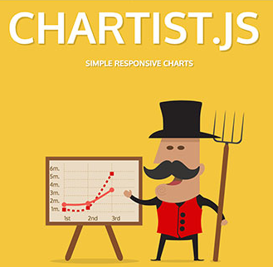

Underlying Frameworks & Technologies
Bower

Slide 6
Hygieia DevOps Dashboard – Components
Jira
Jenkins
Performance Monitoring
Deployments
Git
SonarQube / HP Fortify
Analysis / Code Coverage

Slide 7
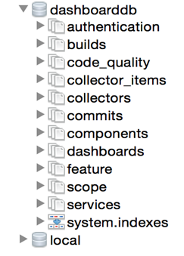
MongoDB – Collections for Dashboard
Dashboard Authentication
Jenkins
Sonar
Fortify
Stash
Dashboard UI
Jira
MongoDb Client
http://3t.io/mongochef/

Slide 8
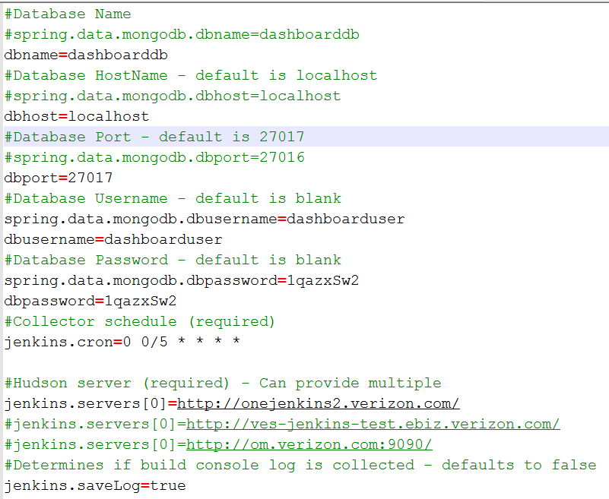
DevOps Dashboard Collectors - Properties

Slide 9
Hygieia DevOps Dashboard – Components
Jira
Jenkins
Performance Monitoring
Deployments
Git
SonarQube / HP Fortify
Analysis / Code Coverage

Slide 10
Demo

Slide 11
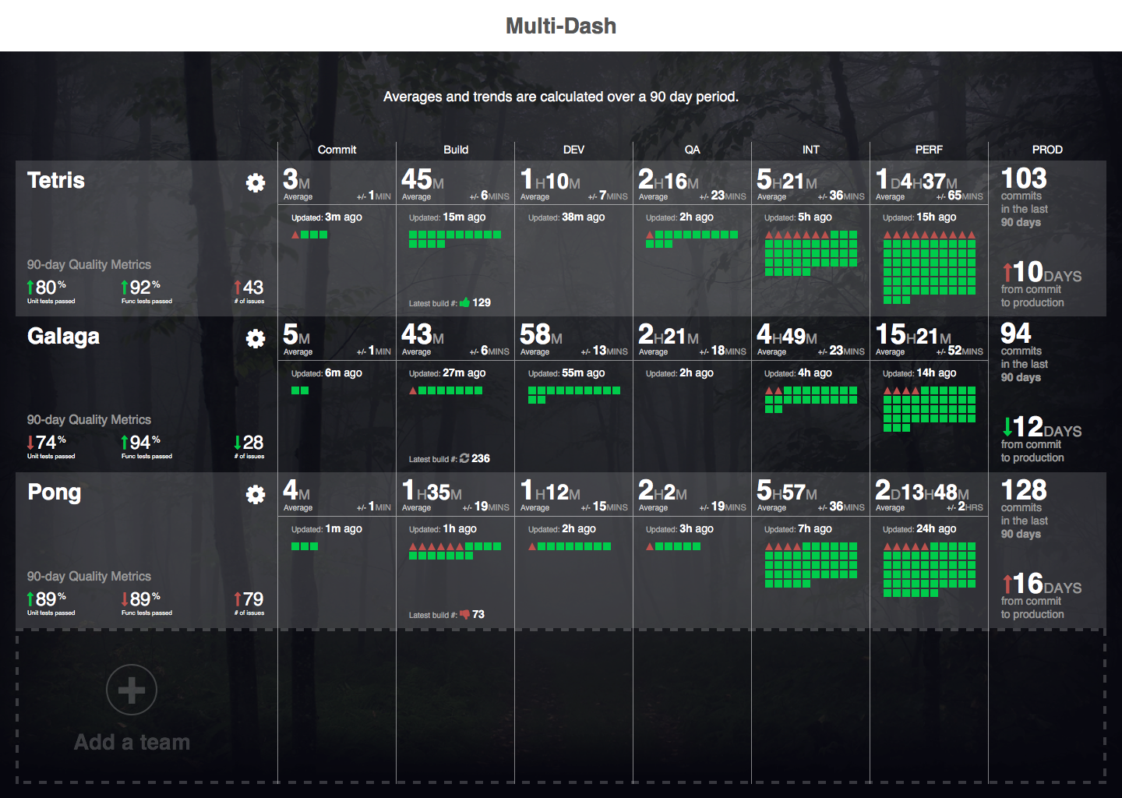
Hygieia DevOps Dashboard – 2.0 [In Works]

