Slide 1

CS_basicEEG
Something is basic but you still need to know
Presenter: hyijie
6/13/26
Email: hyijie_psy@foxmail.com

Slide 2

Data colletion:
What devices should I know about?
How should I use them correctly?
How to collect a nice data?
…
Hi, {your name} EEG is good for our questions. So…
Data analysis:
How to understand the data structure?
What is the analysis pipeline?
…

Slide 3
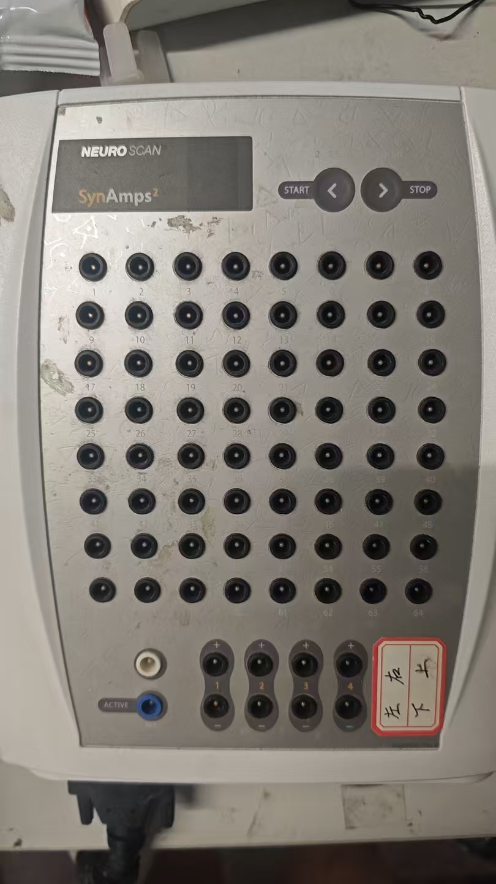
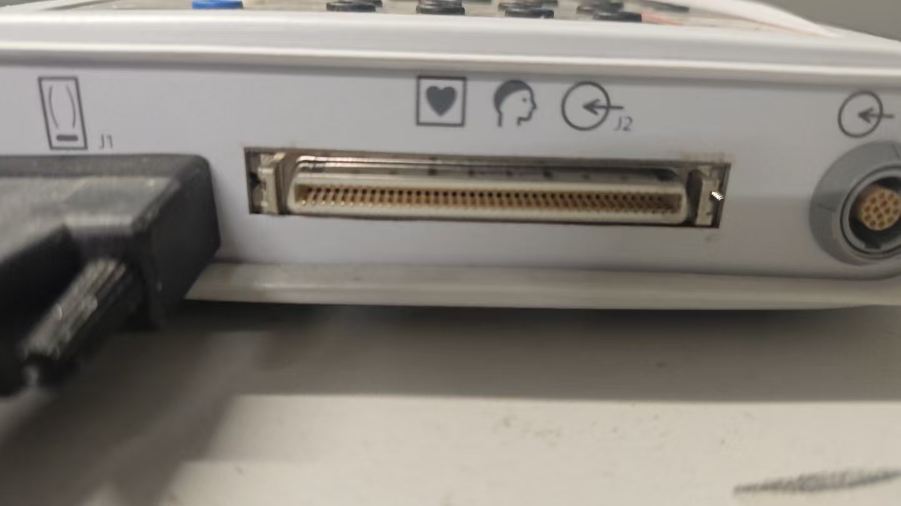
Main devices and collection tips

Slide 4
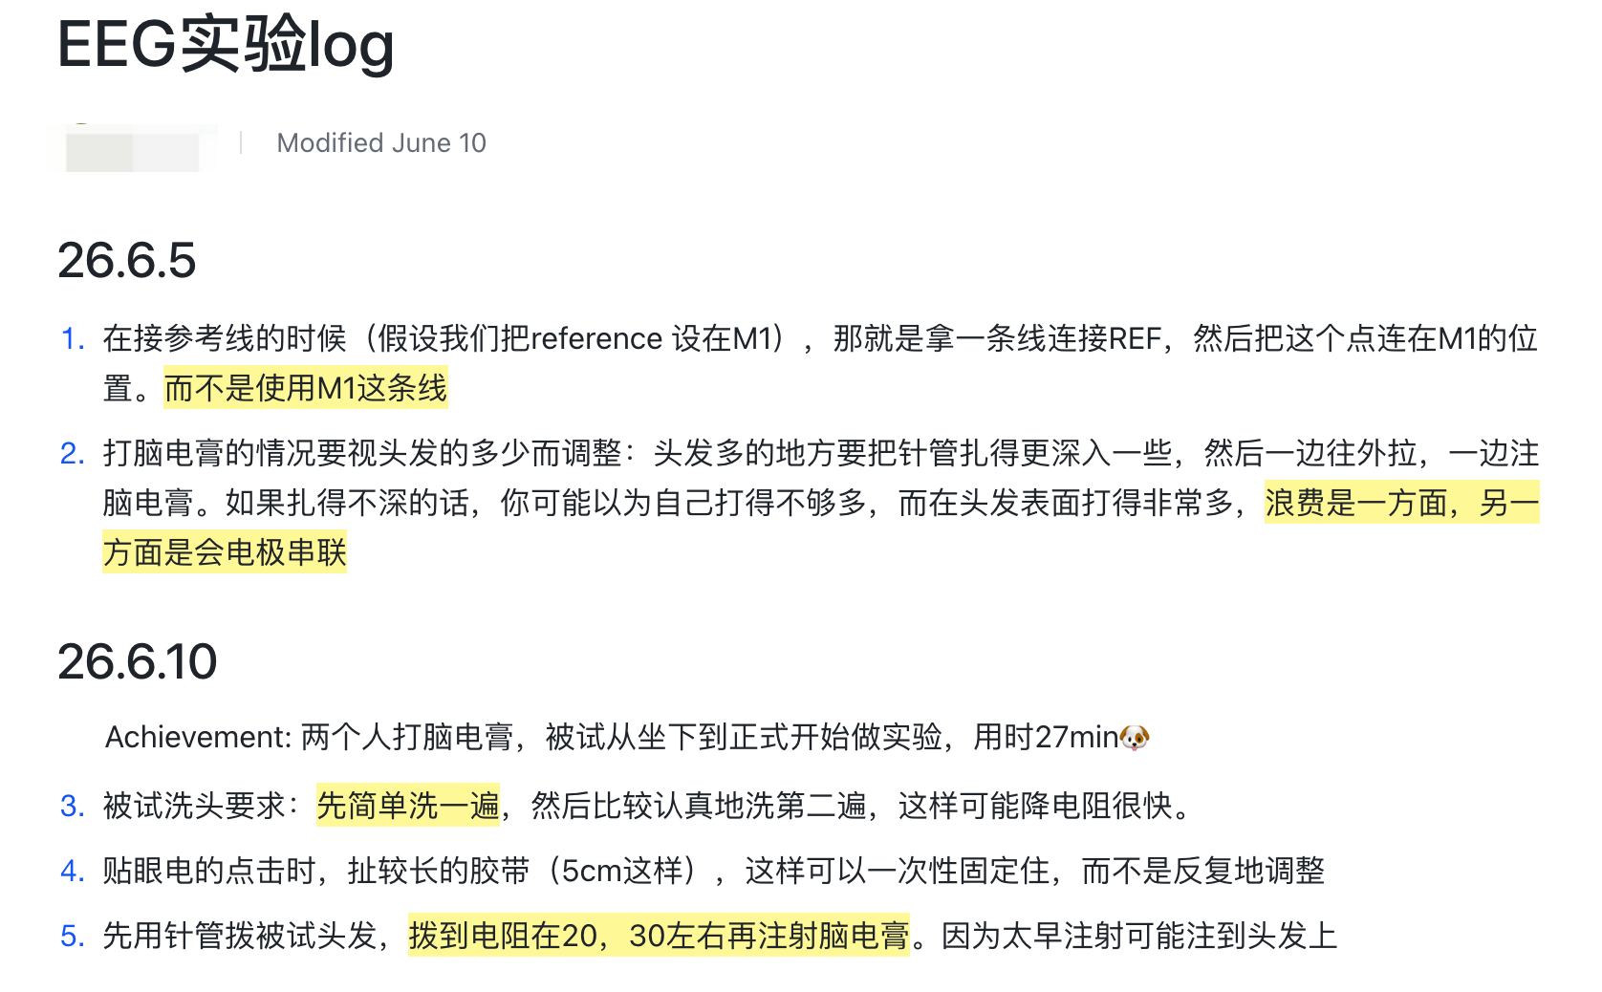
Tips

Slide 5
Data analysis
1_preprocess (metadata)
2_channel_select
3_permutation_analysis
4_time_frequency_analysis

Slide 6
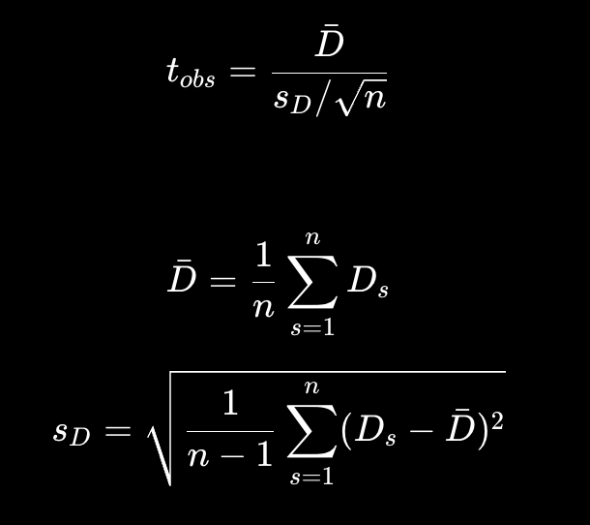
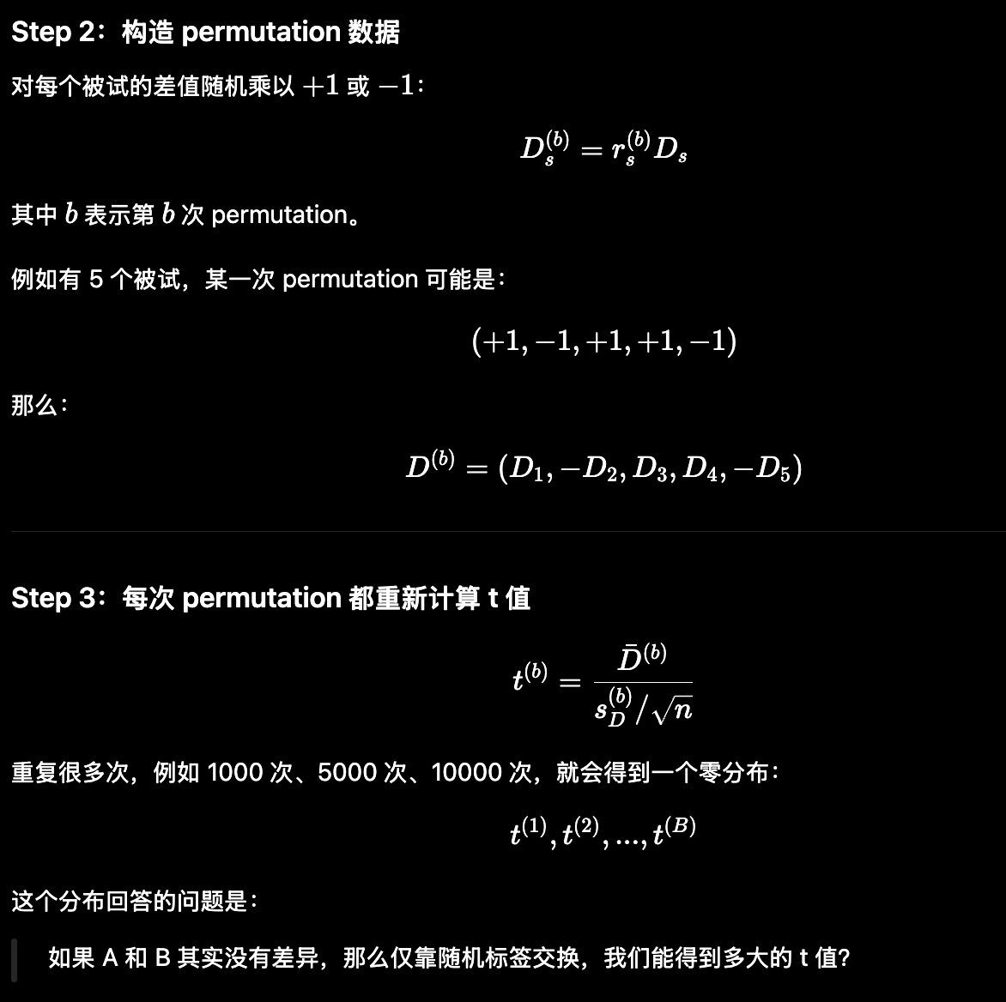
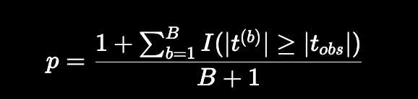
3_permutation_analysis
sign-flip:
If two samples come from the same distribution, their expected difference will not change after assigning label randomly

Slide 7
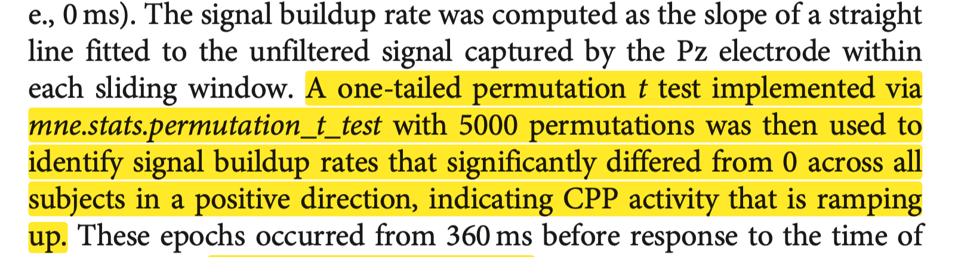
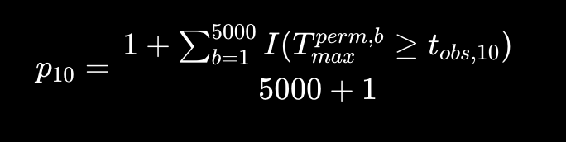
Mass-univariate permutation analysis
(Yau et al., 2021, J. Neurosci)
Input: (30_subject, 50_windows)
Real t value
Sign flip * 5000: each filp can calculate a t value for 50 windows but only saving t_max
t_max * 5000

Slide 8
Cluster permutation analysis
Add information about time/space
Input: (30_subject, 50_windows, 60_channel)
Real t value
Set a t threshold
Cluster the windows*channel which over the threshold
Sign flip * 5000: each filp can calculate a (cluster) t value for 50 windows * 60 hannels but only saving t_max
t_max * 5000

Slide 9
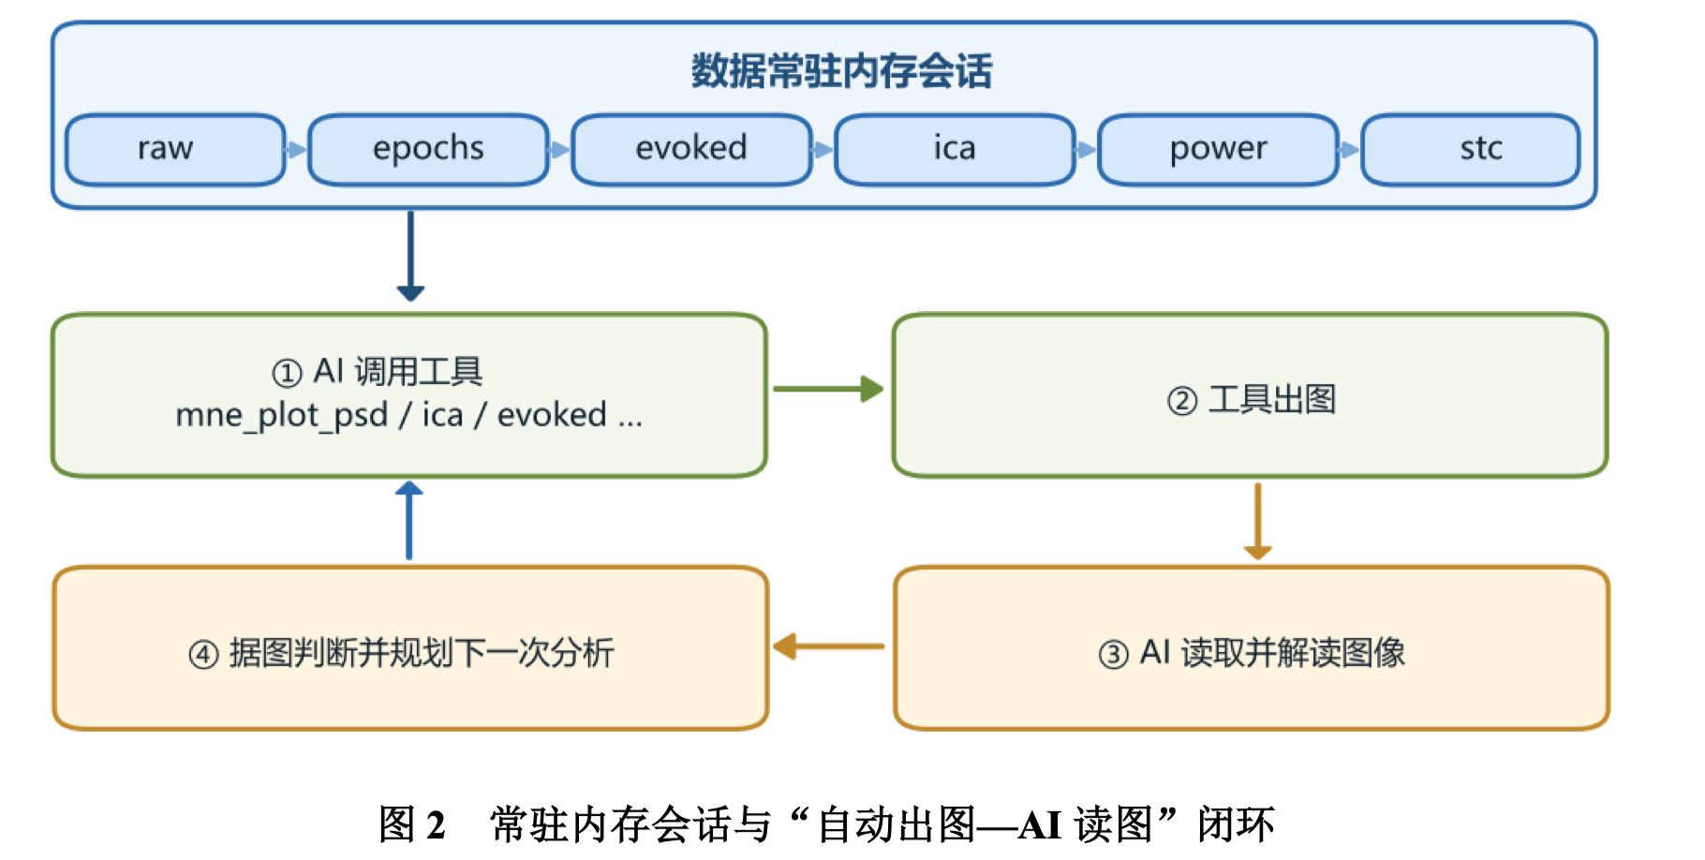
MNE-MCP
Download python 3.12
brew install python@3.12
pipx install "mne-mcp[full]" -- /n python/opt/homebrew/opt/python@3.12/bin/python3.12
mne-mcp setup
https://www.chinaxiv.org/abs/202606.00065

Slide 10
Thank you!
If I have something wrong, please let me know!
Presenter: hyijie
6/13/26
Email: hyijie_psy@foxmail.com

