Slide 1
Life history strategies and psychopathology:
the faster the life strategies,the more symptoms of psychopathology
Jessie E. Hurst, Phillip S. Kavanagh
By: hyijie
6/11/26

Slide 2
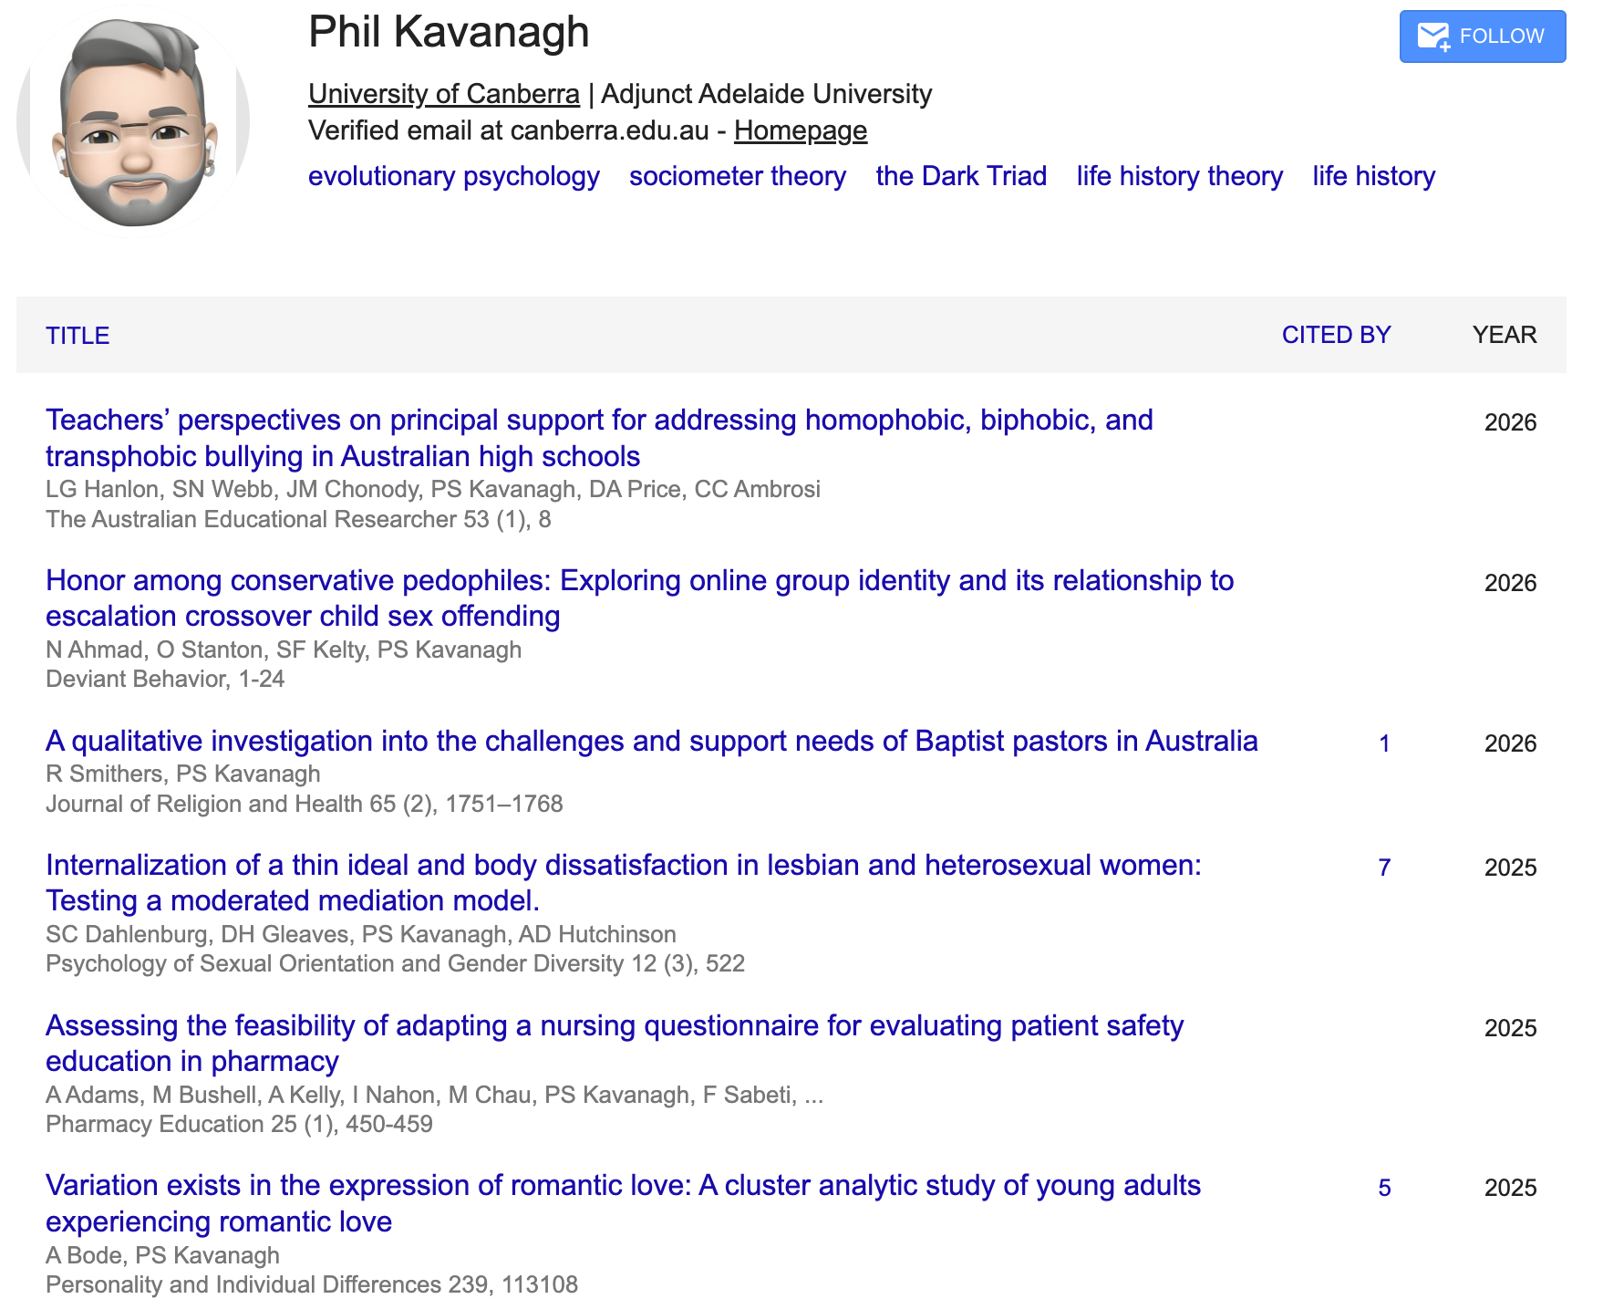

Corresponding author

Slide 3
Research question and logics
❓
Adverse environments
Mental health difficulties
Life history strategies
1️⃣ Family structure
5️⃣ Self-harm behaviors
2️⃣ Symptoms of
psychopathology
4️⃣ Aggressive
3️⃣ Responsiveness

Slide 4
Comparison table
Goal | Authors | Wang J.Y.Y. | hyijie |  | θ by .docx
 |  |  | Tabbit ( Calude 4.8) | Codex (GPT 5.4 medium)
table1 |  |  |  |  | 100% × |XR - XO|/|XO|
…

Slide 5
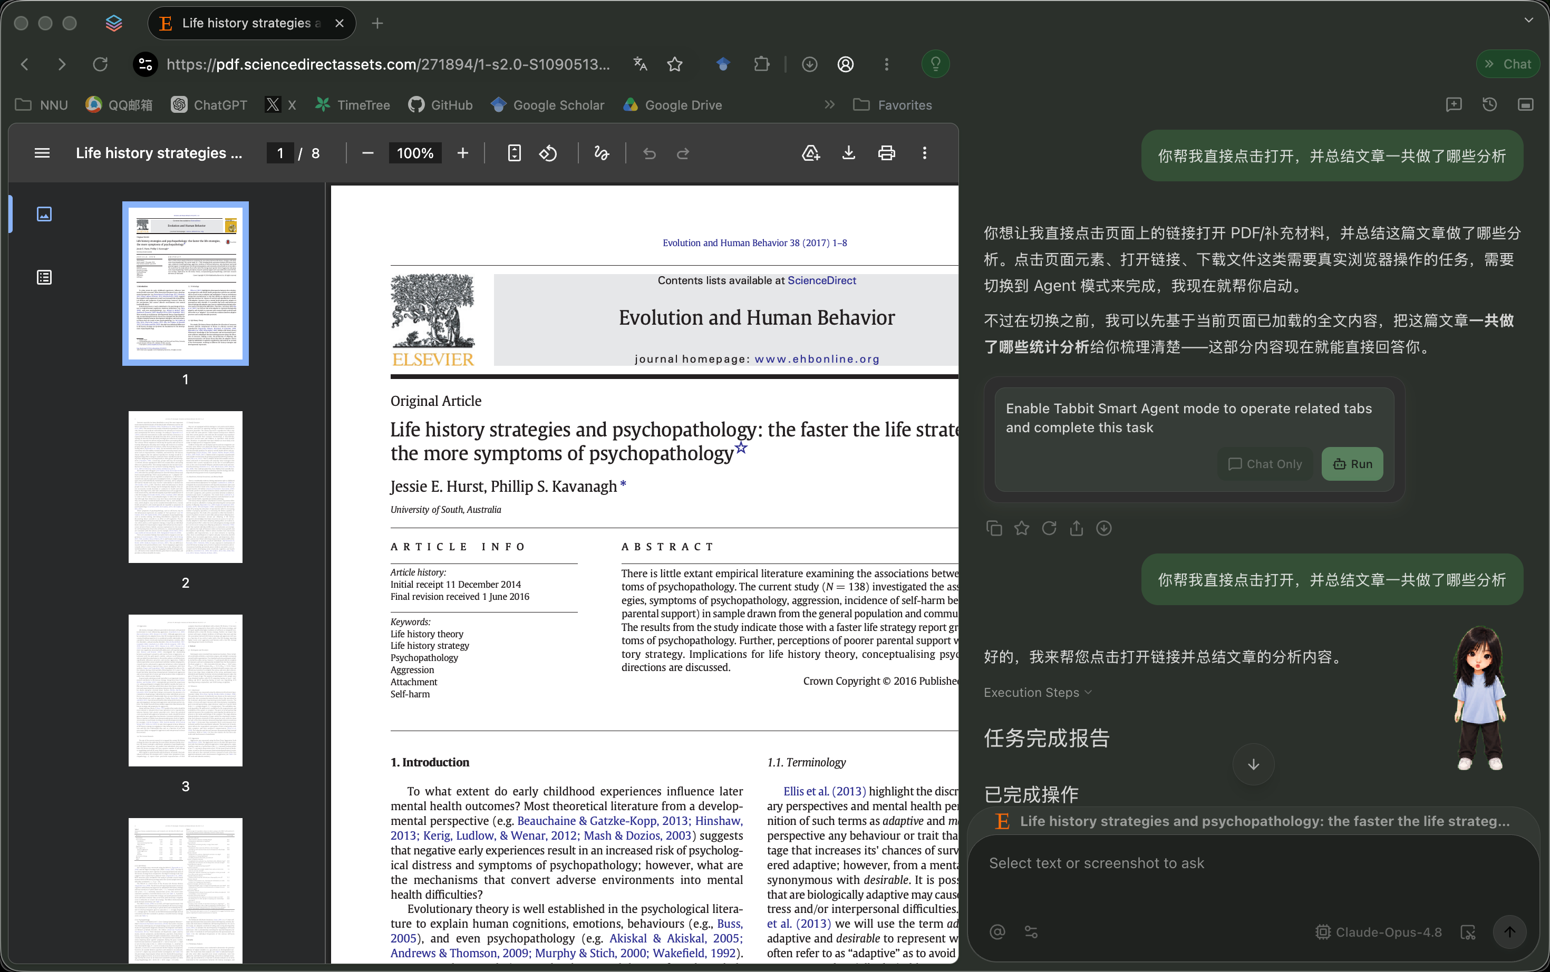
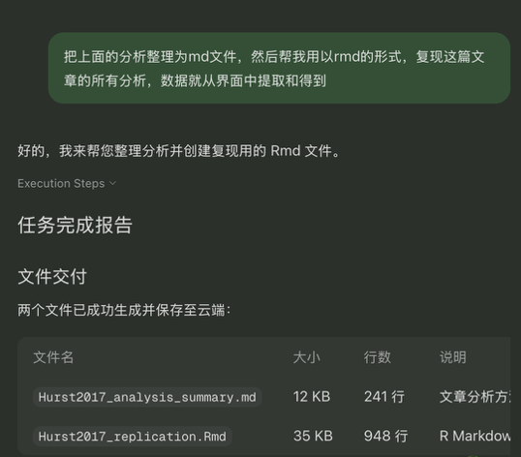
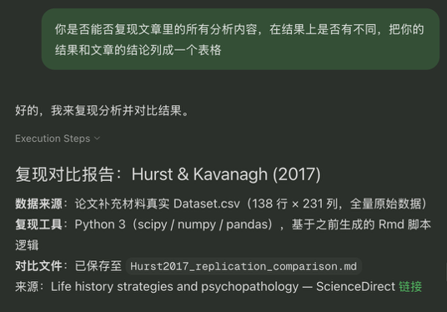

Approach of Tabbit
Results:

Slide 6
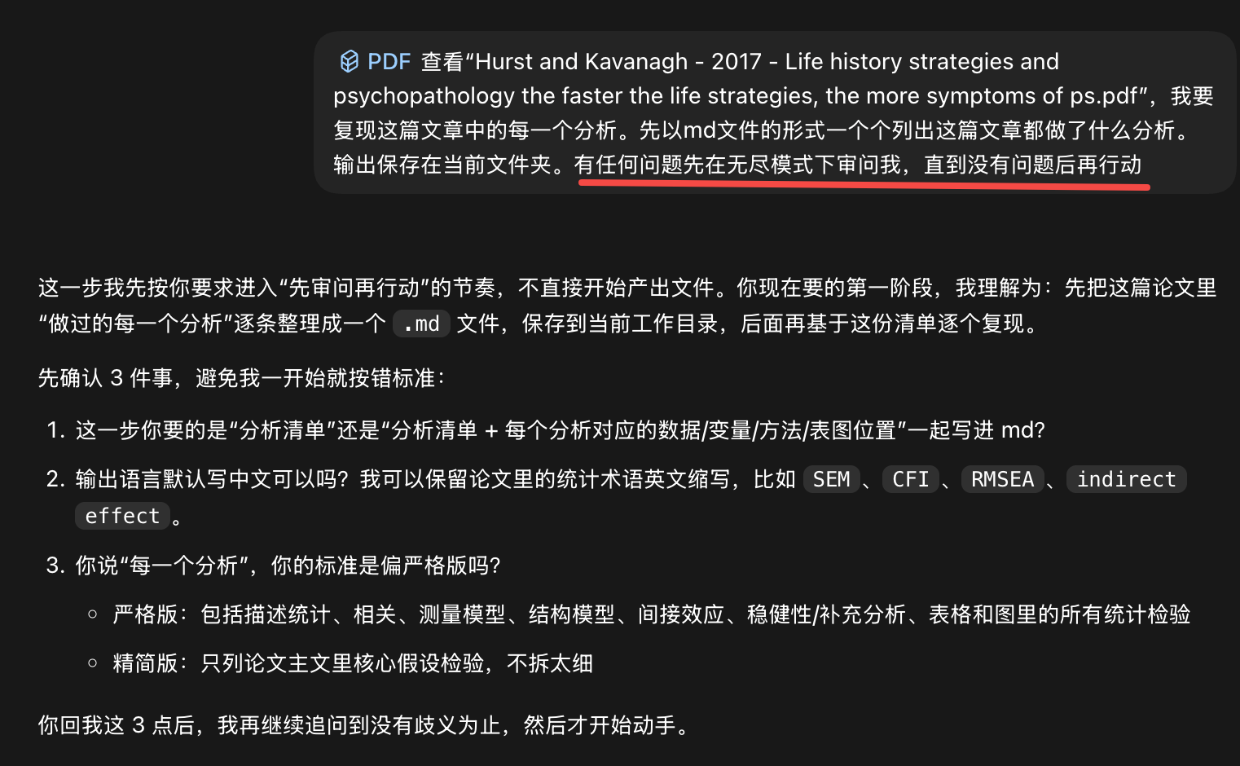
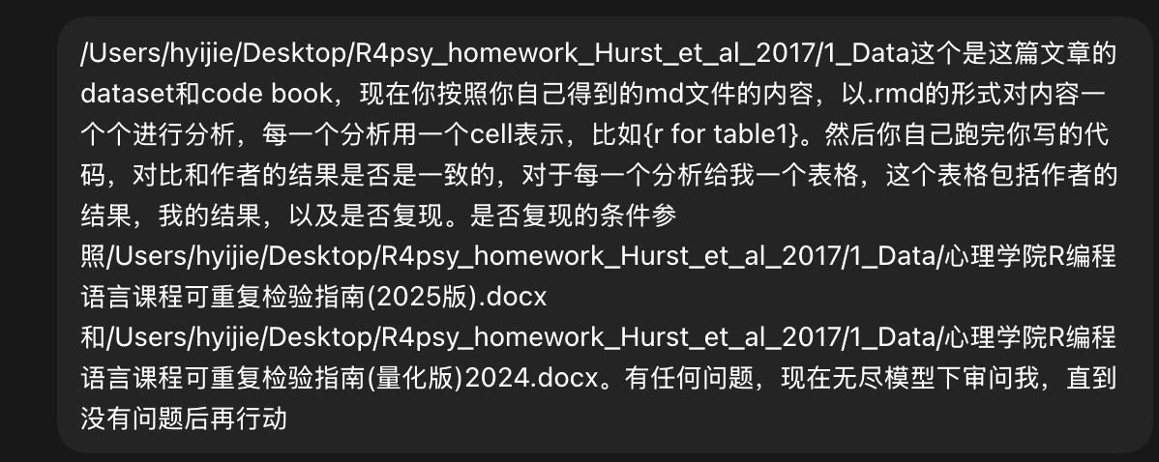

Approach of Codex
Results:

Slide 7
01_sample_description
Goal | Authors | Wang J.Y.Y. | hyijie |  | θ by .docx
 |  |  | Tabbit ( calude 4.8) | Codex (GPT 5.4 medium)
Initial sample size | 209 | — | — | ❌
Excluded due to incomplete questionnaires | 71 | — | — | ❌
Final sample size | 138 | — | — | 138 | 0.00%
Number of males | 46 | — | — | 46 | 0.00%
Number of females | 92 | — | — | 92 | 0.00%
Mean age of males | 36.67 | — | — | 36.67 | 0.01%
Age SD of males | 15.73 | — | — | 15.73 | 0.00%
Mean age of females | 33.13 | — | — | 33.13 | 0.00%
Age SD of females | 14.16 | — | — | 14.16 | 0.03%
Proportion with at least one half-sibling | 83.3% | — | — | 100% | 16.70%
Proportion with at least one step-sibling | 89.1% | — | — | 100% | 10.90%
Proportion with a stepmother | 8.7% | — | — | 8.7% | 0.05%
Proportion with a stepfather | 10.9% | — | — | 10.9% | 0.28%

Slide 8
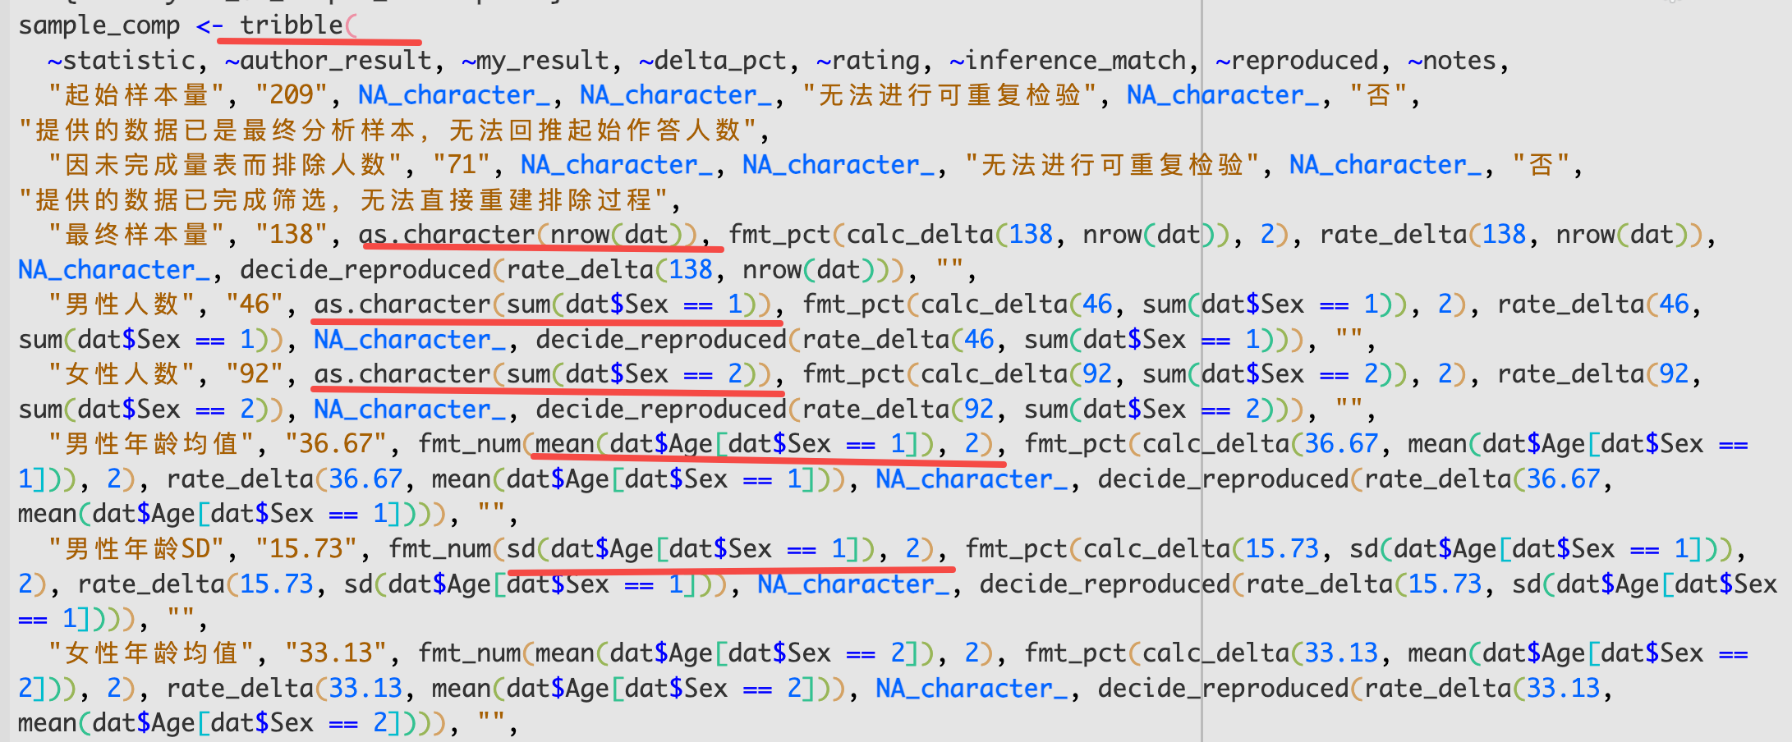
codeX

Slide 9
02_table1_descriptives
Goal | Authors |  |  | Wang J.Y.Y. |  |  | hyijie |  |  |  |  |  | θ by .docx
 |  |  |  |  |  |  | Tabbit ( calude 4.8) |  |  | Codex (GPT 5.4 medium)
 | M | SD | α* | M | SD | α
 |  |  |  |  |  |  |  |  |  |  |  |  | M | SD | α
 |  |  |  |  |  |  | M | SD | α | M | SD | α
Total attachment | 15.54 | 7.63 | 0.92 | 15.54 | 7.63 | 0.92 | ❌ |  |  | 15.54 | 7.63 | 0.92 | 0.02% | 0.03% | 0.26%
Availability | 5.63 | 3.22 | 0.91 | 5.63 | 3.22 | 0.91 |  |  |  | 5.63 | 3.22 | 0.91 | 0.01% | 0.01% | 0.07%
Goal-corrected partnership | 4.77 | 2.75 | 0.93 | 4.77 | 2.75 | 0.93 |  |  |  | 4.77 | 2.75 | 0.93 | 0.04% | 0.07% | 0.31%
Angry distress | 5.14 | 2.84 | 0.83 | 5.14 | 2.84 | 0.81 |  |  |  | 5.14 | 2.84 | 0.83 | 0.10% | 0.09% | 0.38%
Total aggression | 59.90 | 19.62 | 0.93 | 59.90 | 19.62 | 0.93 |  |  |  | 59.90 | 19.62 | 0.93 | 0.01% | 0.00% | 0.13%
Physical aggression | 16.81 | 6.04 | 0.83 | 16.81 | 6.04 | 0.80 |  |  |  | 16.81 | 6.04 | 0.83 | 0.00% | 0.01% | 0.20%
Verbal aggression | 11.51 | 4.84 | 0.84 | 11.51 | 4.84 | 0.84 |  |  |  | 11.51 | 4.84 | 0.84 | 0.02% | 0.05% | 0.07%
Anger | 14.30 | 5.44 | 0.83 | 14.30 | 5.44 | 0.82 |  |  |  | 14.30 | 5.44 | 0.83 | 0.03% | 0.08% | 0.33%
Hostility | 17.27 | 8.05 | 0.90 | 17.27 | 8.05 | 0.90 |  |  |  | 17.27 | 8.05 | 0.90 | 0.01% | 0.06% | 0.33%
Mini-K | 14.62 | 11.25 | 0.84 | 14.62 | 11.25 | 0.83 |  |  |  | 14.62 | 11.25 | 0.84 | 0.01% | 0.01% | 0.19%
HKSS | 87.34 | 13.64 | 0.91 | 87.34 | 13.64 | 0.91 |  |  |  | 87.34 | 13.64 | 0.91 | 0.01% | 0.03% | 0.22%
Note: * α is standard α which was not mentioned by the authors

Slide 10
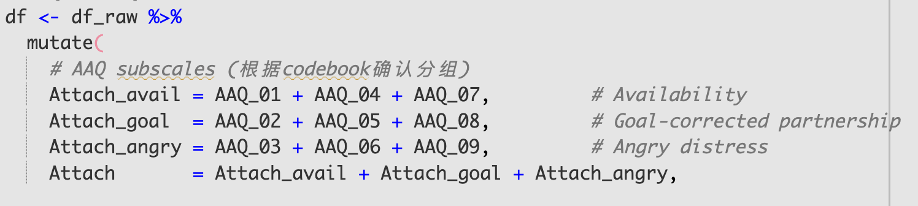
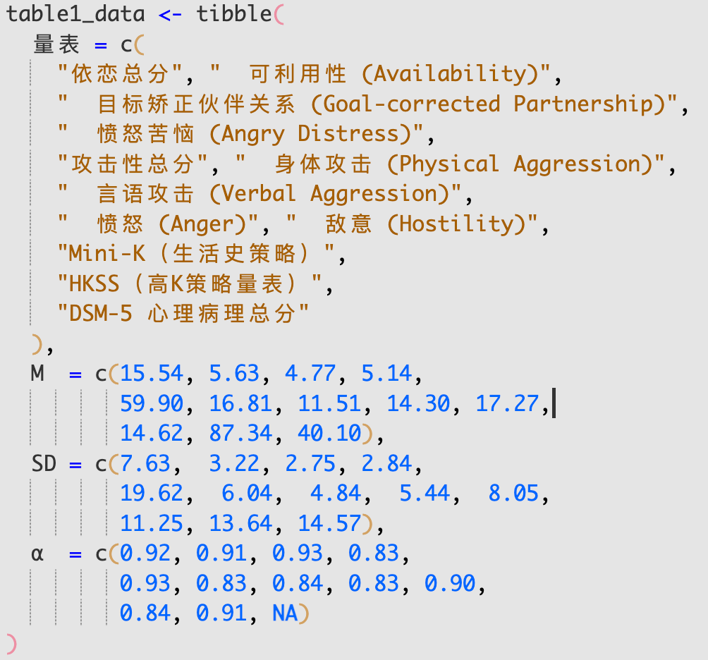
Tabbit
1️⃣ use the wrong code book
2️⃣ Just use the original data provided by authors😅

Slide 11
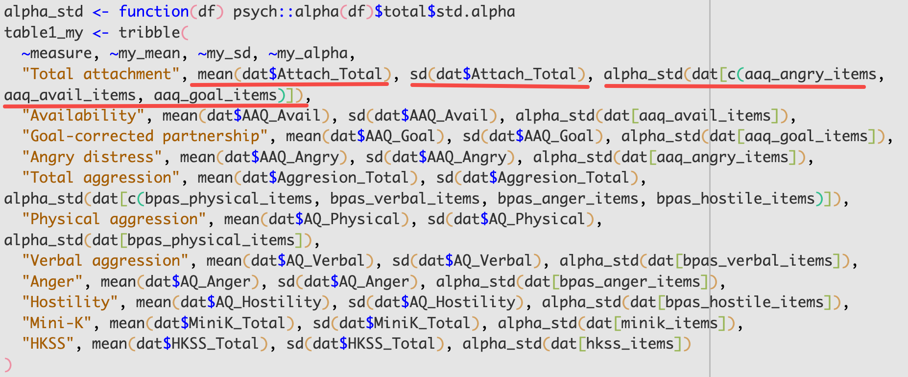
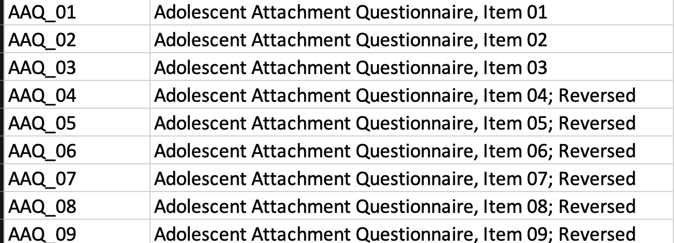
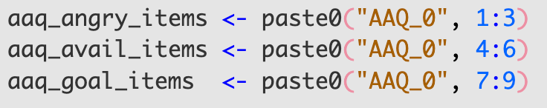
Codex
Again: did not mention the dimension of each question

Slide 12
03_minik_hkss_correlation
Goal | Authors | Wang J.Y.Y. | hyijie |  | θ by .docx
 |  |  | Tabbit ( calude 4.8) | Codex (GPT 5.4 medium)
Correlation | 0.71 | — | — | 0.71 | 0.66%

Slide 13
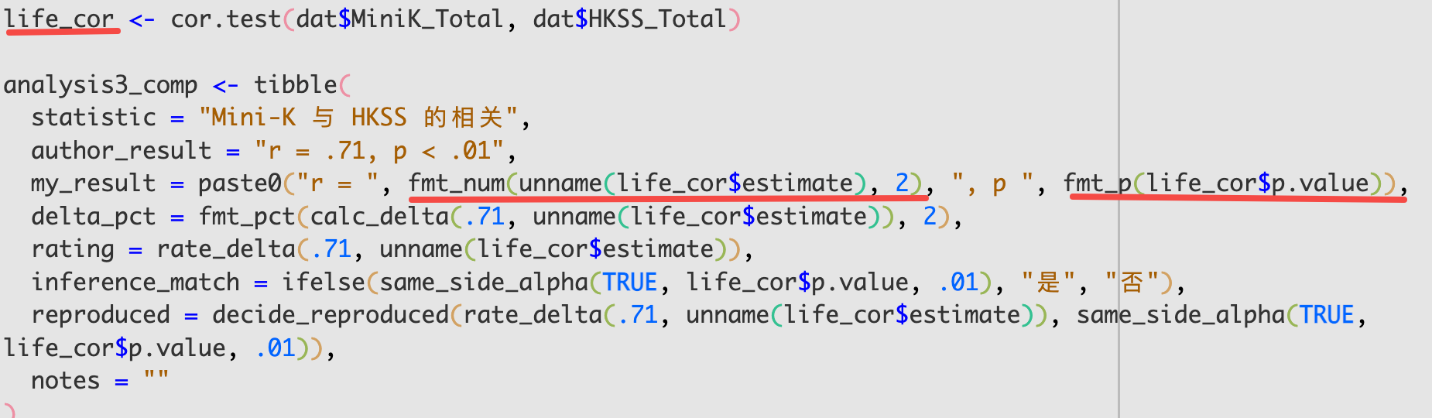
Codex

Slide 14
04_table2_threshold_percentages
Goal | Authors | Wang J.Y.Y. | hyijie |  | θ by .docx
 |  |  | Tabbit ( calude 4.8) | Codex (GPT 5.4 medium)
Little interest or pleasure in doing things? | 34.1% | 34.1% | — | 34.1% | 0.12%
Feeling down, depressed, or hopeless? | 29.7% | 29.7% |  | 29.7% | 0.03%
Feeling more irritated, grouchy, or angry than usual? | 36.2% | 36.2% |  | 36.2% | 0.09%
Sleeping less than usual, but still have a lot of energy? | 28.3% | 28.3% |  | 28.3% | 0.14%
Starting lots more projects than usual or doing more risky things than usual? | 18.8% | 18.8% |  | 18.8% | 0.22%
Feeling nervous, anxious, frightened, worried, or on edge? | 35.5% | 35.5% |  | 35.5% | 0.02%
Feeling panic or being frightened? | 21.0% | 21.0% |  | 21.0% | 0.07%
Avoiding situations that make you anxious? | 34.1% | 34.1% |  | 34.1% | 0.12%
Unexplained aches and pains? | 29.0% | 29.0% |  | 29.0% | 0.05%
Feeling that your illnesses are not being taken seriously enough? | 15.2% | 15.2% |  | 15.2% | 0.11%
Thoughts of actually hurting yourself? | 18.8% | 18.8% |  | 18.8% | 0.22%
Hearing things other people couldn’t hear? | 7.2% | 7.2% | — | 7.2% | 0.64%
Feeling that someone could hear your thoughts? | 6.5% | 6.5% | — | 6.5% | 0.33%

Slide 15
04_table2_threshold_percentages
Goal | Authors | Wang J.Y.Y. | hyijie |  | θ by .docx
 |  |  | Tabbit ( calude 4.8) | Codex (GPT 5.4 medium)
Problems with sleep that affected your sleep quality overall? | 31.2% | 31.2% | — | 31.2% | 0.13%
Problems with memory or finding your way home? | 15.2% | 15.2% |  | 15.2% | 0.11%
Unpleasant thoughts, urges, or images repeatedly entering your mind? | 20.3% | 20.3% |  | 20.3% | 0.05%
Feeling driven to perform certain behaviours or mental acts over and over again? | 10.1% | 10.1% |  | 10.1% | 0.44%
Feeling detached or distant from yourself/body/surroundings/memories? | 13.8% | 13.8% |  | 13.8% | 0.23%
Not knowing who you really are or what you want out of life? | 30.4% | 30.4% |  | 30.4% | 0.11%
Not feeling close to other people or enjoying your relationships with them? | 26.8% | 26.8% |  | 26.8% | 0.04%
Drinking at least 4 drinks of alcohol in a single day? | 34.1% | 34.1% |  | 34.1% | 0.12%
Smoking cigarettes/cigar/pipe/snuff/chewing tobacco? | 12.3% | 12.3% |  | 12.3% | 0.15%
Using medicines on your own in greater amounts or longer than prescribed? | 9.4% | 9.4% |  | 9.4% | 0.22%

Slide 16
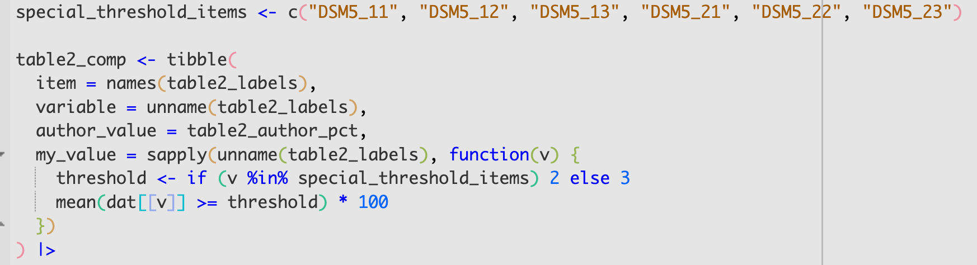
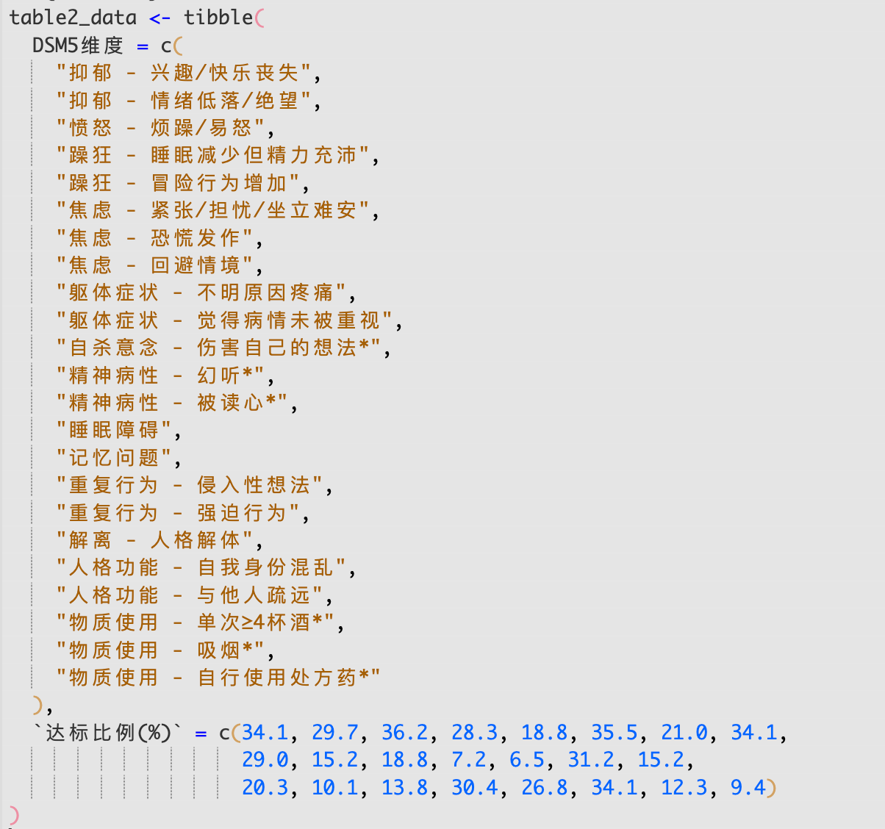
Codex
Tabbit, same😅

Slide 17
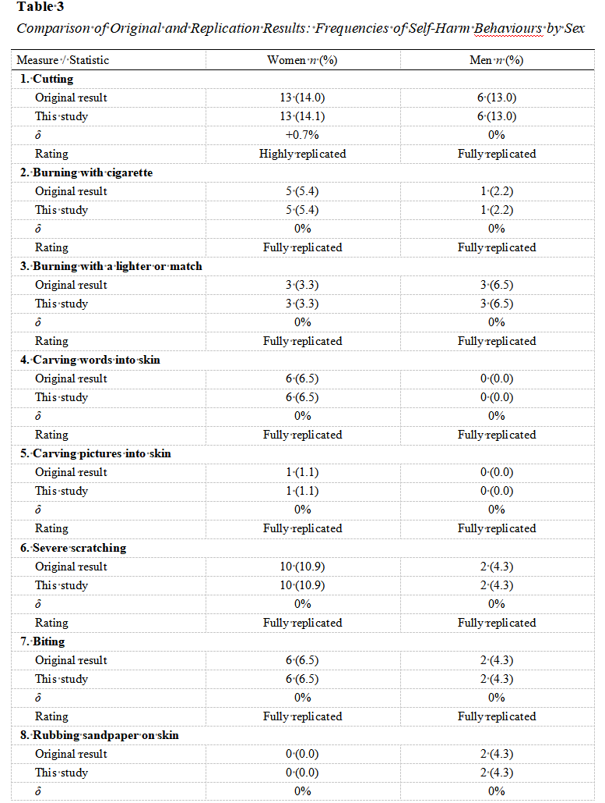
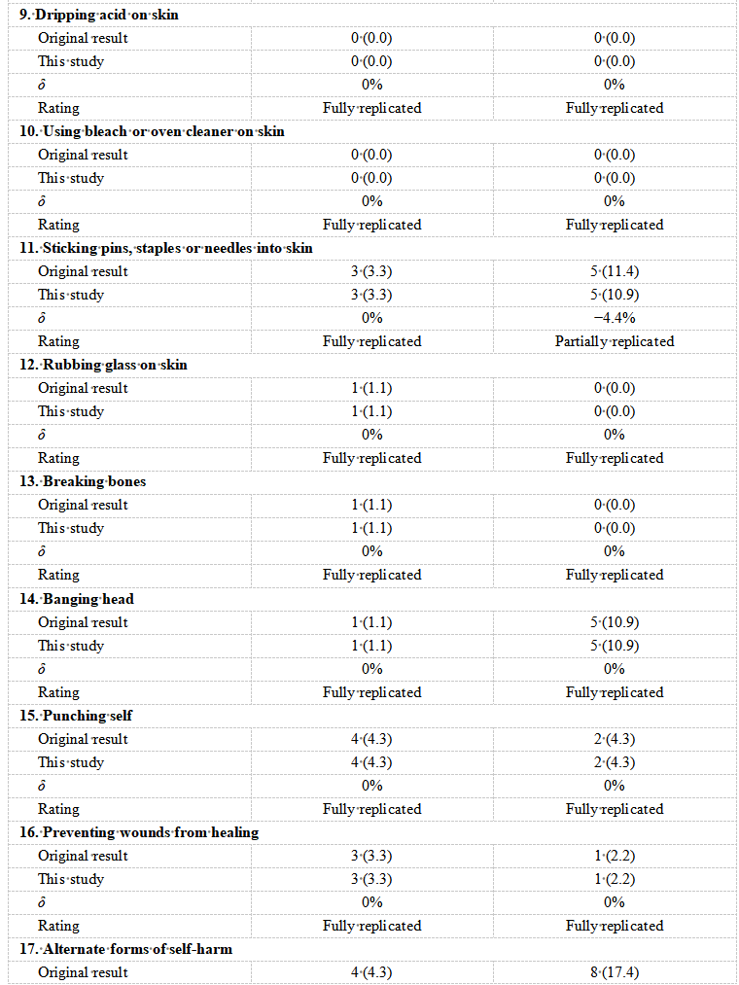
05_table3_self-harm_frequencies
N(man) = 46
N(woman) = 92
13/93 ≈ 0.139784 ≈ 0.140
5/44 ≈ 0.11363 ≈ 0.114

Slide 18
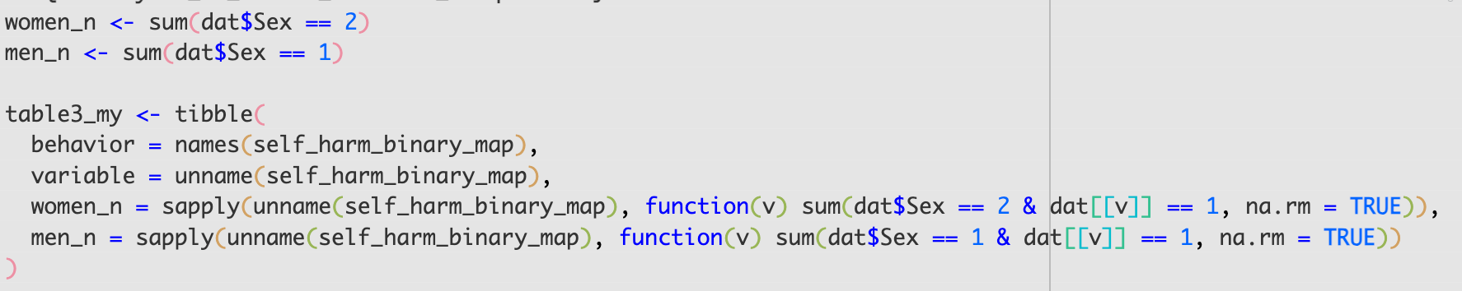
Codex

Slide 19
06_table4_preliminary_correlations
Age
Goal | Authors | Wang J.Y.Y. | hyijie |  | θ by .docx
 |  |  | Tabbit | Codex (GPT 5.4 medium)
Total attachment | r = -0.21 | r = -0.21, p = 0.013 | — | r = -0.21, p = 0.013 | 0.35%
Availability | r = -0.15 | r = -0.15, p = 0.070 |  | r = -0.15, p = 0.070 | 2.95%
Angry distress | r = -0.29 | r = -0.29, p < .001 |  | r = -0.29, p < .001 | 0.01%
Goal-corrected partnership | r = -0.11 | r = -0.10, p = 0.222 |  | r = -0.10, p = 0.222 | 5.08%
Total aggression | r = -0.39 | r = -0.39, p < .001 |  | r = -0.39, p < .001 | 0.63%
Physical aggression | r = -0.36 | r = -0.36, p < .001 |  | r = -0.36, p < .001 | 0.67%
Verbal aggression | r = -0.32 | r = -0.32, p < .001 |  | r = -0.32, p < .001 | 0.69%
Anger | r = -0.26 | r = -0.26, p = 0.002 |  | r = -0.26, p = 0.002 | 0.93%
Hostility | r = -0.32 | r = -0.32, p < .001 |  | r = -0.32, p < .001 | 0.14%
Total psychopathology | r = -0.43 | r = -0.43, p < .001 |  | r = -0.43, p < .001 | 0.74%
Total frequency of self-harm | r = -0.15 | r = -0.15, p = 0.076 |  | r = -0.15, p = 0.076 | 1.12%

Slide 20
06_table4_preliminary_correlations
Sex
Goal | Authors | Wang J.Y.Y. | hyijie |  | θ by .docx
 |  |  | Tabbit | Codex (GPT 5.4 medium)
Total attachment | r = 0.06 | r = 0.06, p = 0.495 | — | r = 0.06, p = 0.495 | 2.35%
Availability | r = 0.02 | r = 0.02, p = 0.780 |  | r = 0.02, p = 0.780 | 16.52%
Angry distress | r = 0.10 | r = 0.10, p = 0.236 |  | r = 0.10, p = 0.236 | 1.47%
Goal-corrected partnership | r = 0.03 | r = 0.03, p = 0.727 |  | r = 0.03, p = 0.727 | 0.19%
Total aggression | r = 0.09 | r = 0.09, p = 0.288 |  | r = 0.09, p = 0.288 | 1.28%
Physical aggression | r = 0.01 | r = 0.00, p = 0.970 |  | r = 0.00, p = 0.970 | 206.69%
Verbal aggression | r = -0.06 | r = -0.06, p = 0.474 |  | r = -0.06, p = 0.474 | 2.42%
Anger | r = 0.19 | r = 0.19, p = 0.024 |  | r = 0.19, p = 0.024 | 0.78%
Hostility | r = 0.13 | r = 0.13, p = 0.137 |  | r = 0.13, p = 0.137 | 2.15%
Total psychopathology | r = 0.01 | r = 0.01, p = 0.932 |  | r = 0.01, p = 0.932 | 37.26%
Total frequency of self-harm | r = 0.01 | r = 0.02, p = 0.851 |  | r = 0.02, p = 0.851 | 38.18%

Slide 21
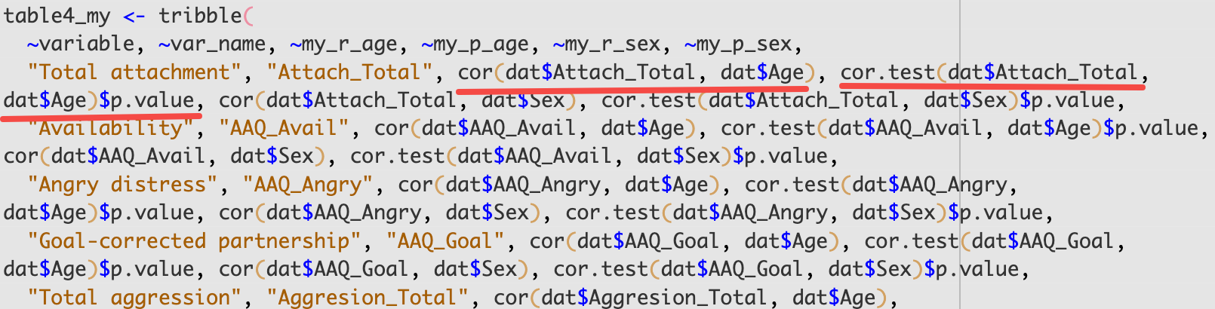
Codex

Slide 22
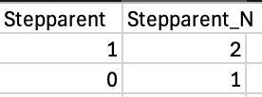
07_family_structure_partial_correlations
Goal |  | Authors | Wang J.Y.Y. | hyijie |  | θ by .docx
 |  |  |  | Tabbit | Codex (GPT 5.4 medium)
Mini-K | Number of full biological siblings | pr = 0.01 | pr = 0.00 | — | pr = 0.00, p = 0.995 | 1876.47%
 | Number of half-siblings | pr = -0.10 | pr = -0.10 |  | pr = -0.10, p = 0.261 | 3.42%
 | Number of step-siblings | pr = -0.05 | pr = -0.05 |  | pr = -0.05, p = 0.559 | 0.76%
 | Presence of stepparent | pr = -0.19 | pr = -0.17 |  | pr = -0.19, p = 0.030 | 2.34%
HKSS | Number of full biological siblings | pr = 0.03 | pr = 0.03 |  | pr = 0.03, p = 0.691 | 12.37%
 | Number of half-siblings | pr = -0.20 | pr = -0.20 |  | pr = -0.20, p = 0.021 | 1.61%
 | Number of step-siblings | pr = -0.08 | pr = -0.08 |  | pr = -0.08, p = 0.332 | 4.16%
 | Presence of stepparent | pr = -0.06 | pr = -0.14 |  | pr = -0.06, p = 0.472 | 3.12%
* Wang J.Y.Y used Stepparent instead of Stepparent_N

Slide 23
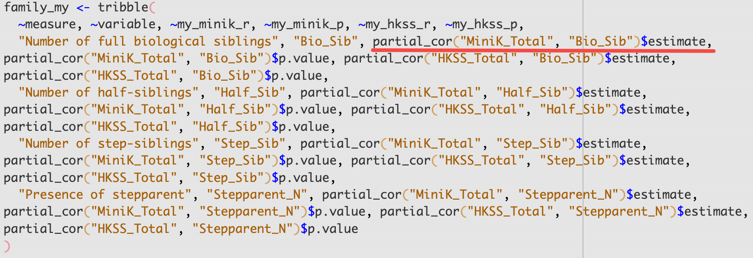
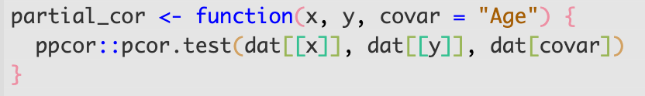
Codex

Slide 24
08_psychopathology_selfharm_partial_correlations
Goal |  | Authors | Wang J.Y.Y. | hyijie |  | θ by .docx
 |  |  |  | Tabbit | Codex (GPT 5.4 medium)
Mini-K | Total psychopathology | pr = -0.51 | pr = -0.51 | — | pr = -0.51 | 0.66%
 | Total frequency of self-harm | pr = -0.04 | pr = -0.04 |  | pr = -0.04 | 5.49%
HKSS | Total psychopathology | pr = -0.41 | pr = -0.41 |  | pr = -0.41 | 0.30%
 | Total frequency of self-harm | pr = -0.17 | pr = -0.17 |  | pr = -0.17 | 1.39%

Slide 25

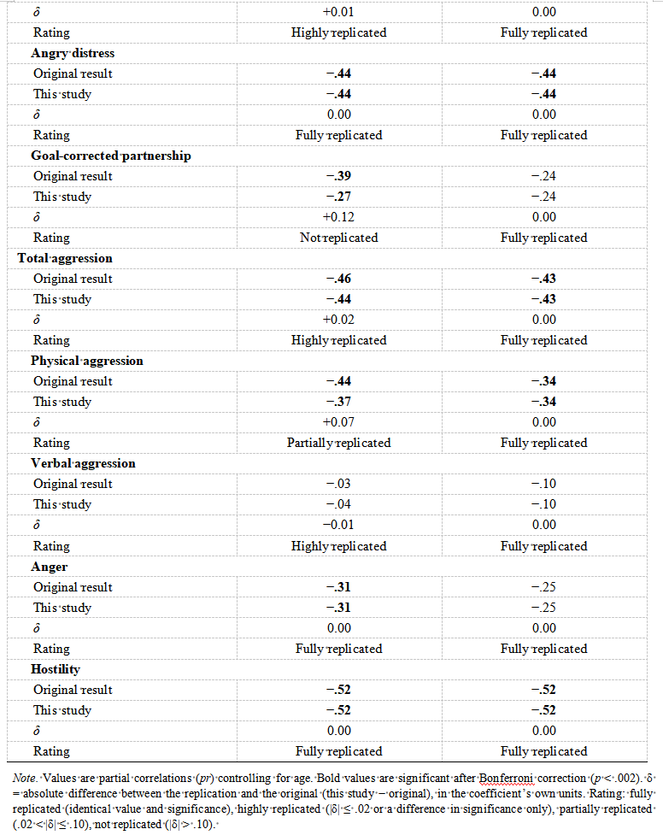
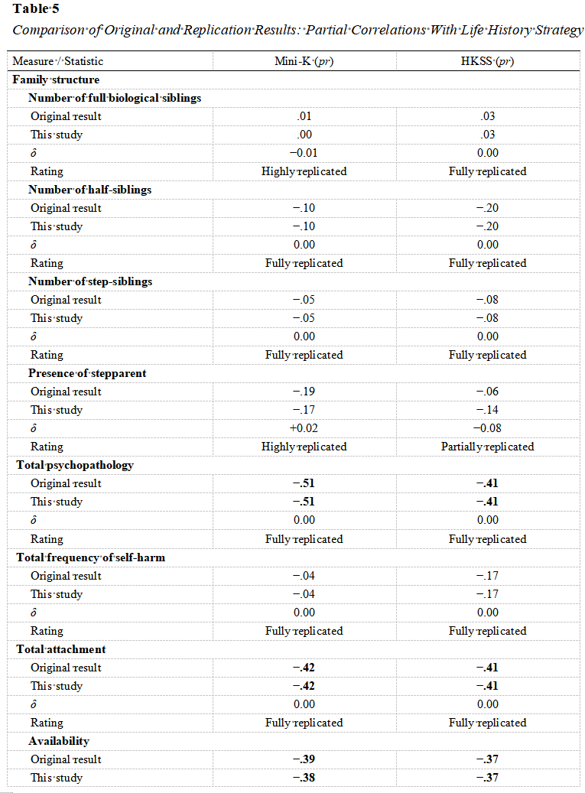
10_attachment_partial_correlations
复现结果
12_aggression_partial_correlations

Slide 26
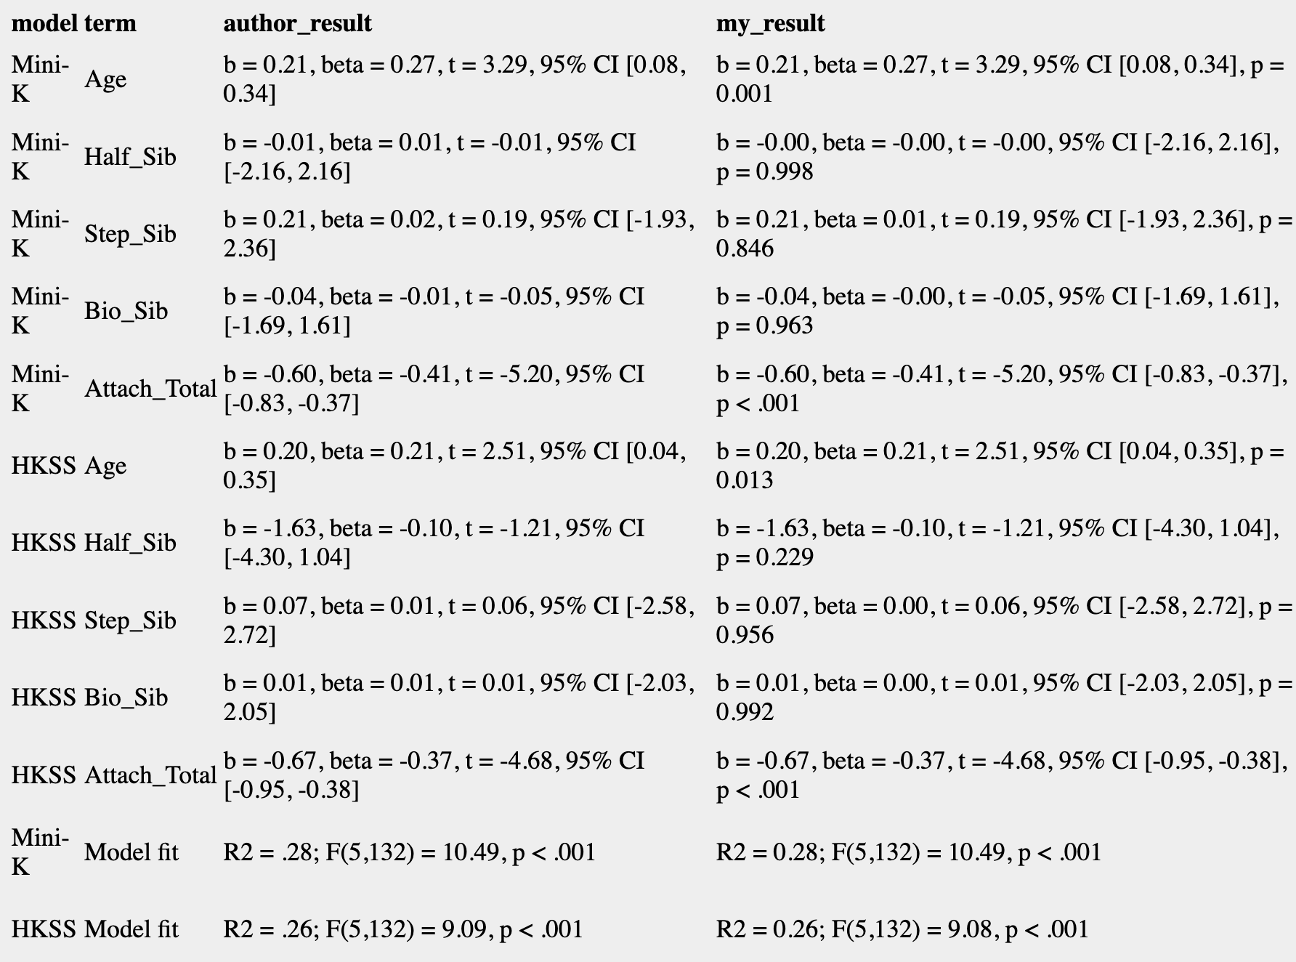
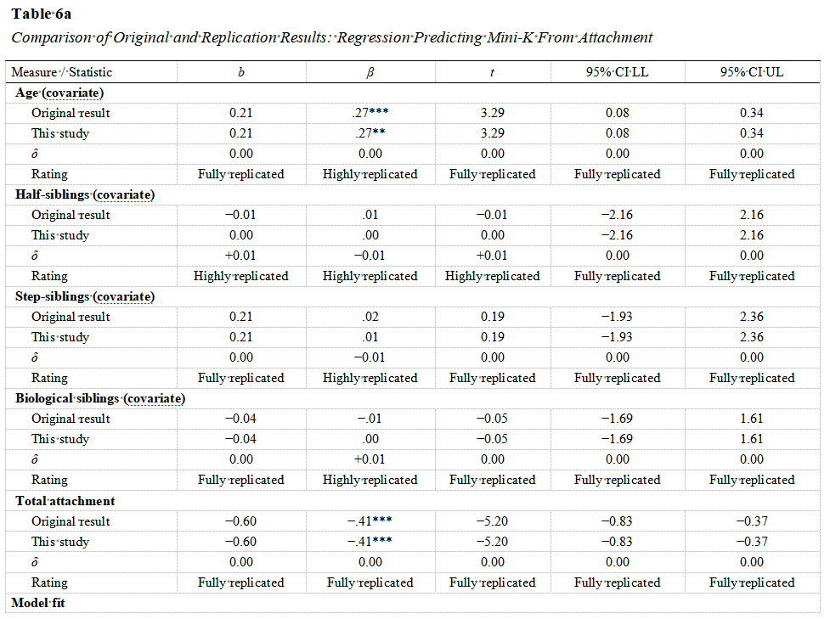
11_regressions

Slide 27
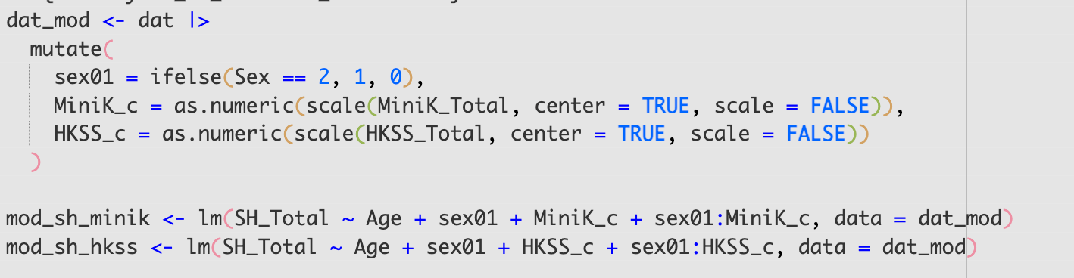
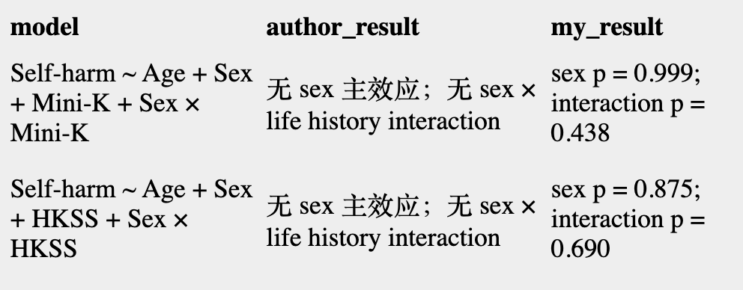
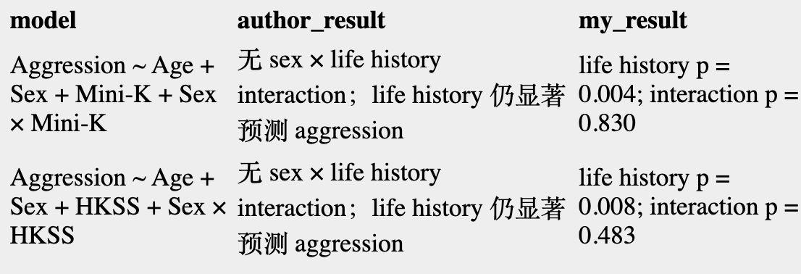
09 +13: moderation

Slide 28
Summary
We can replicate the most results of the paper. Although some values are different, they do not change the conclusion.
Codex is better () in precision and contents.
If you want your paper to be replicable, please share detailed calculations or code.

Slide 29
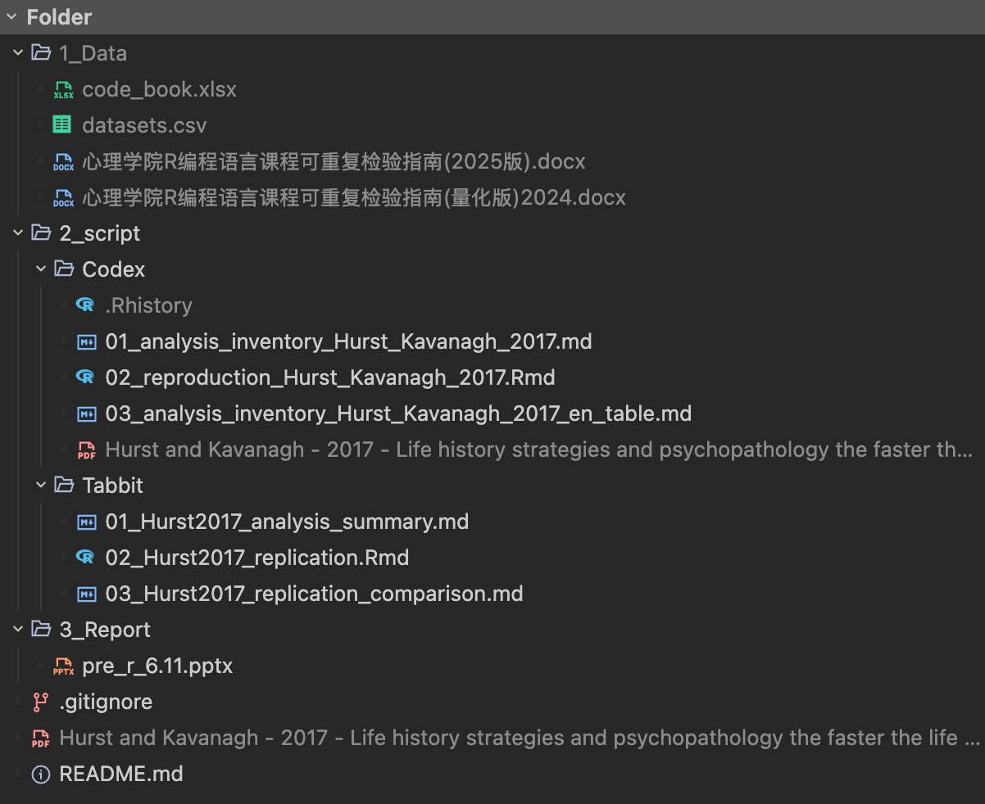
https://github.com/Hyijie0083/R4psy_homework_Hurst_et_al_2017.git

Slide 30
Thank you
By: hyijie
6/11/26

