Slide 1
Product Review Analysis
Project Batch No : 2
Under the guidance of
Name RegNo
Project Guide: Dr. A.Sri Krishna
Designation : HOD, Dept Of AI
Department : AI & DS
Institution : SHRI VISHNU ENGINEERING COLLEGE FOR WOMEN
Y.LAKSHMI SOWMYA 22B01A45C6 P.HYMAVATHI 22B01A4577 N.TEJASWI 22B01A4573
S.HARINI 22B01A45A6
Y.KEERTHI 22B01A45C5

Slide 2
Motivation
We were motivated to choose sentiment analysis using machine learning because understanding human emotions and opinions is essential in today's digital world.
With so much text data being generated daily through social media, reviews, and customer feedback, sentiment analysis helps uncover valuable insights that can drive better decisions.
Imagine a company launches a new product and receives thousands of customer reviews online. Instead of manually reading each review, sentiment analysis can quickly classify them as positive, negative, or neutral. This helps the company understand customer satisfaction, identify problems, and improve their product.
For example, if many reviews are negative and mention “poor battery life,” the company knows to focus on improving that feature.
Our project can also be applied to analyze public opinions on social media based on people's sentiments.

Slide 3
Objectives
Efficient Data Extraction Automate the extraction of customer reviews from e-commerce platforms like Amazon or Flipkart and store the data in a structured format for streamlined analysis.
Sentiment Classification and Summary Perform sentiment analysis to classify reviews as positive, negative, or neutral, and generate a concise summary for better understanding.
Product Evaluation and Rating Derive an overall product rating based on sentiment polarity and provide insights into whether the product is Good, Okay, or Bad according to customer feedback.

Slide 4
Literature Survey
1. Review Scraping and Analysis
Web scraping tools like BeautifulSoup and Selenium are commonly used to extract reviews from platforms like Amazon and Flipkart, enabling automated and real-time sentiment analysis.
2. Sentiment Analysis in E-commerce
Sentiment analysis leverages machine learning algorithms like Naive Bayes, SVM, and deep learning to classify customer reviews as positive, negative, or neutral, providing insights into customer feedback.
3. Text Summarization Techniques
Extractive and abstractive summarization methods help condense large amounts of review data into concise summaries, offering meaningful insights for sentiment interpretation.
research paper :
https://drive.google.com/file/d/1NooO70ff7TItsnqNBAfxt5pWQjc0G1oJ/view?usp=sharing

Slide 5
Problem Identification
Identification of the problem
We identified the problem by observing how consumers face challenges in analyzing product reviews on e-commerce platforms. Products often have hundreds or thousands of reviews, and manually reading them is time-consuming and inefficient. This led us to focus on creating a solution that:
Collects reviews automatically from product URLs.
Summarizes the overall sentiment in a clear and concise way.
Helps users make informed decisions without spending hours reading reviews.
Additionally, we noticed that many review systems lack an intelligent recommendation mechanism that evaluates whether a product is worth purchasing based on customer feedback. This gap inspired us to address the problem using sentiment analysis and machine learning.
Reasons for selecting the problem
Relevance and Real-World Impact: Online shopping has become a part of daily life, and helping users quickly understand product feedback makes their experience better and more efficient.

Slide 6
Dataset Description
Number of Records: Approximately 50,000 reviews.
Number of Features: 3 features included in the dataset.
Source of Dataset: The data was web-scraped from product URLs on e-commerce platforms.
Features in the Dataset
Review: The detailed feedback provided by customers about the product.
Rating: Numerical rating given by the customers, typically on a scale (1-5).
Comment: Additional remarks or insights shared by the customers regarding their experience with the product.

Slide 7
Proposed Solution
Our proposed solution is a Sentiment Analysis System that automates the process of summarizing product reviews and determining whether a product is worth purchasing based on customer feedback. The system works as follows:
URL-Based Review Extraction:
Users input the URL of a product (or multiple product URLs).
The system extracts reviews from the provided URLs using web scraping techniques.
Sentiment Analysis:
The extracted reviews are processed using Natural Language Processing (NLP) techniques.
Machine Learning (ML) models classify the reviews into sentiments (e.g., Positive, Negative, Neutral).
Extract the reviews and assign ratings based on sentiment polarity.
Review Summarization:
Reviews are summarized into a concise format using text summarization algorithms (e.g., extractive summarization or transformers like BERT).
This helps users quickly understand the overall sentiment of the reviews.
Product Analysis:
Based on the summarized sentiment analysis, the system provides a recommendation on whether the product is "Good" or "Not Good" for purchase.

Slide 8
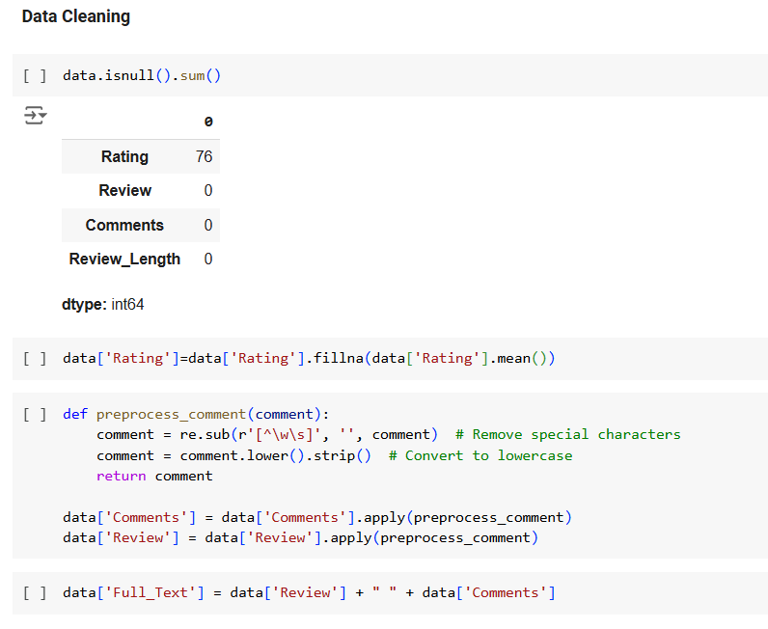
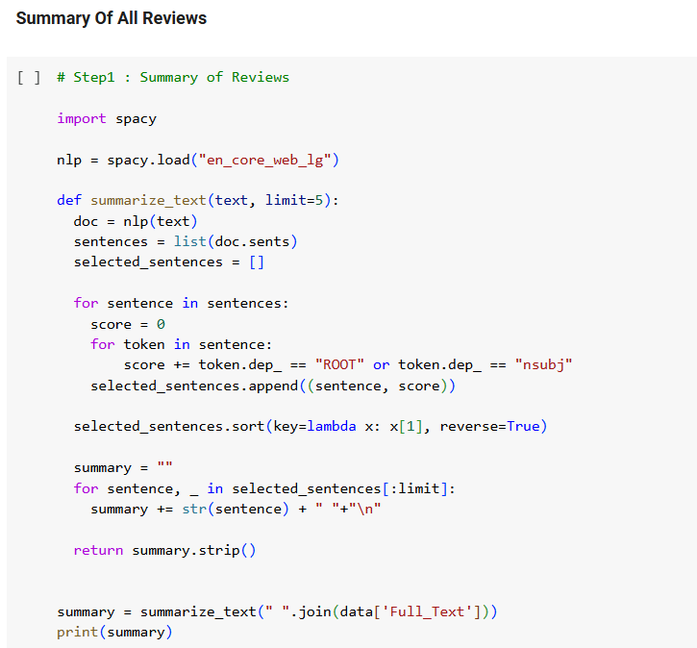
Project Implementation Details
This code snippet handles missing values in the "Rating" column by replacing them with the column's mean and preprocesses text data in "Review" and "Comments" by removing special characters, converting to lowercase, and stripping whitespace. Finally, it combines the cleaned "Review" and "Comments" columns into a new column called "Full_Text".
The code uses the spaCy library to summarize text by extracting the top sentences based on a simple scoring system (focusing on the main clause and subjects). It then combines the selected sentences into a concise summary limited to a specified number of sentences.

Slide 9
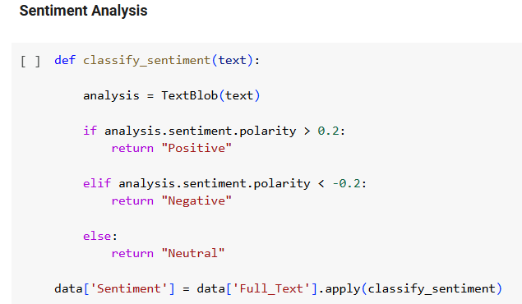
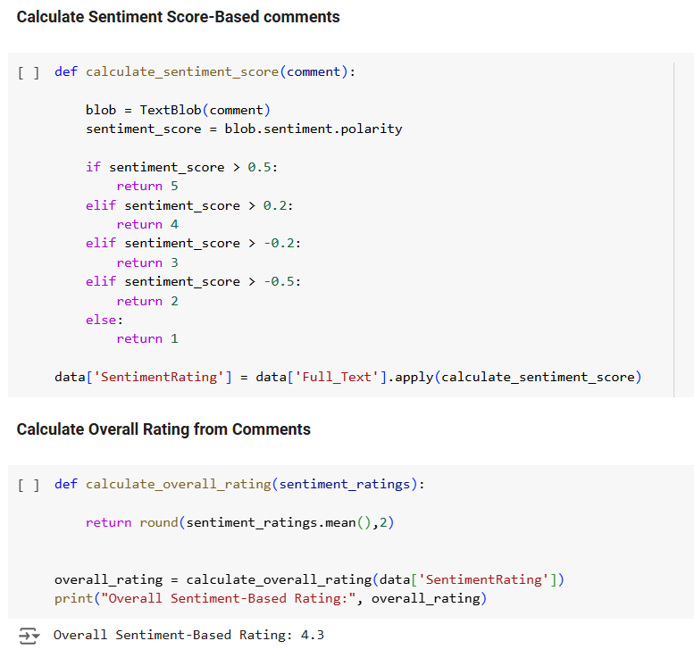
The code uses TextBlob to assign a sentiment score to each comment, mapping it to a rating between 1 and 5 based on polarity. It then calculates the average sentiment-based rating for all comments and displays it.
The code uses TextBlob to assign a sentiment score to each comment, mapping it to a rating between 1 and 5 based on polarity. It then calculates the average sentiment-based rating for all comments and displays it.

Slide 10
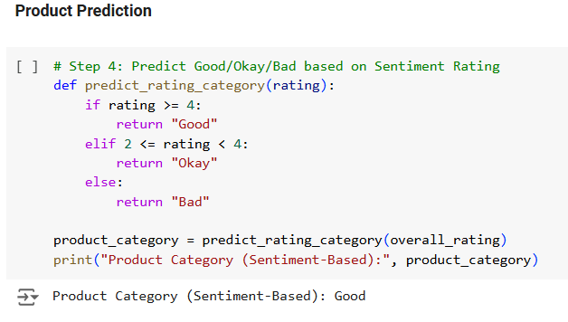
The code categorizes the overall sentiment-based rating into "Good" (4 or higher), "Okay" (between 2 and 4), or "Bad" (below 2). It then assigns the product to a category based on this logic and prints the result.

Slide 11
Tools required
Software Requirements
Jupyter Notebook: Used for coding, testing, and debugging the implementation.
Python: The primary programming language used for sentiment analysis.
Libraries:
Pandas: For data manipulation and preprocessing.
BeautifulSoup/Selenium: For web scraping reviews from e-commerce platforms.
NLTK/TextBlob: For natural language processing and sentiment classification.
Matplotlib/Seaborn: For visualizing data trends and sentiment results.
TextRank: For extractive summarization of the reviews
SpaCy: For advanced NLP tasks, such as tokenization and named entity recognition.

Slide 12
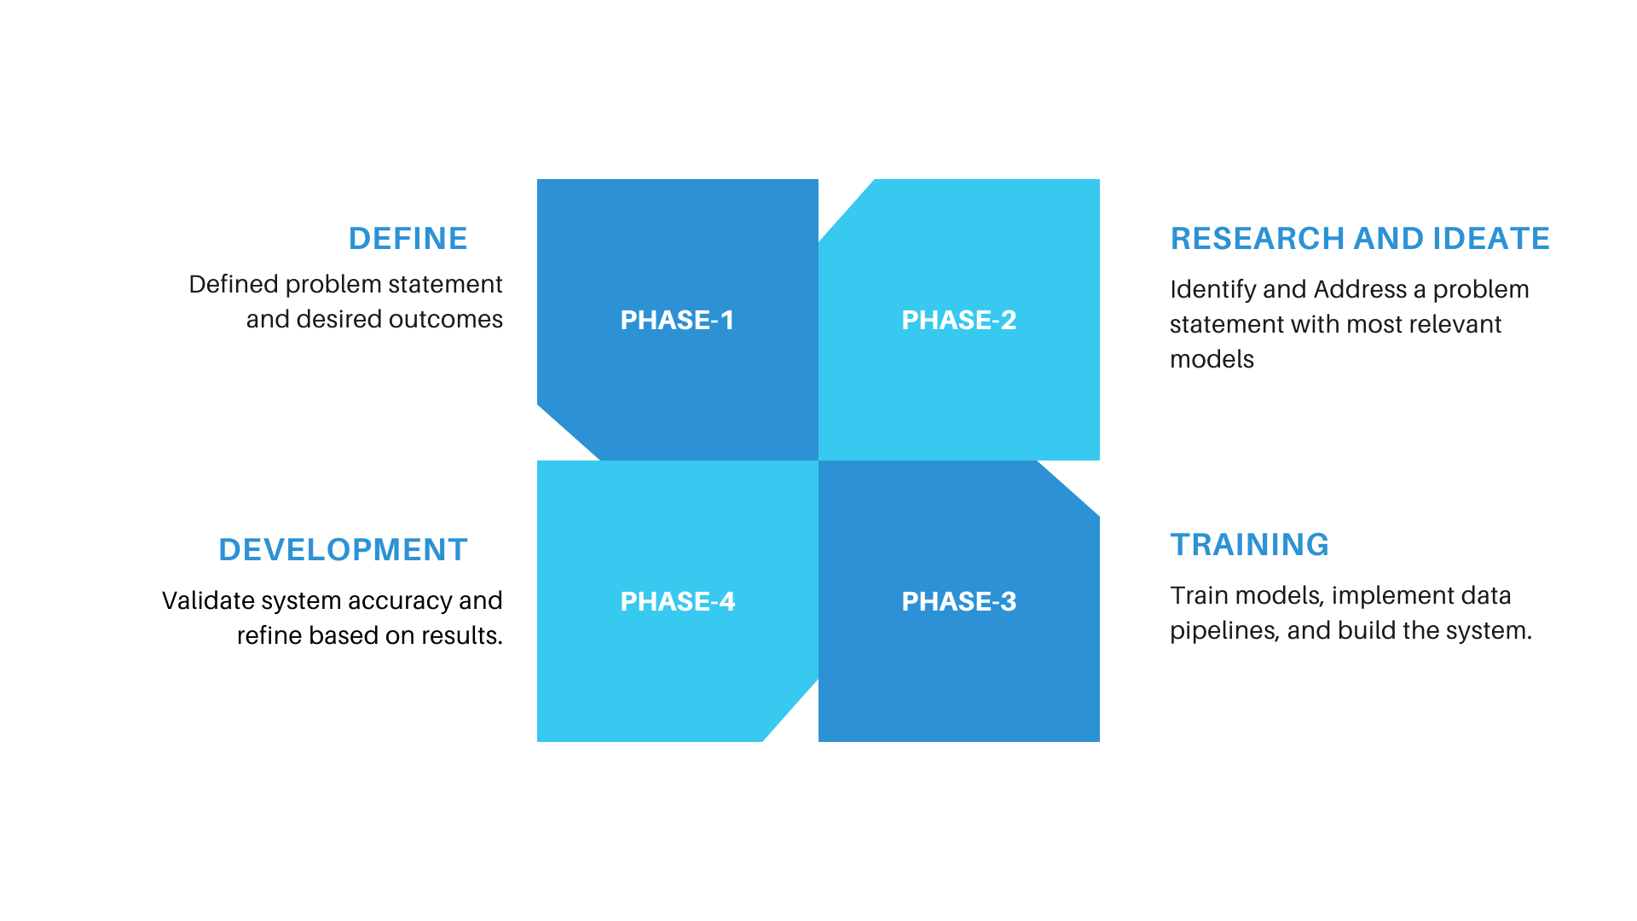
Timeline

Slide 13
Learning Outcomes
Sentiment Analysis
Learned to analyze product reviews and determine their sentiment (positive, negative, or neutral) using machine learning models.
Natural Language Processing (NLP)
Worked with text processing techniques like tokenization, lemmatization, and stopword removal to prepare review data for sentiment analysis.
Web Scraping
Developed skills in web scraping to extract reviews from product URLs, enabling automated collection of review data for analysis.
Sentiment Classification Models
Applied machine learning models like TextBlob and VADER to classify the sentiment of reviews, identifying customer satisfaction levels.

Slide 14
Role of each project Member
Y. LAKSHMI SOWMYA –
Summarization and Visualization : Developed text summarization methods and visualized data trends using graphs and charts.
P. HYMAVATHI –
Model Development and Training : Implemented and trained machine learning models for sentiment analysis.
N. TEJASWINI –
Data Collection and Preprocessing: Collected and cleaned review data using web scraping and preprocessing techniques.
S. HARINI –
Feature Engineering and Optimization: Focused on feature extraction, engineering, and optimizing model performance.
Y. KEERTHI –
Integration and Documentation: Integrated all components, ensured smooth execution, and prepared project documentation and presentation materials.

Slide 15
References
1.Research paper link : https://drive.google.com/file/d/1NooO70ff7TItsnqNBAfxt5pWQjc0G1oJ/view?usp=sharing
2. https://www.netguru.com/blog/sentiment-analysis-nlp
3. https://www.geeksforgeeks.org/text-summarization-in-nlp/
4. https://www.geeksforgeeks.org/python-web-scraping-tutorial/

Slide 16
Thank you

