Slide 1
Cloud-Based Generalized Data Analysis Platform - Hymavathi Gummudala, Shreyas Aswar, Siddesh Chavan
INFO H - 516
IUPUI

Slide 2
Why ?
In the age of data-driven decision-making, the ability of preprocessing and analyzing the data is important.
However -
With large amounts of data, data analysis is often time taking and it might require additional computing resources which everyone don’t have.
It might be difficult for a broader audience to perform basic data analysis as it requires technical knowledge.

Slide 3
Why Cloud ?
Scalable - With this platform, we will be able to handle as many users as required based on the demand.
No Dependencies - No need to install software, libraries
Time-saving - Streamlined pipeline to make the process fast

Slide 4
Generalized Analysis Approach
Built each function for each task
Combined all small functions in a user defined function
Where we keep collecting the results in empty json
One function passes processed csv to next function
Final result will be the dataframe and JSON ( Keys – Function names, Values – Descritpive statistics)
Based on Target Variable Datatype it chooses Classification or Regression

Slide 5


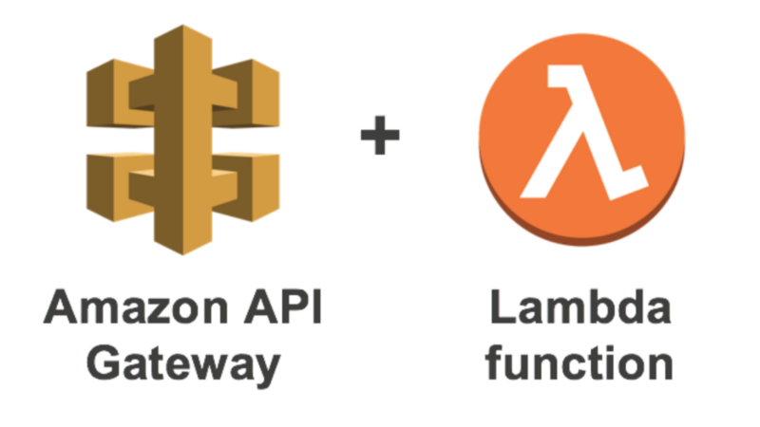




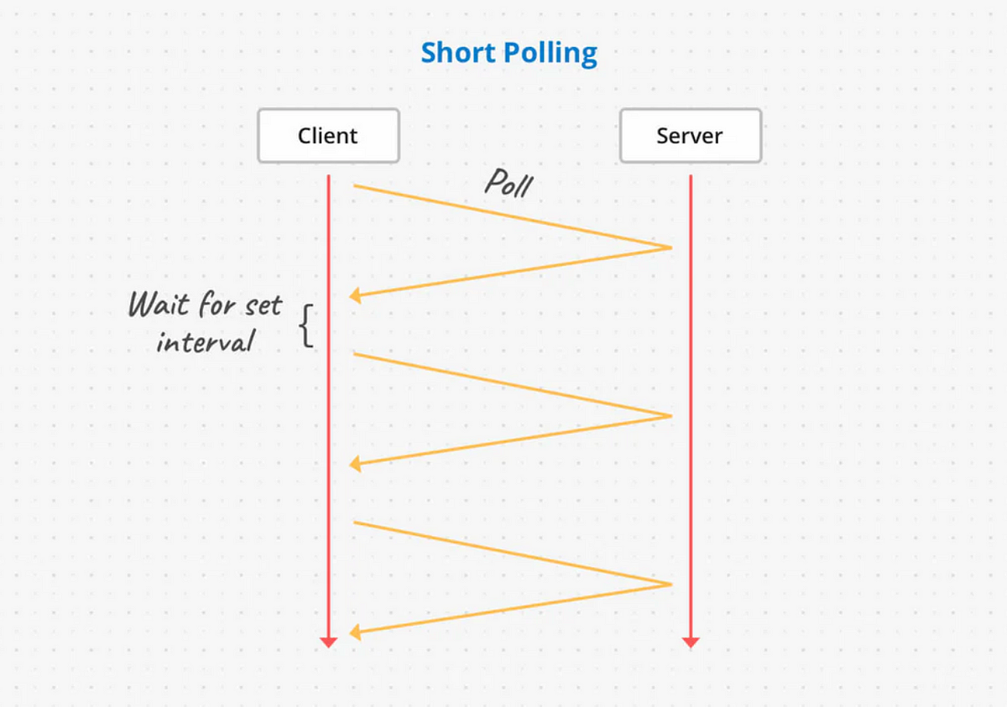


Passes CSV
Triggers
S3 Bucket
POST CALL
Results
GET CALL
Results
Web Interface
Polling Mechanism

Slide 6
Limitations & Assumptions
Some CSV's include Encoding
Column names which Includes Special Characters
Threshold decided based on dataset Length
When Target Variable is Float -> Regression, String/Object -> Classification
If its Int -> based on the unique categories of Target Variable it choose Reg or Class

Slide 7
Demo

Slide 8
Evaluation
Dataset | User time | Reason for user | Our Platform
BostonHousing | 4 mins | Library issue | 2 min 4 sec
Titanic | 6mins | Column has . In it | 2 min 13 sec
Iris | 4 mins | No issues | 2 min 3 sec

Slide 9
Thank you

