Slide 1
Cloud-Based Generalized Data Analysis Platform - Hymavathi Gummudala, Shreyas Aswar, Siddesh Chavan
INFO H - 516
IUPUI

Slide 2
Why ?
In the age of data-driven decision-making, the ability of preprocessing and analyzing the data is important.
However -
With large amounts of data, data analysis is often time taking and it might require additional computing resources which everyone don’t have.
It might be difficult for a broader audience to perform basic data analysis as it requires technical knowledge.

Slide 3
Our Solution
Our innovative platform offers a solution that leverages the power of cloud computing to automate and streamline the data preprocessing and analysis pipeline
It will be a cloud based user-friendly website where individuals can effortlessly upload CSV data files.
The platform then takes over, performing a series of critical data processing tasks and produces descriptive statistics and model evaluation matrix.

Slide 4

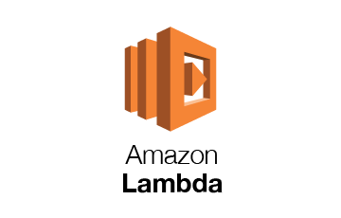





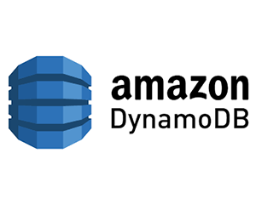
How ?
S3 Bucket
Map-reduce
Web Interface

Slide 5
Previous works
https://www.sciencedirect.com/science/article/pii/S2665963823000696
https://www.ncbi.nlm.nih.gov/pmc/articles/PMC7304122/
Advantages
On demand Network Access - No need of software installations or requirements
Scalability - beneficial for data analysis irrespective of size of the dataset and computational requirements.
Accessibility- Users can upload their CSV files and perform analysis regardless of their location
Performance- Results in faster analysis

Slide 6
Thank you

