Slide 1
Job Matching : A Neural Network Approach
PROJECT PRESENTATION – Group 14
DEEP LEARNING – INFO H 518
Group 14 - hymavathi Gummudala & shreyas aswar
Advisor – Prof. Sunandan Chakraborty

Slide 2
WHY ? (problem description)
Everyone might have received this advice from friends or peers that one must tailor Resume as per the Job Description.
Matching resumes to job descriptions is a time-consuming and challenging task for job seekers as well as for the recruiter.
We might commit manual errors just by skimming and scanning the JD.
Applying to jobs where the job description does not match with a resume lower the chances of getting the job.
To select the most qualified candidate the recruiter also needs to go through the job description and resumes of thousands of candidates.

Slide 3
HOW ? (OUR APPROACH)
Currently, methods like Keyword Matching, and Semantic Matching are used for this problem.
So, we decided to create a Job Matching algorithm using NLP and Neural Network Approach.

Slide 4
Data Collection
Surprisingly, we could not find the dataset of Resumes and Job Descriptions together.
We collected the Resumes from Online (i.e., GitHub and Kaggle)
We decided to generate the Job Descriptions using Pre-Trained Models
After researching, we learned that we need text Generation Models like BART-base, BART-Large, and GPT 2 for fine-tuning.
We have 29k resumes We generated 4500 JD from GPT 3.5
We used this collection of Resumes and JD's to fine-tune the pre-trained models.
Out of three, as Expected BART-Large was performing better in generating as it was trained on too many parameters.

Slide 5
Preprocessing - Data cleaning
Tokenization Lowercasing, Removing special characters
Why not numbers ?
Based on the problem in hand, numbers are important in this context since resume and job descriptions might have experience or skills where numbers are essential.
HTML5 , D3
At least 5 years of experience in Python

Slide 6
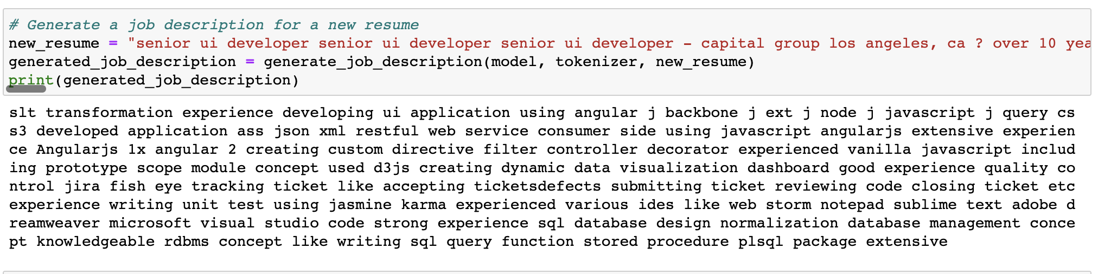
Job Description Generated Using BART – BASE without Stop words

Slide 7
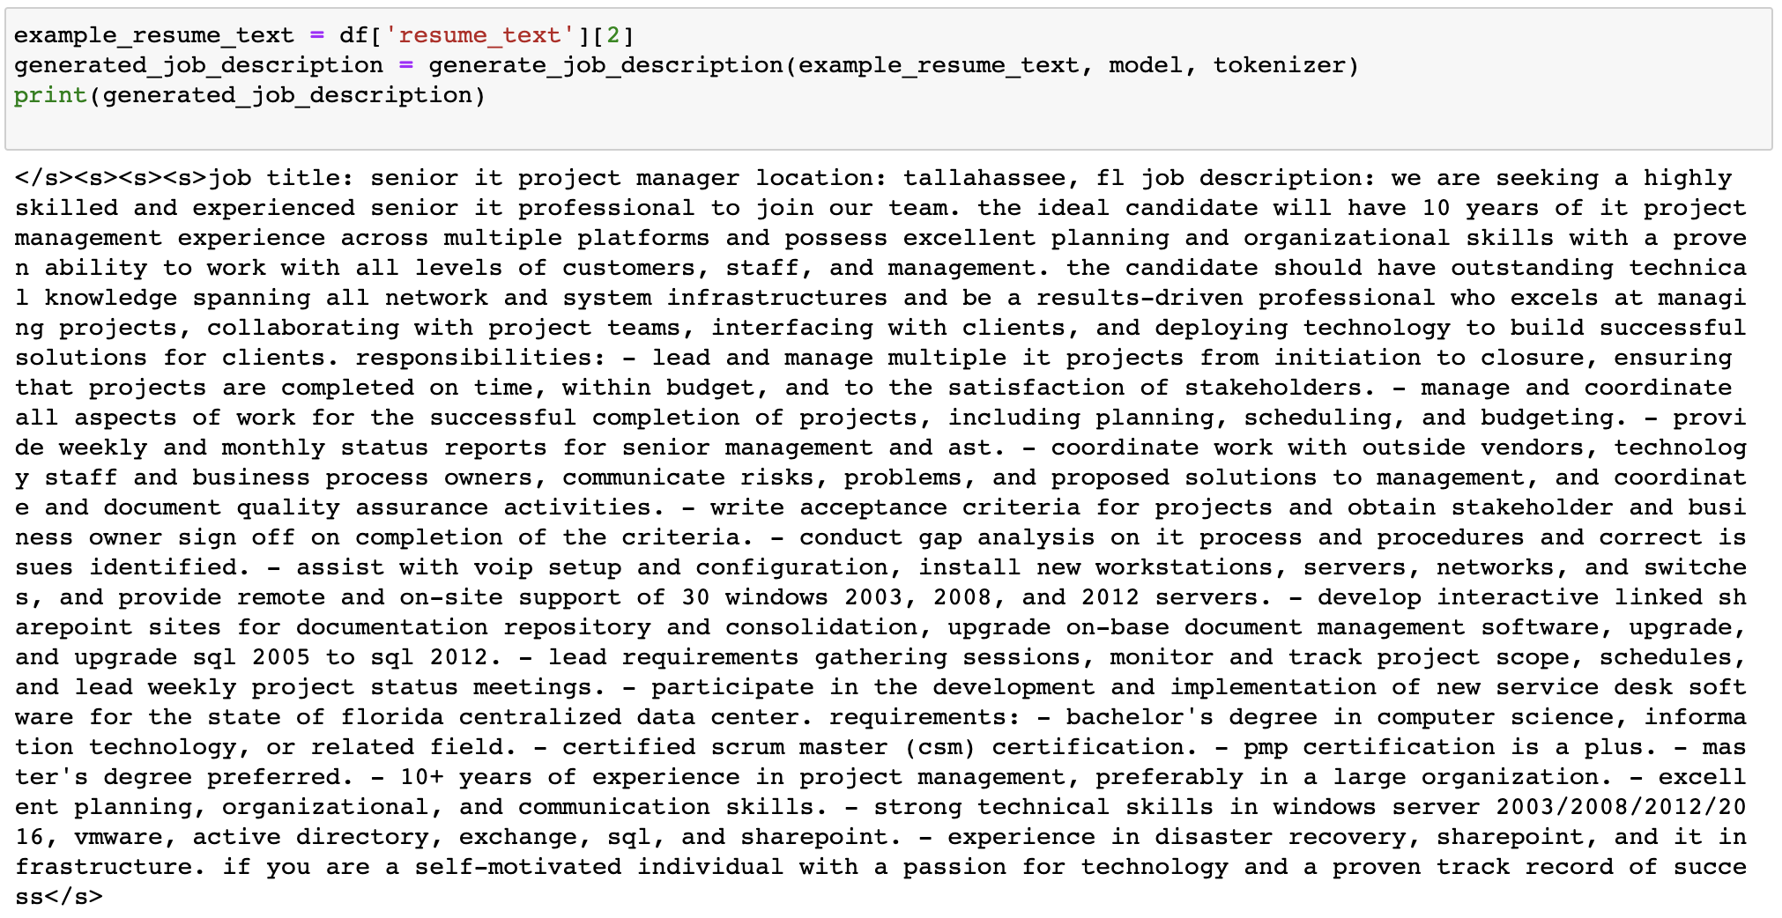
Job Description Generated Using BART – BASE LARGE with Stop words

Slide 8
NEGATIVE SAMPLING
We have Resumes and Job Description which are Matching.
What about negative examples
We created negative examples by randomly matching resumes and job descriptions.
Added more examples, by using gpt 3.5.

Slide 9
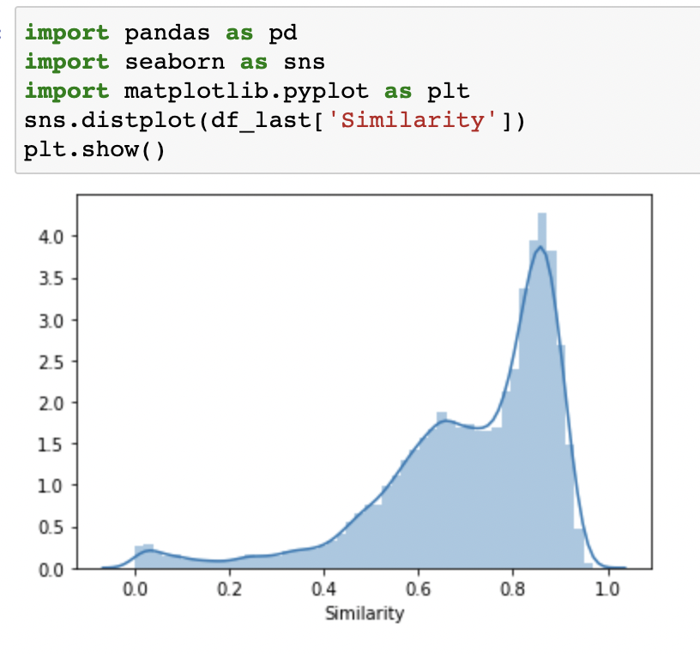
labeling
How to decide Threshold ?
We decided to go with COSINE SIMILARITY.
(x, y) = (x . y) / (||x|| ||y||)
where "." denotes the dot product of the two vectors, and "||x||" and "||y||" denote the Euclidean norms of the two vector

Slide 10
Feature extraction
Word embedding
TF-IDF
Word2vec

Slide 11
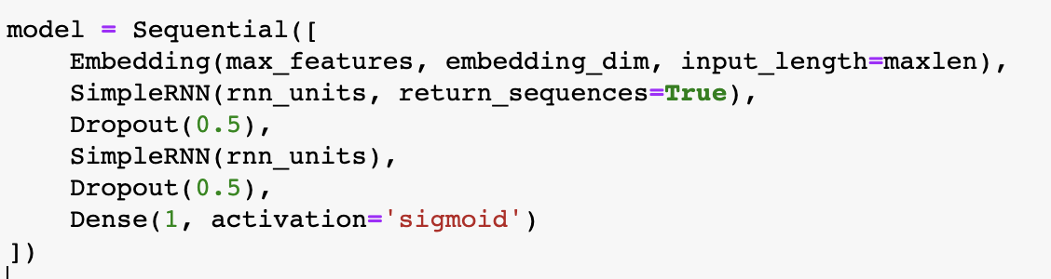
MODELING - RNN
Accuracy – 0.8194

Slide 12
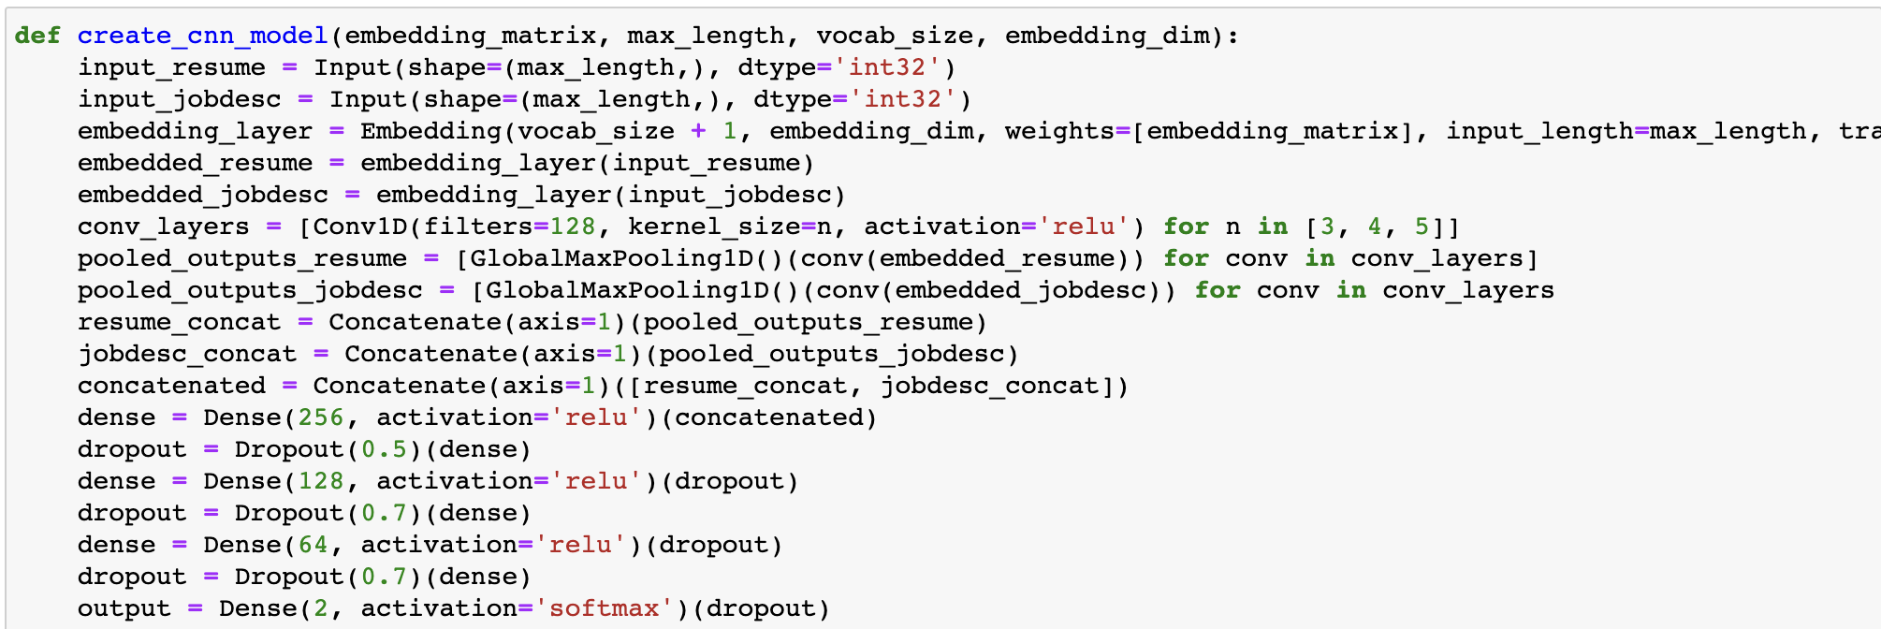
MODELING - CNN
Accuracy – 0.7421

Slide 13
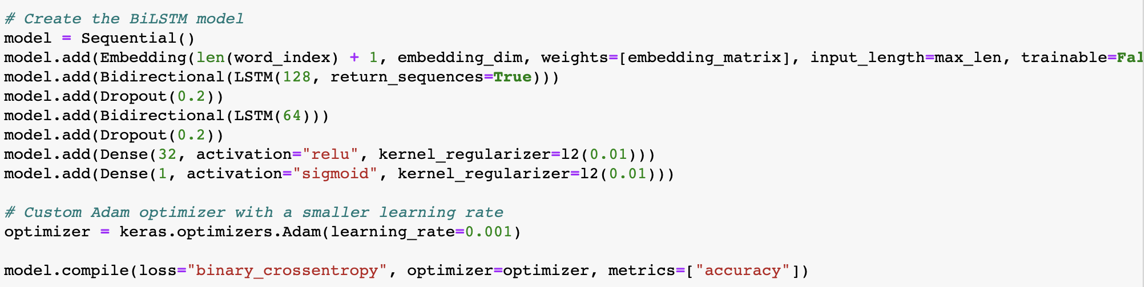
MODELING – bi-LSTM
Accuracy – 0.8333

Slide 14
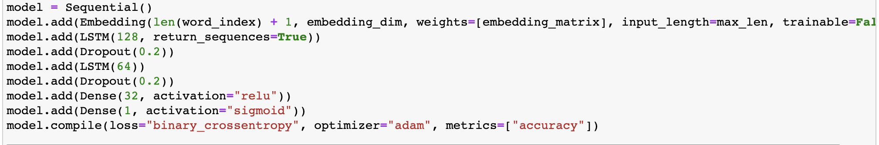
MODELING - LSTM
Accuracy – 0.8483

Slide 15
RESULTS
LSTM = 0.8483
BILSTM = 0.8333
CNN = 0.7421
RNN = 0.8194

Slide 16
SAMPLE EVALUATION

Slide 17
FURTHER PLAN OF ACTION
PRINTING THE CLASSIFICATION REPORT AND IDENTIFYING THE BUGS
HYPERTUNING THE MODELS
TRAINING THE MODELS FOR MORE EPOCHS

Slide 18
Literature review
We have found attempts on Kaggle and github where something similar has been done.
In ‘https://github.com/binoydutt/Resume-Job-Description-Matching’ – the job description is being scapped using tools and cosine similarity is used for resume matching.
In ‘https://github.com/florex/resume_corpus’ – the resumes are matched with IT skills and skills are extracted.
Job board sites such as Linkedin, Indeed are using this features.

Slide 19
References :
https://github.com/florex/resume_corpus, https://www.kaggle.com/code/akashkotal/resume-screening-with-nlp
https://www.kaggle.com/datasets/gauravduttakiit/resume-dataset
https://www.kaggle.com/discussions/general/202112
https://huggingface.co/facebook/bart-large
https://chat.openai.com/
https://datastock.shop/download-indeed-job-resume-dataset/

Slide 20
THANK YOU

Slide 21
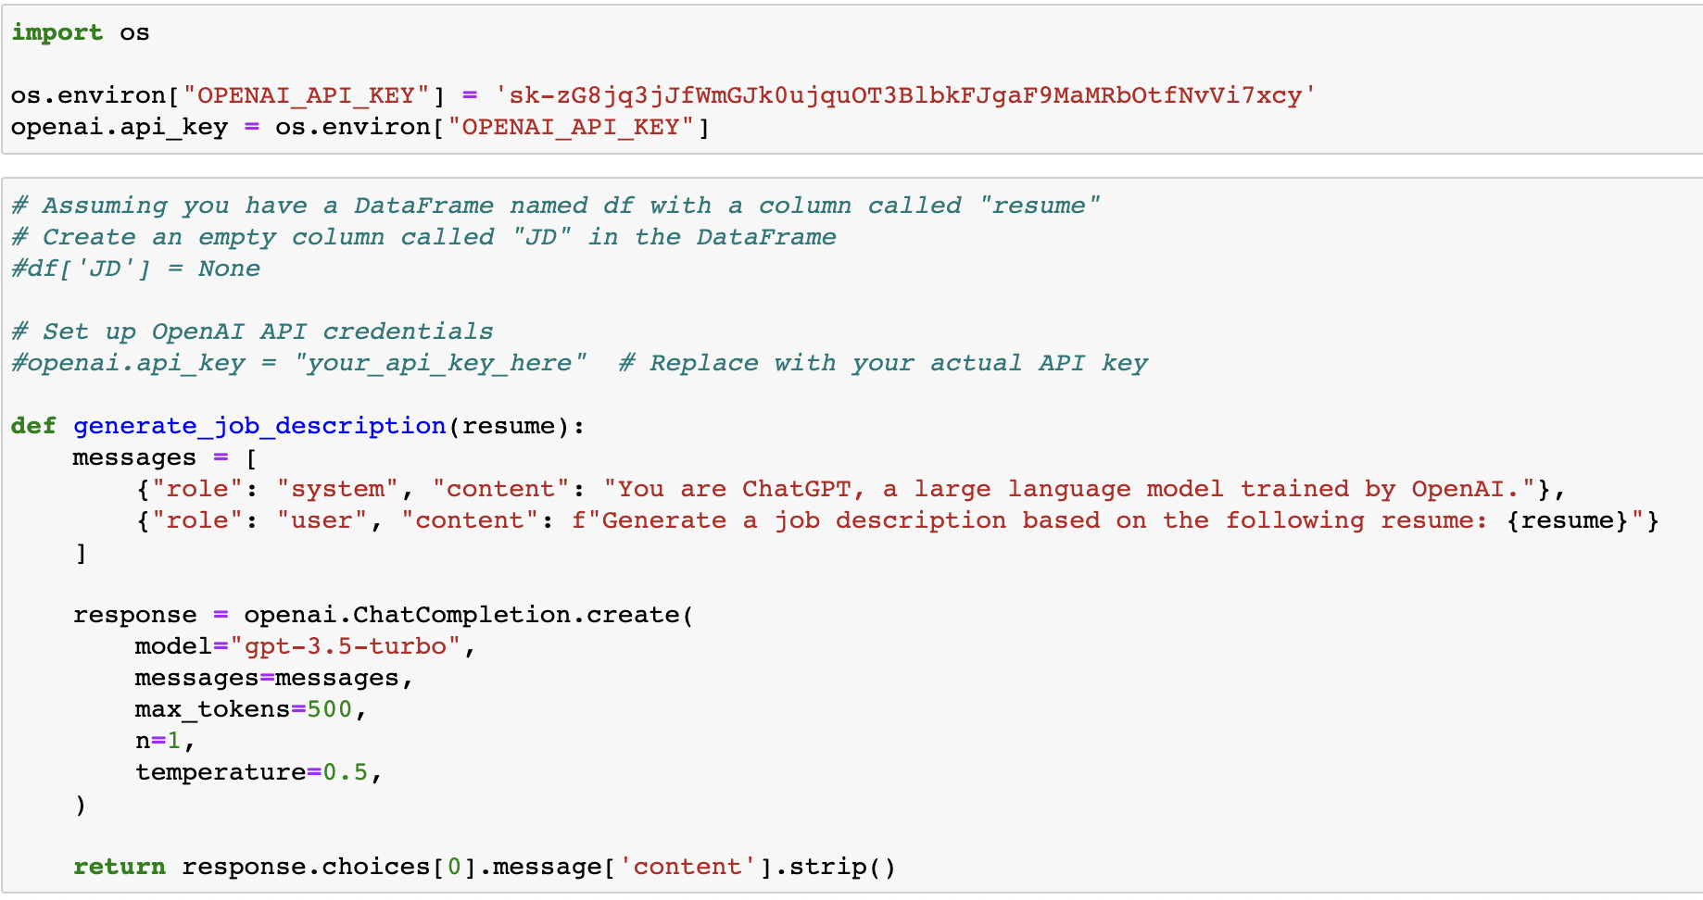
Appendix

Slide 22
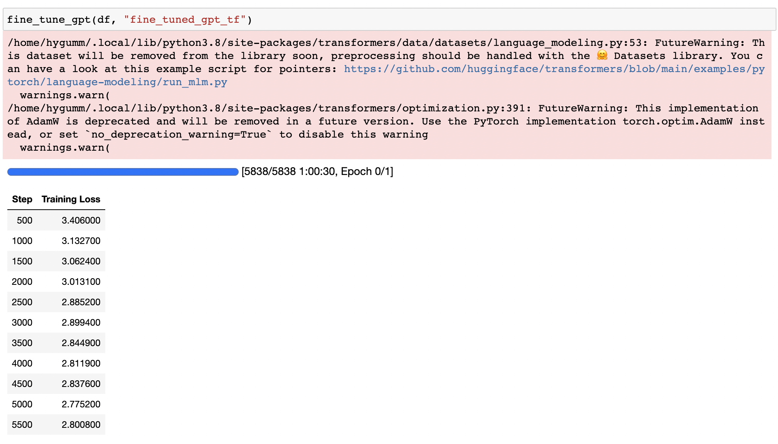
GPT Pre trained Model

Slide 23
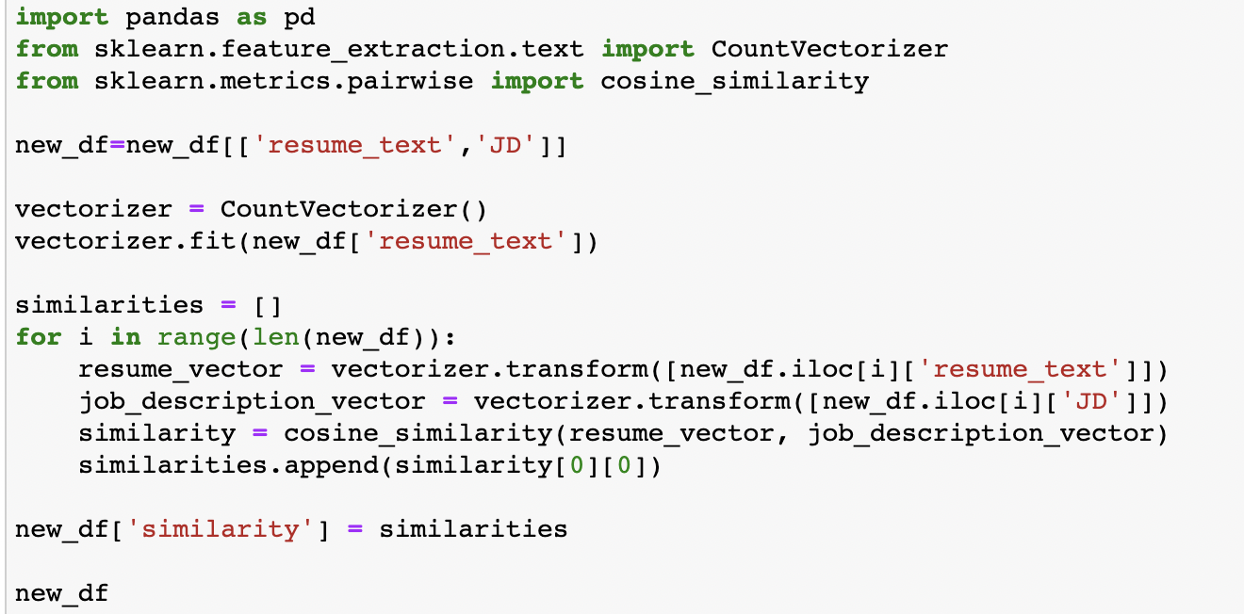
Cosine Similarity

Slide 24
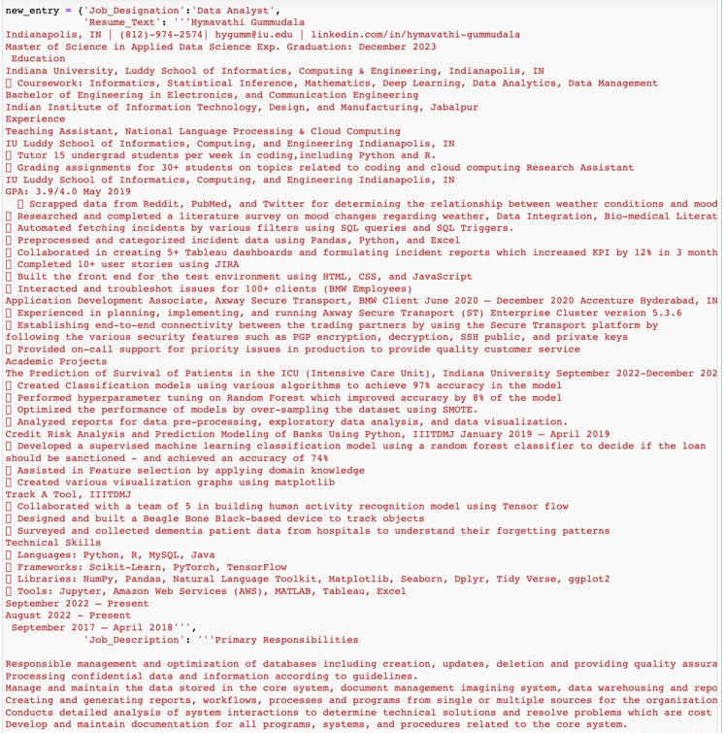

Slide 25
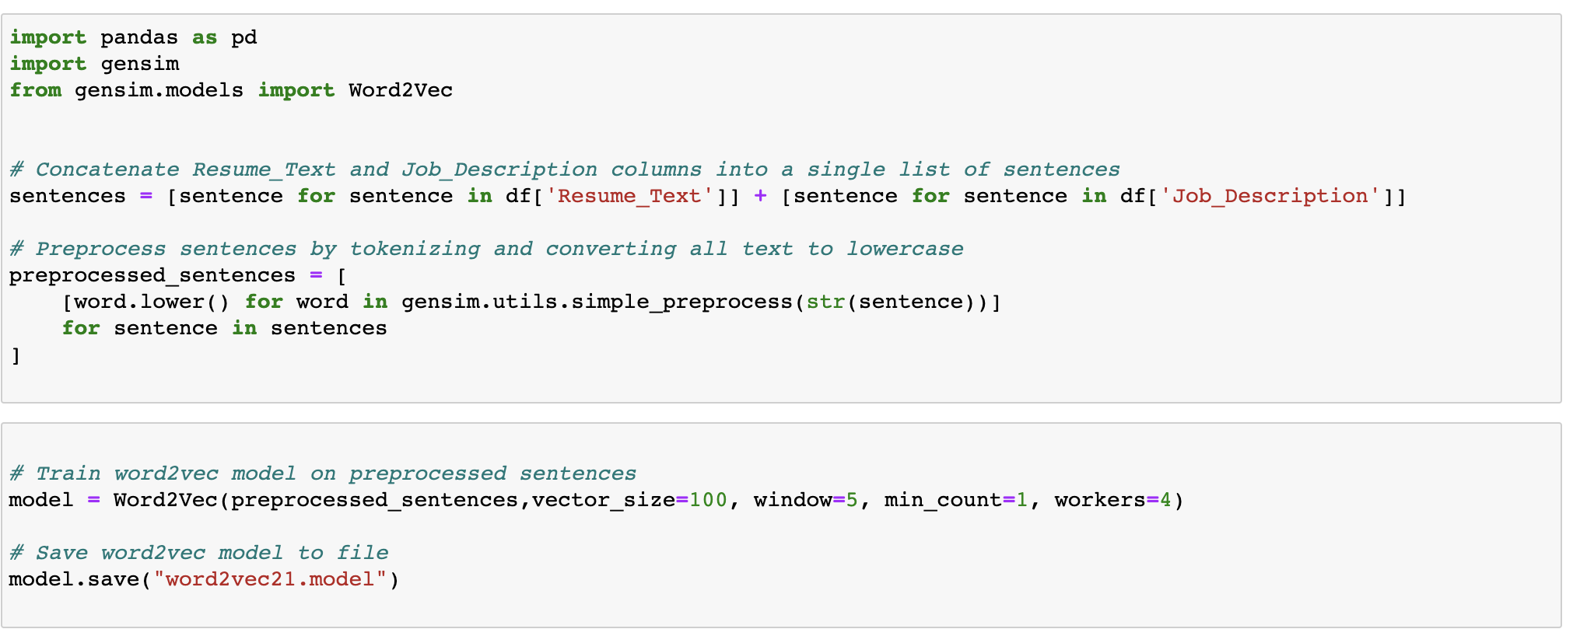
WORD2VEC MODEL

