Slide 1

Employee Attrition
James ng
27 Nov 2019

Slide 2
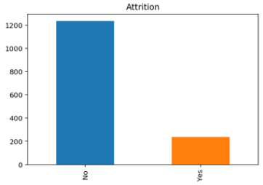
Dataset
There are 1,470 observations with 34 characteristics of employees (Features) and 1 target variable (attrition 0 for ”no” or 1 for ”yes”)
Features: ['Age', 'BusinessTravel', 'DailyRate', 'Department', 'DistanceFromHome', 'Education', 'EducationField', 'EmployeeCount', 'EmployeeNumber', 'EnvironmentSatisfaction', 'Gender', 'HourlyRate', 'JobInvolvement', 'JobLevel', 'JobRole', 'JobSatisfaction', 'MaritalStatus', 'MonthlyIncome', 'MonthlyRate', 'NumCompaniesWorked', 'Over18', 'OverTime', 'PercentSalaryHike', 'PerformanceRating', 'RelationshipSatisfaction', 'StandardHours', 'StockOptionLevel', 'TotalWorkingYears', 'TrainingTimesLastYear', 'WorkLifeBalance', 'YearsAtCompany', 'YearsInCurrentRole', 'YearsSinceLastPromotion', 'YearsWithCurrManager']
Attrition
16%
No
Yes
Data source: IBM HR Analytics Employee Attrition & Performance
https://www.kaggle.com/pavansubhasht/ibm-hr-analytics-attrition-dataset

Slide 3
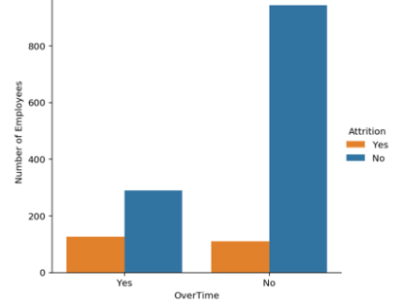
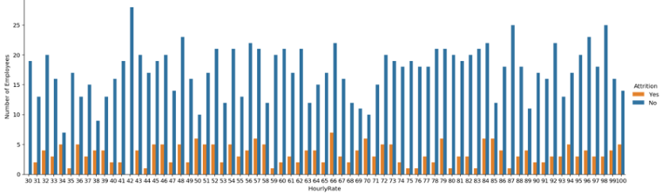
Exploratory Data Analysis (EDA)
Attrition seems to happen at every level regardless of employee hourly rate
Overtime seems to be a key factor to attrition
HourlyRate
OverTime

Slide 4
Iteration 1: Baseline Model Performance
The performance metrics used in the evaluation are: · Accuracy Score: proportion of correct predictions out of the whole dataset. Be careful when the target class is imbalance, for example, if a model predicts all flight passengers as non-terrorist, then the model would be 99.99% accurate. · Precision Score: proportion of correct predictions out of all predicted attrition cases. · Recall Score: proportion of correct predictions out of all actual attrition cases. · F1 Score: optimised balance between Precision and Recall for binary targets. · Area Under ROC Curve: prediction scores from area under Receiver Operating Characteristic (ROC) curve, which is a relationship between True Positive Rate and False Positive Rate. · Log Loss: aka logistic loss or cross-entropy loss, defined as the negative log-likelihood of the true labels given a probabilistic classifier’s predictions, and has to be as low as possible.
Below 10 models have been evaluated: · Gaussian Naive Bayes · Bernoulli Naive Bayes · Multinomial Naive Bayes · Logistic Regression · K Nearest Neighbour · Decision Tree Classifier · Random Forest Classifier
· XGBoost · Support Vector Classification (SVC) · Linear SVC

Slide 5
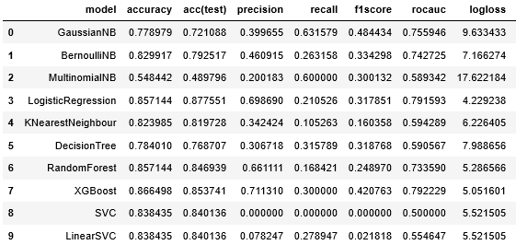
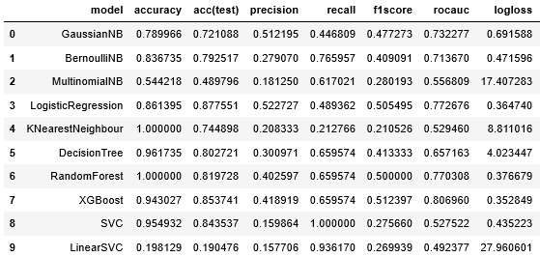
Iteration 1: Baseline Model Performance
Baseline model performance
After tuning hyperparameters and threshold

Slide 6
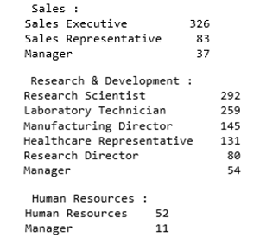
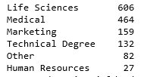
Iteration 2: Feature Engineering, Feature Selection
‘JobRole’
'EducationField'
New feature
‘EduField_Dept’
whether JobRole is
related to EducationField:
0 = not related,
1 = related,
2 = somewhat related
Other new features created: · Job_Coy = JobLevel / (YearsAtCompany + 1) · Edu_Age_TotalWorking = Education / (Age + TotalWorkingYears) · CurrMgr_Coy = YearsWithCurrManager / (YearsAtCompany + 1) · CurrRole_CurrMgr = YearsInCurrentRole / (YearsWithCurrManager + 1)

Slide 7
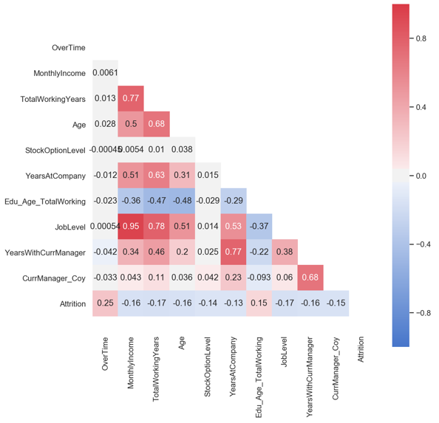
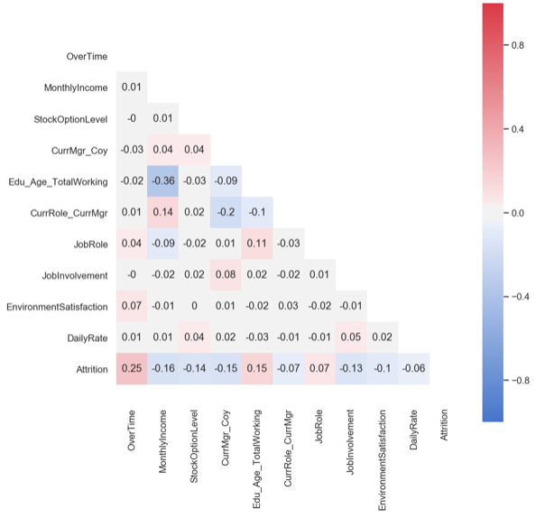
Iteration 2: Feature Engineering, Feature Selection
Remove
multicollinearity

Slide 8
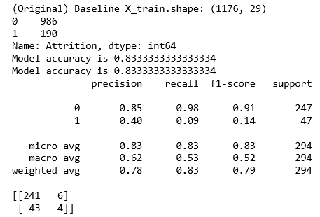
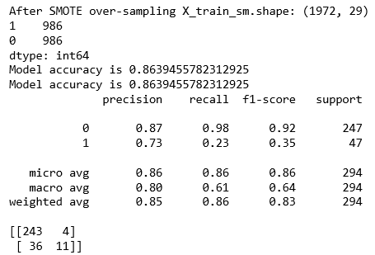
Iteration 3: Over-sampling with SMOTE

Slide 9
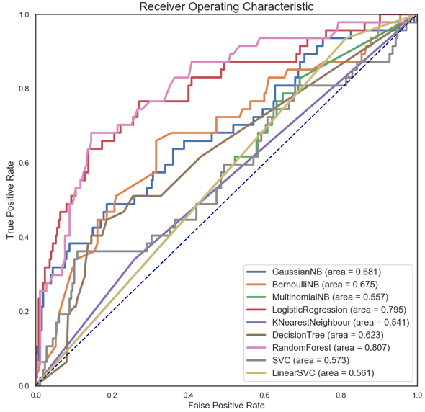
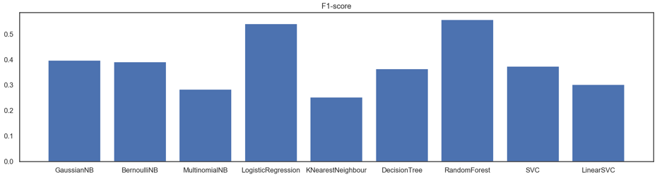
Final Model Performance (including tuning)

Slide 10
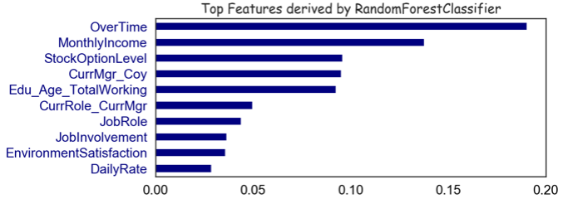
Key Findings – Employee Attrition Factors
Factor 1: monetary
‘OverTime’
‘MonthlyIncome’
‘StockOptionLevel’
Factor 2: relationships
‘CurrMgr_Coy’
‘CurrRole_CurrMgr’
‘JobRole’
Factor 3: engagement
‘JobInvolvement’,
‘EnvironmentSatisfaction’

Slide 11

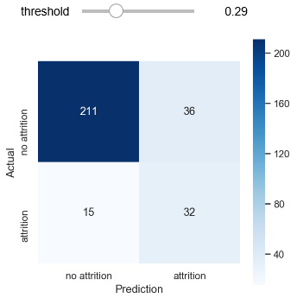
Conclusion
Optimal threshold 0.288
F1 Score = 55.7%
In this project, the Random Forest Classifier model has achieved prediction (Recall) score of 68.1%
Out of all 47 attrition employees, 68.1% of them will be classified correctly based on their background and characteristics
proportion of correct predictions out of all predicted attrition cases
Precision = 32/68
= 47.1%
proportion of correct predictions out of all actual attrition cases
Recall = 32/47
= 68.1%
Python codes are available:
https://github.com/JNYH/employee_attrition

Slide 12

Thank You!
James Ng
27 Nov 2019

