Slide 1
Azure Zero-Secret: Secure Application Authentication
Course: 24CC3046 – Microsoft Certified Azure Administrator Associate
Team: T132
Team Members:
2400090138 – P. Siva Sai Subramanya Likith
2400090146 – M. Sakyath
2400090153 – D. Hyndhavi
2400090158 – D. Yaswanth
Faculty/Mentor: Dr. Surya Kiran
Academic Year: Odd Semester 2026–27

Slide 2

Problem Statement:
Organizations often use service principals with client secrets to authenticate applications with Azure services. Managing these secrets creates security and operational challenges because secrets must be securely stored, rotated, monitored, and protected from accidental exposure.
This project focuses on adopting Azure Managed Identity to enable applications to authenticate to Azure services without storing service-principal secrets.

Slide 3
Use Cases & Key Bottlenecks:
Use Cases
• Remove all service principal secrets.
• Enable secretless authentication to Azure services.
Key Bottlenecks
• Some legacy services may not support Managed Identity.
• Cross-tenant scenarios are not covered by the basic Managed Identity approach.

Slide 4
Proposed Solution & Architecture:
The project demonstrates how an application hosted on Azure App Service can use:
• Managed Identity
• Microsoft Entra ID
• Azure RBAC
to securely access services such as Azure Key Vault and Azure Blob Storage without storing client secrets.
Architecture: App Service → Managed Identity / Entra ID → Azure RBAC → Key Vault & Blob Storage

Slide 5
Services Used for the Project:
Azure Resource Group – Organizes and manages all project resources.
Microsoft Entra ID – Provides identity and authentication for the application.
Managed Identity – Provides a secure identity without storing client secrets.
Azure RBAC – Provides role-based permissions to Azure resources.
Azure App Service – Hosts the web application; Free F1 tier available.
Azure Key Vault – Securely stores application secrets and sensitive information.
Azure Storage Account / Blob Storage – Provides an Azure service accessed using Managed Identity.
Application Insights – Monitors application performance and activity; optional.

Slide 6
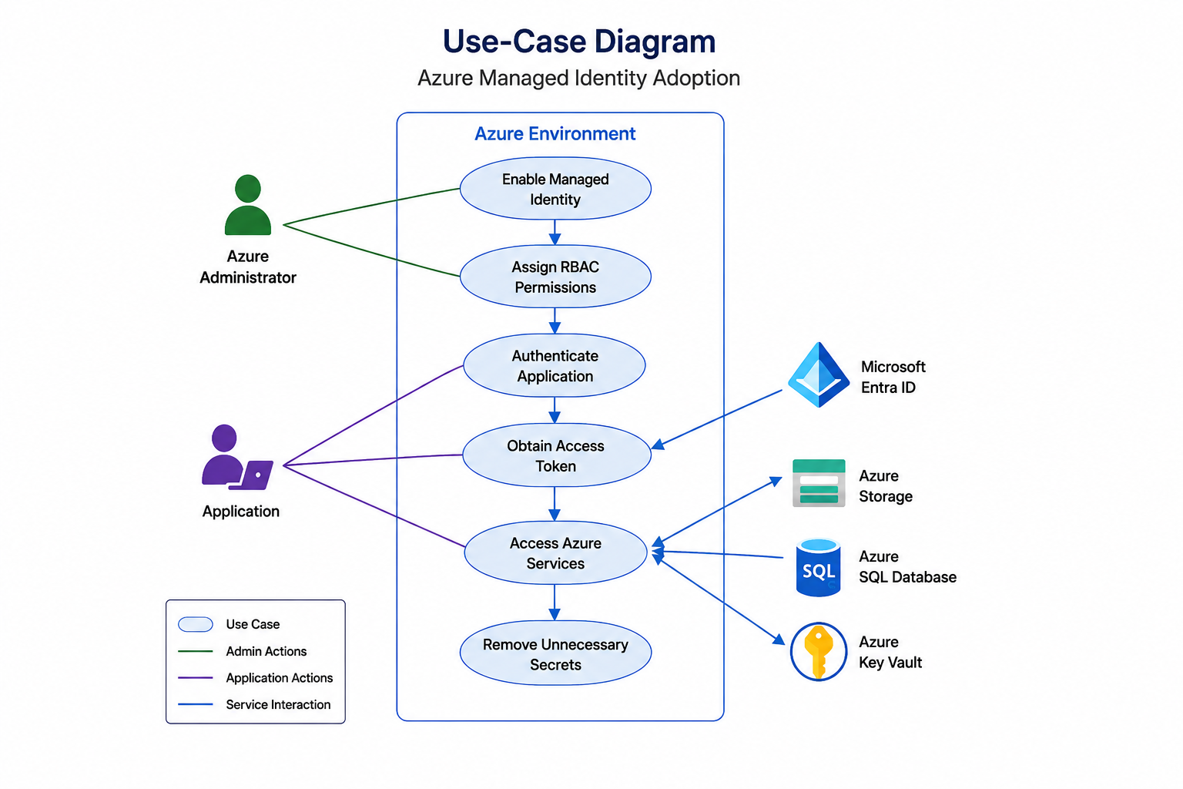
ARCHITECTURE:

Slide 7
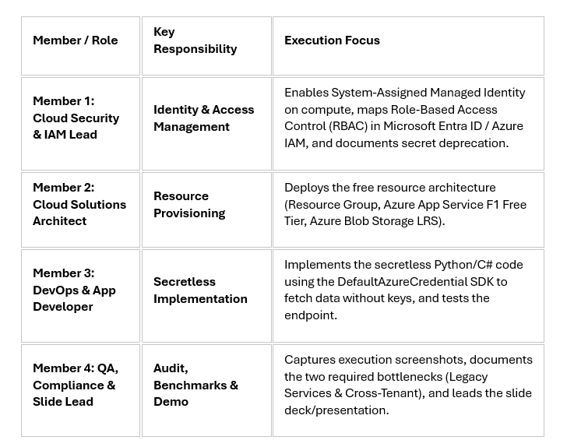
TEAM MEMBERS ROLES:

Slide 8
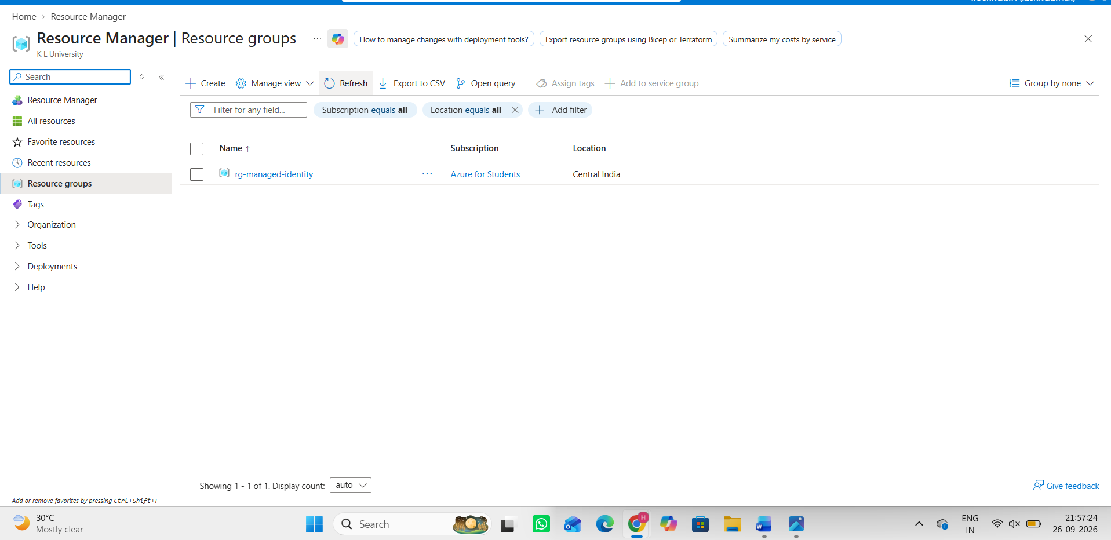
Resource Group:
Azure Resource Group
• Organizes and manages all project resources.
• Provides a single logical container for the Azure services used in the project.

Slide 9
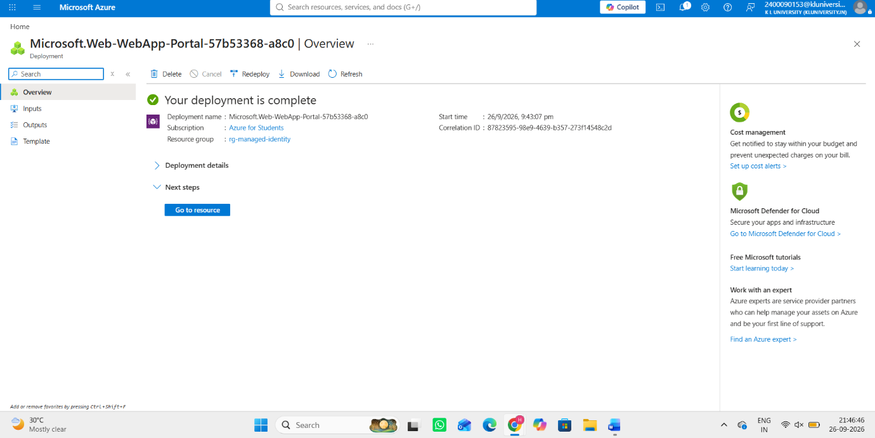
App Services:
Azure App Service
• Hosts the web application.
• Provides the application environment used to demonstrate Managed Identity.
• Free F1 tier is identified in the project document.

Slide 10
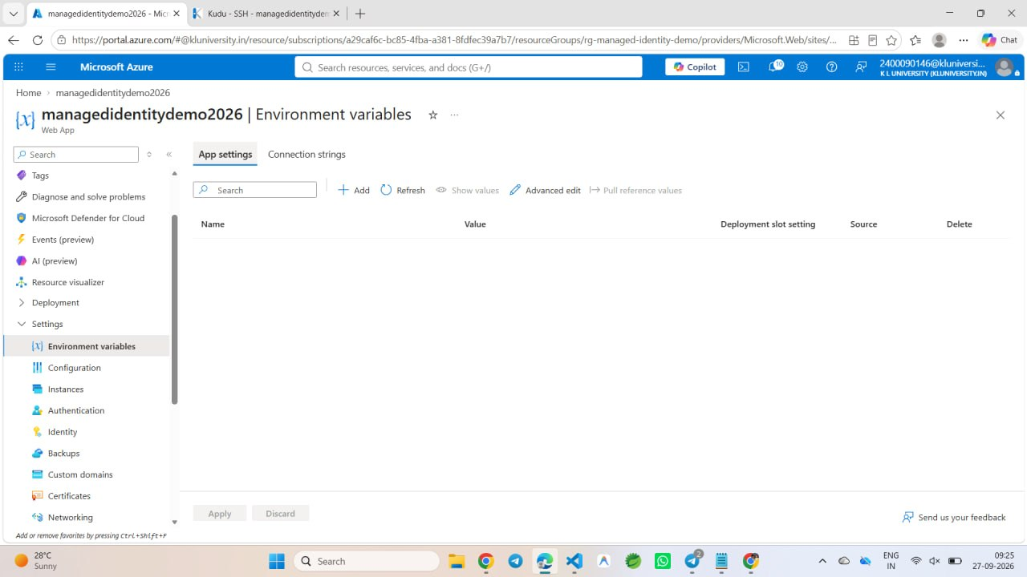
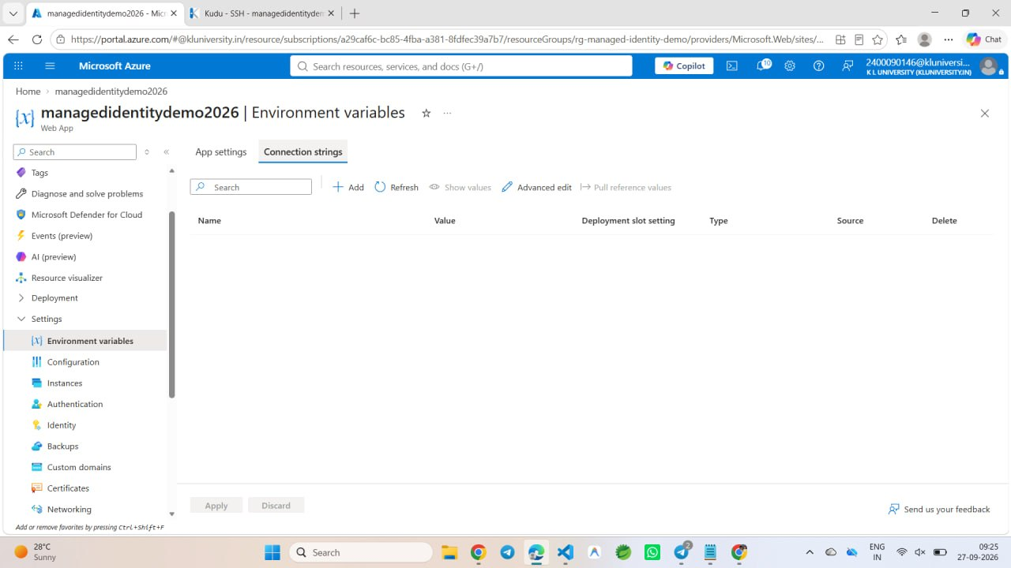
USES CASES:

Slide 11
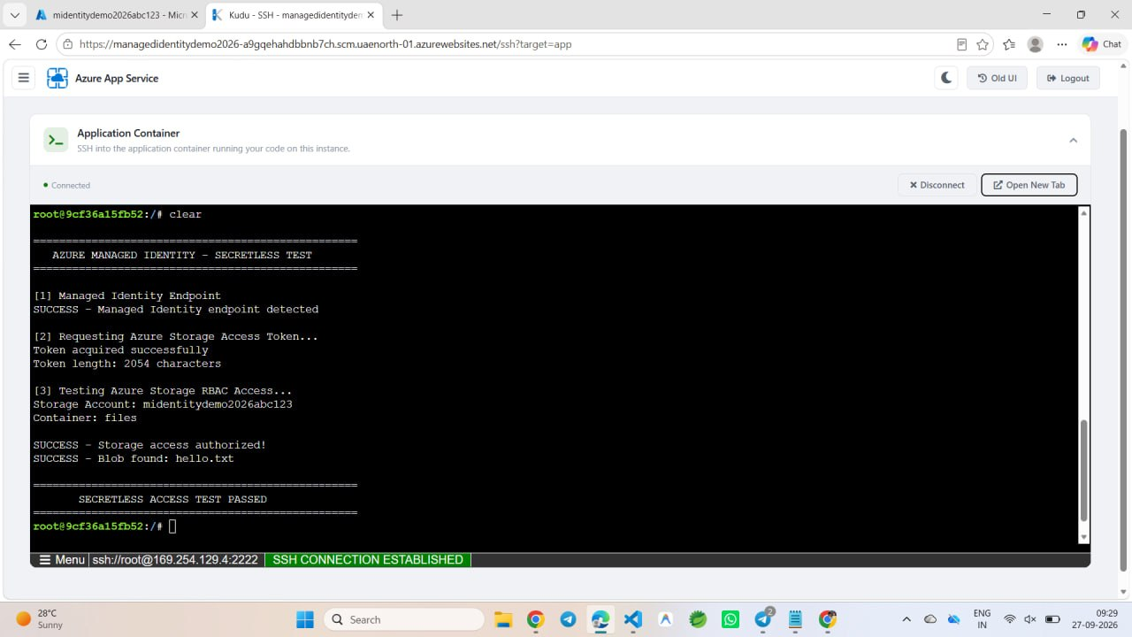

Slide 12
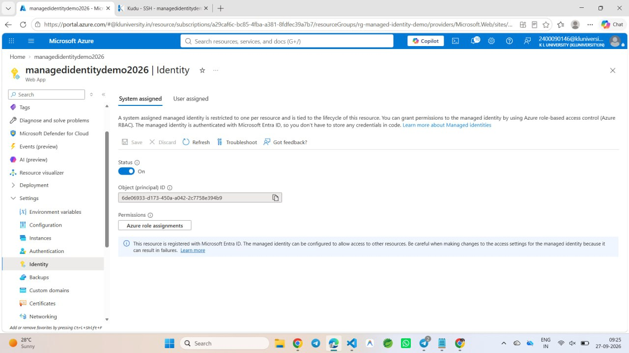
Implementation
The project connects the hosted application with Azure identity and access services so that Azure resources can be accessed without storing service-principal client secrets.

Slide 13
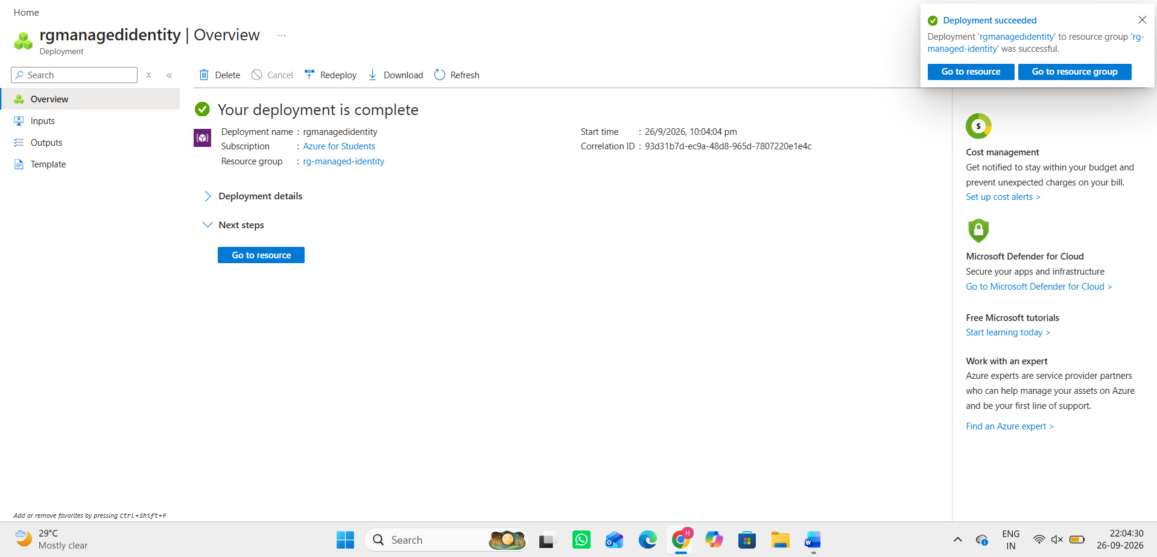

Slide 14
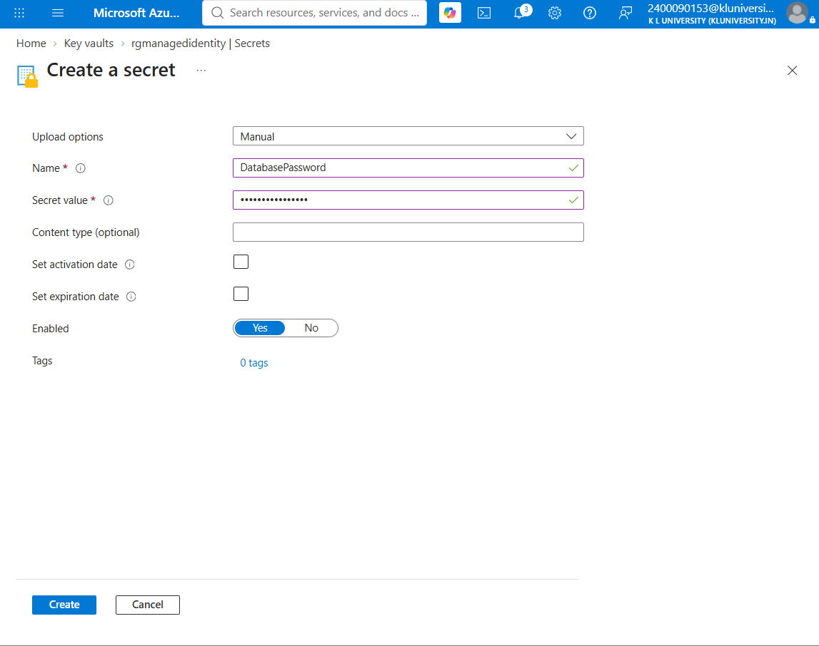
Creating a Secret Key & Containers
Creating a Secret Key
• The original document contains screenshots showing the secret-key/container setup.

Slide 15
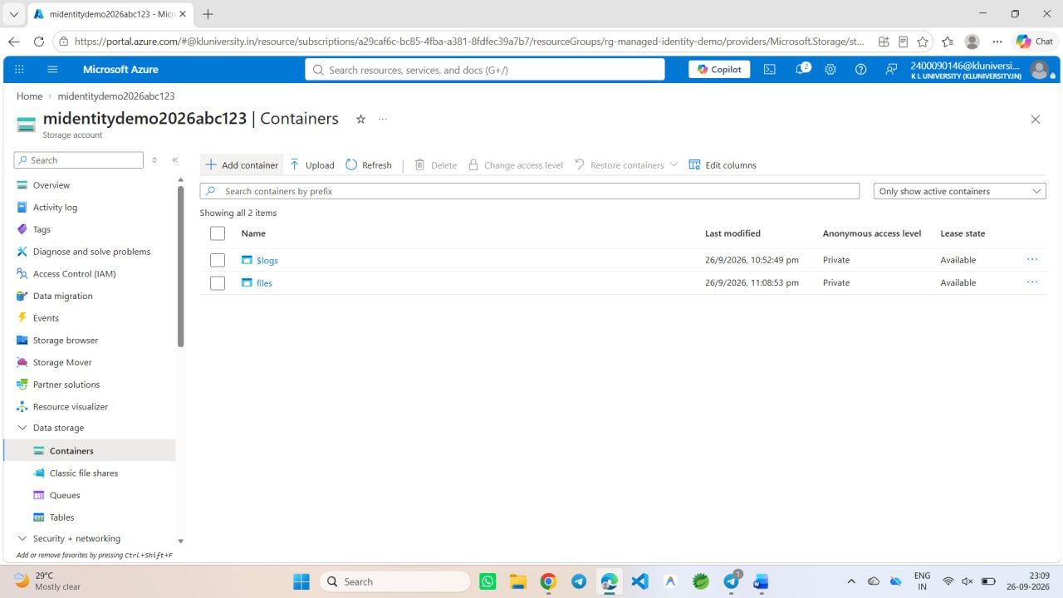

Slide 16
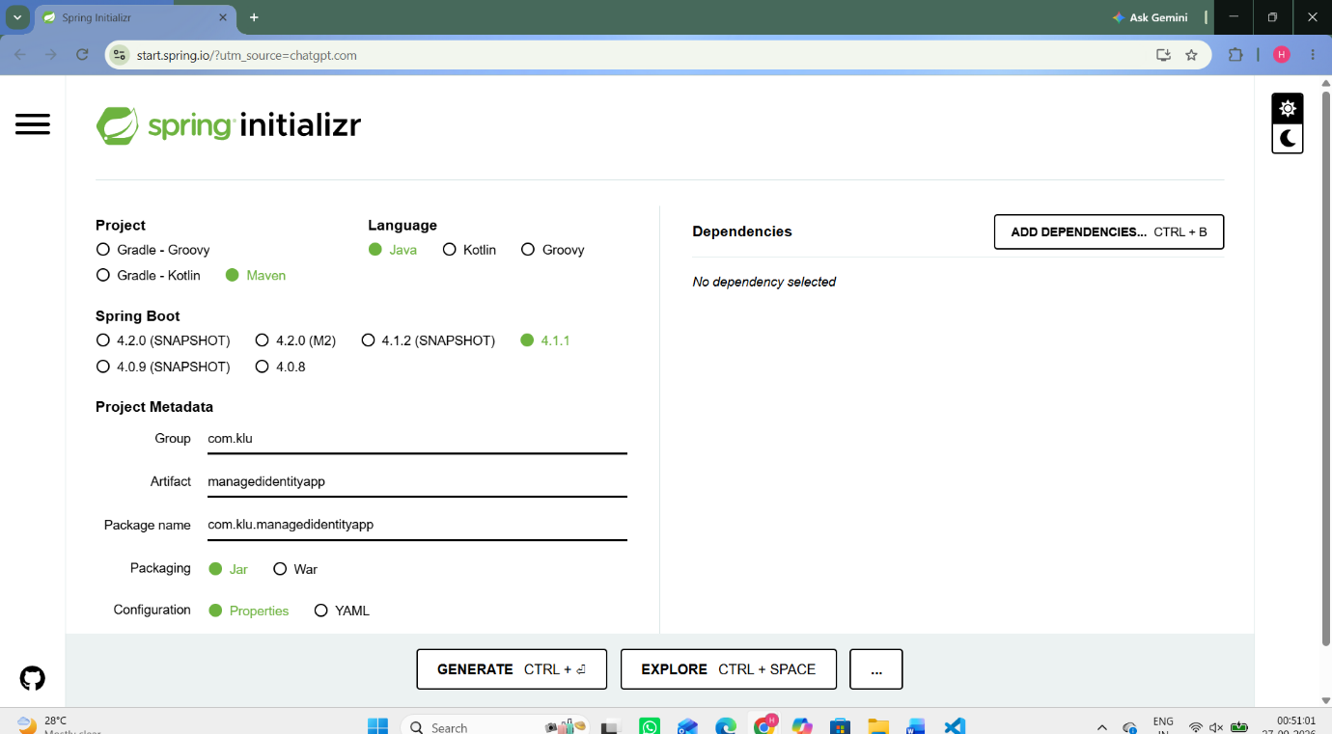
Spring & VS Code
Spring
• The project includes a Spring-based backend/application implementation.

Slide 17
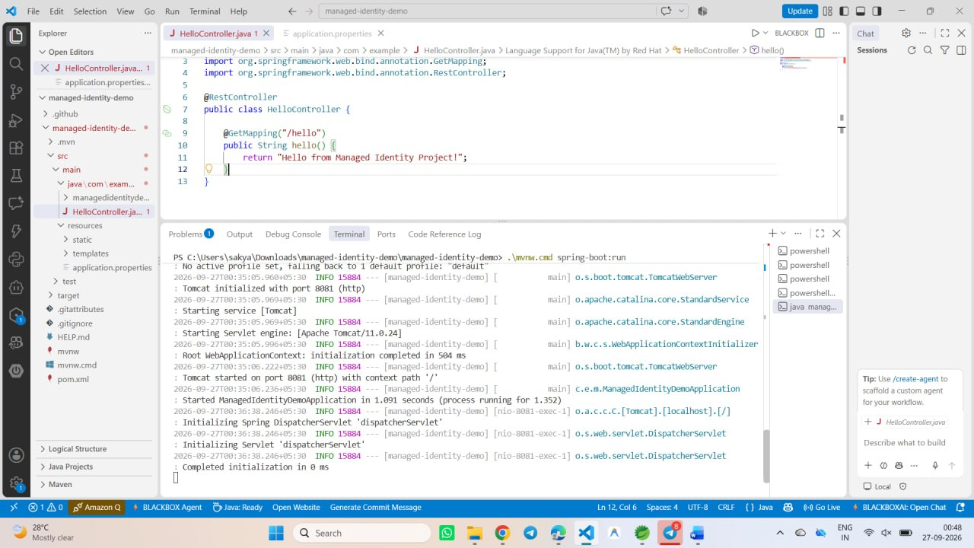
VSCODE:

Slide 18
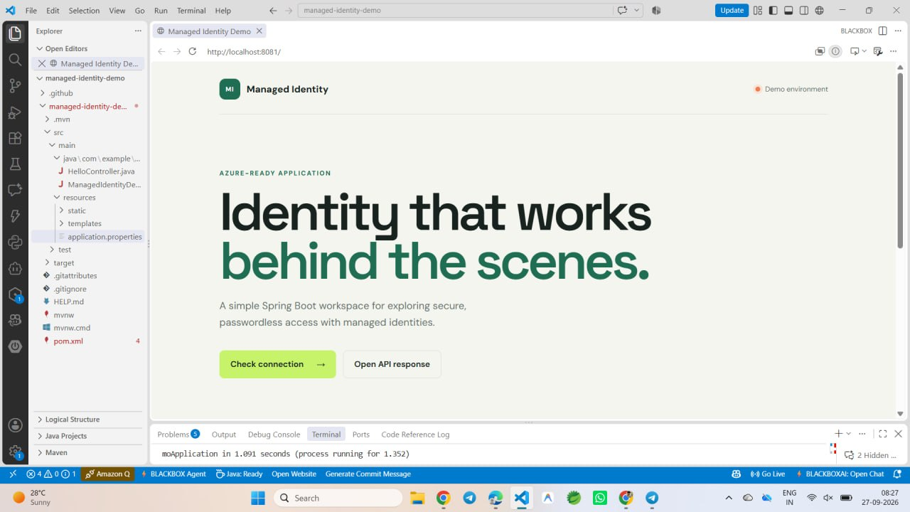
Frontend & Backend:
Frontend:
• The project includes a frontend component for interacting with the application.

Slide 19
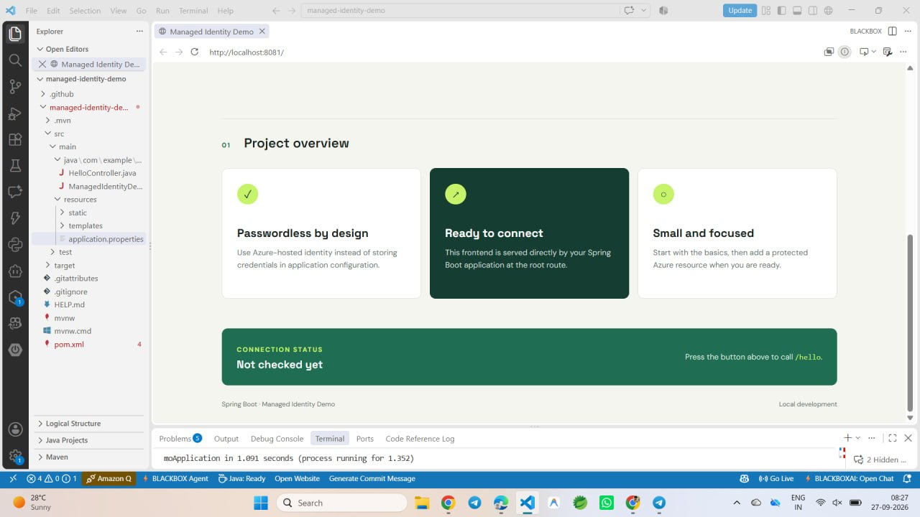

Slide 20
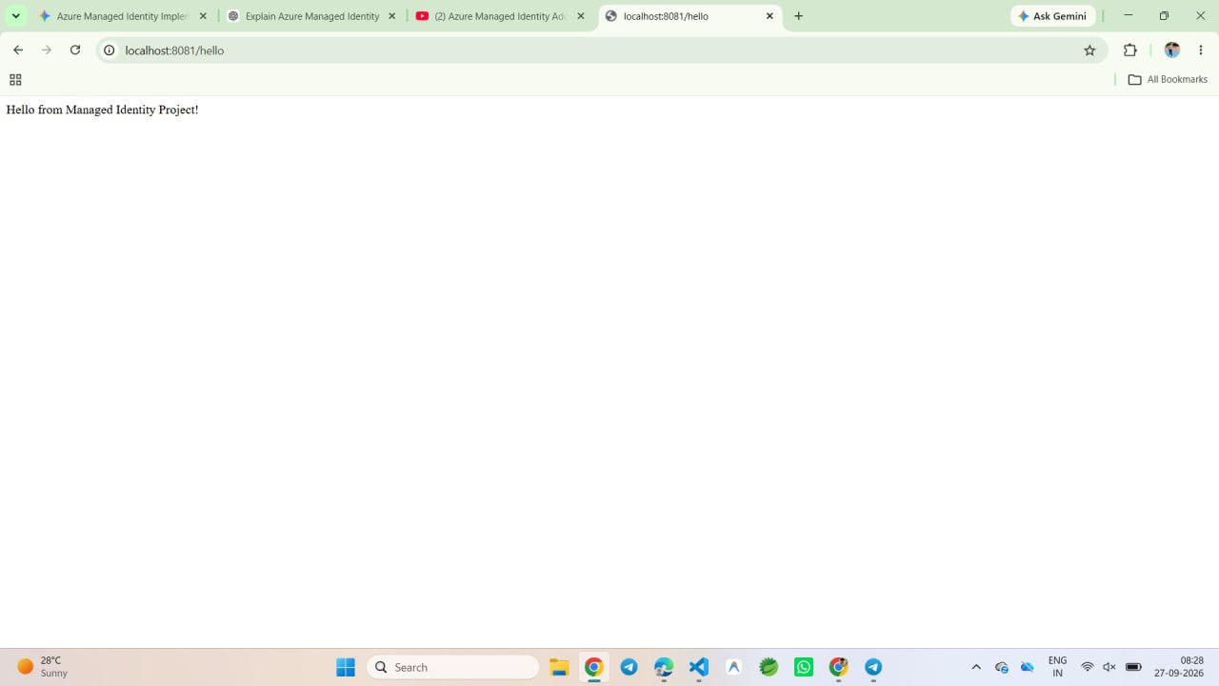
Backend:
• The backend connects the application to Azure services using the identity-based approach described in the project.

Slide 21
THANK YOU

