Slide 1
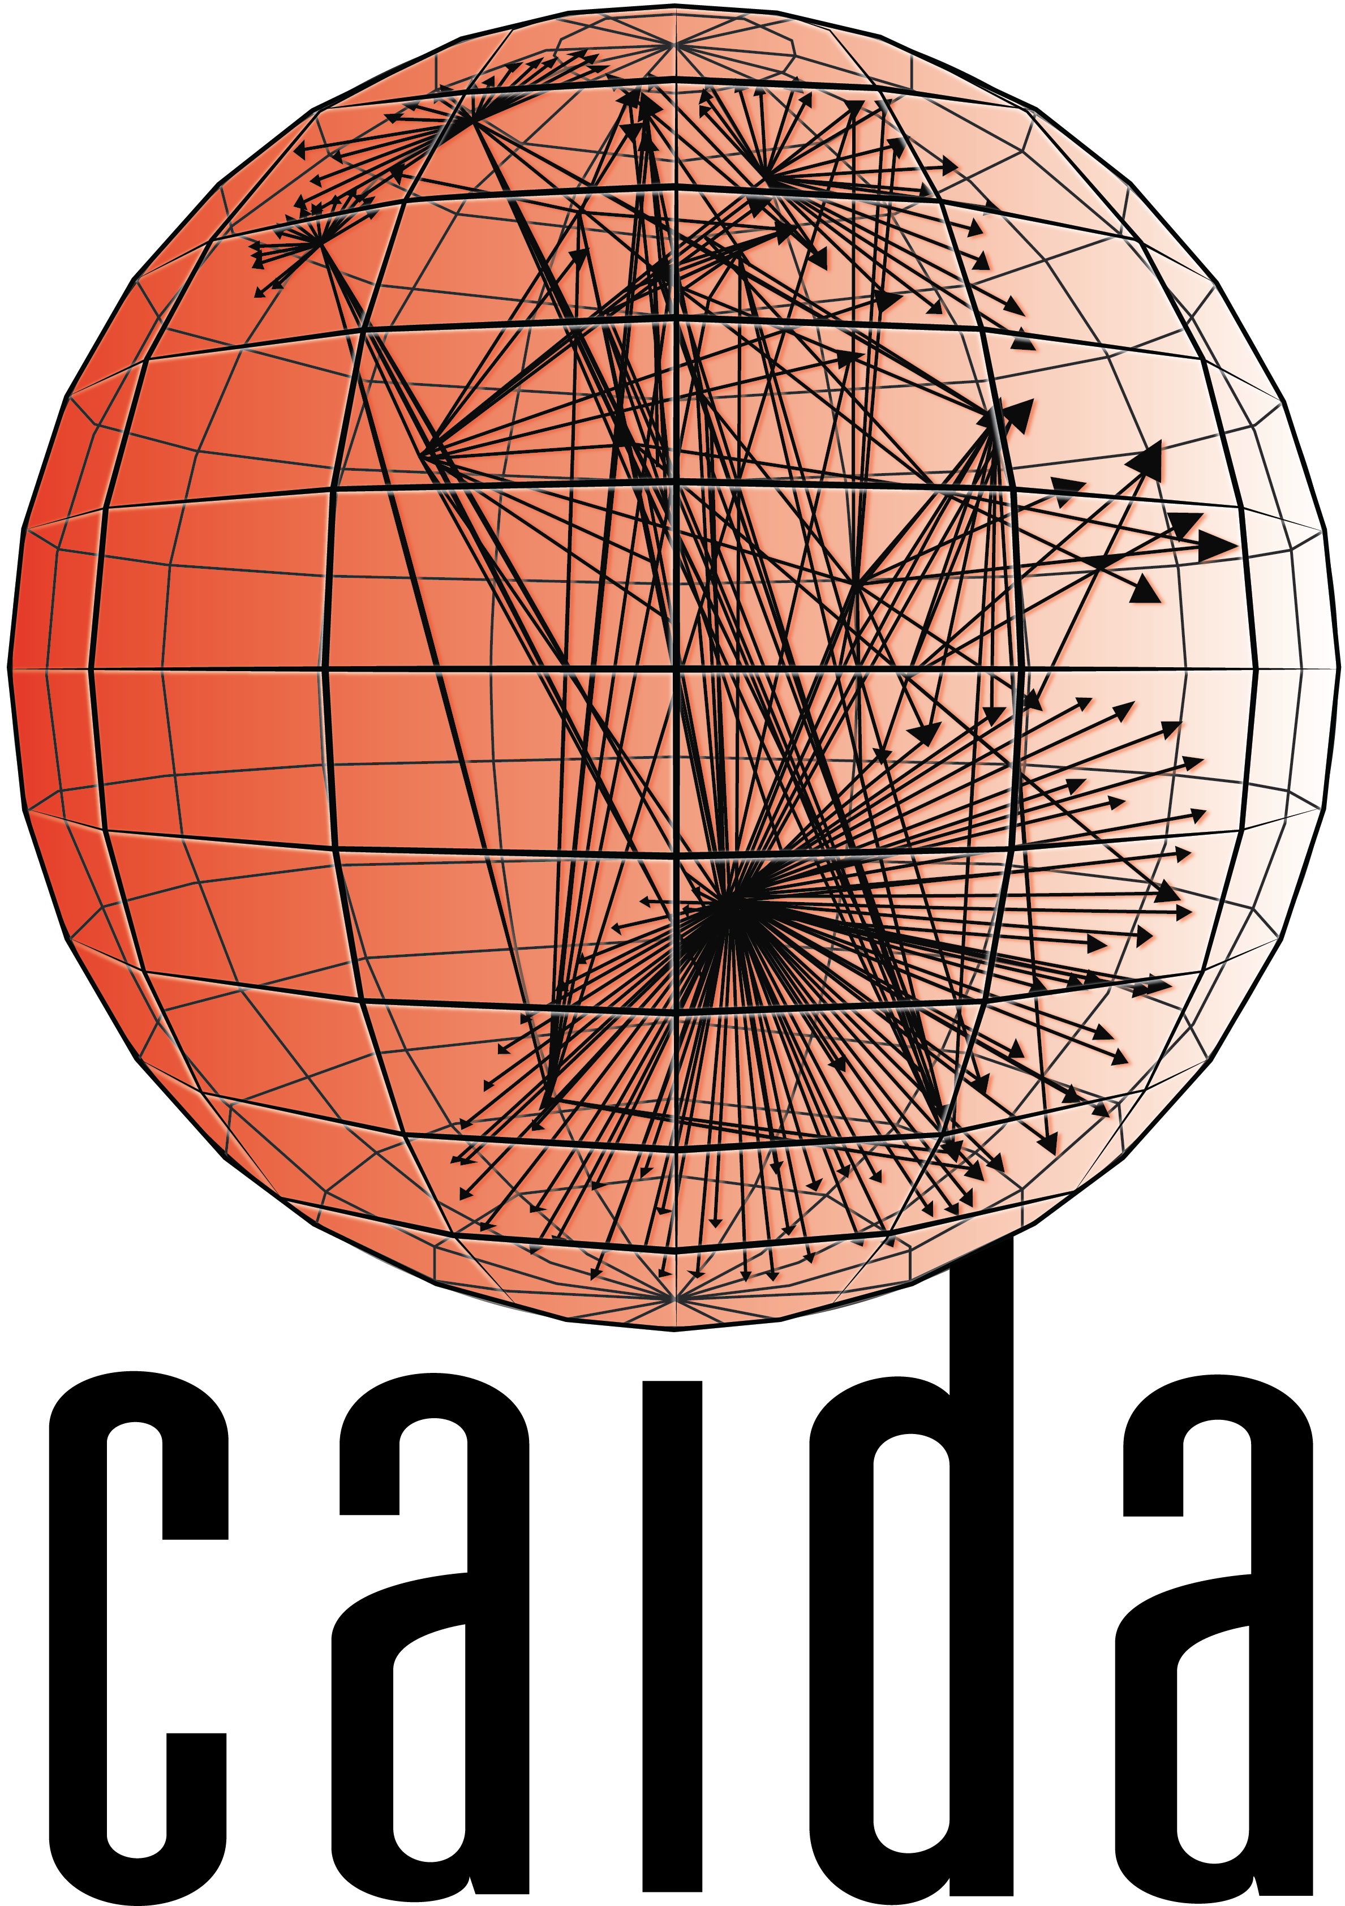

The Catch-22 Attack
Lumin Shi, Devkishen Sisodia, Mingwei Zhang, Jun Li, Alberto Dainotti, Peter Reiher
luminshi@cs.uoregon.edu, dsisodia@cs.uoregon.edu, mingwei@caida.org, lijun@cs.uoregon.edu, alberto@caida.org, reiher@cs.ucla.edu
Abstract
Preliminary Evaluation
The Catch-22 attack is a distributed denial-of-service (DDoS) link-flooding attack that exploits real-world limitations of DDoS defense.
An attacker leverages:
virtual private server (VPS) providers and residential proxy services as sources for assembling a botnet
moving target attack to maximize the amount of strain on DDoS defense, and
the collateral damage triggered by the DDoS defense of the attacked networks.
With our preliminary evaluation, the attack can cause significant collateral damage to thousands of websites hosted at a major VPS provider.
We conducted two experiments on two VPS providers to answer two obvious questions on server hostages.
Do VPS providers block potential outbound DDoS flows?
Ran large HTTP requests for an hour between two virtual machines (VMs), each located in a different VPS network.
No throughput degradation within a one-hour experiment period.
What server hostages can we possibly obtain?
Requested VMs from AWS and use each VM’s /16 network prefix to mimic the effect of a large-scale attack.
Over 1,000 websites that are potential hostages using the 6 /16 network prefixes from AWS alone.
E.g., deepai.org, uw.edu, xmind.net, etc.
Background
The catch-22 attack
Conclusion
Today, websites and small networks often subscribe to DDoS protection services (DPSes) for DDoS defense.
DPSes have finite bandwidth and computational capacity, and thereby cannot provide protection to all networks.
For the remaining networks that are not protected by DPSes, the network community utilizes n-tuple traffic matching baked into modern IP routers for fine-grained DDoS filtering.
Protocols such as BGP FlowSpec, allow networks to disseminate n-tuple filtering rules to their neighboring autonomous systems (Ases).
Each router has a limited amount of high-speed memory (CAM/TCAM) in which filtering rules can be deployed.
The attack consists of two steps:
Finding hostages: acquire bots that are co-located with the targeted hostages in a small subnet
Moving target attack: attack multiple networks to increase the scale of the attack.
Link-flooding attacks require victims to deploy filters in their upstream networks, e.g., router X in the figure above.
However, the attacked network may not be able to deploy rules on certain routers in upstream networks
The attacked network is forced to deploy coarsely granular source prefix rules (e.g., two /24 rules that filter all traffic from A and B) instead of finely granular individual IP rules (i.e., /32 rules that only filter the individual bots).
The attack introduces a mitigation conundrum for the victims:
Deploy fine-grained filters that incur no collateral damage but face ineffective DDoS mitigation
Deploy coarse-grained filters to mitigate link-flooding attacks but face high collateral damage.
We presented the Catch-22 attack, an imminent threat to today’s Internet that can force attacked networks to cause large-scale collateral damage during DDoS defense.
The Catch-22 attack is made possible due to the following limitations in real world defense:
DPSes have finite filtering capacity, and
inline mitigation depends on the scarce TCAM space available in today’s networking devices.
We plan to experiment with resources from VPS and residential proxy providers to quantify the attack damage.
The core contribution of this work and its future extension is to examine fundamental vulnerabilities in today’s DDoS defense infrastructure.

