Slide 1
Introduction
Computer Graphics
Notes:
Hello everyone.
I think we can begin now if you’re ready.
As you know, this class will be taught in English.
I try to speak English clearly.
So you should also listen to me carefully.
If you have any question, don’t hesitate to ask me.
I think you can learn more if you ask more.
Today’s lecture will be an overview of everything which we’ll study in this course.

Slide 2
Computer Graphics
Wikipedia
Computer graphics is a sub-field of computer science which studies methods for digitally synthesizing and manipulating visual content. Although the term often refers to the study of three-dimensional computer graphics, it also encompasses two-dimensional graphics and image processing.
Informal definition
Data => Image
Compare to
Computer Vision: Image => Data
Image Processing: Image => Image

Slide 3
Computer Graphics
Models
Data containing 2D/3D shapes
Images
Rendering
Generating images from data
Simple drawing (lines, images, …)
Photo-realistic image synthesis
Animation
Making images move
How to make them move realistically

Slide 4
Computer Graphics Applications
Entertainments
Animated Film
Post-production
Game
Visualization
Medical visualization
Scientific visualization
Data visualization
Etc.
Computer aided design
Training
Education

Slide 5
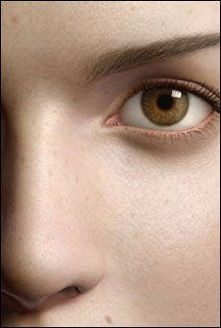

Graphics Applications
Entertainment: Cinema
Pixar: Monster’s Inc.
Square: Final Fantasy
Notes:
The films like these are completely generated using computer rendering and animations techniques.
Many films employ computer-graphics methods to produce special effects and
Graphics images are combined with live actors and scenes.
Computer graphics are related to all process of making films which consists of modeling, rendering, and animations.

Slide 6
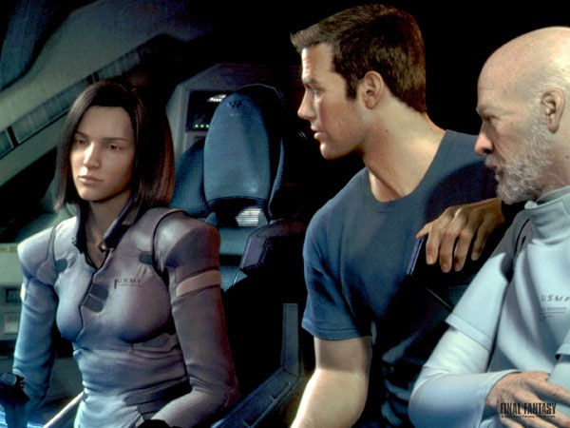
Entertainment
Notes:
This figure shows a scene from the film Final Fantasy.
This employed photorealistic techniques to closely simulate the appearance of a cast of human actors.
You can see that the actors’ flesh tones and facial features are much realistic.

Slide 7

Entertainment
Notes:
This is another example of fully computer-generated film.

Slide 8
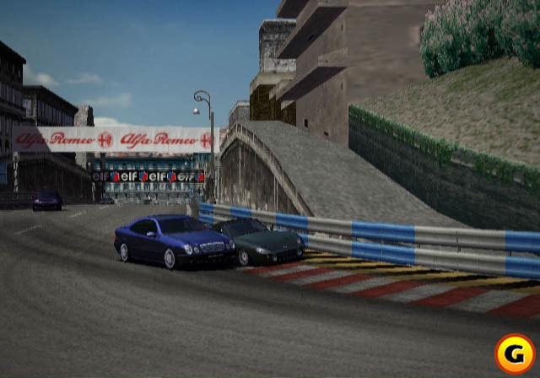

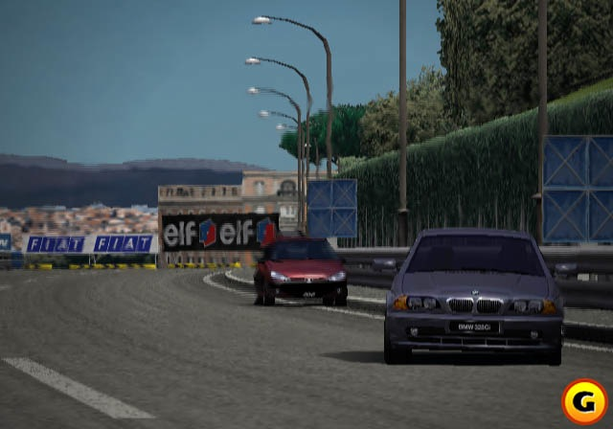
Graphics Applications
Entertainment: Games
Notes:
To give immersion to gamers, photorealistic techniques are employed in many computer games.

Slide 9
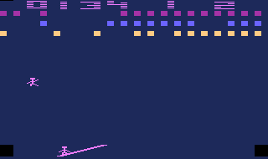
Games
Notes:
This is an example generated by 2D computer graphics.

Slide 10
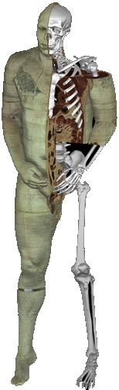
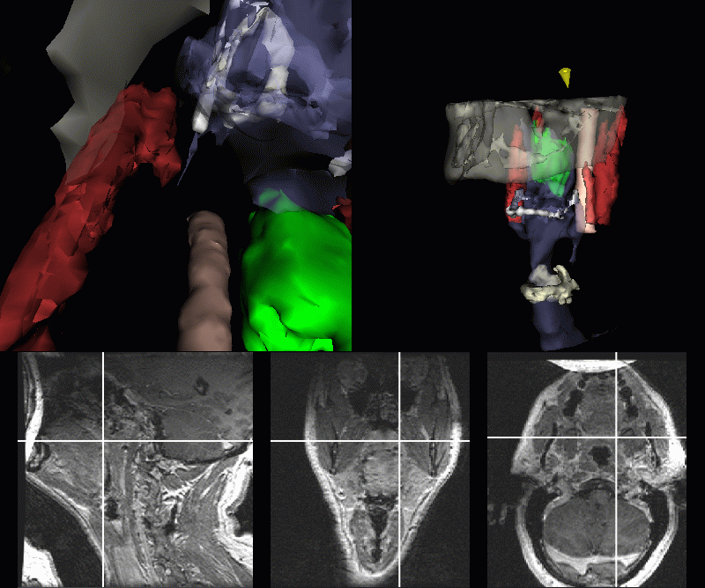
Graphics Applications
Medical Visualization
Notes:
Computer graphics methods are also employed to analyze and visualize medical data.
In this figure, these gray-scale images are taken using X-ray photography.
We can reconstruct the shapes of internal organs like this figure.
This can be used for performing a virtual surgery or examining internal organs.
In 1989, the National Library of Medicine (NLM) began an ambitious project to create a digital atlas of the human anatomy.
The project is called "The Visible Man."
The project created XRAY Computed Tomography (XRAY-CT), Magnetic Resonance Imaging (MRI) and physical sections of a human
cadaver.

Slide 11
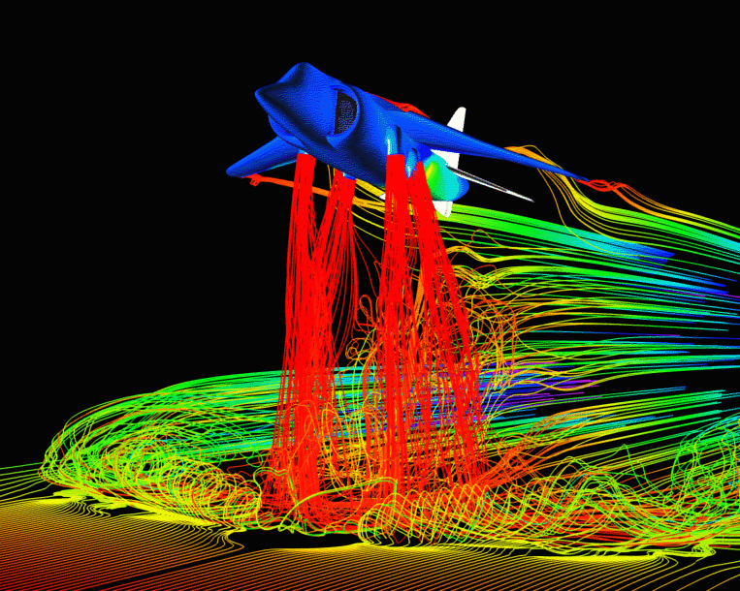
Graphics Applications
Scientific Visualization
Notes:
Scientific visualization is another application of computer graphics.
It is producing graphical representations for scientific data sets.
This figure shows airflow around a Harrier Jet.
Visual techniques are used to aid in the understanding and analysis of numerous data.

Slide 12
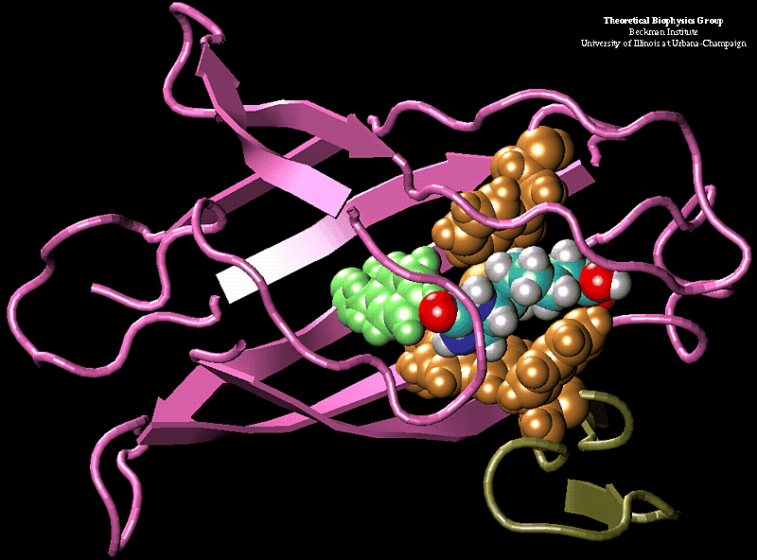
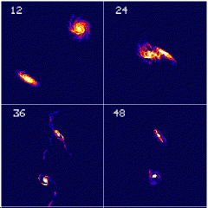
Scientific Visualization

Slide 13
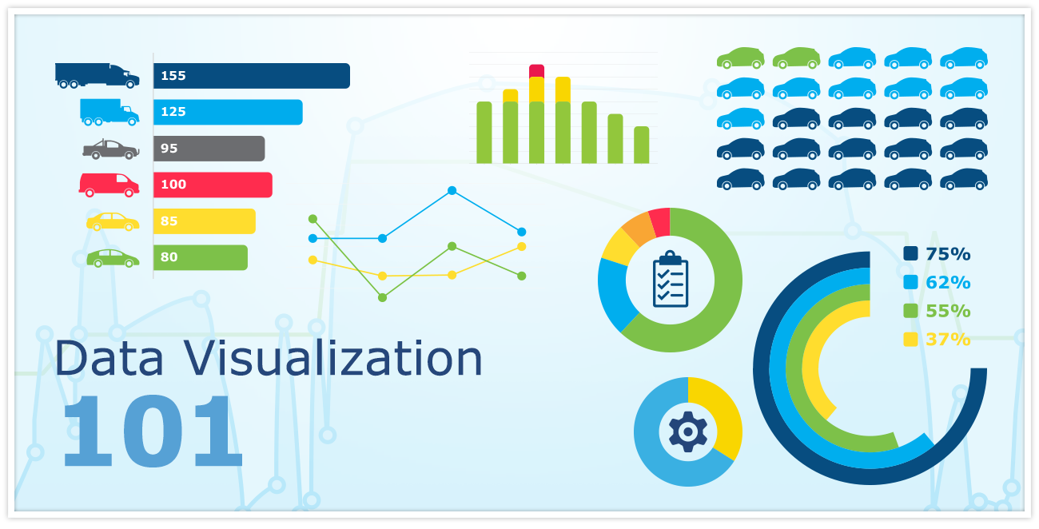
Data Visualization

Slide 14
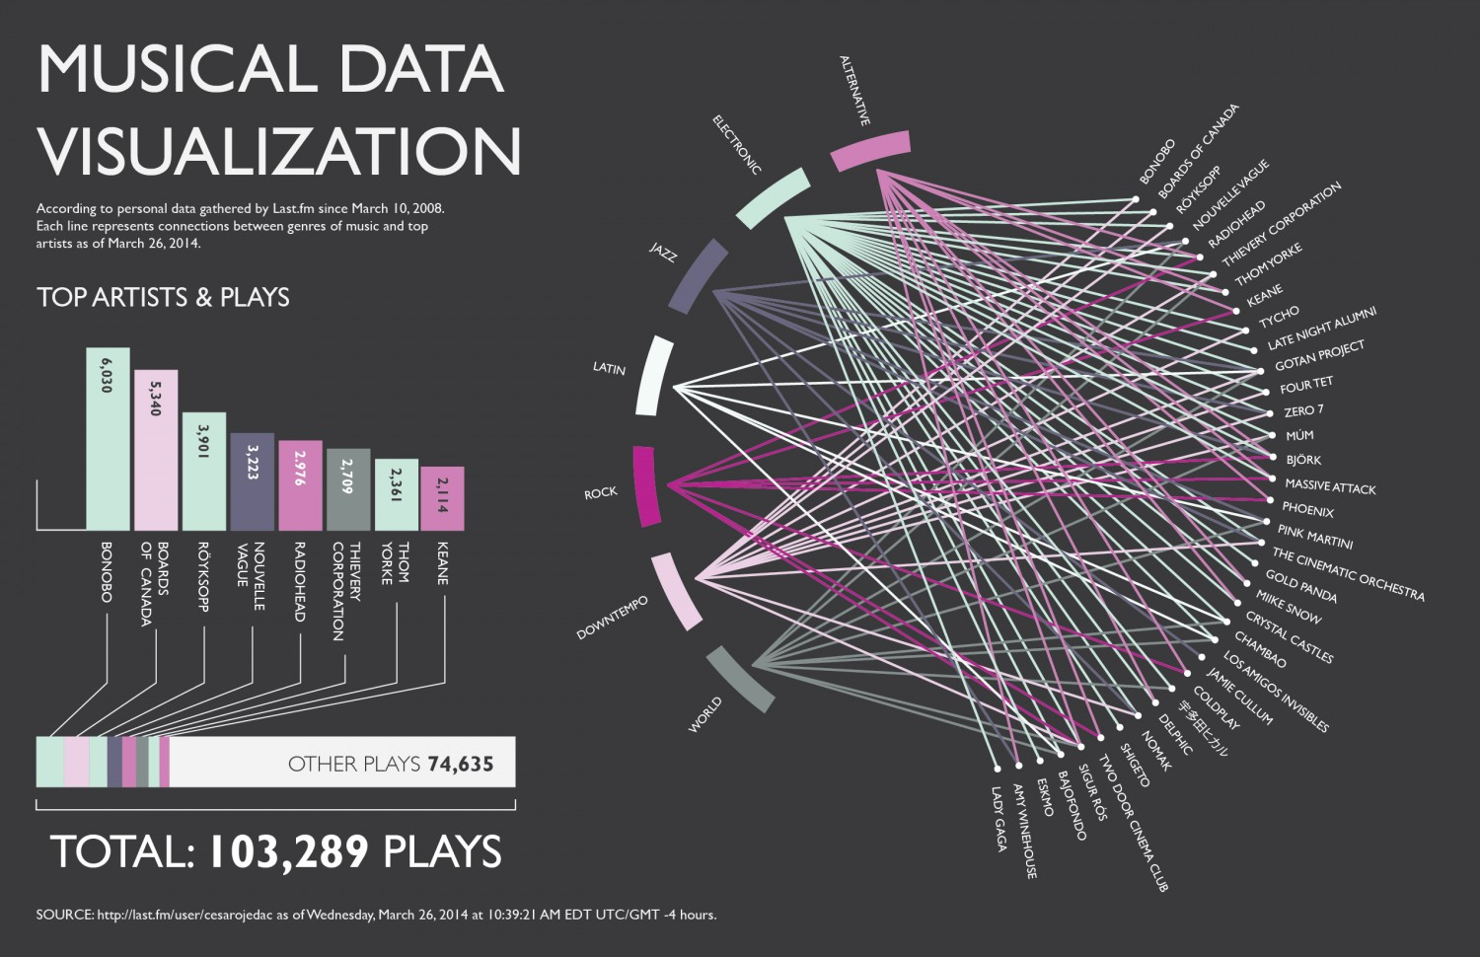
Data Visualization

Slide 15
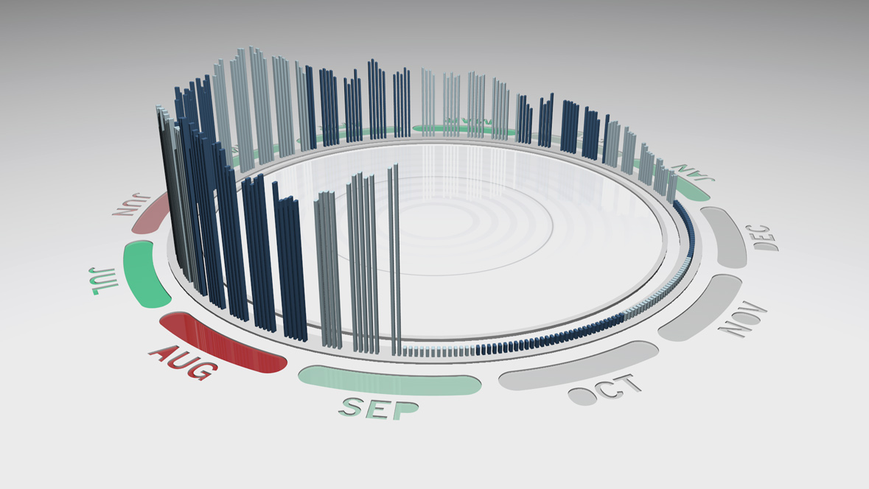
Data Visualization

Slide 16
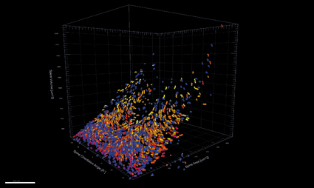
Data Visualization

Slide 17
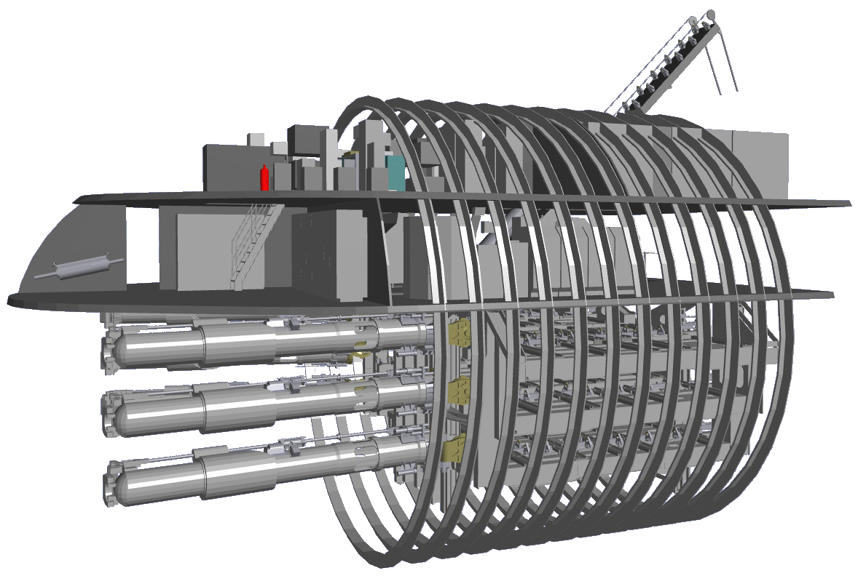

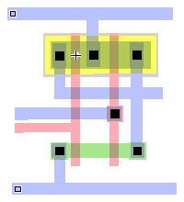
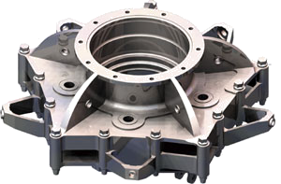
Graphics Applications
Computer Aided Design (CAD)
Notes:
A major use of computer graphics is in design processes, particularly for engineering and architectural systems.
Computer Aided Design methods are now routinely used in the design of buildings, automobiles, aircraft, watercraft,
computers, and other products.

Slide 18
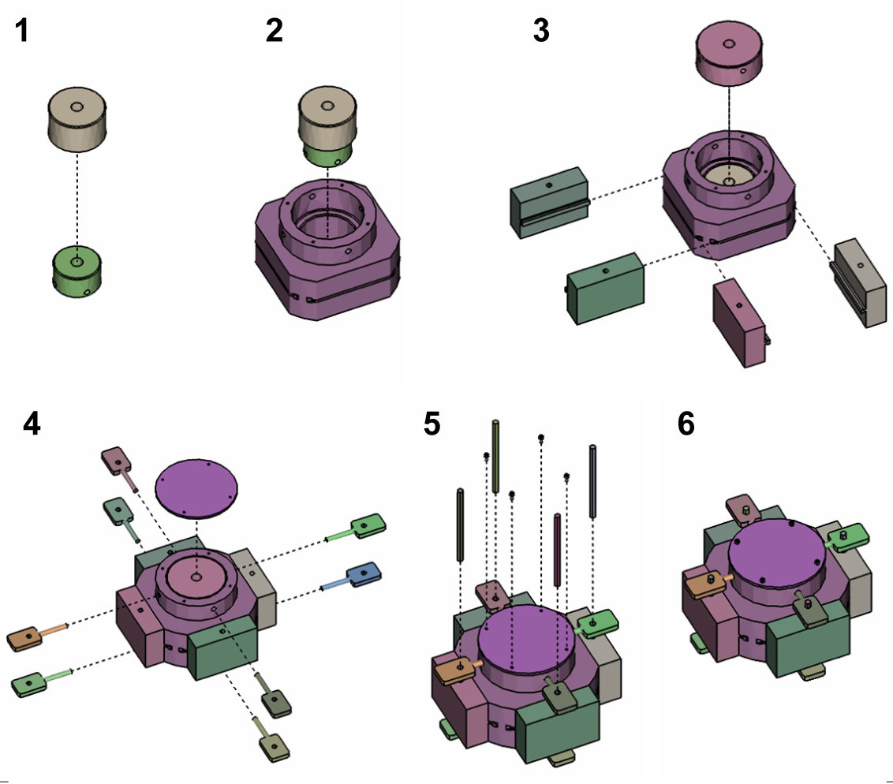
Graphics Applications
Training
Notes:
Computer-generated models are often used as educational aids.
This figure shows how to assemble the part of a machine.

Slide 19
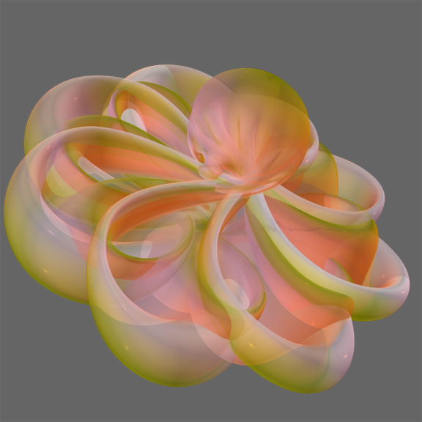
Education
Notes:
The computer animation Outside In explains the amazing discovery, made by Steve Smale in 1957,
that a sphere can be turned inside out by means of smooth motions and self-intersections.
By visualizing this, we can understand the mathematical theory easily.

Slide 20
Graphics Applications
Everyday Use
Microsoft’s Windows OS uses graphics seriously
Graphics visualizations and debuggers
Visualize complex software systems
Notes:
It is common now for applications software to provide a graphical user interface.

Slide 21
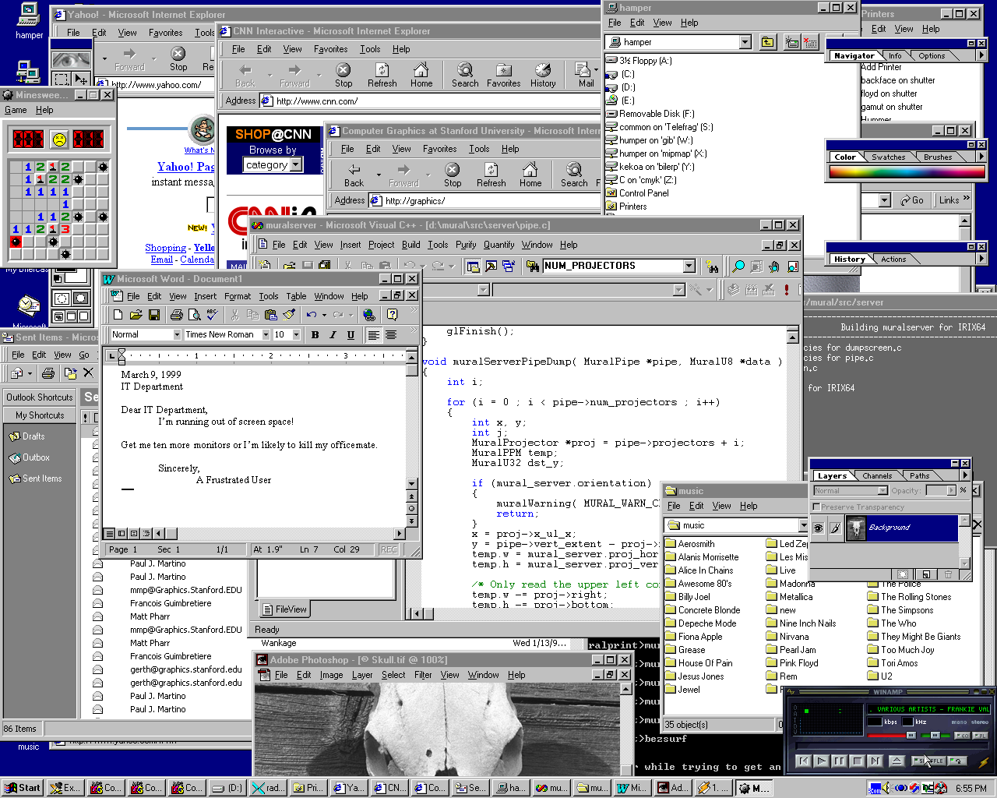
Everyday Use
Notes:
MS windows will use graphics seriously.
Everyday we use windows programs like this figure.
When I was a freshman, I used a MS-DOS which is text-based OS.
I could not image that window systems became common.

Slide 22
Computer Graphics
Generating 2D images of a 3D world represented in a computer
Main tasks:
modeling: (shape) creating and representing the geometry of objects in the 3D world
rendering: (light, perspective) generating 2D images of the objects
animation: (movement) describing how objects change in time
Notes:
We’ve looked at the applications of computer graphics.
Next I’ll explain the topics which this course will cover.

Slide 23
Related Courses
Rendering Theory
More about rendering
GPU Programming
About small program for realistic rendering and effects
Many softwares (Maya, Unity, Houdini, …) uses shaders.
Animation Theory
About automatic animation
Physical simulation, …
Computer Vision
Image Processing

Slide 24
Questions ?

