Slide 1
Graphics System and API
Computer Graphics

Slide 2
Slide Credits
Angel: Interactive Computer Graphics, 5th edition
Chapter 1
http://www.cs.unm.edu/~angel/BOOK/INTERACTIVE_COMPUTER_GRAPHICS/FIFTH_EDITION/PPT/

Slide 3
Contents
Basic graphics system
Image formation
Pipeline architecture
Software components
API

Slide 4
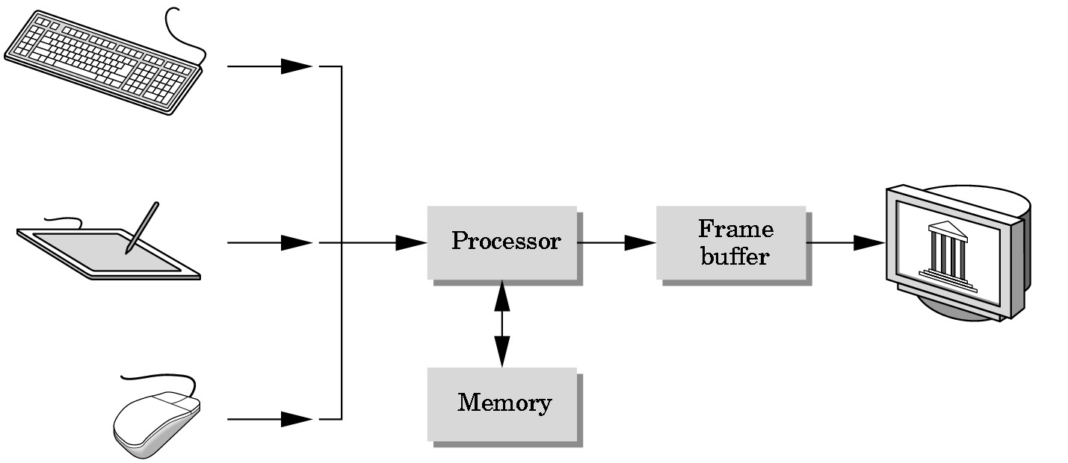
Basic Graphics System
Computer graphics system is a computer system
It must have all the components of a general-purpose computer system
Five major elements
Input devices
Processor
Memory
Frame buffer
Output devices
Output device
Input devices
Image formed in FB
Notes:
Input devices: most graphics systems provide a keyboard and at least one other input device.
The most common input devices are the mouse, the joystick and the data tablet.
The input devices provide positional information to system

Slide 5
Basic Graphics System
CPU (central processing units)
Do both the normal processing and the graphical processing
GPU (graphics processing units)
Today, virtually all graphics systems are characterized by special-purpose GPUs, custom-tailored to carry out specific graphics functions
Either on the motherborad or on a graphics card

Slide 6
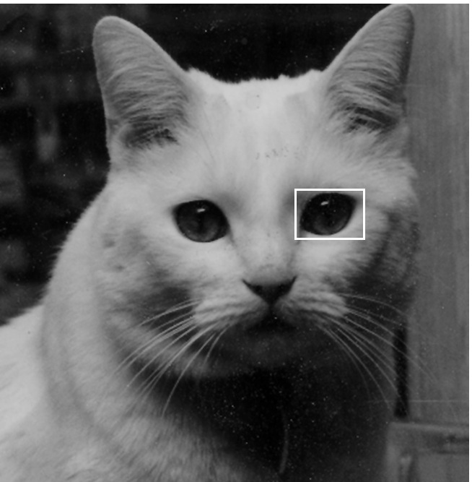
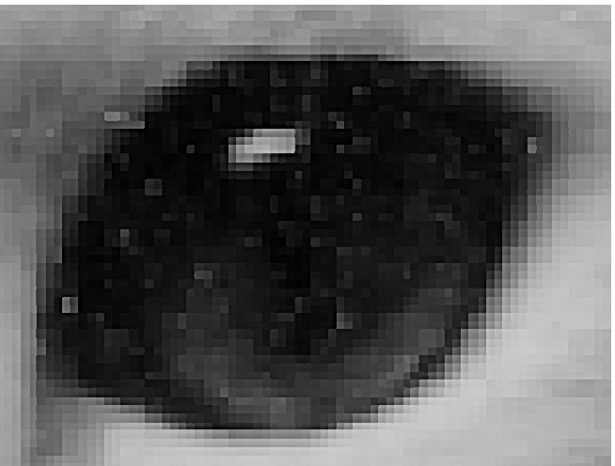
Pixels and Frame Buffer
Presently, almost all graphics systems are raster based
Image is produced as an array (the raster) of picture elements (pixels) in the frame buffer (a part of memory)

Slide 7
Pixels and Frame Buffer
Frame buffer
Core element of a graphics system
Resolution
# of pixels in the frame buffer
determine the details that you can see in the image
Depth (precision)
# of bits that are used for each pixel
determine properties such as how many colors can be represented on a given system
ex) 1-bit-deep: only two colors, 8-bit-deep: 28 (256) colors
Implemented with special types of memory chips for fast redisply of the contents

Slide 8
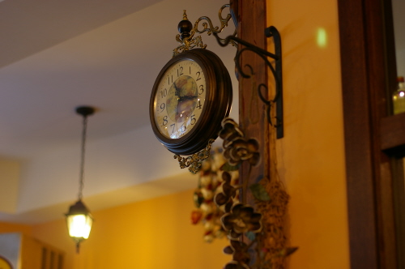


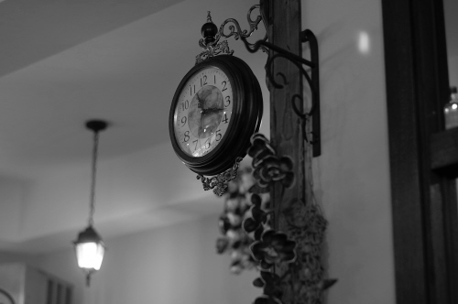
Resolution and Depth
500x332
1/10 resolution
4 bit
8 bit

Slide 9
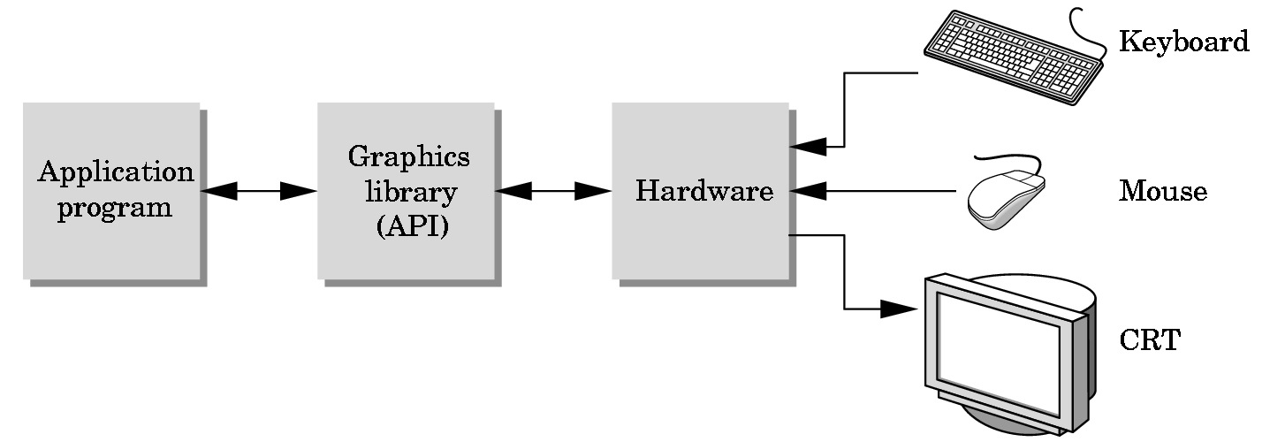
The Programmer’s Interface
Programmer sees the graphics system through a software interface
The Application Programmer Interface (API)
Hide the details of both the hardware and the software implementation of the graphics library

Slide 10
Image Formation
In computer graphics, we form images which are generally two dimensional using a process analogous to how images are formed by physical imaging systems (optical systems)
Cameras
Microscopes
Telescopes
Human visual system

Slide 11
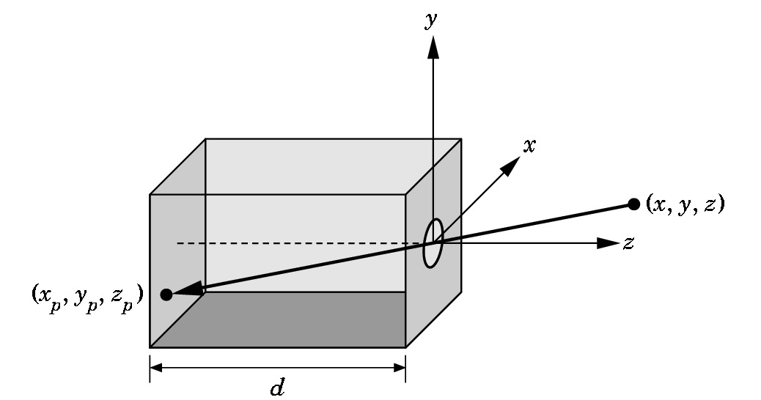
Pinhole Camera

Slide 12
Real-time Graphics Pipeline
Pipeline architecture
All steps can be implemented in hardware on the graphics card
application
program
display

Slide 13
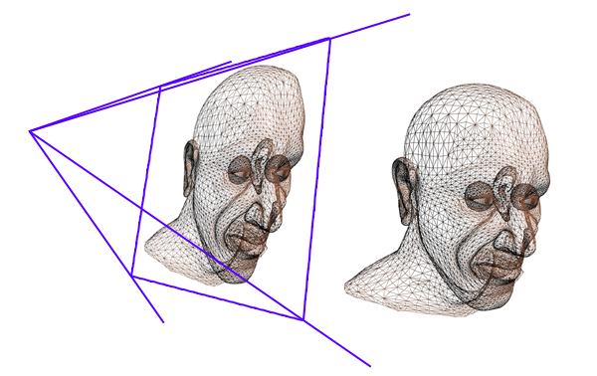
Vertex Processing
Converting object representations from one coordinate system to another
Object coordinates
Camera (eye) coordinates
Screen coordinates
Every change of coordinates is equivalent to a matrix transformation
Vertex processor also produces other data for following processes

Slide 14
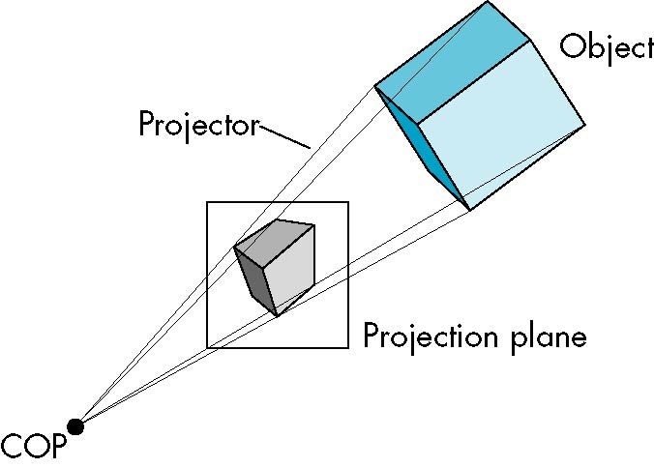
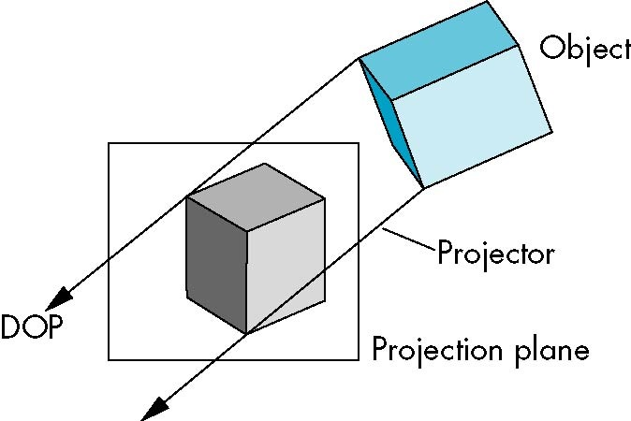
Projection
Projection is the process that combines the 3D viewer with the 3D objects to produce the 2D image
Perspective projections: all projectors meet at the center of projection
Parallel projection: projectors are parallel, center of projection is replaced by a direction of projection

Slide 15

Primitive Assembly
Vertices must be collected into geometric objects before clipping and rasterization can take place
Line segments
Polygons
Curves and surfaces

Slide 16
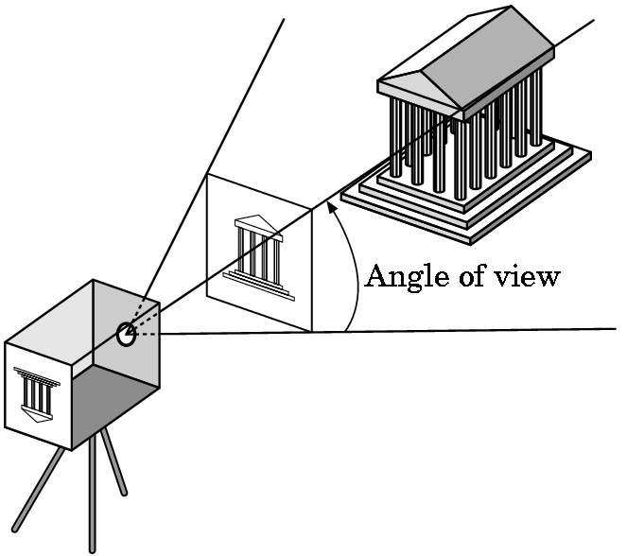
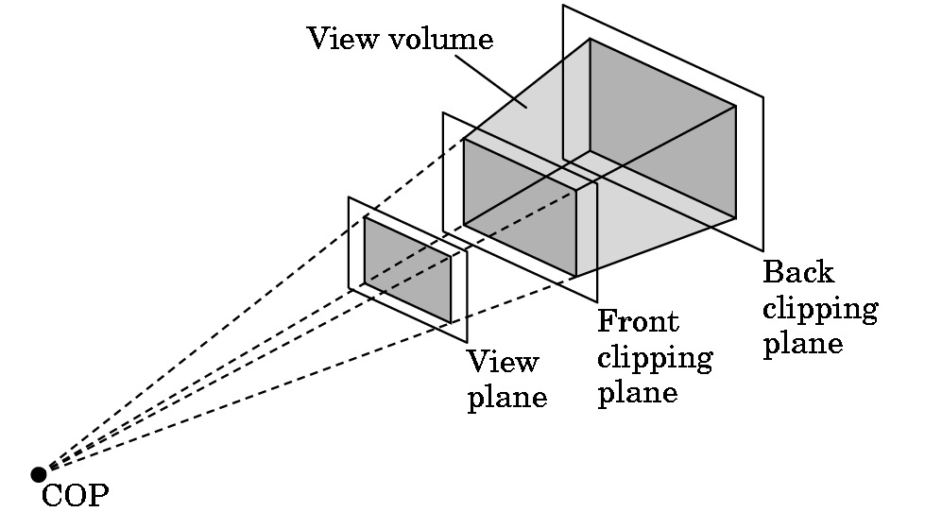
Clipping
Just as a real camera cannot “see” the whole world, the virtual camera can only see part of the world or object space
Objects that are not within this volume are said to be clipped out of the scene

Slide 17

Rasterization
If an object is not clipped out, the appropriate pixels in the frame buffer must be assigned colors
Rasterizer produces a set of fragments for each object
Fragments are “potential pixels”
Have a location in frame buffer
Color and depth attributes
Vertex attributes are interpolated over objects by the rasterizer

Slide 18
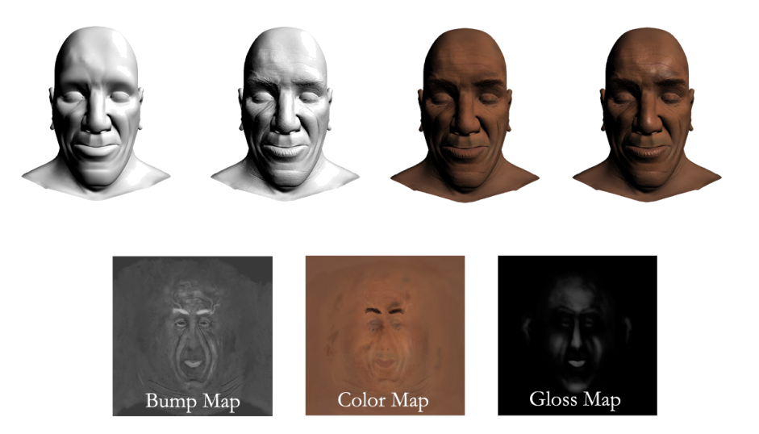
Fragment Processing
Fragments are processed to determine the color of the corresponding pixel in the frame buffer
Colors can be determined by texture mapping or interpolation of vertex colors
Fragments may be blocked by other fragments closer to the camera
Hidden-surface removal

Slide 19
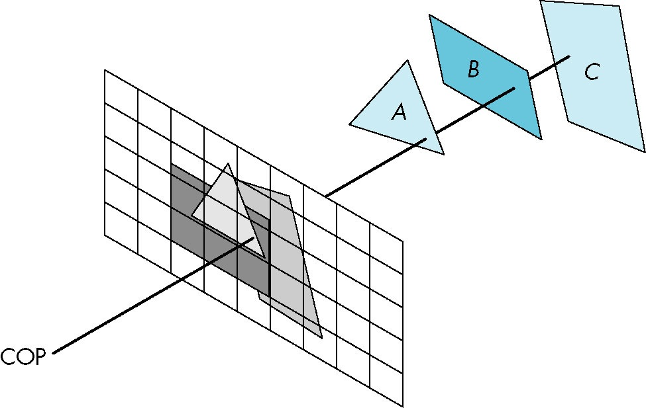
Hidden Surface Removal

Slide 20
Typical API
OpenGL
Standard open API for 2D/3D graphics
OpenGL|ES
Standard open API for mobile graphics
WebGL
Standard open API for web browser
Direct3D
Microsoft propriety API
Etc
Metal, Glide, RenderMan, Vulkan

Slide 21
OpenGL
Open Graphics Library
Cross-language, cross platform application programming interface
Most GPU’s support OpenGL
Very similar to WebGL & OpenGL|ES
Profile
Compatible profile (~V3.1)
Core profile (V3.2~)

Slide 22
OpenGL
Documentation
The Red Book
OpenGL Programming Guide, 8th Edition
The Green Book
OpenGL Programming for X Window Systems
The Blue Book
OpenGL Reference manual, 4th Edition
The Alpha Book (white)
OpenGL Programming for Window 95 and Windows NT
The Orange Book
OpenGL Shading Language, 3rd Edition

Slide 23
OpenGL Window Toolkit
Creating OpenGL context
Complex process
Platform dependent
Popular toolkits
GLFW
GLUT
freeglut
Multimedia libraries
Allegro 5, SDL, SFML, …
Widget toolkits
FLTK, Qt, wxWidgets, …

Slide 24
GLFW
http://www.glfw.org/download.html
Advantage
Free, Open-source
Very easy
Featureful
Multi-language binding
Disadvantage
No user interface
Desktop only
No threading
No image loading library

Slide 25
GLFW Basic
#include <GLFW/glfw3.h>
void render( GLFWWindow* window );
int main(void){
if ( !glfwInit() ) exit(EXIT_FAILURE);
#ifdef __APPLE__
glfwWindowHint( GLFW_CONTEXT_VERSION_MAJOR, 4 );
glfwWindowHint( GLFW_CONTEXT_VERSION_MINOR, 1 );
glfwWindowHint (GLFW_OPENGL_FORWARD_COMPAT, GL_TRUE);
glfwWindowHint( GLFW_OPENGL_PROFILE, GLFW_OPENGL_CORE_PROFILE );
#endif
GLFWwindow* window = glfwCreateWindow( 640, 480, "Hello", NULL, NULL );
glfwMakeContextCurrent( window );
while ( !glfwWindowShouldClose( window ) ) {
render( window );
glfwPollEvents();
}
glfwDestroyWindow( window );
glfwTerminate();
}

Slide 26
GLFW Basic
void render( GLFWWindow* window ) {
int width, height;
glfwGetFramebufferSize( window, &width, &height );
glViewport( 0, 0, width, height );
glClearColor( 0, 0, .5, 0 );
glClear( GL_COLOR_BUFFER_BIT );
glfwSwapBuffers( window );
}

Slide 27
For MS Windows
Problem
Default OpenGL library (and headers) does not support higher version of OpenGL
Solutions
Glade
GLEW
http://glew.sourceforge.net

Slide 28
Other Library to Use
GLM
Math library
Vectors, matrices, etc.
Header files only
https://github.com/g-truc/glm/tags

Slide 29
Assignment #1 (0 point but mendatory)
Make OpenGL program
Create window (640x480, with your ID)
Initially clear the window black
At each frame, the window becomes blue by 5%.
When it become 100% blue, turn it back to black.
Repeat the color change.

Slide 30
Questions ?

