Slide 1
Geometry
Computer Graphics

Slide 2
Objectives
Introduce the elements of geometry
Scalars
Vectors
Points
Develop mathematical operations among them in a coordinate-free manner
Define basic primitives
Line segments
Polygons

Slide 3
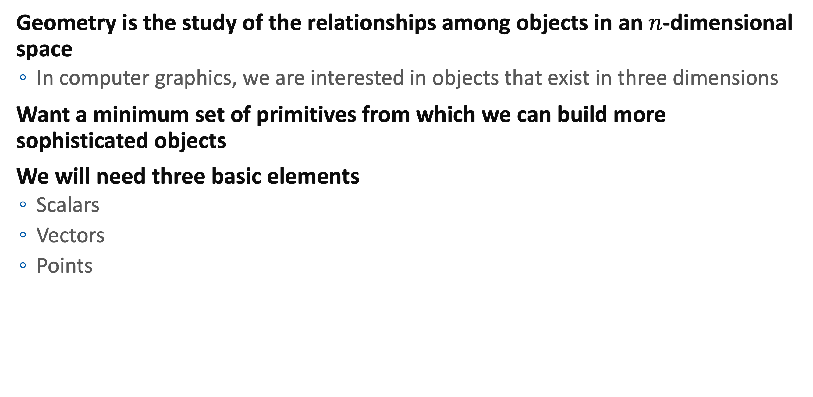
Basic Elements
Geometry is the study of the relationships among objects in an $n$-dimensional space
In computer graphics, we are interested in objects that exist in three dimensions
Want a minimum set of primitives from which we can build more sophisticated objects
We will need three basic elements
Scalars
Vectors
Points

Slide 4
History of Geometry
Questions of shape, size, relative position of figures, and the properties of space.
Practical Needs
Lengths, areas, and volumes
Eudoxus (408-c. 355 BC): method of exhaustion
Euclid (Mid-4th centry BC – Mid-3rd centry BC)
Upgrade geometry to pure mathematics
Axiomatic method
Rene Descartes (1596-1650)
Provided ”analytic geometry”
Basis for the calculus
Fermat, Klein, Riemann, Poincare, …

Slide 5
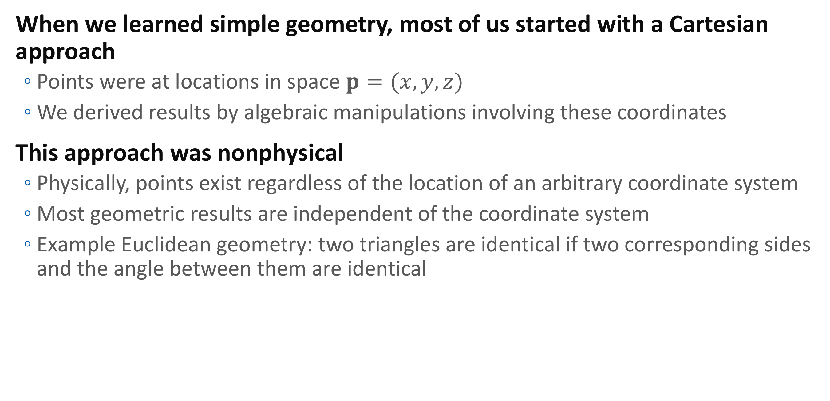
Coordinate-Free Geometry
When we learned simple geometry, most of us started with a Cartesian approach
Points were at locations in space $p=(x,y,z)$
We derived results by algebraic manipulations involving these coordinates
This approach was nonphysical
Physically, points exist regardless of the location of an arbitrary coordinate system
Most geometric results are independent of the coordinate system
Example Euclidean geometry: two triangles are identical if two corresponding sides and the angle between them are identical

Slide 6
Scalars
Need three basic elements in geometry
Scalars, Vectors, Points
Scalars can be defined as members of sets which can be combined by two operations (addition and multiplication) obeying some fundamental axioms (associativity, commutivity, inverses)
Examples include the real and complex number systems under the ordinary rules with which we are familiar
Scalars alone have no geometric properties

Slide 7

Vectors
Physical definition: a vector is a quantity with two attributes
Direction
Magnitude
Examples include
Force
Velocity
Directed line segments
Most important example for graphics
Can map to other types
$$v$$

Slide 8
Vector Operations
Every vector has an inverse
Same magnitude but points in opposite direction
Every vector can be multiplied by a scalar
There is a zero vector
Zero magnitude, undefined orientation
The sum of any two vectors is a vector
Use head-to-tail axiom
v
-v
αv
v
w
u

Slide 9
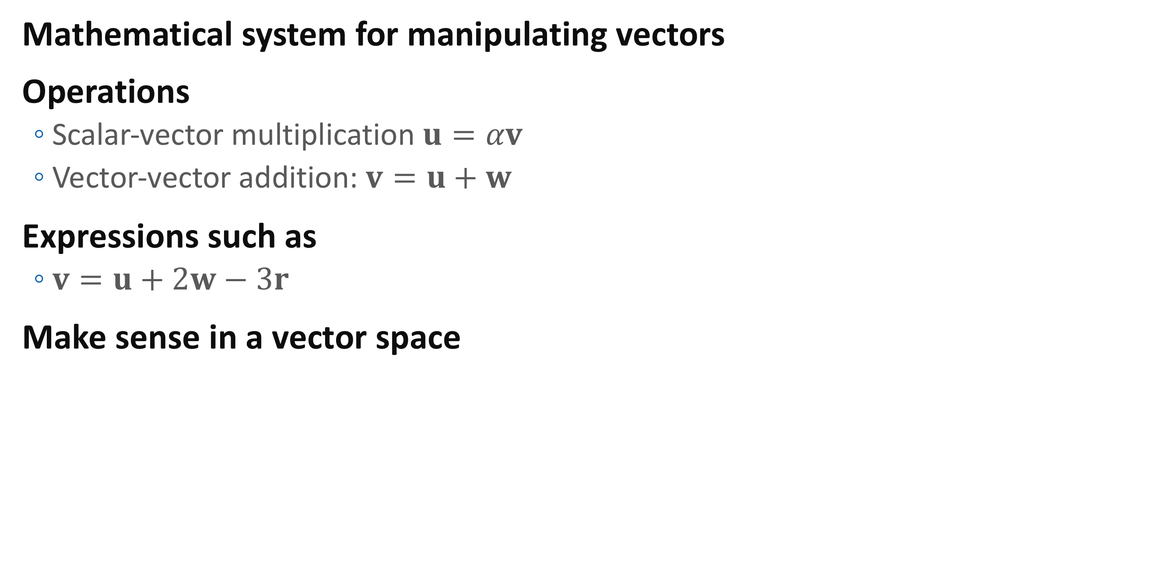
Linear Vector Spaces
Mathematical system for manipulating vectors
Operations
Scalar-vector multiplication $u=αv$
Vector-vector addition: $v=u+w$
Expressions such as
$v=u+2w−3r$
Make sense in a vector space

Slide 10
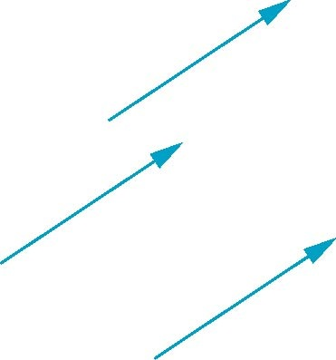
Vectors Lack Position
These vectors are identical
Same length and magnitude
Vectors spaces insufficient for geometry
Need points

Slide 11
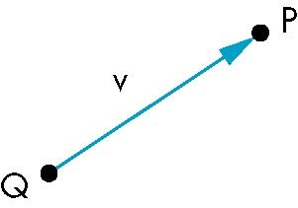
Points
Location in space
Operations allowed between points and vectors
Point-point subtraction yields a vector
Equivalent to point-vector addition
v = P - Q
P = v + Q

Slide 12

Affine Spaces
Point + a vector space
Operations
Vector-vector addition
Scalar-vector multiplication
Point-vector addition
Scalar-scalar operations
For any point define
$1∙P = P$
$0∙P = 0$(zero vector)

Slide 13
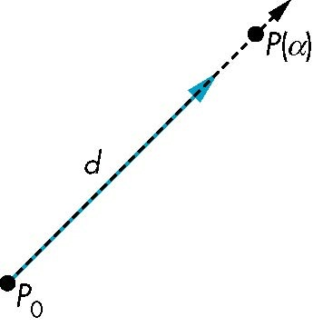

Lines
Consider all points of the form
P(α)=P₀ + α d
Set of all points that pass through $P_{0}$ in the direction of the vector $d$

Slide 14
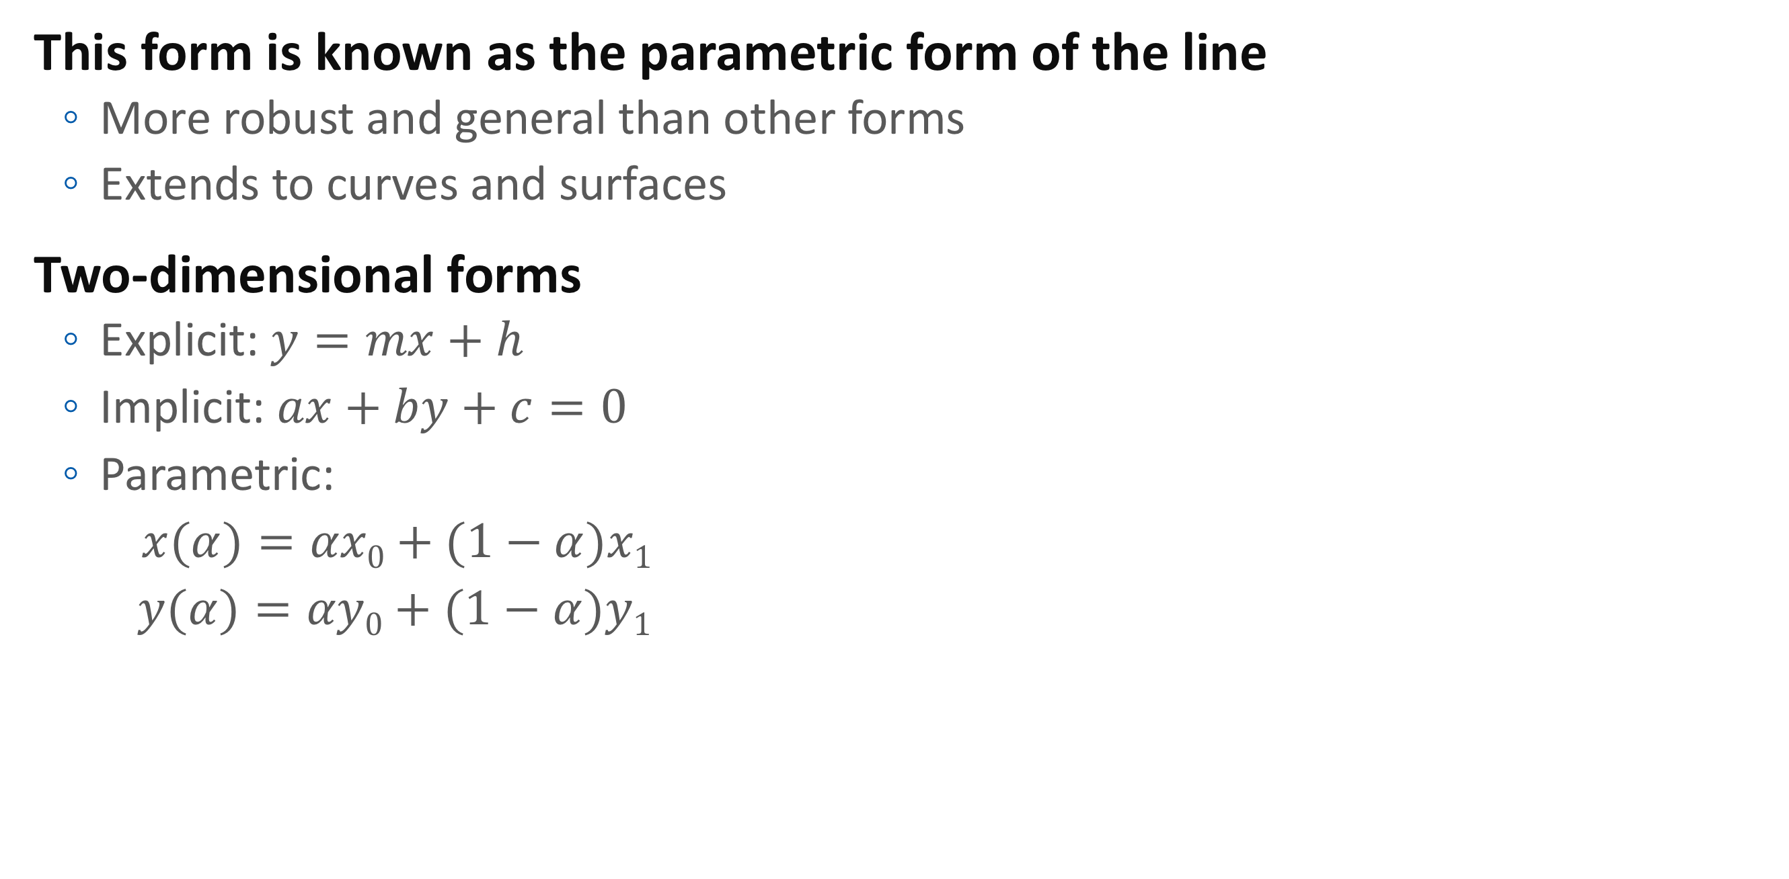
Parametric Form
This form is known as the parametric form of the line
More robust and general than other forms
Extends to curves and surfaces
Two-dimensional forms
Explicit: $y=mx+h$
Implicit: $ax+by+c=0$
Parametric:
$x(α)=αx0+(1−α)x1$
$y(α)=αy0+(1−α)y1$

Slide 15
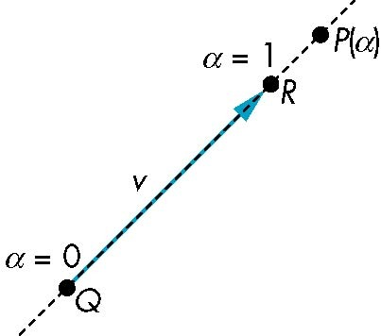

Rays and Line Segments
If $α≥0$, then $P(α)$ is the ray leaving $P_{0}$ in the direction $d$
If we use two points to define $v$, then
$P(α) = Q + α (R−Q)= Q+αv =αR + (1−α)Q$
For $0≤α≤1$ we get all the points on the line segment
joining $R$ and $Q$

Slide 16




Convexity
An object is convex iff for any two points in the object all points on the line segment between these points are also in the object
$$P$$
$$P$$
$$Q$$
$$Q$$
not convex
convex

Slide 17
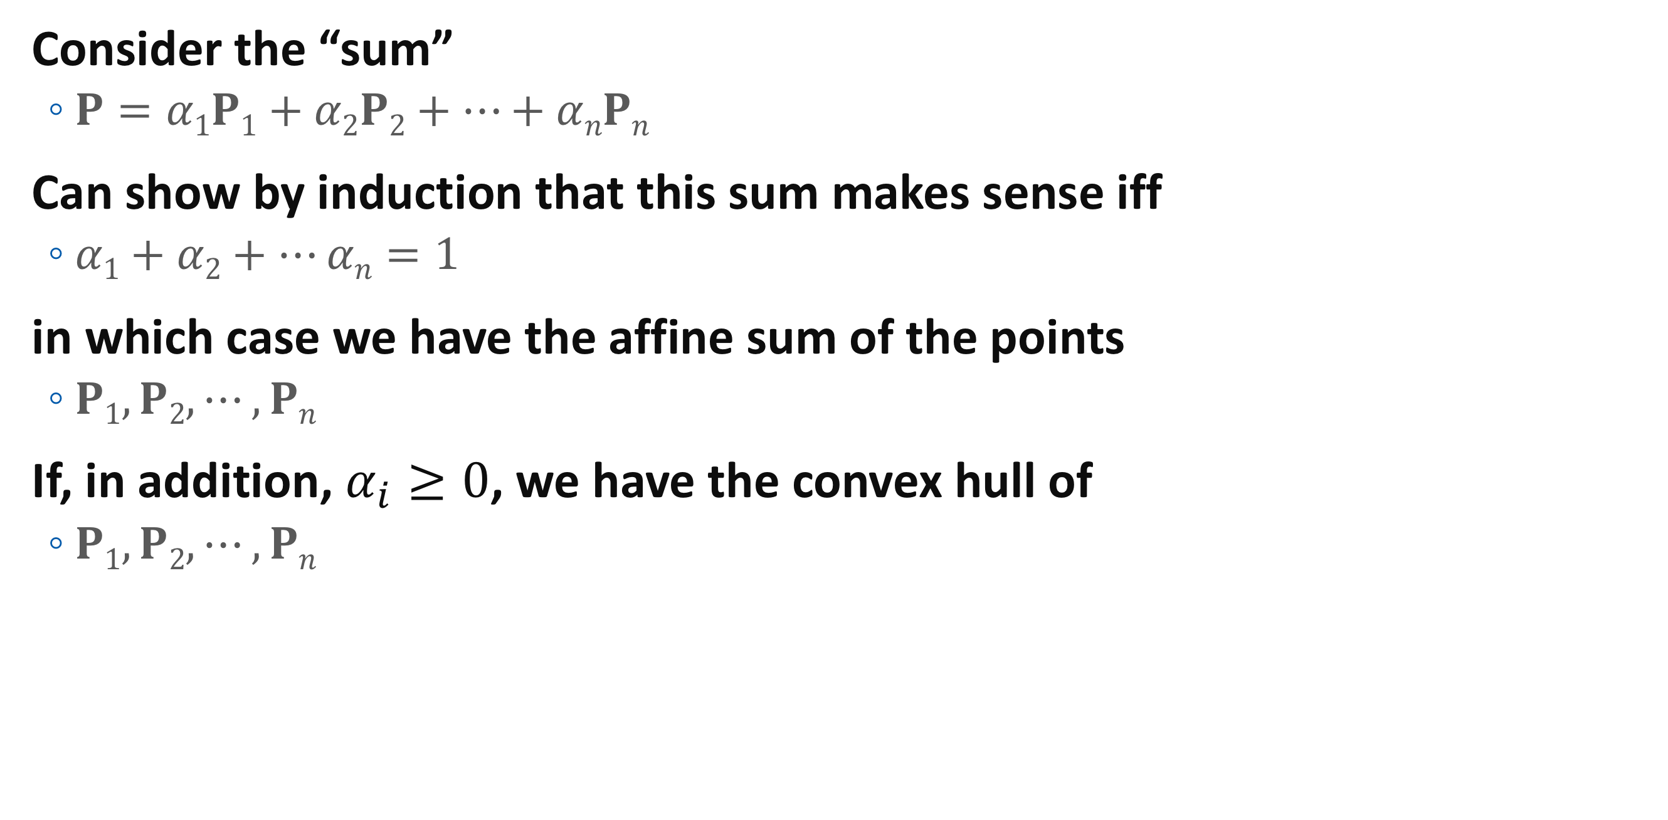
Affine Sums
Consider the “sum”
$P=α1P1+α2P2+…+αnPn$
Can show by induction that this sum makes sense iff
$α1+α2+…αn=1$
in which case we have the affine sum of the points
$P1,P2,⋯,Pn$
If, in addition, $α_{i}≥0$, we have the convex hull of
$P1,P2,⋯,Pn$

Slide 18
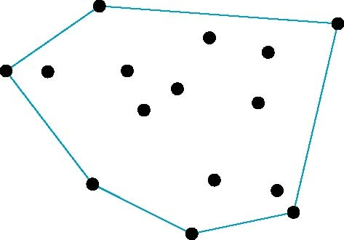

Convex Hull
Smallest convex object containing $P1,P2,⋯,Pn$
Formed by “shrink wrapping” points

Slide 19

Curves and Surfaces
Curves are one parameter entities of the form $P(α)$ where the function is nonlinear
Surfaces are formed from two-parameter functions $P(α, β)$
Linear functions give planes and polygons
P(α)
P(α, β)

Slide 20
Planes
A plane can be defined by a point and two vectors or by three points
P
v
Q
R
u
R
P(α, β)=R+αu+βv
P(α, β)=R+α(Q-R)+β(P-Q)

Slide 21
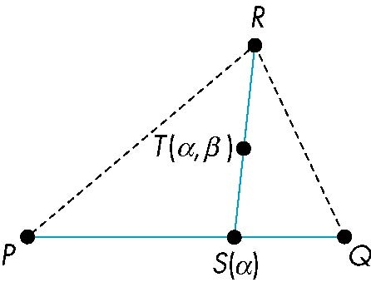
Triangles
convex sum of S(α) and R
convex sum of P and Q
for 0<=α,β<=1, we get all points in triangle

Slide 22
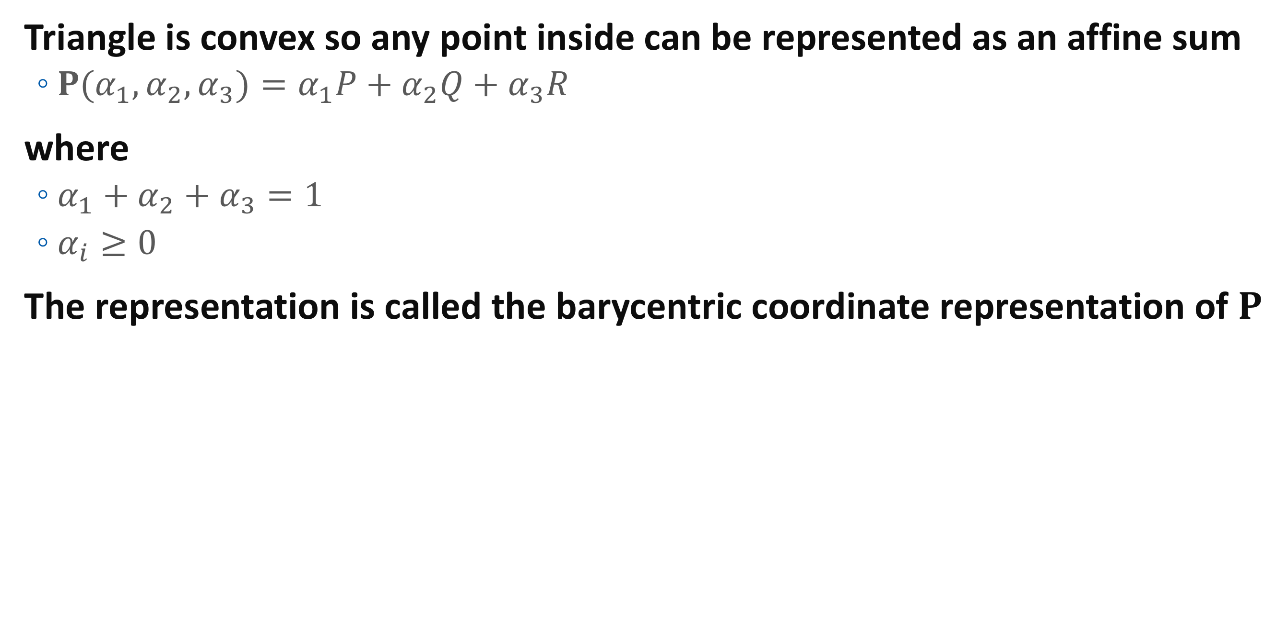
Barycentric Coordinates
Triangle is convex so any point inside can be represented as an affine sum
$P(α_{1}, α_{2}, α_{3})=α_{1}P+α_{2}Q+α_{3}R$
where
$α_{1}+α_{2}+α_{3}=1$
$α_{i}≥0$
The representation is called the barycentric coordinate representation of $P$

Slide 23
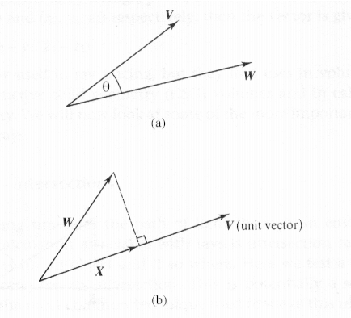
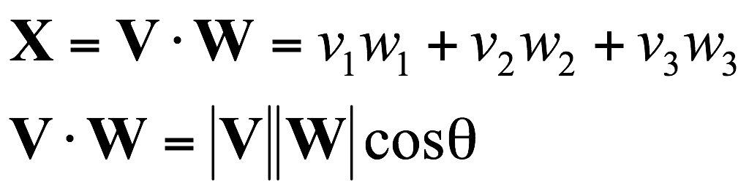
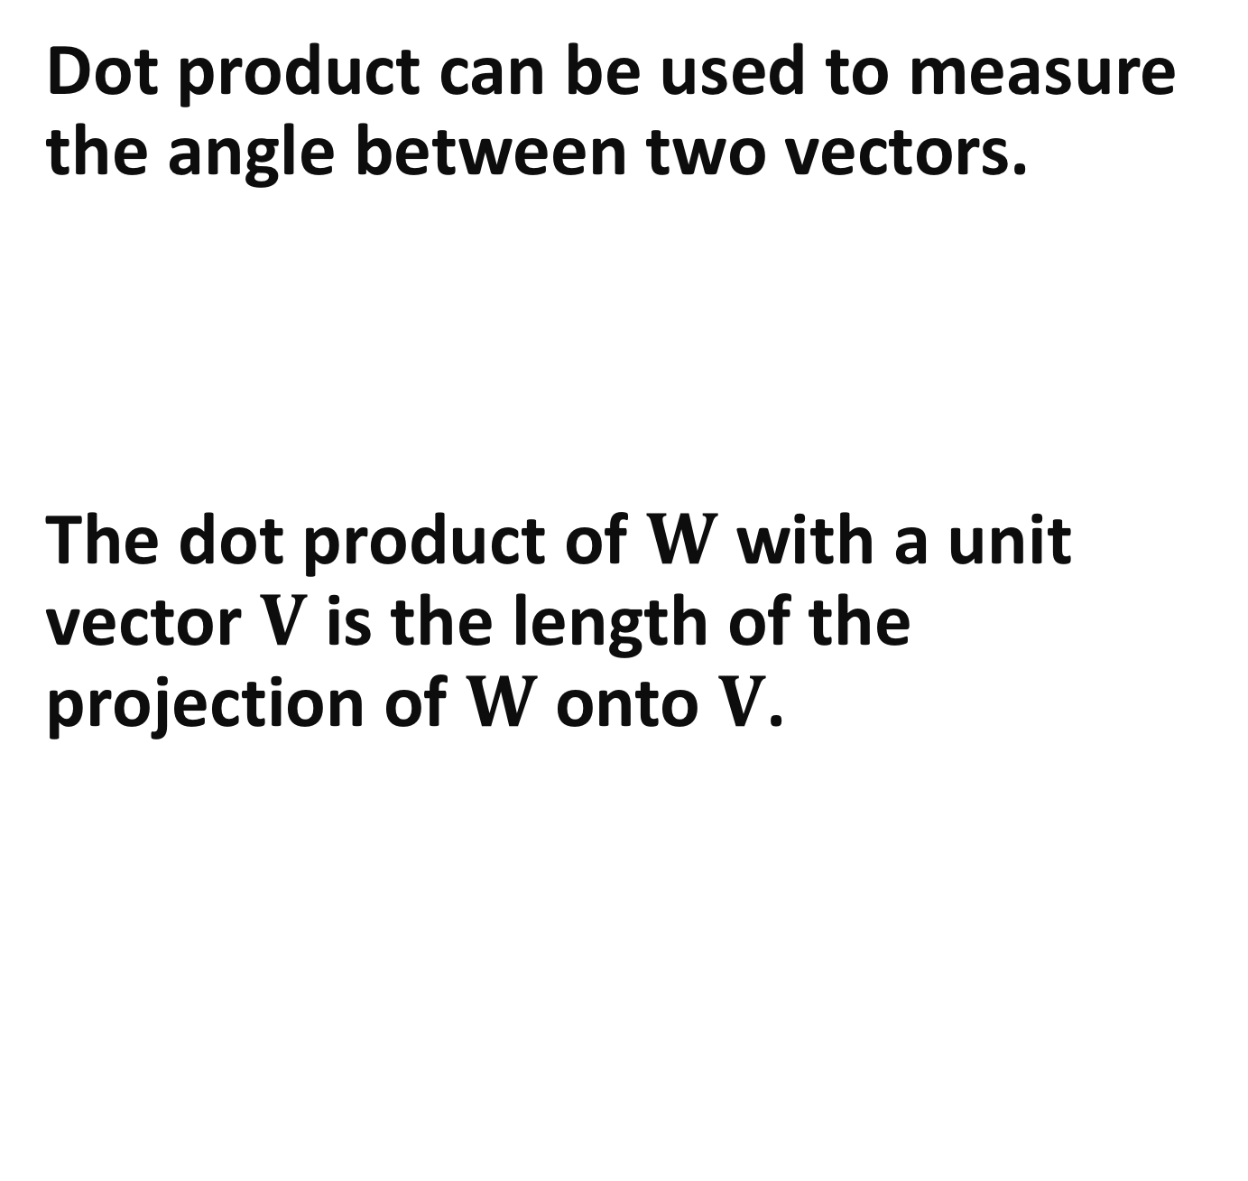
Dot Product
Dot product can be used to measure the angle between two vectors.
The dot product of $W$ with a unit vector $V$ is the length of the projection of $W$ onto $V$.

Slide 24
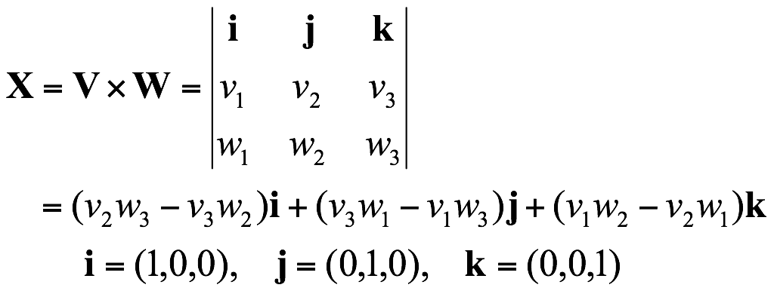

Cross Product
Cross product outputs a vector perpendicular to the plane defined by the two vectors.
In $X=V×W$, $(V,W,X)$ defines a right-hand coordinate system.

Slide 25

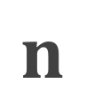




Normals
Every plane has a vector $n$ normal (perpendicular, orthogonal) to it
From point-two vector form $P(α,β)=R+αu+βv$, we know we can use the cross product to find $n=u×v$and the equivalent form
$(P(α)−R)⋅n=0$
$$n$$
$$v$$
$$P$$
$$R$$
$$u$$

Slide 26

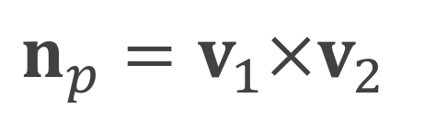


Normal Vector of a Polygon
$$n_{p}$$
Polygon defined by four vertices
$$v_{1}$$
$$v_{1}$$
$$n_{p}=v_{1}×v_{2}$$

Slide 27
Questions ?

