Slide 1
Geometric Transformations (1)
Computer Graphics

Slide 2
Reading
Hearn & Baker, Chapter 5
Angel, Chapter 4
Watt, Chapter 1

Slide 3
Contents
Geometric transformations
Basic 2D geometric transformations
translation, rotation, and scaling
Homogeneous coordinates
Composite transformations
2D rigid-body transformations
Other 2D geometric transformations
reflection and shear
Transformations between 2D coordinate systems

Slide 4
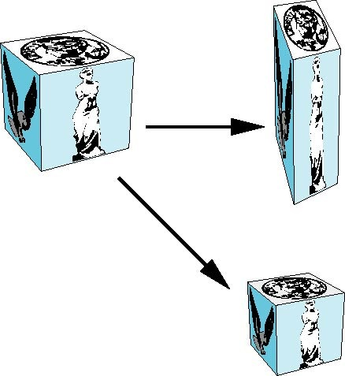
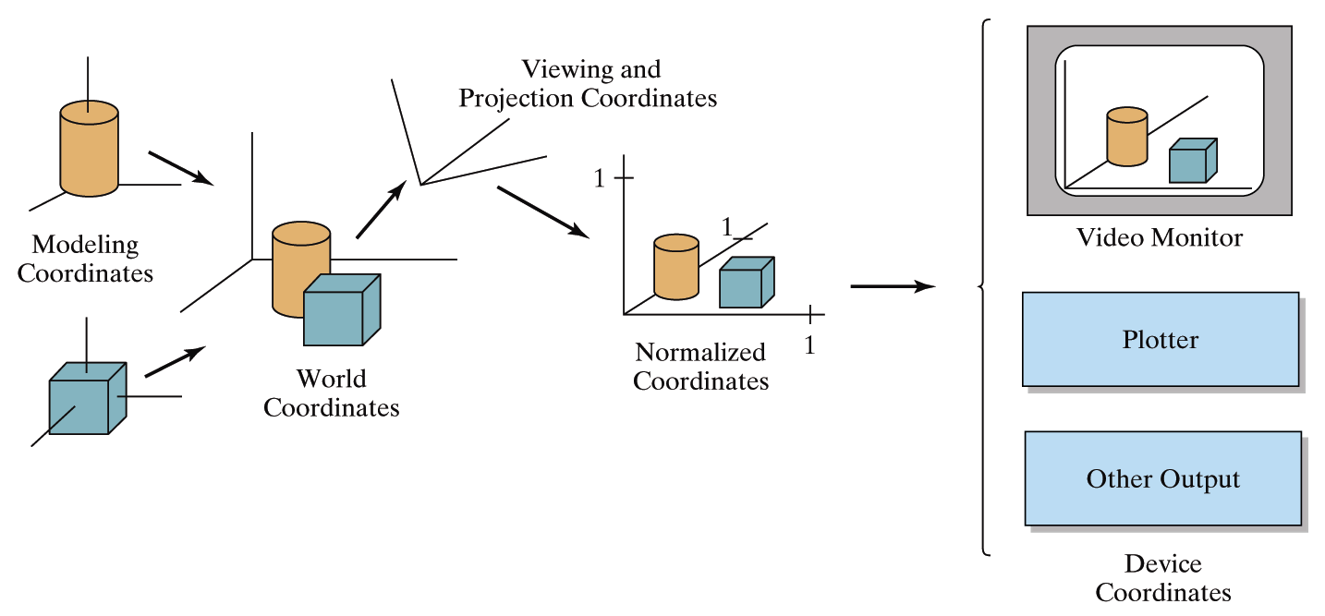
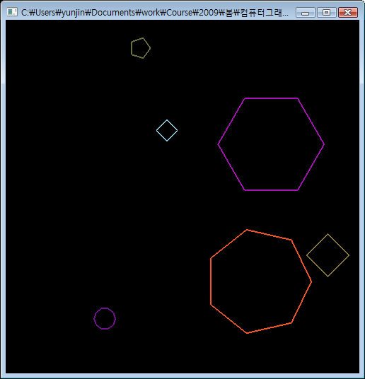
Geometric Transformations
Operations that are applied to the geometric description of an object to change its position, orientation, or size
applied to objects to reposition or resize them
used in the viewing routines that convert a world-coordinates scene description to a display for an output device
…
Object repositioning or resizing
Coordinate conversion
Animation

Slide 5
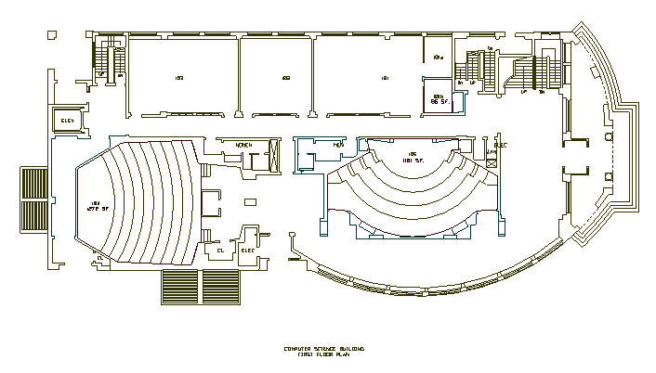
Geometric Transformations
Modeling transformations?
used to construct a scene or to give the hierarchical description of a complex object that is composed of several parts
Modeling Coordinates
y
Scale Translate
x
Scale Rotate Translate
World Coordinates

Slide 6
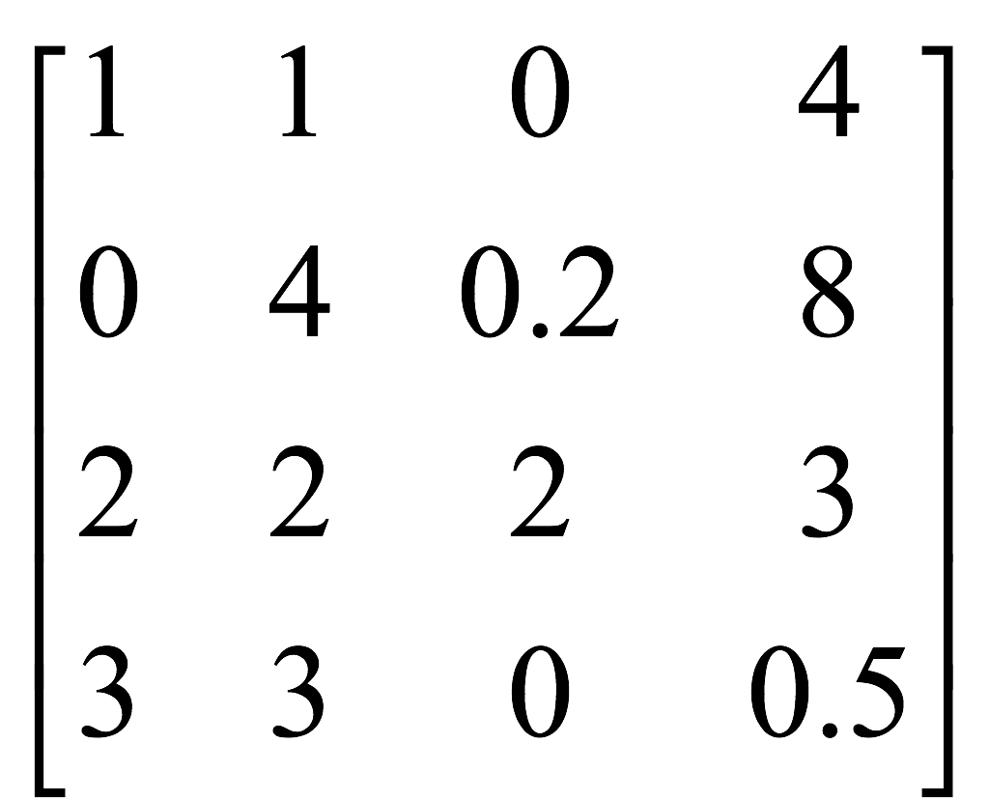
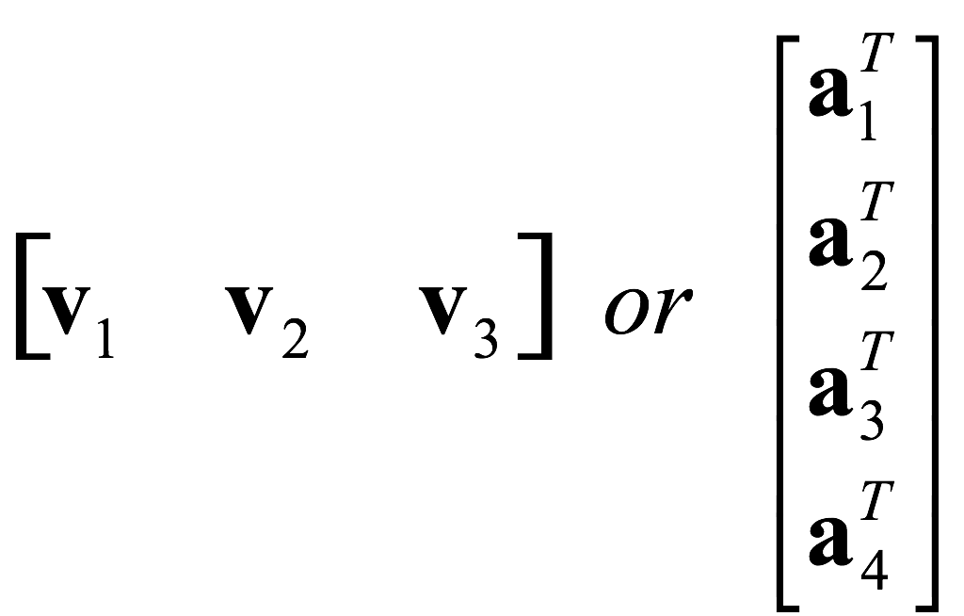
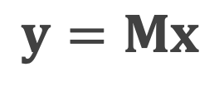
Matrices
bunch of numbers in box
vector of vectors
transformation
$$y=Mx$$

Slide 7
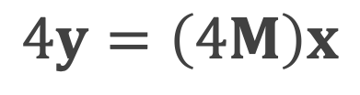
Matrix Operations
Addition
element-wise addition
Scalar multiplication
element-wise scaling
additional scaling within transformation
$$4y=\left(4M\right)x$$

Slide 8
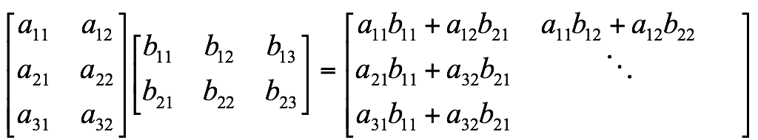

Matrix Product
As you’ve learned at high school,
Vector Product

Slide 9
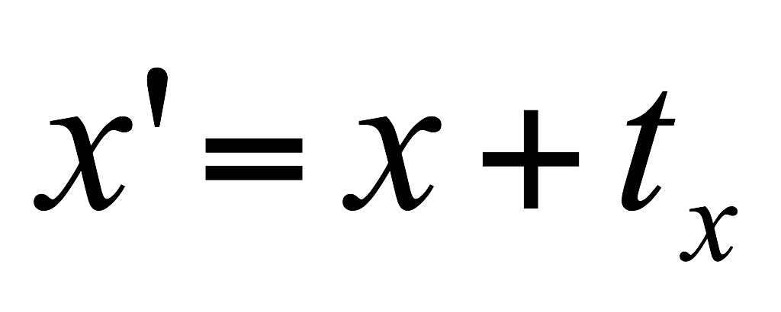
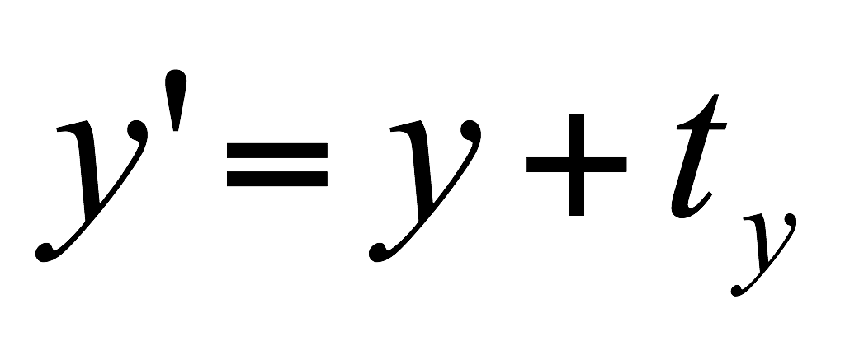


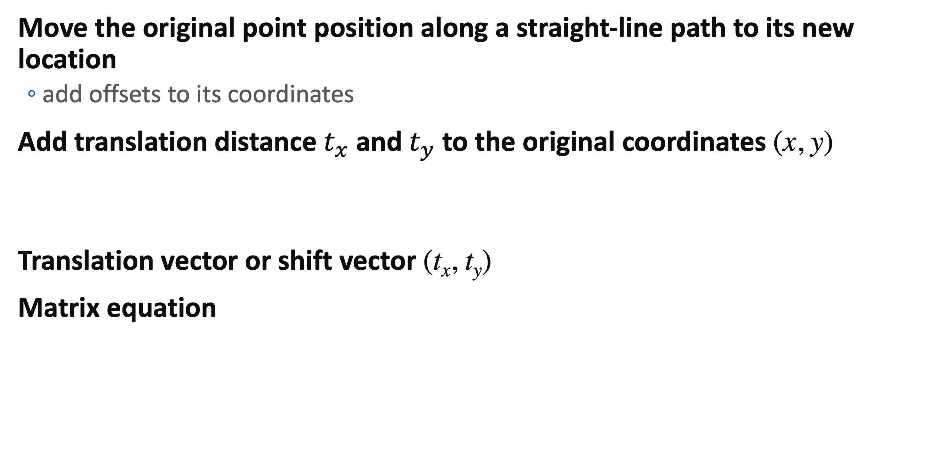


2D Translation
Move the original point position along a straight-line path to its new location
add offsets to its coordinates
Add translation distance $t_{x}$ and $t_{y}$ to the original coordinates (x, y)
Translation vector or shift vector (t_{x}, t_{y})
Matrix equation
y
p′
t
p
x
$$p=\left[\begin{matrix}x \\ y\end{matrix}\right]$$
$$p′=\left[\begin{matrix}x′ \\ y′\end{matrix}\right]$$
$$t=\left[\begin{matrix}t_{x} \\ t_{y}\end{matrix}\right]$$
$$p^{′}=p+t$$

Slide 10
2D Translation
Rigid-body transformation
move objects without deformation
every point on the object is translated by the same amount
Straight line segment
apply the translation to each points
redraw the line between the new points
Polygon
translate the position of each vertex
regenerate the polygon
Circle or ellipse
translate the center coordinates
redraw the figure
y
x
y
x

Slide 11
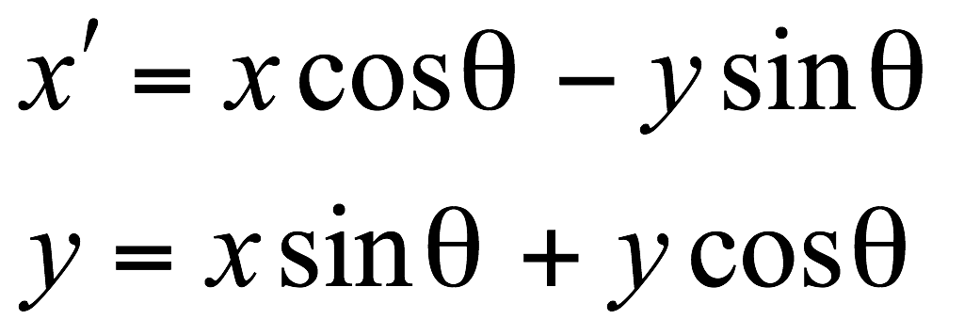
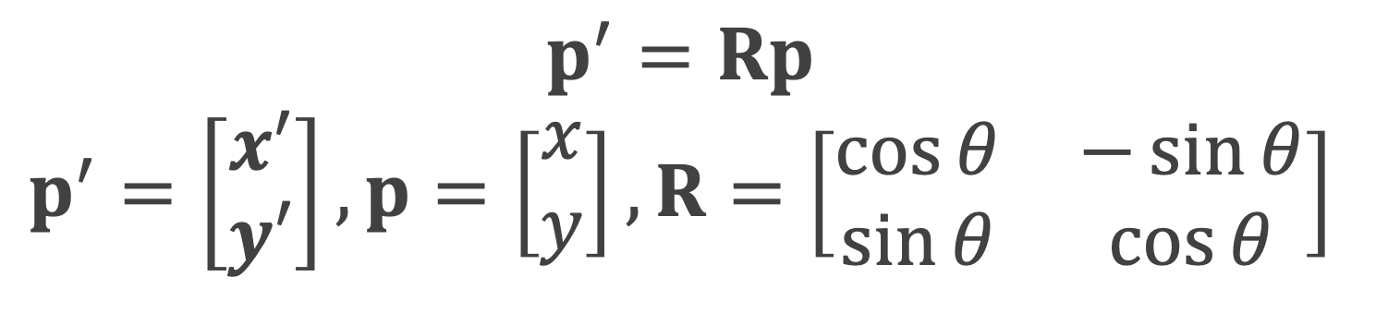
2D Rotation
Reposition an object along a circular path in the xy plane
rigid-body transformation
Rotation point (or pivot point) (x_{r}, y_{r}) and rotation angle θ
counterclockwise – positive angle
clockwise – negative angle
Rotation about the pivot point at the origin
Matrix equation
θ
(x_{r}, y_{r})
(x′, y′)
(x, y)
$$p^{′}=Rp \\ p^{′}=\left[\begin{matrix}x′ \\ y′\end{matrix}\right], p=\left[\begin{matrix}x \\ y\end{matrix}\right], R=\left[\begin{matrix}\cos{θ} & −\sin{θ} \\ \sin{θ} & \cos{θ}\end{matrix}\right]$$
θ

Slide 12
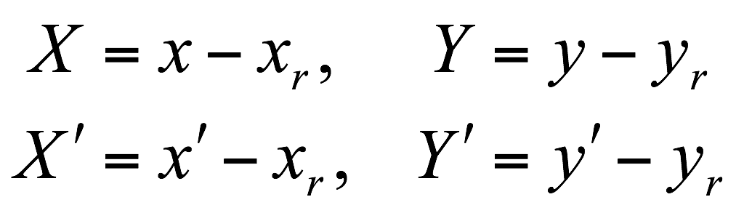
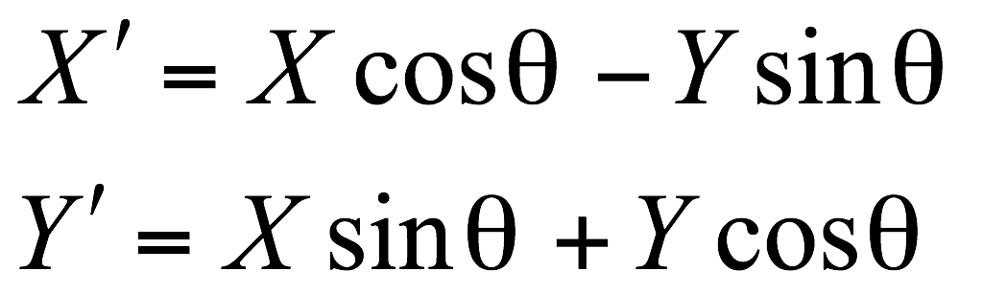
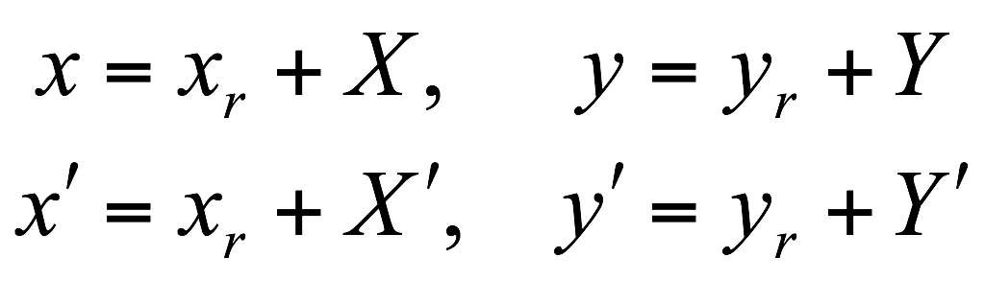
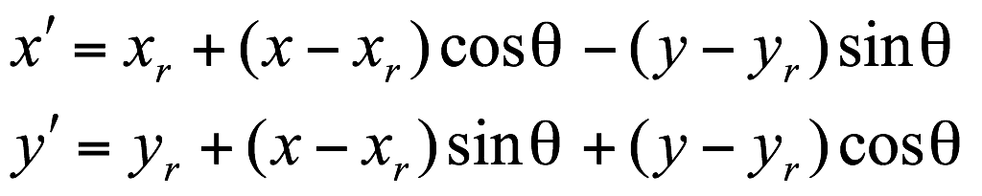

2D Rotation
Rotation about an arbitrary pivot position
(x′, y′)
(x′, y′)
(x, y)
(x′, y′)
(x, y)
θ
θ
(x, y)
θ
(x_{r}, y_{r})
(x_{r}, y_{r})
(0, 0)
$$p^{′}=Rp+t$$

Slide 13
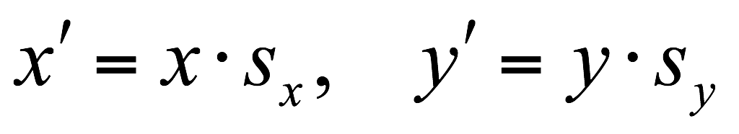
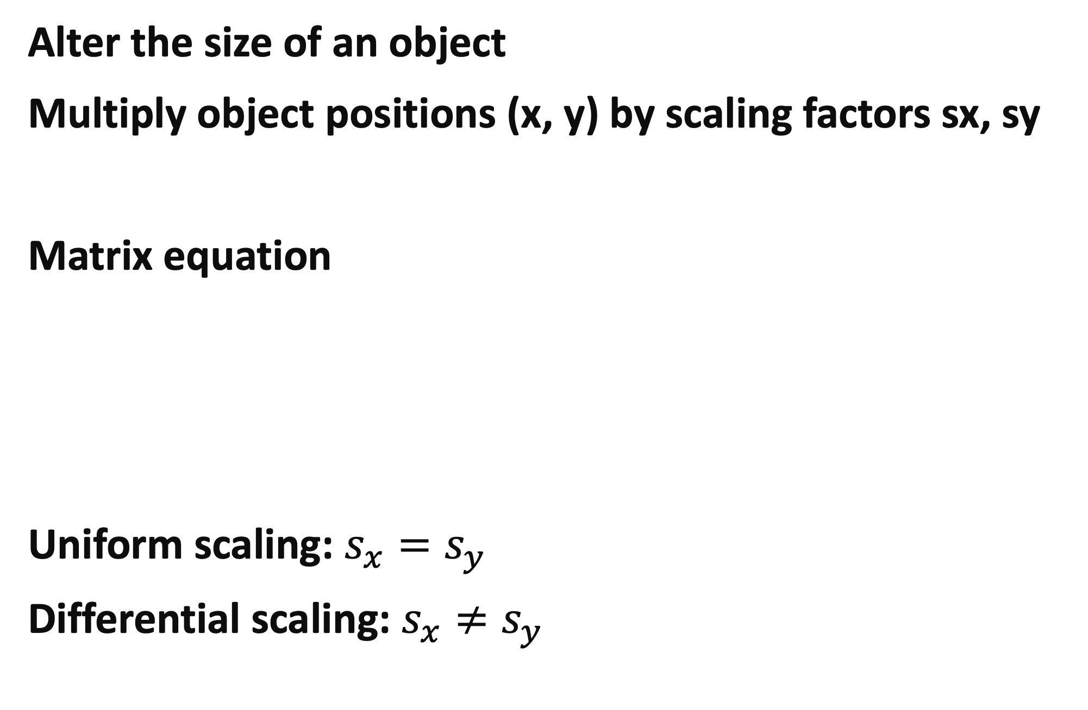
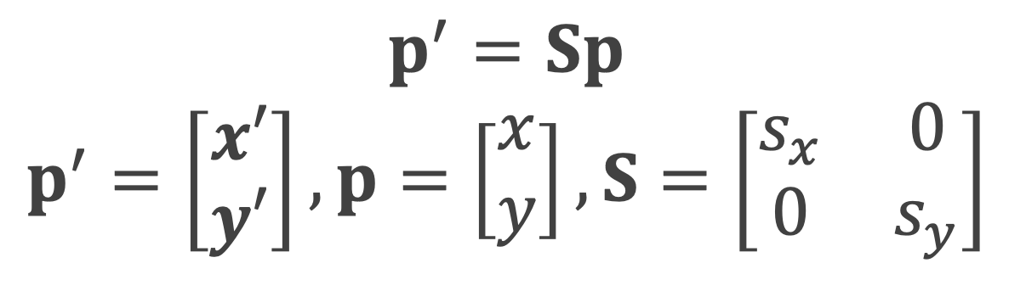
2D Scaling
Alter the size of an object
Multiply object positions (x, y) by scaling factors sx, sy
Matrix equation
Uniform scaling: $s_{x}=s_{y}$
Differential scaling: $s_{x}≠s_{y}$
$$p^{′}=Sp \\ p^{′}=\left[\begin{matrix}x′ \\ y′\end{matrix}\right], p=\left[\begin{matrix}x \\ y\end{matrix}\right], S=\left[\begin{matrix}s_{x} & 0 \\ 0 & s_{y}\end{matrix}\right]$$

Slide 14
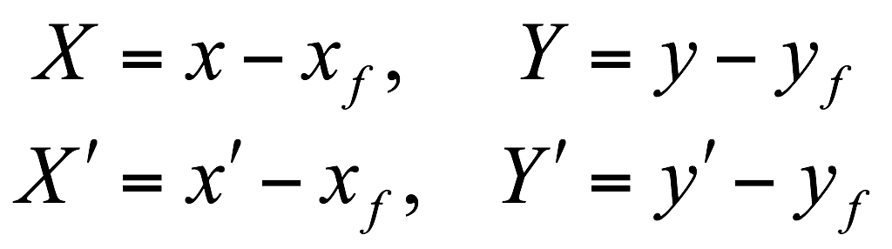
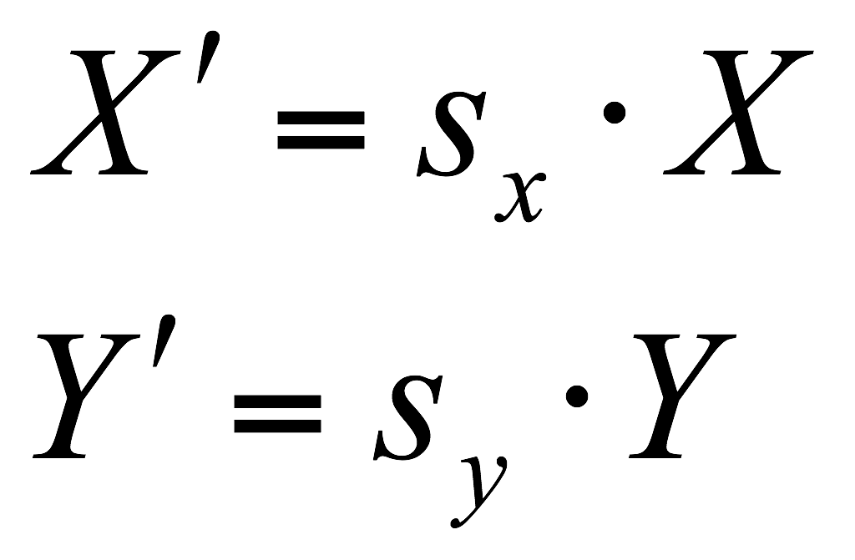
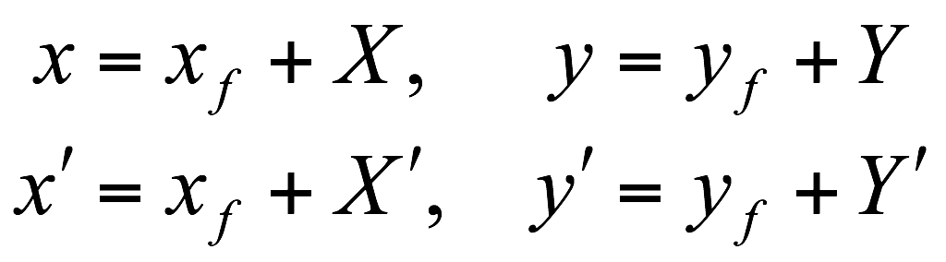
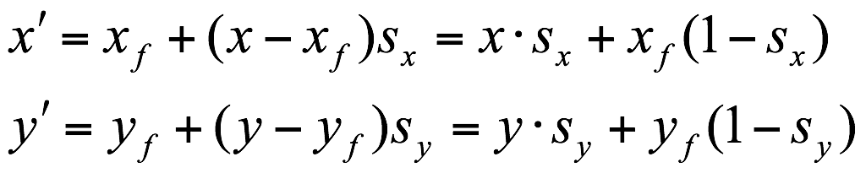

2D Scaling
Scaling relative to a scaling fixed point (xf, yf)
(x′, y′)
(x′, y′)
(x, y)
(x, y)
(x_{f}, y_{f})
(x′, y′)
(x_{f}, y_{f})
(0, 0)
(x, y)
$$p^{′}=Sp+t$$

Slide 15


Matrix Representation
Each of the basic transformation can be expressed in the general matrix form
M: 2 by 2 matrix containing multiplicative factors
translation: identity matrix
t : vector containing translational terms
rotation: pivot point
scaling: scaling fixed point
If we can eliminate the matrix addition, we can obtain final coordinate positions directly from initial coordinates
$$p^{′}=Mp+t$$
$$p^{′}=T_{n}∙⋯∙T_{2}∙T_{1}∙p=T∙p$$

Slide 16
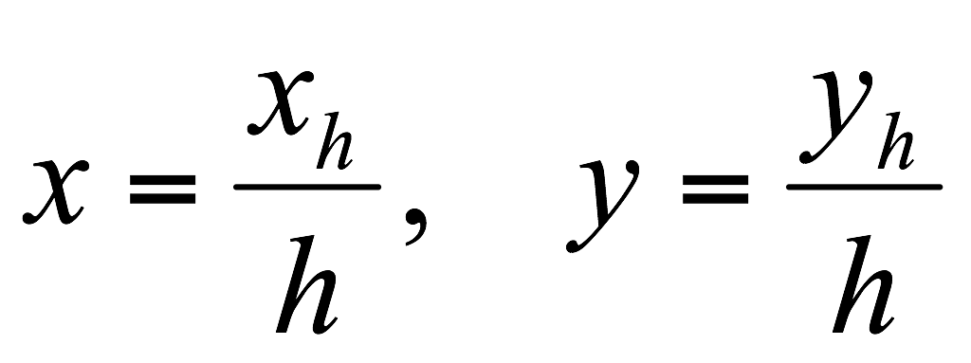
Homogeneous Coordinates
Used for combining multiplicative and translational terms for 2D geometric transformation into a single matrix
Expand 2D coordinate position (x, y) to a three-element column representation (x_{h}, y_{h}, h), where the homogeneous parameter h is a nonzero
For geometric transformation, we can choose h to be any nonzero value
a conventional choice is simply to set h = 1
Each 2D position (Cartesian coordinates) is represented with homogeneous coordinates (x, y, 1)

Slide 17

Homogeneous Coordinates
(x, y, h) represents a point at location $\left(\frac{x}{h},\frac{y}{h}\right)$
usually h = 1 (augmented vector)
(2, 1, 1) = (4, 2, 2) = (6, 3, 3)
origin case (0, 0, 1)
(x, y, 0) represents a point at infinity
(0, 0, 0) is not allowed

Slide 18
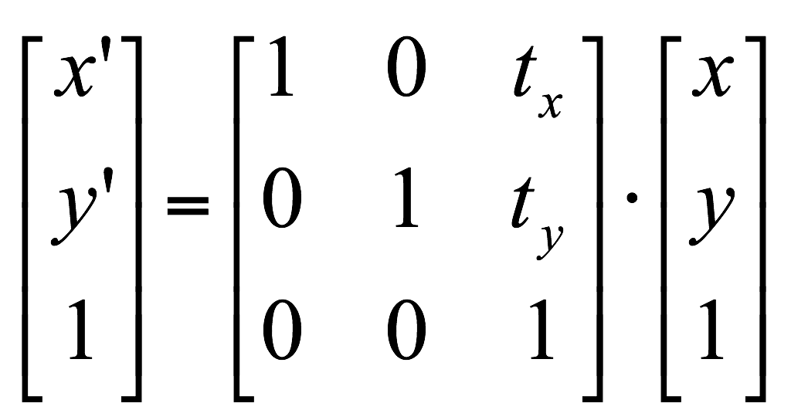
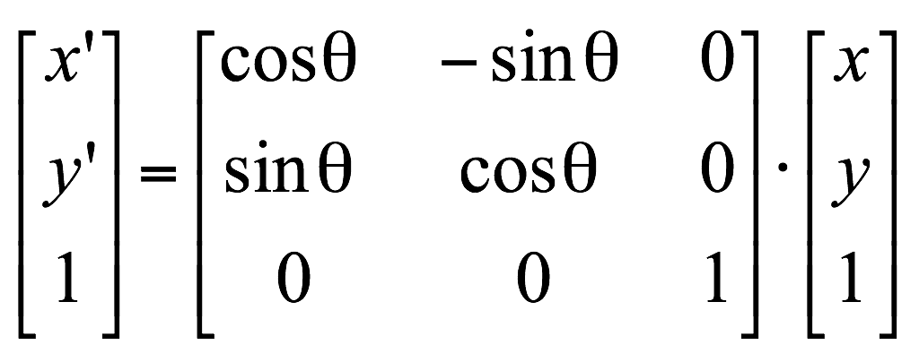
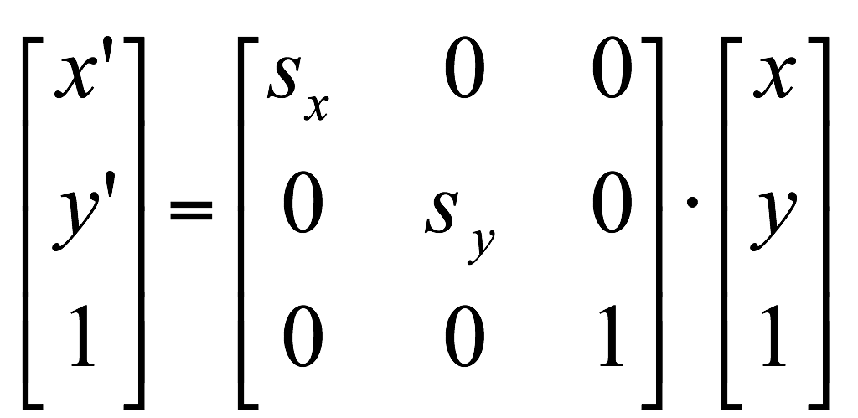



Matrix Equations Using Homogeneous Coordinates
Translation
Rotation
Scaling
$$p^{′}=T(t_{x}, t_{y})∙p$$
$$p^{′}=R(θ)∙p$$
$$p^{′}=S(s_{x}, s_{y})∙p$$

Slide 19
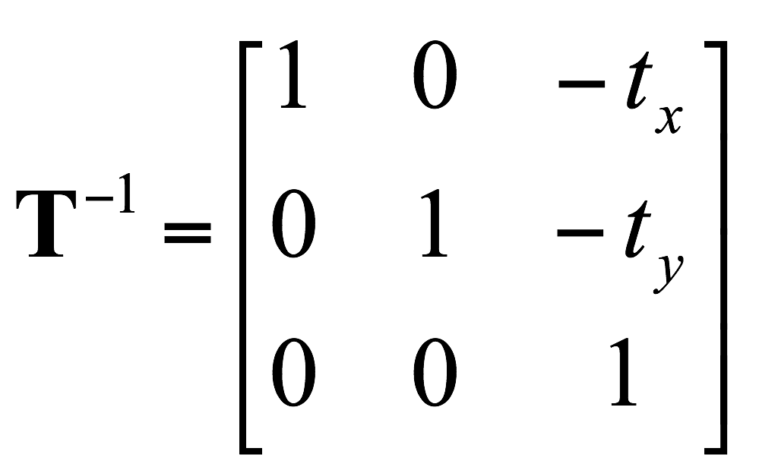
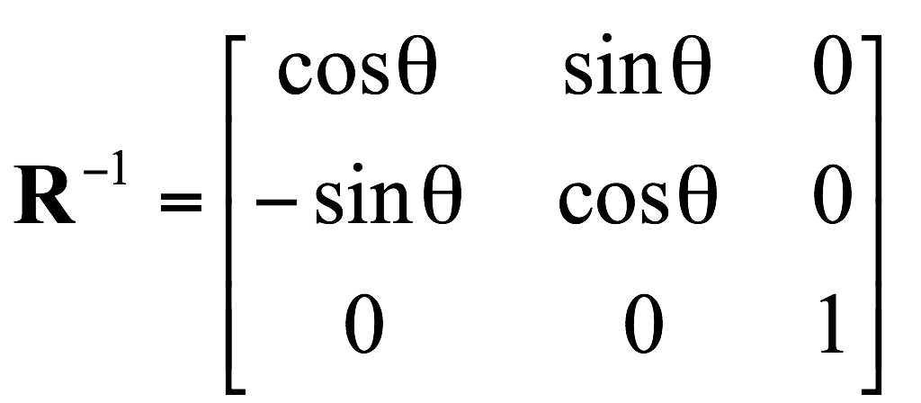
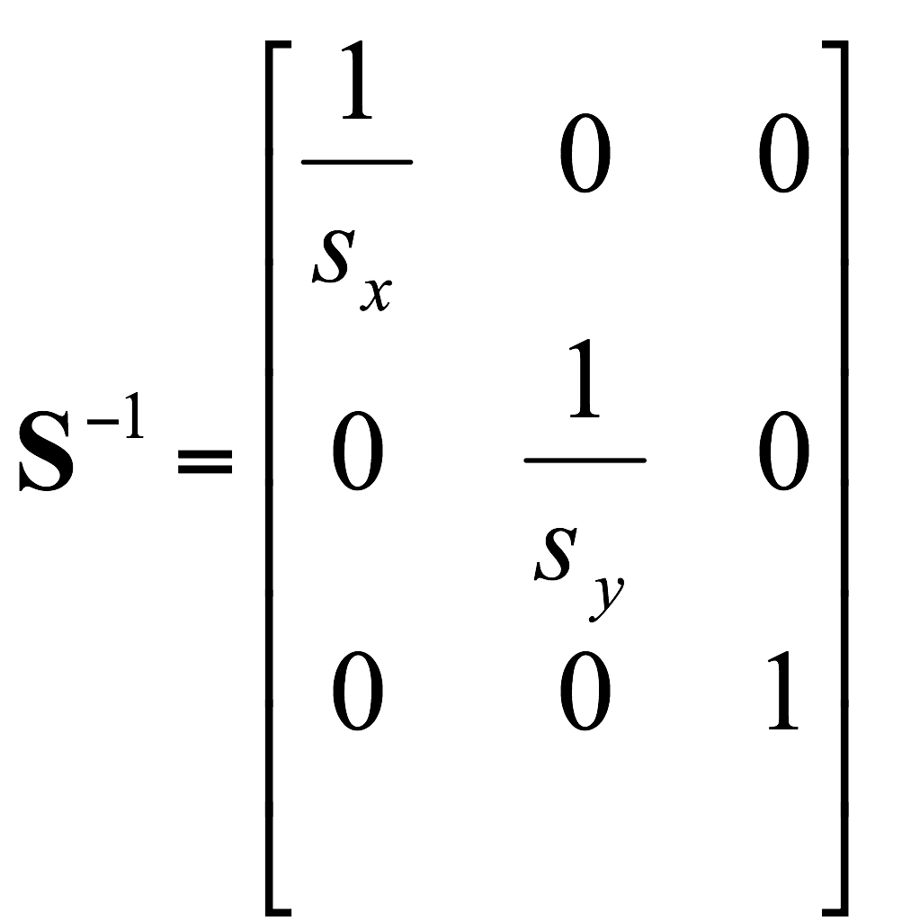
Inverse Transformations
Translation
negating the translation distances
Rotation
replacing the rotation angle by its negative
Scaling
replacing the scaling parameters with their reciprocals

Slide 20
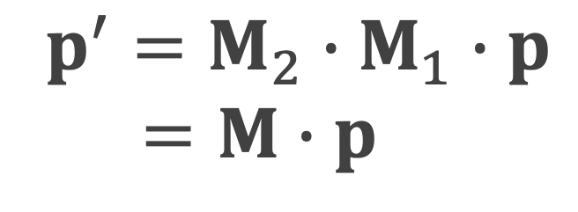
2D Composite Transformations
Composite transformation matrix
a matrix for any sequence of transformations
the product of the individual transformations
Concatenation, or composition of matrices
forming products of transformation matrices
by multiplying matrices in order from right to left
More efficient to first multiply the transformation matrices to form a single composite matrix
$$p^{′}=M_{2}∙M_{1}∙p \\ =M∙p$$

Slide 21
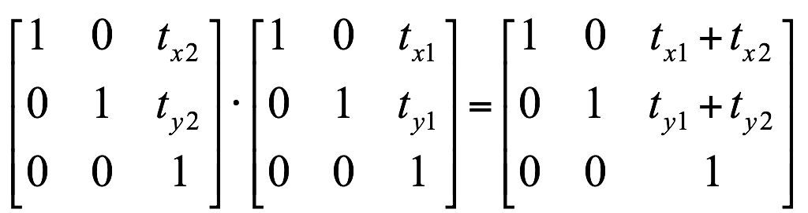
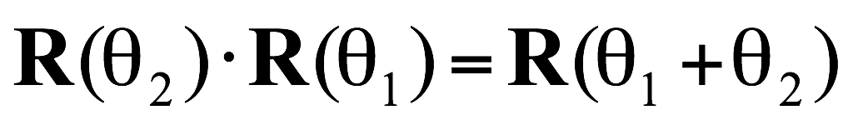
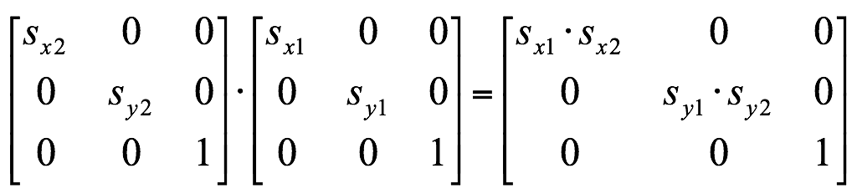
2D Composite Transformations
Composite 2D translations
Composite 2D rotations
Composite 2D scalings

Slide 22
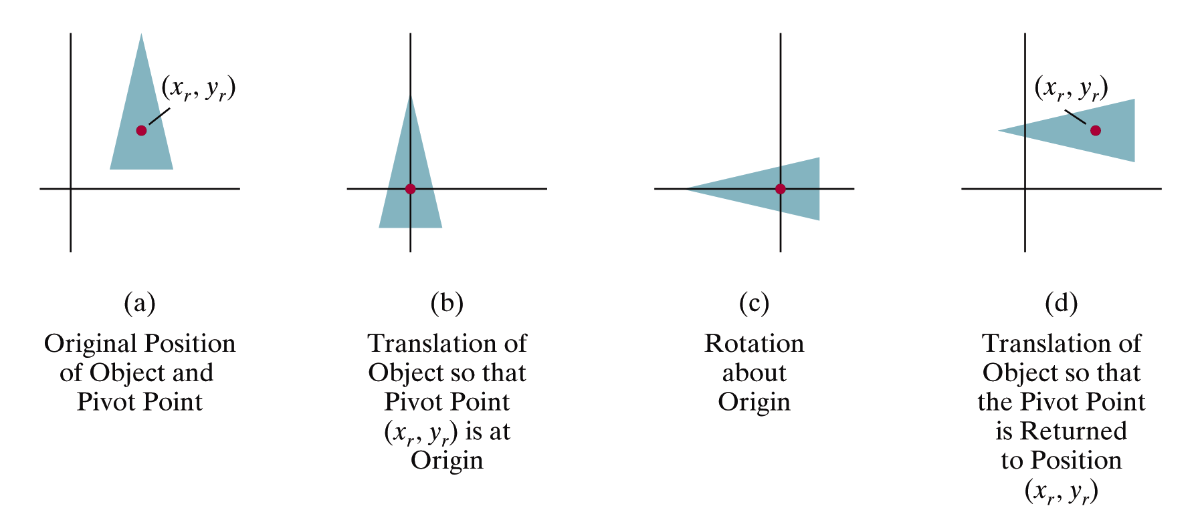
General 2D Pivot-Point Rotation

Slide 23
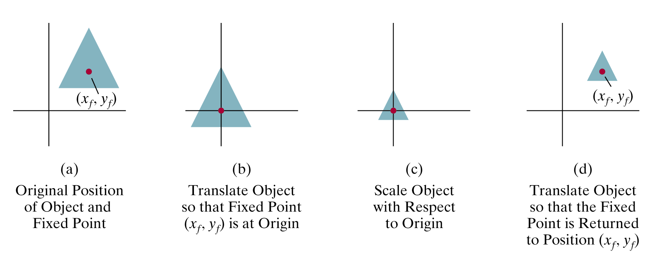
General 2D Pivot-Point Scaling

Slide 24
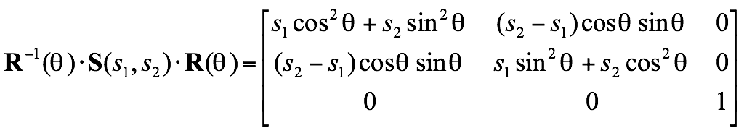

General 2D Scaling Directions
Parameter s_{x} and s_{y} scale objects along the x and y directions
Scale an object along desired scaling directions
rotating the object to align the desired scaling directions with the coordinate axes before applying the scaling transformations
y
s₂
y
y
(2, 2)
= 45°
s₁=1
s₂=2
(1/2, 3/2)
(0, 1)
(1, 1)
x
(0, 0)
(3/2, 1/2)
s₁
(0, 0)
(1, 0)
x
x

Slide 25
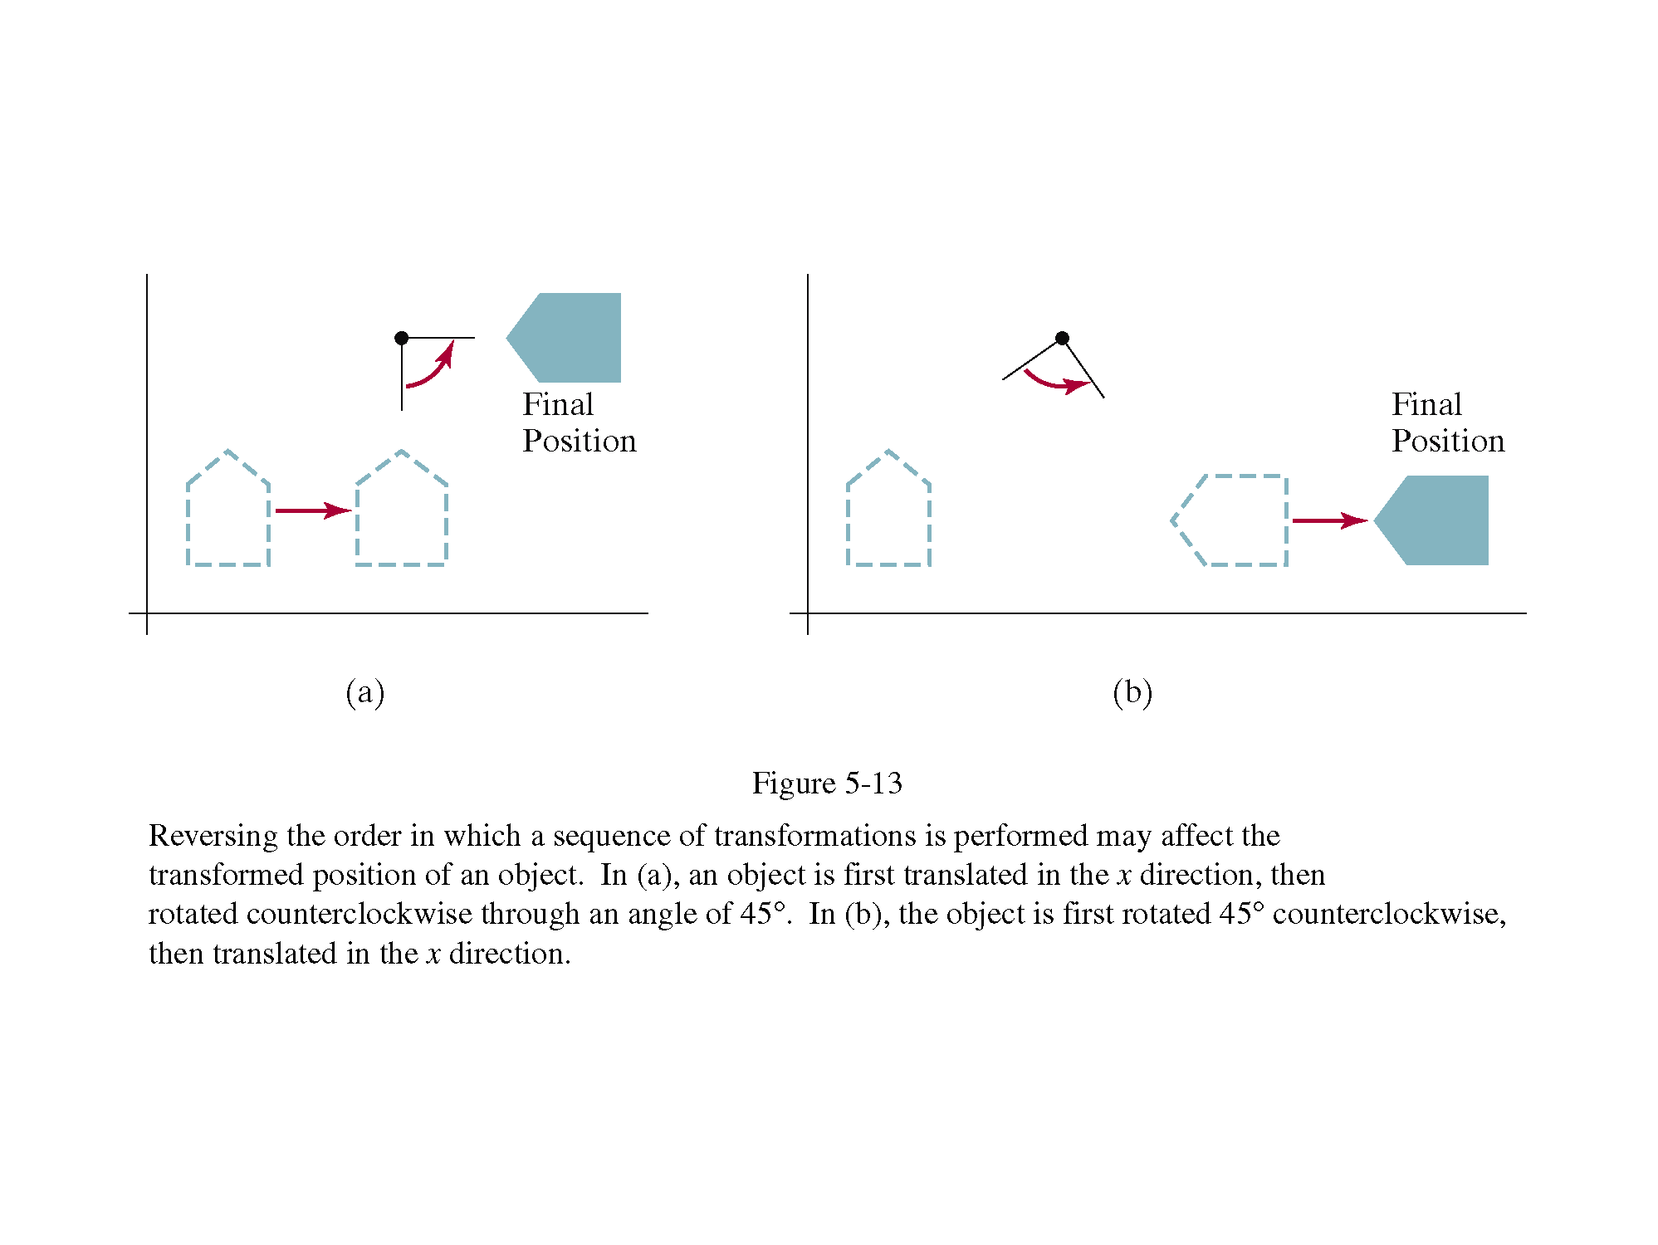
Matrix Concatenation Properties
Associative
A∙B∙C = (A∙B)∙C = A∙(B∙C)
But, may not be commutative
A∙B ≠ B∙A
must be careful about the order in which the composite matrix is evaluated
for special case, commutative
two successive rotation, scaling and translation
rotation and uniform scaling

Slide 26
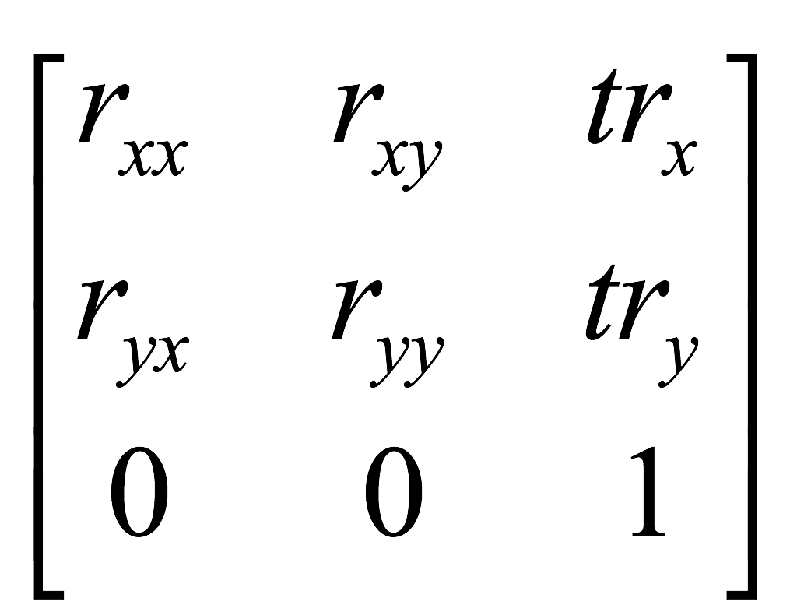
2D Rigid-Body Transformation
All angles and distances between coordinate positions are unchanged by the transformation
Rigid-body transformation matrix
a transformation matrix includes only translation and rotation parameters

Slide 27
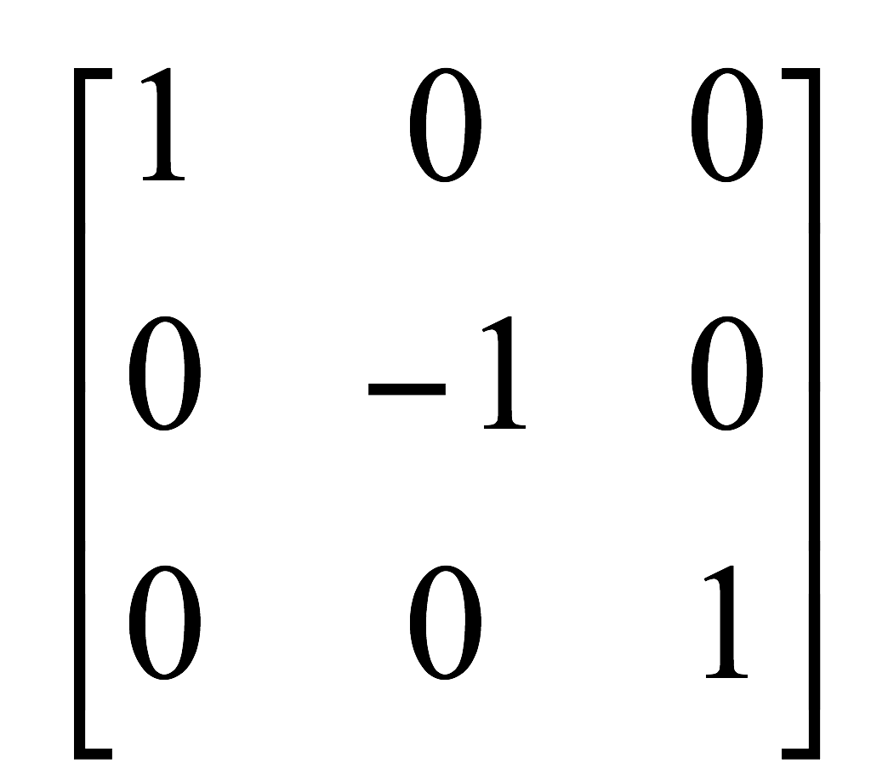
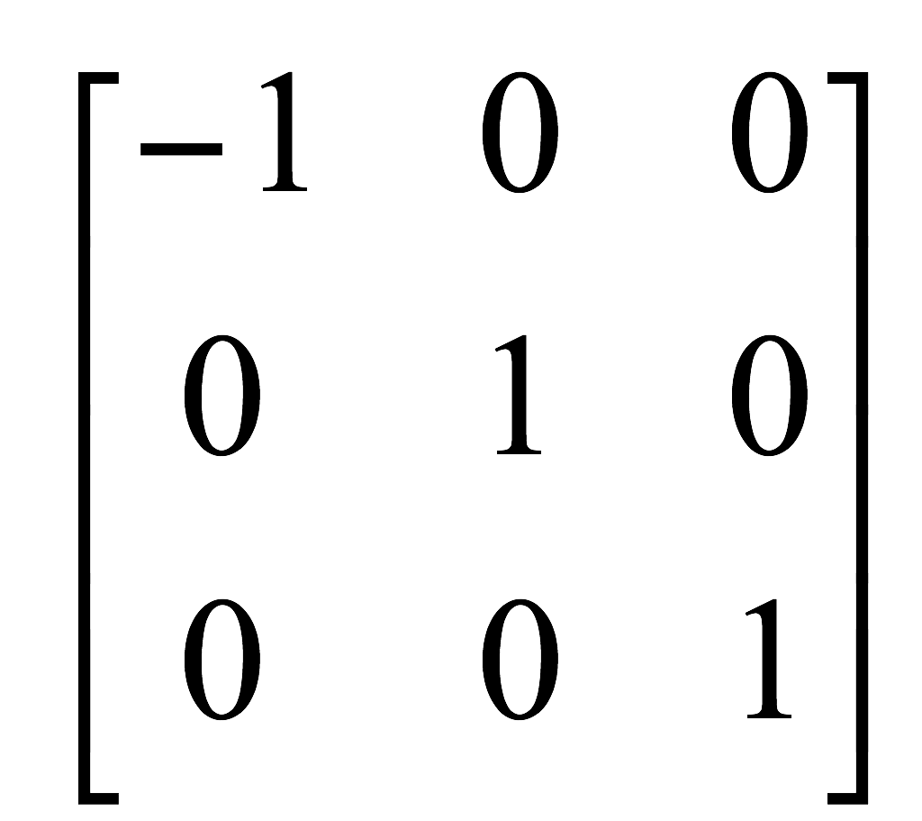
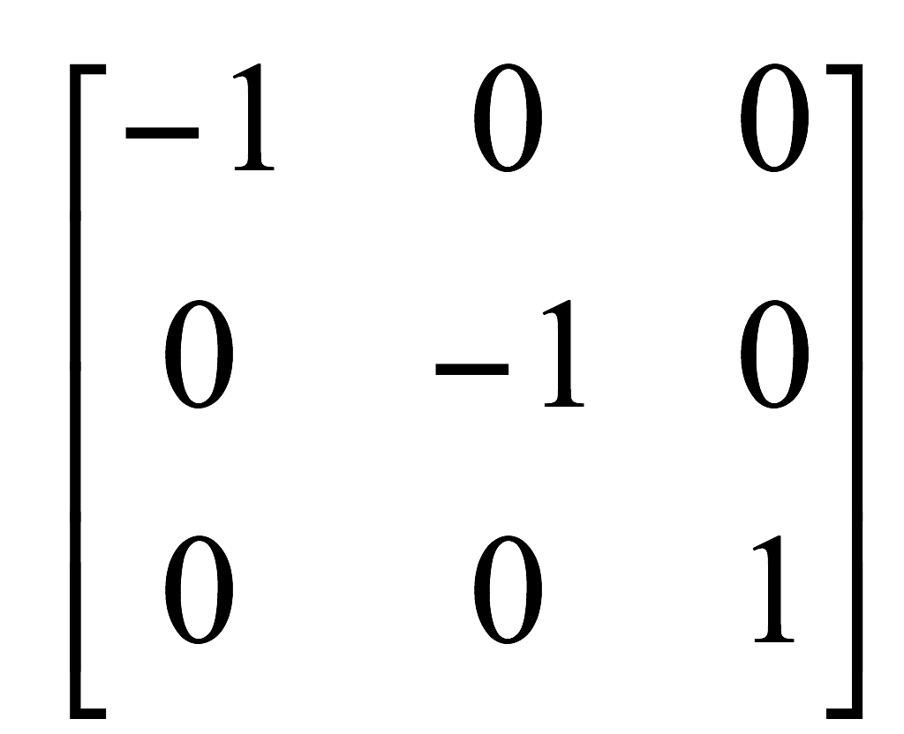
Other 2D Transformations: Reflection
Transformation that produces a mirror image of an object
Reflection about the line y = 0 (x-axis)
Reflection about the line x = 0 (y-axis)
Reflection relative to the coordinate origin
y
x
y
x
y
x

Slide 28
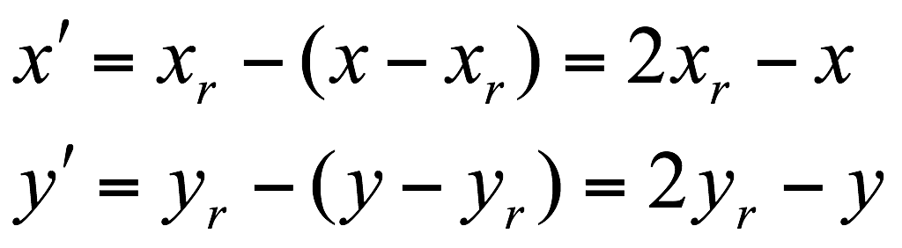
Other 2D Transformations
Reflection to any reflection point
the same as a 180° rotation in the xy plane about the reflection point
y
(x_{r}, y_{r})
x

Slide 29
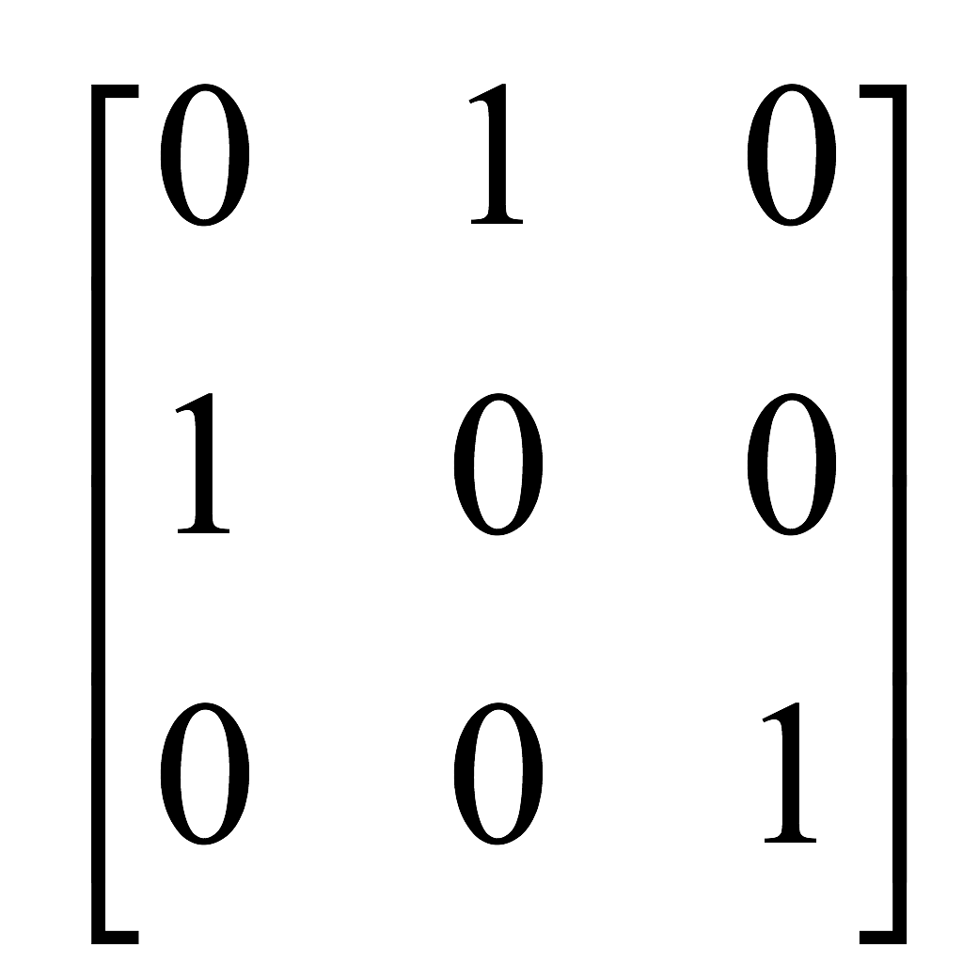
Other 2D Transformations
Reflection about the line y = x
concatenating a sequence of rotation and coordinate axis reflection matrices
clockwise rotation with respect to the origin through a 45° angle, which rotates the line y = x onto the x-axis
a reflection with respect to the x-axis
counterclockwise rotation with respect to the origin through a 45° angle, which rotates the line y = x back to its original position
y
y = x
y
y
y = x
x
x
x

Slide 30

Other 2D Transformations
Reflection about the line y = mx + b
translate the line so that it passes through the origin
rotate the line onto one of the coordinate axes and reflect about that axis
restore the line to its original position with the inverse rotation and translation transformations

Slide 31


Other 2D Transformations: Shear
Transformation that distorts the shape of an object such that the transformed shape appears as if the object were composed of internal layers that had been caused to slide over each other
x-direction shear relative to the x-axis
y
y
(2, 1)
(3, 1)
(0, 1)
(1, 1)
x
x
(0, 0)
(1, 0)
(0, 0)
(1, 0)

Slide 32




Other 2D Transformations: Shear
x-direction shears relative to the line y = y_{ref}
y-direction shears relative to the line x = x_{ref}
y
y
(1, 1)
(2, 1)
(0, 1)
(1, 1)
x
x
(0, 0)
(1, 0)
(1/2, 0)
(3/2, 0)
y
y
(1, 2)
(0, 3/2)
(0, 1)
(1, 1)
(1, 1)
x
(0, 1/2)
x
(0, 0)
(1, 0)

Slide 33



Transformations between 2D Coordinate Systems
Transformation of object description from xy coordinates to x′y′ coordinates
translate so that the origin (x₀, y₀) of the x′y′ system is moved to the origin (0, 0) of the xy system
rotate the x′ axis onto the x-axis
y
y′
y
x′
y′
x′
x
x

Slide 34



Transformations between 2D Coordinate Systems
Alternative method
describe the orientation of the x′y′ coordinate system by specifying a vector V that indicates the direction for the positive y′-axis
convert V to the unit vector v
obtain the unit vector u along the x′-axis by applying a 90° clockwise rotation to vector v
y
y′
V
x′
x

Slide 35
Questions?

