Slide 1
9. Rasterization
Computer Graphics

Slide 2
Objectives
Survey Line Drawing Algorithms
DDA
Bresenham
Scan-line Algorithm
Anti-aliasing

Slide 3
Rasterization
Rasterization (scan conversion)
Determine which pixels that are inside primitive specified by a set of vertices
Produces a set of fragments
Fragments have a location (pixel location) and other attributes such color and texture coordinates (output of vertex shader) that are determined by interpolating values at vertices
All output values of the vertex shader are interpolated

Slide 4
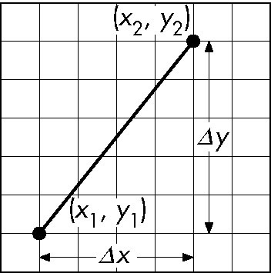
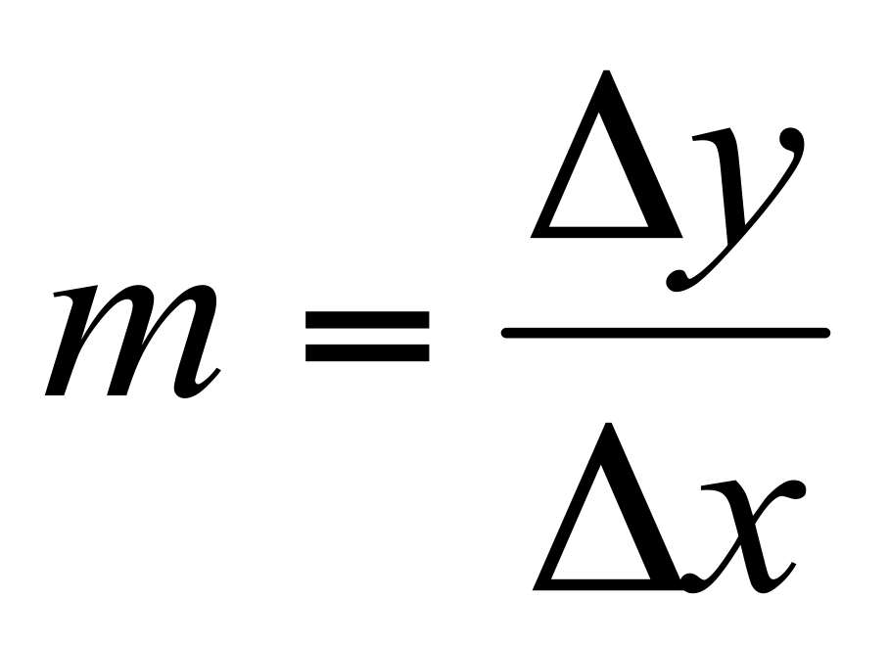
Scan Conversion of Line Segments
Start with line segment in window coordinates with integer values for endpoints
Assume implementation has a write_pixel function
y = mx + h

Slide 5

DDA Algorithm
Digital Differential Analyzer
DDA was a mechanical device for numerical solution of differential equations
Line $y=mx+h$ satisfies differential equation
$\frac{dy}{dx} = m =\frac{Δy}{Δx} =\frac{y2−y1}{x2−x1}$
Along scan line Δx = 1
float y = y1;
for(x=x1; x<=x2,ix++) {
y+=m;
write_pixel(x, round(y), line_color)
}

Slide 6
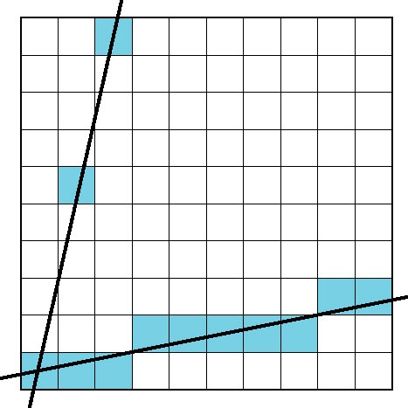
Problem
DDA = for each x plot pixel at closest y
Problems for steep lines

Slide 7
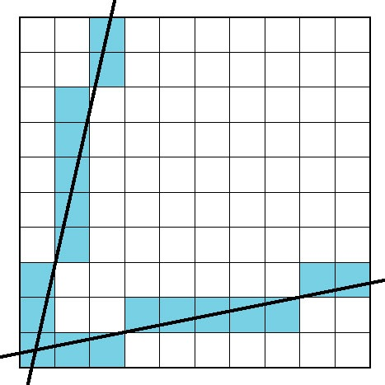
Using Symmetry
Use for 1 ≥ m ≥ 0
For m > 1, swap role of x and y
For each y, plot closest x

Slide 8
Bresenham’s Algorithm
DDA requires one floating point addition per step
We can eliminate all fp through Bresenham’s algorithm
Consider only 1 ≥ m ≥ 0
Other cases by symmetry
Assume pixel centers are at half integers
If we start at a pixel that has been written, there are only two candidates for the next pixel to be written into the frame buffer

Slide 9
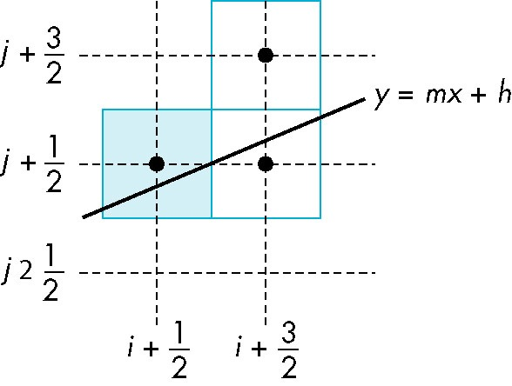
Candidate Pixels
1 ≥ m ≥ 0
candidates
last pixel
Note that line could have
passed through any
part of this pixel

Slide 10
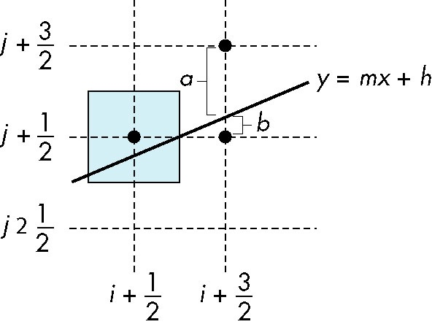
Decision Variable
d = Δx(b-a)
d is an integer
d > 0 use upper pixel
d < 0 use lower pixel

Slide 11
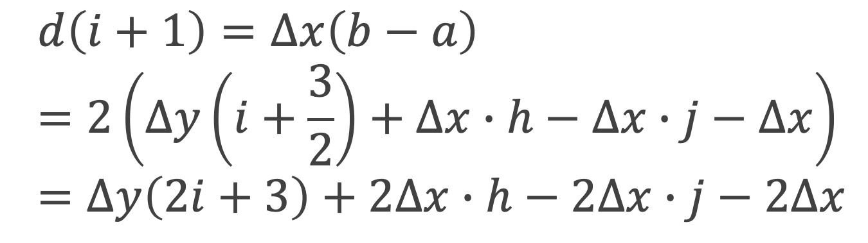
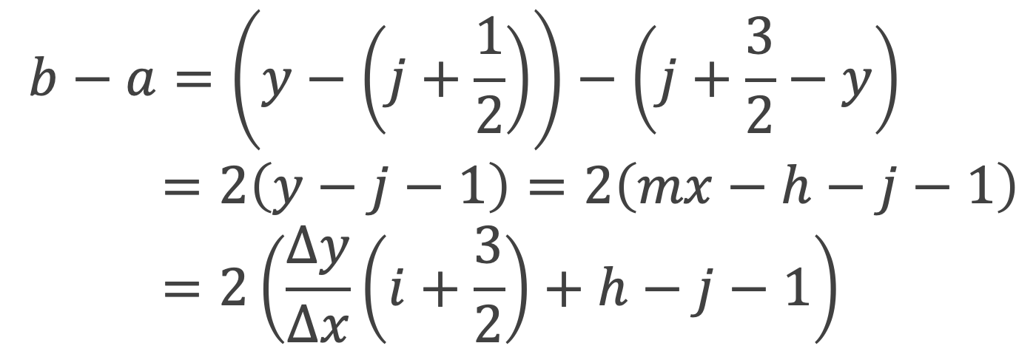
Decision Variable
$$b−a=\left(y−\left(j+\frac{1}{2}\right)\right)−\left(j+\frac{3}{2}−y\right) \\ =2\left(y−j−1\right)=2\left(mx−h−j−1\right) \\ =2\left(\frac{∆y}{∆x}\left(i+\frac{3}{2}\right)+h−j−1\right)$$
$$d\left(i+1\right)=∆x\left(b−a\right)=2\left(∆y\left(i+\frac{3}{2}\right)+∆x∙h−∆x∙j−∆x\right)=∆y\left(2i+3\right)+2∆x∙h−2∆x∙j−2∆x$$

Slide 12
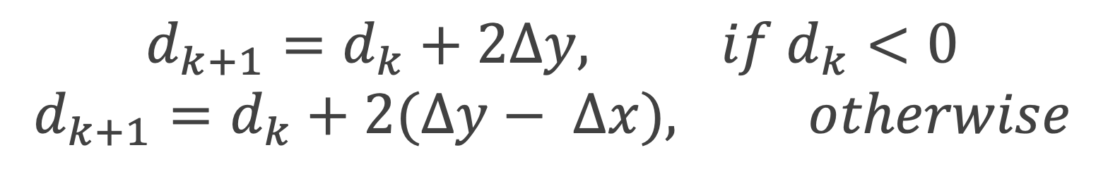
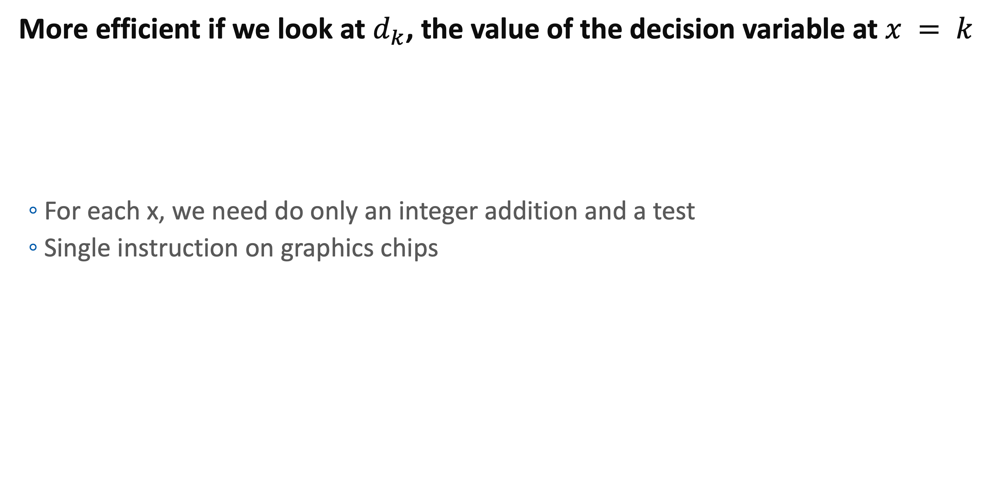
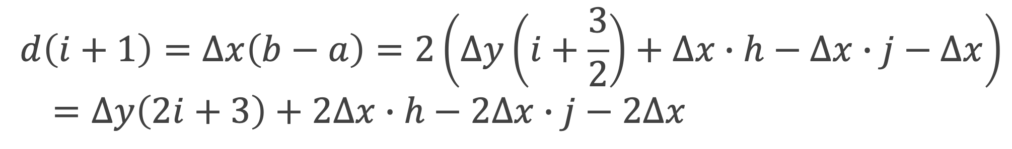
Incremental Form
More efficient if we look at $d_{k}$, the value of the decision variable at $x = k$
For each x, we need do only an integer addition and a test
Single instruction on graphics chips
$$d_{k+1}=d_{k}+2Δy, if d_{k}<0$$
$$d_{k+1}=d_{k}+2(Δy− Δx), otherwise$$
$$d\left(i+1\right)=∆x\left(b−a\right)=2\left(∆y\left(i+\frac{3}{2}\right)+∆x∙h−∆x∙j−∆x\right) \\ =∆y\left(2i+3\right)+2∆x∙h−2∆x∙j−2∆x$$

Slide 13
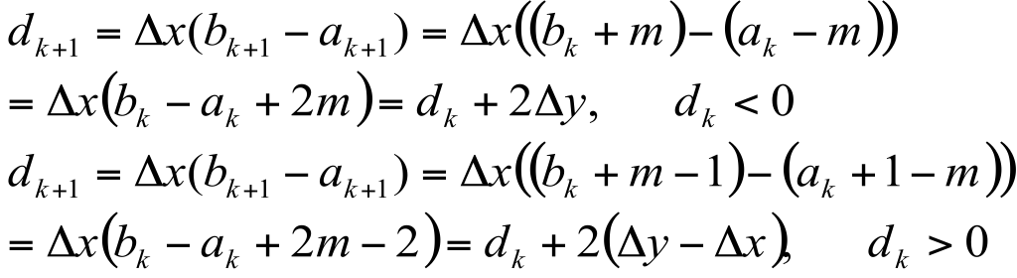
Decision Variable

Slide 14
Incremental Form
a
m
b
a
m
b

Slide 15

Polygon Scan Conversion
Scan Conversion = Fill
How to tell inside from outside
Convex: easy
Non-simple: difficult
Odd even test
Count edge crossings
Winding number
odd-even fill

Slide 16
Winding Number
Count clockwise encirclements of point
Alternate definition of inside: inside if winding number ≠ 0
winding number = 1
winding number = 2

Slide 17
Filling in the Frame Buffer
Fill at end of pipeline
Convex Polygons only
Nonconvex polygons assumed to have been tessellated
Shades (colors) have been computed for vertices (Gouraud shading)
Combine with z-buffer algorithm
March across scan lines interpolating shades
Incremental work small

Slide 18
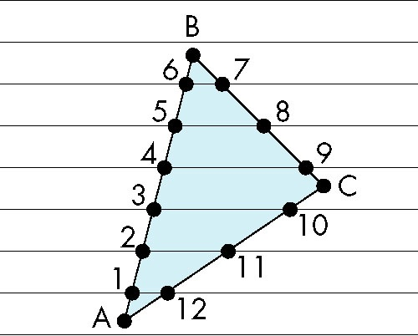
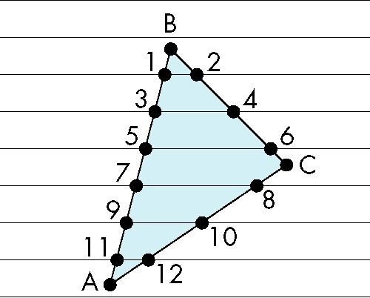
Scan Line Fill
Can also fill by maintaining a data structure of all intersections of polygons with scan lines
Sort by scan line
Fill each span
vertex order generated
by vertex list
desired order

Slide 19
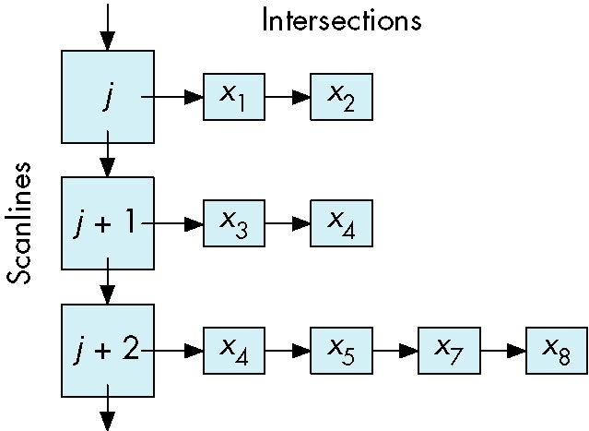
Data Structure

Slide 20
Using Interpolation
A1 A2 A3 are values of output A of vertex shader
A4 determined by interpolating between A1 and A2
A5 determined by interpolating between A2 and A3
interpolate between A4 and A5 along span
C1
C2
scan line
C4
C5
span
C3

Slide 21
In OpenGL
Vertex shader output
Computed from vertex attributes and uniform
ex) out vec3 normal;
out vec2 texCoord;
Interpolated value is as input of fragment shader
ex) in vec3 normal;
in vec2 texCoord;
Notes
Output and input must match.
Okay to have un-used output.

Slide 22
Flood Fill
Fill can be done recursively if we know a seed point located inside (WHITE)
Scan convert edges into buffer in edge/inside color (BLACK)
flood_fill(int x, int y) {
if(read_pixel(x,y)= = WHITE) {
write_pixel(x,y,BLACK);
flood_fill(x-1, y);
flood_fill(x+1, y);
flood_fill(x, y+1);
flood_fill(x, y-1);
} }

Slide 23
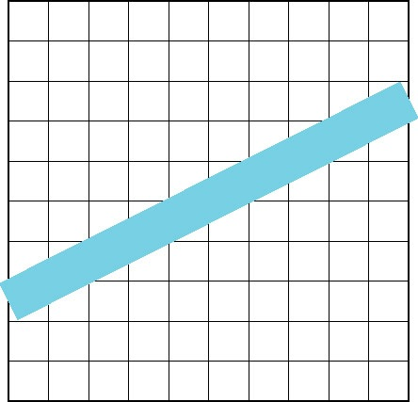
Aliasing
Ideal rasterized line should be 1 pixel wide
Choosing best y for each x (or visa versa) produces aliased raster lines

Slide 24
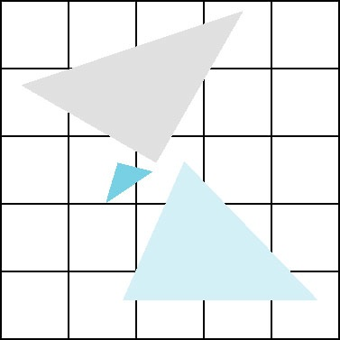
Polygon Aliasing
Aliasing problems can be serious for polygons
Jaggedness of edges
Small polygons neglected
Need compositing so color
of one polygon does not
totally determine color of
pixel
All three polygons should contribute to color

Slide 25
Aliasing
Formal definition
Error cause by ”insufficient” sampling
Ex) Nyquist frequency
In image
Number of image sample (pixels) per area is insufficient for viewer’s request
Human eye requires more than 300 dpi in 1 feet distance
Ex) Retina display, Laser printer

Slide 26
Anti-aliasing
Resolving the problem caused by aliasing
Simulating more sampling
Image Limitation
The more samples, the better image
Screen resolution is fixed physically
Anti-aliasing
Generate bigger image
Shrink the bigger image down to the resulting image
or simulating such effect

Slide 27
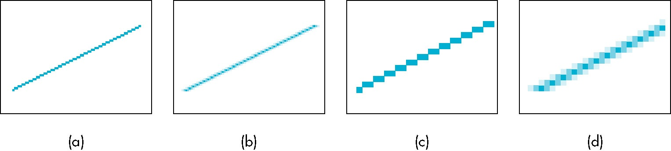
Anti-aliasing by Area Averaging
Computing how much the ideal line covers each pixel
Blend the primitive color with background color according to the coverage
original
antialiased
magnified

Slide 28
Full-Screen Anti-Aliasing
Supersampling
At each pixel, compute the colors at many sample points
Averaging the sample colors
Multisampling
Multi-samples for pixel coverage of a primitive
Benefit
Single sample for color
Very simple for general shapes
In OpenGL (GLFW): glfwWindowHint( GLFW_SAMPLES, 8 );
Before glfwCreateWindow(..)

Slide 29
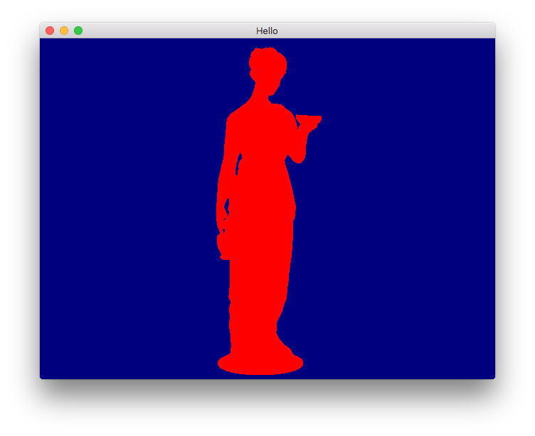

In OpenGL

Slide 30
Question?

