Slide 1
10. Visibility
Computer Graphics

Slide 2
Reading
Hearn & Baker, Chapter 9
Angel, Chapter 5
Watt, Chapter 5

Slide 3
Contents
Visibility
Hidden surface removal
Back-face culling
BSP-tree

Slide 4
Clipping and Visibility
Clipping has much in common with hidden-surface removal
In both cases, we are trying to remove objects that are not visible to the camera
Often we can use visibility or occlusion testing early in the process to eliminate as many polygons as possible before going through the entire pipeline

Slide 5
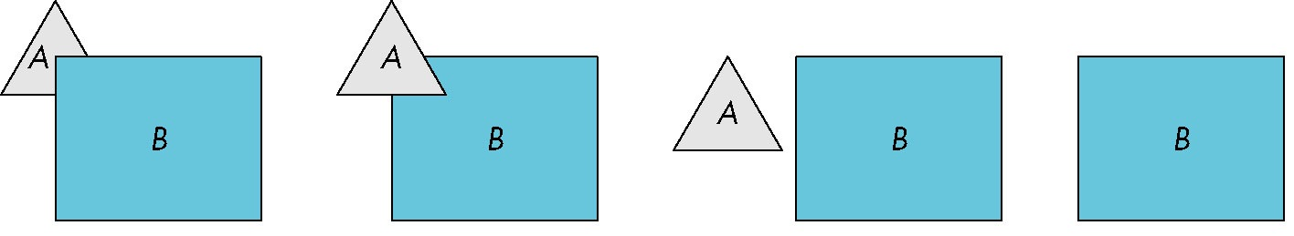

Hidden Surface Removal
Object-space approach: use pairwise testing between polygons (objects)
Worst case complexity $O(n^{2})$ for $n$ polygons
partially obscuring
can draw independently

Slide 6
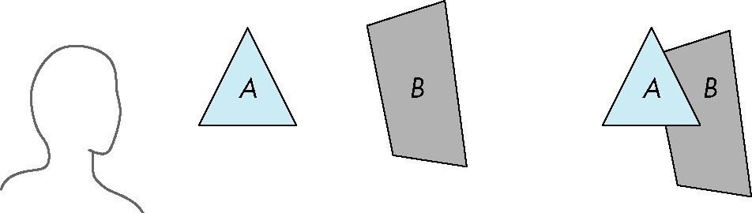
Painter’s Algorithm
Render polygons a back to front order so that polygons behind others are simply painted over
B behind A as seen by viewer
Fill B then A

Slide 7
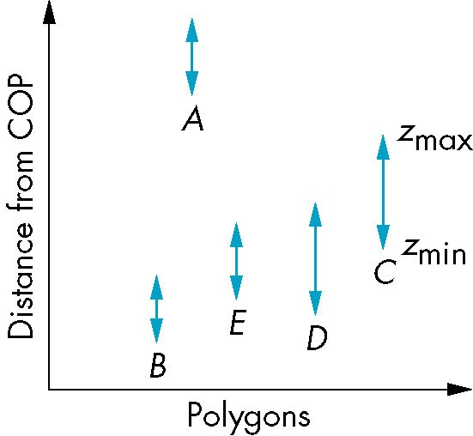
Depth Sort
Requires ordering of polygons first
O(n log n) calculation for ordering
Not every polygon is either in front or behind all other polygons
Order polygons and deal with
easy cases first, harder later
Polygons sorted by
distance from COP

Slide 8
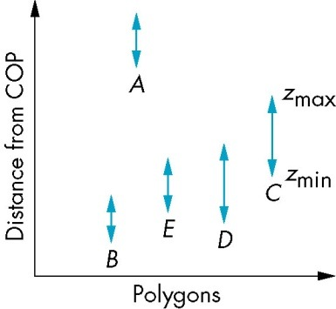
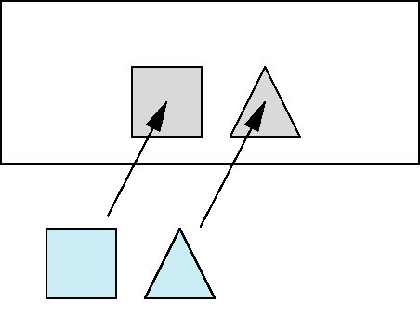
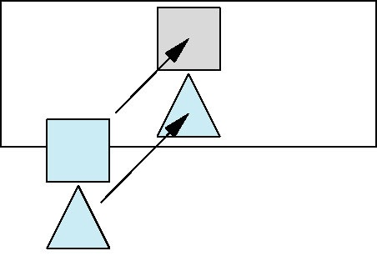
Easy Cases
A lies behind all other polygons
Can render
Polygons overlap in z but not in either x or y
Can render independently

Slide 9
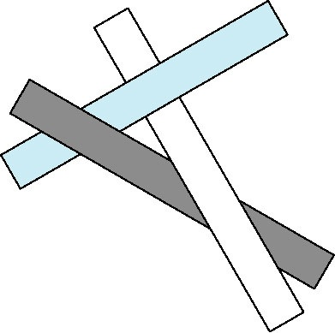
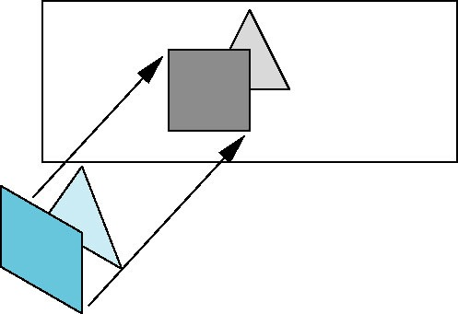
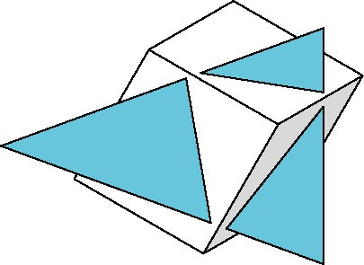
Hard Cases
cyclic overlap
Overlap in all directions
but can one is fully on
one side of the other
penetration

Slide 10
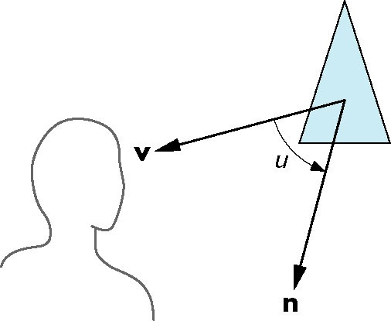
Back-Face Removal (Culling)
face is visible iff 90 ≥ u ≥ -90
equivalently cos u ≥ 0
or v • n ≥ 0
plane of face has form ax + by +cz +d =0
but after normalization v = ( 0 0 1 0)T
need only test the sign of c
In OpenGL we can simply enable culling
but may not work correctly if we have nonconvex objects

Slide 11
In OpenGL
In OpenGL (and other API)
Front & Back face by vertex winding
Enabling face culling
glEnable( GL_CULL_FACE );
Decide which face is being culled
glCullFace( GL_BACK ); // Default
What is back face?
glFrontFace( GL_CCW ); // Default

Slide 12
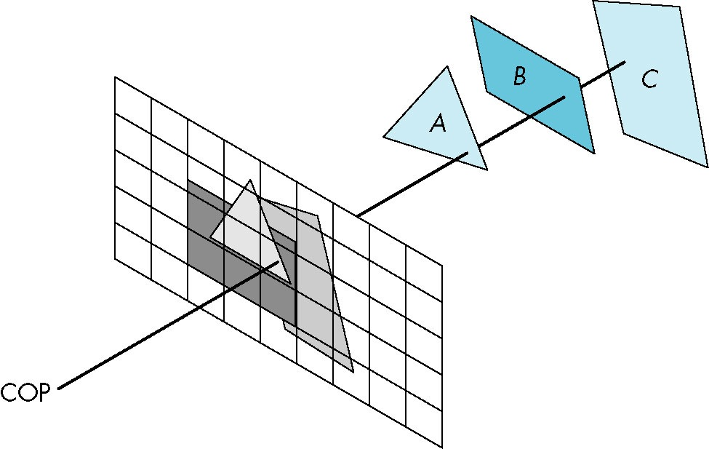

Image Space Approach
Look at each projector (nm for an n x m frame buffer) and find closest of k polygons
Complexity $O(nmk)$
Ray tracing
z-buffer

Slide 13
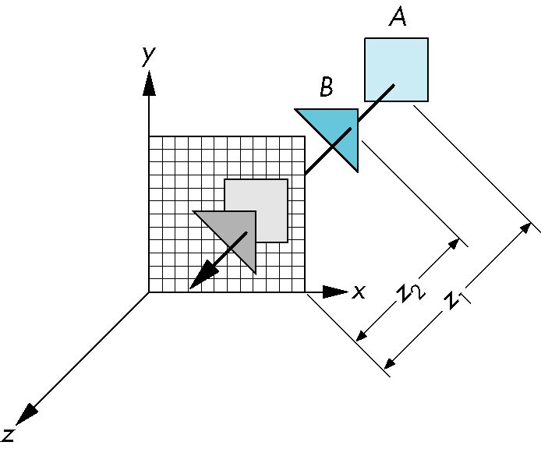
z-Buffer Algorithm
Use a buffer called the z or depth buffer to store the depth of the closest object at each pixel found so far
As we render each polygon, compare the depth of each pixel to depth in z buffer
If less, place shade of pixel in color buffer and update z buffer

Slide 14
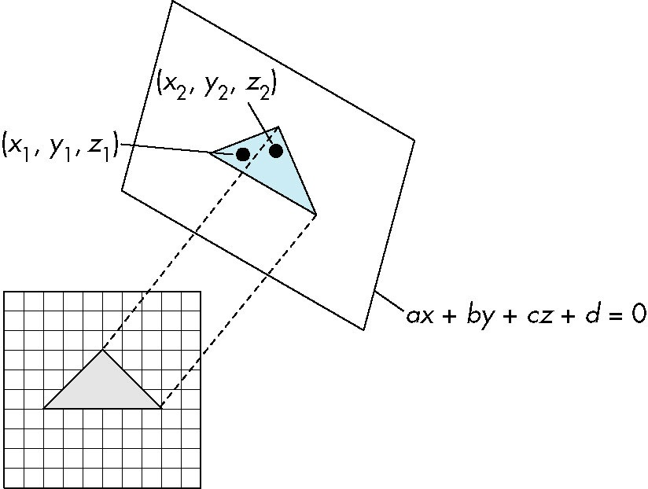

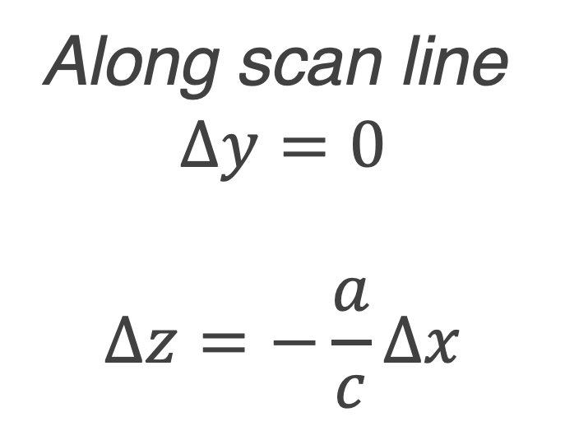
Efficiency
If we work scan line by scan line as we move across a scan line, the depth changes satisfy $aΔx+bΔy+cΔz=0$
Along scan line
$$Δy=0$$
$$Δz=−\frac{a}{c}Δx$$
In screen space Δx = 1

Slide 15
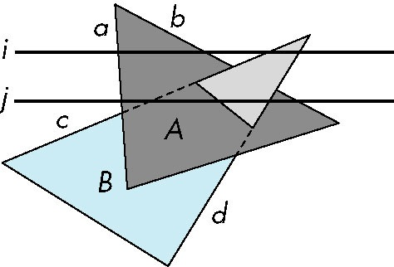
Scan-Line Algorithm
Can combine shading and hsr through scan line algorithm
scan line i: no need for depth
information, can only be in no
or one polygon
scan line j: need depth
information only when in
more than one polygon

Slide 16
Implementation
Need a data structure to store
Flag for each polygon (inside/outside)
Incremental structure for scan lines that stores which edges are encountered
Parameters for planes

Slide 17
In OpenGL
Z-buffer algorithm
In GLFW, z-buffer (depth-buffer) is default
Enabling depth test
glEnable(GL_DEPTH_TEST);
At each frame clear z-buffer
glClear( GL_COLOR_BUFFER_BIT | GL_DEPTH_BUFFER_BIT );

Slide 18
Questions?

