Slide 1
Chapter 17 Linked Lists

Slide 2
17.1 Introduction to the Linked List ADT
A linked list is a series of connected nodes, where each node is a data structure.
A linked list can grow or shrink in size as the program runs

Slide 3
Advantages of Linked Lists over Arrays and vectors
A linked list can easily grow or shrink in size.
Insertion and deletion of nodes is quicker with linked lists than with vectors.

Slide 4

The composition of a Linked List
Each node in a linked list contains one or more members that represent data.
In addition to the data, each node contains a pointer, which can point to another node.

Slide 5
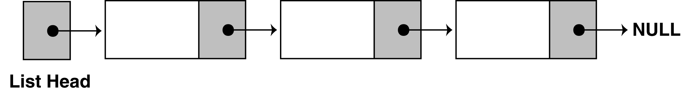
The composition of a Linked List
A linked list is called "linked" because each node in the series has a pointer that points to the next node in the list.

Slide 6
Declarations
First you must declare a data structure that will be used for the nodes. For example, the following struct could be used to create a list where each node holds a float:
struct ListNode
{
float value;
struct ListNode *next;
};

Slide 7
Declarations
The next step is to declare a pointer to serve as the list head, as shown below.
ListNode *head;
Once you have declared a node data structure and have created a NULL head pointer, you have an empty linked list.
The next step is to implement operations with the list.

Slide 8
17.2 Linked List Operations
We will use the following class declaration (on the next slide), which is stored in FloatList.h.

Slide 9
class FloatList
{
private:
// Declare a structure for the list
struct ListNode
{
float value;
struct ListNode *next;
};
ListNode *head; // List head pointer
public:
FloatList(void) // Constructor
{ head = NULL; }
~FloatList(void); // Destructor
void appendNode(float);
void insertNode(float);
void deleteNode(float);
void displayList(void);
};

Slide 10
Appending a Node to the List
To append a node to a linked list means to add the node to the end of the list.
The pseudocode is shown below. The C++ code follows.
Create a new node.
Store data in the new node.
If there are no nodes in the list
Make the new node the first node.
Else
Traverse the List to Find the last node.
Add the new node to the end of the list.
End If.

Slide 11
void FloatList::appendNode(float num)
{
ListNode *newNode, *nodePtr;
// Allocate a new node & store num
newNode = new ListNode;
newNode->value = num;
newNode->next = NULL;
// If there are no nodes in the list
// make newNode the first node
if (!head)
head = newNode;
else // Otherwise, insert newNode at end
{
// Initialize nodePtr to head of list
nodePtr = head;
// Find the last node in the list
while (nodePtr->next)
nodePtr = nodePtr->next;
// Insert newNode as the last node
nodePtr->next = newNode;
}
}

Slide 12
Program 17-1
// This program demonstrates a simple append
// operation on a linked list.
#include <iostream.h>
#include "FloatList.h”
void main(void)
{
FloatList List;
list.appendNode(2.5);
list.appendNode(7.9);
list.appendNode(12.6);
}
(This program displays no output.)

Slide 13
Stepping Through the Program
The head pointer is declared as a global variable. head is automatically initialized to 0 (NULL), which indicates that the list is empty.
The first call to appendNode passes 2.5 as the argument. In the following statements, a new node is allocated in memory, 2.5 is copied into its value member, and NULL is assigned to the node's next pointer.

Slide 14
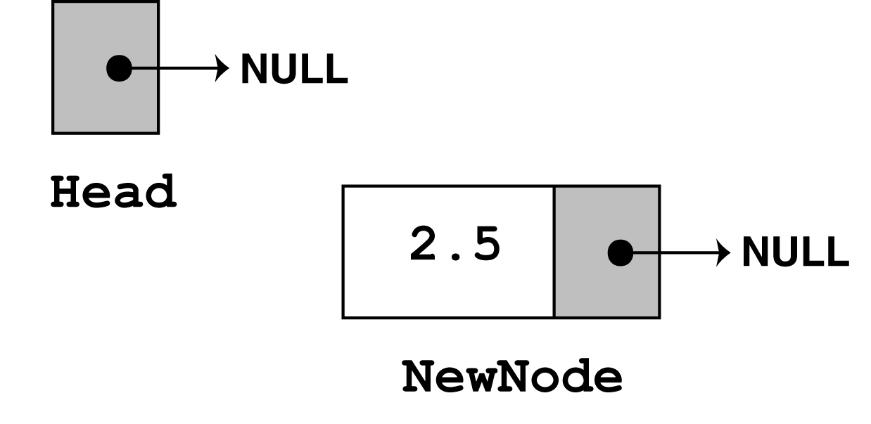
newNode = new ListNode;
newNode->value = num;
newNode->next = nULL;

Slide 15
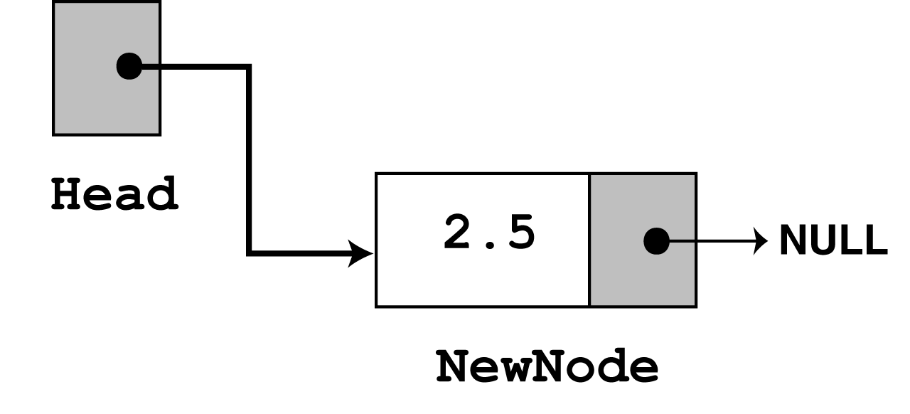
The next statement to execute is the following if statement.
if (!head)
head = newNode;
There are no more statements to execute, so control returns to function main.

Slide 16
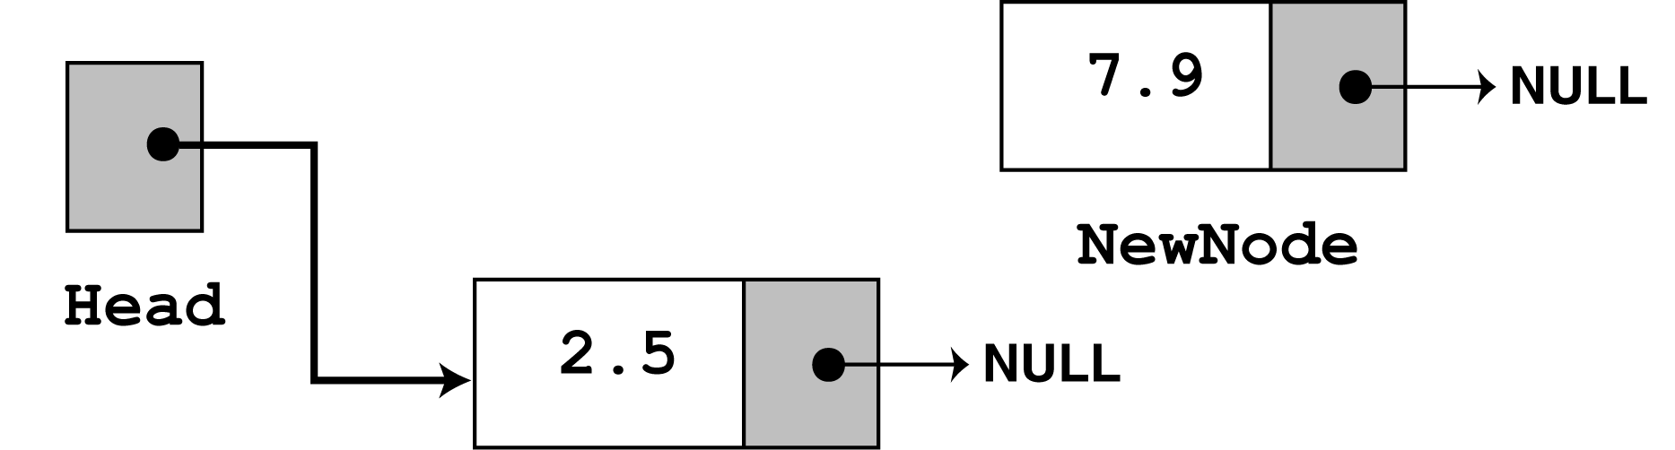
In the second call to appendNode, 7.9 is passed as the argument. Once again, the first three statements in the function create a new node, store the argument in the node's value member, and assign its next pointer to NULL.

Slide 17
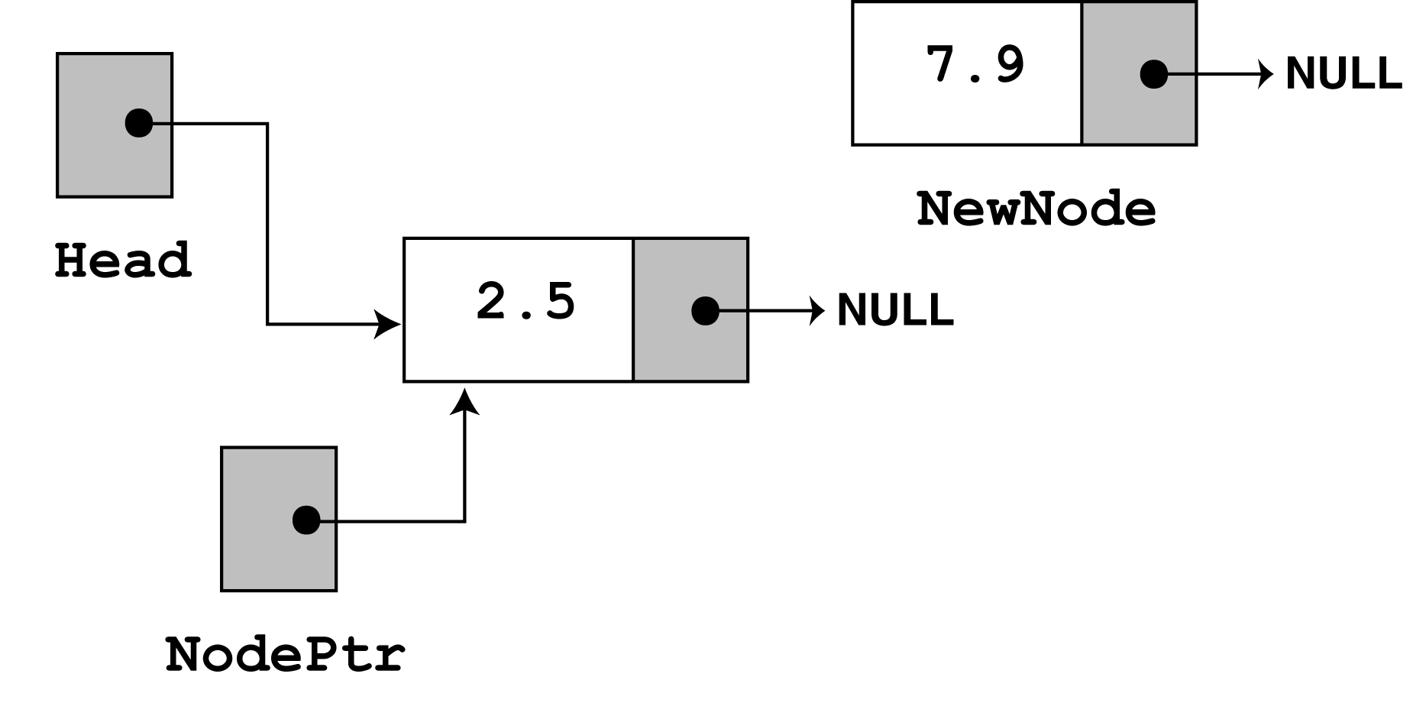
Since head no longer points to NULL, the else part of the if statement executes:
else // Otherwise, insert newNode at end
{
// Initialize nodePtr to head of list
nodePtr = head;
// Find the last node in the list
while (nodePtr->next)
nodePtr = nodePtr->next;
// Insert newNode as the last node
nodePtr->next = newNode;
}

Slide 18
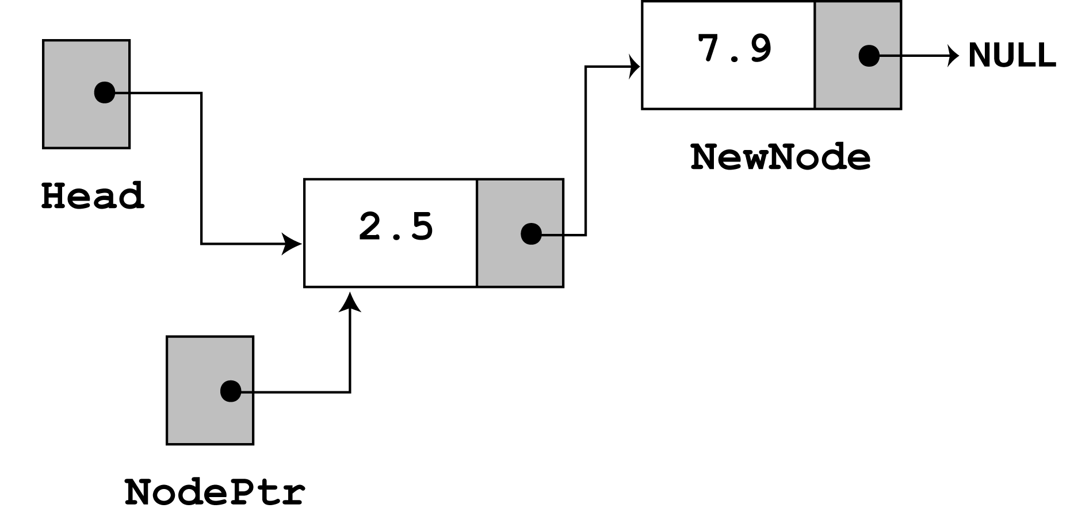
nodePtr is already at the end of the list, so the while loop immediately terminates. The last statement, nodePtr->next = newNode; causes nodePtr->next to point to the new node. This inserts newNode at the end of the list.

Slide 19
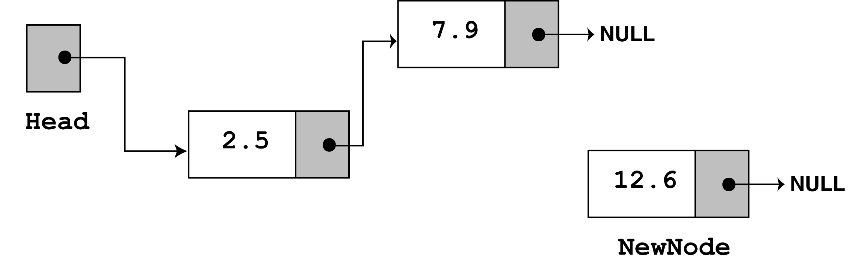
The third time appendNode is called, 12.6 is passed as the argument. Once again, the first three statements create a node with the argument stored in the value member.

Slide 20
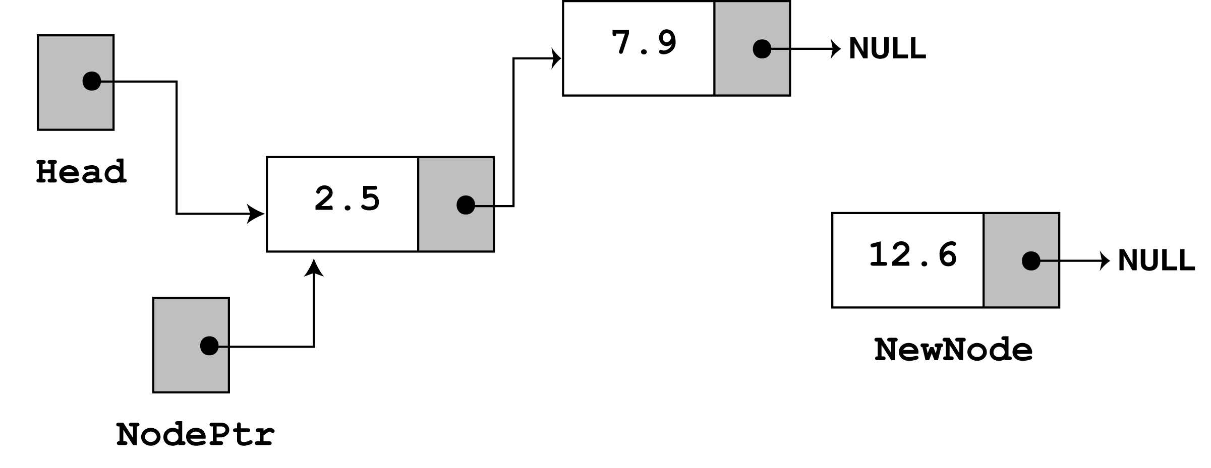
next, the else part of the if statement executes. As before, nodePtr is made to point to the same node as head.

Slide 21
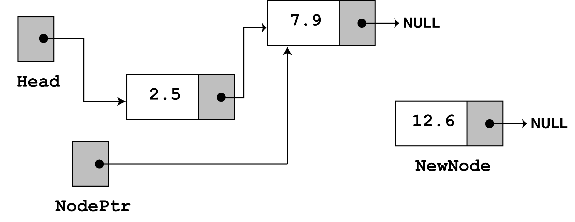
Since nodePtr->next is not NULL, the while loop will execute. After its first iteration, nodePtr will point to the second node in the list.

Slide 22
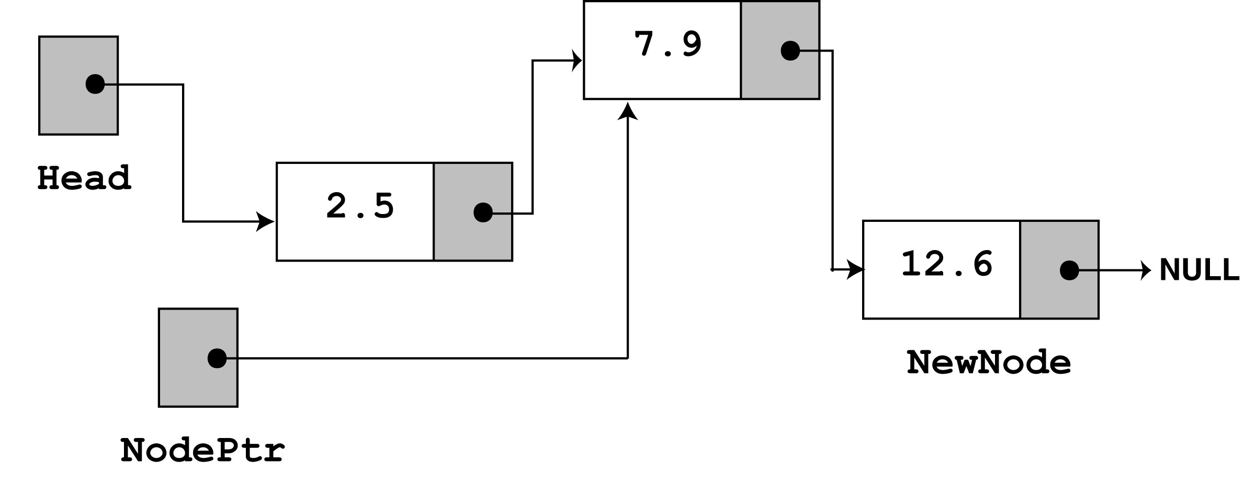
The while loop's conditional test will fail after the first iteration because nodePtr->next now points to NULL. The last statement, nodePtr->next = newNode; causes
nodePtr->next to point to the new node. This inserts newNode at the end of the list
The figure above depicts the final state of the linked list.

Slide 23
Traversing the List
The displayList member function traverses the list, displaying the value member of each node. The following pseudocode represents the algorithm. The C++ code for the member function follows on the next slide.
Assign List head to node pointer.
While node pointer is not NULL
Display the value member of the node pointed to by node pointer.
Assign node pointer to its own next member.
End While.

Slide 24
void FloatList::displayList(void)
{
ListNode *nodePtr;
nodePtr = head;
while (nodePtr)
{
cout << nodePtr->value << endl;
nodePtr = nodePtr->next;
}
}

Slide 25
Program 17-2
// This program calls the displayList member function.
// The funcion traverses the linked list displaying
// the value stored in each node.
#include <iostream.h>
#include "FloatList.h"
void main(void)
{
FloatList List;
list.appendNode(2.5);
list.appendNode(7.9);
list.appendNode(12.6);
list.displayList();
}

Slide 26
Program 17-2 Output
2.5
7.9
12.6

Slide 27
Inserting a Node
Using the listNode structure again, the pseudocode on the next slide shows an algorithm for finding a new node’s proper position in the list and inserting there.
The algorithm assumes the nodes in the list are already in order.

Slide 28
Create a new node.
Store data in the new node.
If there are no nodes in the list
Make the new node the first node.
Else
Find the first node whose value is greater than or equal
the new value, or the end of the list (whichever is first).
Insert the new node before the found node, or at the end of
the list if no node was found.
End If.

Slide 29
The code for the traversal algorithm is shown below. (As before, num holds the value being inserted into the list.)
// Initialize nodePtr to head of list
nodePtr = head;
// Skip all nodes whose value member is less
// than num.
while (nodePtr != NULL && nodePtr->value < num)
{
previousNode = nodePtr;
nodePtr = nodePtr->next;
}
The entire insertNode function begins on the next slide.

Slide 30
void FloatList::insertNode(float num)
{
ListNode *newNode, *nodePtr, *previousNode;
// Allocate a new node & store Num
newNode = new ListNode;
newNode->value = num;
// If there are no nodes in the list
// make newNode the first node
if (!head)
{
head = newNode;
newNode->next = NULL;
}
else // Otherwise, insert newNode.
{
// Initialize nodePtr to head of list
nodePtr = head;
// Skip all nodes whose value member is less
// than num.
while (nodePtr != NULL && nodePtr->value < num)
{
previousNode = nodePtr;
nodePtr = nodePtr->next;
}
Continued on next slide…

Slide 31
Continued from previous slide.
// If the new mode is to be the 1st in the list,
// insert it before all other nodes.
if (previousNode == NULL)
{
head = newNode;
newNode-> = nodePtr;
}
else
{
previousNode->next = newNode;
newNode->next = nodePtr;
}
}
}

Slide 32
Program 17-3
// This program calls the displayList member function.
// The function traverses the linked list displaying
// the value stored in each node.
#include <iostream.h>
#include "FloatList.h”
void main(void)
{
FloatList list;
// Build the list
list.appendNode(2.5);
list.appendNode(7.9);
list.appendNode(12.6);
// Insert a node in the middle
// of the list.
list.insertNode(10.5);
// Dispay the list
list.displayList();
}

Slide 33
Program 17-3 Output
2.5
7.9
10.5
12.6

Slide 34
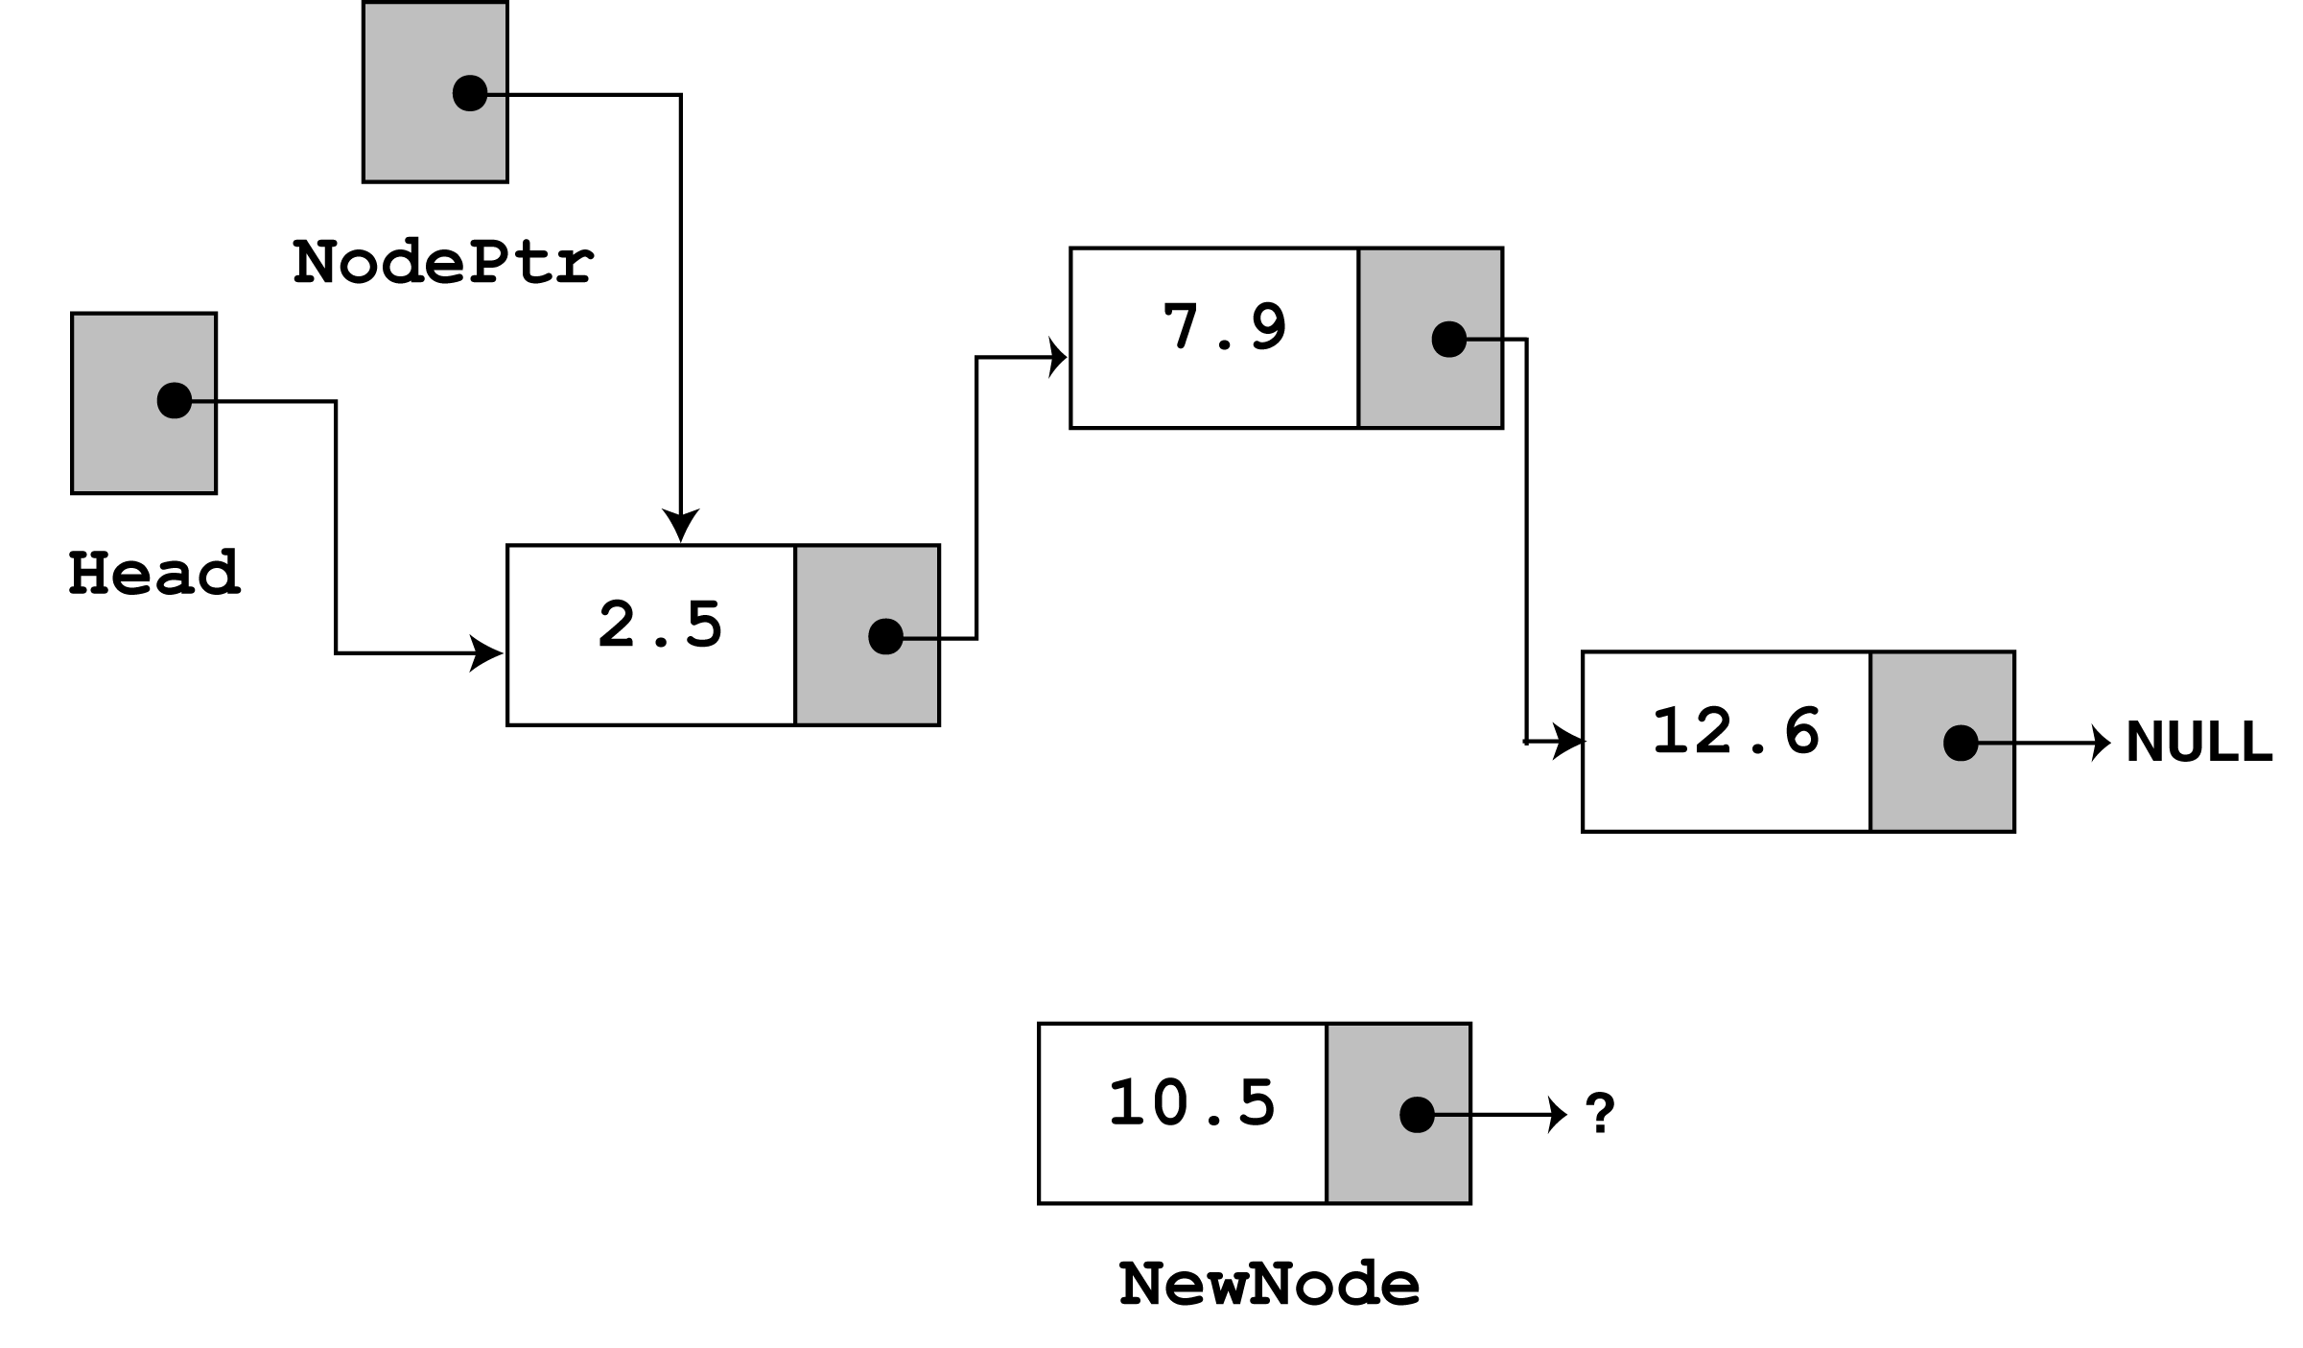
In insertNode, a new node is created and the function argument is copied to its value member. Since the list already has nodes stored in it, the else part of the if statement will execute. It begins by assigning nodePtr to head.

Slide 35
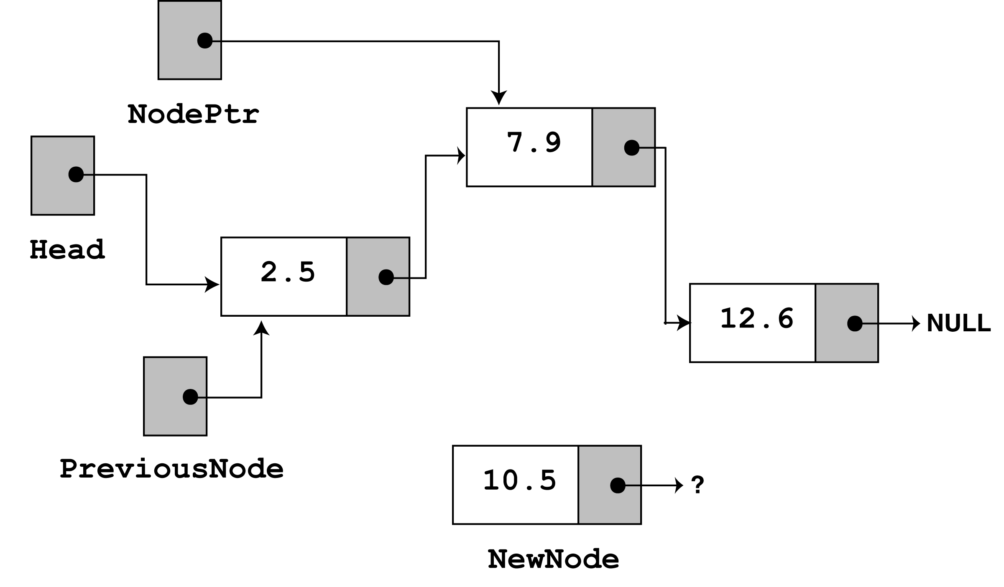
Since nodePtr is not NULL and nodePtr->value is less than num, the while loop will iterate. During the iteration, previousNode will be made to point to the node that nodePtr is pointing to. nodePtr will then be advanced to point to the next node.

Slide 36
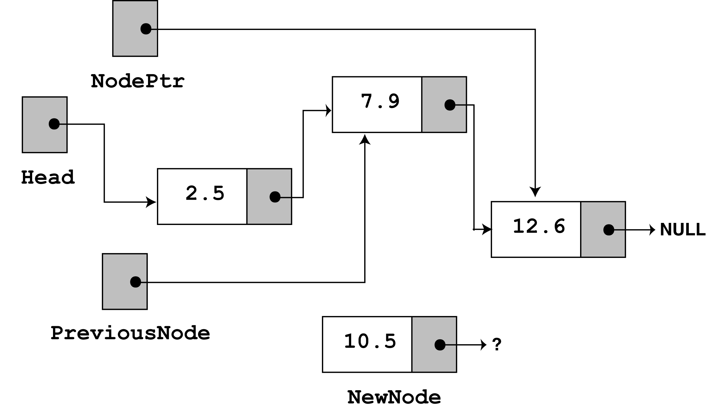
Once again, the loop performs its test. Since nodePtr is not NULL and nodePtr->value is less than num, the loop will iterate a second time. During the second iteration, both previousNode and nodePtr are advanced by one node in the list.

Slide 37
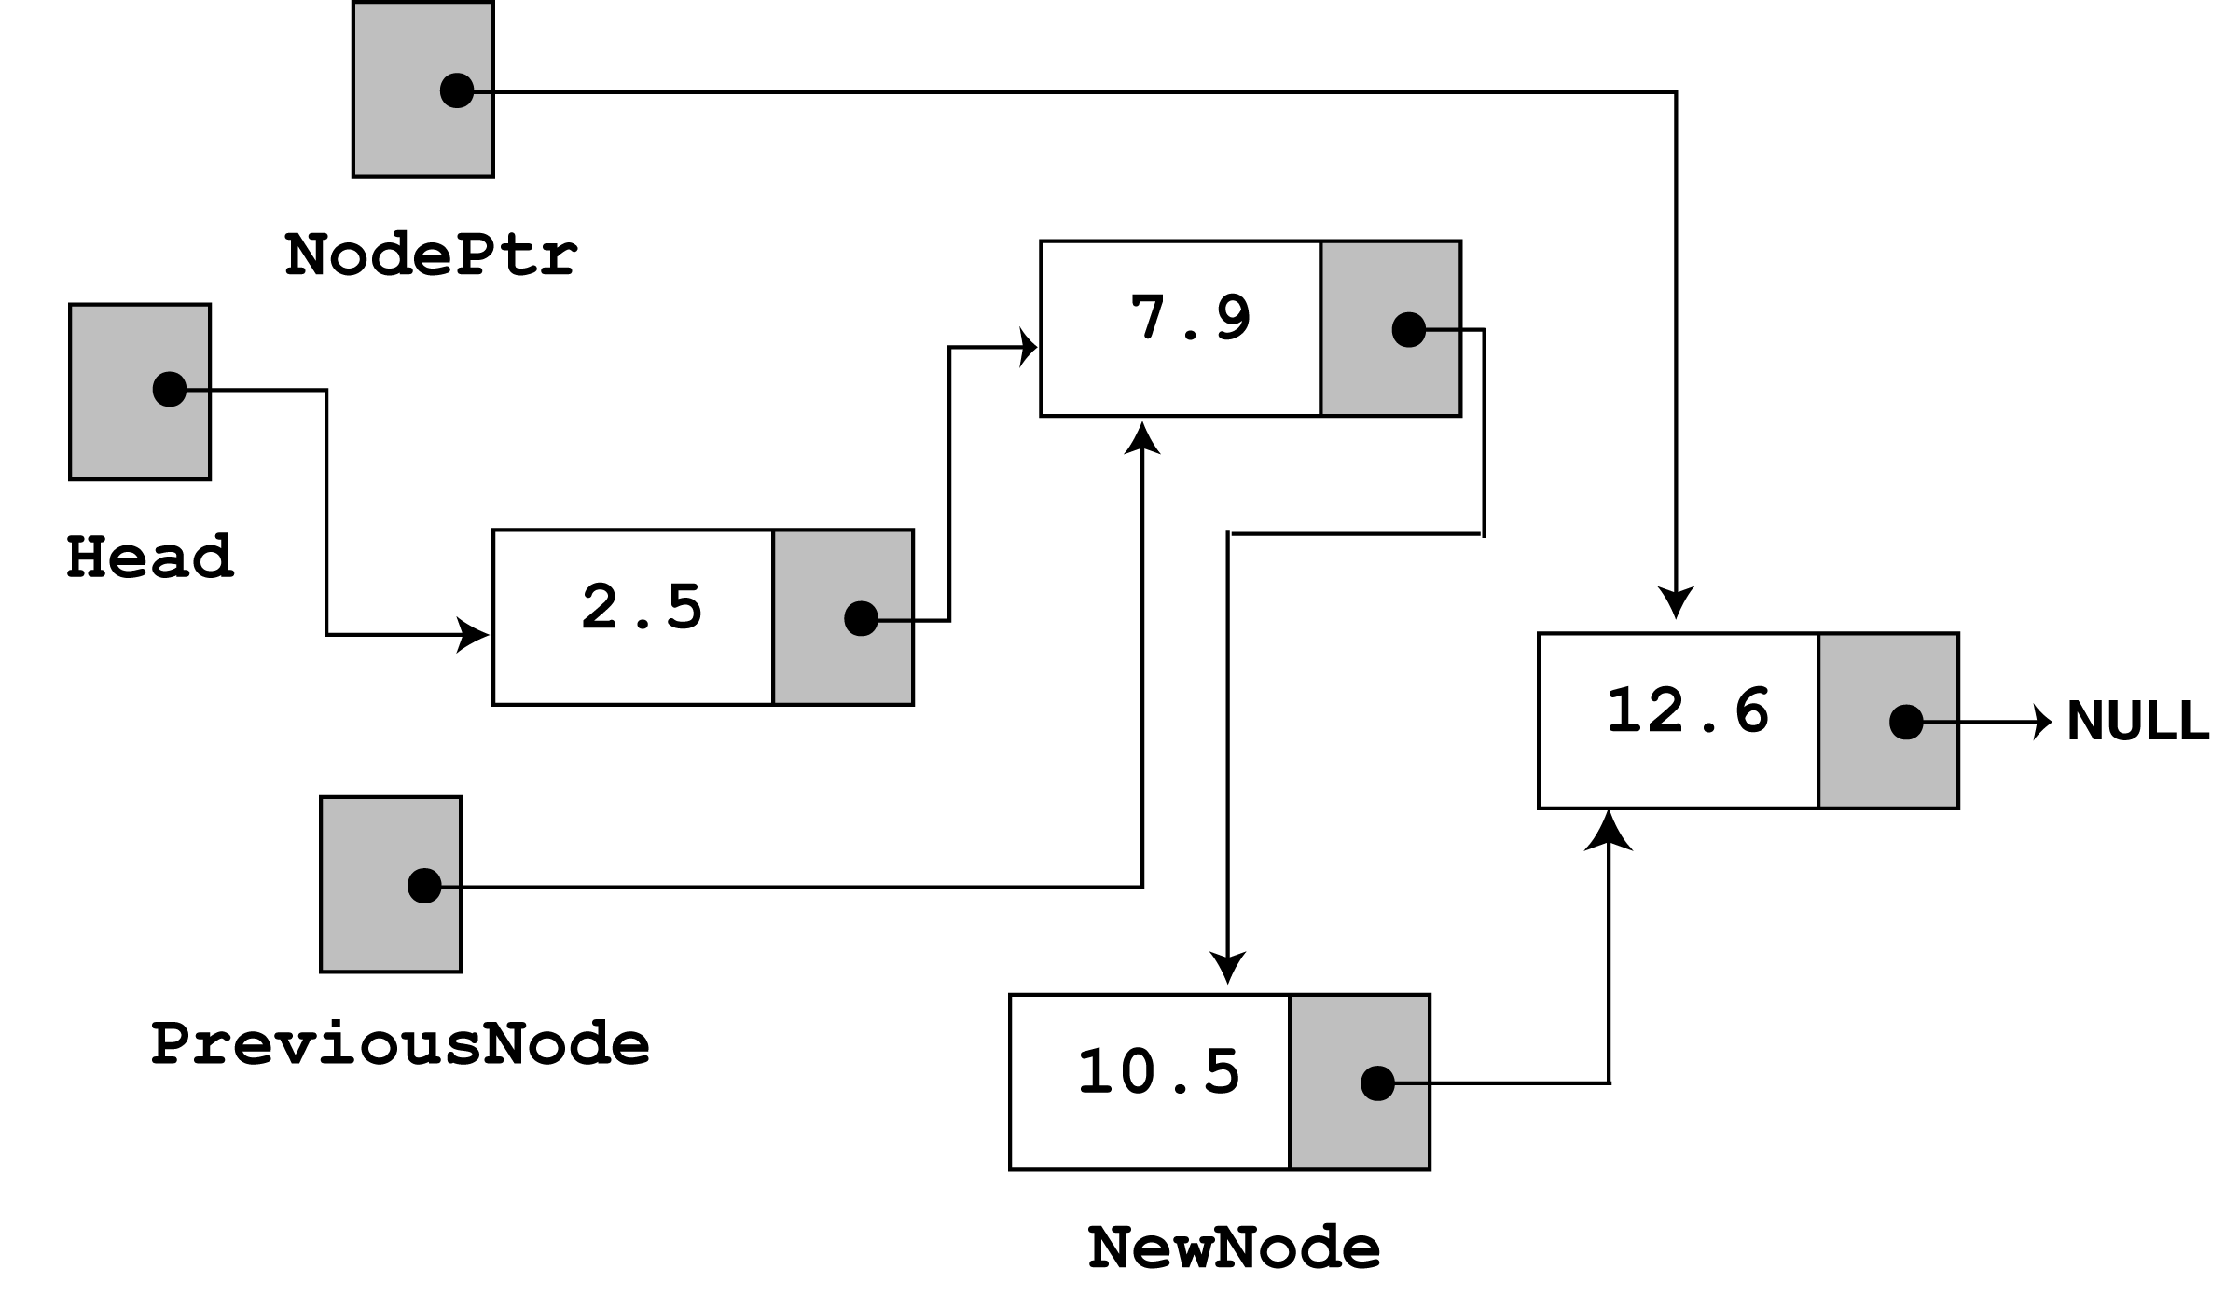
This time, the loop's test will fail because nodePtr is not less than num. The statements after the loop will execute, which cause previousNode->next to point to newNode, and
newNode->next to point to nodePtr.
If you follow the links, from the head pointer to the NULL, you will see that the nodes are stored in the order of their value members.

Slide 38
Deleting a Node
Deleting a node from a linked list requires two steps:
  Remove the node from the list without breaking the links created by the next pointers
  Deleting the node from memory
The deleteNode function begins on the next slide.

Slide 39
void FloatList::deleteNode(float num)
{
ListNode *nodePtr, *previousNode;
// If the list is empty, do nothing.
if (!head)
return;
// Determine if the first node is the one.
if (head->value == num)
{
nodePtr = head->next;
delete head;
head = nodePtr;
}
Continued on next slide…

Slide 40
Continued from previous slide.
else
{
// Initialize nodePtr to head of list
nodePtr = head;
// Skip all nodes whose value member is
// not equal to num.
while (nodePtr != NULL && nodePtr->value != num)
{
previousNode = nodePtr;
nodePtr = nodePtr->next;
}
// Link the previous node to the node after
// nodePtr, then delete nodePtr.
previousNode->next = nodePtr->next;
delete nodePtr;
}
}

Slide 41
Program 17-4
// This program demonstrates the deleteNode member function
#include <iostream.h>
#include "FloatList.h“
void main(void)
{
FloatList list;
// Build the list
list.appendNode(2.5);
list.appendNode(7.9);
list.appendNode(12.6);
cout << "Here are the initial values:\n";
list.displayList();
cout << endl;
cout << "Now deleting the node in the middle.\n";
cout << "Here are the nodes left.\n";
list.deleteNode(7.9);
list.displayList();
cout << endl;
Continued on next slide…

Slide 42
Continued from previous slide.
cout << "Now deleting the last node.\n";
cout << "Here are the nodes left.\n";
list.deleteNode(12.6);
list.displayList();
cout << endl;
cout << "Now deleting the only remaining node.\n";
cout << "Here are the nodes left.\n";
list.deleteNode(2.5);
list.displayList();
}

Slide 43
Program Output
Here are the initial values:
2.5
7.9
12.6
Now deleting the node in the middle.
Here are the nodes left.
2.5
12.6
Now deleting the last node.
Here are the nodes left.
2.5
Now deleting the only remaining node.
Here are the nodes left.

Slide 44
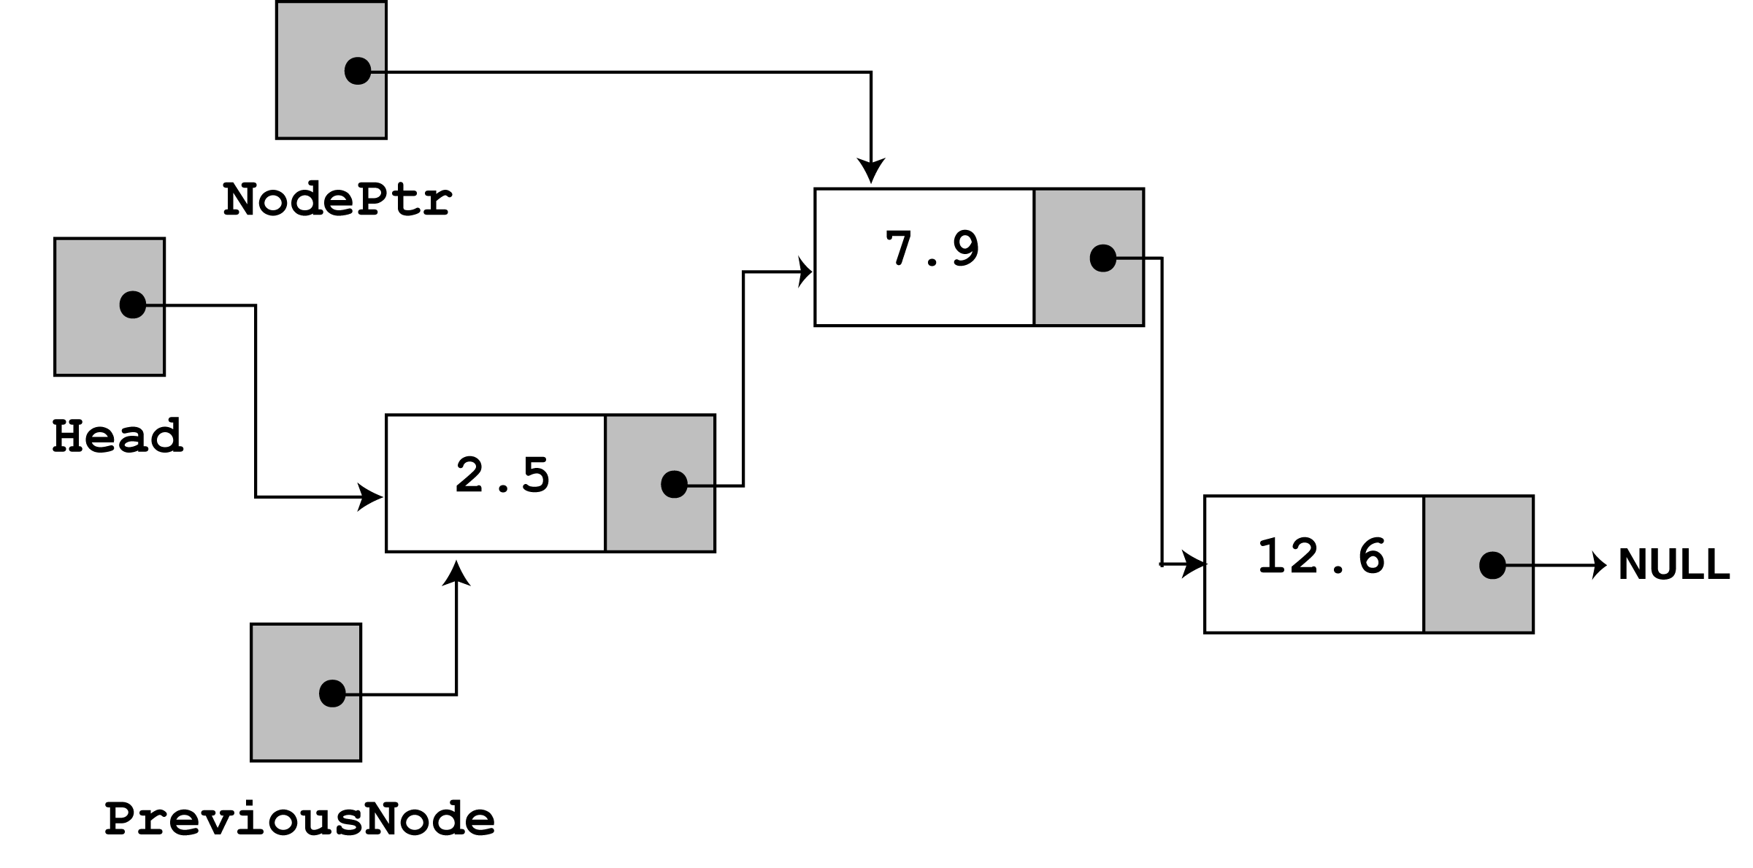
Look at the else part of the second if statement. This is where the function will perform its action since the list is not empty, and the first node does not contain the value 7.9. Just like insertNode, this function uses nodePtr and previousNode to traverse the list. The while loop terminates when the value 7.9 is located. At this point, the list and the other pointers will be in the state depicted in the figure below.

Slide 45
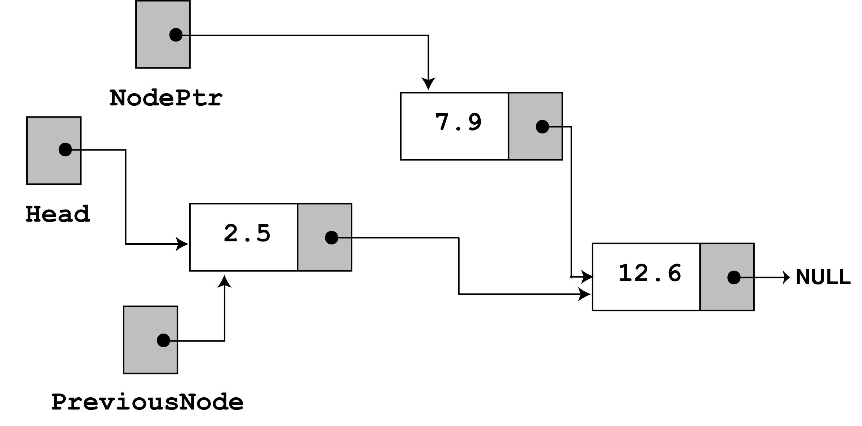
next, the following statement executes.
previousNode->next = nodePtr->next;
The statement above causes the links in the list to bypass the node that nodePtr points to. Although the node still exists in memory, this removes it from the list.
The last statement uses the delete operator to complete the total deletion of the node.

Slide 46
Destroying the List
The class's destructor should release all the memory used by the list.
It does so by stepping through the list, deleting each node one-by-one. The code is shown on the next slide.

Slide 47
FloatList::~FloatList(void)
{
ListNode *nodePtr, *nextNode;
nodePtr = head;
while (nodePtr != NULL)
{
nextNode = nodePtr->next;
delete nodePtr;
nodePtr = nextNode;
}
}
Notice the use of nextNode instead of previousNode. The nextNode pointer is used to hold the position of the next node in the list, so it will be available after the node pointed to by nodePtr is deleted.

Slide 48
17.3 A Linked List Template
#ifndef LINKEDLIST_H
#define LINKEDLIST_H
template <class T>
class LinkedList
{
private:
// Declare a structure for the list
struct ListNode
{
T value;
struct ListNode *next;
};
ListNode *head; // List head pointer
Continued on next slide…

Slide 49
public:
LinkedList(void) // Constructor
{ head = NULL; }
~LinkedList(void); // Destructor
void appendNode(T);
void insertNode(T);
void deleteNode(T);
void displayList(void);
};
// appendNode appends a node containing the
// value pased into num, to the end of the list.
template <class T>
void LinkedList<T>::AppendNode(T num)
{
ListNode *newNode, *nodePtr;
// Allocate a new node & store num
newNode = new ListNode;
newNode->value = num;
newNode->next = NULL;
Continued on next slide…

Slide 50
// If there are no nodes in the list
// make newNode the first node
if (!head)
head = newNode;
else // Otherwise, insert newNode at end
{
// Initialize nodePtr to head of list
nodePtr = head;
// Find the last node in the list
while (nodePtr->next)
nodePtr = nodePtr->next;
// Insert newNode as the last node
nodePtr->next = newNode;
}
}
Continued on next slide…

Slide 51
// DisplayList shows the value
// stored in each node of the linked list
// pointed to by head.
template <class T>
void LinkedList<T>::DisplayList(void)
{
ListNode *nodePtr;
nodePtr = head;
while (nodePtr)
{
cout << nodePtr->value << endl;
nodePtr = nodePtr->next;
}
}
Continued on next slide…

Slide 52
// The insertNode function inserts a node with
// num copied to its value member.
template <class T>
void LinkedList<T>::insertNode(T num)
{
ListNode *newNode, *nodePtr, *previousNode;
// Allocate a new node & store Num
newNode = new ListNode;
newNode->value = num;
// If there are no nodes in the list
// make newNode the first node
if (!head)
{
head = newNode;
newNode->next = NULL;
}
Continued on next slide…

Slide 53
else // Otherwise, insert newNode at end
{
// Initialize nodePtr to head of list
nodePtr = head;
// Skip all nodes whose value member is less
// than num.
while (nodePtr != NULL && nodePtr->value < num)
{
previousNode = nodePtr;
nodePtr = nodePtr->next;
}
// Insert the node after the one pointed to
// by previousNode and before the one pointed to
// by nodePtr.
previousNode->next = newNode;
newNode->next = nodePtr;
}
}
Continued on next slide…

Slide 54
// The deleteNode function searches for a node
// with Num as its value. The node, if found, is
// deleted from the list and from memory.
template <class T>
void LinkedList<T>::deleteNode(T num)
{
ListNode *nodePtr, *previousNode;
// If the list is empty, do nothing.
if (!head)
return;
// Determine if the first node is the one.
if (head->value == num)
{
nodePtr = head->next;
delete head;
head = nodePtr;
}
Continued on next slide…

Slide 55
else
{
// Initialize nodePtr to head of list
nodePtr = head;
// Skip all nodes whose value member is
// not equal to num.
while (nodePtr != NULL && nodePtr->value != num)
{
previousNode = nodePtr;
nodePtr = nodePtr->next;
}
// Link the previous node to the node after
// nodePtr, then delete nodePtr.
previousNode->next = nodePtr->next;
delete nodePtr;
}
}
Continued on next slide…

Slide 56
// Destructor
// This function deletes every node in the list.
template <class T>
LinkedList<T>::~LinkedList(void)
{
ListNode *nodePtr, *nextNode;
nodePtr = head;
while (nodePtr != NULL)
{
nextNode = nodePtr->next;
delete nodePtr;
nodePtr = nextNode;
}
}
#endif

Slide 57
Program 17-5
// This program demonstrates the linked list template.
#include <iostream.h>
#include "LinkedList.h“
void main(void)
{
LinkedList<int> list;
// Build the list
list.appendNode(2);
list.appendNode(4);
list.appendNode(6);
cout << "Here are the initial values:\n";
list.displayList();
cout << endl;
Continued on next slide…

Slide 58
cout << "Now inserting the value 5.\n";
list.insertNode(5);
cout << "Here are the nodes now.\n";
list.displayList();
cout << endl;
cout << "Now deleting the last node.\n";
list.deleteNode(6);
cout << "Here are the nodes left.\n";
list.displayList();
}

Slide 59
Program Output
Here are the initial values:
2
4
6
Now inserting the value 5.
Here are the nodes now.
2
4
5
6
Now deleting the last node.
Here are the nodes left.
2
4
5

Slide 60
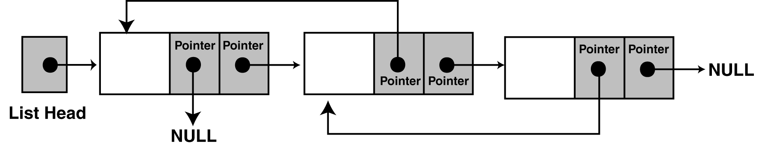
17.4 Variations of the Linked List
The Doubly-Linked List

Slide 61
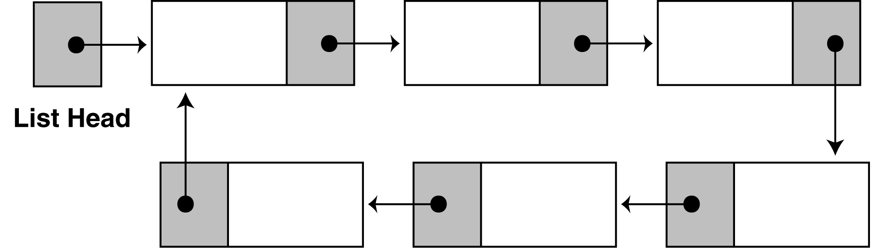
17.4 Variations of the Linked List
The Circular Linked List

Slide 62
17.5 The STL list Container
The list container, found in the Standard Template Library, is a template version of a doubly linked list.
STL lists can insert elements, or add elements to their front quicker than vectors can, because lists do not have to shift the other elements.
lists are also efficient at adding elements at their back because they have a built-in pointer to the last element in the list (no traversal required).

Slide 63
Member Function Examples & Description
back cout << list.back() << endl; The back member function returns a reference to the
last element in the list.
erase list.erase(iter);
list.erase(firstIter, lastIter)
The first example causes the list element pointed to by the iterator
iter to be removed. The second example causes all of the list
elements from firstIter to lastIter to be removed.
empty if (list.empty())
The empty member function returns true if the list is empty. If
the list has elements, it returns false.

Slide 64
Member Function Examples & Description
end iter = list.end();
end returns a bi-directional iterator to the end of the list.
front cout << list.front() << endl;
front returns a reference to the first element of the list.
insert list.insert(iter, x)
The insert member function inserts an element into the list. The
example shown above inserts an element with the value x, just before
the element pointed to by iter.
merge list1.merge(list2);
merge inserts all the items in list2 into list1. list1 is
expanded to accommodate the new elements plus any elements
already stored in list1. merge expects both lists to be sorted.
When list2 is inserted into list1, the elements are inserted into
their correct position, so the resulting list is also sorted.

Slide 65
Member Function Examples & Description
pop_back list.pop_back();
pop_back removes the last element of the list.
pop_front list.pop_front();
pop_front removes the first element of the list.
push_back list.push_back(x);
push_back inserts an element with value x at the end of
the list.
push_front list.push_front(x);
push_front inserts an element with value x at the beginning of the
list.
reverse list.reverse();
reverse reverses the order in which the elements appear in the list.

Slide 66
Member Function Examples & Description
size() Returns the number of elements in the list.
swap list1.swap(List2)
The swap member function swaps the elements stored in two
lists. For example, assuming list1 and list2 are lists, the
statement shown above will exchange the values in the two.
unique list.unique();
unique removes any element that has the same value as the element
before it.

Slide 67
Program 17-6
// This program demonstrates the STL list container.
#include <iostream.h>
#include <list> // Include the list header
using namespace std; // Required by some compilers
void main(void)
{
list<int> myList;
list<int>::iterator iter;
// Add values to the list
for (int x = 0; x < 100; x += 10)
myList.push_back(x);
// Display the values
for (iter = myList.begin(); iter != myList.end(); iter++)
cout << *iter << " ";
cout << endl;
Continued on next slide…

Slide 68
// Now reverse the order of the elements
myList.reverse();
// Display the values again
for (iter = myList.begin(); iter != myList.end(); iter++)
cout << *iter << " ";
cout << endl;
}
Program Output
0 10 20 30 40 50 60 70 80 90
90 80 70 60 50 40 30 20 10 0

