Slide 1
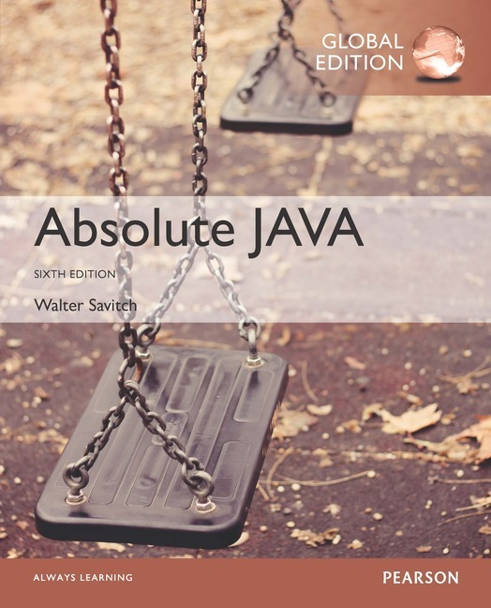
Chapter 11
Recursion
Slides prepared by Rose Williams, Binghamton University
Kenrick Mock, University of Alaska Anchorage
Copyright © 2017 Pearson Ltd. All rights reserved.

Slide 2
Recursive void Methods
A recursive method is a method that includes a call to itself
Recursion is based on the general problem solving technique of breaking down a task into subtasks
In particular, recursion can be used whenever one subtask is a smaller version of the original task

Slide 3
Vertical Numbers
The static recursive method writeVertical takes one (nonnegative) int argument, and writes that int with the digits going down the screen one per line
Note: Recursive methods need not be static
This task may be broken down into the following two subtasks
Simple case: If n<10, then write the number n to the screen
Recursive Case: If n>=10, then do two subtasks:
Output all the digits except the last digit
Output the last digit

Slide 4
Vertical Numbers
Given the argument 1234, the output of the first subtask would be:
1
2
3
The output of the second part would be:
4

Slide 5
Vertical Numbers
The decomposition of tasks into subtasks can be used to derive the method definition:
Subtask 1 is a smaller version of the original task, so it can be implemented with a recursive call
Subtask 2 is just the simple case

Slide 6
Algorithm for Vertical Numbers
Given parameter n:
if (n<10)
System.out.println(n);
else
{
writeVertical
(the number n with the last digit removed);
System.out.println(the last digit of n);
}
Note: n/10 is the number n with the last digit removed, and n%n is the last digit of n

Slide 7
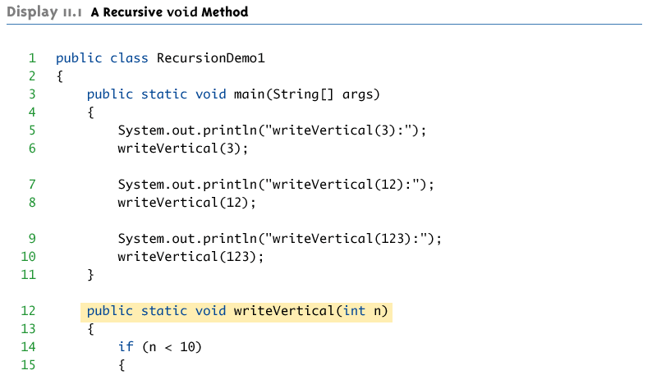
A Recursive void Method (Part 1 of 2)

Slide 8
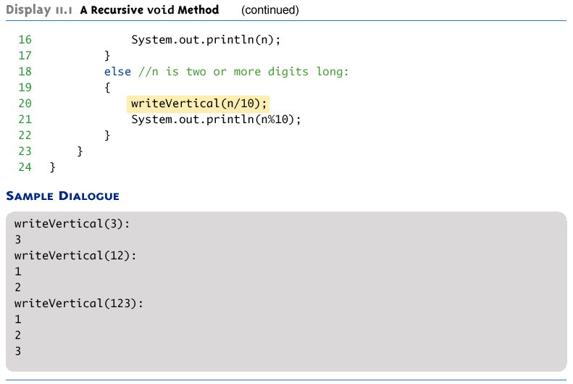
A Recursive void Method (Part 2 of 2)

Slide 9
Tracing a Recursive Call
Recursive methods are processed in the same way as any method call
writeVertical(123);
When this call is executed, the argument 123 is substituted for the parameter n, and the body of the method is executed
Since 123 is not less than 10, the else part is executed

Slide 10
Tracing a Recursive Call
The else part begins with the method call:
writeVertical(n/10);
Substituting n equal to 123 produces:
writeVertical(123/10);
Which evaluates to
writeVertical(12);
At this point, the current method computation is placed on hold, and the recursive call writeVertical is executed with the parameter 12
When the recursive call is finished, the execution of the suspended computation will return and continue from the point above

Slide 11
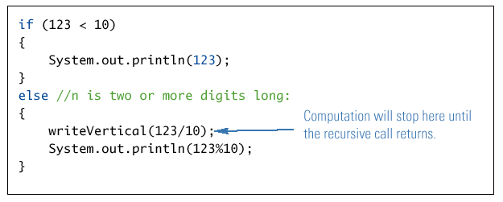
Execution of writeVertical(123)

Slide 12
Tracing a Recursive Call
writeVertical(12);
When this call is executed, the argument 12 is substituted for the parameter n, and the body of the method is executed
Since 12 is not less than 10, the else part is executed
The else part begins with the method call:
writeVertical(n/10);
Substituting n equal to 12 produces:
writeVertical(12/10);
Which evaluates to
write Vertical(1);

Slide 13
Tracing a Recursive Call
So this second computation of writeVertical is suspended, leaving two computations waiting to resume , as the computer begins to execute another recursive call
When this recursive call is finished, the execution of the second suspended computation will return and continue from the point above

Slide 14
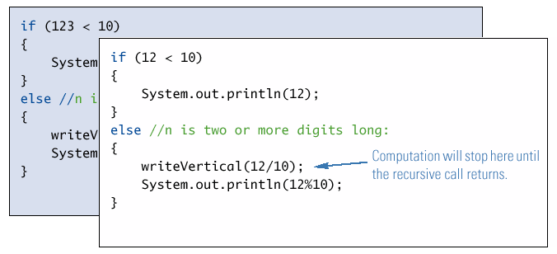
Execution of writeVertical(12)

Slide 15
Tracing a Recursive Call
write Vertical(1);
When this call is executed, the argument 1 is substituted for the parameter n, and the body of the method is executed
Since 1 is less than 10, the if-else statement Boolean expression is finally true
The output statement writes the argument 1 to the screen, and the method ends without making another recursive call
Note that this is the stopping case

Slide 16
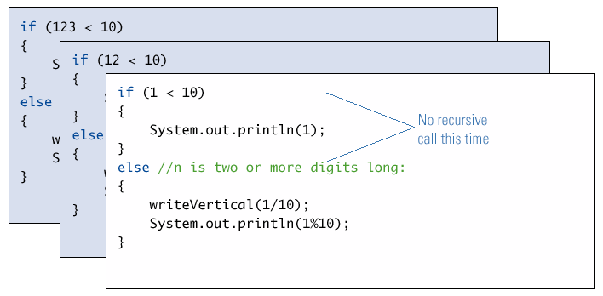
Execution of writeVertical(1)

Slide 17
Tracing a Recursive Call
When the call writeVertical(1) ends, the suspended computation that was waiting for it to end (the one that was initiated by the call writeVertical(12)) resumes execution where it left off
It outputs the value 12%10, which is 2
This ends the method
Now the first suspended computation can resume execution

Slide 18
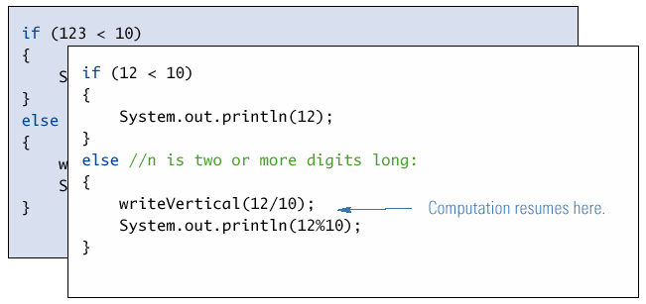
Completion of writeVertical(12)

Slide 19
Tracing a Recursive Call
The first suspended method was the one that was initiated by the call writeVertical(123)
It resumes execution where it left off
It outputs the value 123%10, which is 3
The execution of the original method call ends
As a result, the digits 1,2, and 3 have been written to the screen one per line, in that order

Slide 20
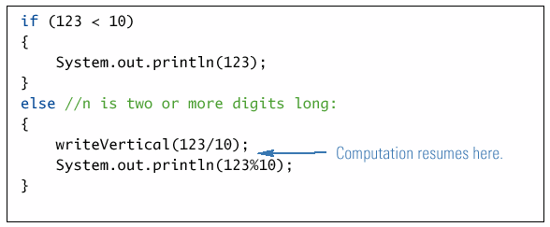
Completion of writeVertical(123)

Slide 21
A Closer Look at Recursion
The computer keeps track of recursive calls as follows:
When a method is called, the computer plugs in the arguments for the parameter(s), and starts executing the code
If it encounters a recursive call, it temporarily stops its computation
When the recursive call is completed, the computer returns to finish the outer computation

Slide 22
A Closer Look at Recursion
When the computer encounters a recursive call, it must temporarily suspend its execution of a method
It does this because it must know the result of the recursive call before it can proceed
It saves all the information it needs to continue the computation later on, when it returns from the recursive call
Ultimately, this entire process terminates when one of the recursive calls does not depend upon recursion to return

Slide 23
General Form of a Recursive Method Definition
The general outline of a successful recursive method definition is as follows:
One or more cases that include one or more recursive calls to the method being defined
These recursive calls should solve "smaller" versions of the task performed by the method being defined
One or more cases that include no recursive calls: base cases or stopping cases

Slide 24
Pitfall: Infinite Recursion
In the writeVertical example, the series of recursive calls eventually reached a call of the method that did not involve recursion (a stopping case)
If, instead, every recursive call had produced another recursive call, then a call to that method would, in theory, run forever
This is called infinite recursion
In practice, such a method runs until the computer runs out of resources, and the program terminates abnormally

Slide 25
Pitfall: Infinite Recursion
An alternative version of writeVertical
Note: No stopping case!
public static void
newWriteVertical(int n)
{
newWriteVertical(n/10);
System.out.println(n%10);
}

Slide 26
Pitfall: Infinite Recursion
A program with this method will compile and run
Calling newWriteVertical(12) causes that execution to stop to execute the recursive call newWriteVertical(12/10)
Which is equivalent to newWriteVertical(1)
Calling newWriteVertical(1) causes that execution to stop to execute the recursive call newWriteVertical(1/10)
Which is equivalent to newWriteVertical(0)

Slide 27
Pitfall: Infinite Recursion
Calling newWriteVertical(0) causes that execution to stop to execute the recursive call newWriteVertical(0/10)
Which is equivalent to newWriteVertical(0)
. . . And so on, forever!
Since the definition of newWriteVertical has no stopping case, the process will proceed forever (or until the computer runs out of resources)

Slide 28
Stacks for Recursion
To keep track of recursion (and other things), most computer systems use a stack
A stack is a very specialized kind of memory structure analogous to a stack of paper
As an analogy, there is also an inexhaustible supply of extra blank sheets of paper
Information is placed on the stack by writing on one of these sheets, and placing it on top of the stack (becoming the new top of the stack)
More information is placed on the stack by writing on another one of these sheets, placing it on top of the stack, and so on

Slide 29
Stacks for Recursion
To get information out of the stack, the top paper can be read, but only the top paper
To get more information, the top paper can be thrown away, and then the new top paper can be read, and so on
Since the last sheet put on the stack is the first sheet taken off the stack, a stack is called a last-in/first-out memory structure (LIFO)

Slide 30
Stacks for Recursion
To keep track of recursion, whenever a method is called, a new "sheet of paper" is taken
The method definition is copied onto this sheet, and the arguments are plugged in for the method parameters
The computer starts to execute the method body
When it encounters a recursive call, it stops the computation in order to make the recursive call
It writes information about the current method on the sheet of paper, and places it on the stack

Slide 31
Stacks for Recursion
A new sheet of paper is used for the recursive call
The computer writes a second copy of the method, plugs in the arguments, and starts to execute its body
When this copy gets to a recursive call, its information is saved on the stack also, and a new sheet of paper is used for the new recursive call

Slide 32
Stacks for Recursion
This process continues until some recursive call to the method completes its computation without producing any more recursive calls
Its sheet of paper is then discarded
Then the computer goes to the top sheet of paper on the stack
This sheet contains the partially completed computation that is waiting for the recursive computation that just ended
Now it is possible to proceed with that suspended computation

Slide 33
Stacks for Recursion
After the suspended computation ends, the computer discards its corresponding sheet of paper (the one on top)
The suspended computation that is below it on the stack now becomes the computation on top of the stack
This process continues until the computation on the bottom sheet is completed

Slide 34
Stacks for Recursion
Depending on how many recursive calls are made, and how the method definition is written, the stack may grow and shrink in any fashion
The stack of paper analogy has its counterpart in the computer
The contents of one of the sheets of paper is called a stack frame or activation record
The stack frames don't actually contain a complete copy of the method definition, but reference a single copy instead

Slide 35
Pitfall: Stack Overflow
There is always some limit to the size of the stack
If there is a long chain in which a method makes a call to itself, and that call makes another recursive call, . . . , and so forth, there will be many suspended computations placed on the stack
If there are too many, then the stack will attempt to grow beyond its limit, resulting in an error condition known as a stack overflow
A common cause of stack overflow is infinite recursion

Slide 36
Recursion Versus Iteration
Recursion is not absolutely necessary
Any task that can be done using recursion can also be done in a nonrecursive manner
A nonrecursive version of a method is called an iterative version
An iteratively written method will typically use loops of some sort in place of recursion
A recursively written method can be simpler, but will usually run slower and use more storage than an equivalent iterative version

Slide 37
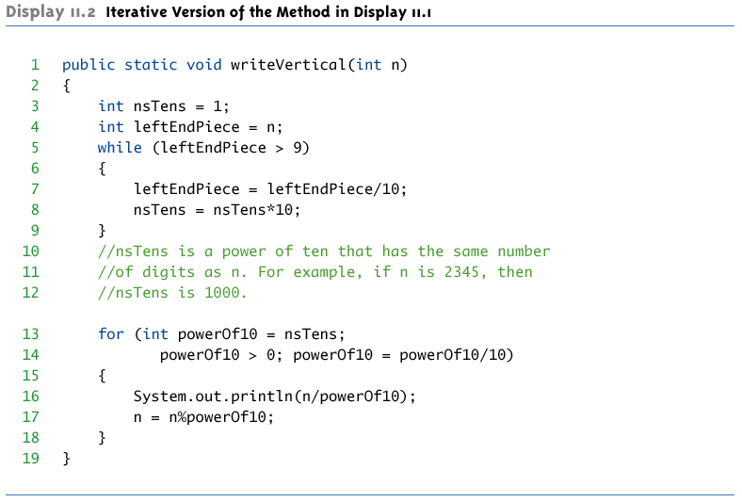
Iterative version of writeVertical

Slide 38
Recursive Methods that Return a Value
Recursion is not limited to void methods
A recursive method can return a value of any type
An outline for a successful recursive method that returns a value is as follows:
One or more cases in which the value returned is computed in terms of calls to the same method
the arguments for the recursive calls should be intuitively "smaller"
One or more cases in which the value returned is computed without the use of any recursive calls (the base or stopping cases)

Slide 39
Another Powers Method
The method pow from the Math class computes powers
It takes two arguments of type double and returns a value of type double
The recursive method power takes two arguments of type int and returns a value of type int
The definition of power is based on the following formula:
x^{n} is equal to x^{n-1} * x

Slide 40
Another Powers Method
In terms of Java, the value returned by power(x, n) for n>0 should be the same as
power(x, n-1) * x
When n=0, then power(x, n) should return 1
This is the stopping case

Slide 41
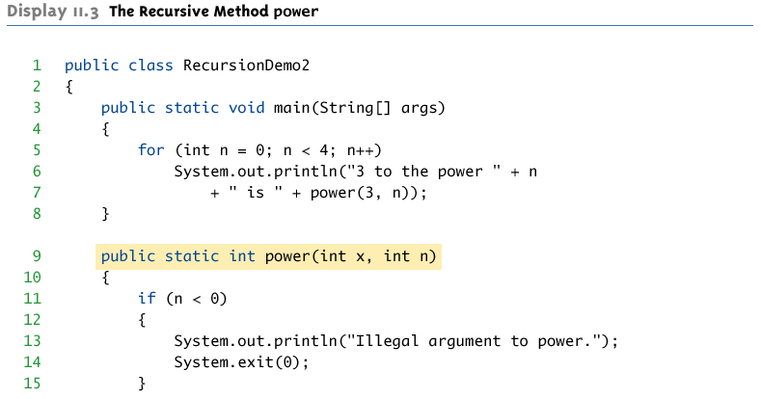
The Recursive Method power (Part 1 of 2)

Slide 42
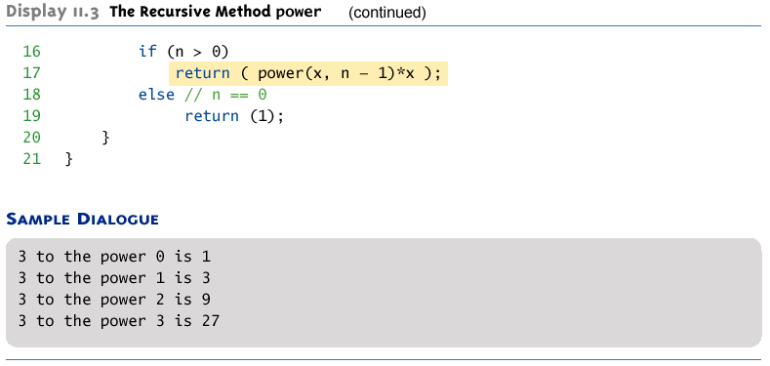
The Recursive Method power (Part 1 of 2)

Slide 43
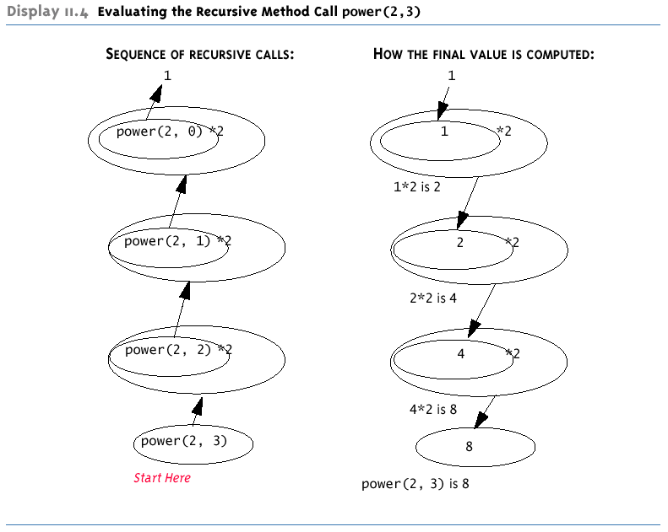
Evaluating the Recursive Method Call power(2,3)

Slide 44
Thinking Recursively
If a problem lends itself to recursion, it is more important to think of it in recursive terms, rather than concentrating on the stack and the suspended computations
power(x,n) returns power(x, n-1) * x
In the case of methods that return a value, there are three properties that must be satisfied, as follows:

Slide 45
Thinking Recursively
There is no infinite recursion
Every chain of recursive calls must reach a stopping case
Each stopping case returns the correct value for that case
For the cases that involve recursion: if all recursive calls return the correct value, then the final value returned by the method is the correct value
These properties follow a technique also known as mathematical induction

Slide 46
Tail Recursion
When the recursive method does nothing after the recursive call except return the value then the method is called tail recursive
Tail recursive methods can easily be converted into an equivalent iterative algorithm
Your compiler may do this automatically for greater efficiency
A similar effect can be achieved if the compiler re-uses the stack frame for successive recursive calls

Slide 47
Recursive Design Techniques
The same rules can be applied to a recursive void method:
There is no infinite recursion
Each stopping case performs the correct action for that case
For each of the cases that involve recursion: if all recursive calls perform their actions correctly, then the entire case performs correctly

Slide 48
Binary Search
Binary search uses a recursive method to search an array to find a specified value
The array must be a sorted array:
a[0]≤a[1]≤a[2]≤. . . ≤ a[finalIndex]
If the value is found, its index is returned
If the value is not found, -1 is returned
Note: Each execution of the recursive method reduces the search space by about a half

Slide 49
Binary Search
An algorithm to solve this task looks at the middle of the array or array segment first
If the value looked for is smaller than the value in the middle of the array
Then the second half of the array or array segment can be ignored
This strategy is then applied to the first half of the array or array segment

Slide 50
Binary Search
If the value looked for is larger than the value in the middle of the array or array segment
Then the first half of the array or array segment can be ignored
This strategy is then applied to the second half of the array or array segment
If the value looked for is at the middle of the array or array segment, then it has been found
If the entire array (or array segment) has been searched in this way without finding the value, then it is not in the array

Slide 51
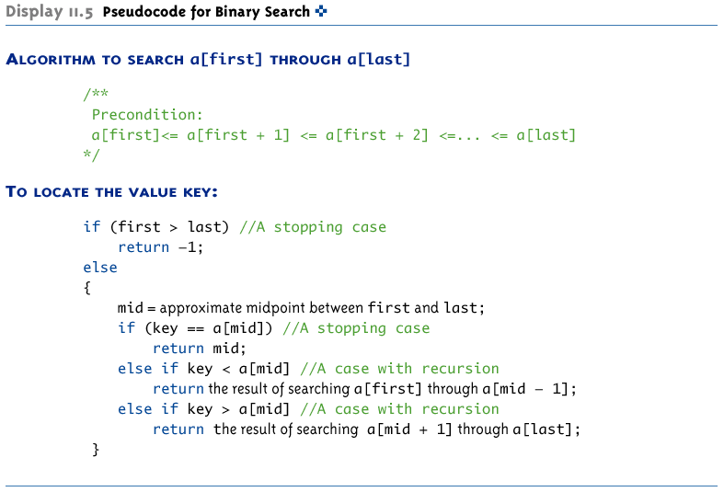
Pseudocode for Binary Search

Slide 52
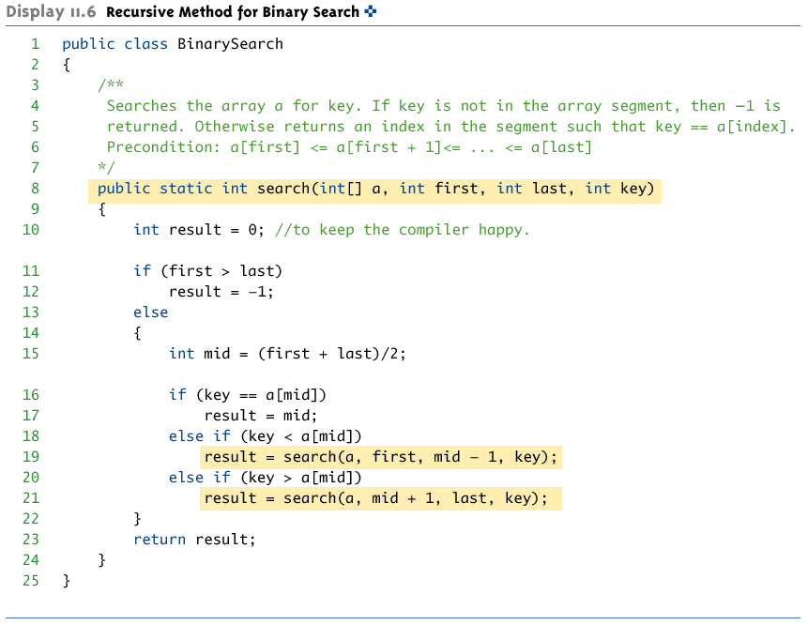
Recursive Method for Binary Search

Slide 53
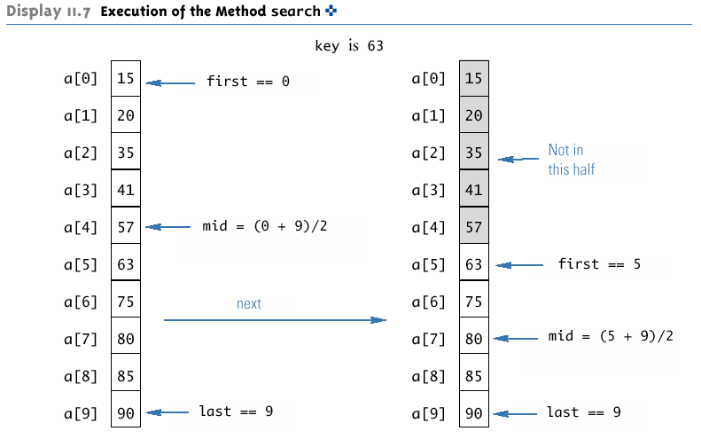
Execution of the Method search (Part 1 of 2)

Slide 54
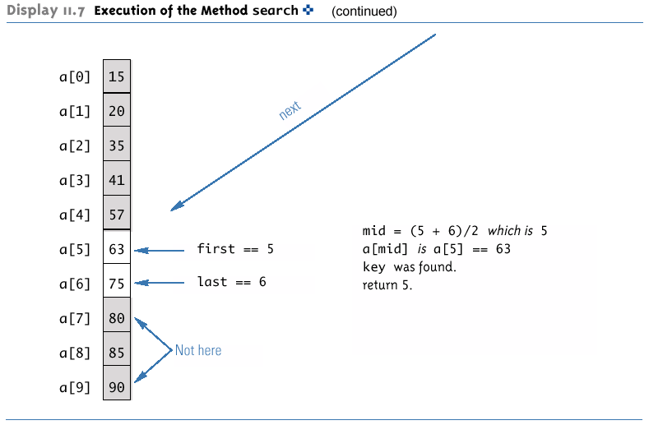
Execution of the Method search (Part 1 of 2)

Slide 55
Checking the search Method
There is no infinite recursion
On each recursive call, the value of first is increased, or the value of last is decreased
If the chain of recursive calls does not end in some other way, then eventually the method will be called with first larger than last

Slide 56
Checking the search Method
Each stopping case performs the correct action for that case
If first > last, there are no array elements between a[first] and a[last], so key is not in this segment of the array, and result is correctly set to -1
If key == a[mid], result is correctly set to mid

Slide 57
Checking the search Method
For each of the cases that involve recursion, if all recursive calls perform their actions correctly, then the entire case performs correctly
If key < a[mid], then key must be one of the elements a[first] through a[mid-1], or it is not in the array
The method should then search only those elements, which it does
The recursive call is correct, therefore the entire action is correct

Slide 58
Checking the search Method
If key > a[mid], then key must be one of the elements a[mid+1] through a[last], or it is not in the array
The method should then search only those elements, which it does
The recursive call is correct, therefore the entire action is correct
The method search passes all three tests:
Therefore, it is a good recursive method definition

Slide 59
Efficiency of Binary Search
The binary search algorithm is extremely fast compared to an algorithm that tries all array elements in order
About half the array is eliminated from consideration right at the start
Then a quarter of the array, then an eighth of the array, and so forth

Slide 60
Efficiency of Binary Search
Given an array with 1,000 elements, the binary search will only need to compare about 10 array elements to the key value, as compared to an average of 500 for a serial search algorithm
The binary search algorithm has a worst-case running time that is logarithmic: O(log₂ n)
A serial search algorithm is linear: O(n)
If desired, the recursive version of the method search can be converted to an iterative version that will run more efficiently

Slide 61
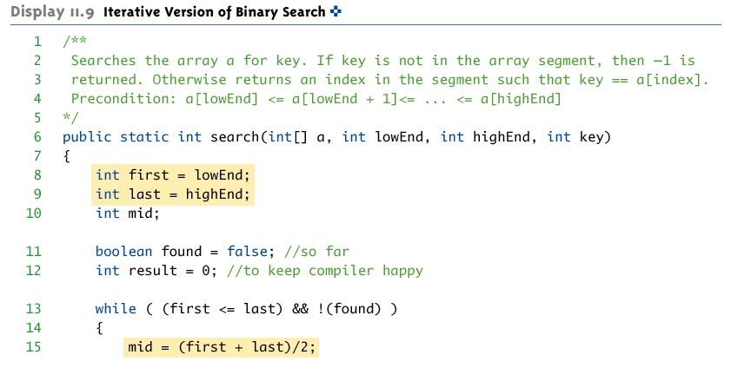
Iterative Version of Binary Search (Part 1 of 2)

Slide 62
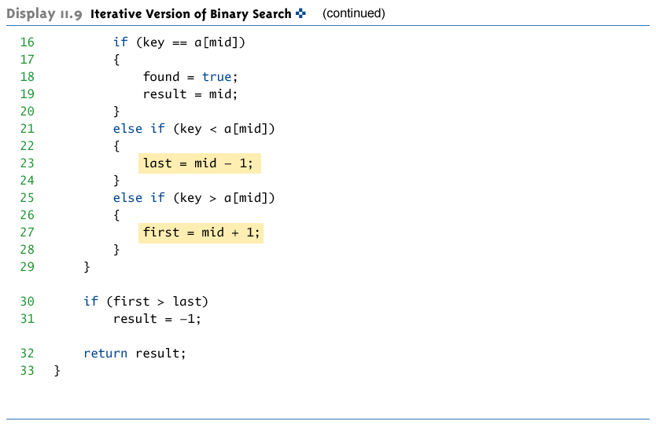
Iterative Version of Binary Search (Part 2 of 2)

