Slide 1

Chapter 13
Interfaces and Inner Classes
Slides prepared by Rose Williams, Binghamton University
Kenrick Mock, University of Alaska Anchorage
Copyright © 2017 Pearson Ltd. All rights reserved.

Slide 2
Interfaces
An interface is something like an extreme case of an abstract class
However, an interface is not a class
It is a type that can be satisfied by any class that implements the interface
The syntax for defining an interface is similar to that of defining a class
Except the word interface is used in place of class
An interface specifies a set of methods that any class that implements the interface must have
It contains method headings and constant definitions only
It contains no instance variables nor any complete method definitions

Slide 3
Interfaces
An interface serves a function similar to a base class, though it is not a base class
Some languages allow one class to be derived from two or more different base classes
This multiple inheritance is not allowed in Java
Instead, Java's way of approximating multiple inheritance is through interfaces

Slide 4
Interfaces
An interface and all of its method headings should be declared public
They cannot be given private, protected, or package access
When a class implements an interface, it must make all the methods in the interface public
Because an interface is a type, a method may be written with a parameter of an interface type
That parameter will accept as an argument any class that implements the interface

Slide 5
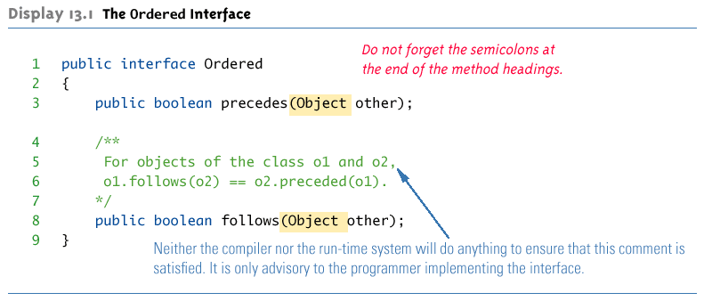
The Ordered Interface

Slide 6
Interfaces
To implement an interface, a concrete class must do two things:
It must include the phrase
implements Interface_Name
at the start of the class definition
If more than one interface is implemented, each is listed, separated by commas
The class must implement all the method headings listed in the definition(s) of the interface(s)
Note the use of Object as the parameter type in the following examples

Slide 7
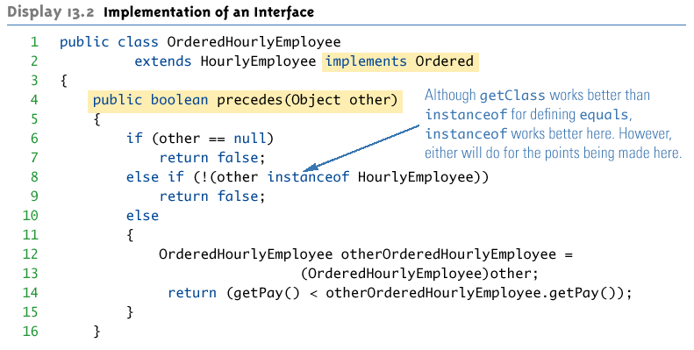
Implementation of an Interface

Slide 8
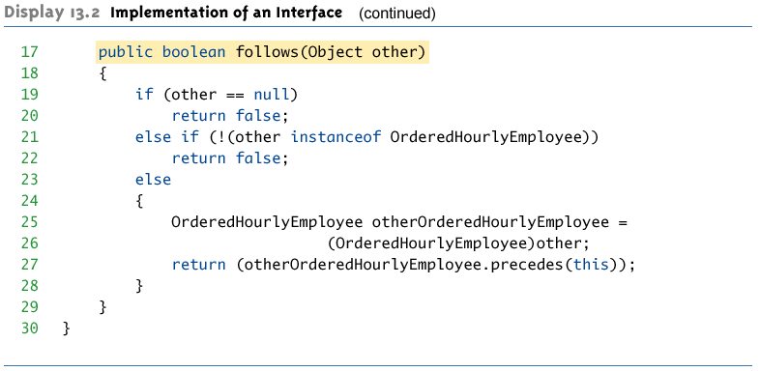
Implementation of an Interface

Slide 9
Abstract Classes Implementing Interfaces
Abstract classes may implement one or more interfaces
Any method headings given in the interface that are not given definitions are made into abstract methods
A concrete class must give definitions for all the method headings given in the abstract class and the interface

Slide 10
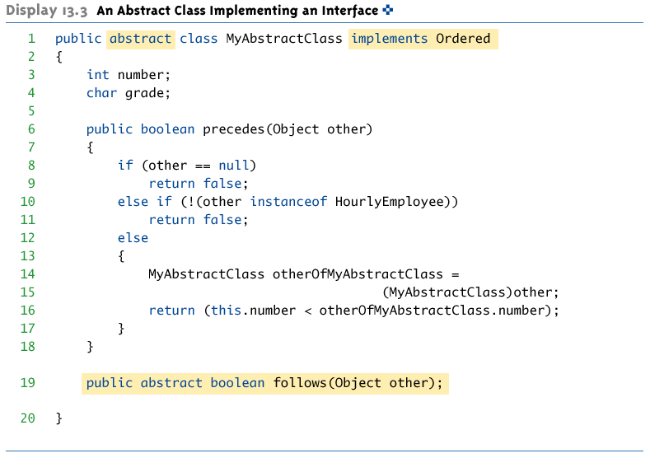
An Abstract Class Implementing an Interface

Slide 11
Derived Interfaces
Like classes, an interface may be derived from a base interface
This is called extending the interface
The derived interface must include the phrase
extends BaseInterfaceName
A concrete class that implements a derived interface must have definitions for any methods in the derived interface as well as any methods in the base interface

Slide 12
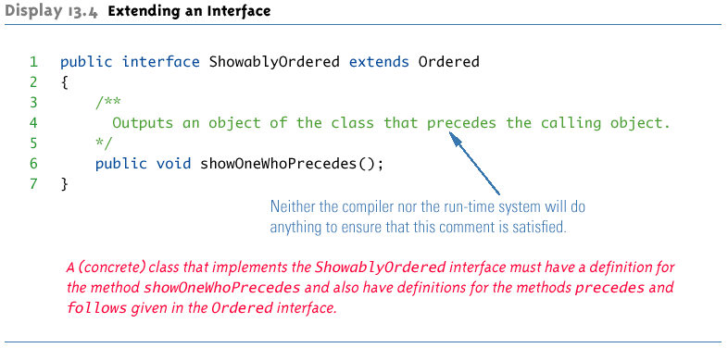
Extending an Interface

Slide 13
Pitfall: Interface Semantics Are Not Enforced
When a class implements an interface, the compiler and run-time system check the syntax of the interface and its implementation
However, neither checks that the body of an interface is consistent with its intended meaning
Required semantics for an interface are normally added to the documentation for an interface
It then becomes the responsibility of each programmer implementing the interface to follow the semantics
If the method body does not satisfy the specified semantics, then software written for classes that implement the interface may not work correctly

Slide 14
The Comparable Interface
Chapter 6 discussed the Selection Sort algorithm, and examined a method for sorting a partially filled array of type double into increasing order
This code could be modified to sort into decreasing order, or to sort integers or strings instead
Each of these methods would be essentially the same, but making each modification would be a nuisance
The only difference would be the types of values being sorted, and the definition of the ordering
Using the Comparable interface could provide a single sorting method that covers all these cases

Slide 15
The Comparable Interface
The Comparable interface is in the java.lang package, and so is automatically available to any program
It has only the following method heading that must be implemented:
public int compareTo(Object other);
It is the programmer's responsibility to follow the semantics of the Comparable interface when implementing it

Slide 16
The Comparable Interface Semantics
The method compareTo must return
A negative number if the calling object "comes before" the parameter other
A zero if the calling object "equals" the parameter other
A positive number if the calling object "comes after" the parameter other
If the parameter other is not of the same type as the class being defined, then a ClassCastException should be thrown

Slide 17
The Comparable Interface Semantics
Almost any reasonable notion of "comes before" is acceptable
In particular, all of the standard less-than relations on numbers and lexicographic ordering on strings are suitable
The relationship "comes after" is just the reverse of "comes before"

Slide 18
The Comparable Interface Semantics
Other orderings may be considered, as long as they are a total ordering
Such an ordering must satisfy the following rules:
(Irreflexivity) For no object o does o come before o
(Trichotomy) For any two object o1 and o2, one and only one of the following holds true: o1 comes before o2, o1 comes after o2, or o1 equals o2
(Transitivity) If o1 comes before o2 and o2 comes before o3, then o1 comes before o3
The "equals" of the compareTo method semantics should coincide with the equals method if possible, but this is not absolutely required

Slide 19
Using the Comparable Interface
The following example reworks the SelectionSort class from Chapter 6
The new version, GeneralizedSelectionSort, includes a method that can sort any partially filled array whose base type implements the Comparable interface
It contains appropriate indexOfSmallest and interchange methods as well
Note: Both the Double and String classes implement the Comparable interface
Interfaces apply to classes only
A primitive type (e.g., double) cannot implement an interface

Slide 20
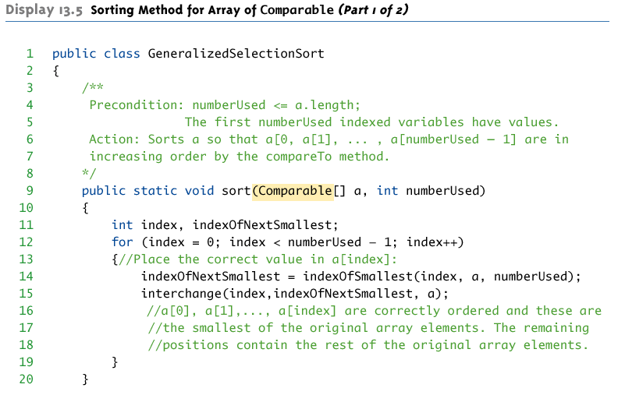
GeneralizedSelectionSort class: sort Method

Slide 21
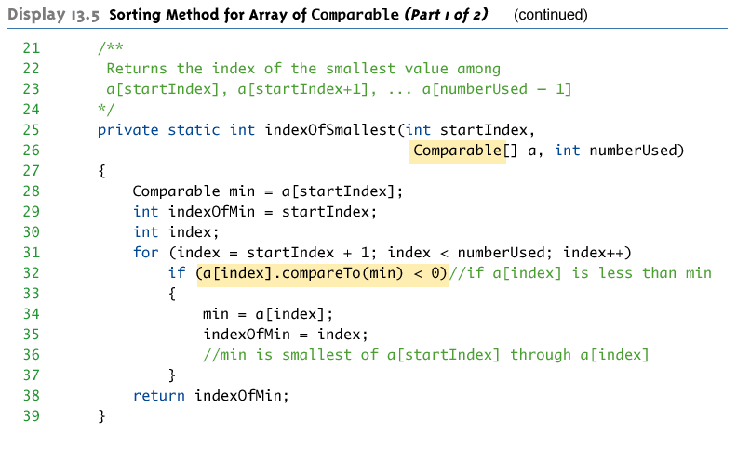
GeneralizedSelectionSort class: sort Method

Slide 22
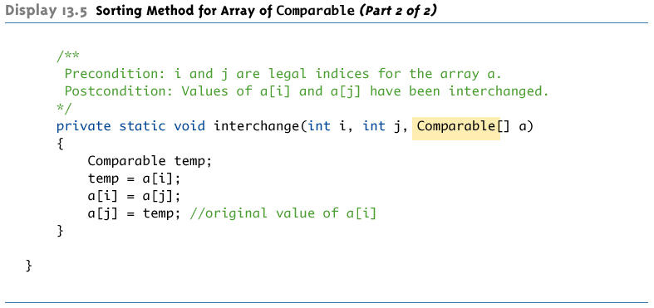
GeneralizedSelectionSort class: interchange Method

Slide 23
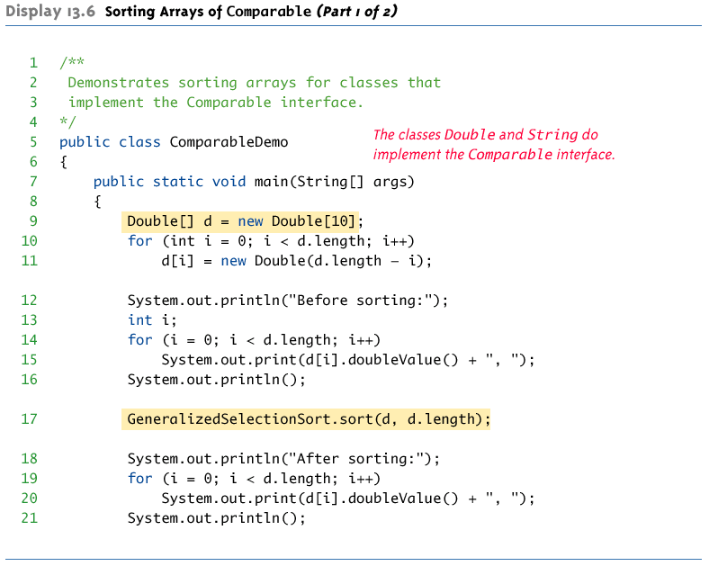
Sorting Arrays of Comparable

Slide 24
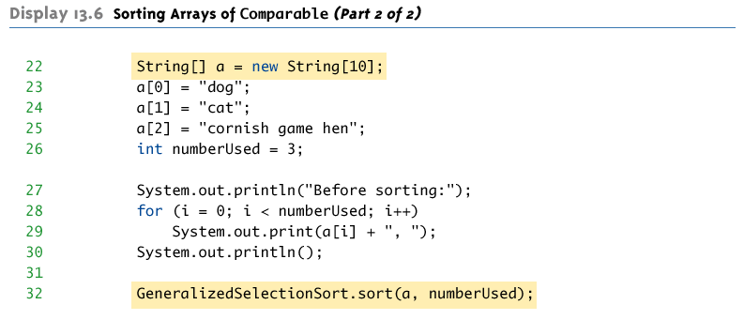
Sorting Arrays of Comparable

Slide 25
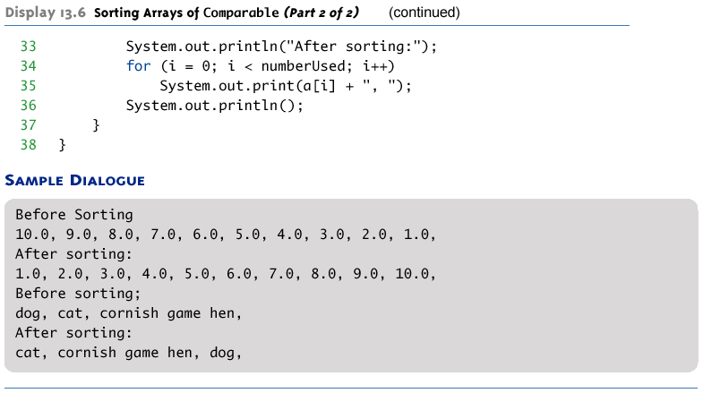
Sorting Arrays of Comparable

Slide 26
Defined Constants in Interfaces
An interface can contain defined constants in addition to or instead of method headings
Any variables defined in an interface must be public, static, and final
Because this is understood, Java allows these modifiers to be omitted
Any class that implements the interface has access to these defined constants

Slide 27
Pitfall: Inconsistent Interfaces
In Java, a class can have only one base class
This prevents any inconsistencies arising from different definitions having the same method heading
In addition, a class may implement any number of interfaces
Since interfaces do not have method bodies, the above problem cannot arise
However, there are other types of inconsistencies that can arise

Slide 28
Pitfall: Inconsistent Interfaces
When a class implements two interfaces:
One type of inconsistency will occur if the interfaces have constants with the same name, but with different values
Another type of inconsistency will occur if the interfaces contain methods with the same name but different return types
If a class definition implements two inconsistent interfaces, then that is an error, and the class definition is illegal

Slide 29
The Serializable Interface
An extreme but commonly used example of an interface is the Serializable interface
It has no method headings and no defined constants: It is completely empty
It is used merely as a type tag that indicates to the system that it may implement file I/O in a particular way

Slide 30
The Cloneable Interface
The Cloneable interface is another unusual example of a Java interface
It does not contain method headings or defined constants
It is used to indicate how the method clone (inherited from the Object class) should be used and redefined

Slide 31
The Cloneable Interface
The method Object.clone() does a bit-by-bit copy of the object's data in storage
If the data is all primitive type data or data of immutable class types (such as String), then this is adequate
This is the simple case
The following is an example of a simple class that has no instance variables of a mutable class type, and no specified base class
So the base class is Object

Slide 32
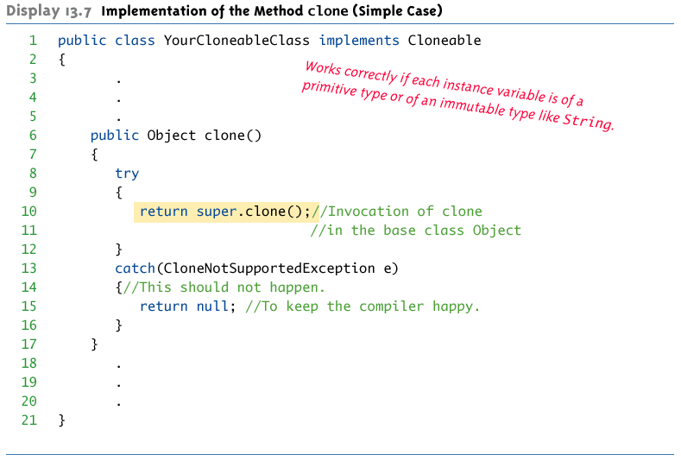
Implementation of the Method clone: Simple Case

Slide 33
The Cloneable Interface
If the data in the object to be cloned includes instance variables whose type is a mutable class, then the simple implementation of clone would cause a privacy leak
When implementing the Cloneable interface for a class like this:
First invoke the clone method of the base class Object (or whatever the base class is)
Then reset the values of any new instance variables whose types are mutable class types
This is done by making copies of the instance variables by invoking their clone methods

Slide 34
The Cloneable Interface
Note that this will work properly only if the Cloneable interface is implemented properly for the classes to which the instance variables belong
And for the classes to which any of the instance variables of the above classes belong, and so on and so forth
The following shows an example

Slide 35
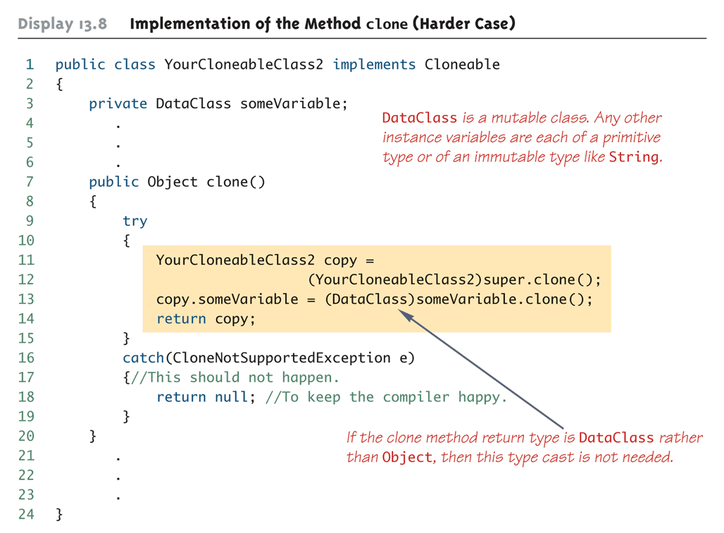
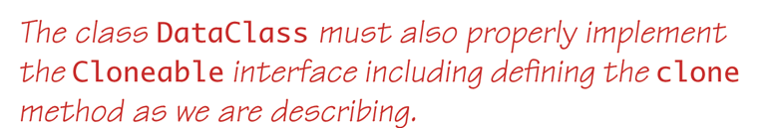
Implementation of the Method clone: Harder Case

Slide 36
Simple Uses of Inner Classes
Inner classes are classes defined within other classes
The class that includes the inner class is called the outer class
There is no particular location where the definition of the inner class (or classes) must be place within the outer class
Placing it first or last, however, will guarantee that it is easy to find

Slide 37
Simple Uses of Inner Classes
An inner class definition is a member of the outer class in the same way that the instance variables and methods of the outer class are members
An inner class is local to the outer class definition
The name of an inner class may be reused for something else outside the outer class definition
If the inner class is private, then the inner class cannot be accessed by name outside the definition of the outer class

Slide 38
Simple Uses of Inner Classes
There are two main advantages to inner classes
They can make the outer class more self-contained since they are defined inside a class
Both of their methods have access to each other's private methods and instance variables
Using an inner class as a helping class is one of the most useful applications of inner classes
If used as a helping class, an inner class should be marked private

Slide 39
Tip: Inner and Outer Classes Have Access to Each Other's Private Members
Within the definition of a method of an inner class:
It is legal to reference a private instance variable of the outer class
It is legal to invoke a private method of the outer class
Within the definition of a method of the outer class
It is legal to reference a private instance variable of the inner class on an object of the inner class
It is legal to invoke a (nonstatic) method of the inner class as long as an object of the inner class is used as a calling object
Within the definition of the inner or outer classes, the modifiers public and private are equivalent

Slide 40
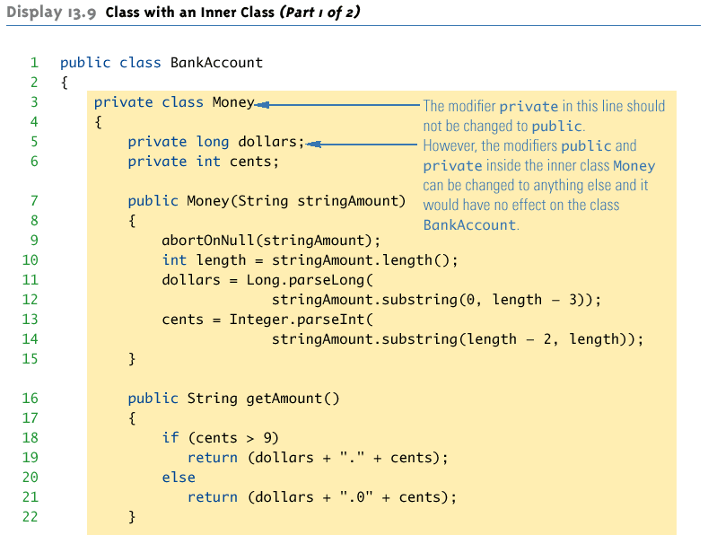
Class with an Inner Class

Slide 41
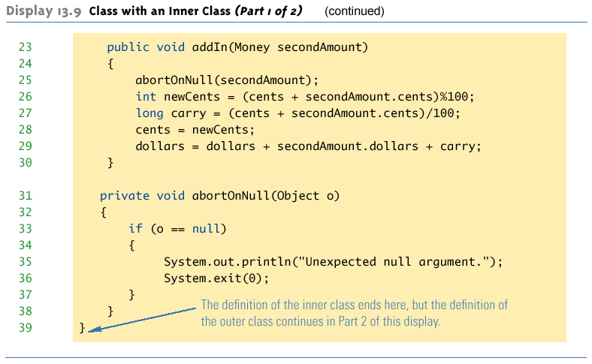
Class with an Inner Class

Slide 42
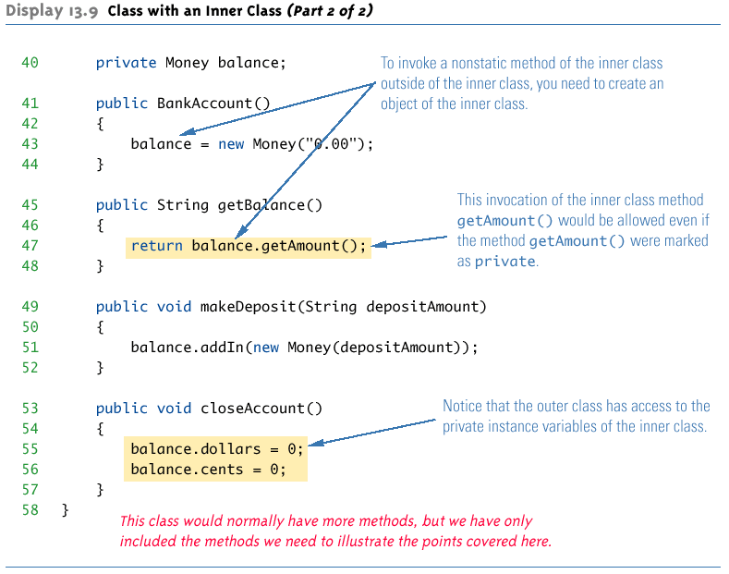
Class with an Inner Class

Slide 43
The .class File for an Inner Class
Compiling any class in Java produces a .class file named ClassName.class
Compiling a class with one (or more) inner classes causes both (or more) classes to be compiled, and produces two (or more) .class files
Such as ClassName.class and ClassName$InnerClassName.class

Slide 44
Static Inner Classes
A normal inner class has a connection between its objects and the outer class object that created the inner class object
This allows an inner class definition to reference an instance variable, or invoke a method of the outer class
There are certain situations, however, when an inner class must be static
If an object of the inner class is created within a static method of the outer class
If the inner class must have static members
일반적인 내부 클래스는 내부 클래스 객체를 생성 한 외부 클래스 객체와 객체 사이의 연결을가집니다.
이렇게하면 내부 클래스 정의가 인스턴스 변수를 참조하거나 외부 클래스의 메서드를 호출 할 수 있습니다.
그러나 내부 클래스가 정적이어야하는 특정 상황이 있습니다.
내부 클래스의 객체가 외부 클래스의 정적 메서드 내에서 만들어진 경우
내부 클래스에 정적 멤버가 있어야하는 경우

Slide 45
Static Inner Classes
Since a static inner class has no connection to an object of the outer class, within an inner class method
Instance variables of the outer class cannot be referenced
Nonstatic methods of the outer class cannot be invoked
To invoke a static method or to name a static variable of a static inner class within the outer class, preface each with the name of the inner class and a dot
Outer nonstatic 변수/메소드 참조x
Innerclass. < 으로 불러야함

Slide 46
Public Inner Classes
내부 클래스가 public으로 표시된 경우 외부 클래스 외부에서 사용할 수 있습니다. 비 정적 내부 클래스의 경우에는 외부 클래스의 객체를 사용하여 만들어야합니다.
If an inner class is marked public, then it can be used outside of the outer class
In the case of a nonstatic inner class, it must be created using an object of the outer class
BankAccount account = new BankAccount();
BankAccount.Money amount =
account.new Money("41.99");
Note that the prefix account. must come before new
The new object amount can now invoke methods from the inner class, but only from the inner class
새로운 객체 amount는 이제 내부 클래스에서 메소드를 호출 할 수 있지만 내부 클래스에 있는 메소드만 호출 할 수 있습니다.

Slide 47
Public Inner Classes
In the case of a static inner class, the procedure is similar to, but simpler than, that for nonstatic inner classes
OuterClass.InnerClass innerObject =
new OuterClass.InnerClass();
Note that all of the following are acceptable
innerObject.nonstaticMethod();
innerObject.staticMethod();
OuterClass.InnerClass.staticMethod();
이너클래스가 static일 때 선언하는 방법

Slide 48
Tip: Referring to a Method of the Outer Class
If a method is invoked in an inner class
If the inner class has no such method, then it is assumed to be an invocation of the method of that name in the outer class
If both the inner and outer class have a method with the same name, then it is assumed to be an invocation of the method in the inner class
If both the inner and outer class have a method with the same name, and the intent is to invoke the method in the outer class, then the following invocation must be used:
OuterClassName.this.methodName()
메소드가 내부 클래스에서 호출되는 경우 내부 클래스가 그러한 메소드를 가지고 있지 않은 경우는, 외부 클래스에 그 이름의 메소드의 호출이라고 보여집니다
내부 클래스와 외부 클래스의 이름이 같은 메서드가있는 경우, 내부 클래스의 메서드 호출로 간주됩니다
내부 클래스와 외부 클래스가 모두 같은 이름의 메소드를 가지고 있고 의도가 외부 클래스의 메소드를 호출하는 것이라면 다음 호출을 사용해야합니다.

Slide 49
Nesting Inner Classes
It is legal to nest inner classes within inner classes
The rules are the same as before, but the names get longer
Given class A, which has public inner class B, which has public inner class C, then the following is valid:
A aObject = new A();
A.B bObject = aObject.new B();
A.B.C cObject = bObject.new C();

Slide 50
Inner Classes and Inheritance
아우터클래스를 상속받은 클래스는 자동으로 이너클래스도 가진다
이때 이너클래스는 오버라이드 하지 못한다
Given an OuterClass that has an InnerClass
Any DerivedClass of OuterClass will automatically have InnerClass as an inner class
In this case, the DerivedClass cannot override the InnerClass
An outer class can be a derived class
An inner class can be a derived class also
아우터클래스와 이너클래스 모두 상속가능하다

Slide 51
Anonymous Classes
If an object is to be created, but there is no need to name the object's class, then an anonymous class definition can be used
The class definition is embedded inside the expression with the new operator
Anonymous classes are sometimes used when they are to be assigned to a variable of another type
The other type must be such that an object of the anonymous class is also an object of the other type
The other type is usually a Java interface

Slide 52
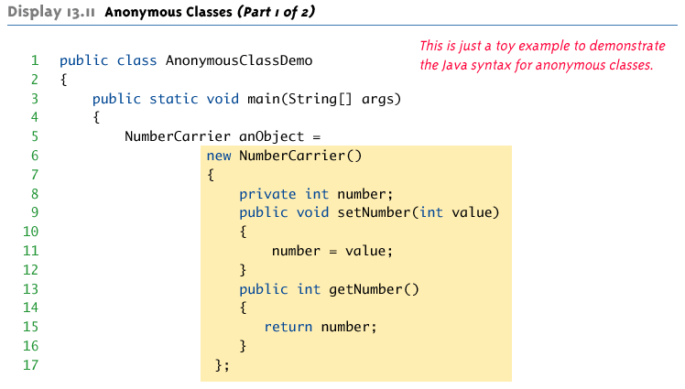
Anonymous Classes

Slide 53
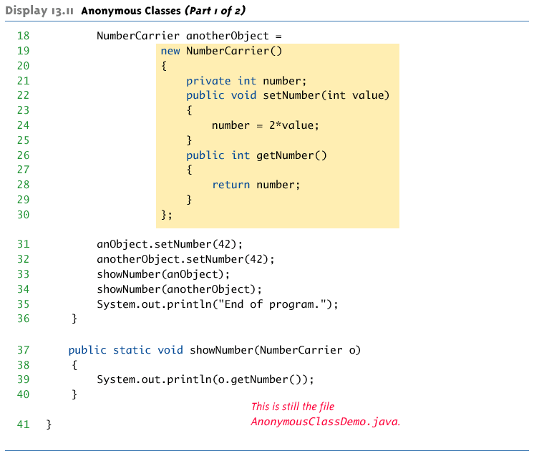
Anonymous Classes

Slide 54
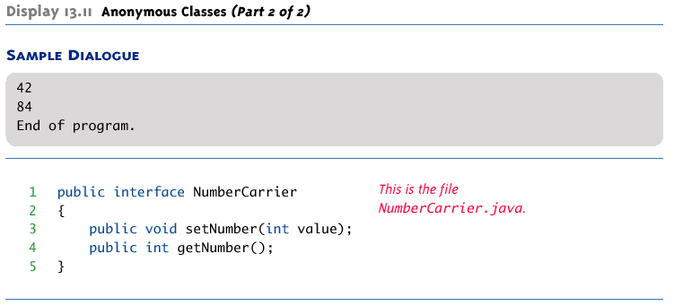
Anonymous Classes

