Slide 1
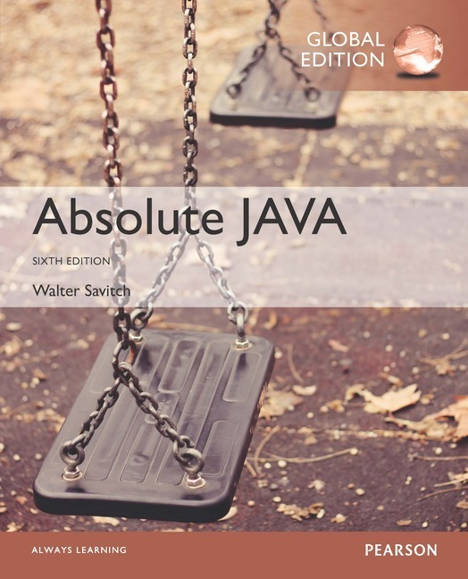
Chapter 14
Generics and the ArrayList Class
Slides prepared by Rose Williams, Binghamton University
Kenrick Mock, University of Alaska Anchorage
Copyright © 2017 Pearson Ltd. All rights reserved.

Slide 2
Introduction to Generics
Beginning with version 5.0, Java allows class and method definitions that include parameters for types
Such definitions are called generics
Generic programming with a type parameter enables code to be written that applies to any class

Slide 3
The ArrayList Class
ArrayList is a class in the standard Java libraries
Unlike arrays, which have a fixed length once they have been created, an ArrayList is an object that can grow and shrink while your program is running
In general, an ArrayList serves the same purpose as an array, except that an ArrayList can change length while the program is running

Slide 4
The ArrayList Class
The class ArrayList is implemented using an array as a private instance variable
When this hidden array is full, a new larger hidden array is created and the data is transferred to this new array

Slide 5
The ArrayList Class
Why not always use an ArrayList instead of an array?
An ArrayList is less efficient than an array
It does not have the convenient square bracket notation
The base type of an ArrayList must be a class type (or other reference type): it cannot be a primitive type
This last point is less of a problem now that Java provides automatic boxing and unboxing of primitives

Slide 6
Using the ArrayList Class
In order to make use of the ArrayList class, it must first be imported from the package java.util
An ArrayList is created and named in the same way as object of any class, except that you specify the base type as follows:
ArrayList<BaseType> aList =
new ArrayList<BaseType>();

Slide 7
Using the ArrayList Class
An initial capacity can be specified when creating an ArrayList as well
The following code creates an ArrayList that stores objects of the base type String with an initial capacity of 20 items
ArrayList<String> list =
new ArrayList<String>(20);
Specifying an initial capacity does not limit the size to which an ArrayList can eventually grow
Note that the base type of an ArrayList is specified as a type parameter

Slide 8
Using the ArrayList Class
The add method is used to set an element for the first time in an ArrayList
list.add("something");
The method name add is overloaded
There is also a two argument version that allows an item to be added at any currently used index position or at the first unused position

Slide 9
Using the ArrayList Class
The size method is used to find out how many indices already have elements in the ArrayList
int howMany = list.size();
The set method is used to replace any existing element, and the get method is used to access the value of any existing element
list.set(index, "something else");
String thing = list.get(index);

Slide 10
Tip: Summary of Adding to an ArrayList
The add method is usually used to place an element in an ArrayList position for the first time (at an ArrayList index)
The simplest add method has a single parameter for the element to be added, and adds an element at the next unused index, in order

Slide 11
Tip: Summary of Adding to an ArrayList
An element can be added at an already occupied list position by using the two-parameter version of add
This causes the new element to be placed at the index specified, and every other member of the ArrayList to be moved up by one position

Slide 12
Tip: Summary of Adding to an ArrayList
The two-argument version of add can also be used to add an element at the first unused position (if that position is known)
Any individual element can be changed using the set method
However, set can only reset an element at an index that already contains an element
In addition, the method size can be used to determine how many elements are stored in an ArrayList

Slide 13
Methods in the Class ArrayList
The tools for manipulating arrays consist only of the square brackets and the instance variable length
ArrayLists, however, come with a selection of powerful methods that can do many of the things for which code would have to be written in order to do them using arrays

Slide 14
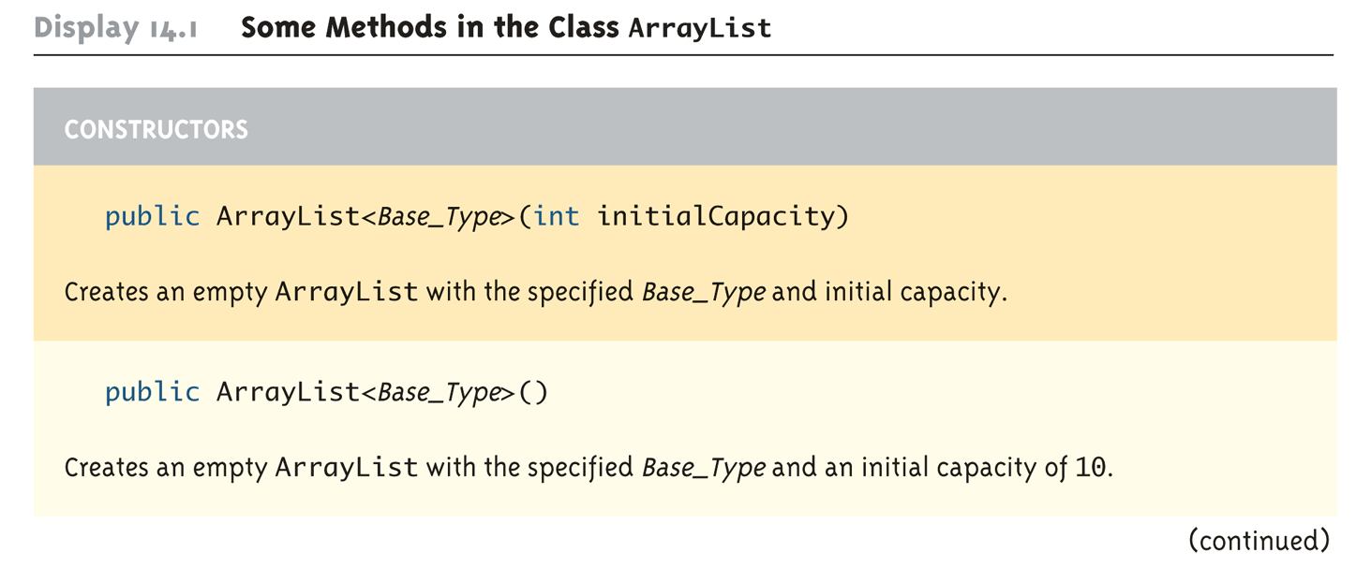
Some Methods in the Class ArrayList (Part 1 of 11)

Slide 15
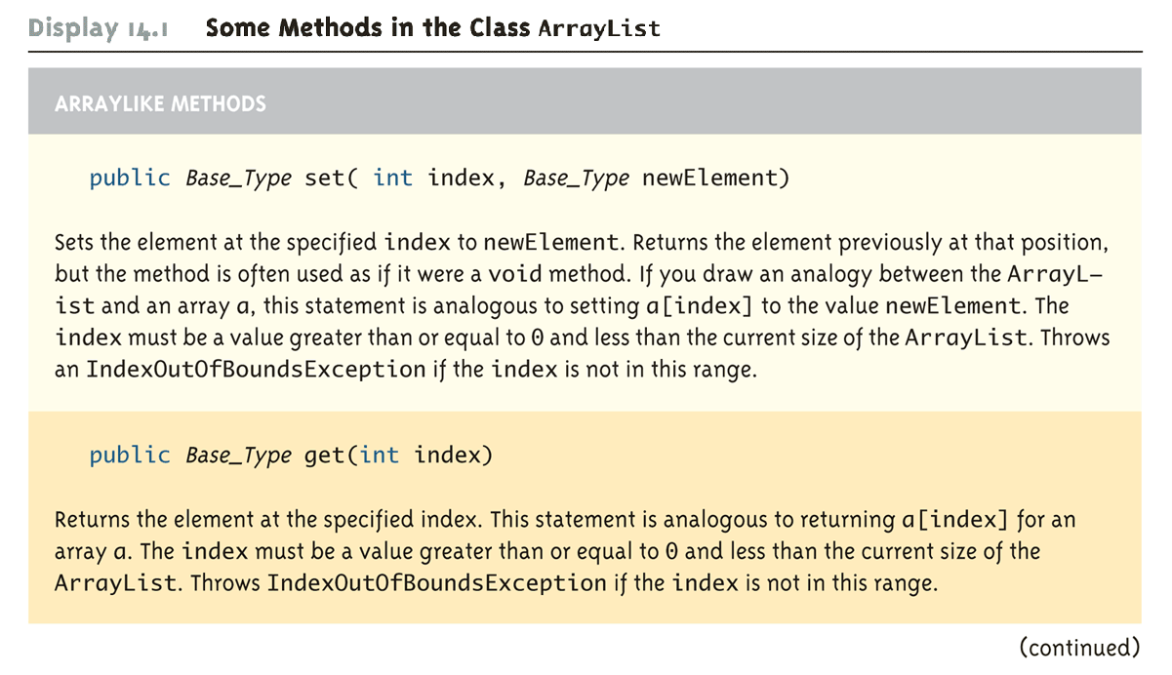
Some Methods in the Class ArrayList (Part 2 of 11)

Slide 16
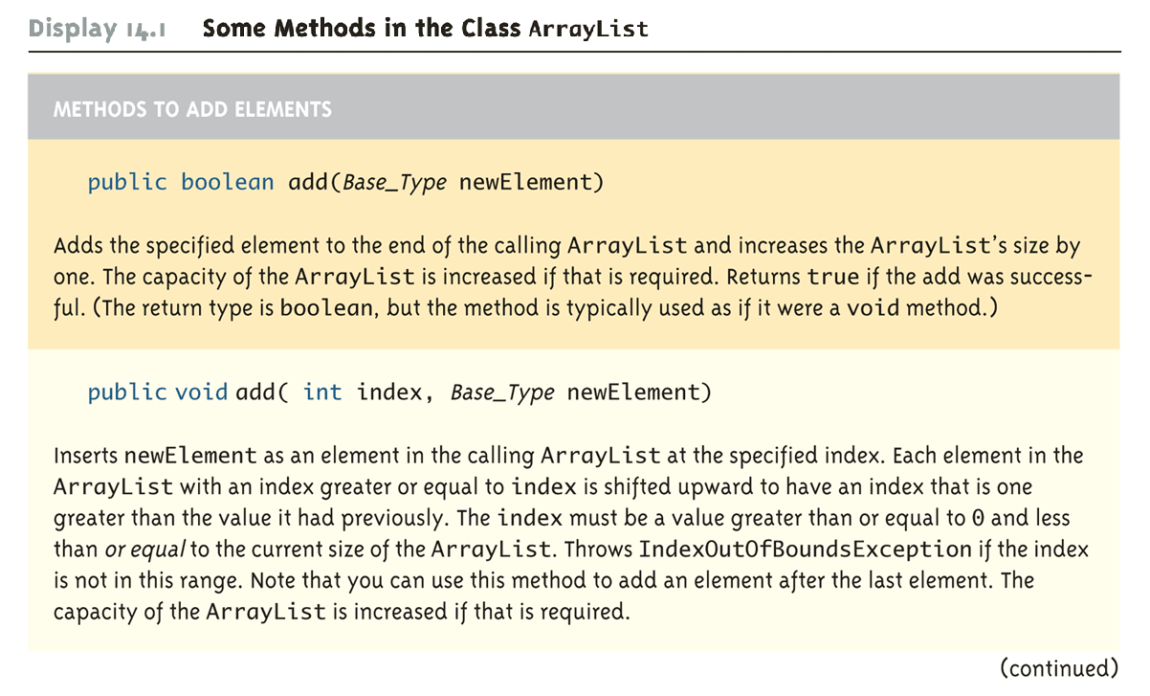
Some Methods in the Class ArrayList (Part 3 of 11)

Slide 17
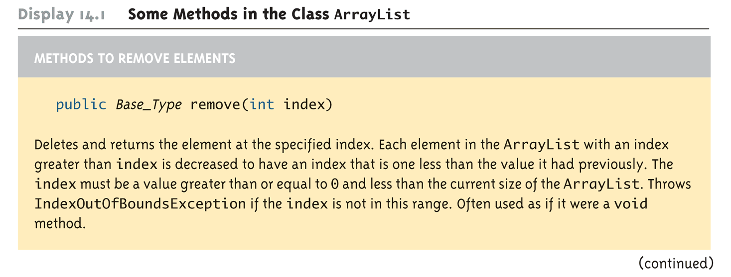
Some Methods in the Class ArrayList (Part 4 of 11)

Slide 18
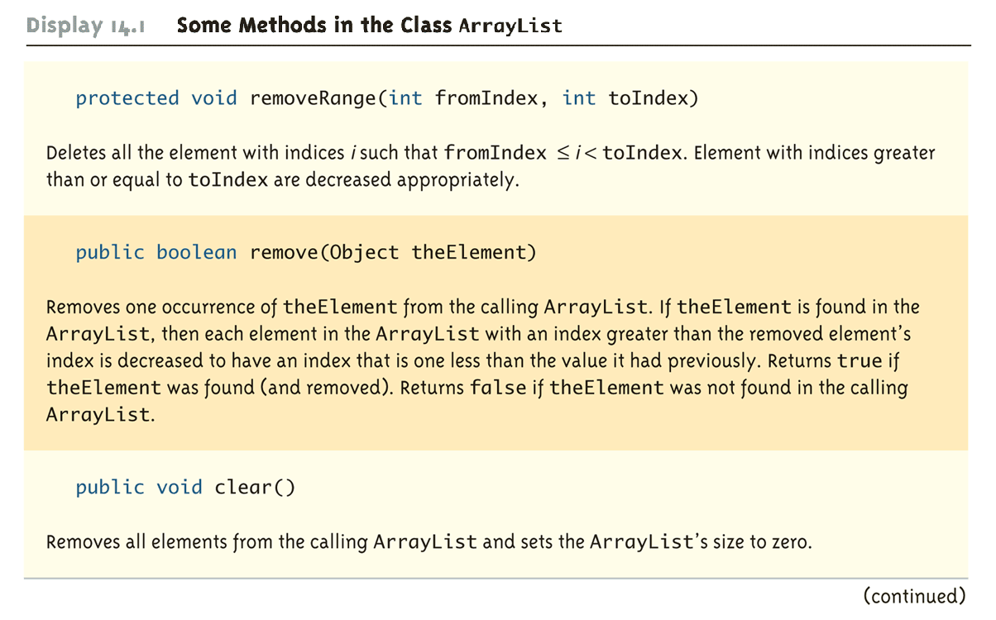
Some Methods in the Class ArrayList (Part 5 of 11)

Slide 19
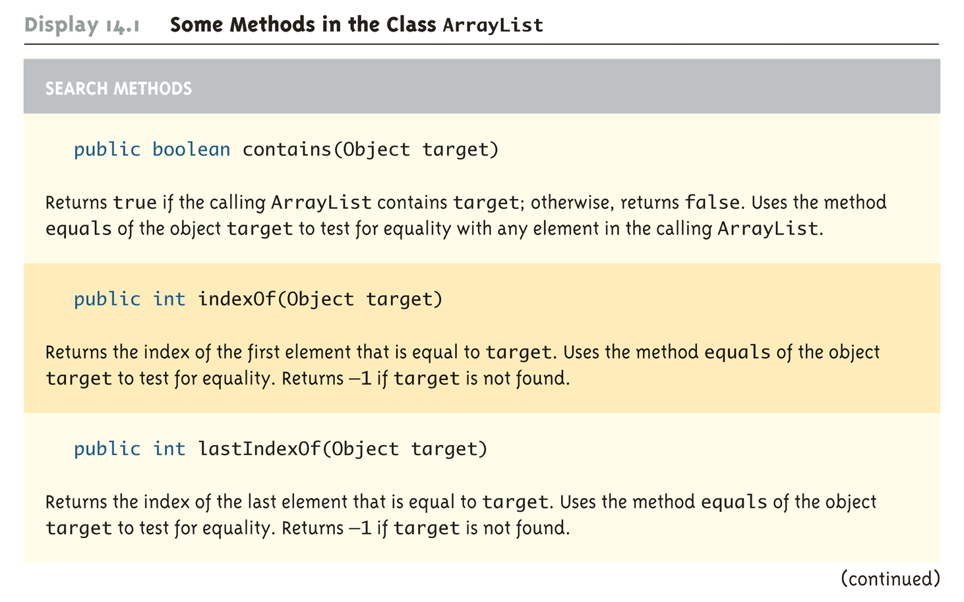
Some Methods in the Class ArrayList (Part 6 of 11)

Slide 20
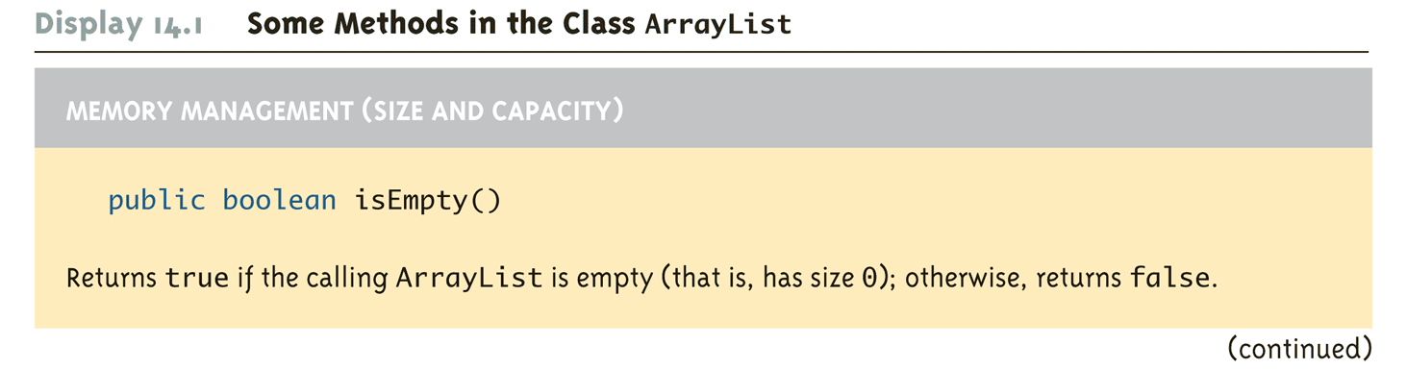
Some Methods in the Class ArrayList (Part 7 of 11)

Slide 21
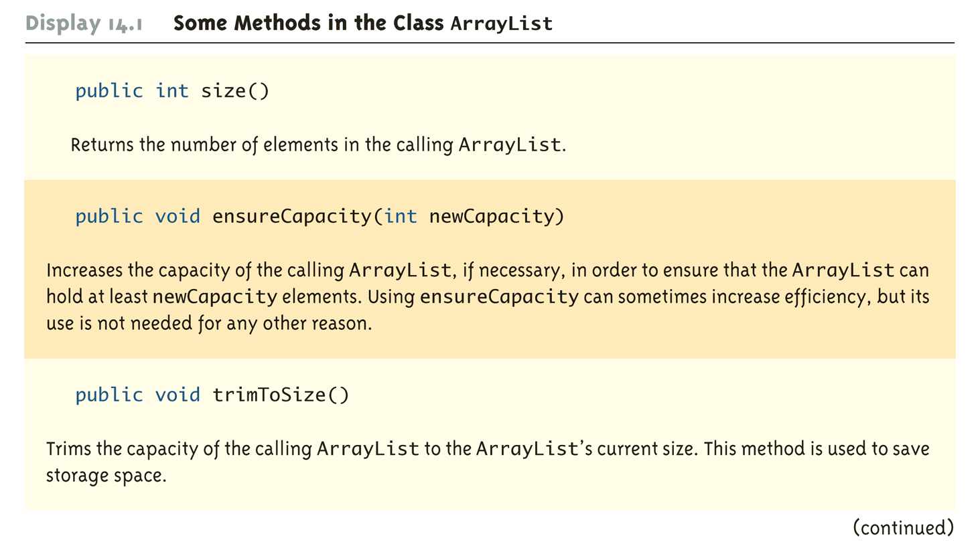
Some Methods in the Class ArrayList (Part 8 of 11)

Slide 22
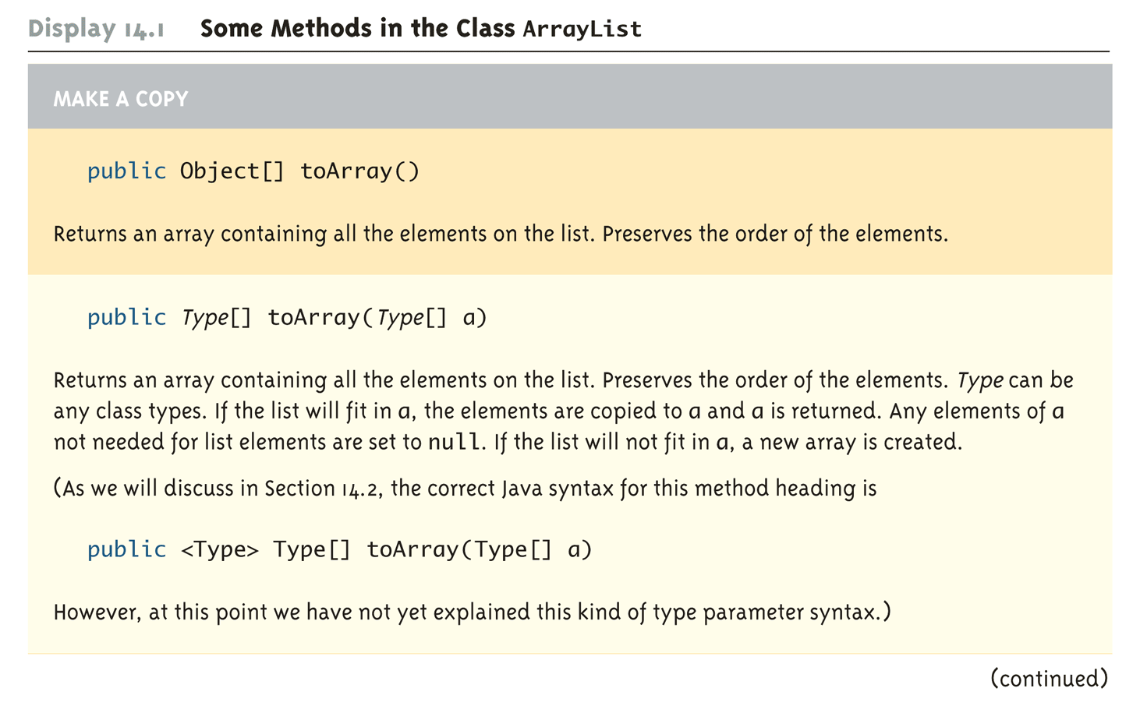
Some Methods in the Class ArrayList (Part 9 of 11)

Slide 23
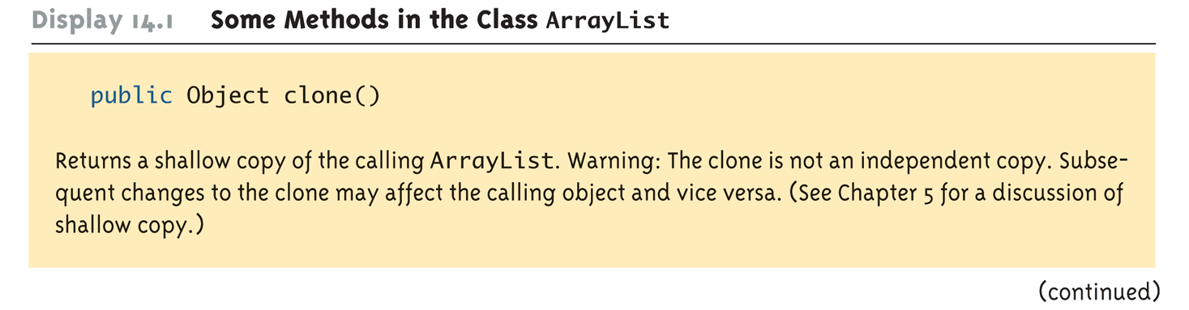
Some Methods in the Class ArrayList (Part 10 of 11)

Slide 24
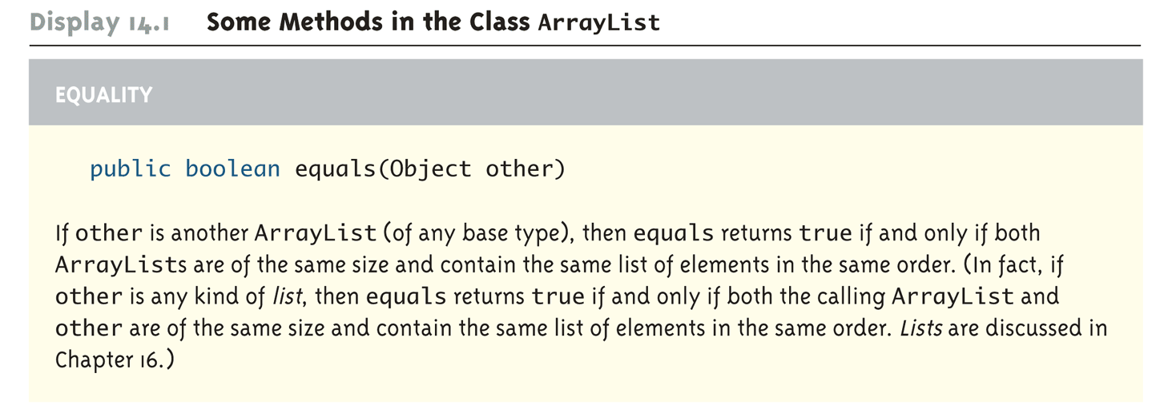
Some Methods in the Class ArrayList (Part 11 of 11)

Slide 25
Why are Some Parameters of Type Base_Type and Others of type Object
When looking at the methods available in the ArrayList class, there appears to be some inconsistency
In some cases, when a parameter is naturally an object of the base type, the parameter type is the base type
However, in other cases, it is the type Object
This is because the ArrayList class implements a number of interfaces, and inherits methods from various ancestor classes
These interfaces and ancestor classes specify that certain parameters have type Object

Slide 26
The "For Each" Loop
The ArrayList class is an example of a collection class
Starting with version 5.0, Java has added a new kind of for loop called a for-each or enhanced for loop
This kind of loop has been designed to cycle through all the elements in a collection (like an ArrayList)

Slide 27
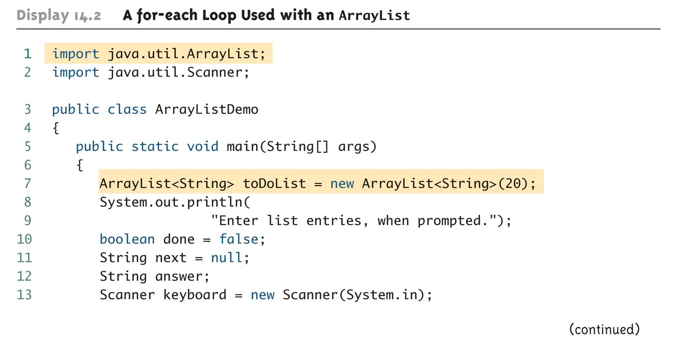
A for-each Loop Used with an ArrayList (Part 1 of 3)

Slide 28
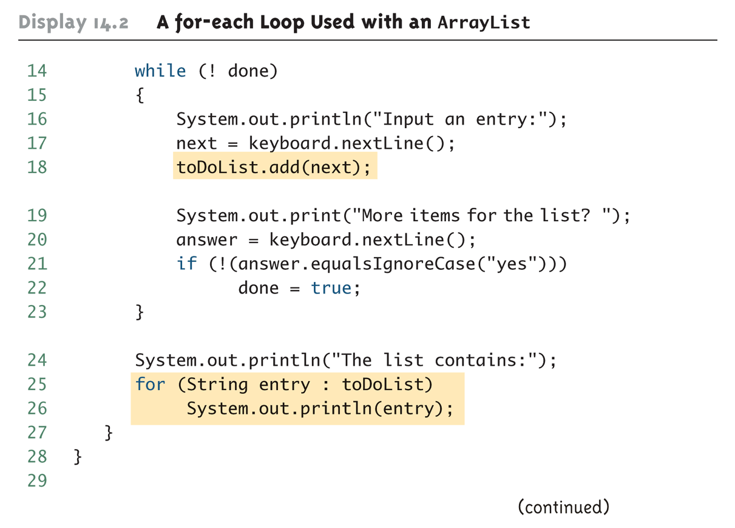
A for-each Loop Used with an ArrayList (Part 2 of 3)

Slide 29
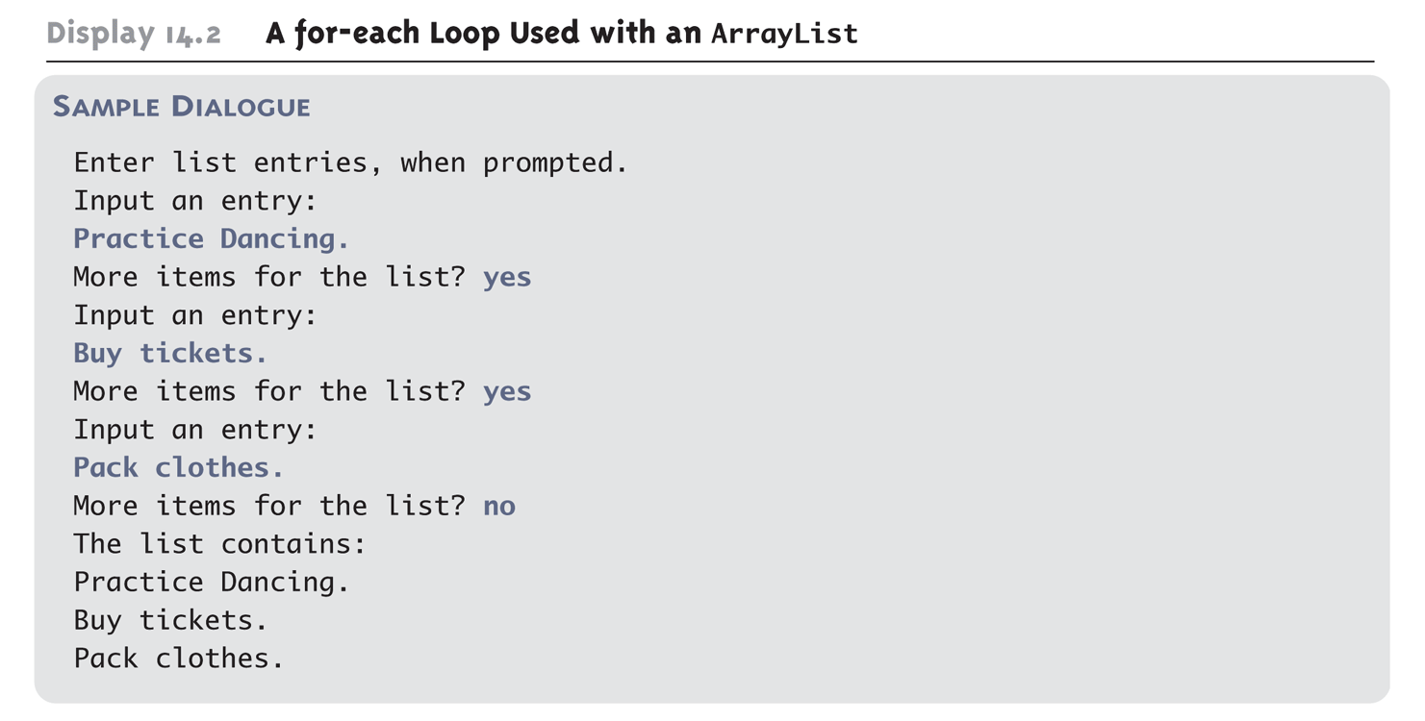
A for-each Loop Used with an ArrayList (Part 3 of 3)

Slide 30
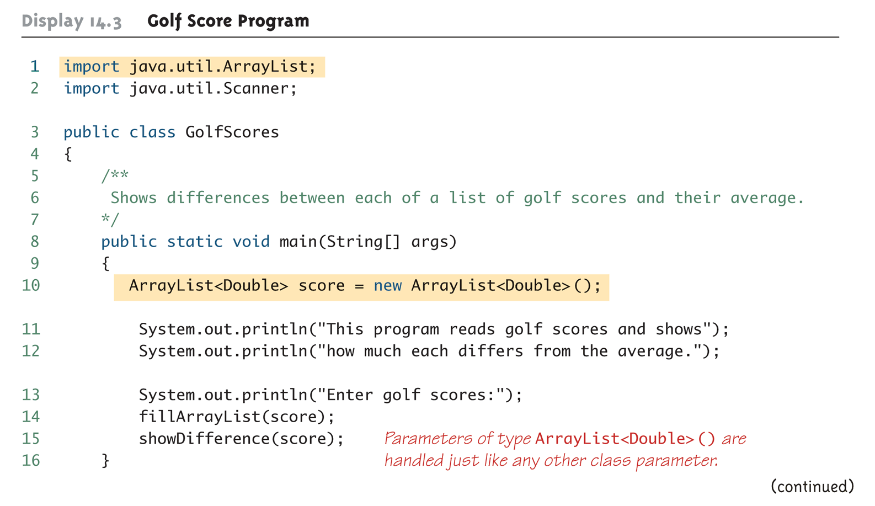
Golf Score Program (Part 1 of 6)

Slide 31
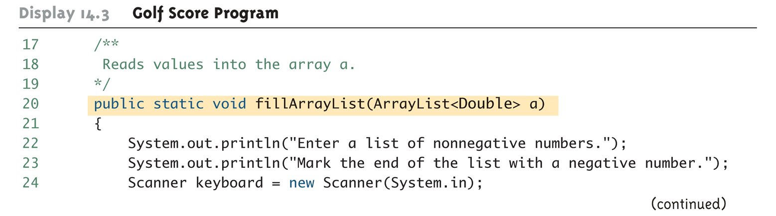
Golf Score Program (Part 2 of 6)

Slide 32
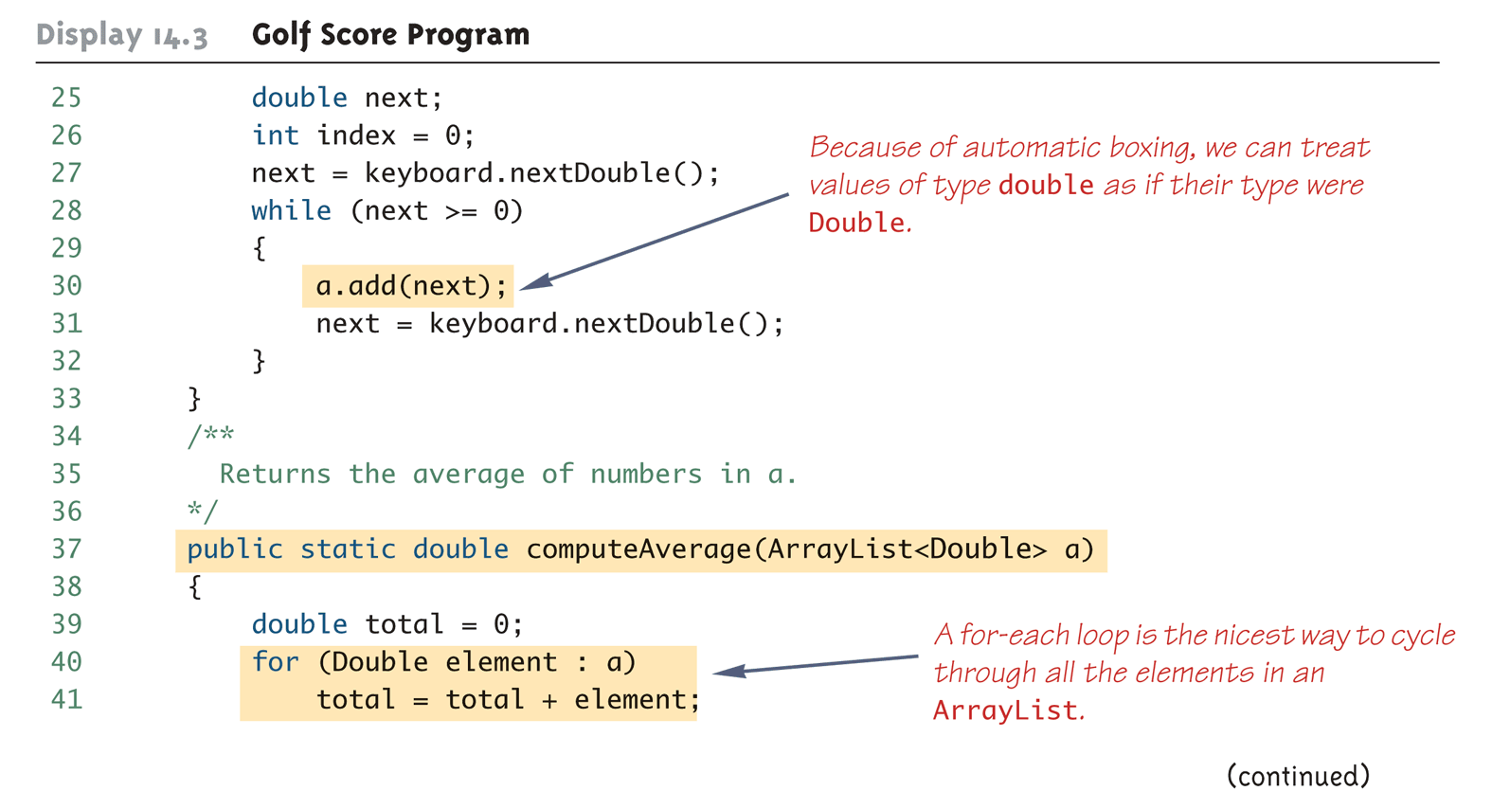
Golf Score Program (Part 3 of 6)

Slide 33
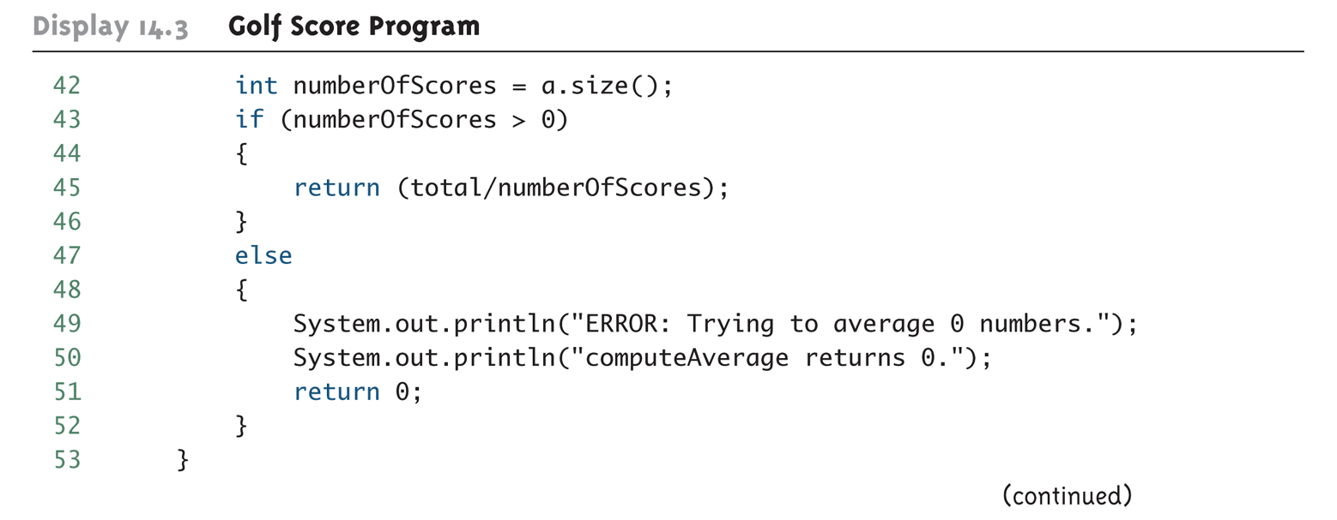
Golf Score Program (Part 4 of 6)

Slide 34
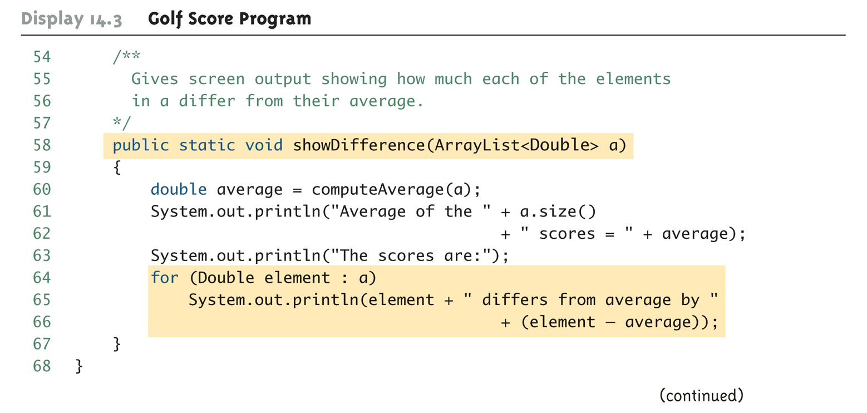
Golf Score Program (Part 5 of 6)

Slide 35
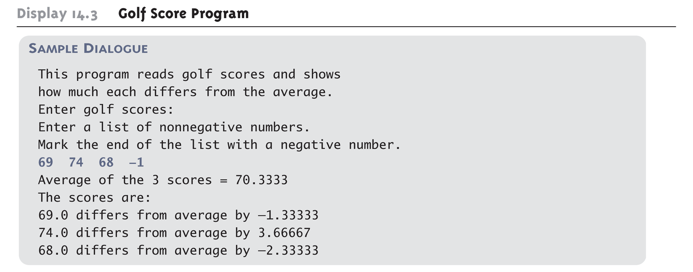
Golf Score Program (Part 6 of 6)

Slide 36
Tip: Use trimToSize to Save Memory
An ArrayList automatically increases its capacity when needed
However, the capacity may increase beyond what a program requires
In addition, although an ArrayList grows automatically when needed, it does not shrink automatically
If an ArrayList has a large amount of excess capacity, an invocation of the method trimToSize will shrink the capacity of the ArrayList down to the size needed

Slide 37
Pitfall: The clone method Makes a Shallow Copy
When a deep copy of an ArrayList is needed, using the clone method is not sufficient
Invoking clone on an ArrayList object produces a shallow copy, not a deep copy
In order to make a deep copy, it must be possible to make a deep copy of objects of the base type
Then a deep copy of each element in the ArrayList can be created and placed into a new ArrayList object

Slide 38
The Vector Class
The Java standard libraries have a class named Vector that behaves almost exactly the same as the class ArrayList
In most situations, either class could be used
However the ArrayList class is newer, and is becoming the preferred class

Slide 39
Parameterized Classes and Generics
The class ArrayList is a parameterized class
It has a parameter, denoted by Base_Type, that can be replaced by any reference type to obtain a class for ArrayLists with the specified base type
Starting with version 5.0, Java allows class definitions with parameters for types
These classes that have type parameters are called parameterized class or generic definitions, or, simply, generics

Slide 40
Nonparameterized ArrayList and Vector Classes
The ArrayList and Vector classes discussed here have a type parameter for the base type
There are also ArrayList and Vector classes with no parameter whose base type is Object
These classes are left over from earlier versions of Java

Slide 41
Generics
Classes and methods can have a type parameter
A type parameter can have any reference type (i.e., any class type) plugged in for the type parameter
When a specific type is plugged in, this produces a specific class type or method
Traditionally, a single uppercase letter is used for a type parameter, but any non-keyword identifier may be used

Slide 42
Generics
A class definition with a type parameter is stored in a file and compiled just like any other class
Once a parameterized class is compiled, it can be used like any other class
However, the class type plugged in for the type parameter must be specified before it can be used in a program
Doing this is said to instantiate the generic class
Sample<String> object =
new Sample<String>();

Slide 43
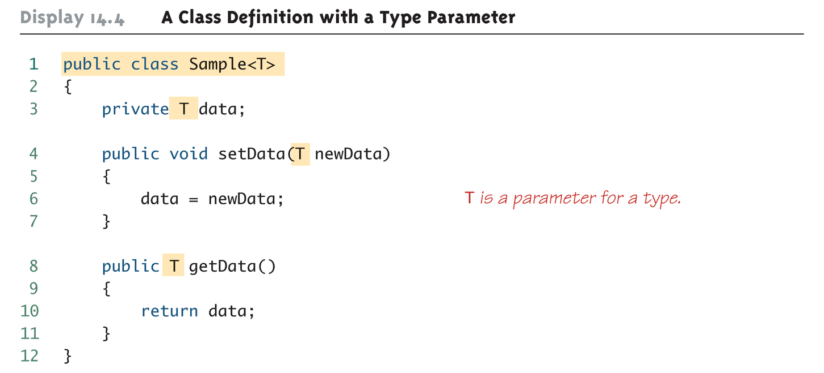
A Class Definition with a Type Parameter

Slide 44
Class Definition with a Type Parameter
A class that is defined with a parameter for a type is called a generic class or a parameterized class
The type parameter is included in angular brackets after the class name in the class definition heading
Any non-keyword identifier can be used for the type parameter, but by convention, the parameter starts with an uppercase letter
The type parameter can be used like other types used in the definition of a class

Slide 45
Tip: Compile with the -Xlint Option
There are many pitfalls that can be encountered when using type parameters
Compiling with the -Xlint option will provide more informative diagnostics of any problems or potential problems in the code
javac –Xlint Sample.java

Slide 46
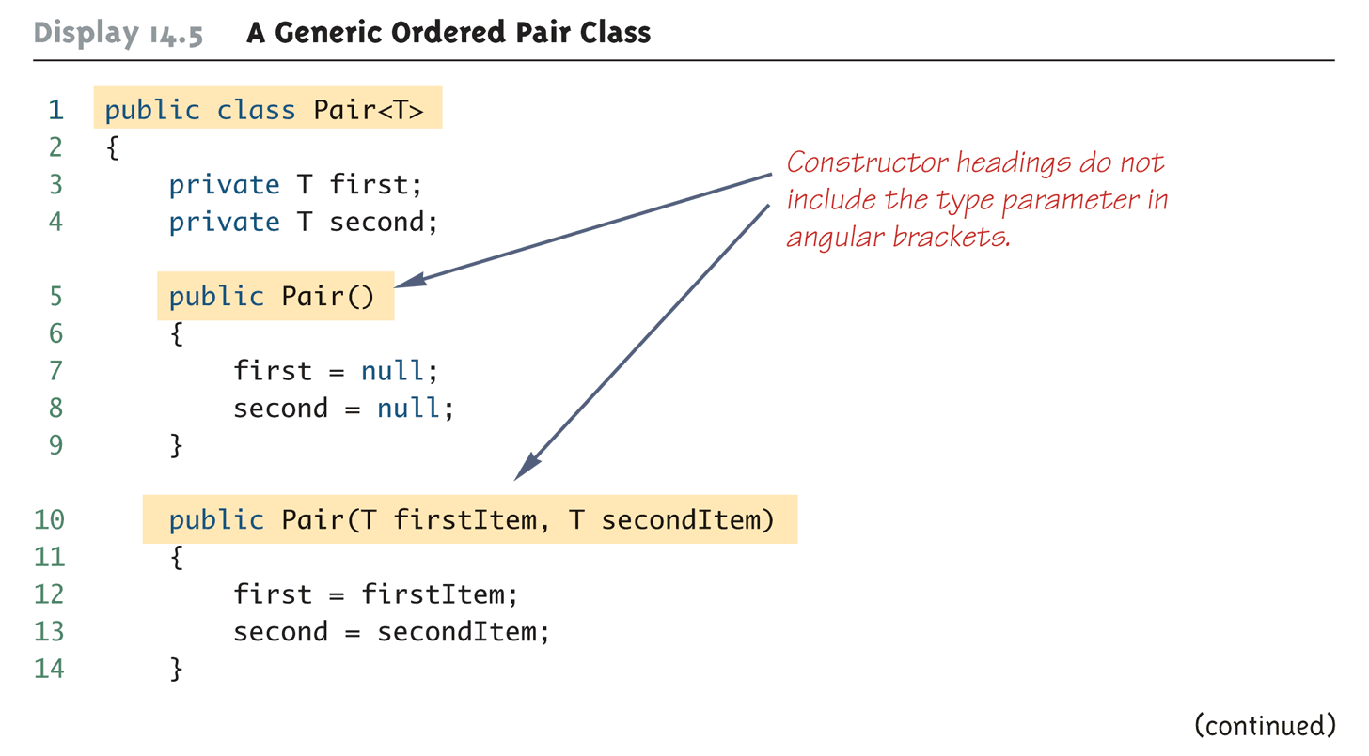
A Generic Ordered Pair Class (Part 1 of 4)

Slide 47
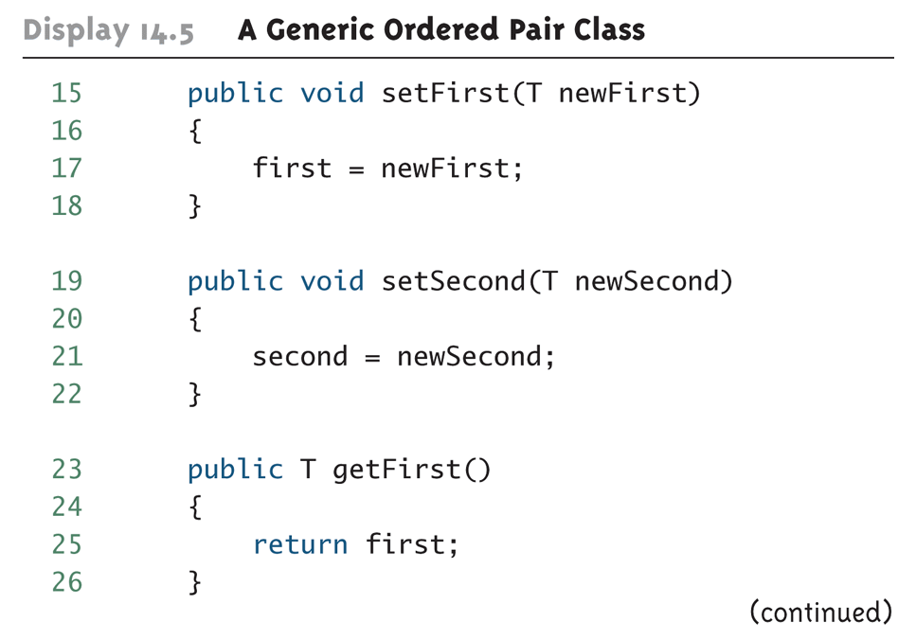
A Generic Ordered Pair Class (Part 2 of 4)

Slide 48
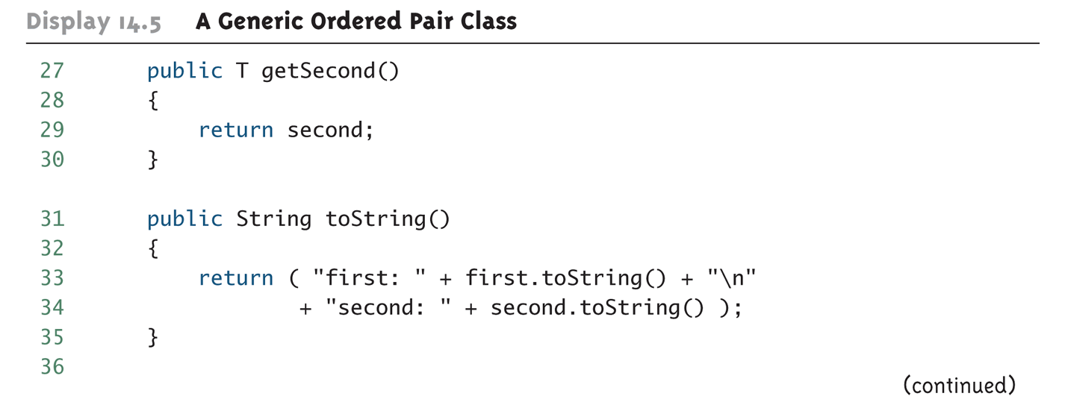
A Generic Ordered Pair Class (Part 3 of 4)

Slide 49
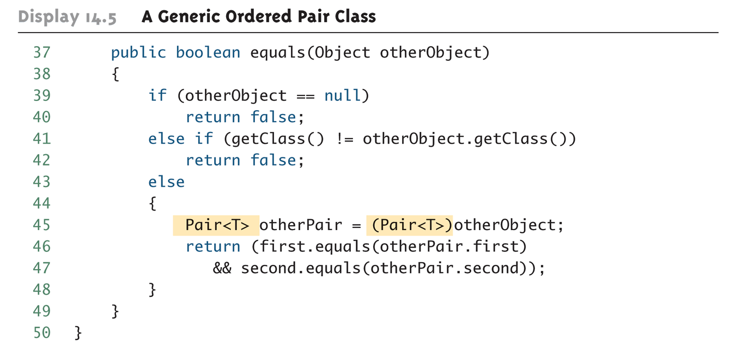
A Generic Ordered Pair Class (Part 4 of 4)

Slide 50
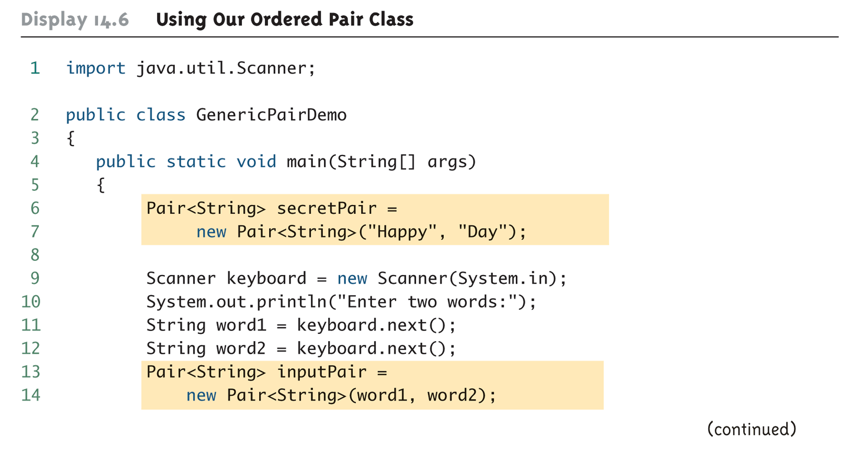
Using Our Ordered Pair Class (Part 1 of 3)

Slide 51
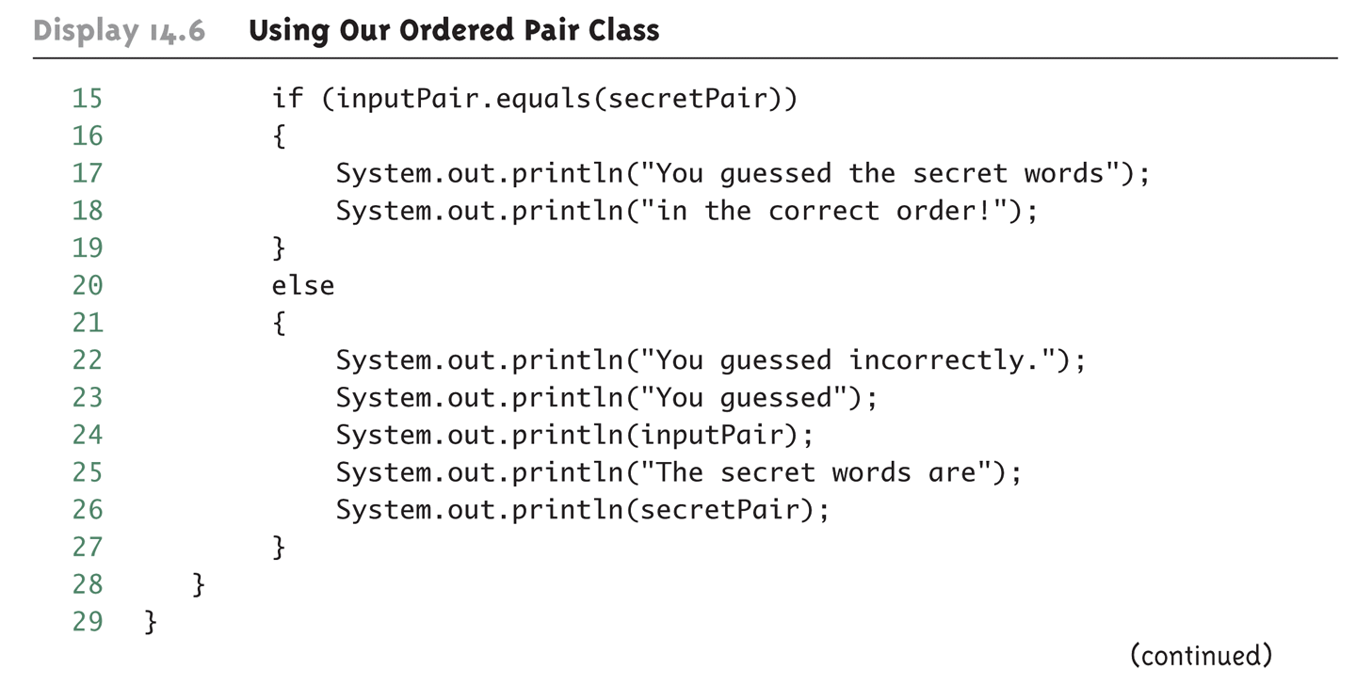
Using Our Ordered Pair Class (Part 2 of 3)

Slide 52
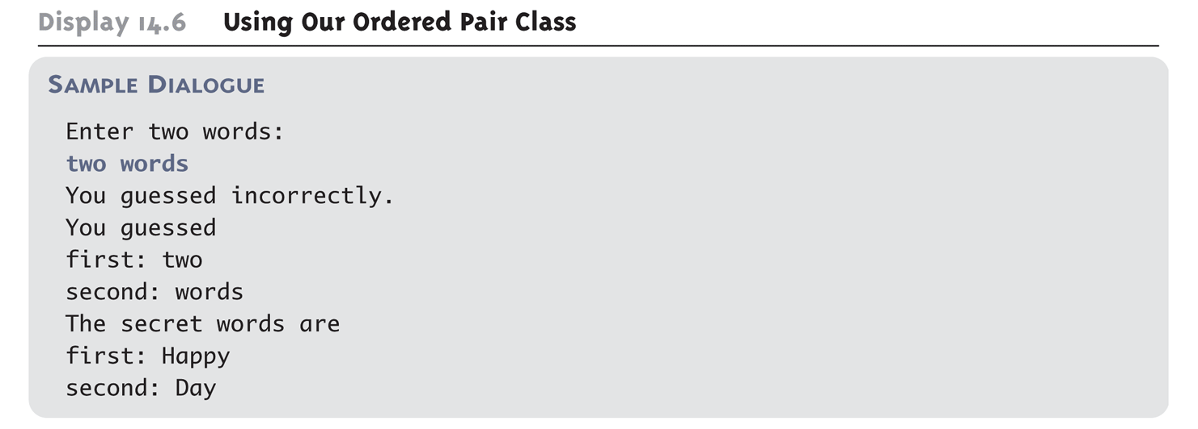
Using Our Ordered Pair Class (Part 3 of 3)

Slide 53
Pitfall: A Generic Constructor Name Has No Type Parameter
Although the class name in a parameterized class definition has a type parameter attached, the type parameter is not used in the heading of the constructor definition
public Pair<T>()
A constructor can use the type parameter as the type for a parameter of the constructor, but in this case, the angular brackets are not used
public Pair(T first, T second)
However, when a generic class is instantiated, the angular brackets are used
Pair<String> pair =
new Pair<STring>("Happy", "Day");

Slide 54
Pitfall: A Primitive Type Cannot be Plugged in for a Type Parameter
The type plugged in for a type parameter must always be a reference type
It cannot be a primitive type such as int, double, or char
However, now that Java has automatic boxing, this is not a big restriction
Note: reference types can include arrays

Slide 55
Pitfall: A Type Parameter Cannot Be Used Everywhere a Type Name Can Be Used
Within the definition of a parameterized class definition, there are places where an ordinary class name would be allowed, but a type parameter is not allowed
In particular, the type parameter cannot be used in simple expressions using new to create a new object
For instance, the type parameter cannot be used as a constructor name or like a constructor:
T object = new T();
T[] a = new T[10];

Slide 56
Pitfall: An Instantiation of a Generic Class Cannot be an Array Base Type
Arrays such as the following are illegal:
Pair<String>[] a =
new Pair<String>[10];
Although this is a reasonable thing to want to do, it is not allowed given the way that Java implements generic classes

Slide 57
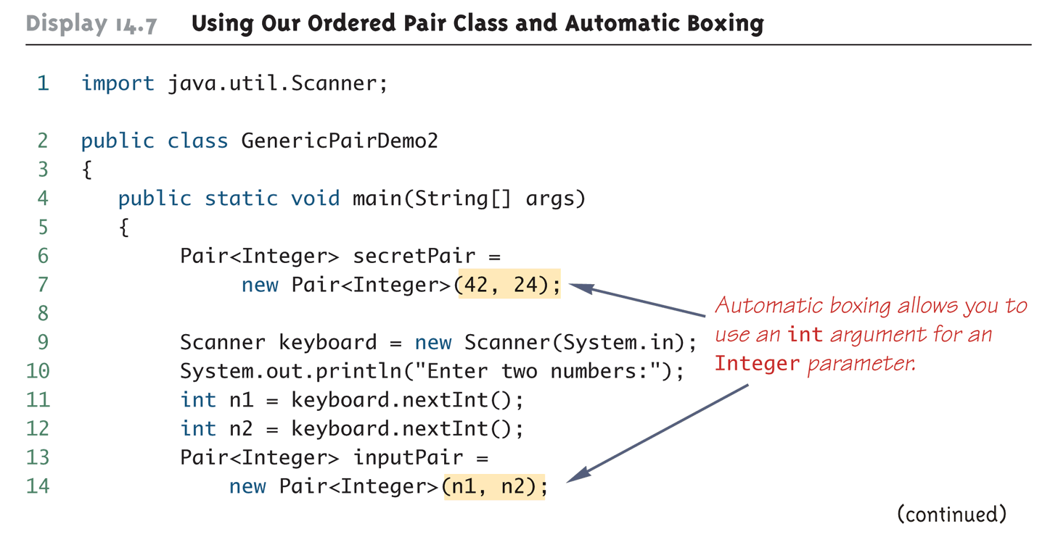
Using Our Ordered Pair Class and Automatic Boxing (Part 1 of 3)

Slide 58
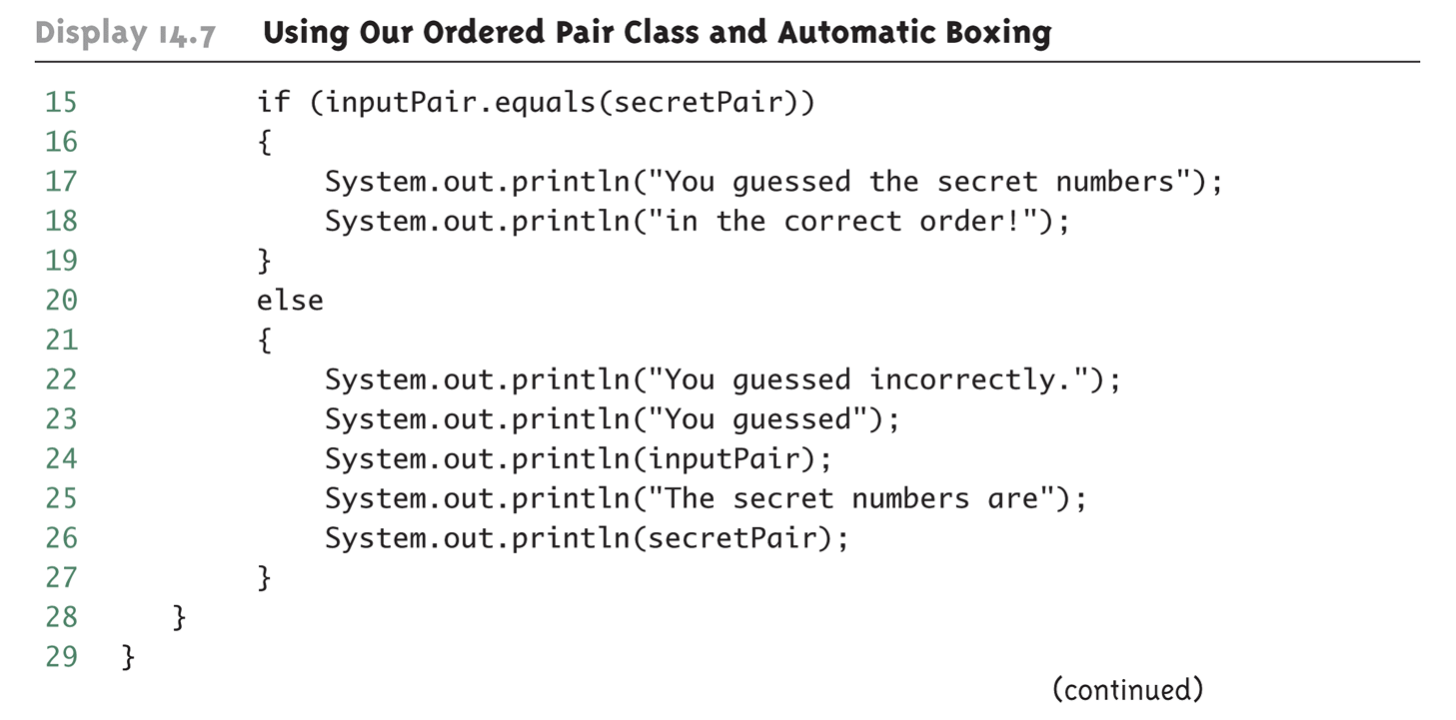
Using Our Ordered Pair Class and Automatic Boxing (Part 2 of 3)

Slide 59
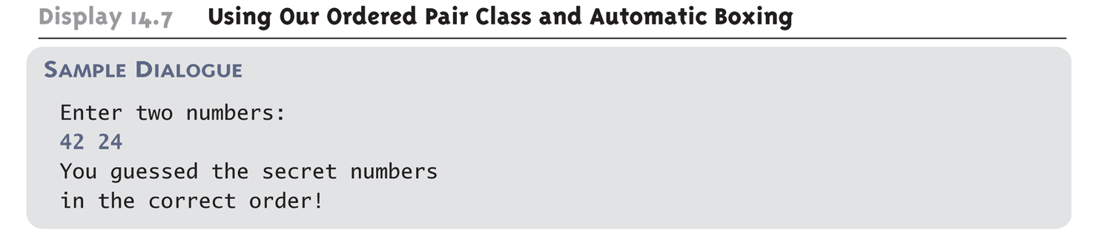
Using Our Ordered Pair Class and Automatic Boxing (Part 3 of 3)

Slide 60
Pitfall: A Class Definition Can Have More Than One Type Parameter
A generic class definition can have any number of type parameters
Multiple type parameters are listed in angular brackets just as in the single type parameter case, but are separated by commas

Slide 61
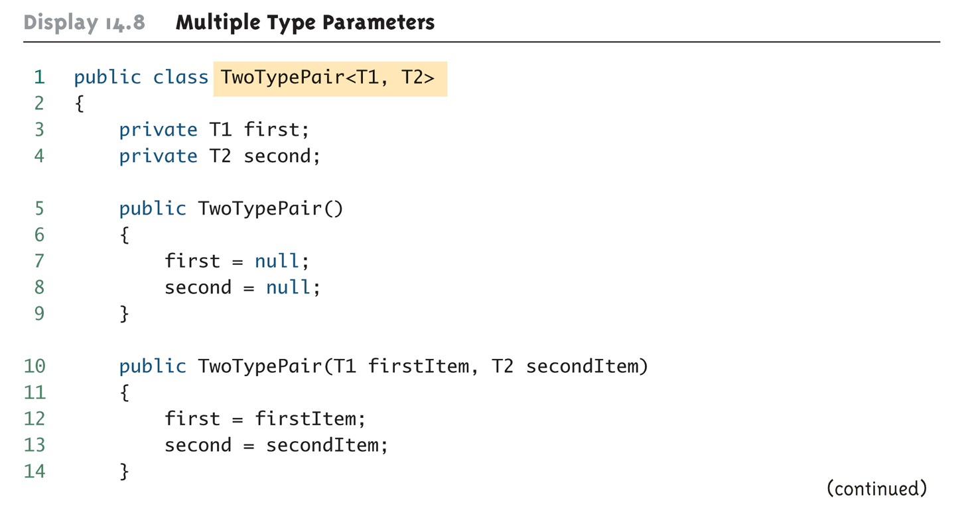
Multiple Type Parameters (Part 1 of 4)

Slide 62
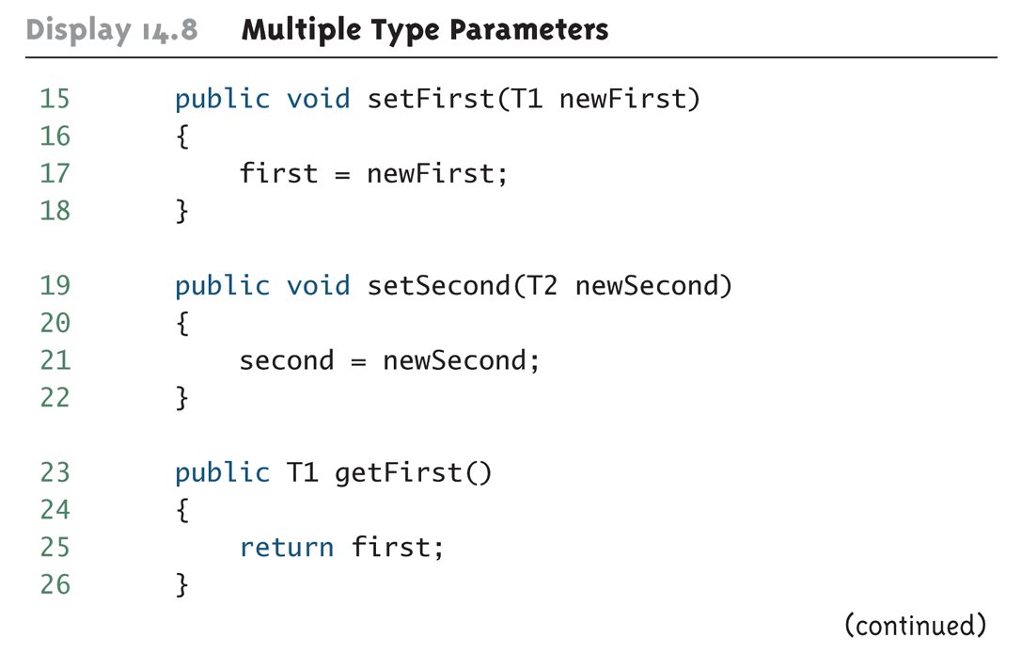
Multiple Type Parameters (Part 2 of 4)

Slide 63
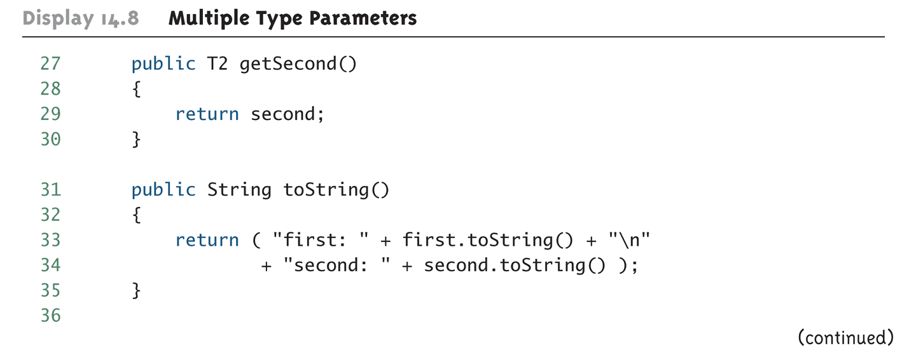
Multiple Type Parameters (Part 3 of 4)

Slide 64
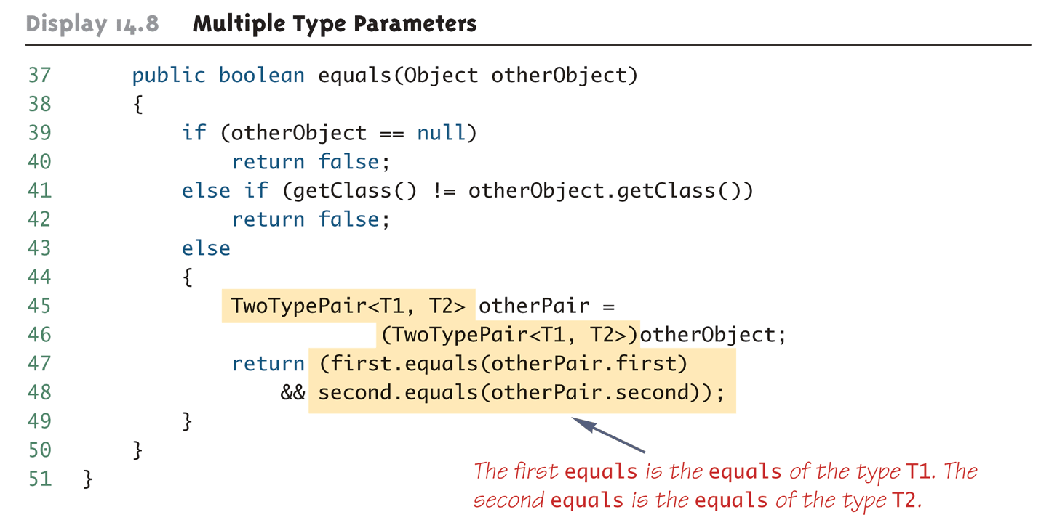
Multiple Type Parameters (Part 4 of 4)

Slide 65
Pitfall: A Generic Class Cannot Be an Exception Class
It is not permitted to create a generic class with Exception, Error, Throwable, or any descendent class of Throwable
A generic class cannot be created whose objects are throwable
public class Gex<T> extends Exception
The above example will generate a compiler error message

Slide 66
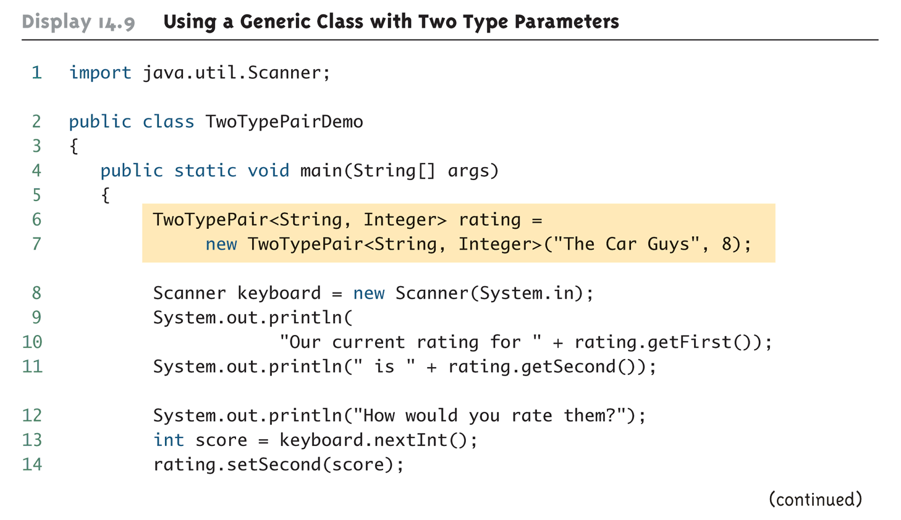
Using a Generic Class with Two Type Parameters (Part 1 of 2)

Slide 67
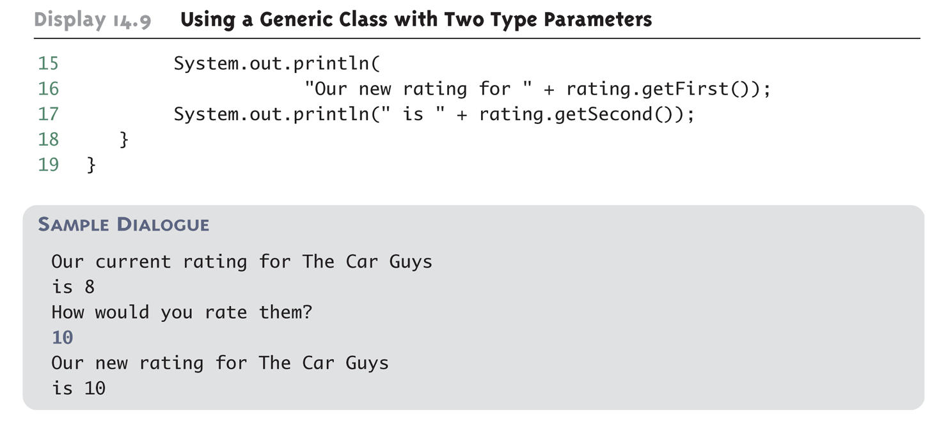
Using a Generic Class with Two Type Parameters (Part 2 of 2)

Slide 68
Bounds for Type Parameters
Sometimes it makes sense to restrict the possible types that can be plugged in for a type parameter T
For instance, to ensure that only classes that implement the Comparable interface are plugged in for T, define a class as follows:
public class RClass<T extends Comparable>
"extends Comparable" serves as a bound on the type parameter T
Any attempt to plug in a type for T which does not implement the Comparable interface will result in a compiler error message

Slide 69
Bounds for Type Parameters
A bound on a type may be a class name (rather than an interface name)
Then only descendent classes of the bounding class may be plugged in for the type parameters
public class ExClass<T extends Class1>
A bounds expression may contain multiple interfaces and up to one class
If there is more than one type parameter, the syntax is as follows:
public class Two<T1 extends Class1, T2 extends Class2 & Comparable>

Slide 70
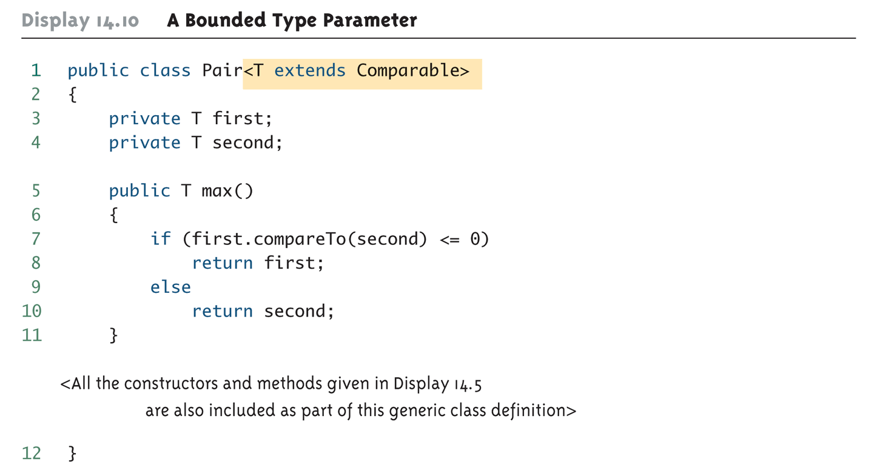
A Bounded Type Parameter

Slide 71
Tip: Generic Interfaces
An interface can have one or more type parameters
The details and notation are the same as they are for classes with type parameters

Slide 72
Generic Methods
When a generic class is defined, the type parameter can be used in the definitions of the methods for that generic class
In addition, a generic method can be defined that has its own type parameter that is not the type parameter of any class
A generic method can be a member of an ordinary class or a member of a generic class that has some other type parameter
The type parameter of a generic method is local to that method, not to the class

Slide 73
Generic Methods
The type parameter must be placed (in angular brackets) after all the modifiers, and before the returned type
public static <T> T genMethod(T[] a)
When one of these generic methods is invoked, the method name is prefaced with the type to be plugged in, enclosed in angular brackets
String s = NonG.<String>genMethod(c);

Slide 74
Inheritance with Generic Classes
A generic class can be defined as a derived class of an ordinary class or of another generic class
As in ordinary classes, an object of the subclass type would also be of the superclass type
Given two classes: A and B, and given G: a generic class, there is no relationship between G<A> and G<B>
This is true regardless of the relationship between class A and B, e.g., if class B is a subclass of class A

Slide 75
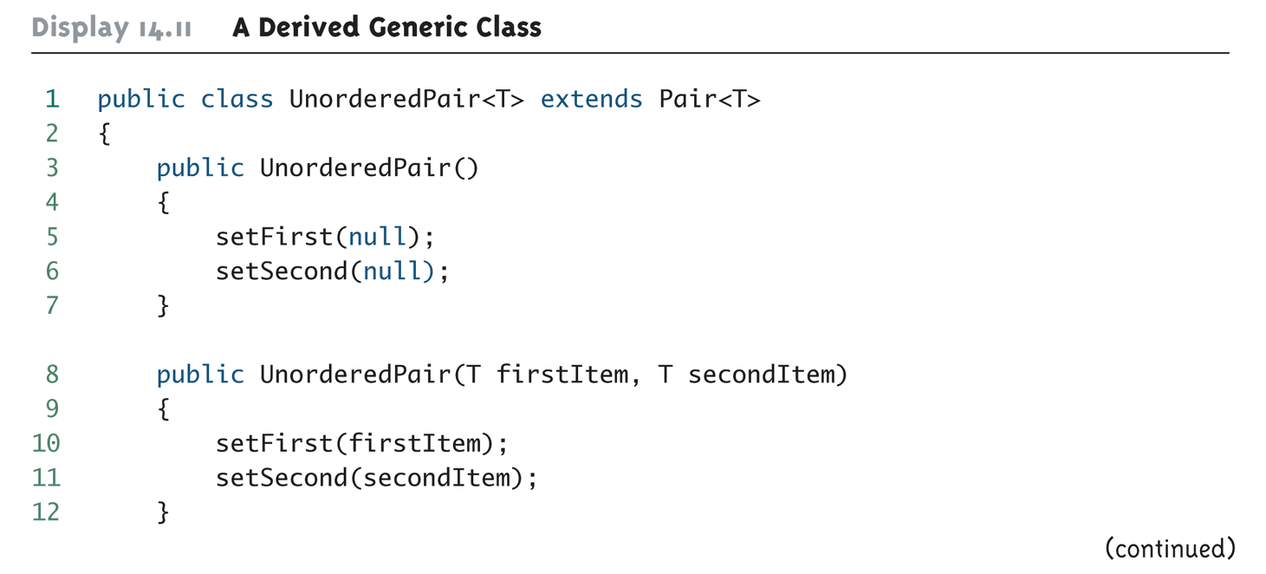
A Derived Generic Class (Part 1 of 2)

Slide 76
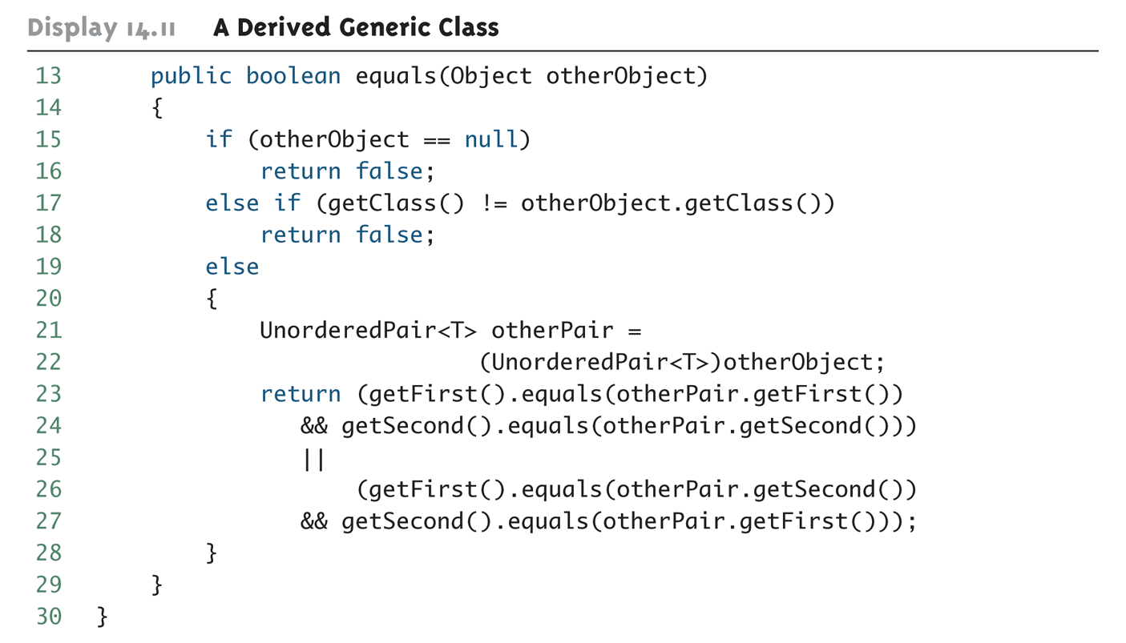
A Derived Generic Class (Part 2 of 2)

Slide 77
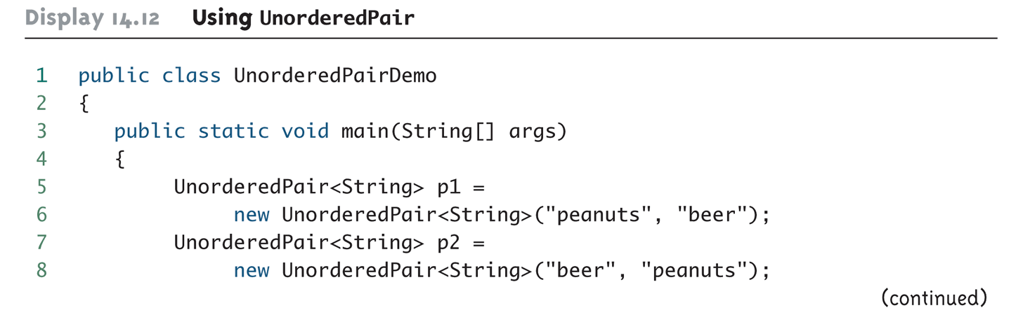
Using UnorderedPair (Part 1 of 2)

Slide 78
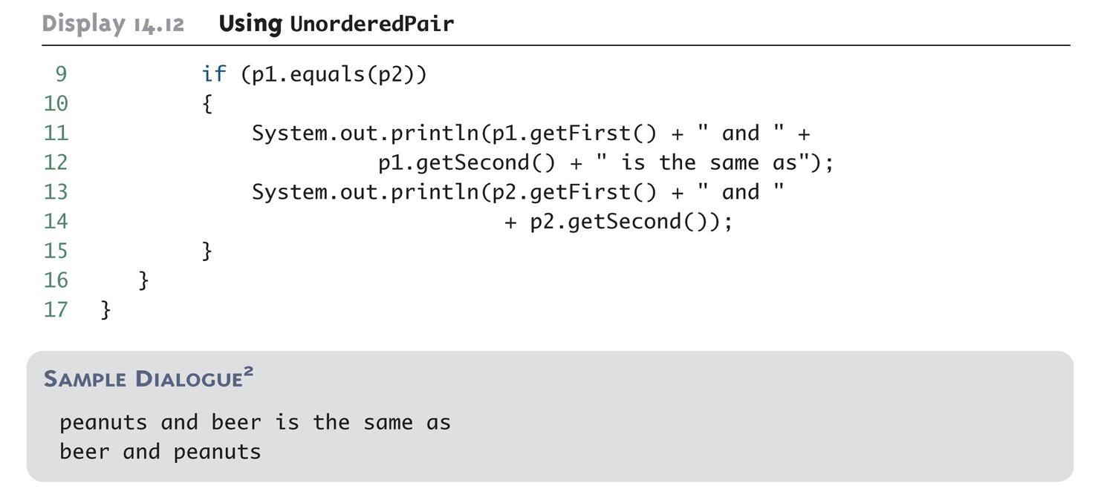
Using UnorderedPair (Part 2 of 2)

