Slide 1
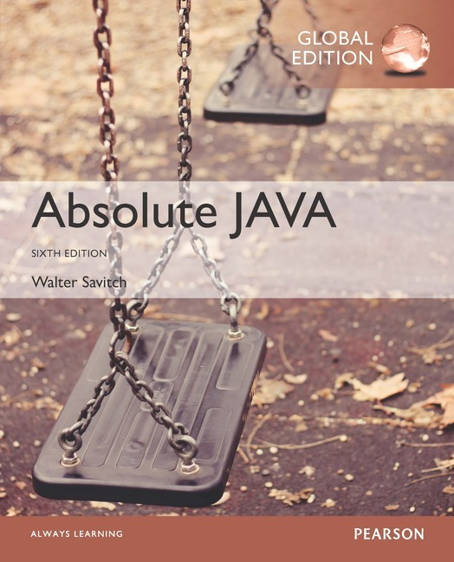
Chapter 2
Console Input and Output
Slides prepared by Rose Williams, Binghamton University
Kenrick Mock, University of Alaska Anchorage
Copyright © 2017 Pearson Ltd. All rights reserved.

Slide 2
System.out.println for console output
System.out is an object that is part of the Java language
println is a method invoked by the System.out object that can be used for console output
The data to be output is given as an argument in parentheses
A plus sign is used to connect more than one item
Every invocation of println ends a line of output
System.out.println("The answer is " + 42);

Slide 3
println Versus print
Another method that can be invoked by the System.out object is print
The print method is like println, except that it does not end a line
With println, the next output goes on a new line
With print, the next output goes on the same line

Slide 4
Formatting Output with printf
Starting with version 5.0, Java includes a method named printf that can be used to produce output in a specific format
The Java method printf is similar to the print method
Like print, printf does not advance the output to the next line
System.out.printf can have any number of arguments
The first argument is always a format string that contains one or more format specifiers for the remaining arguments
All the arguments except the first are values to be output to the screen

Slide 5
printf Format Specifier
The code
double price = 19.8;
System.out.print("$");
System.out.printf("%6.2f", price);
System.out.println(" each");
will output the line
$ 19.80 each
The format string "%6.2f" indicates the following:
End any text to be output and start the format specifier (%)
Display up to 6 right-justified characters, pad fewer than six characters on the left with blank spaces (i.e., field width is 6)
Display exactly 2 digits after the decimal point (.2)
Display a floating point number, and end the format specifier (i.e., the conversion character is f)

Slide 6
Right and Left Justification in printf
The code
double value = 12.123;
System.out.printf("Start%8.2fEnd", value);
System.out.println();
System.out.printf("Start%-8.2fEnd", value);
System.out.println();
will output the following
Start 12.12End
Start12.12 End
The format string "Start%8.2fEnd" produces output that is right justified with three blank spaces before the 12.12
The format string "Start%-8.2fEnd" produces output that is left justified with three blank spaces after the 12.12

Slide 7
Multiple arguments with printf
The following code contains a printf statement having three arguments
The code
double price = 19.8;
String name = "magic apple";
System.out.printf("$%6.2f for each %s.",
price, name);
System.out.println();
System.out.println("Wow");
will output
$ 19.80 for each magic apple.
Wow
Note that the first argument is a format string containing two format specifiers (%6.2f and %s)
These format specifiers match up with the two arguments that follow (price and name)

Slide 8
Line Breaks with printf
Line breaks can be included in a format string using %n
The code
double price = 19.8;
String name = "magic apple";
System.outprintf("$%6.2f for each %s.%n", price, name);
System.out.println("Wow");
will output
$ 19.80 for each magic apple.
Wow

Slide 9
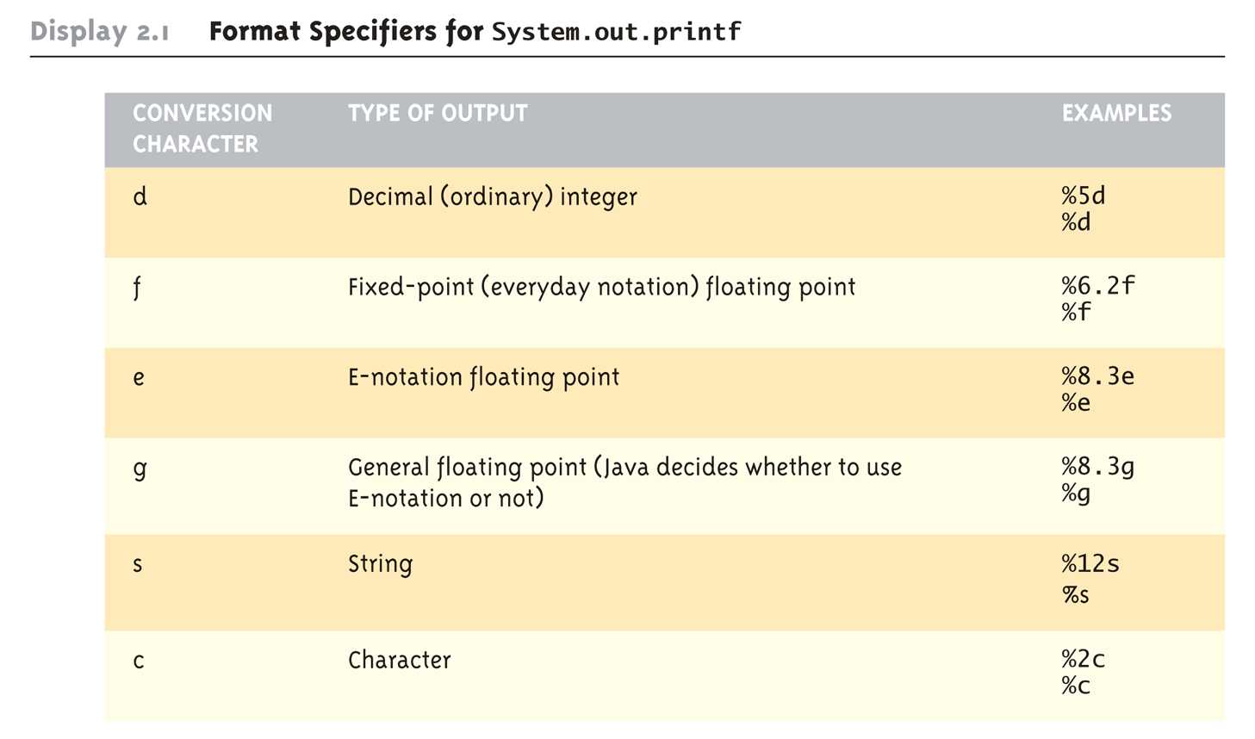
Format Specifiers for System.out.printf

Slide 10
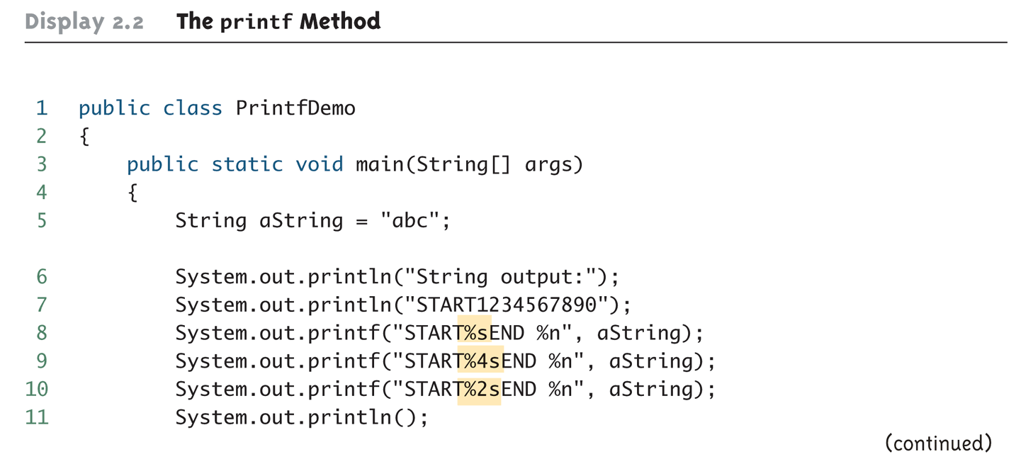
The printf Method (Part 1 of 3)

Slide 11
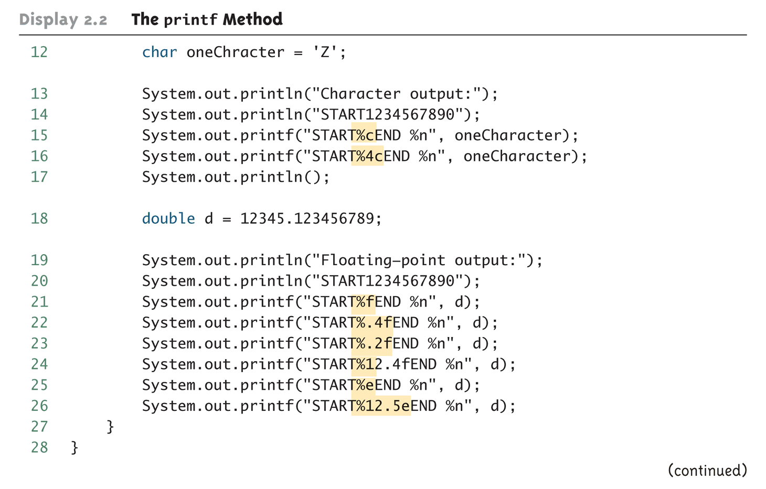
The printf Method (Part 2 of 3)

Slide 12
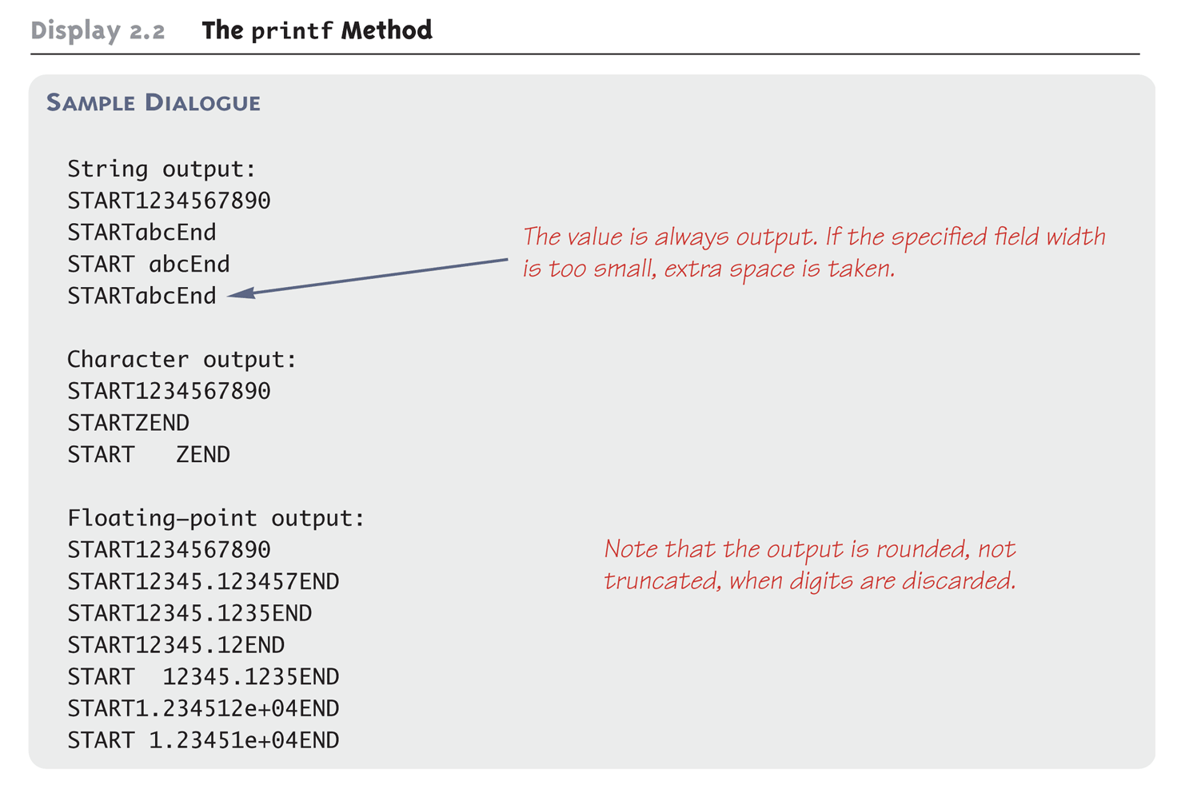
The printf Method (Part 3 of 3)

Slide 13
Formatting Money Amounts with printf
A good format specifier for outputting an amount of money stored as a double type is %.2f
It says to include exactly two digits after the decimal point and to use the smallest field width that the value will fit into:
double price = 19.99;
System.out.printf("The price is $%.2f each.")
produces the output:
The price is $19.99 each.

Slide 14
Legacy Code
Code that is "old fashioned" but too expensive to replace is called legacy code
Sometimes legacy code is translated into a more modern language
The Java method printf is just like a C language function of the same name
This was done intentionally to make it easier to translate C code into Java

Slide 15
Money Formats
Using the NumberFormat class enables a program to output amounts of money using the appropriate format
The NumberFormat class must first be imported in order to use it
import java.text.NumberFormat
An object of NumberFormat must then be created using the getCurrencyInstance() method
The format method takes a floating-point number as an argument and returns a String value representation of the number in the local currency

Slide 16
Money Formats
import java.text.NumberFormat;
public class CurrencyFormatDemo
{
public static void main(String[] args)
{
System.out.println("Default location:");
NumberFormat moneyFormater =
NumberFormat.getCurrencyInstance();
System.out.println(moneyFormater.format(19.8));
System.out.println(moneyFormater.format(19.81111));
System.out.println(moneyFormater.format(19.89999));
System.out.println(moneyFormater.format(19));
System.out.println();
}
}

Slide 17
Money Formats
Output of the previous program
Default location:
$19.80
$19.81
$19.90
$19.00

Slide 18
Specifying Locale
Invoking the getCurrencyInstance() method without any arguments produces an object that will format numbers according to the default location
In contrast, the location can be explicitly specified by providing a location from the Locale class as an argument to the getCurrencyInstance() method
When doing so, the Locale class must first be imported
import java.util.Locale;

Slide 19
Specifiying Locale
import java.text.NumberFormat;
import java.util.Locale;
public class CurrencyFormatDemo
{
public static void main(String[] args)
{
System.out.println("US as location:");
NumberFormat moneyFormater2 =
NumberFormat.getCurrencyInstance(Locale.US);
System.out.println(moneyFormater2.format(19.8));
System.out.println(moneyFormater2.format(19.81111));
System.out.println(moneyFormater2.format(19.89999));
System.out.println(moneyFormater2.format(19));
}
}

Slide 20
Specifying Locale
Output of the previous program
US as location:
$19.80
$19.81
$19.90
$19.00

Slide 21
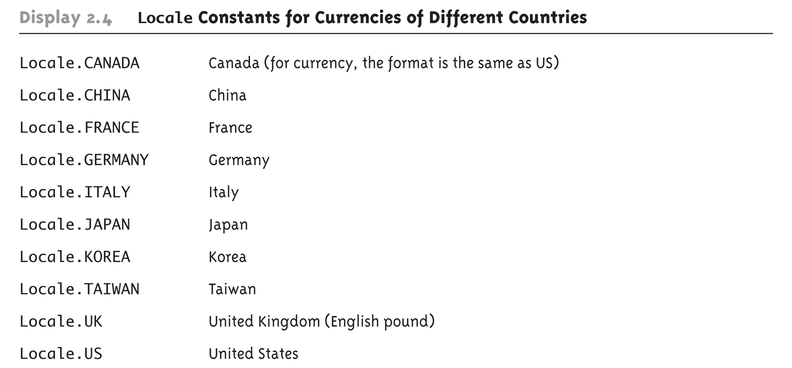
Locale Constants for Currencies of Different Countries

Slide 22
Importing Packages and Classes
Libraries in Java are called packages
A package is a collection of classes that is stored in a manner that makes it easily accessible to any program
In order to use a class that belongs to a package, the class must be brought into a program using an import statement
Classes found in the package java.lang are imported automatically into every Java program
import java.text.NumberFormat;
// import theNumberFormat class only
import java.text.*;
//import all the classes in package java.text

Slide 23
The DecimalFormat Class
Using the DecimalFormat class enables a program to format numbers in a variety of ways
The DecimalFormat class must first be imported
A DecimalFormat object is associated with a pattern when it is created using the new command
The object can then be used with the method format to create strings that satisfy the format
An object of the class DecimalFormat has a number of different methods that can be used to produce numeral strings in various formats

Slide 24
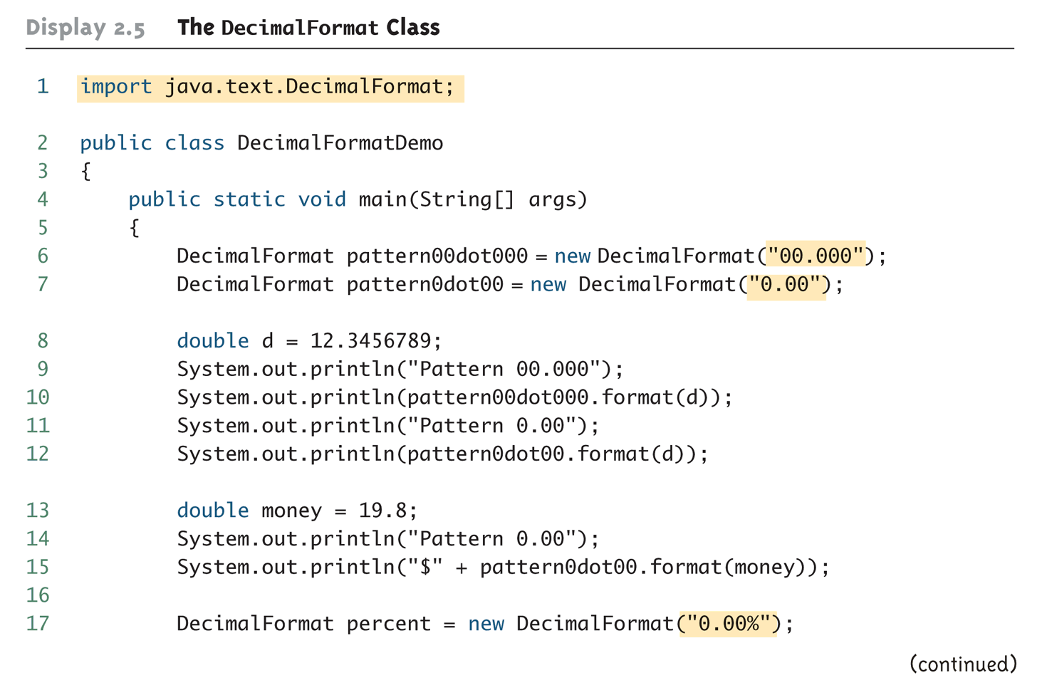
The DecimalFormat Class (Part 1 of 3)

Slide 25
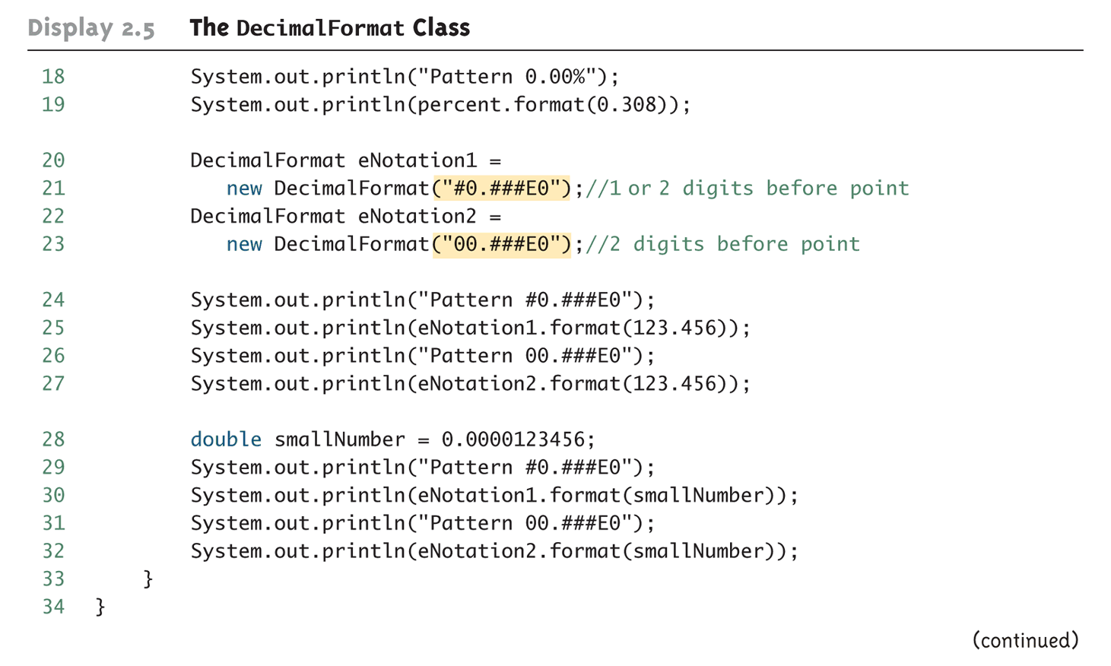
The DecimalFormat Class (Part 2 of 3)

Slide 26
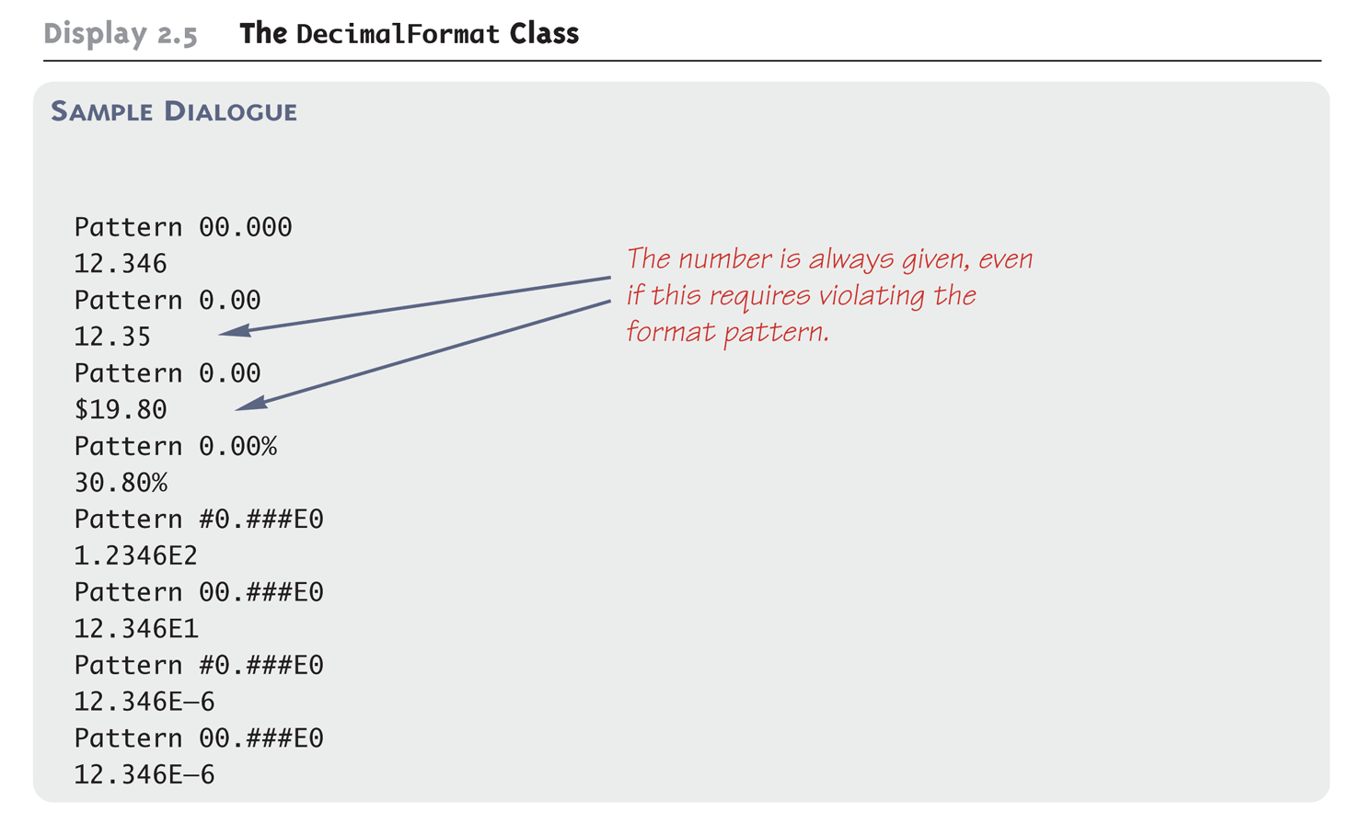
The DecimalFormat Class (Part 3 of 3)

Slide 27
Console Input Using the Scanner Class
Starting with version 5.0, Java includes a class for doing simple keyboard input named the Scanner class
In order to use the Scanner class, a program must include the following line near the start of the file:
import java.util.Scanner
This statement tells Java to
Make the Scanner class available to the program
Find the Scanner class in a library of classes (i.e., Java package) named java.util

Slide 28
Console Input Using the Scanner Class
The following line creates an object of the class Scanner and names the object keyboard :
Scanner keyboard = new Scanner(System.in);
Although a name like keyboard is often used, a Scanner object can be given any name
For example, in the following code the Scanner object is named scannerObject
Scanner scannerObject = new Scanner(System.in);
Once a Scanner object has been created, a program can then use that object to perform keyboard input using methods of the Scanner class

Slide 29
Console Input Using the Scanner Class
The method nextInt reads one int value typed in at the keyboard and assigns it to a variable:
int numberOfPods = keyboard.nextInt();
The method nextDouble reads one double value typed in at the keyboard and assigns it to a variable:
double d1 = keyboard.nextDouble();
Multiple inputs must be separated by whitespace and read by multiple invocations of the appropriate method
Whitespace is any string of characters, such as blank spaces, tabs, and line breaks that print out as white space

Slide 30
Console Input Using the Scanner Class
The method next reads one string of non-whitespace characters delimited by whitespace characters such as blanks or the beginning or end of a line
Given the code
String word1 = keyboard.next();
String word2 = keyboard.next();
and the input line
jelly beans
The value of word1 would be jelly, and the value of word2 would be beans

Slide 31
Console Input Using the Scanner Class
The method nextLine reads an entire line of keyboard input
The code,
String line = keyboard.nextLine();
reads in an entire line and places the string that is read into the variable line
The end of an input line is indicated by the escape sequence '\n'
This is the character input when the Enter key is pressed
On the screen it is indicated by the ending of one line and the beginning of the next line
When nextLine reads a line of text, it reads the '\n' character, so the next reading of input begins on the next line
However, the '\n' does not become part of the string value returned (e.g., the string named by the variable line above does not end with the '\n' character)

Slide 32
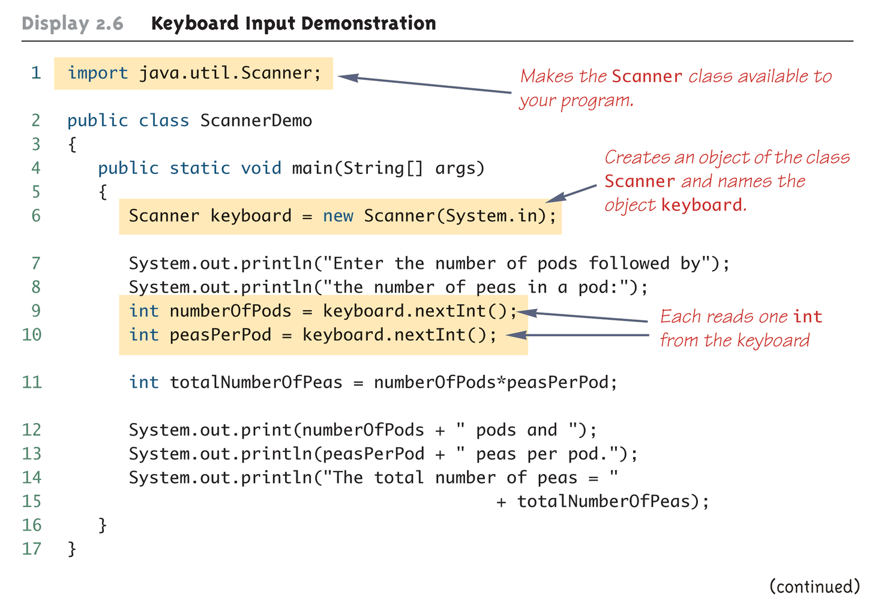
Keyboard Input Demonstration (Part 1 of 2)

Slide 33
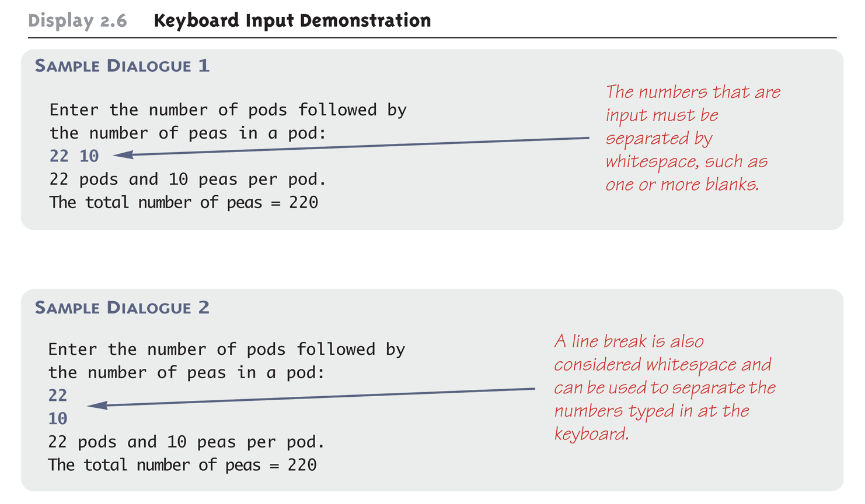
Keyboard Input Demonstration (Part 2 of 2)

Slide 34
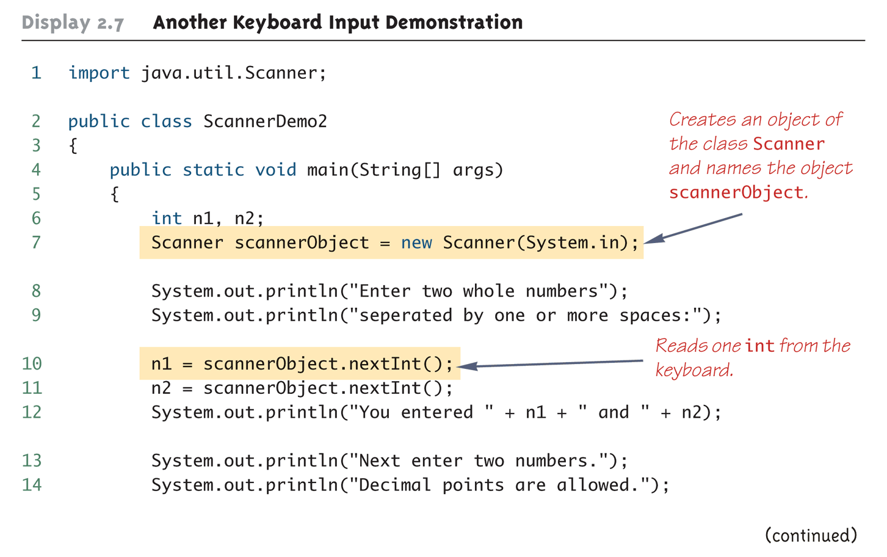
Another Keyboard Input Demonstration (Part 1 of 3)

Slide 35
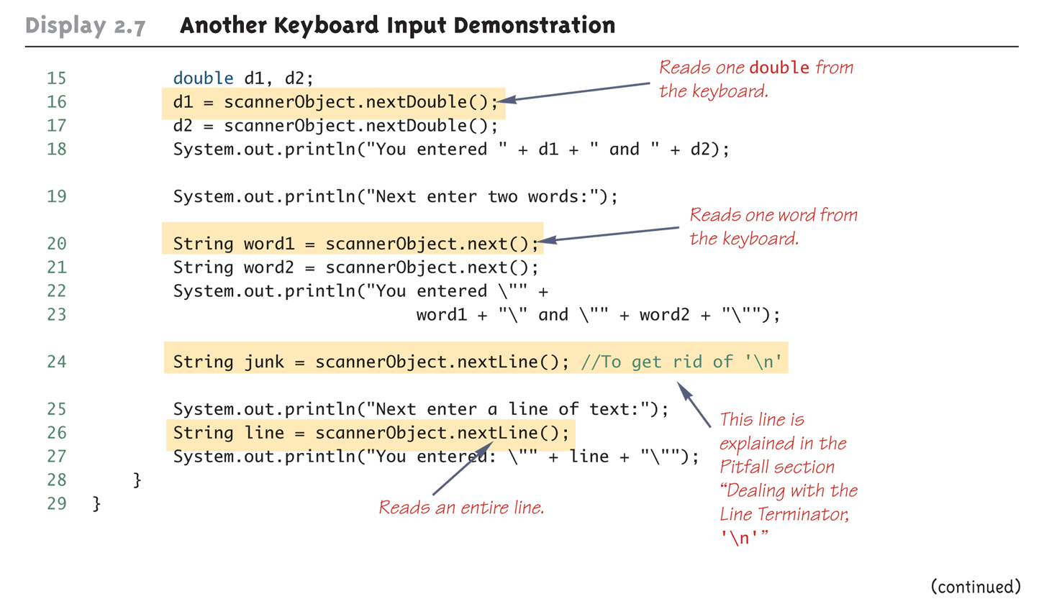
Another Keyboard Input Demonstration (Part 2 of 3)

Slide 36
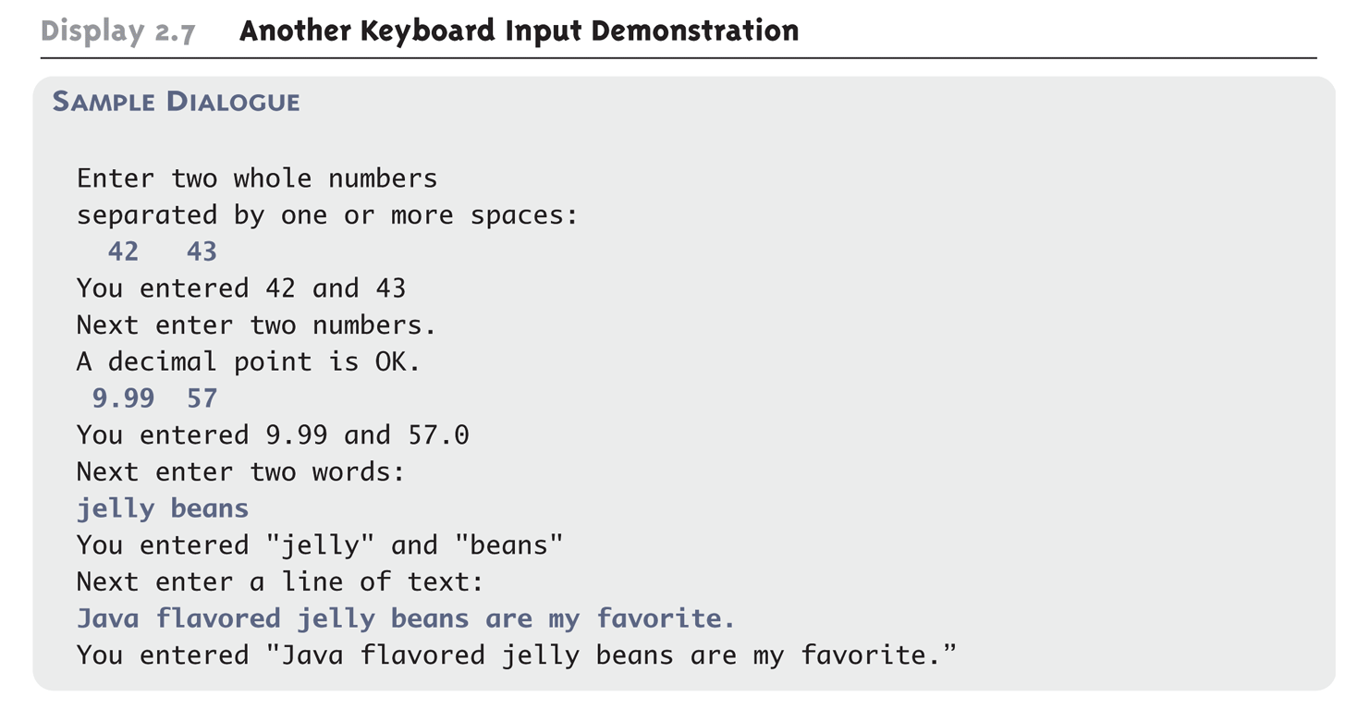
Another Keyboard Input Demonstration (Part 3 of 3)

Slide 37
Pitfall: Dealing with the Line Terminator, '\n'
The method nextLine of the class Scanner reads the remainder of a line of text starting wherever the last keyboard reading left off
This can cause problems when combining it with different methods for reading from the keyboard such as nextInt
Given the code,
Scanner keyboard = new Scanner(System.in);
int n = keyboard.nextInt();
String s1 = keyboard.nextLine();
String s2 = keyboard.nextLine();
and the input,
2
Heads are better than
1 head.
what are the values of n, s1, and s2?

Slide 38
Pitfall: Dealing with the Line Terminator, '\n'
Given the code and input on the previous slide
n will be equal to "2",
s1 will be equal to "", and
s2 will be equal to "heads are better than"
If the following results were desired instead
n equal to "2",
s1 equal to "heads are better than", and
s2 equal to "1 head"
then an extra invocation of nextLine would be needed to get rid of the end of line character ('\n')

Slide 39
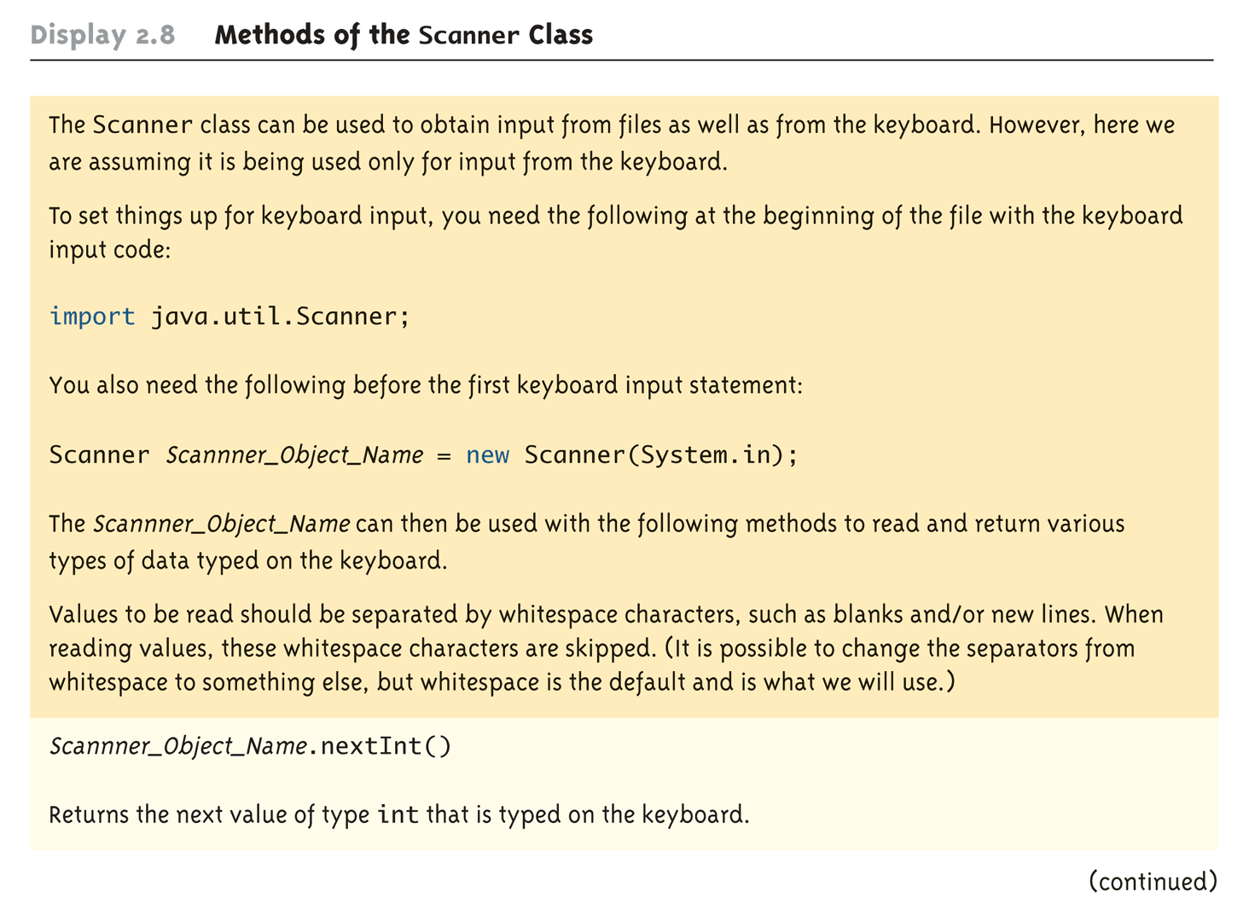
Methods in the Class Scanner (Part 1 of 3)

Slide 40
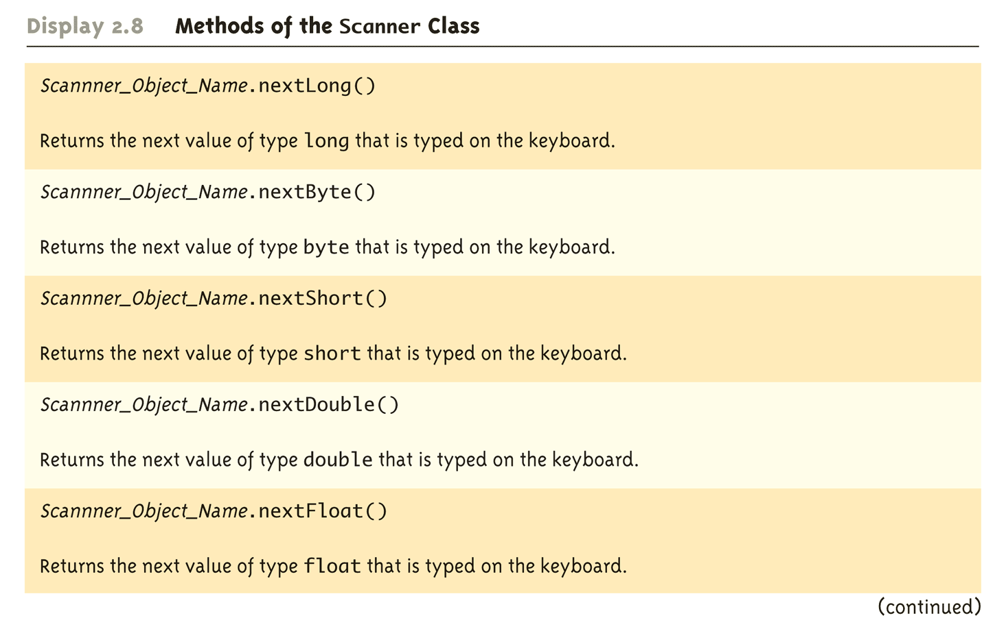
Methods in the Class Scanner (Part 2 of 3)

Slide 41
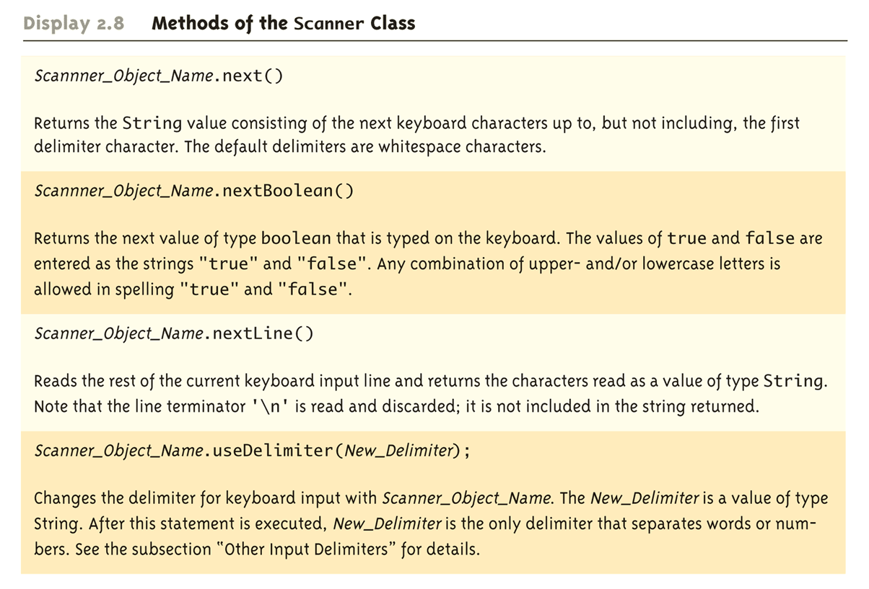
Methods in the Class Scanner (Part 3 of 3)

Slide 42
Programming Tip: Prompt for Input
A program should always prompt the user when he or she needs to input some data:
System.out.println(
"Enter the number of pods followed by");
System.out.println(
"the number of peas in a pod:");

Slide 43
Programming Tip: Echo Input
Always echo all input that a program receives from the keyboard
In this way a user can check that he or she has entered the input correctly
Even though the input is automatically displayed as the user enters it, echoing the input may expose subtle errors (such as entering the letter "O" instead of a zero)

Slide 44
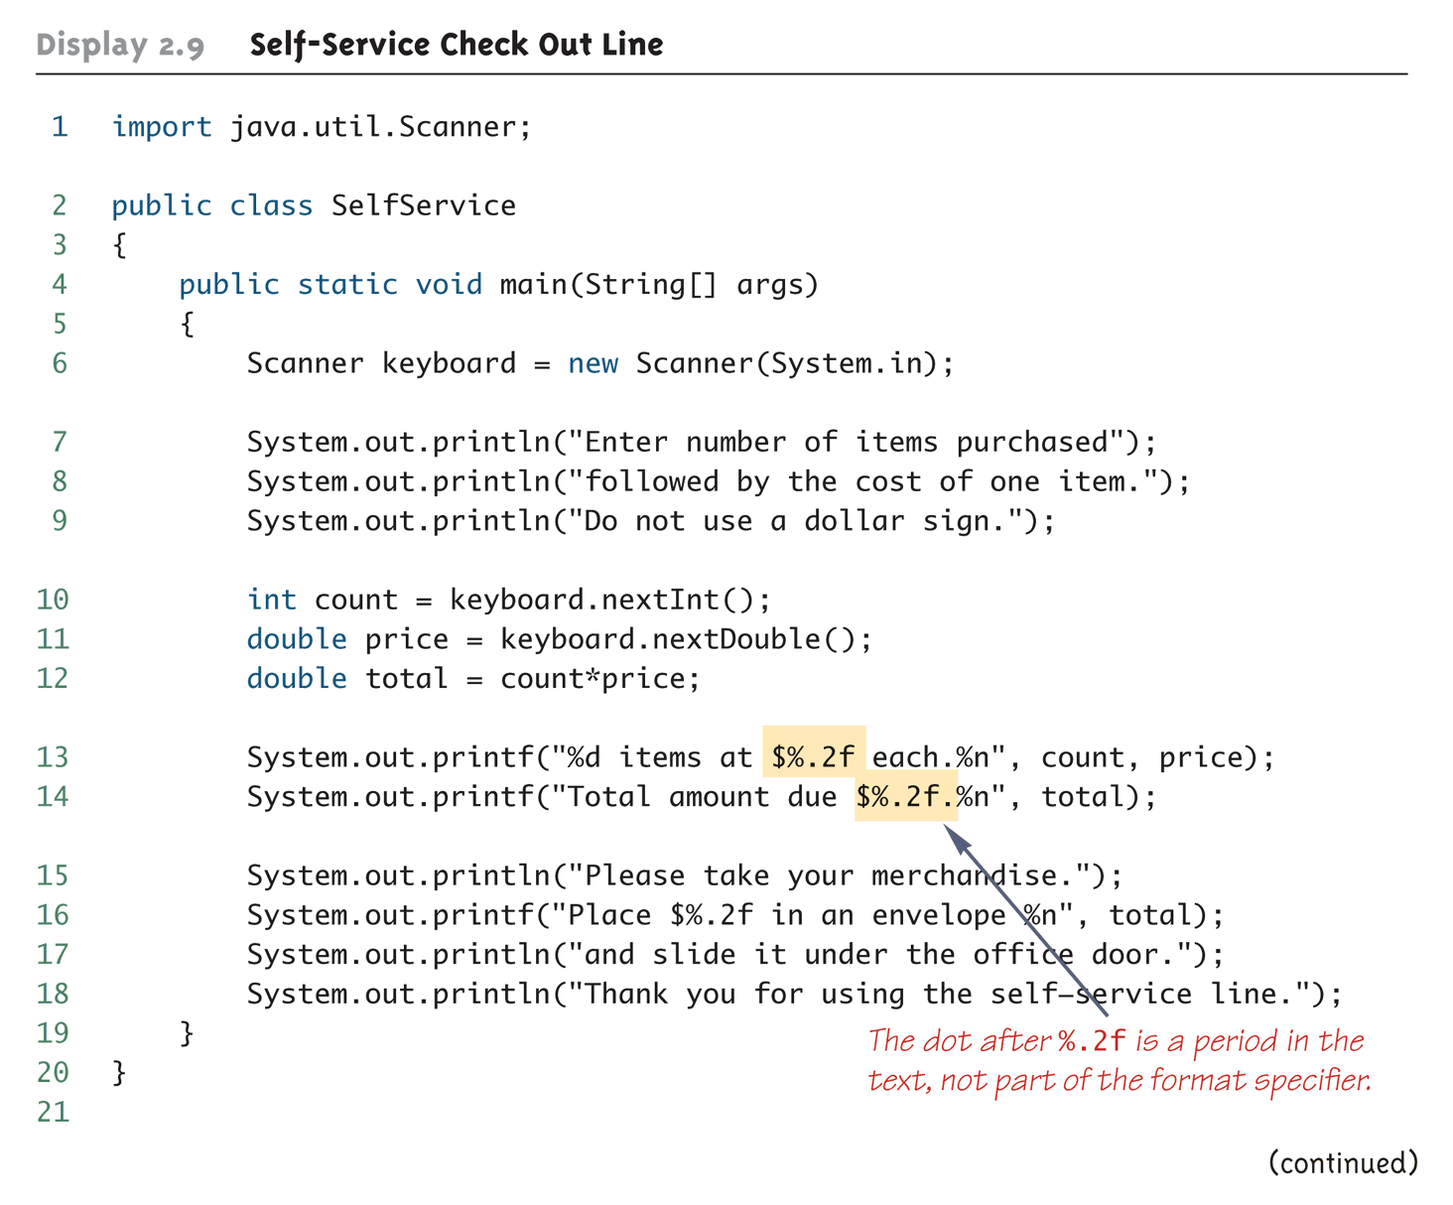
Self-Service Checkout Line (Part 1 of 2)

Slide 45
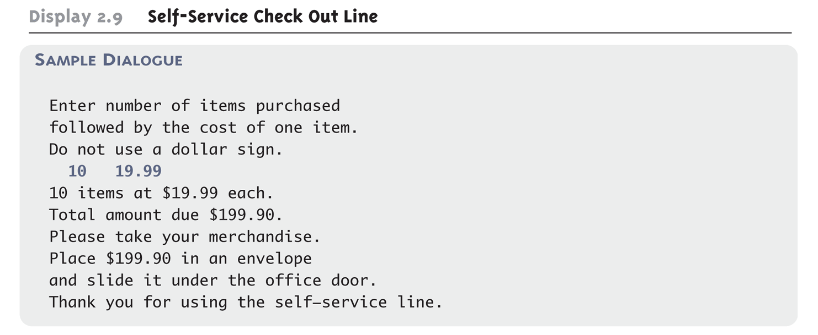
Self-Service Checkout Line (Part 2 of 2)

Slide 46
The Empty String
A string can have any number of characters, including zero characters
"" is the empty string
When a program executes the nextLine method to read a line of text, and the user types nothing on the line but presses the Enter key, then the nextLine Method reads the empty string

Slide 47
Other Input Delimiters
The delimiters that separate keyboard input can be changed when using the Scanner class
For example, the following code could be used to create a Scanner object and change the delimiter from whitespace to "##"
Scanner keyboard2 = new Scanner(System.in);
Keyboard2.useDelimiter("##");
After invocation of the useDelimiter method, "##" and not whitespace will be the only input delimiter for the input object keyboard2

Slide 48
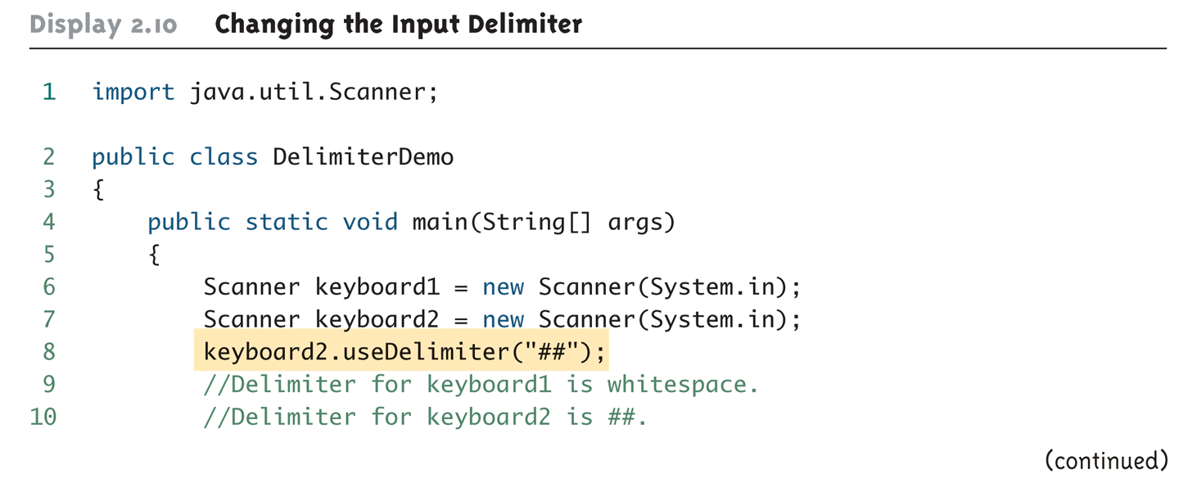
Changing the Input Delimiter (Part 1 of 3)

Slide 49
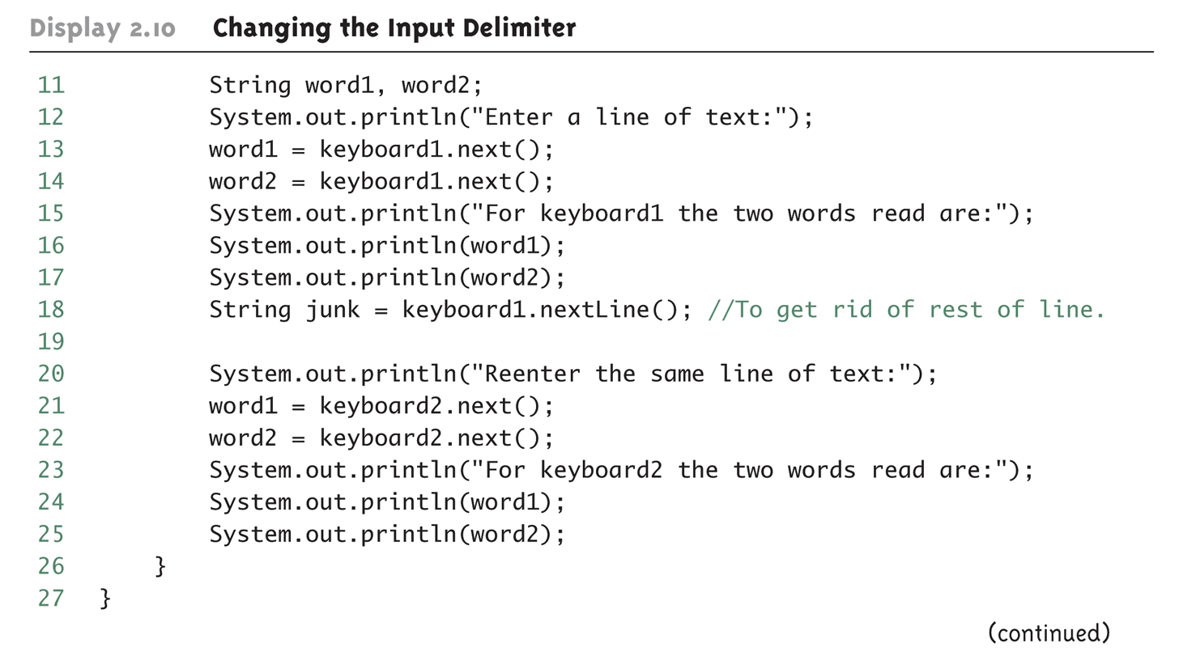
Changing the Input Delimiter (Part 2 of 3)

Slide 50
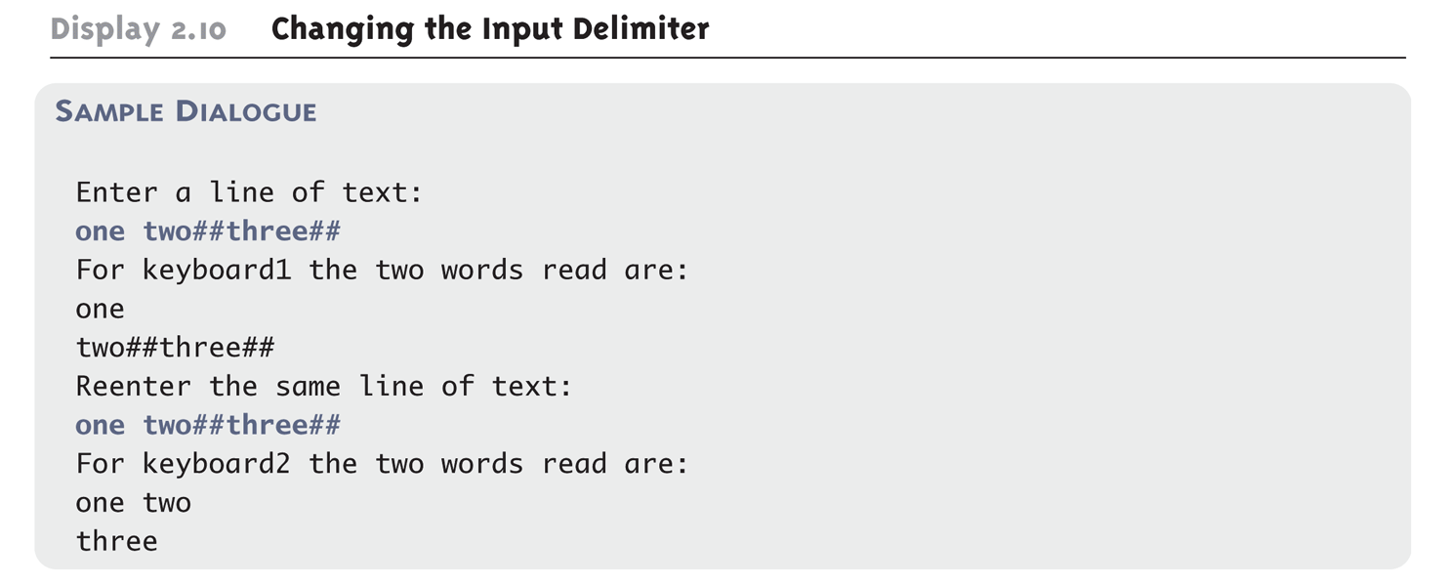
Changing the Input Delimiter (Part 3 of 3)

Slide 51
Introduction to File Input/Output
The Scanner class can also be used to read from files on the disk
Here we only present the basic structure of reading from text files
Some keywords are introduced without full explanation
More detail in Chapter 10
By covering the basics here your programs can work with real-world data that would otherwise be too much work to type into your program every time it is run

Slide 52
Text Input
Import the necessary classes in addition to Scanner
import java.io.FileInputStream; import java.io.FileNotFoundException;
Open the file inside a try/catch block
If an error occurs while trying to open the file then execution jumps to the catch block
This is discussed in more detail in Chapter 9
Use nextInt(), nextLine(), etc. to read from the Scanner like reading from the console, except the input comes from the file

Slide 53
Try/Catch Block
Scanner fileIn = null ; // initializes fileIn to empty
try
{
// Attempt to open the file
fileIn = new Scanner( new FileInputStream("PathToFile"));
}
catch (FileNotFoundException e)
{
// If the file could not be found, this code is executed
// and then the program exits
System.out.println("File not found.");
System.exit(0);
}
... Code continues here

Slide 54
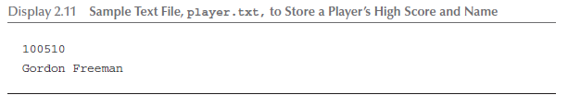
Text File to Read
This file should be stored in the same folder as the Java program in the following display

Slide 55
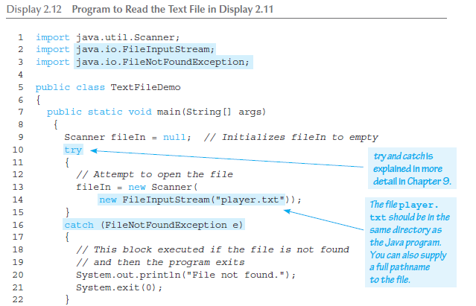
Program to Read a Text File

Slide 56
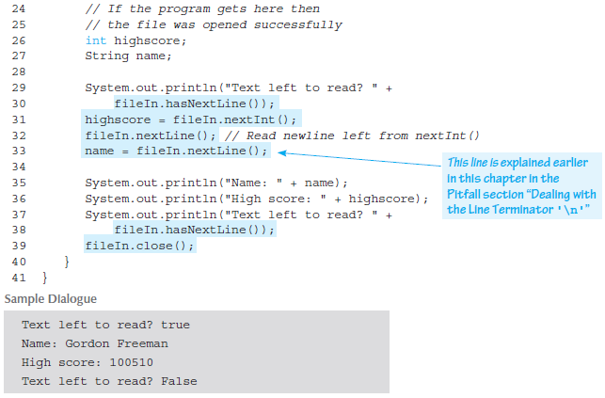
Program to Read a Text File

