Slide 1
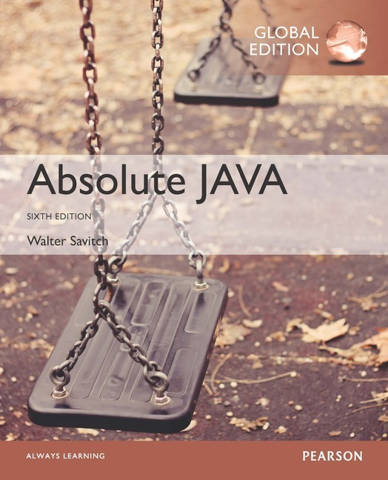
Chapter 3
Flow of Control
Slides prepared by Rose Williams, Binghamton University
Kenrick Mock, University of Alaska Anchorage
Copyright © 2017 Pearson Ltd. All rights reserved.

Slide 2
Flow of Control
As in most programming languages, flow of control in Java refers to its branching and looping mechanisms
Java has several branching mechanisms: if-else, if, and switch statements
Java has three types of loop statements: the while, do-while, and for statements
Most branching and looping statements are controlled by Boolean expressions
A Boolean expression evaluates to either true or false
The primitive type boolean may only take the values true or false

Slide 3
Branching with an if-else Statement
An if-else statement chooses between two alternative statements based on the value of a Boolean expression
if (Boolean_Expression)
Yes_Statement
else
No_Statement
The Boolean_Expression must be enclosed in parentheses
If the Boolean_Expression is true, then the Yes_Statement is executed
If the Boolean_Expression is false, then the No_Statement is executed

Slide 4
Compound Statements
Each Yes_Statement and No_Statement branch of an if-else can be a made up of a single statement or many statements
Compound Statement: A branch statement that is made up of a list of statements
A compound statement must always be enclosed in a pair of braces ({ })
A compound statement can be used anywhere that a single statement can be used

Slide 5
Compound Statements
if (myScore > your Score)
{
System.out.println("I win!");
wager = wager + 100;
}
else
{
System.out.println
("I wish these were golf scores.");
wager = 0;
}

Slide 6
Omitting the else Part
The else part may be omitted to obtain what is often called an if statement
if (Boolean_Expression)
Action_Statement
If the Boolean_Expression is true, then the Action_Statement is executed
The Action_Statement can be a single or compound statement
Otherwise, nothing happens, and the program goes on to the next statement
if (weight > ideal)
calorieIntake = calorieIntake – 500;

Slide 7
Nested Statements
if-else statements and if statements both contain smaller statements within them
For example, single or compound statements
In fact, any statement at all can be used as a subpart of an if-else or if statement, including another if-else or if statement
Each level of a nested if-else or if should be indented further than the previous level
Exception: multiway if-else statements

Slide 8
Multiway if-else Statements
The multiway if-else statement is simply a normal if-else statement that nests another if-else statement at every else branch
It is indented differently from other nested statements
All of the Boolean_Expressions are aligned with one another, and their corresponding actions are also aligned with one another
The Boolean_Expressions are evaluated in order until one that evaluates to true is found
The final else is optional

Slide 9
Multiway if-else Statement
if (Boolean_Expression)
Statement_1
else if (Boolean_Expression)
Statement_2
else if (Boolean_Expression_n)
Statement_n
else
Statement_For_All_Other_Possibilities
. . .

Slide 10
The switch Statement
The switch statement is the only other kind of Java statement that implements multiway branching
When a switch statement is evaluated, one of a number of different branches is executed
The choice of which branch to execute is determined by a controlling expression enclosed in parentheses after the keyword switch
The controlling expression must evaluate to a char, int, short, or byte

Slide 11
The switch Statement
Each branch statement in a switch statement starts with the reserved word case, followed by a constant called a case label, followed by a colon, and then a sequence of statements
Each case label must be of the same type as the controlling expression
Case labels need not be listed in order or span a complete interval, but each one may appear only once
Each sequence of statements may be followed by a break statement ( break;)

Slide 12
The switch Statement
There can also be a section labeled default:
The default section is optional, and is usually last
Even if the case labels cover all possible outcomes in a given switch statement, it is still a good practice to include a default section
It can be used to output an error message, for example
When the controlling expression is evaluated, the code for the case label whose value matches the controlling expression is executed
If no case label matches, then the only statements executed are those following the default label (if there is one)

Slide 13
The switch Statement
The switch statement ends when it executes a break statement, or when the end of the switch statement is reached
When the computer executes the statements after a case label, it continues until a break statement is reached
If the break statement is omitted, then after executing the code for one case, the computer will go on to execute the code for the next case
If the break statement is omitted inadvertently, the compiler will not issue an error message

Slide 14
The switch Statement
switch (Controlling_Expression)
{
case Case_Label_1:
Statement_Sequence_1
break;
case Case_Label_2:
Statement_Sequence_2
break;
case Case_Label_n:
Statement_Sequence_n
break;
default:
Default_Statement Sequence
break;
}
. . .

Slide 15
The Conditional Operator
The conditional operator is a notational variant on certain forms of the if-else statement
Also called the ternary operator or arithmetic if
The following examples are equivalent:
if (n1 > n2) max = n1;
else max = n2;
vs.
max = (n1 > n2) ? n1 : n2;
The expression to the right of the assignment operator is a conditional operator expression
If the Boolean expression is true, then the expression evaluates to the value of the first expression (n1), otherwise it evaluates to the value of the second expression (n2)

Slide 16
Boolean Expressions
A Boolean expression is an expression that is either true or false
The simplest Boolean expressions compare the value of two expressions
time < limit
yourScore == myScore
Note that Java uses two equal signs (==) to perform equality testing: A single equal sign (=) is used only for assignment
A Boolean expression does not need to be enclosed in parentheses, unless it is used in an if-else statement

Slide 17
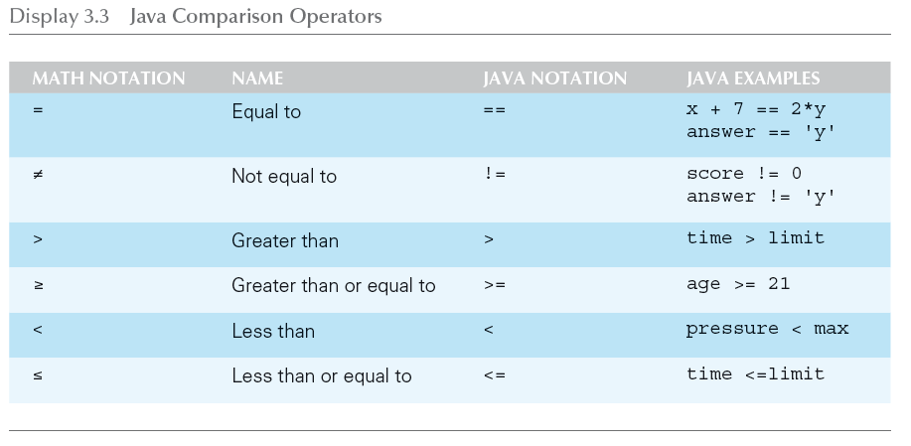
Java Comparison Operators

Slide 18
Pitfall: Using == with Strings
The equality comparison operator (==) can correctly test two values of a primitive type
However, when applied to two objects such as objects of the String class, == tests to see if they are stored in the same memory location, not whether or not they have the same value
In order to test two strings to see if they have equal values, use the method equals, or equalsIgnoreCase
string1.equals(string2)
string1.equalsIgnoreCase(string2)

Slide 19
Lexicographic and Alphabetical Order
Lexicographic ordering is the same as ASCII ordering, and includes letters, numbers, and other characters
All uppercase letters are in alphabetic order, and all lowercase letters are in alphabetic order, but all uppercase letters come before lowercase letters
If s1 and s2 are two variables of type String that have been given String values, then s1.compareTo(s2) returns a negative number if s1 comes before s2 in lexicographic ordering, returns zero if the two strings are equal, and returns a positive number if s2 comes before s1
When performing an alphabetic comparison of strings (rather than a lexicographic comparison) that consist of a mix of lowercase and uppercase letters, use the compareToIgnoreCase method instead

Slide 20
Building Boolean Expressions
When two Boolean expressions are combined using the "and" (&&) operator, the entire expression is true provided both expressions are true
Otherwise the expression is false
When two Boolean expressions are combined using the "or" (||) operator, the entire expression is true as long as one of the expressions is true
The expression is false only if both expressions are false
Any Boolean expression can be negated using the ! operator
Place the expression in parentheses and place the ! operator in front of it
Unlike mathematical notation, strings of inequalities must be joined by &&
Use (min < result) && (result < max) rather than min < result < max

Slide 21
Evaluating Boolean Expressions
Even though Boolean expressions are used to control branch and loop statements, Boolean expressions can exist independently as well
A Boolean variable can be given the value of a Boolean expression by using an assignment statement
A Boolean expression can be evaluated in the same way that an arithmetic expression is evaluated
The only difference is that arithmetic expressions produce a number as a result, while Boolean expressions produce either true or false as their result
boolean madeIt = (time < limit) && (limit < max);

Slide 22
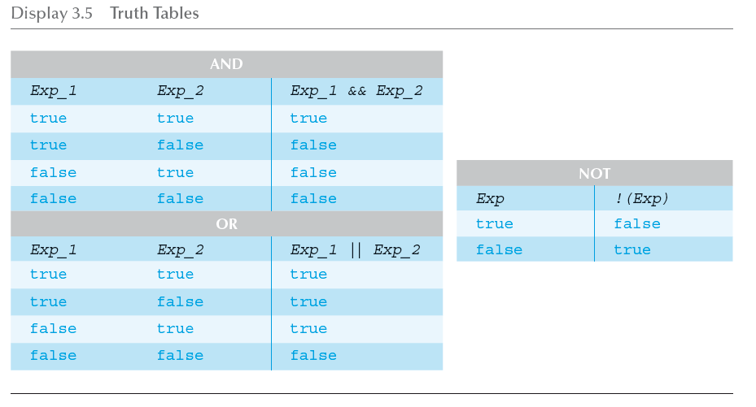
Truth Tables

Slide 23
Short-Circuit and Complete Evaluation
Java can take a shortcut when the evaluation of the first part of a Boolean expression produces a result that evaluation of the second part cannot change
This is called short-circuit evaluation or lazy evaluation
For example, when evaluating two Boolean subexpressions joined by &&, if the first subexpression evaluates to false, then the entire expression will evaluate to false, no matter the value of the second subexpression
In like manner, when evaluating two Boolean subexpressions joined by ||, if the first subexpression evaluates to true, then the entire expression will evaluate to true

Slide 24
Short-Circuit and Complete Evaluation
There are times when using short-circuit evaluation can prevent a runtime error
In the following example, if the number of kids is equal to zero, then the second subexpression will not be evaluated, thus preventing a divide by zero error
Note that reversing the order of the subexpressions will not prevent this
if ((kids !=0) && ((toys/kids) >=2)) . . .
Sometimes it is preferable to always evaluate both expressions, i.e., request complete evaluation
In this case, use the & and | operators instead of && and ||

Slide 25
Precedence and Associativity Rules
Boolean and arithmetic expressions need not be fully parenthesized
If some or all of the parentheses are omitted, Java will follow precedence and associativity rules (summarized in the following table) to determine the order of operations
If one operator occurs higher in the table than another, it has higher precedence, and is grouped with its operands before the operator of lower precedence
If two operators have the same precedence, then associativity rules determine which is grouped first

Slide 26
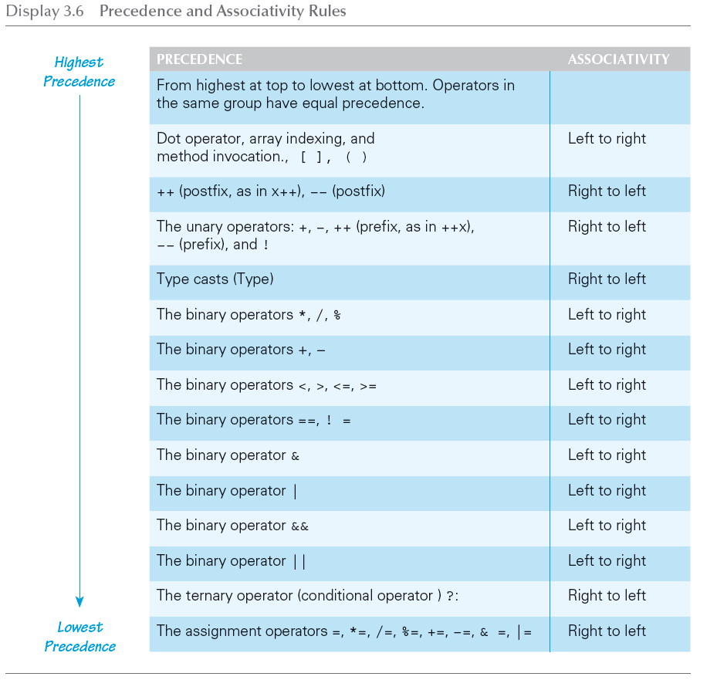
Precedence and Associativity Rules

Slide 27
Evaluating Expressions
In general, parentheses in an expression help to document the programmer's intent
Instead of relying on precedence and associativity rules, it is best to include most parentheses, except where the intended meaning is obvious
Binding: The association of operands with their operators
A fully parenthesized expression accomplishes binding for all the operators in an expression
Side Effects: When, in addition to returning a value, an expression changes something, such as the value of a variable
The assignment, increment, and decrement operators all produce side effects

Slide 28
Rules for Evaluating Expressions
Perform binding
Determine the equivalent fully parenthesized expression using the precedence and associativity rules
Proceeding left to right, evaluate whatever subexpressions can be immediately evaluated
These subexpressions will be operands or method arguments, e.g., numeric constants or variables
Evaluate each outer operation and method invocation as soon as all of its operands (i.e., arguments) have been evaluated

Slide 29
Loops
Loops in Java are similar to those in other high-level languages
Java has three types of loop statements: the while, the do-while, and the for statements
The code that is repeated in a loop is called the body of the loop
Each repetition of the loop body is called an iteration of the loop

Slide 30
while statement
A while statement is used to repeat a portion of code (i.e., the loop body) based on the evaluation of a Boolean expression
The Boolean expression is checked before the loop body is executed
When false, the loop body is not executed at all
Before the execution of each following iteration of the loop body, the Boolean expression is checked again
If true, the loop body is executed again
If false, the loop statement ends
The loop body can consist of a single statement, or multiple statements enclosed in a pair of braces ({ })

Slide 31
while Syntax
while (Boolean_Expression)
Statement
Or
while (Boolean_Expression)
{
Statement_1
Statement_2
Statement_Last
}
. . .

Slide 32
do-while Statement
A do-while statement is used to execute a portion of code (i.e., the loop body), and then repeat it based on the evaluation of a Boolean expression
The loop body is executed at least once
The Boolean expression is checked after the loop body is executed
The Boolean expression is checked after each iteration of the loop body
If true, the loop body is executed again
If false, the loop statement ends
Don't forget to put a semicolon after the Boolean expression
Like the while statement, the loop body can consist of a single statement, or multiple statements enclosed in a pair of braces ({ })

Slide 33
do-while Syntax
do
Statement
while (Boolean_Expression);
Or
do
{
Statement_1
Statement_2
Statement_Last
} while (Boolean_Expression);
. . .

Slide 34
Equivalence of while and do-while loop
Given the following structure for a do-while loop:
do
{
Statements;
} while (Boolean condition);
The equivalent while loop is:
Statements;
while (Boolean condition)
{
Statements;
}

Slide 35
Equivalence of do-while and while loop
Given the following structure for a while loop:
while (Boolean condition)
{
Statements;
}
The equivalent do-while loop is:
if (Boolean condition)
{
do
{
Statements;
} while (Boolean condition);
}

Slide 36
Algorithms and Pseudocode
The hard part of solving a problem with a computer program is not dealing with the syntax rules of a programming language
Rather, coming up with the underlying solution method is the most difficult part
An algorithm is a set of precise instructions that lead to a solution
An algorithm is normally written in pseudocode, which is a mixture of programming language and a human language, like English
Pseudocode must be precise and clear enough so that a good programmer can convert it to syntactically correct code
However, pseudocode is much less rigid than code: One needn't worry about the fine points of syntax or declaring variables, for example

Slide 37
The for Statement
The for statement is most commonly used to step through an integer variable in equal increments
It begins with the keyword for, followed by three expressions in parentheses that describe what to do with one or more controlling variables
The first expression tells how the control variable or variables are initialized or declared and initialized before the first iteration
The second expression determines when the loop should end, based on the evaluation of a Boolean expression before each iteration
The third expression tells how the control variable or variables are updated after each iteration of the loop body

Slide 38
The for Statement Syntax
for (Initializing; Boolean_Expression; Update)
Body
The Body may consist of a single statement or a list of statements enclosed in a pair of braces ({ })
Note that the three control expressions are separated by two, not three, semicolons
Note that there is no semicolon after the closing parenthesis at the beginning of the loop

Slide 39
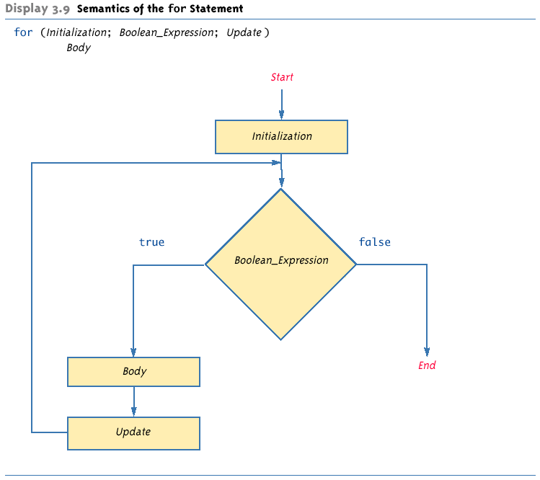
Semantics of the for Statement

Slide 40
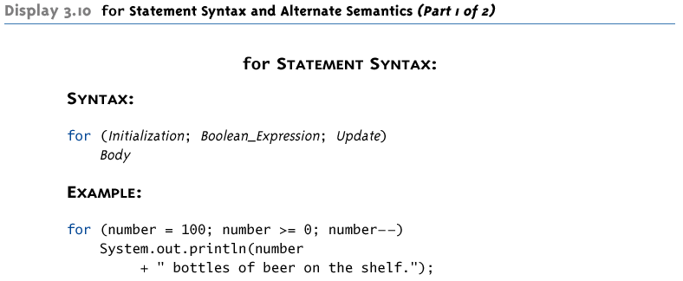
for Statement Syntax and Alternate Semantics

Slide 41
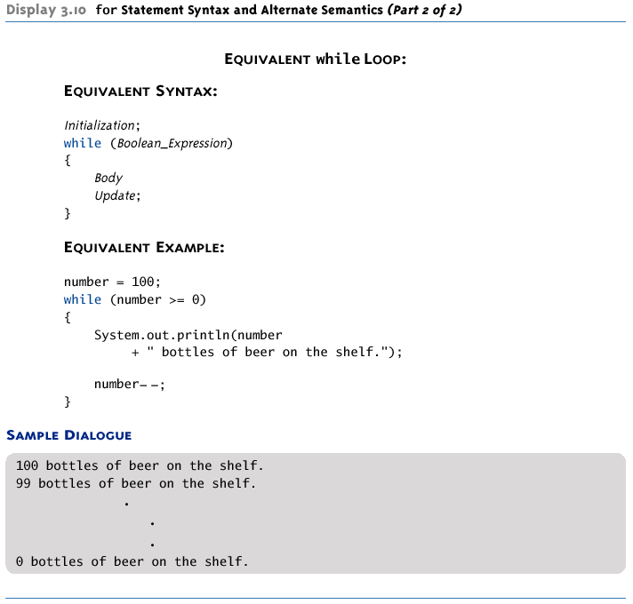
for Statement Syntax and Alternate Semantics

Slide 42
The Comma in for Statements
A for loop can contain multiple initialization actions separated with commas
Caution must be used when combining a declaration with multiple actions
It is illegal to combine multiple type declarations with multiple actions, for example
To avoid possible problems, it is best to declare all variables outside the for statement
A for loop can contain multiple update actions, separated with commas, also
It is even possible to eliminate the loop body in this way
However, a for loop can contain only one Boolean expression to test for ending the loop

Slide 43
Infinite Loops
A while, do-while, or for loop should be designed so that the value tested in the Boolean expression is changed in a way that eventually makes it false, and terminates the loop
If the Boolean expression remains true, then the loop will run forever, resulting in an infinite loop
Loops that check for equality or inequality (== or !=) are especially prone to this error and should be avoided if possible

Slide 44
Nested Loops
Loops can be nested, just like other Java structures
When nested, the inner loop iterates from beginning to end for each single iteration of the outer loop
int rowNum, columnNum;
for (rowNum = 1; rowNum <=3; rowNum++)
{
for (columnNum = 1; columnNum <=2;
columnNum++)
System.out.print(" row " + rowNum +
" column " + columnNum);
System.out.println();
}

Slide 45
The break and continue Statements
The break statement consists of the keyword break followed by a semicolon
When executed, the break statement ends the nearest enclosing switch or loop statement
The continue statement consists of the keyword continue followed by a semicolon
When executed, the continue statement ends the current loop body iteration of the nearest enclosing loop statement
Note that in a for loop, the continue statement transfers control to the update expression
When loop statements are nested, remember that any break or continue statement applies to the innermost, containing loop statement

Slide 46
The Labeled break Statement
There is a type of break statement that, when used in nested loops, can end any containing loop, not just the innermost loop
If an enclosing loop statement is labeled with an Identifier, then the following version of the break statement will exit the labeled loop, even if it is not the innermost enclosing loop:
break someIdentifier;
To label a loop, simply precede it with an Identifier and a colon:
someIdentifier:

Slide 47
The exit Statement
A break statement will end a loop or switch statement, but will not end the program
The exit statement will immediately end the program as soon as it is invoked:
System.exit(0);
The exit statement takes one integer argument
By tradition, a zero argument is used to indicate a normal ending of the program

Slide 48
Loop Bugs
The two most common kinds of loop errors are unintended infinite loops and off-by-one errors
An off-by-one error is when a loop repeats the loop body one too many or one too few times
This usually results from a carelessly designed Boolean test expression
Use of == in the controlling Boolean expression can lead to an infinite loop or an off-by-one error
This sort of testing works only for characters and integers, and should never be used for floating-point

Slide 49
Tracing Variables
Tracing variables involves watching one or more variables change value while a program is running
This can make it easier to discover errors in a program and debug them
Many IDEs (Integrated Development Environments) have a built-in utility that allows variables to be traced without making any changes to the program
Another way to trace variables is to simply insert temporary output statements in a program
System.out.println("n = " + n); // Tracing n
When the error is found and corrected, the trace statements can simply be commented out

Slide 50
General Debugging Techniques
Examine the system as a whole – don’t assume the bug occurs in one particular place
Try different test cases and check the input values
Comment out blocks of code to narrow down the offending code
Check common pitfalls
Take a break and come back later
DO NOT make random changes just hoping that the change will fix the problem!

Slide 51
Debugging Example (1 of 9)
The following code is supposed to present a menu and get user input until either ‘a’ or ‘b’ is entered.
String s = "";
char c = ' ';
Scanner keyboard = new Scanner(System.in);
do
{
System.out.println("Enter 'A' for option A or 'B' for option B.");
s = keyboard.next();
s.toLowerCase();
c = s.substring(0,1);
}
while ((c != 'a') || (c != 'b'));

Slide 52
Debugging Example (2 of 9)
Result: Syntax error:
c = s.substring(0,1); : incompatible types
found: java.lang.String
required: char
Using the “random change” debugging technique we might try to change the data type of c to String, to make the types match
This results in more errors since the rest of the code treats c like a char

Slide 53
Debugging Example (3 of 9)
First problem: substring returns a String, use charAt to get the first character:
String s = "";
char c = ' ';
Scanner keyboard = new Scanner(System.in);
do
{
System.out.println("Enter 'A' for option A or 'B' for option B.");
s = keyboard.next();
s.toLowerCase();
c = s.charAt(0);
}
while ((c != 'a') || (c != 'b'));
Now the program compiles, but it is stuck in an infinite loop. Employ tracing:

Slide 54
Debugging Example (4 of 9)
do
{
System.out.println("Enter 'A' for option A or 'B' for option B.");
s = keyboard.next();
System.out.println("String s = " + s);
s.toLowerCase();
System.out.println("Lowercase s = " + s);
c = s.charAt(0);
System.out.println("c = " + c);
}
while ((c != 'a') || (c != 'b'));
Sample output:
Enter 'A' for option A or 'B' for option B.
A
String s = A
Lowercase s = A
c = A
Enter 'A' for option A or 'B' for option B.
From tracing we can see that the string is never changed to lowercase.
Reassign the lowercase string back to s.

Slide 55
Debugging Example (5 of 9)
The following code is supposed to present a menu and get user input until either ‘a’ or ‘b’ is entered.
do
{
System.out.println("Enter 'A' for option A or 'B' for option B.");
s = keyboard.next();
s = s.toLowerCase();
c = s.charAt(0);
}
while ((c != 'a') || (c != 'b'));
However, it’s still stuck in an infinite loop. What to try next?

Slide 56
Debugging Example (6 of 9)
Could try the following “patch”
do
{
System.out.println("Enter 'A' for option A or 'B' for option B.");
s = keyboard.next();
s = s.toLowerCase();
c = s.charAt(0);
if ( c == 'a')
break;
if (c == 'b')
break;
}
while ((c != 'a') || (c != 'b'));
This works, but it is ugly! Considered a coding atrocity, it doesn’t fix the
underlying problem. The boolean condition after the while loop has also
become meaningless. Try more tracing:

Slide 57
Debugging Example (7 of 9)
do
{
System.out.println("Enter 'A' for option A or 'B' for option B.");
s = keyboard.next();
s = s.toLowerCase();
c = s.charAt(0);
System.out.println("c != 'a' is " + (c != 'a'));
System.out.println("c != 'b' is " + (c != 'b'));
System.out.println("(c != 'a') || (c != 'b')) is "
+ ((c != 'a') || (c != 'b')));
}
while ((c != 'a') || (c != 'b'));
Sample output:
Enter 'A' for option A or 'B' for option B.
A
c != 'a' is false
c != 'b' is true
(c != 'a') || (c != 'b')) is true
From the trace we can see that the loop’s boolean expression is true because c
cannot be not equal to ‘a’ and not equal to ‘b’ at the same time.

Slide 58
Debugging Example (8 of 9)
Fix: We use && instead of ||
do
{
System.out.println("Enter 'A' for option A or 'B' for option B.");
s = keyboard.next();
s = s.toLowerCase();
c = s.charAt(0);
}
while ((c != 'a') && (c != 'b'));

Slide 59
Debugging Example (9 of 9)
Even better: Declare a boolean variable to control the do-while loop. This makes it clear when the loop exits if we pick a meaningful variable name.
boolean invalidKey;
do
{
System.out.println("Enter 'A' for option A or 'B' for option B.");
s = keyboard.next();
s = s.toLowerCase();
c = s.charAt(0);
if (c == 'a')
invalidKey = false;
else if (c == 'b')
invalidKey = false;
else
invalidKey = true;
}
while (invalidKey);

Slide 60
Assertion Checks
An assertion is a sentence that says (asserts) something about the state of a program
An assertion must be either true or false, and should be true if a program is working properly
Assertions can be placed in a program as comments
Java has a statement that can check if an assertion is true
assert Boolean_Expression;
If assertion checking is turned on and the Boolean_Expression evaluates to false, the program ends, and outputs an assertion failed error message
Otherwise, the program finishes execution normally

Slide 61
Assertion Checks
A program or other class containing assertions is compiled in the usual way
After compilation, a program can run with assertion checking turned on or turned off
Normally a program runs with assertion checking turned off
In order to run a program with assertion checking turned on, use the following command (using the actual ProgramName):
java –enableassertions ProgramName

Slide 62
Preventive Coding
Incremental Development
Write a little bit of code at a time and test it before moving on
Code Review
Have others look at your code
Pair Programming
Programming in a team, one typing while the other watches, and periodically switch roles

Slide 63
Generating Random Numbers
The Random class can be used to generate pseudo-random numbers
Not truly random, but uniform distribution based on a mathematical function and good enough in most cases
Add the following import
import java.util.Random;
Create an object of type Random
Random rnd = new Random();

Slide 64
Generating Random Numbers
To generate random numbers use the nextInt() method to get a random number from 0 to n-1
int i = rnd.nextInt(10); // Random number from 0 to 9
Use the nextDouble() method to get a random number from 0 to 1 (always less than 1)
double d = rnd.nextDouble(); // d is >=0 and < 1

Slide 65
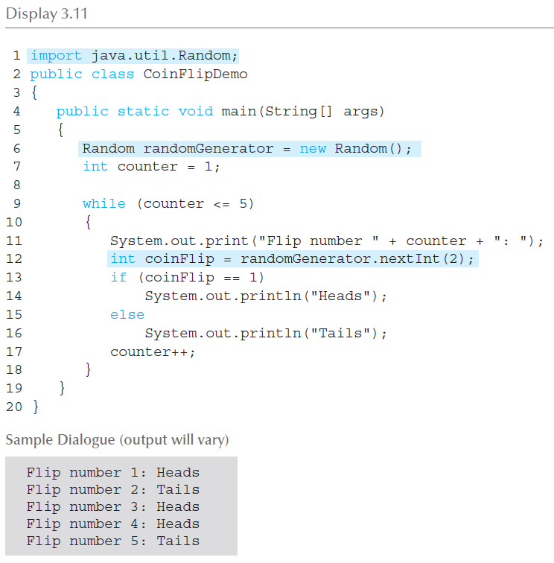
Simulating a Coin Flip

