Slide 1
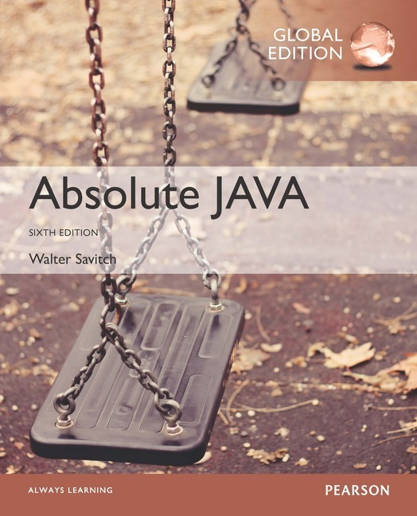
Chapter 9
Exception Handling
Slides prepared by Rose Williams, Binghamton University
Kenrick Mock, University of Alaska Anchorage
Copyright © 2017 Pearson Ltd. All rights reserved.

Slide 2
Introduction to Exception Handling
Sometimes the best outcome can be when nothing unusual happens
However, the case where exceptional things happen must also be prepared for
Java exception handling facilities are used when the invocation of a method may cause something exceptional to occur
Often the exception is some type of error condition

Slide 3
Introduction to Exception Handling
Java library software (or programmer-defined code) provides a mechanism that signals when something unusual happens
This is called throwing an exception
In another place in the program, the programmer must provide code that deals with the exceptional case
This is called handling the exception

Slide 4
try-throw-catch Mechanism
The basic way of handling exceptions in Java consists of the try-throw-catch trio
The try block contains the code for the basic algorithm
It tells what to do when everything goes smoothly
It is called a try block because it "tries" to execute the case where all goes as planned
It can also contain code that throws an exception if something unusual happens
try
{
CodeThatMayThrowAnException
}

Slide 5
try-throw-catch Mechanism
throw new
ExceptionClassName(PossiblySomeArguments);
When an exception is thrown, the execution of the surrounding try block is stopped
Normally, the flow of control is transferred to another portion of code known as the catch block
The value thrown is the argument to the throw operator, and is always an object of some exception class
The execution of a throw statement is called throwing an exception

Slide 6
try-throw-catch Mechanism
A throw statement is similar to a method call:
throw new ExceptionClassName(SomeString);
In the above example, the object of class ExceptionClassName is created using a string as its argument
This object, which is an argument to the throw operator, is the exception object thrown
Instead of calling a method, a throw statement calls a catch block

Slide 7
try-throw-catch Mechanism
When an exception is thrown, the catch block begins execution
The catch block has one parameter
The exception object thrown is plugged in for the catch block parameter
The execution of the catch block is called catching the exception, or handling the exception
Whenever an exception is thrown, it should ultimately be handled (or caught) by some catch block

Slide 8
try-throw-catch Mechanism
catch(Exception e)
{
ExceptionHandlingCode
}
A catch block looks like a method definition that has a parameter of type Exception class
It is not really a method definition, however
A catch block is a separate piece of code that is executed when a program encounters and executes a throw statement in the preceding try block
A catch block is often referred to as an exception handler
It can have at most one parameter

Slide 9
try-throw-catch Mechanism
catch(Exception e) { . . . }
The identifier e in the above catch block heading is called the catch block parameter
The catch block parameter does two things:
It specifies the type of thrown exception object that the catch block can catch (e.g., an Exception class object above)
It provides a name (for the thrown object that is caught) on which it can operate in the catch block
Note: The identifier e is often used by convention, but any non-keyword identifier can be used

Slide 10
try-throw-catch Mechanism
When a try block is executed, two things can happen:
1. No exception is thrown in the try block
The code in the try block is executed to the end of the block
The catch block is skipped
The execution continues with the code placed after the catch block

Slide 11
try-throw-catch Mechanism
2. An exception is thrown in the try block and caught in the catch block
The rest of the code in the try block is skipped
Control is transferred to a following catch block (in simple cases)
The thrown object is plugged in for the catch block parameter
The code in the catch block is executed
The code that follows that catch block is executed (if any)

Slide 12
Exception Example
In many cases your own code doesn’t throw the exception, but instead it is thrown by an existing Java library
Example: Input an integer using nextInt()
What if the user doesn’t enter an integer?
The nextInt method throws an InputMismatchException

Slide 13
Exception Handling with the Scanner Class
If a user enters something other than a well-formed int value, an InputMismatchException will be thrown
Unless this exception is caught, the program will end with an error message
If the exception is caught, the catch block can give code for some alternative action, such as asking the user to reenter the input

Slide 14
The InputMismatchException
The InputMismatchException is in the standard Java package java.util
A program that refers to it must use an import statement, such as the following:
import java.util.InputMismatchException;
It is a descendent class of RuntimeException
Therefore, it is an unchecked exception and does not have to be caught in a catch block or declared in a throws clause
However, catching it in a catch block is allowed, and can sometimes be useful

Slide 15
Tip: Exception Controlled Loops
Sometimes it is better to simply loop through an action again when an exception is thrown, as follows:
boolean done = false;
while (! done)
{
try
{
CodeThatMayThrowAnException
done = true;
}
catch (SomeExceptionClass e)
{
SomeMoreCode
}
}

Slide 16
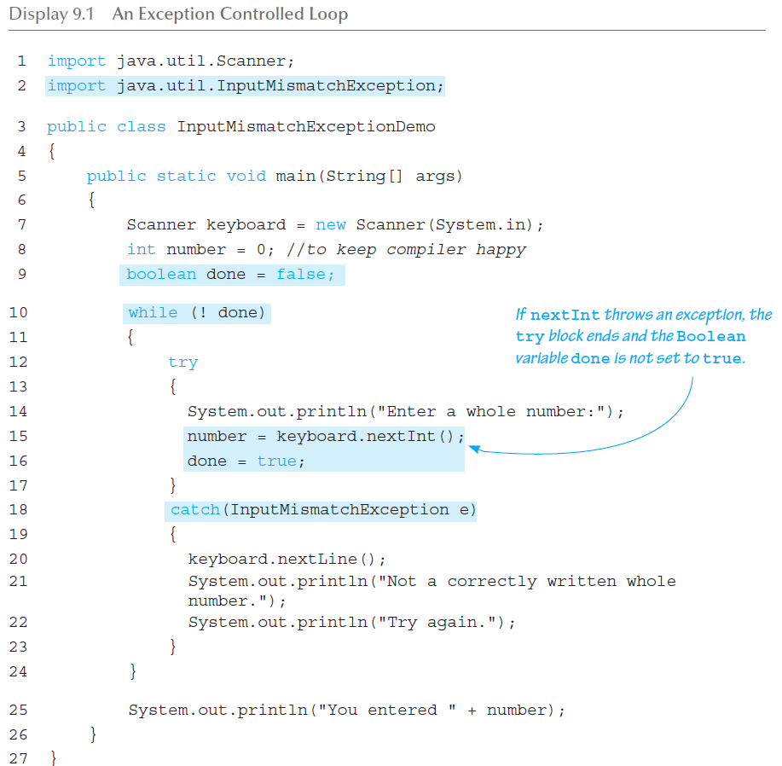
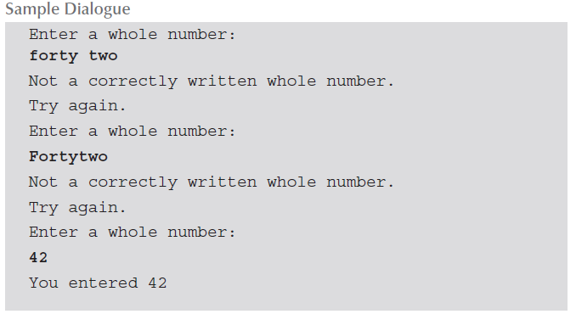
Exception Controlled Loop

Slide 17
Exception Classes
There are more exception classes than just the single class Exception
There are more exception classes in the standard Java libraries
New exception classes can be defined like any other class
All predefined exception classes have the following properties:
There is a constructor that takes a single argument of type String
The class has an accessor method getMessage that can recover the string given as an argument to the constructor when the exception object was created
All programmer-defined classes should have the same properties

Slide 18
Exception Classes from Standard Packages
Numerous predefined exception classes are included in the standard packages that come with Java
For example:
IOException
NoSuchMethodException
FileNotFoundException
Many exception classes must be imported in order to use them
import java.io.IOException;

Slide 19
Exception Classes from Standard Packages
The predefined exception class Exception is the root class for all exceptions
Every exception class is a descendent class of the class Exception
Although the Exception class can be used directly in a class or program, it is most often used to define a derived class
The class Exception is in the java.lang package, and so requires no import statement

Slide 20
Using the getMessage Method
. . . // method code
try
{
. . .
throw new Exception(StringArgument);
. . .
}
catch(Exception e)
{
String message = e.getMessage();
System.out.println(message);
System.exit(0);
} . . .

Slide 21
Using the getMessage Method
Every exception has a String instance variable that contains some message
This string typically identifies the reason for the exception
In the previous example, StringArgument is an argument to the Exception constructor
This is the string used for the value of the string instance variable of exception e
Therefore, the method call e.getMessage() returns this string

Slide 22
Defining Exception Classes
A throw statement can throw an exception object of any exception class
Instead of using a predefined class, exception classes can be programmer-defined
These can be tailored to carry the precise kinds of information needed in the catch block
A different type of exception can be defined to identify each different exceptional situation

Slide 23
Defining Exception Classes
Every exception class to be defined must be a derived class of some already defined exception class
It can be a derived class of any exception class in the standard Java libraries, or of any programmer defined exception class
Constructors are the most important members to define in an exception class
They must behave appropriately with respect to the variables and methods inherited from the base class
Often, there are no other members, except those inherited from the base class
The following exception class performs these basic tasks only

Slide 24
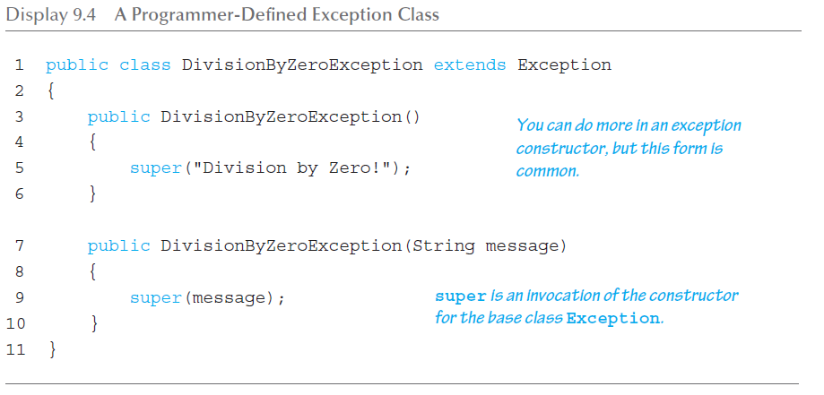
A Programmer-Defined Exception Class

Slide 25
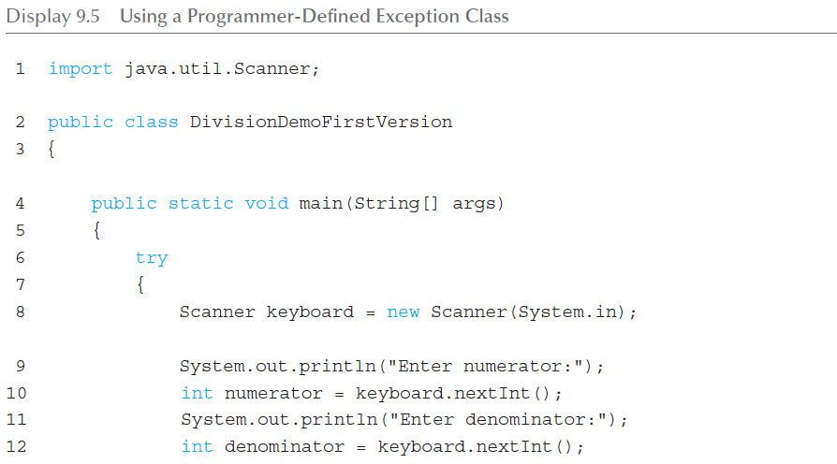
Using our own Exception Class (1 of 3)

Slide 26
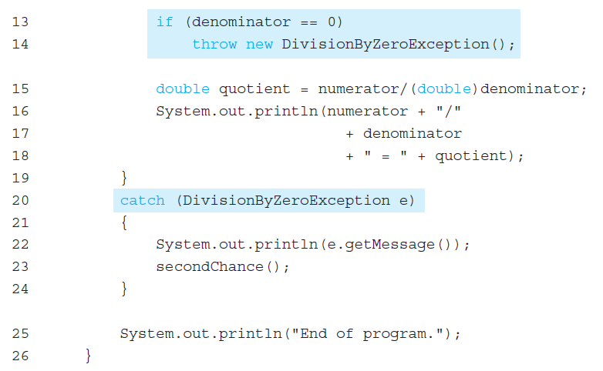
Using our own Exception Class (2 of 3)

Slide 27
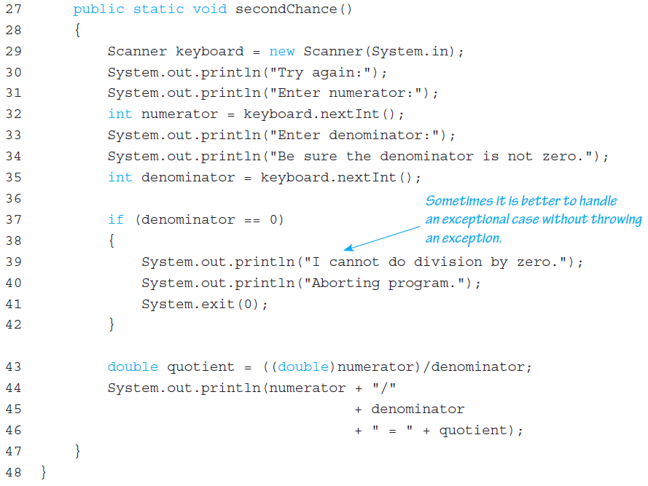
Using our own Exception Class (3 of 3)

Slide 28
Tip: An Exception Class Can Carry a Message of Any Type: int Message
An exception class constructor can be defined that takes an argument of another type
It would stores its value in an instance variable
It would need to define accessor methods for this instance variable

Slide 29
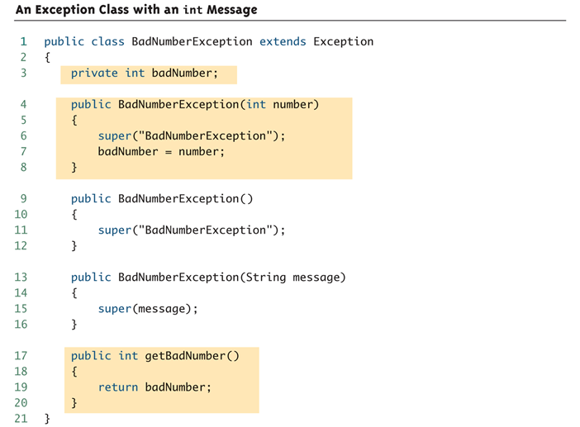
An Exception Class with an int Message

Slide 30
Exception Object Characteristics
The two most important things about an exception object are its type (i.e., exception class) and the message it carries
The message is sent along with the exception object as an instance variable
This message can be recovered with the accessor method getMessage, so that the catch block can use the message

Slide 31
Programmer-Defined Exception Class Guidelines
Exception classes may be programmer-defined, but every such class must be a derived class of an already existing exception class
The class Exception can be used as the base class, unless another exception class would be more suitable
At least two constructors should be defined, sometimes more
The exception class should allow for the fact that the method getMessage is inherited
최소 2개의 생성자 정의
getMessage메소드를 상속받는 것을 허락

Slide 32
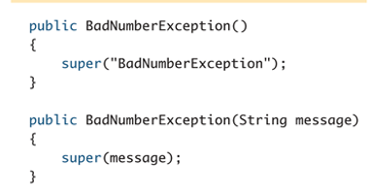
Preserve getMessage
For all predefined exception classes, getMessage returns the string that is passed to its constructor as an argument
Or it will return a default string if no argument is used with the constructor
This behavior must be preserved in all programmer-defined exception class
A constructor must be included having a string parameter whose body begins with a call to super
The call to super must use the parameter as its argument
A no-argument constructor must also be included whose body begins with a call to super
This call to super must use a default string as its argument
문자열 parameter를 가지는 생성자를 포함해야하며 body는 super로시작한다
Super는 파라미터를 반드시 사용해야한다
Argumnet가 없는 생성자의 body는 super로 시작해야한다
Super는 fault string을 사용해야한다

Slide 33
Multiple catch Blocks
A try block can potentially throw any number of exception values, and they can be of differing types
In any one execution of a try block, at most one exception can be thrown (since a throw statement ends the execution of the try block)
However, different types of exception values can be thrown on different executions of the try block

Slide 34
Multiple catch Blocks
Each catch block can only catch values of the exception class type given in the catch block heading
Different types of exceptions can be caught by placing more than one catch block after a try block
Any number of catch blocks can be included, but they must be placed in the correct order

Slide 35
Pitfall: Catch the More Specific Exception First
When catching multiple exceptions, the order of the catch blocks is important
When an exception is thrown in a try block, the catch blocks are examined in order
The first one that matches the type of the exception thrown is the one that is executed

Slide 36
Pitfall: Catch the More Specific Exception First
catch (Exception e)
{ . . . }
catch (NegativeNumberException e)
{ . . . }
Because a NegativeNumberException is a type of Exception, all NegativeNumberExceptions will be caught by the first catch block before ever reaching the second block
The catch block for NegativeNumberException will never be used!
For the correct ordering, simply reverse the two blocks

Slide 37
Throwing an Exception in a Method
Sometimes it makes sense to throw an exception in a method, but not catch it in the same method
Some programs that use a method should just end if an exception is thrown, and other programs should do something else
In such cases, the program using the method should enclose the method invocation in a try block, and catch the exception in a catch block that follows
In this case, the method itself would not include try and catch blocks
However, it would have to include a throws clause

Slide 38
Declaring Exceptions in a throws Clause
If a method can throw an exception but does not catch it, it must provide a warning
This warning is called a throws clause
The process of including an exception class in a throws clause is called declaring the exception
throws AnException //throws clause
The following states that an invocation of aMethod could throw AnException
public void aMethod() throws AnException

Slide 39
Declaring Exceptions in a throws Clause
If a method can throw more than one type of exception, then separate the exception types by commas
public void aMethod() throws
AnException, AnotherException
If a method throws an exception and does not catch it, then the method invocation ends immediately

Slide 40
The Catch or Declare Rule
Most ordinary exceptions that might be thrown within a method must be accounted for in one of two ways:
The code that can throw an exception is placed within a try block, and the possible exception is caught in a catch block within the same method
The possible exception can be declared at the start of the method definition by placing the exception class name in a throws clause

Slide 41
The Catch or Declare Rule
The first technique handles an exception in a catch block
The second technique is a way to shift the exception handling responsibility to the method that invoked the exception throwing method
The invoking method must handle the exception, unless it too uses the same technique to "pass the buck"
Ultimately, every exception that is thrown should eventually be caught by a catch block in some method that does not just declare the exception class in a throws clause

Slide 42
The Catch or Declare Rule
In any one method, both techniques can be mixed
Some exceptions may be caught, and others may be declared in a throws clause
However, these techniques must be used consistently with a given exception
If an exception is not declared, then it must be handled within the method
If an exception is declared, then the responsibility for handling it is shifted to some other calling method
Note that if a method definition encloses an invocation of a second method, and the second method can throw an exception and does not catch it, then the first method must catch or declare it

Slide 43
Checked and Unchecked Exceptions
Exceptions that are subject to the catch or declare rule are called checked exceptions
The compiler checks to see if they are accounted for with either a catch block or a throws clause
The classes Throwable, Exception, and all descendants of the class Exception are checked exceptions
All other exceptions are unchecked exceptions
The class Error and all its descendant classes are called error classes
Error classes are not subject to the Catch or Declare Rule

Slide 44
Exceptions to the Catch or Declare Rule
Checked exceptions must follow the Catch or Declare Rule
Programs in which these exceptions can be thrown will not compile until they are handled properly
Unchecked exceptions are exempt from the Catch or Declare Rule
Programs in which these exceptions are thrown simply need to be corrected, as they result from some sort of error

Slide 45
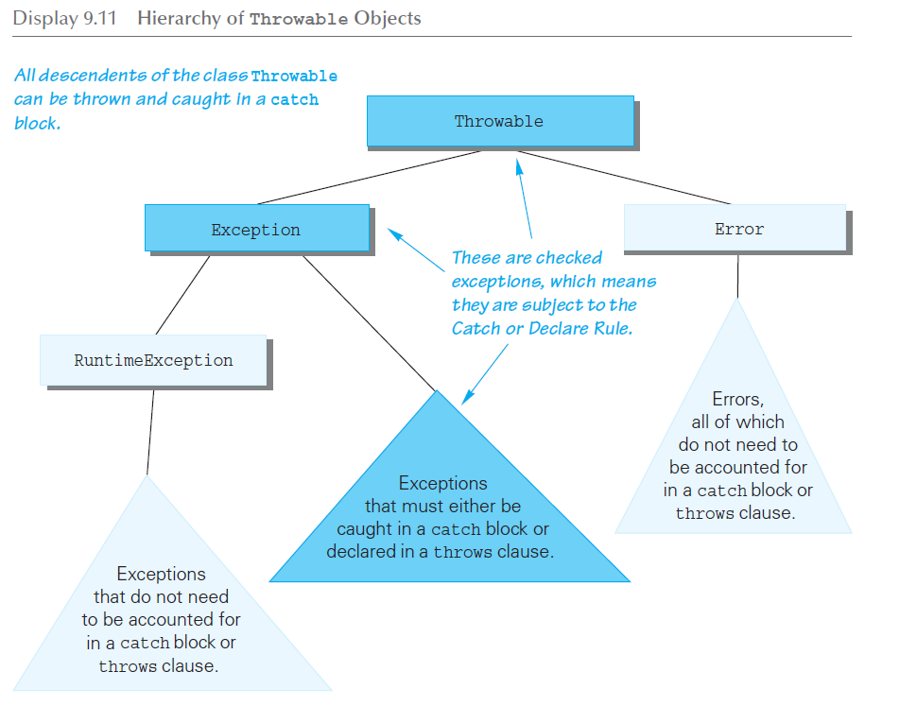
Hierarchy of Throwable Objects

Slide 46
The throws Clause in Derived Classes
When a method in a derived class is overridden, it should have the same exception classes listed in its throws clause that it had in the base class
Or it should have a subset of them
A derived class may not add any exceptions to the throws clause
But it can delete some
부모가 throws있으면 자식도 throws를 해줘야 상속가능
자식클래스는
Throw절을 추가하지 못하지만 지우는건 가능하다

Slide 47
What Happens If an Exception is Never Caught?
If every method up to and including the main method simply includes a throws clause for an exception, that exception may be thrown but never caught
In a GUI program (i.e., a program with a windowing interface), nothing happens - but the user may be left in an unexplained situation, and the program may be no longer be reliable
In non-GUI programs, this causes the program to terminate with an error message giving the name of the exception class
Every well-written program should eventually catch every exception by a catch block in some method

Slide 48
Example – Retrieving a High Score Without Exceptions (1 of 2)
No exceptions, return -1 if there is no score
public class HighScoreNoException
{
private int score = 0;
private boolean scoreSet = false;
public HighScoreNoException()
{
score = 0;
scoreSet = false;
}
public void setScore(int newScore)
{
score = newScore;
scoreSet = true;
}

Slide 49
Example – Retrieving a High Score Without Exceptions (2 of 2)
public int getScore()
{
if (!scoreSet)
return -1;
else
return score;
}
// Short test program
public static void main(String[] args)
{
HighScoreNoException highscore = new HighScoreNoException();
System.out.println(highscore.getScore());
highscore.setScore(100);
System.out.println(highscore.getScore());
}
}
Problems if negative
scores are allowed!

Slide 50
Example – Retrieving a High Score with Exceptions (1 of 4)
Problem solved with exceptions
public class ScoreNotSetException extends Exception
{
public ScoreNotSetException()
{
super("Score not set");
}
public ScoreNotSetException(String message)
{
super(message);
}
}

Slide 51
Example – Retrieving a High Score with Exceptions (2 of 4)
public class HighScoreException
{
private int score = 0;
private boolean scoreSet = false;
public HighScoreException()
{
score = 0;
scoreSet = false;
}
public void setScore(int newScore)
{
score = newScore;
scoreSet = true;
}

Slide 52
Example – Retrieving a High Score with Exceptions (3 of 4)
public int getScore() throws ScoreNotSetException
{
if (!scoreSet)
throw new ScoreNotSetException();
else
return score;
}
// Short test program
public static void main(String[] args)
{
HighScoreException highscore = new HighScoreException();
try
{
System.out.println
(highscore.getScore());
}

Slide 53
Example – Retrieving a High Score with Exceptions (4 of 4)
catch (ScoreNotSetException e)
{
System.out.println
(e.getMessage());
}
highscore.setScore(100);
try
{
System.out.println
(highscore.getScore());
}
catch (ScoreNotSetException e)
{
System.out.println
(e.getMessage());
}
}
}

Slide 54
When to Use Exceptions
Exceptions should be reserved for situations where a method encounters an unusual or unexpected case that cannot be handled easily in some other way
When exception handling must be used, here are some basic guidelines:
Include throw statements and list the exception classes in a throws clause within a method definition
Place the try and catch blocks in a different method

Slide 55
When to Use Exceptions
Here is an example of a method from which the exception originates:
public void someMethod()
throws SomeException
{
. . .
throw new
SomeException(SomeArgument);
. . .
}

Slide 56
When to Use Exceptions
When someMethod is used by an otherMethod, the otherMethod must then deal with the exception:
public void otherMethod()
{
try
{
someMethod();
. . .
}
catch (SomeException e)
{
CodeToHandleException
}
. . .
}

Slide 57
Event Driven Programming
Exception handling is an example of a programming methodology known as event-driven programming
When using event-driven programming, objects are defined so that they send events to other objects that handle the events
An event is an object also
Sending an event is called firing an event

Slide 58
Event Driven Programming
In exception handling, the event objects are the exception objects
They are fired (thrown) by an object when the object invokes a method that throws the exception
An exception event is sent to a catch block, where it is handled

Slide 59
Pitfall: Nested try-catch Blocks
It is possible to place a try block and its following catch blocks inside a larger try block, or inside a larger catch block
If a set of try-catch blocks are placed inside a larger catch block, different names must be used for the catch block parameters in the inner and outer blocks, just like any other set of nested blocks
If a set of try-catch blocks are placed inside a larger try block, and an exception is thrown in the inner try block that is not caught, then the exception is thrown to the outer try block for processing, and may be caught in one of its catch blocks

Slide 60
The finally Block
The finally block contains code to be executed whether or not an exception is thrown in a try block
If it is used, a finally block is placed after a try block and its following catch blocks
try
{ . . . }
catch(ExceptionClass1 e)
{ . . . }
. . .
catch(ExceptionClassN e)
{ . . . }
finally
{
CodeToBeExecutedInAllCases
}

Slide 61
The finally Block
If the try-catch-finally blocks are inside a method definition, there are three possibilities when the code is run:
The try block runs to the end, no exception is thrown, and the finally block is executed
An exception is thrown in the try block, caught in one of the catch blocks, and the finally block is executed
An exception is thrown in the try block, there is no matching catch block in the method, the finally block is executed, and then the method invocation ends and the exception object is thrown to the enclosing method
Catch에 적합한 예외처리가 없으면 finally를 처리한 다음 메소드가 throw된다

Slide 62
Rethrowing an Exception
A catch block can contain code that throws an exception
Sometimes it is useful to catch an exception and then, depending on the string produced by getMessage (or perhaps something else), throw the same or a different exception for handling further up the chain of exception handling blocks
Catch구간에서 throw를 하는 경우도 있다

Slide 63
The AssertionError Class
When a program contains an assertion check, and the assertion check fails, an object of the class AssertionError is thrown
This causes the program to end with an error message
The class AssertionError is derived from the class Error, and therefore is an unchecked exception
In order to prevent the program from ending, it could be handled, but this is not required

Slide 64
ArrayIndexOutOfBoundsException
An ArrayIndexOutOfBoundsException is thrown whenever a program attempts to use an array index that is out of bounds
This normally causes the program to end
Like all other descendents of the class RuntimeException, it is an unchecked exception
There is no requirement to handle it
When this exception is thrown, it is an indication that the program contains an error
Instead of attempting to handle the exception, the program should simply be fixed

