Slide 1
Object Oriented Programming
Lab #4

Slide 2
Context
Classes
Fields and Methods
Constructor
Overloading
equals() and toString()
StringTokenizer
Self Test

Slide 3

Classes and Objects
Class: A class is a blueprint or prototype from which objects are created.
Object: An object is an instance (variable) of a class. The relationship is such that many objects can be created using one class. Each object has its own data but its underlying structure (i.e., the type of data it stores, its behaviors) are defined by the class. An object has both data and actions (methods).
object
class
bicycle

Slide 4
Classes
A class is a collection of fields (data) and methods (procedure or function) that operate on that data.
Instance of the circle class
Circle
centre radius
circumference() area()
x,y

Slide 5
Classes
The basic syntax for a class definition:
class ClassName {
[fields declarations]
[methods declarations]
}
Bare bone class – no fields, no methods
public class Circle {
// my circle class
}

Slide 6
Adding Fields: Class Circle with fields
Add fields
 |  | q Instance Variable
public class Circle { public double x, y; // centre coordinate public double r; // radius of the circle
} | q Instance Variable Type
클래스 내에서 전역변수와 같다
q Modifiers: specifies the visibility of the instance variable.
The fields (data) are also called the instance variables.

Slide 7
Adding Methods
A class with only data fields has no life. Objects created by such a class cannot respond to any messages.
Methods are declared inside the body of the class but immediately after the declaration of data fields.

Slide 8
Adding Methods
Method definition have the following parts
Public, private, protected
Modifier
Return type
–
–
–
Method name List of parameters Method body
Method signature
The general form of a method declaration is:
Modifier ReturnType MethodName(parameter-list)
{
Method-body Statements;
}

Slide 9
Adding Methods to Class Circle
class Circle {
public double x, y; // centre of the circle public double r; // radius of circle
//Methods to return circumference and area
public double circumference() {
return 2*3.14*r;
}
public double area() {
return 3.14 * r * r;
}
}

Slide 10
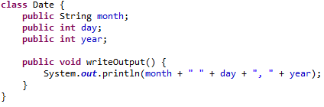
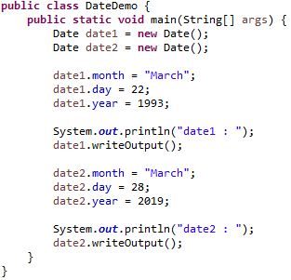
Classes - Example
Note: You need to create 2 classes in the project, one with name Date and one with name DateDemo which is the main class.

Slide 11
The new Operator
The new Operator
The new operator is used to create an object of a class and associate the object with a variable that names it.
SYNTAX
Class variable = new Class();
Class variable;
variable = new Class() ;
Example
Date date1 = new Date ();
Date date1;
date1 = new Date();
New Class처럼 참조변수 없이 사용가능

Slide 12
Instance Variables and Methods
In order to use an object we can reference its instance variables or methods using dot notation.
objectIdentifier.variableidentifier
objectIdentifier.methodname
We can use this to
get information from the variables
Set variables to specific values
Get the methods to perform actions
This however depends on the modifier

Slide 13
The return keyword
The return keyword immediately stops execution of a method
Jumps back to whatever called that method
Returns a value
Void methods do not return a value
Consider the following method
public static void foo (int x) { if ( x == 1 )
{
return;
}
System.out.println (“x is not 1”);
}
This method will only print the String if x is not 1
How can this be modified to return a string?

Slide 14
Variables
There are several kinds of variables:
Member variables in a class—these are called fields.
Variables in a method or block of code—these are called local variables.
Variables in method declarations—these are called
parameters.
클래스 안에서 있는 변수는 인스턴스 변수라고 한다

Slide 15
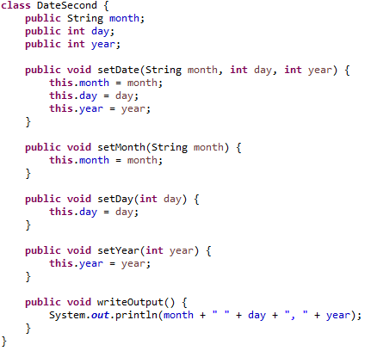
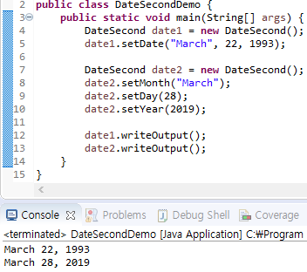
Example 2
This: 자기 자신의 변수를 사용한다는 것을 알려주기 위해서
Output:
March 22 1993
March 28, 2019

Slide 16
The this Reference
In Java, the this reference is used to refer to the object you are inside of at this moment.
We say that each object has a reference to itself
- called the this reference.

Slide 17
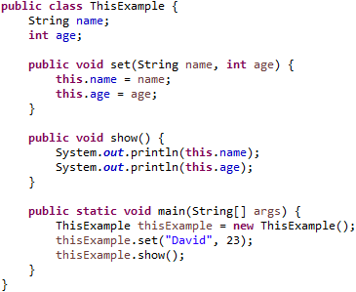
The this Reference
I am this object. My name is
Fred and I am 25.
test1
name: Fred age: 25

Slide 18
Accessor-Mutator methods
An accessor method (getter) is used to return the value of a private field.
It follows a naming scheme prefixing the word "get" to the start of the method name
A mutator method (setter) is used to set a value of a private field.
It follows a naming scheme prefixing the word "set" to the start of the method name.

Slide 19
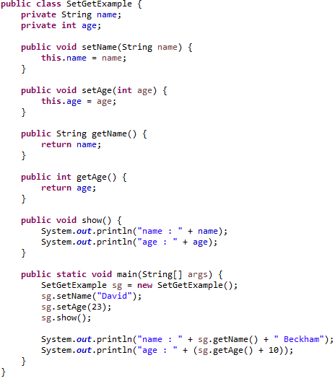
Accessor-Mutator methods
Output :
name : David
age : 23
name : David Beckham
age : 33

Slide 20
Method Overloading
Methods must all have different headers.
Methods within a class can have the same name if they have different parameter lists.
Differentiated by the number and the type of the arguments passed into the method.
We’ve seen overloading before:
3+4
3.0+4.0
“3”+”4”
Performs integer addition Performs floating-point addition Performs string concatenation
The ‘+’ operator is overloaded

Slide 21
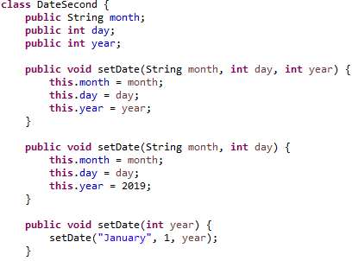
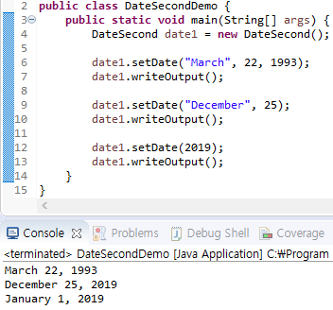
Example 2 cont
값을 넣지 않으면 hashvalue가
찍히니까 지정하는 것이 좋다

Slide 22
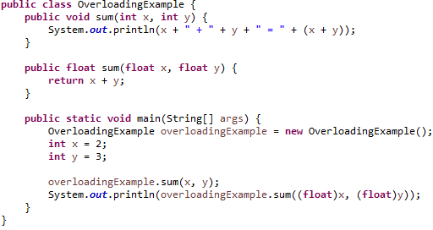
Overloading Example

Slide 23
Overloading Example

Slide 24
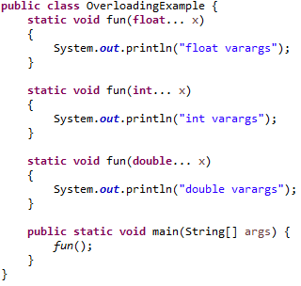
Overloading Example
double > float
float > long
long > int
int > char
int > short
short > byte
Int
Char
Short있으면 -> error
무엇을 실행할까?
->가변인자(파라미터 없어도 가능)를 int가 됨
바이트가 낮은 걸로 변환 됨

Slide 25
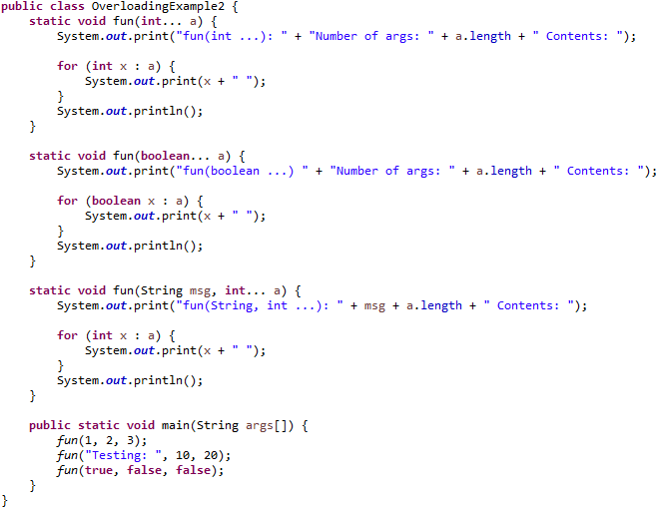
Overloading Example
파라미터 값을 배열로 불러 올 때 사용 : …
Ok
Ok
Ok

Slide 26
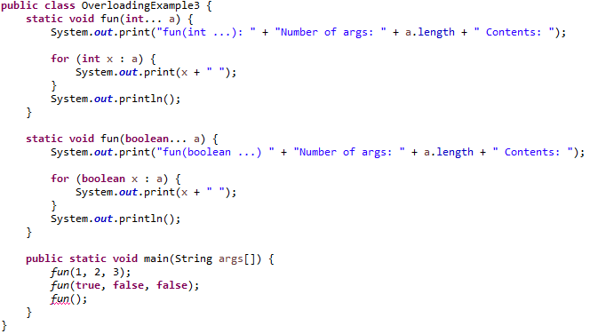
Overloading Example
OK
OK
Error

Slide 27
Constructor
A constructor is a special member function whose name is always the same as the name of the class
A constructor is invoked each time a new object is created
Usually used for initializing variables
The constructor cannot have any return type—not even void.
The “default” constructor accepts no arguments.
The constructor is usually overloaded.
특징
한번 씩 읽어보기

Slide 28
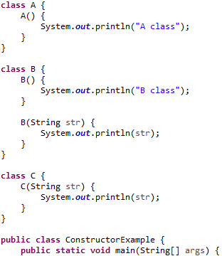
Example 3
A a = new A();
Output : A class
B b = new B();
Output : B class
B b = new B(“B”);
Output : B
C c = new C();
Error
C c = new C(“C class”);
Output : C class

Slide 29
equals() and toString()
== : 참조하는 것이 같은가?
Equals(): 각각 참조하는 값이 같은가?
It is expected by java that objects be able to determine if they are equal to another.
The equals() method returns a Boolean
True if the object is the same. False if it not.
The programmer must determine the criteria for objects being equal.
public boolean equals(Person anotherPerson){
if (this.name.equals(anotherPerson.name) && this.age == anotherPerson.age) return true;
else
return false;
Person
name: Fred age: 25
}

Slide 30
equals() and toString()
It is useful for an object to return a string representation of itself.
The toString() method returns this String.
The programmer must determine the information that is returned by the method.
public String toString(){
return “Person:: \n”+
“Name: “+this.name+”\n”+ “Age: “+this.age+”\n”;
}
Person
name: Fred age: 25

Slide 31
Method notes
You can put the methods in a class in any order
Java doesn’t care which one is listed first
Thus, you can call a method listed later within another method
All methods must specify a return type
If it’s void, then no value is returned
Parameters can’t be changed within a method
순서 제약 x
파라미터 타입자체를 변경 할 수 없다

Slide 32
StringTokenizer
StringTokenizer is a trivial tokenizer provided by Sun
Everything is either a “token” or a “delimiter”
The most important methods are hasMoreTokens() and nextToken()
There are three constructors:
StringTokenizer(String str)
Delimiters are whitespace characters; any sequence of non-whitespace characters is returned as a token
StringTokenizer(String str, String delim)
Same as above, except you get to specify which characters are delimiters
StringTokenizer(String str, String delim, boolean returnDelims)
Same as above, except you get to say you also want the delimiters returned as tokens

Slide 33
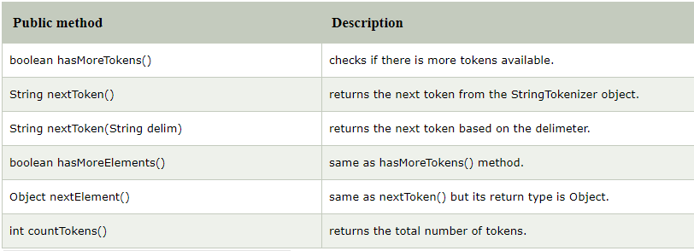
StringTokenizer
Methods of StringTokenizer class
The 6 useful methods of StringTokenizer class are as follows:
구분자 바꾸기

Slide 34
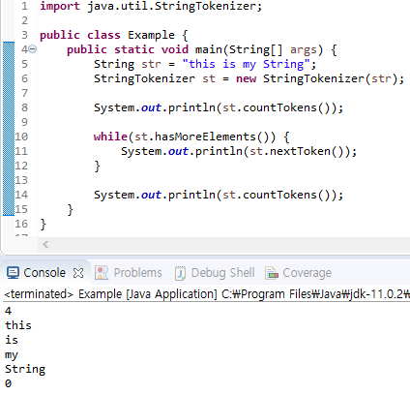
StringTokenizer
Example 1

Slide 35
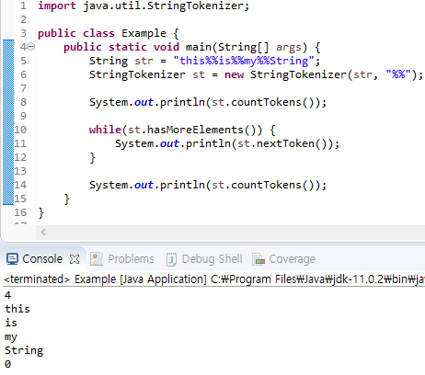
StringTokenizer
Example 2

Slide 36
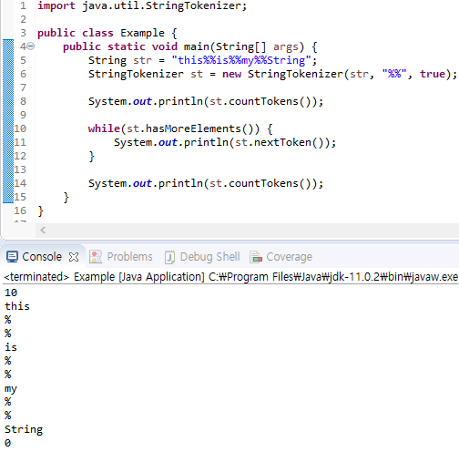
StringTokenizer
Example 3
같은 문자면 구분자를 하나로 인식

Slide 37
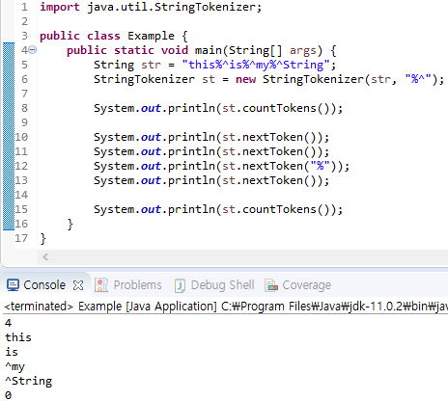
StringTokenizer
Example 4

Slide 38
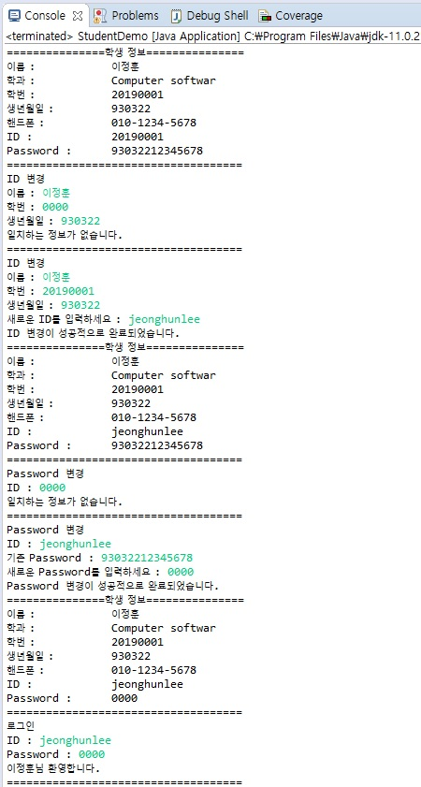
Self-Test
Sample output

Slide 39
Self-Test
학생 정보 프로그램
Student라는 이름으로 class 생성
Student class는 학생 이름, 학과, 학번, 생년월일, 핸드폰 번호, ID, Password 전역 변수를 가지며 private로 선언한다.
Scanner, StringTokenizer를 참조하는 전역 변수를 private로 선언한다.
Student class는 2개의 생성자를 가진다. Hint : Overloading
학생 이름, 학과, 학번, 생년월일, 핸드폰 번호를 매개변수를 가진다.
학생 이름, 학과, 학번 , 생년월일을 매개변수로 가진다. 핸드폰 번호는 010-0000-0000을 default 값으로 설정한다.
setSudent() : 학생 이름, 학과, 학번, 생년월일, ID, Password를 설정해주는 method ID는 default 값을 학번으로 설정하다. Password는 default 값을 생년월일 6자리 + 010을 제외한 핸드폰 번호로 한다. Hint : toString(), StringTokenizer
studentImpormation() : 학생 정보를 console에 출력하는 method

Slide 40
Self-Test
학생 정보 프로그램
changeId() : ID를 변경하는 method. 이름, 학번, 생년월일을 console로 입력 받아 일치하면 새로운 ID로 변경한다. 일치하지 않을 경우 다시 입력 받는다. ID를 변경한 후에는 학생 정보를 보여준다. Hint : Scanner, equals()
changePassword() : Password를 변경하는 method. ID, Password를 console로 입력 받아 일치하면 새로운 Password로 변경한다. 일치하지 않을 경우 다시 입력 받는다. Password를 변경한 후에는 학생 정보를 보여준다. Hint : Scanner, equals()
Login() : ID, Password를 console로 입력 받아 일치하면 console에 로그인 성공 관련 문구를 출력하고 종료한다. 일치하지 않을 경우 다시 입력 받는다.
StudentDemo class를 생성한다. 이 class는 main() method를 가지고 있다.

Slide 41
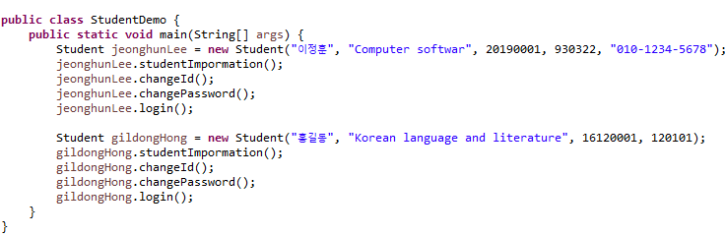
Self-Test
학생 정보 프로그램
StudentDemo Example

Slide 42
Q & A

