Slide 1
Object Oriented Programming
Lab #5
1

Slide 2
Content
Classes review
Static Variables and Method
Math Method
Boxing/UnBoxing
Call by Value
Git LAB

Slide 3
Classes: Review
public class ClassName{
instance variables;
Constructors(){…}
getters(){…} //accessors
setters(parameters){…} //mutators other methods(){…}
}

Slide 4
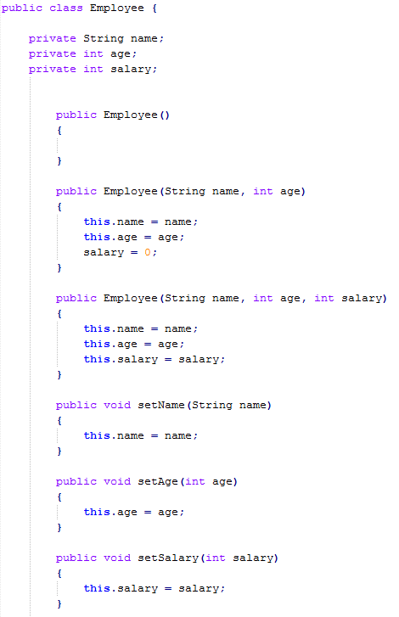
Classes: Review
Private Instance variables
Constructor의 overoading이 있으면 default constructor생성x
Method Overloading
Allows us to have multiple methods with the same name but different parameters.
Constructors
Employee emp = new Employee();
emp.age = -20; //직접 접근
emp.setAge(20); //메소드 접근
메소드 접근을 하면 예외처리 가능
Mutators

Slide 5
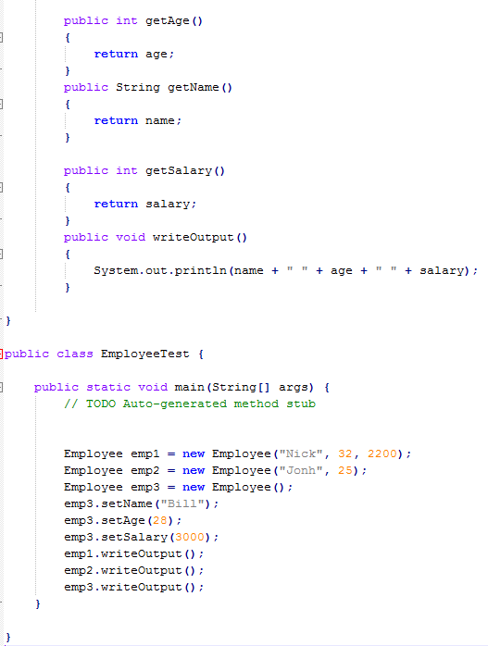
Classes: Review
Accessors
Creating Object
Calling instance method

Slide 6
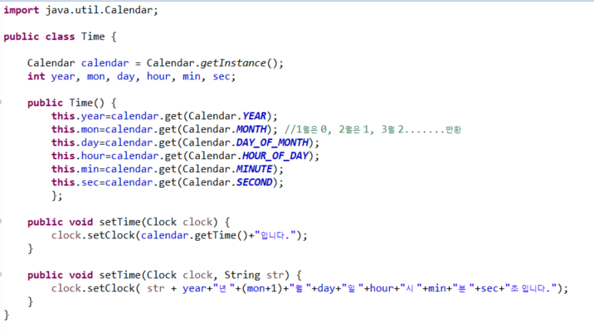
Self test1
시간 알람 프로그램 작성
시간을 설정하는 Time Class, 시간을 알려주는 Clock Class 그리고 Main Class를 작성하시오.
Time class
6

Slide 7
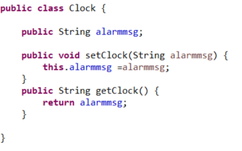
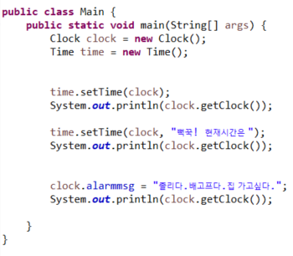

Self test1
시간 알람 프로그램 작성
Clock class
Main class
인스턴스 변수에 직접접근 피해야함
Bad !!! Why?
출력 화면
7

Slide 8
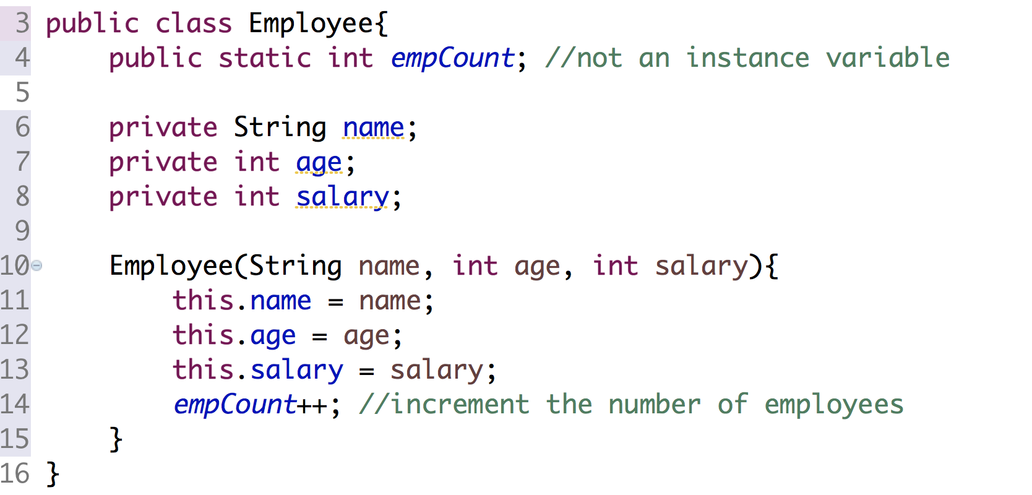
Static
A class can have data and methods of its own (not part of the objects)
For example, Employee class can keep a count of the number of objects it has created
8

Slide 9
Static (contd..)
In Java
public class EmployeeManager {
public static void main (String[] args){
Employee emp1 = new Employee("James Wright",42,"Manager", 20000);
Employee emp2 = new Employee("Amy Smith",27,"Design Coordinator", 8000,15);
Employee emp3 = new Employee("Peter Coolidge",32,"Assistant Manager", 12000,7); Employee emp4 = new Employee("John Doe",22,"Engineer", 10000,10);
System.out.println(emp1.toString()+emp2+emp3+emp4);
System.out.println("Number of Employees: "+Employee.empCount +"\n");
}
}
Employee.empCount is asking Employee class for the count of the employees created
Since empCount belongs to class and not the object
Hence use the classname and not Object name to access variable dogCount
9

Slide 10
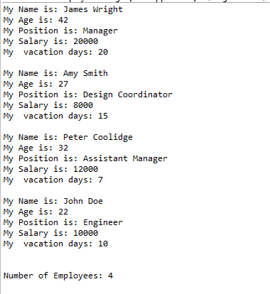
Static (contd..)
Output after running the program.
10

Slide 11
Static Variables
A static variable is a variable that belongs to the class as a whole, and not just to one object
– There is only one copy of a static variable per class, unlike instance variables where each object has its own copy
All objects of the class can read and change a static variable
Although a static method cannot access an instance variable, a static method can access a static variable
A static variable is declared like an instance variable, with the addition of the modifier static
private static int myStaticVariable;
5-12

Slide 12
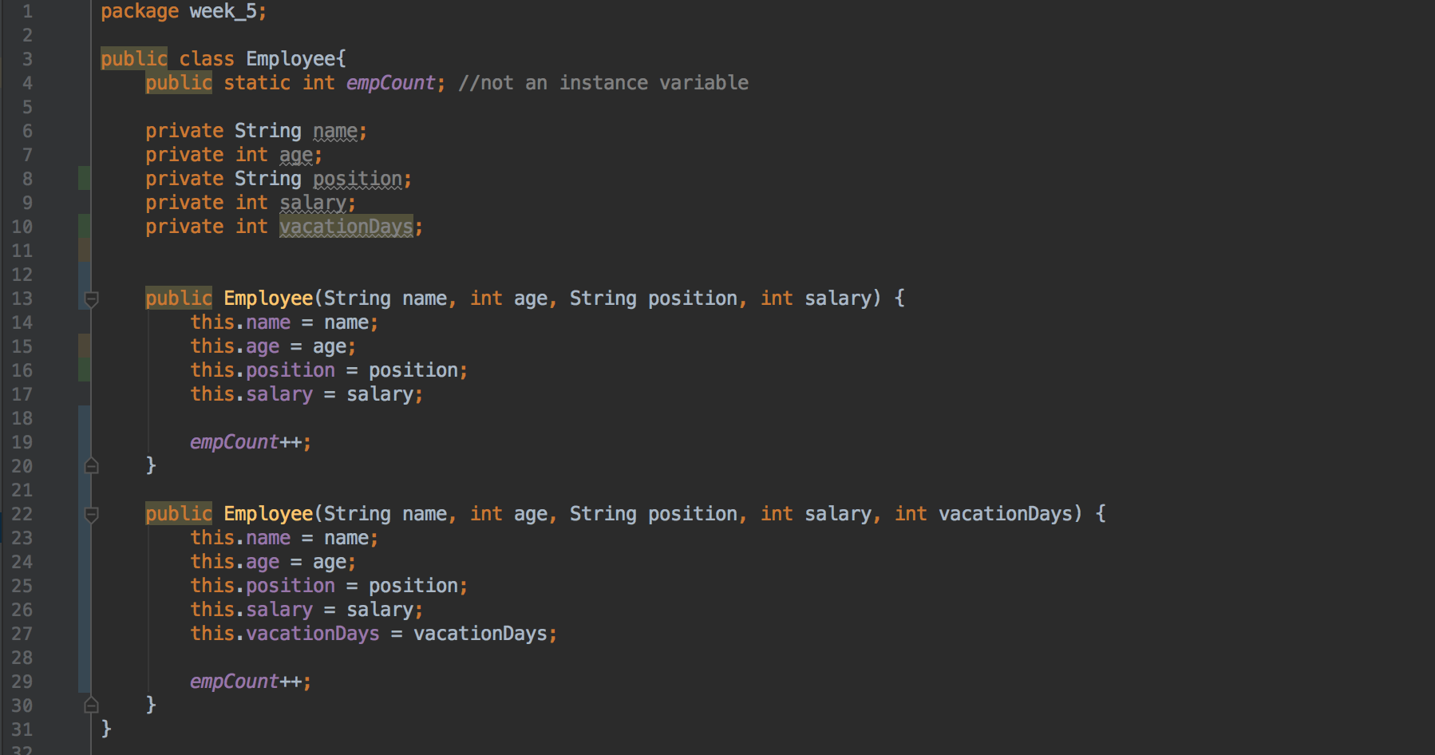
Self Test2
13

Slide 13
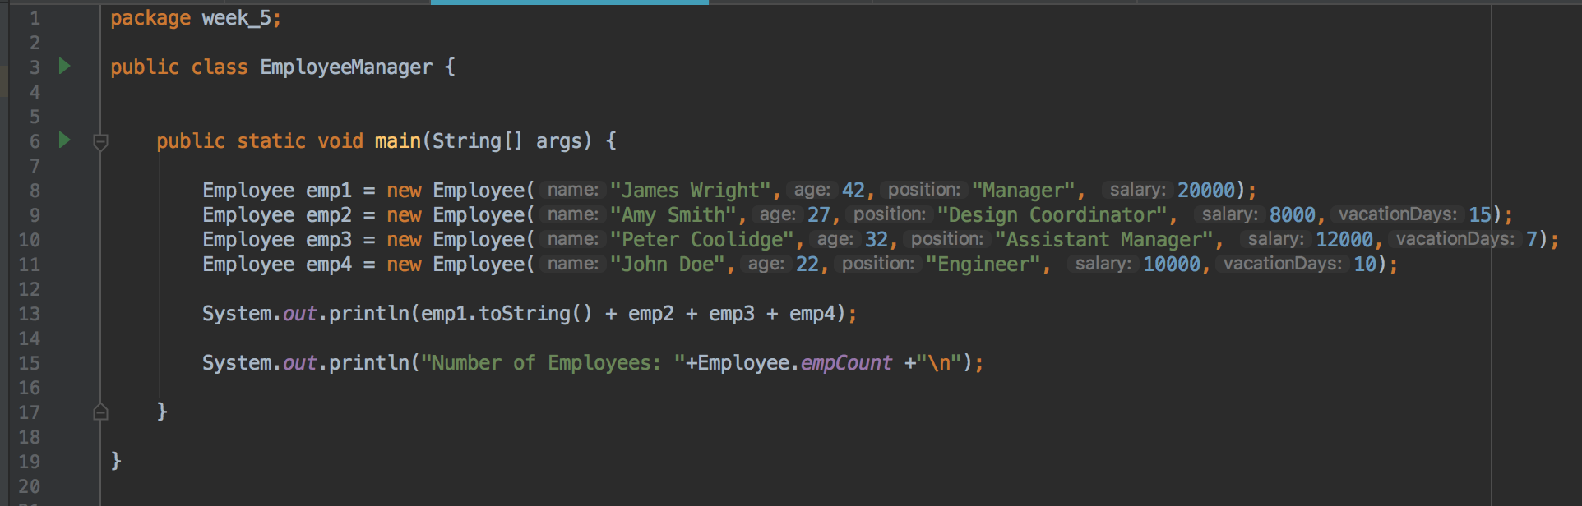
Self Test2
toString() 클래스 안에 자동내재?
13

Slide 14
Static Variables
Employee Class
empCount:
4
2
3
0
1
emp1
name: James age: 42
emp2
name: Amy age: 27
emp3
emp4
name: Peter age: 32
name: John age: 22
13

Slide 15
Static Methods
A static method is one that can be used without a calling object
A static method still belongs to a class, and its definition is given inside the class definition
When a static method is defined, the keyword static is placed in the method header
public static returnedType myMethod(parameters)
{ . . . }
Static methods are invoked using the class name in place of a calling object
returnedValue = MyClass.myMethod(arguments);

Slide 16
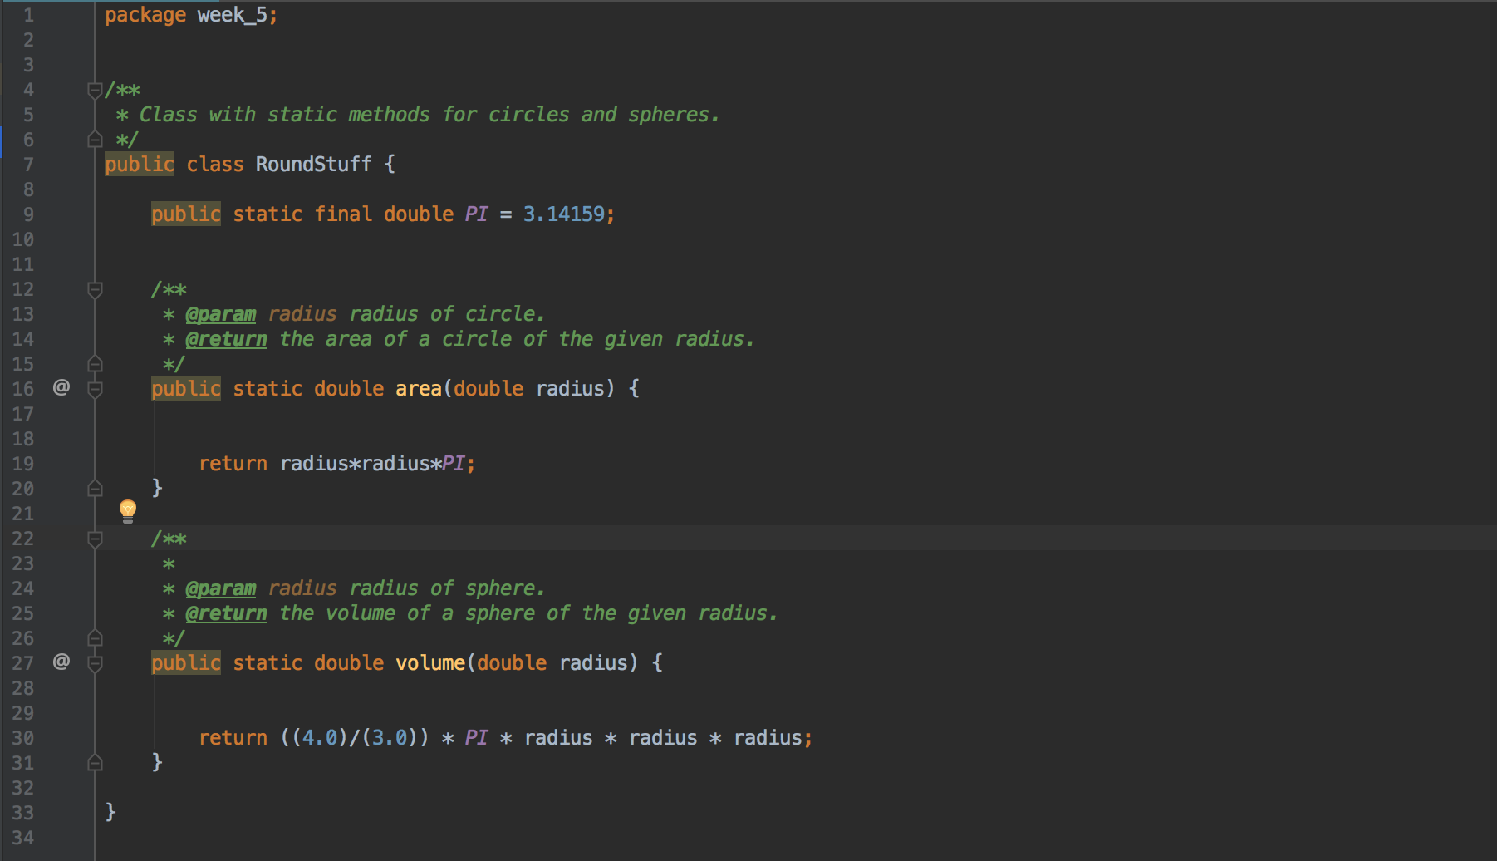
Static Methods

Slide 17
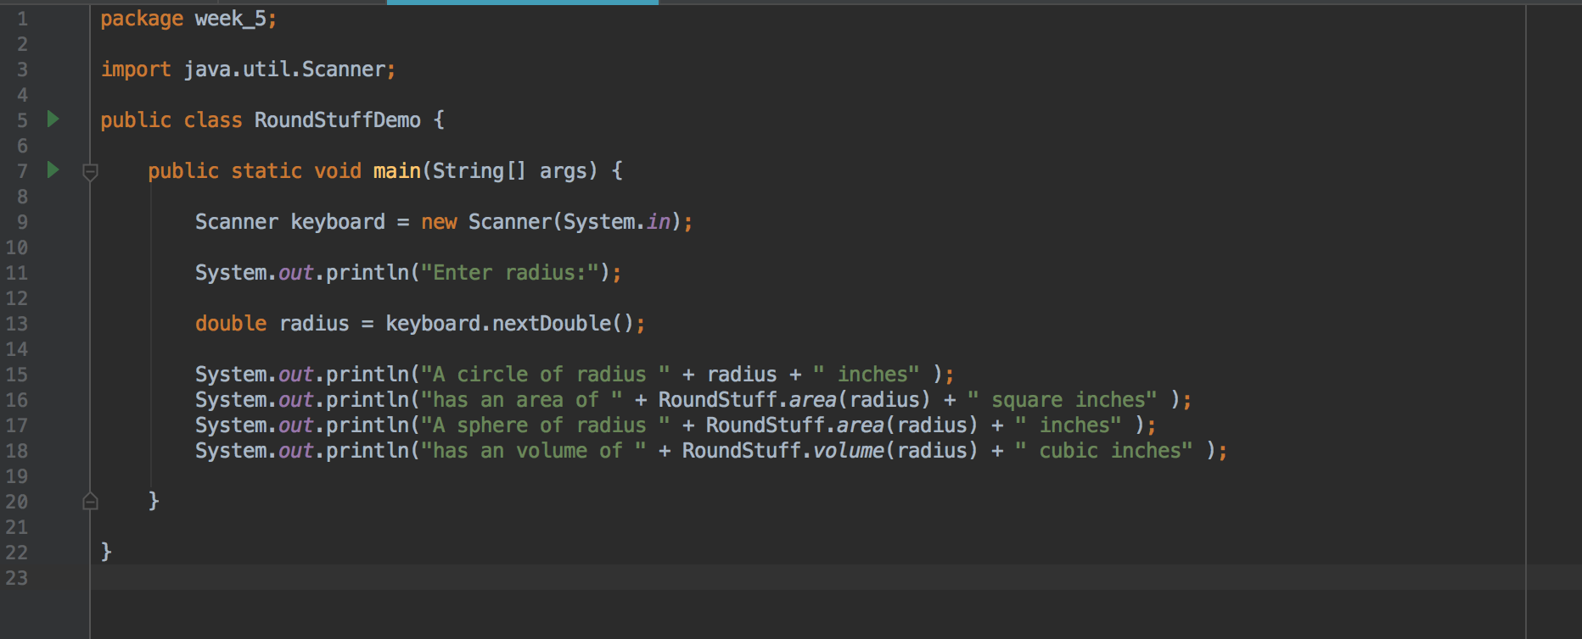
Static Methods

Slide 18
Main
The Main method is a well known static method
You Can Put a main in any Class
Although the main method is often by itself in a class separate from the other classes of a program, it can also be contained within a regular class definition
In this way the class in which it is contained can be used to create objects in other classes, or it can be run as a program
A main method so included in a regular class definition is especially useful when it contains diagnostic code for the class

Slide 19
String args[ ]
Parameter in the main method
Command-line arguments in Java
When an application is launched, the runtime system passes the command-line arguments to the application's main method via an array of Strings.
19

Slide 20
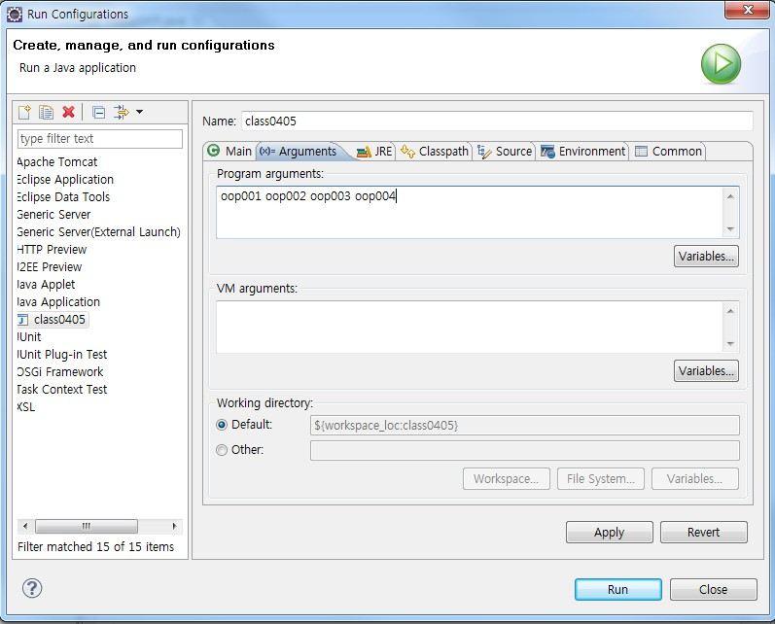
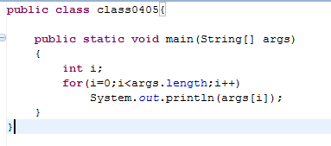
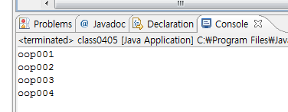
String args[ ]
From the menu bar select Run -> Run Configuration
20

Slide 21
The Math Class
The Math class is an important built-in class.
Contains static variables and methods.
Collection of common math functions (sin, cos, sqrt, etc.).
Two constants: PI and E
20

Slide 22
The Math Class
The Math class provides a number of standard mathematical methods
It is found in the java.lang package, so it does not require an import statement
All of its methods and data are static, therefore they are invoked with the class name Math instead of a calling object
The Math class has two predefined constants, E (e, the base of the natural logarithm system) and PI (π, 3.1415 . .
.)
Ex) Math.E , Math.PI
area = Math.PI * radius * radius;
5-21

Slide 23
What's different about Math Class
It’s different from a typical Java class
It is a “stateless” class
We only need one Math class (not multiple instances)
No need to instantiate it (hence, no public constructor)
All of its variables and methods are static
static means “applies to the class as a whole” vs. “applies to an individual instance”
23

Slide 24
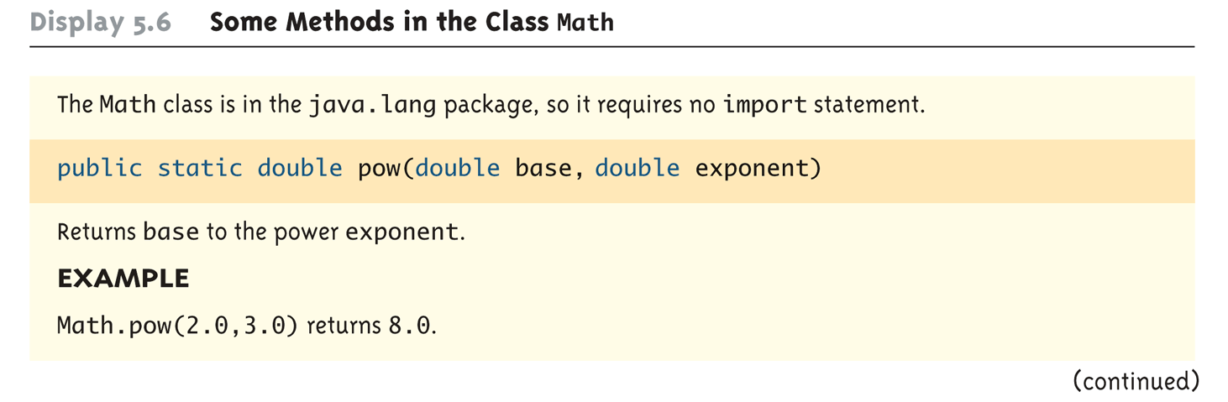
Some Methods in the Class Math
(Part 1 of 5)

Slide 25
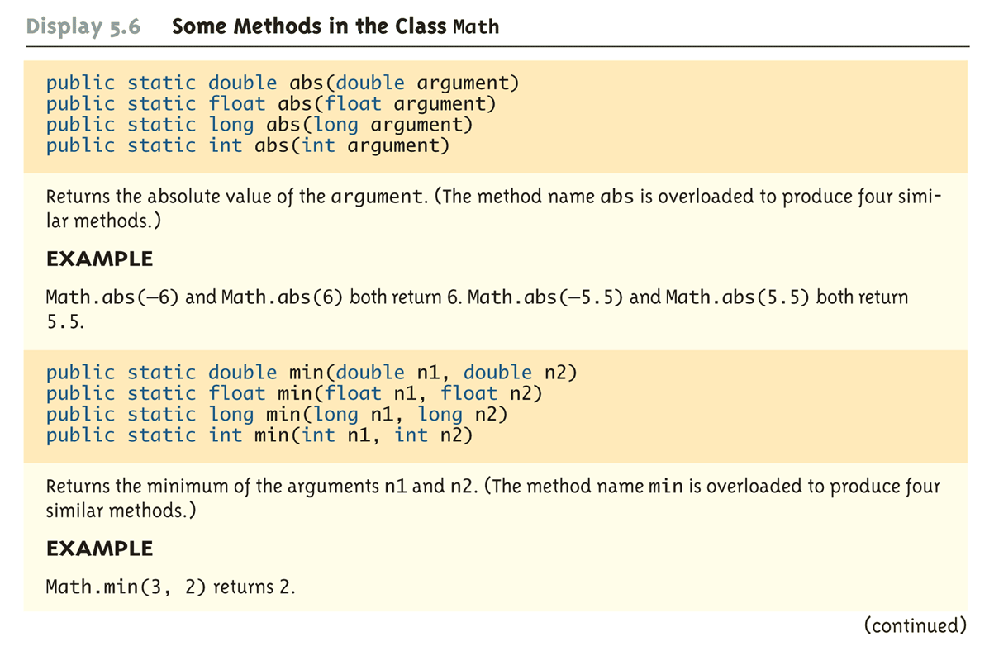
Some Methods in the Class Math
(Part 2 of 5)

Slide 26
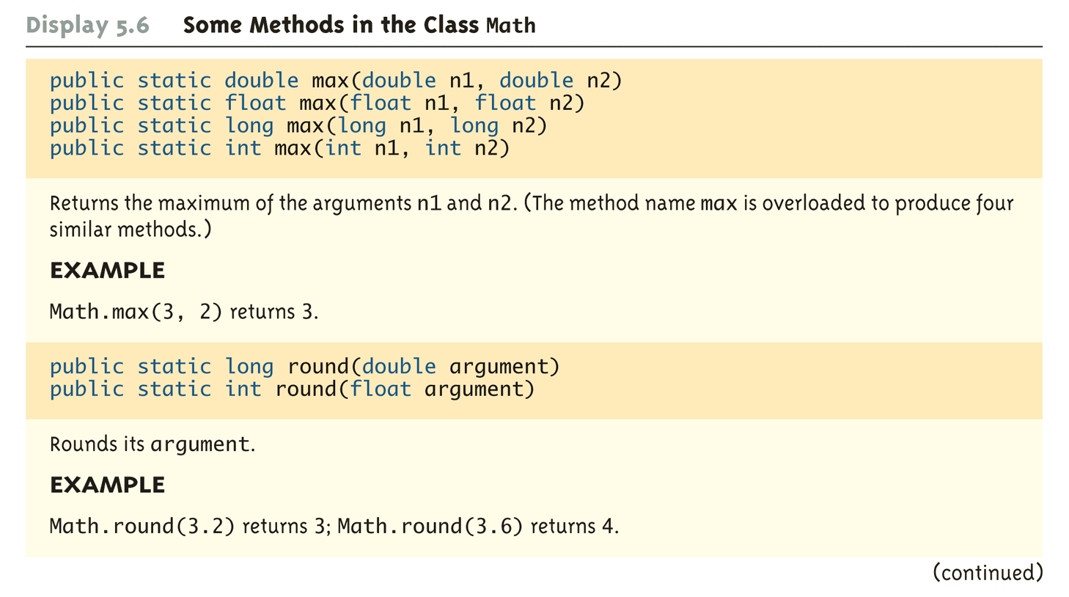
Some Methods in the Class Math
(Part 3 of 5)

Slide 27
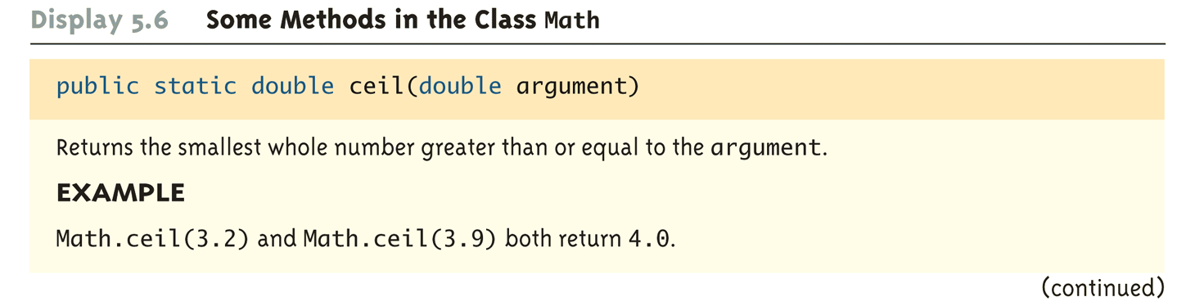
Some Methods in the Class Math
(Part 4 of 5)

Slide 28
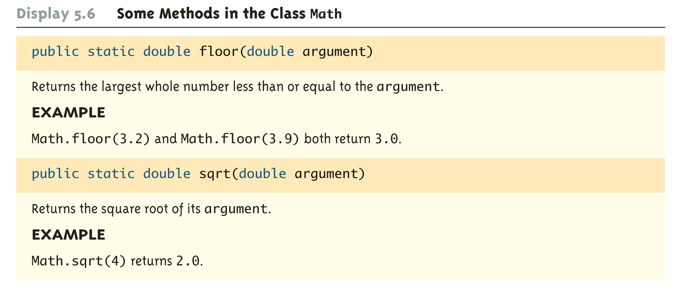
Some Methods in the Class Math
(Part 5 of 5)

Slide 29
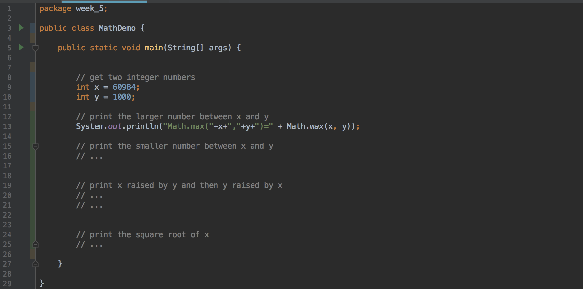
Self Test3
Lets try this
29

Slide 30
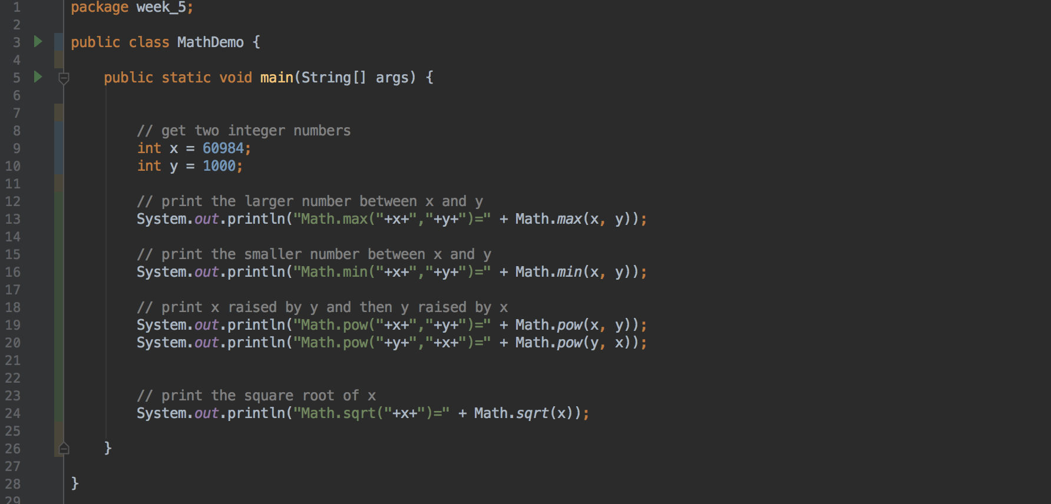
Self Test3
29

Slide 31

Random Numbers
The Math class also provides a facility to generate pseudo-random numbers
public static double random()
-A pseudo-random number appears random but is re리Iy generated bya deterministic function
There is also a more flexible class named Random
Sample use:
double num = Math .random();
Returns a pseudo-random number greater than or equal to 0.0 and less than 1.0

Slide 32
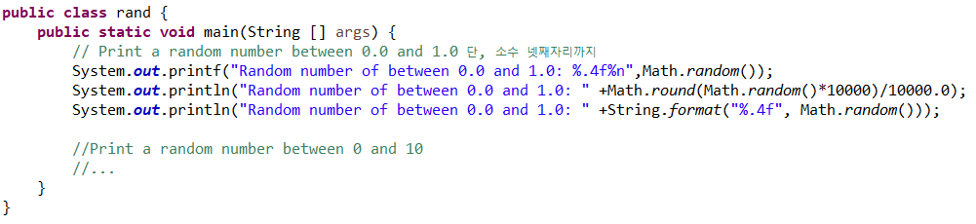
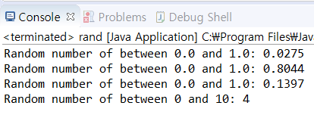
Random Numbers
Self test4

Slide 33
Primitives & Wrapper Classes
• Java’s primitive data types (boolean, int, etc.) are not classes.
• Wrapper classes are used in situations where objects are required, such as for elements of a Collection: //HashMap, Generic

Slide 34
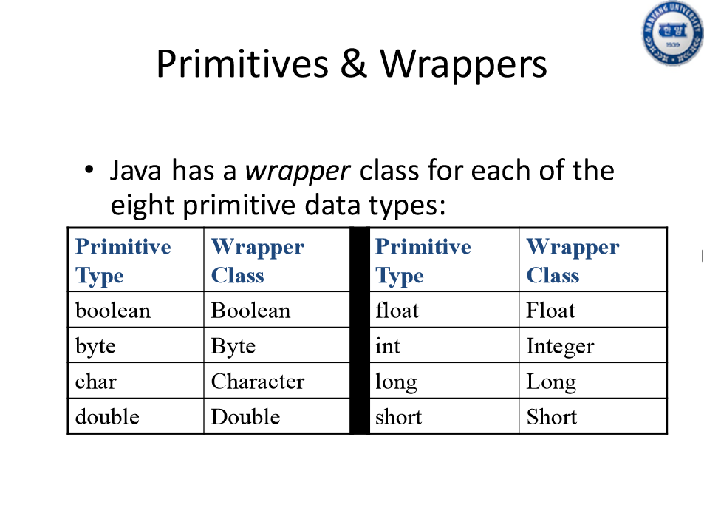

Slide 35

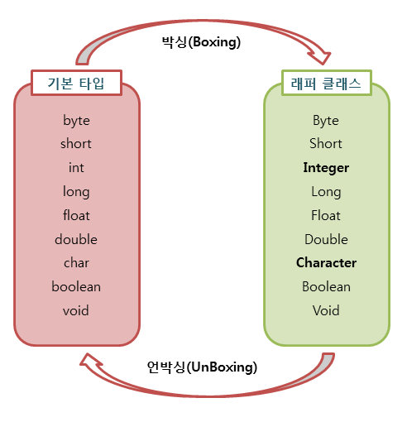

Slide 36
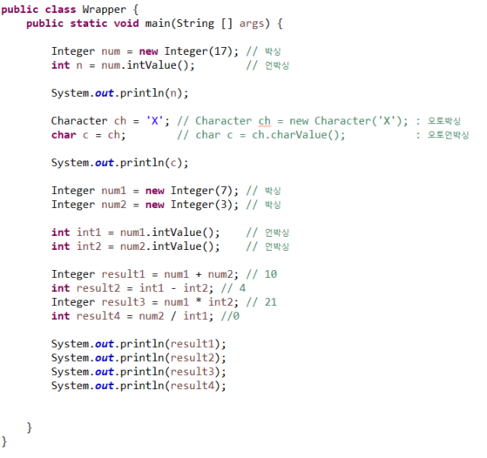
박싱 op 박싱 (O)
언박싱 op 박싱??
컴파일러가 언박싱과
박싱을 자동으로 처리

Slide 37
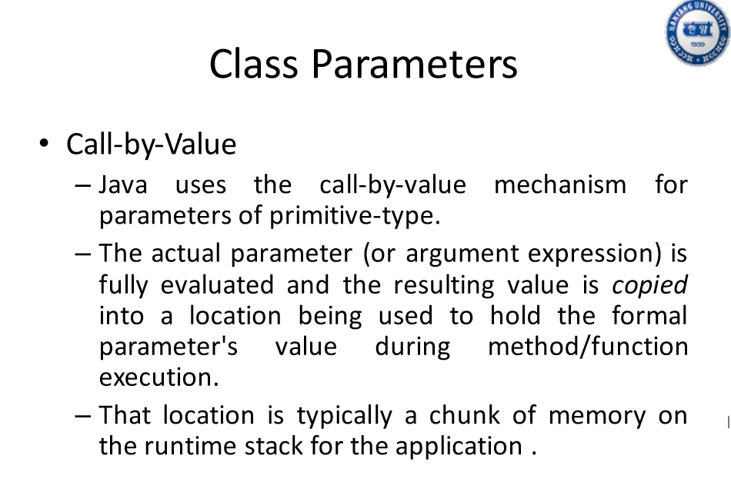

Slide 38
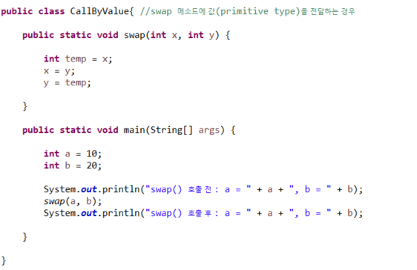
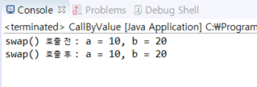

Slide 39
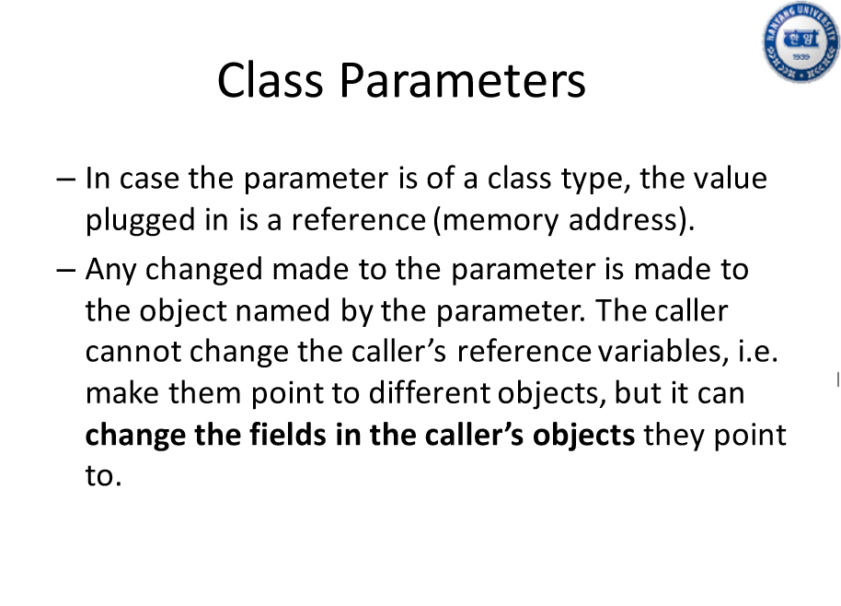

Slide 40
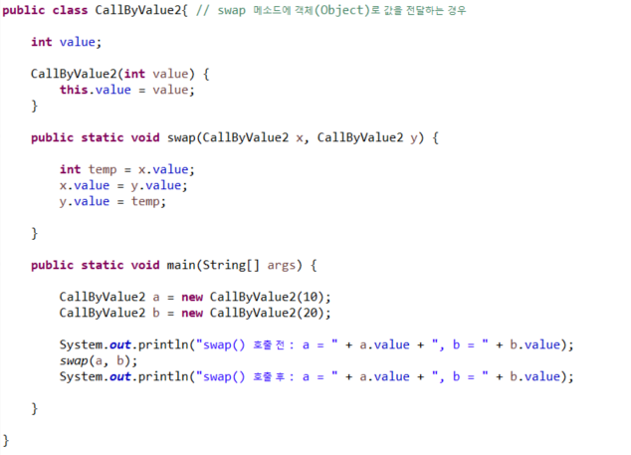
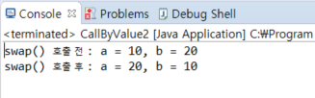

Slide 41
GIT LAB

Slide 42
Q/A

