Slide 1
Object Oriented Programming
Lab #6

Slide 2
Content
Arrays
Object Arrays
Multidimensional Arrays
Self Test
Deep Copy and Shallow Copy
Package
Assignment 1

Slide 3
Arrays
Background
Programmers often need the ability to represent a group of values as a list
– List may be one-dimensional or multidimensional
An array is a data structure used to process a collection of data that is all of the same type

Slide 4
Basic terminology
An array is composed of elements
Elements in an array have a common name
Example: a[3] = 5;
The common name is ‘a’
The entire array is referenced through the common name
Array elements are of the same type — the base type
Elements of an array are referenced by subscripting (indexing) the common name

Slide 5

Arrays
Defining arrays
int[] value;
q Defines the Array identifier value
q Array object variable value is un- initialized
value
q Defines and initializes the Array
q Array object variable value references a new ten element list of integers
q Each of the integers is default initialized to 0
int[]
value
= new int[10];
value
0 | 0 | 0 | 0 | 0 | 0 | 0 | 0 | 0 | 0
Generally declare Arrays in java as follows
BaseType[] ArrayName= new BaseType[size];

Slide 6
Array example
public class ArgsExample {
public static void main(String[] args) {
if (args.length == 0) {
System.exit(0);
}
for (int i = 0; i < args.length; i++) {
System.out.println("args[" + i + "] : " + args[i]);
}
System.out.println("args.length : " + args.length);
}
}
javac ArgsExample.java
java ArgsExample Michael David Lee
args[0] : Michael
args[1] : David
args[2] : Lee
args.length : 3

Slide 7
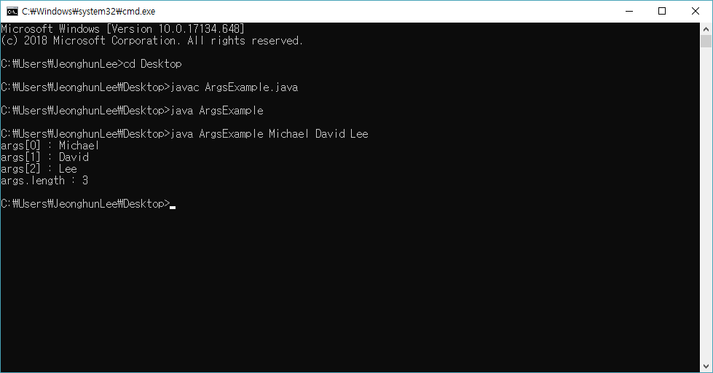
Array example
Command line output :

Slide 8
Arrays
Creating an array:
int[] array; // Java style
int array[]; // C style
int[] array; // declare the array variable
array = new int[10]; // create the array; assign to array variable
int[] array = new array[10];

Slide 9
An array example
int[] v = new int[10];
int i = 7;
int j = 2;
v[0] = 1;
v[i] = 5;
v[j] = v[i] + 3;
v[j+1] = v[i] + v[0];
v[j+2] = 3;
v[8] = 12;
v
1 | 0 | 8 | 6 | 3 | 0 | 0 | 5 | 12 | 0
v[0]
v[1]
v[2]
v[3]
v[4]
v[5]
v[6]
v[7]
v[8]
v[9]

Slide 10
Java array features
Base (element) type can be any type
Size of array can be specified at run time
– double[] score
= new double[count];
Index type is integer and the index range must be 0 ... n-1
Where n is the number of elements
Just like Strings indexing!
Automatic bounds checking
Ensures any reference to an array element is valid
Array is an object
Has features common to all other objects

Slide 11
Explicit initialization
An array can be initialized when it is declared.
Initializing Arrays:
int[] array = new int[3];
array[0] = 1;
array[1] = 2;
array[2] = 3;
int[] array;
array = new int[] {1, 2, 3};
int[] array = new int[] {1, 2, 3};
int[] array = {1, 2, 3};

Slide 12
Variable-size Declaration
In Java, we are not limited to fixed-size array declaration.
The following code prompts the user for the size of an array and declares an array of designated size:
Scanner scan = new Scanner(System.in);
int size;
int[] number;
System.out.print("Size of an array:"));
size= scan.nextInt( );
number = new int[size];

Slide 13
Array length
Member length
– The length of the array
for (int i = 0; i < args.length; i++) {
System.out.println(args[i]);
}
Length - (o)
Length() - (x)
Note that length is a field, not a method!
– i.e., it is not args.length()

Slide 14
Array manipulation
The most natural way to manipulate items in an array is to use the for loop.
Basic for loop
for (int index = 0; index < arr.length; index++) {
//perform array manipulation tasks here
System.out.println(arr[index]);
}
The for loop uses an index from 0 to the end of the array.
This is useful for initializing your array with default values. For example 10’s
10 | 10 | 10 | 10 | 10 | 10

Slide 15
Array manipulation
Another loop suited for arrays is For each loop
this loop however has some limitations
for (int item : array) {
//perform array access tasks here
System.out.println(item);
}
The for iterates through each item in the array and prints the value.
Assigning elements: Avoid using for-each loop when you need to assign a value to an element. This loop can be used when only access is desired.
Use with single structure: You cannot use the loop when you need to compare two arrays in a situation.
Forward iterations only: Use the “for-each” loop only for forward looping and that too in single steps.

Slide 16
Array manipulation
You can use other loops with arrays.
While loop
int i = 0;
while (i < arr.length) {
System.out.println(arr[i]);
i++;
}
Do while loop
int j = 0;
do {
System.out.print(arr[j]);
j++;
} while (j < arr.length);

Slide 17
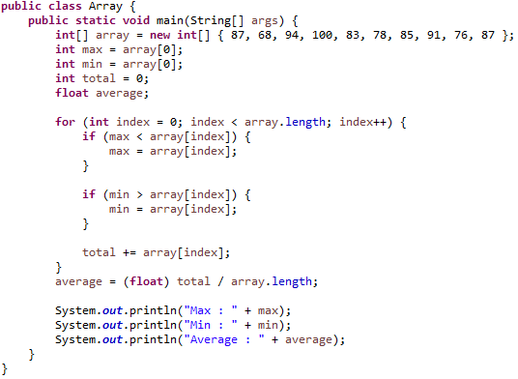
An array example
Output :
Max : 100
Min : 68
Average : 84.9

Slide 18
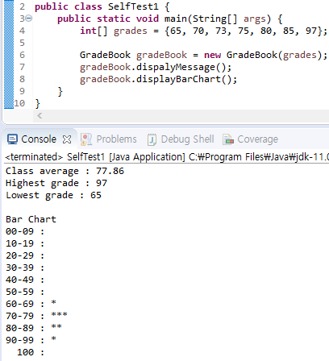
Self Test
Output :
Create class GradeBook.
GradeBook class has private int[] grades instance variable.
GradeBook class only has one constructor with one argument.
displayMessage() : The method prints the average, highest grade, lowest grade.
displayBarChart() : The method counts in units of 10 and prints it as a bar chart.

Slide 19
Arrays and References
Like class types, a variable of an array type holds a reference
Arrays are objects
A variable of an array type holds the address of where the array object is stored in memory
Array types are (usually) considered to be class types

Slide 20
Use of = with Arrays
Because an array variable contains the memory address of the array it names, the assignment operator (=) only copies this memory address
It does not copy the values of each indexed variable
Using the assignment operator will make two array variables be different names for the same array
int[] a = new int[10];
int[] b = a;
The memory address in a is now the same as the memory address in b: They reference the same array
a
0 | 0 | 0 | 0 | 0 | 0 | 0 | 0 | 0 | 0
b

Slide 21
Use of = with Arrays
A for loop is usually used to make two different arrays have the same values in each indexed position:
int i;
for (i = 0; (i < a.length) && (i < b.length); i++) b[i] = a[i];
– Note that the above code will not make b an exact copy of a, unless a and b have the same length

Slide 22
Self Test (Bubble sort)
Initial Initial Unsorted array
Step 1 Compare 1st and 2nd
Step 2 Compare 2nd and 3rd
Step 3 Compare 3rd and 4th
Step 4 Compare 4th and 5th
Step 5 Repeat Step 1-5 until
no more swaps required
5 | 3 | 8 | 4 | 6
5 | 3 | 8 | 4 | 6
3 | 5 | 8 | 4 | 6
3 | 5 | 8 | 4 | 6
3 | 5 | 4 | 8 | 6
3 | 5 | 4 | 6 | 8

Slide 23
Self Test (Bubble sort)
public class BubbleSort {
public static void main(String[] args) {
Scanner scan = new Scanner(System.in);
…..source code……
System.out.print("Output : ");
for (int i = 0; i < array.length; i++) {
System.out.print(array[i] + " ");
}
scan.close();
}
}
Intput : 5 3 8 4 6
Output : 3 4 5 6 8

Slide 24
Self Test (Lotto)
public class Lotto {
public static void main(String[] args) {
Random random = new Random();
…..source code……
System.out.println("로또6/45 당첨번호 정보");
for (int i = 0; i < lottoNumber.length; i++) {
System.out.print(lottoNumber[i] + " ");
}
}
}
Output :
로또6/45 당첨번호 정보
2 8 23 26 27 44

Slide 25
Object Arrays
The base type of an array can be a class type
Date[] holidayList = new Date[20];
The above example creates 20 indexed variables of type Date
It does not create 20 objects of the class Date
Each of these indexed variables are automatically initialized to null
Any attempt to reference any them at this point would result in a "null pointer exception" error message

Slide 26
Object Arrays
Like any other object, each of the indexed variables requires a separate invocation of a constructor using new (singly, or perhaps using a for loop) to create an object to reference
holidayList[0] = new Date();
. .
holidayList[19]
OR
for (int i = 0;
.
= new Date();
i < holidayList.length; i++)
holidayList[i] = new Date();
Each of the indexed variables can now be referenced since each holds the memory address of a Date object

Slide 27
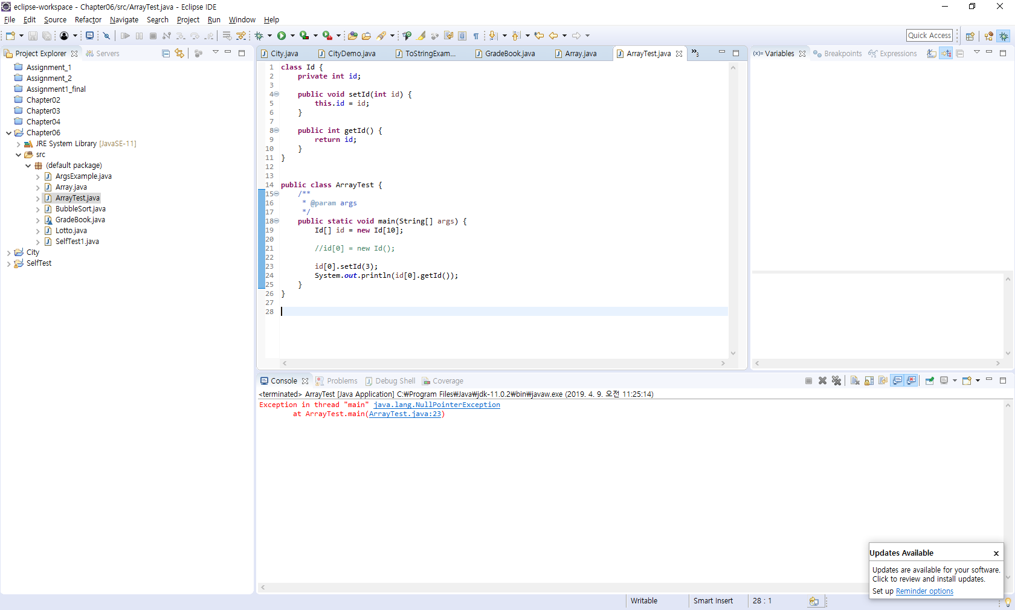
Object Arrays
There is no object

Slide 28

Object Arrays
Output :
3
Creates an object

Slide 29
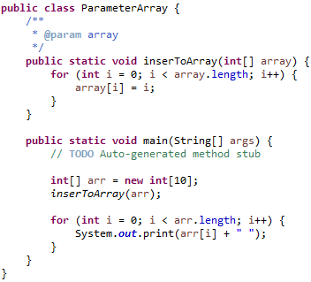
Passing an Array as a Parameter
Output :
0 1 2 3 4 5 6 7 8 9
q To pass an array as a parameter simply declare the identifier.
q You do not need to enter the size of the array

Slide 30
Methods That Return an Array
In Java, a method may also return an array
– The return type is specified in the same way that an array parameter is specified
public static int[] incrementArray(int[] a, int increment){
int[] temp = new int[a.length];
int i;
for (i = 0; i < a.length; i++)
temp[i] = a[i] + increment;
return temp;
}

Slide 31
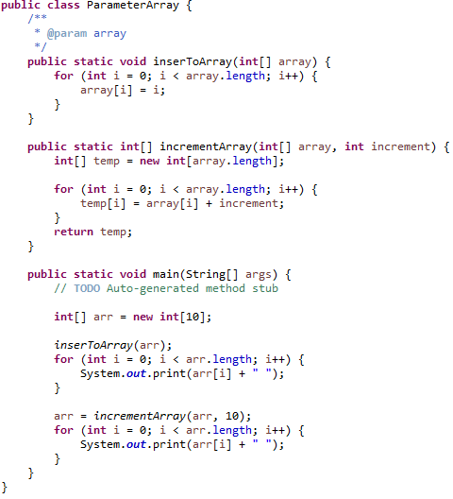
Methods That Return an Array
Output :
1 2 3 4 5 6 7 8 9 10 11 12 13 14 15 16 17 18 19

Slide 32
Multidimensional arrays
Many problems require information be organized as a two-dimensional or multidimensional list
Examples
Matrices
Graphical animation
Economic forecast models
Map representation
Time studies of population change
Microprocessor design

Slide 33
Example
Segment
int[][]
m = new int[3][4];
Produces
m[0]
m[1]
m[2]
m
0 | 0 | 0 | 0
m[2][0]
m[2][1] m[2][2] m[2][3]
0 | 0 | 0 | 0
0 | 0 | 0 | 0
m[0][0]
m[0][1] m[0][2] m[0][3]
m[1][0]
m[1][1] m[1][2] m[1][3]

Slide 34
Multidimensional array visualization
A multi-dimensional array declaration
declaring the array
int[][] m = new int[3][4];
accessing the array
m[2][1] = 4;
0 | 0 | 0 | 0
0 | 0 | 0 | 0
0 | 4 | 0 | 0

Slide 35
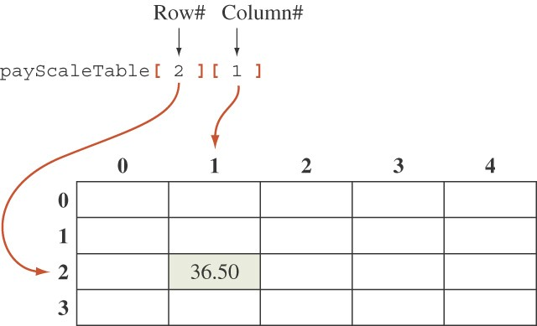
Accessing an Element
An element in a two-dimensional array is accessed by its row and column index.

Slide 36
Explicit initialization
Initializing two dimensional arrays:
Int[][] array = new int[2][3];
array[0][0] = 1;
array[0][1] = 2;
array[0][3] = 3;
array[1][0] = 4;
array[1][1] = 5;
array[1][2] = 6;
Int[][] array = new int[2][];
array[0] = new int[] {1, 2};
array[1] = new int[] {3, 4, 5};
int[][] array = { {1, 2}, {3, 4} };
int[][] array = { {1, 2}, {3, 4, 5} };
int[][] array = { {1, 2}, {3}, {4, 5} };
 | 0 | 1 | 2
0 | 1 | 2 | 3
1 | 4 | 5 | 6
 | 0 | 1 | 2
0 | 1 | 2
1 | 3 | 4 | 5
 | 0 | 1
0 | 1 | 2
1 | 3
2 | 4 | 5
 | 0 | 1
0 | 1 | 2
1 | 3 | 4
 | 0 | 1 | 2
0 | 1 | 2
1 | 3 | 4 | 5

Slide 37
How to get length of raw and column
int[][] m = new int[3][4];
m.Length ... ?
m[0].length ... ?
m[1].length ... ?
m[2].length ... ?
m.Length == 3
m[2].Length == 4
m[1]
m[2]
m
0 | 0 | 0 | 0
m[2][0]
m[2][1] m[2][2] m[2][3]
0 | 0 | 0 | 0
0 | 0 | 0 | 0
m[0][0]
m[0][1] m[0][2] m[0][3]
m[1][0]
m[1][1] m[1][2] m[1][3]
m[0].Length == 4
m[1].Length == 4

Slide 38
How to get length of raw and column
int[][] m = new int[3][4];
m.Length ... ?
m[0].length ... ?
m[1].length ... ?
m[2].length ... ?
Column length
m[0].Length == 4
m[1].Length == 4
m[2].Length == 4
m
Row length
0 | 0 | 0 | 0
0 | 0 | 0 | 0
0 | 0 | 0 | 0
m.Length == 3

Slide 39
Sample 2-D Array Processing
The basic structure of 2D array processing code.
arrayType[][] arrayName = new arrayType[numRows][numCols];
for (int i = 0; i < arrayName.length; i++) {
for (int j = 0; j < arrayName[i].length; j++) {
// Perform actions in here
// e.g. System.out.print(arrayName[i][j])
}
}

Slide 40
Sample 2-D Array Processing
Multidimensional arrays are usually processed using nested loops
The outer loop iterates the rows
The inner loop iterates the items of each row (i.e. column)
double[] average = { 0.0, 0.0, 0.0, 0.0 };
double[][] payScaleTable = new double[3][4];
// payScaleTable setting
for (int i = 0; i < payScaleTable.length; i++) {
for (int j = 0; j < payScaleTable[i].length; j++) {
average[i] += payScaleTable[i][j];
}
average[i] = average[i] / payScaleTable[i].length;
}

Slide 41
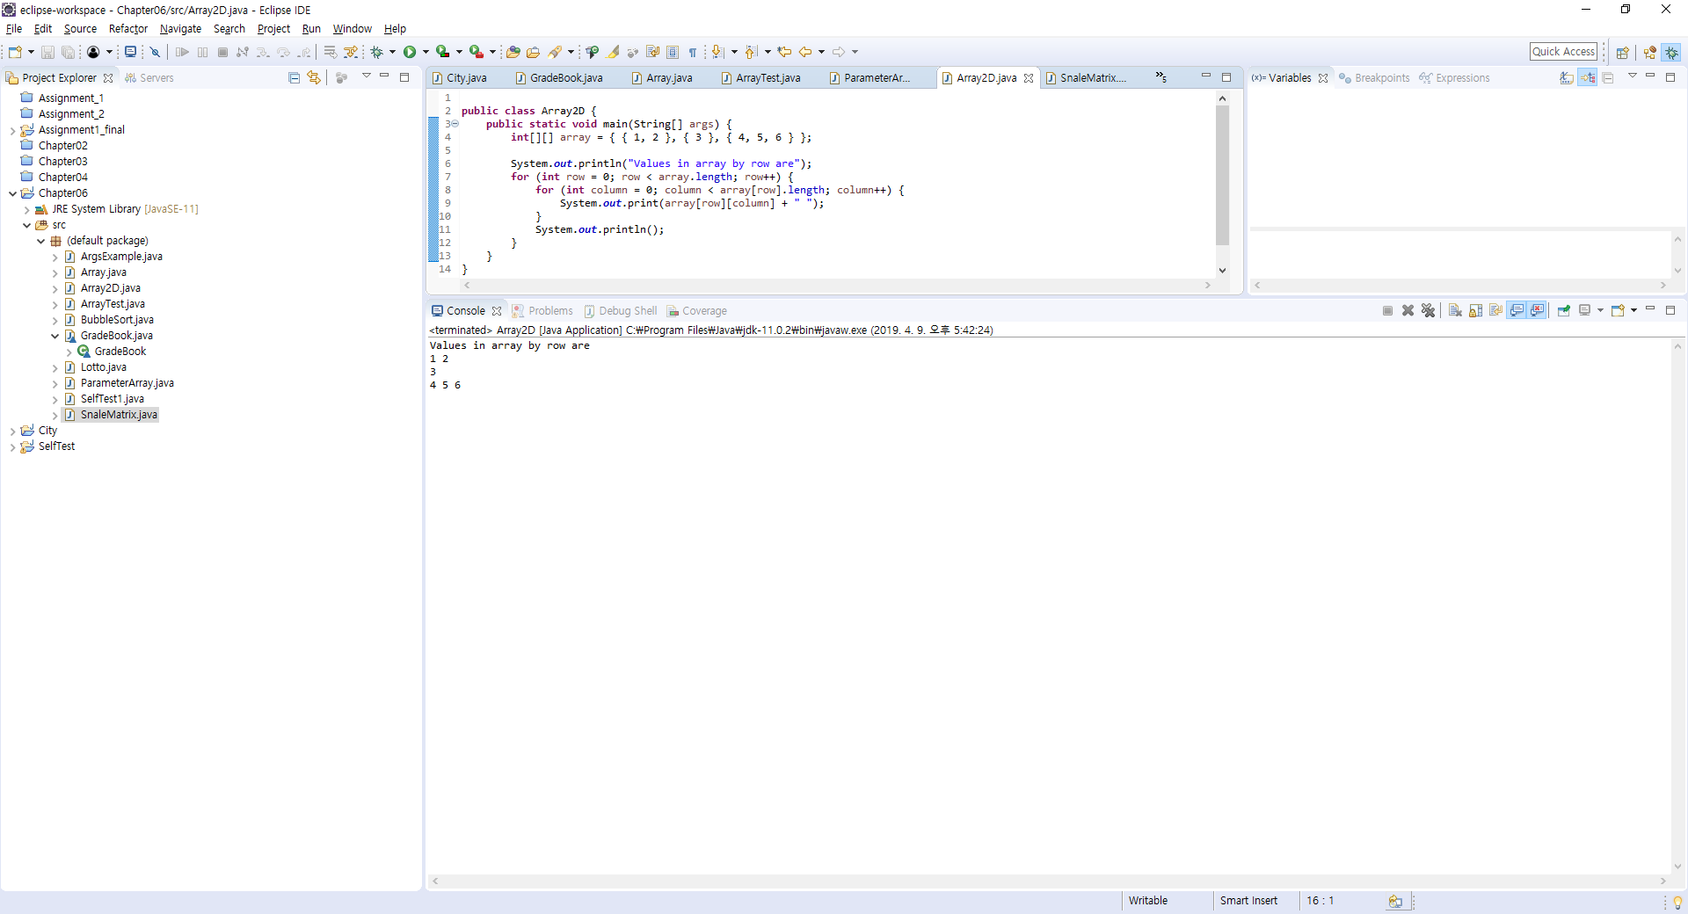
Sample 2-D Array Processing

Slide 42
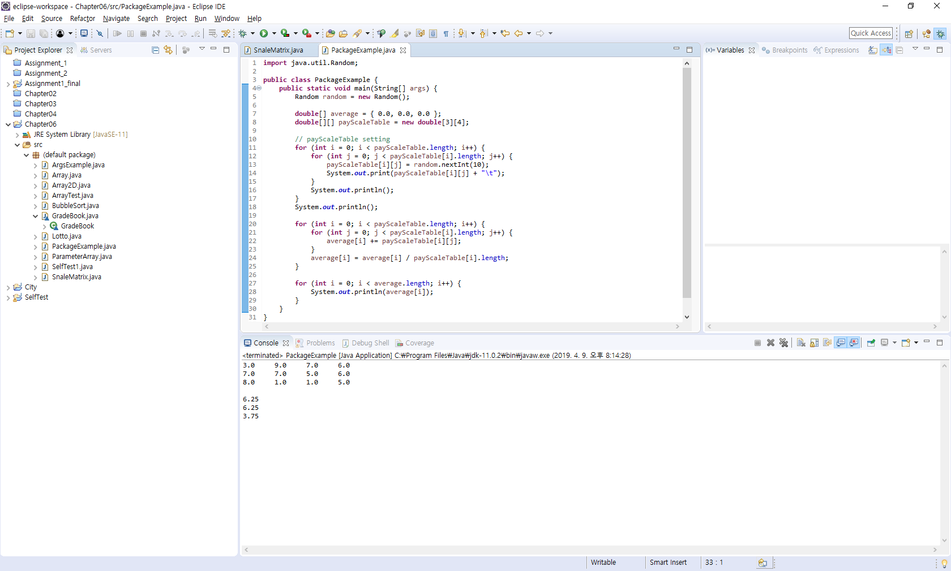
Sample 2-D Array Processing

Slide 43
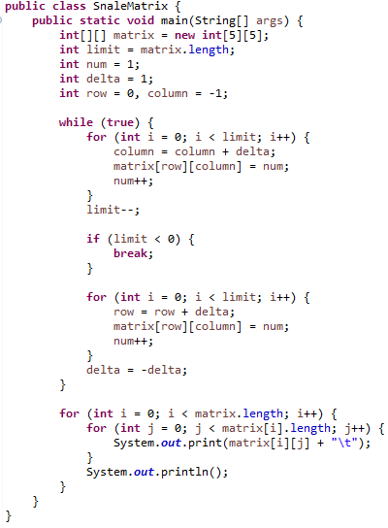
2-D Array example
1 | 2 | 3 | 4 | 5
16 | 17 | 18 | 19 | 6
15 | 24 | 25 | 20 | 7
14 | 23 | 22 | 21 | 8
13 | 12 | 11 | 10 | 9
Output :
1 2 3 4 5
16 17 18 19 6
15 24 25 20 7
14 23 22 21 8
13 12 11 10 9

Slide 44
Deep Copy Versus Shallow Copy
A deep copy of an object is a copy that, with one exception, has no references in common with the original
Exception: References to immutable objects are allowed to be shared
Any copy that is not a deep copy is called a shallow copy
This type of copy can cause dangerous privacy leaks in a program

Slide 45
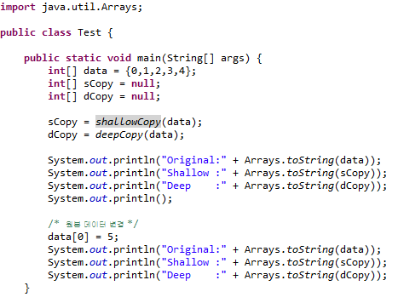
Deep Copy Vs. Shallow Copy

Slide 46
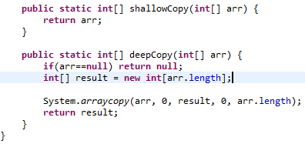
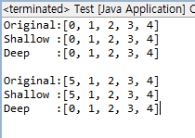
Deep Copy Vs. Shallow Copy

Slide 47
Deep Copy Vs. Shallow Copy
java.lang.System.arraycopy
void arraycopy(Object src, int srcPos, Object dest, int destPos, int length) {
…
}
Parameters:
src : the source array.
srcPos : starting position in the source array.
dest : the destination array.
destPos : starting position in the destination data.
length : the number of array elements to be copied.

Slide 48
Package
Package
A Java package is a collection of related classes or interfaces that are organized into a group.
Classifies and manages Classes through Package as File Classifies and Manages Files through Folders
Java packages enable efficient management of classes when developing large programs
Package is possible to prevent collision between Class names in advance and to control the access right of Package unit

Slide 49
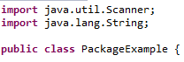
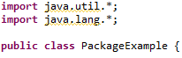
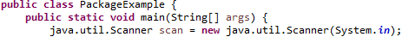
Use Java Package
1. Import a specific class. (import PackageName1. PackageName2.ClassName)
2. Import all classes in the package. (import PackageName1. PackageName2.*)
3. Using without import.

Slide 50
Assignment 1

Slide 51
Assignment 1
<제출 기간>
2019-04-11 ~ 2019-04-25 (2주)
<제출 방법>
각각의 요구조건을 만족하는 TravelInfoRequest, KeyValue, Countries, Distance 4개의 Java 파일 · GitLab 자신의 프로젝트에 업로드
<제공 파일>
Assignment 1.pdf (과제 설명 및 요구 조건)
properties.txt
template_file.txt
Countries.csv

Slide 52
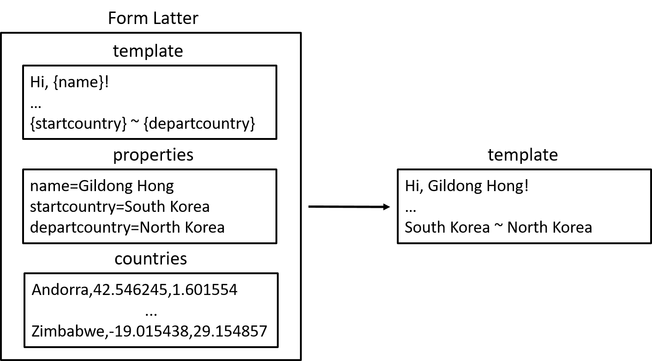
Assignment 1

Slide 53
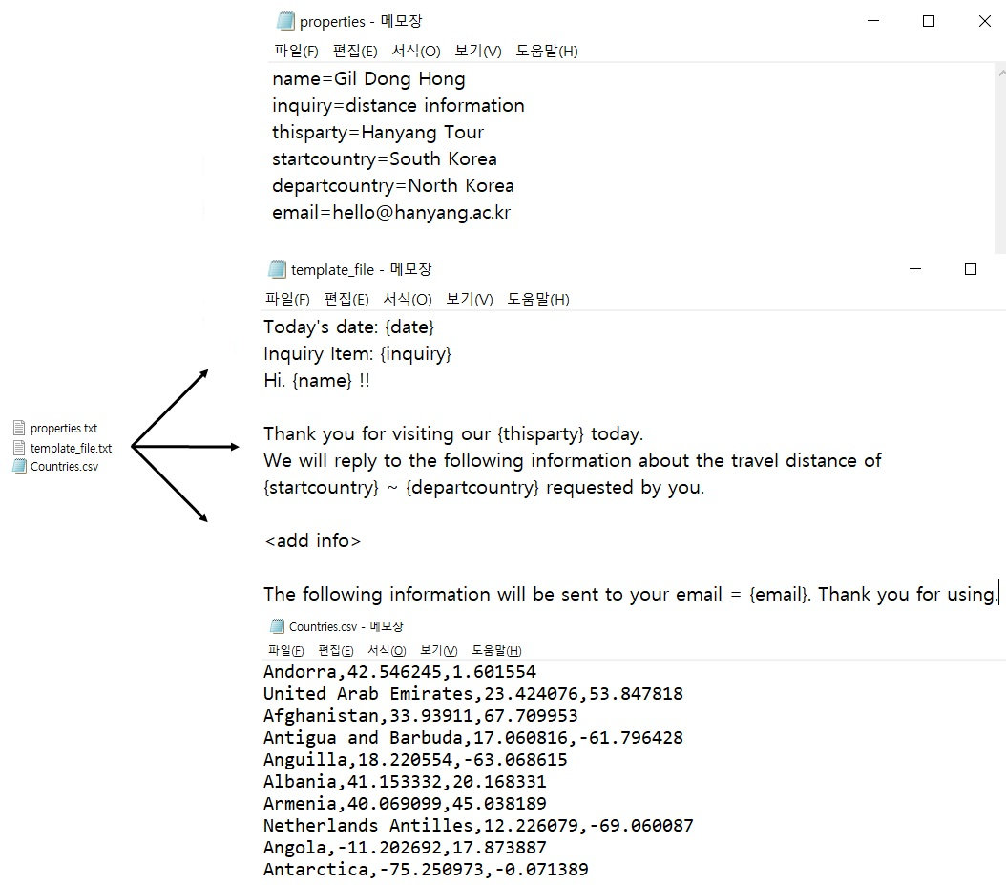

Slide 54
Assignment 1
<문의>
Office : ITBT 805
mail : whrhkdghekd@hanyang.ac.kr
mail : jeonghunlee@hanyang.ac.kr

