Slide 1
Object Oriented Programming
Lab #7
Wednesday, May 2, 2018

Slide 2
Content
Inheritance
Overriding methods
Super and this
Access modifiers
Object class

Slide 3

Inheritance - Motivation
Consider a transportation computer game
Different types of vehicles:
Planes
Jets, helicopters, space shuttle
Automobiles
Cars, trucks, motorcycles
Trains
Diesel, electric, monorail
Ships
…
Let’s assume a class is written for each type of vehicle

Slide 4
Inheritance - Motivation
Sample code for the types of planes:
takeOff()
fly()
setAltitude()
land()
Note that a lot of this code is common to all types of planes
They have a lot in common!
It would be a waste to have to write separate fly() methods for each plane type
What if you then have to change one – you would then have to change dozens of methods

Slide 5
Inheritance - Motivation
Indeed, all vehicles will have similar methods:
move()
getLocation()
setSpeed()
isBroken()
Again, a lot of this code is common to all types of vehicles
It would be a waste to have to write separate move() methods for each vehicle type
What if you then have to change one – you would then have to change dozens of methods
What we want is a means to specify one move() method, and have each vehicle type inherit that code
Then, if we have to change it, we only have to change one copy

Slide 6
Inheritance - Motivation
Provides:
move()
getLocation()
setSpeed()
isBroken()
Provides:
fly()
takeOff()
land()
setAltitude()
Vehicle
Planes
Trains
Automobiles
Helicopter
Jet
Space shuttle
Car
Truck
Motorcycle
Provides:
Diesel
Electric
Monorail
Provides:
oilChange()
derail()
getStation()
isInTraffic()

Slide 7
Inheritance - Motivation
What we will do is create a “parent” class and a “child” class
The “child” class (or subclass) will inherit the methods (etc.) from the “parent” class (or superclass)
Note that some classes (such as Train) are both sub classes and super classes

Slide 8
Inheritance - Motivation
q Child of Vehicle
q Parent of Diesel, Electric and Monorail
q Parent Class
Vehicle
Planes
Trains
Automobiles
Helicopter
Jet
Space shuttle
Car
Truck
Motorcycle
Diesel
Electric
Monorail
q Child class

Slide 9
Inheritance
Inheritance is the process by which a new class is created from another class
The new class is called a derived class or subclass
The original class is called the base class, parent class
or superclass
The subclass
Will automatically inherit all methods and instance and static variables from the superclass.
Can declare more instance variables and methods

Slide 10
Inheritance code
class Vehicle {
...
}
q Superclass
class Train
...
}
extends
Vehicles {
q Subclass of Vehicle
class Monorail
...
}
extends
Train {
q Subclass of Train

Slide 11
About extends
If class A extends class B
Then class A is the subclass of B
Class B is the superclass of class A
A “is a” B
A has (almost) all the methods and variables that B has
If class Train extends class Vehicle
Then class Train is the subclass of Vehicle
Class Vehicle is the superclass of class Train
Train “is a” Vehicle
Train has (almost) all the methods and variables that Vehicle has

Slide 12
Inheritance
VEHICLE
BIKE
NUMBER
Passenger
CAR
NUMBER
Passenger
TRUCK
NUMBER
Passenger
Weather
Mileage
Cargo

Slide 13
Inheritance
VEHICLE NUMBER
Passenger
BIKE
CAR
TRUCK
Weather
mileage
Cargo

Slide 14
Is a VS Has a
Super Class : Animal
eat(){
YumYum!
}
Class : Animal
//Eat 클래스 객체화
Eat e = new Eat();
e.eat();
//Eat 클래스의 변수 및 메소드를 사용할 수 있다.
Class : Eat
eat(){
YumYum!
}
Sub Class : Dog extends Animal
//Animal 클래스의 변수 및 메소드를 사용할 수 있다.
Main Class
Dog d = new Dog();
d.eat();
Output
YumYum!
Output
YumYum!
Dog is a Animal
Animal has a Eat

Slide 15
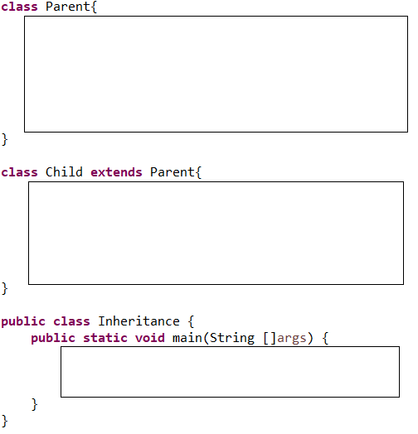

Self Test1
Parent Class : Parent
- variable : 어머니 재산, 아버지 재산(int)
-method : 부모님 총 재산(물려줄 재산) 출력
Child Class : Child
- variable : 자식 재산(int)
-method : 자식 + 부모님 총 재산(물려줄 재산) 출력
Main Class
Child 객체 생성
물려줄 재산, 자식+부모님 총재산 출력 메소드 호출

Slide 16
Overriding
Overriding is the process of changing the definition of an inherited method
Each time you write a class you may override the methods.
equals(Object obj)
toString()

Slide 17
Simple Example
We can effectively model similar, but different types of objects using inheritance
Suppose we want to model dogs and cats. They are different types of pets. We can define the Pet class and the Dog and Cat classes as the subclasses of the Pet class.
Pet{
cry(){}
}
Dog{
cry(){}
}
Cat{
cry(){}
}

Slide 18
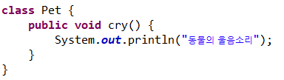
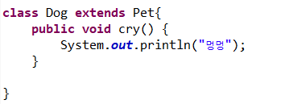
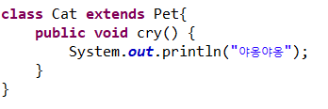
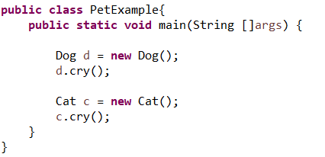
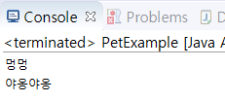
Simple Example
Pet{
cry(){}
}
Dog{
cry(){}
}
Cat{
cry(){}
}

Slide 19
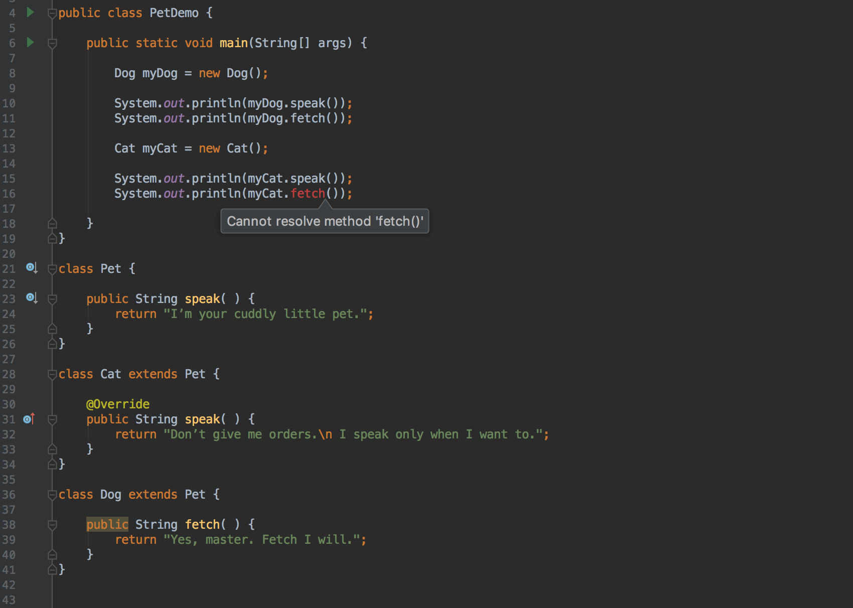
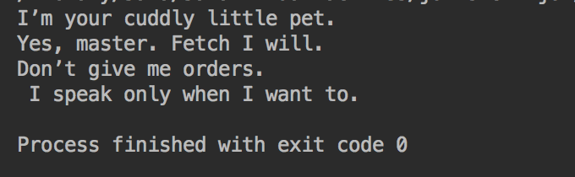
The Pet Class
ERROR

Slide 20
The Pet Class
ERROR

Slide 21
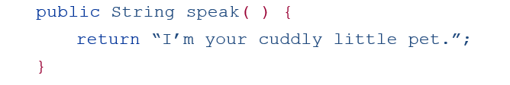
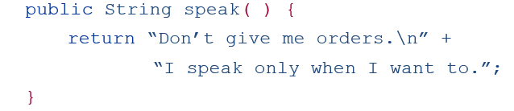
Overriding
To override a method
– Create a method in the subclass with the same header as the method in the parent class.
Pet
Cat

Slide 22
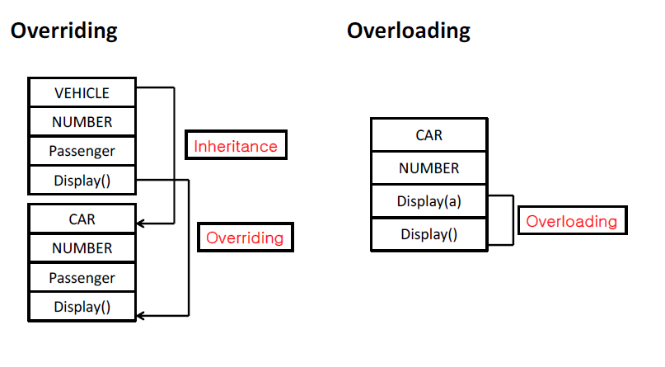
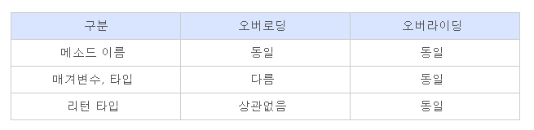
Do not confuse
Overriding - Overloading

Slide 23
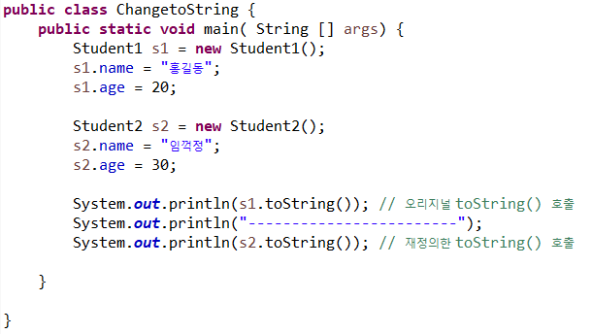
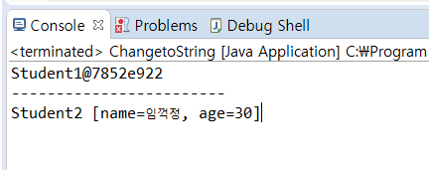
Self test2
toString() 오버라이딩 해보기
Student1, Student2 클래스 구현
//모든 클래스들은 Object 클래스를 상속 받는다.
//toString()은 Object 클래스의 메소드로 객체를 설명해주는 문자열을 리턴해준다.
//toString() 메소드를 오버라이딩하여 다음과 같은 형식의 문자열을 리턴하도록 한다.

Slide 24
The final Modifier
If the modifier final is placed before the definition of a method, then that method may not be redefined in a derived class
If the modifier final is placed before the definition of a class, then that class may not be used as a base class to derive other classes
final prevents inheritance.

Slide 25
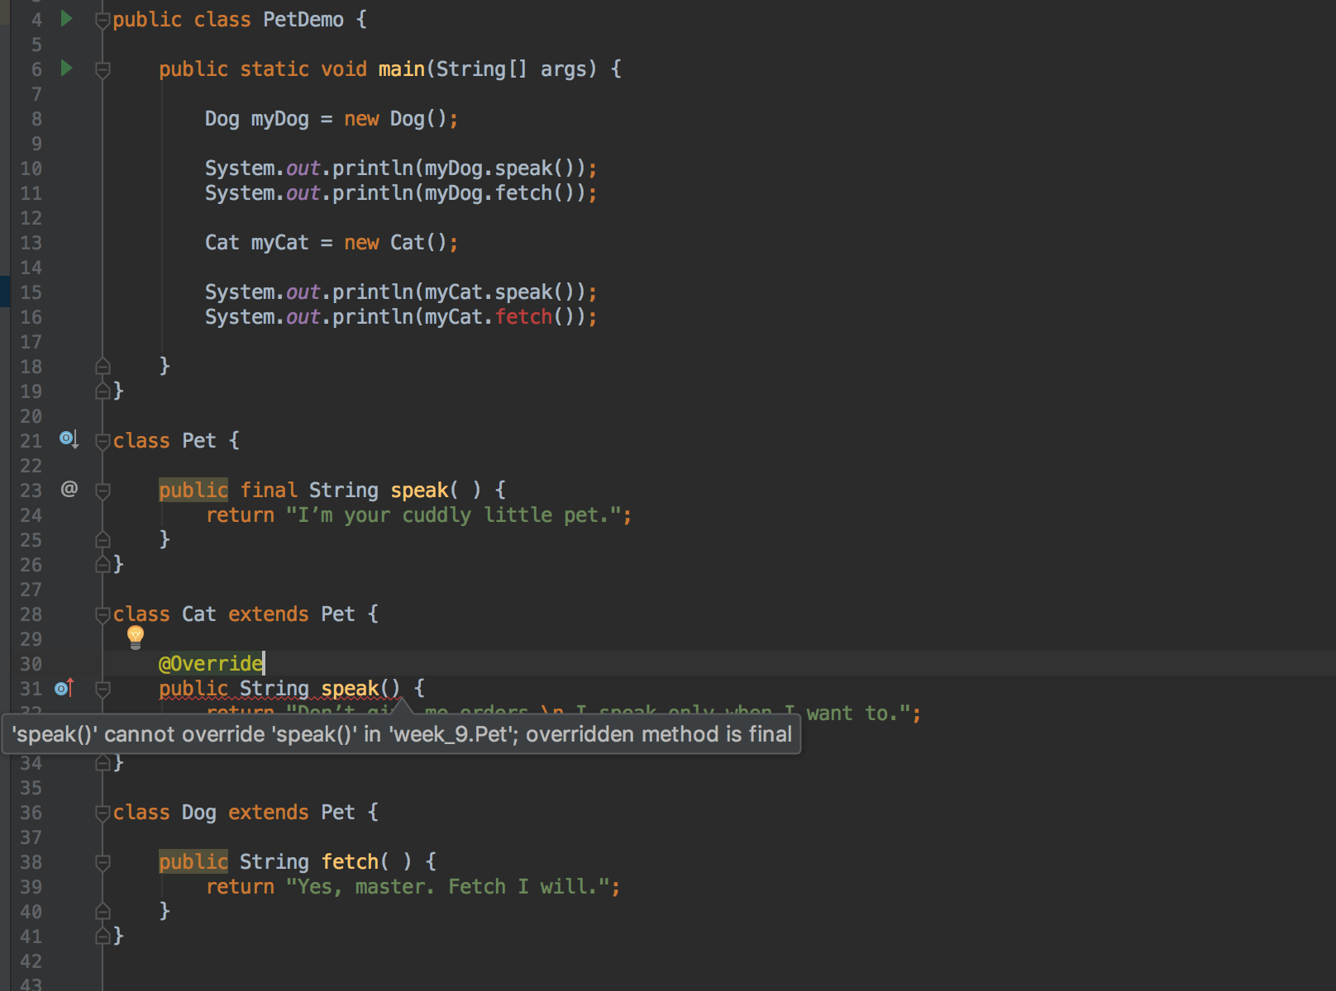
The final Modifier
ERROR

Slide 26
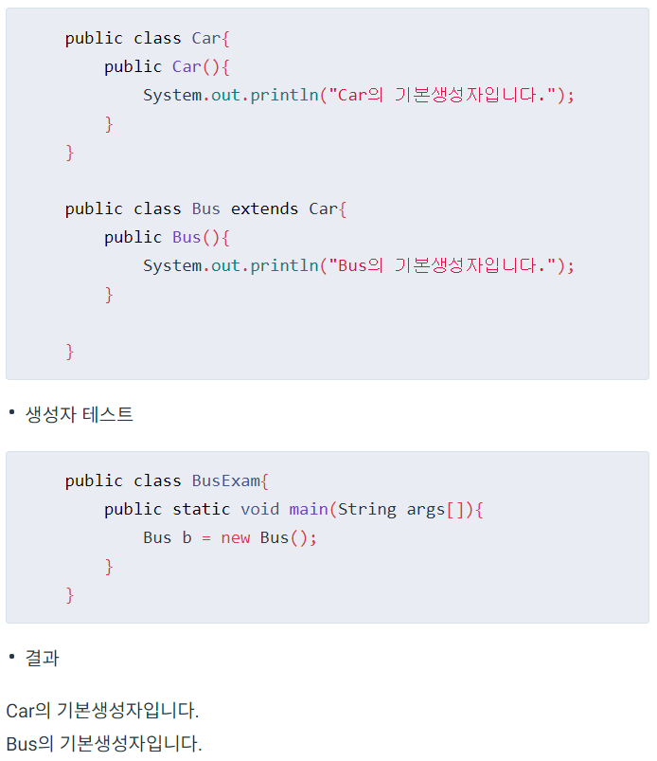
Inheritance and Constructors
class가 인스턴스화 될 때 생성자가 실행되면서 객체의 초기화를 한다. 그 때 자신의 기본 생성자만 실행이 되는 것이 아니고, 부모의 기본 생성자부터 실행된다.

Slide 27
Inheritance and Constructors
Unlike members of a base class, constructors of a base class are
not inherited by its subclasses
You must define a constructor for subclasses
It is useful to use the constructor of the parent class within the constructor of the child class.
This can be done through the keyword super.

Slide 28
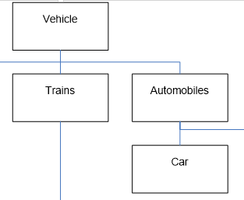
Inheritance and Constructors
super like the word this can be used to refer to different objects in the hierarchy.
super
this

Slide 29
super Constructor
To define a constructor using the superclass’s constructor
– add the super constructor as the first statement of the derived constructor.
public class Car{
public Car(){
System.out.println("Car의 기본생성자입니다.");
}
}
public class Bus extends Car{
public Bus() {
super(); // 생략해도 자동으로 부모의 기본생성자가 호출된다.
System.out.println("Bus의 기본생성자입니다.");
}
}

Slide 30
super Constructor
To define a constructor using the superclass’s constructor
– add the super constructor as the first statement of the derived constructor.
public class Car{
public Car(String name){
System.out.println(name+ “ 을 받아들이는 생성자입니다.");
}
}
public class Bus extends Car{
public Bus() {
System.out.println("Bus의 기본생성자입니다.");
}
}
Compile Error

Slide 31
super Constructor
To define a constructor using the superclass’s constructor
– add the super constructor as the first statement of the derived constructor.
public class Car{
public Car(String name){
System.out.println(name+ “ 을 받아들이는 생성자입니다.");
}
}
public class Bus extends Car{
public Bus() {
super(“소방차“);
System.out.println("Bus의 기본생성자입니다.");
}
}

Slide 32
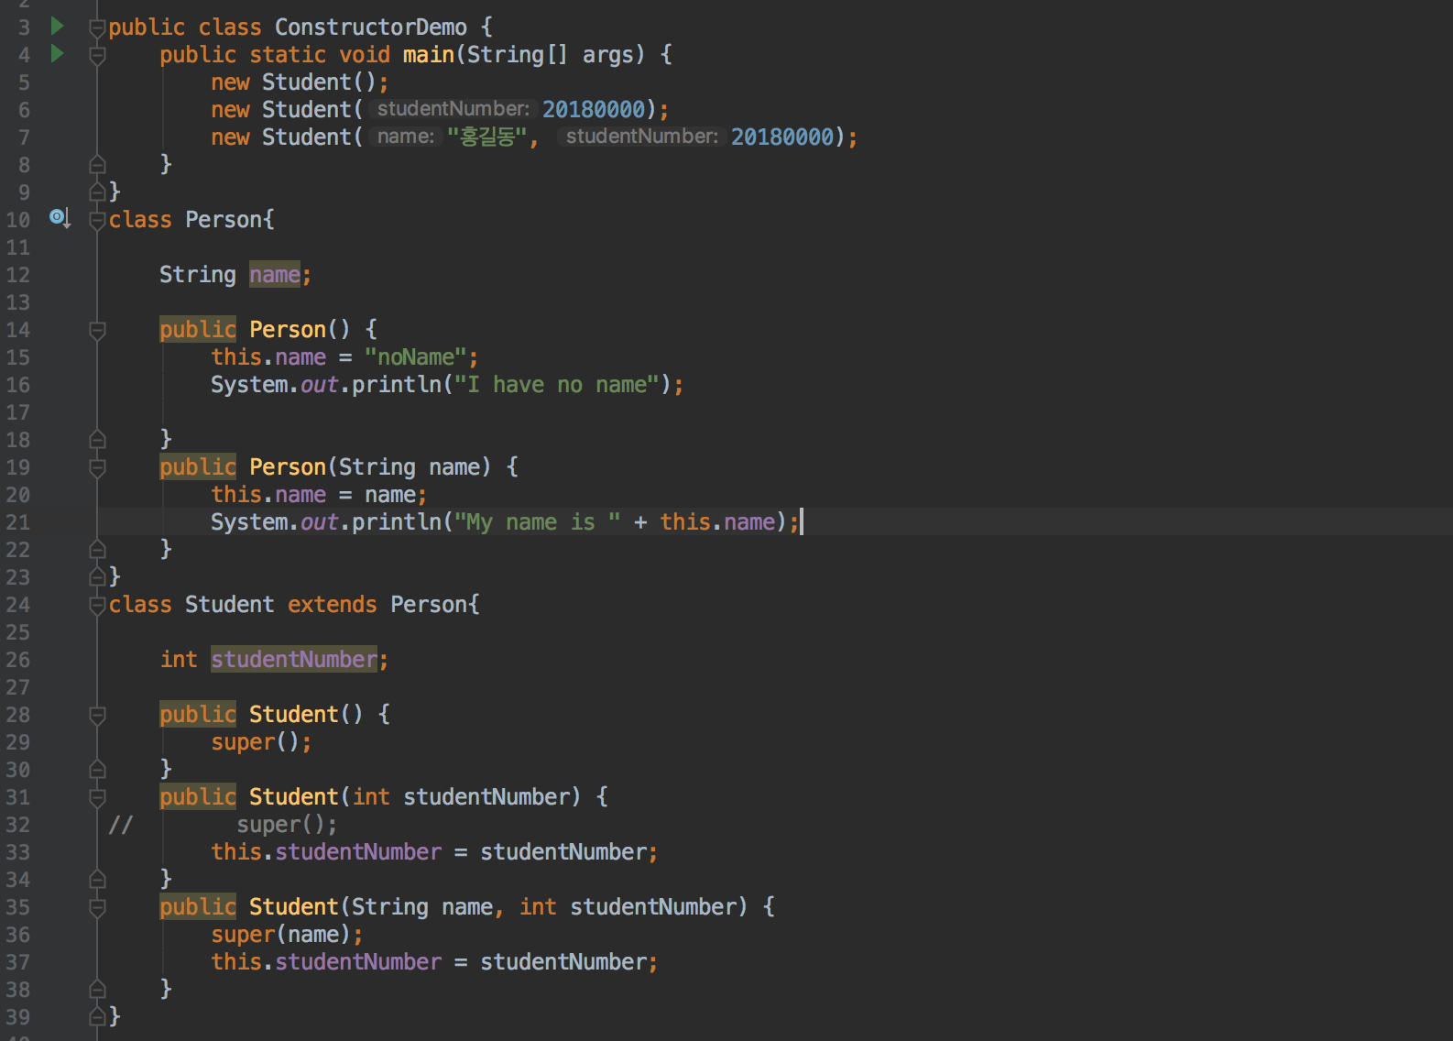
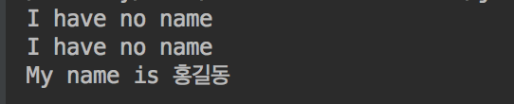
super Constructor

Slide 33
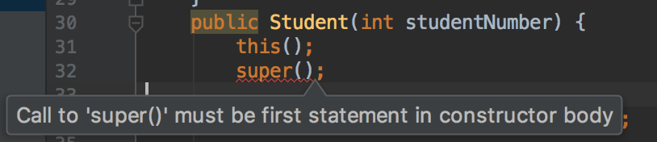
this Constructor
The this constructor refers to an overloaded constructor in the same class.
– i.e. Within the definition of a constructor for a class, this can be used as a name for invoking a constructor of the same class
If it is necessary to include a call to both super and this, the call using this must be made first, and then the constructor that is called must call super as its first action
public Car(){
super();
this.number = 0;
}
public Car(Number num){ this();
this.number = num;
}

Slide 34
The this Constructor
Often, a no-argument constructor uses this to invoke an explicit-value constructor
– No-argument constructor (invokes explicit-value constructor using
this and default arguments):
public ClassName()
{
this(argument1, argument2);
}
– Explicit-value constructor (receives default values):
public ClassName(type1 param1, type2 param2)
{
. . .
}

Slide 35
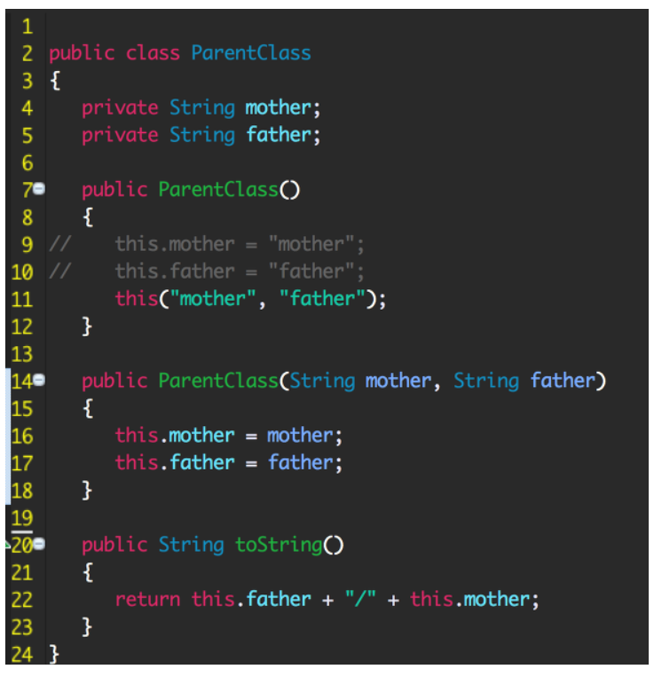
The this Constructor

Slide 36
Self Test 3
class UpperClass {
int x;
int y;
public UpperClass() {
x = 10;
y = 20;
System.out.println("UpperClass()생성자 호출!");
System.out.println("x:"+ x + " y:" +y);
}
public UpperClass(int x) {
this(); // 자신의 클래스 public UpperClass() 생성자 호출
this.x = x;
System.out.println("UpperClass(int x)생성자 호출!");
System.out.println("x:"+ x + " y:" +y);
}
public UpperClass(int x, int y) {
this(x); // 자신의 클래스 public UpperClass(int x) 생성자 호출
this.y = y;
System.out.println("UpperClass(int x, int y)생성자 호출!");
System.out.println("x:"+ x + " y:" +y);
}
}
class LowerClass extends UpperClass {
int r;
public LowerClass() {
super(); // 상위 클래스의 public UpperClass() 생성자 호출.
r = 30;
System.out.println("LowerClass()생성자 호출!");
System.out.println("x:"+ x + " y:" +y+" r:" +r);
}
public LowerClass(int x) {
super(x); // 상위 클래스의 public UpperClass(int x) 생성자 호출
r = 30;
System.out.println("LowerClass(int x)생성자 호출!");
System.out.println("x:"+ x + " y:" +y+" r:" +r); }
public LowerClass(int x, int y) {
super(x, y); // 상위 클래스의 public UpperClass(int x, int y) 호출
r = 30;
System.out.println("LowerClass(int x,int y)생성자 호출!");
System.out.println("x:"+ x + " y:" +y+" r:" +r);
}
public LowerClass(int x, int y, int r) {
this(x, y); // 자신의 클래스 public LowerClass(int x, int y) 호출
this.r = r;
System.out.println("LowerClass(int x, int y, int r)생성자 호출!");
System.out.println("x:"+ x + " y:" +y+" r:" +r);
}
}
public class ThisSuperEx{
public static void main(String[] ar) {
LowerClass lc = new LowerClass(1,2,3);//출력 결과는?
}
}

Slide 37
Access Modifiers
Private instance variables in a superclass are not accessible by name in a subclass
They can be accessed using accessors and mutators.
Private methods of a superclass are also not directly accessible by name in a subclass
They may be indirectly accessed. If a subclass accesses a public method that accesses that private method. (by proxy)

Slide 38
The Protected Modifier
The modifier protected makes a variable or method visible and accessible to the instances of the class and the subclasses of the class.
Public data members and methods are accessible to everyone.
Private data members and methods are accessible only to instances of the class.

Slide 39
Packages
Allow definitions to be collected together into a single entity — a package
Classes and names in the same package are stored in the same folder
Classes in a package go into their own “namespace” and therefore the names in a particular package do not conflict with other names in other packages
30

Slide 40
Packages + Protected modifier
The modifier protected makes a variable or method visible and accessible to the instances of the class
Instances of subclasses of the class.
Instances of classes in the same package

Slide 41
Controlling access
Class access rights
Member Restriction | this | Subclass | Package | General
public | o | o | o | o
protected | o | o | o | -
default | o | - | o | -
private | o | - | - | -

Slide 42
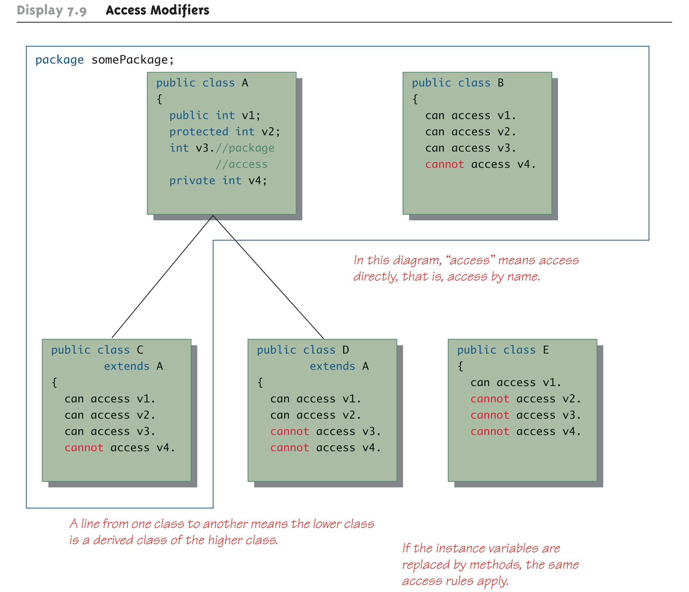
Access Modifiers

Slide 43
Changing the Access Permission of an Overridden Method
The access permission of an overridden method can be changed from private in the base class to public (or some other more permissive access) in the derived class
However, the access permission of an overridden method cannot be changed from public in the base class to a more restricted access permission in the derived class
public ← protected ← (default) ← private 넓은 범위로 변경 가능o
public → protected → (default) → private 좁은 범위로 변경 불가 x

Slide 44
Changing the Access Permission of an Overridden Method
Given the following method header in a base case:
private void doSomething()
The following method header is valid in a derived class:
public void doSomething()
However, the opposite is not valid
Given the following method header in a base case:
public void doSomething()
The following method header is not valid in a derived class:
private void doSomething()

Slide 45
Object class
Java contains a special class in the java.lang package known as Object
All classes in java are inherited from the Object class. This means all classes are Objects.
This general object can be used as a stand-in for any class.
Some methods may be written to accept parameters of type Object since any class is an Object.

Slide 46
Object class
The class Object has some methods that every Java class inherits
equals(Object obj)
toString()
Object
equals()
toString()
It is necessary to override these methods in classes written in Java.
Person
Shape
setName() getName() equals()
toString()
area()
equals()
toString()

Slide 47
Better equals Method
The equals method is inherited from the Object class.
When overriding the equals method it should accept an Object as the parameter.
public boolean equals(Object obj){
. . .
}
The obj is compare by casting. It to the type of object that you would like to compare to.
Our equals method should check if obj is not null and is really of the type you are trying to cast it to.

Slide 48
Better equals Method
public boolean equals(Object obj) {
if(obj == null) // obj 가 null이 아니고,
return false;
else
if(getClass( ) != obj.getClass( ))
return false;
else {//현재 클래스(기준) 과 obj의 클래스(비교) 가 같고
Employee otherEmp = (Employee)obj;
return (name.equals(otherEmp.name) && hireDate.equals(otherEmp.hireDate));
//obj의 이름과 고용일이 일치하면 true를 반환해서 동일 인물이라고 판단한다.
}
}

Slide 49
The getClass() Method
Every object inherits the same getClass()
method from the Object class
This method is marked final, so it cannot be overridden
An invocation of getClass() on an object returns a representation only of the class that was used with new to create the object
The results of any two such invocations can be compared with == or != to determine whether or not they represent the exact same class
(object1.getClass() == object2.getClass())

Slide 50

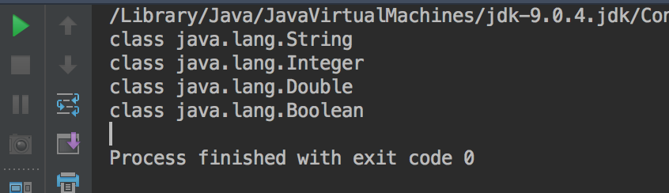
The getClass() Method

Slide 51
The instanceof Operator
The instanceof operator checks if an object is of the type given as its second argument
Object instanceof ClassName
This will return true if Object is of type ClassName, and otherwise return false
Note that this means it will return true if Object is the type of any descendent class of ClassName
40

Slide 52
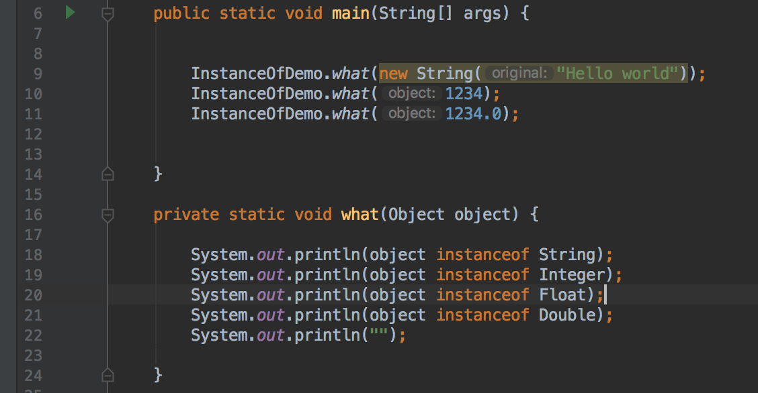
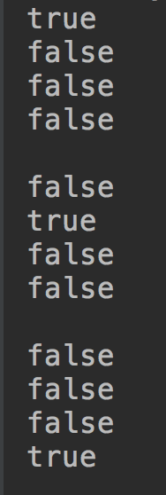
The instanceof Operator
40

Slide 53
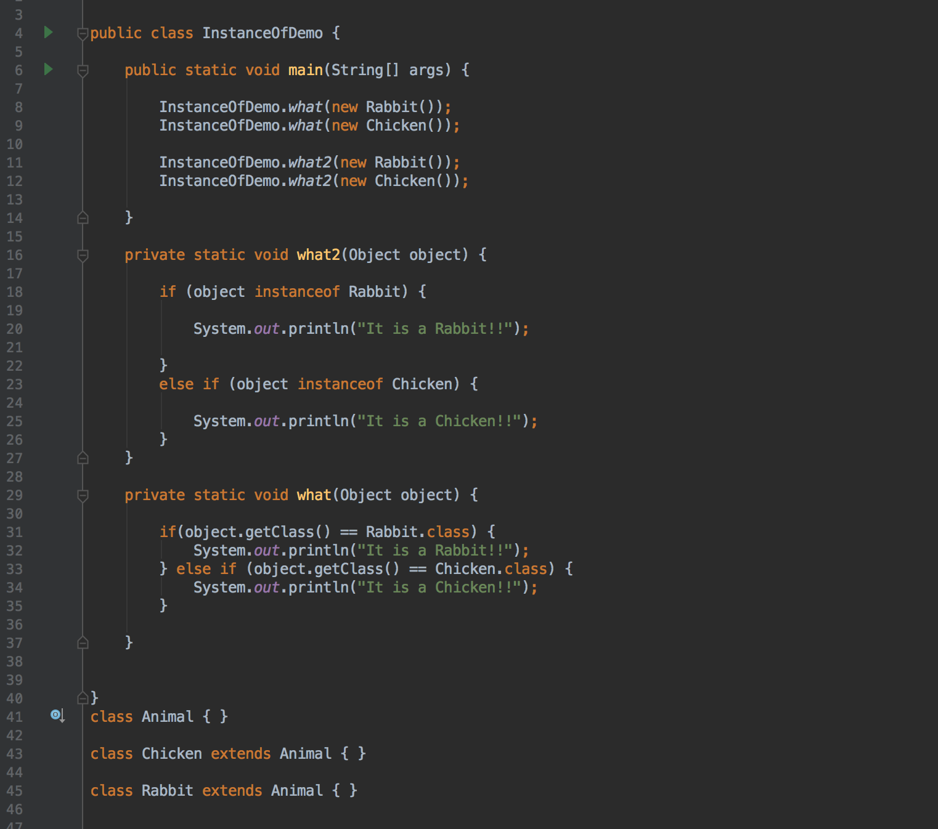
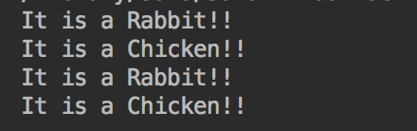
The instanceof Operator
40

Slide 54
Q/A
40

