Slide 1
Object Oriented Programming
Lab #8

Slide 2
Content
Polymorphism
Binding
Casting
Abstract classes
Exception

Slide 3
Introduction to Polymorphism
There are three main programming mechanisms that constitute object-oriented programming (OOP)
Encapsulation: { combining data and actions into a single unit (Class) }
Inheritance: { deriving information and functionality from base or super class}
Polymorphism
What is Polymorhism?
Comes from 2 Greek words
poly {many}
morph {forms, shaps}

Slide 4
Introduction to Polymorphism
Polymorphism is the ability to associate many meanings to one method name by means of a late binding mechanism.
– It does this through a special mechanism known as late binding or dynamic binding

Slide 5
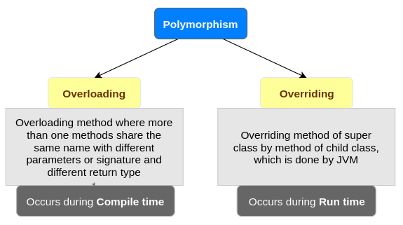
Introduction to Polymorphism
Precisely, polymorphism is a condition of occurring in several different forms. Polymorphism in Java can occur in two ways:
– Overloading
– Overriding

Slide 6
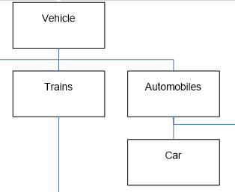

Introduction to Polymorphism
Inheritance allows a base class to be defined, and other classes derived from it
– Code for the base class can then be used for its own objects, as well as objects of any derived classes
super
Code use
this.getX();
super.toString();
this

Slide 7

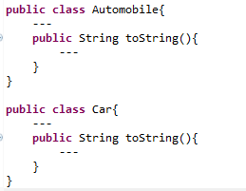

Introduction to Polymorphism
Polymorphism allows changes to be made to method definitions in the derived classes, and have those changes apply to the software written for the base class
?
super
Auto 1
Some auto
this

Slide 8
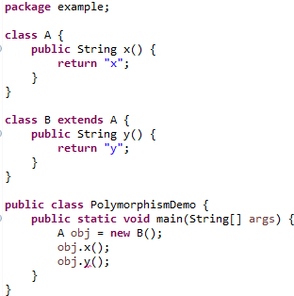
Introduction to Polymorphism
In inheritance, B class can be in the type of A class. B class is used as if it were A class.
A obj = new B();
error

Slide 9
Introduction to Polymorphism
public class Demo {
public static void main(String[] args) {
//Valid or Invalid?
A obj1 = new B();
A obj2 = new C();
C obj3 = new A();
C obj4 = new B();
String str = new Object();
Object object = new String(“”);
}
}
class A {
…
}
class B extends A {
…
}
class C extends B {
…
}
byte -> Int로 타입캐스팅이 가능하지만 반대는 안되는 것과 같은 원리

Slide 10
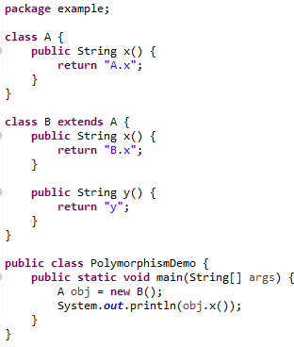
Introduction to Polymorphism
Output :

Slide 11

Binding
The process of associating a method definition with a method invocation is called binding

Slide 12
Binding
Binding in Java
Association/Connecting of method definition to the method call is known as binding. There are two types of binding:
Static Binding
Dynamic Binding
Binding
Static
Dynamic

Slide 13
Binding
If the method definition is associated with its inv-ocation when the code is compiled, that is called early binding
If the method definition is associated with its invoc-ation when the method is invoked (at run time), that is called late binding or dynamic binding
Java uses late binding for all methods
– Except final and static

Slide 14
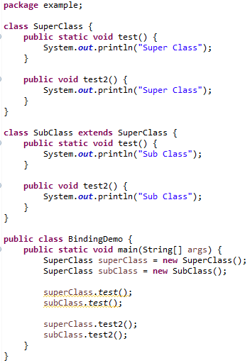
Example
Output :
정적 바인딩 ->
동적 바인딩 ->

Slide 15
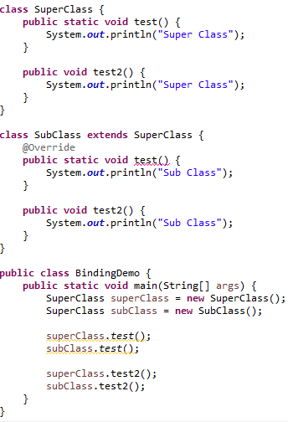
Example
The static method is resolved at compile time cannot be overridden by a subclass.
A static method can be overloaded
error

Slide 16
Upcasting and Downcasting
Upcasting is when an object of a derived class is as-signed to a variable of a base class (or any ancestor class)
Downcasting is when a type cast is performed from a base class to a derived class (or from any ancestor class to any descendent class)
Downcasting has to be done very carefully
In many cases it doesn't make sense, or is illegal:

Slide 17
Upcasting and Downcasting
Downcasting makes sense only if the object to be cast is an instanceof the class type.
If (myObject instanceof ClassType){
ClassType classObject = (ClassType) myObject;
// now you can use classObject from here
}

Slide 18
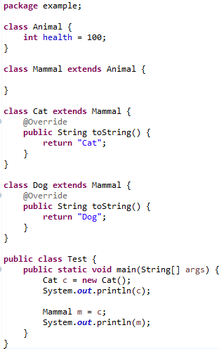
Upcasting and Downcasting
Objcet
Animal
Mammal
Cat
Dog

Slide 19
Upcasting and Downcasting
Animal a = new Dog();
//Upcasting
Dog d = new Animal();
//Compile error
Dog d = (Dog) new Animal();
//Downcasting
//throws ClassCastExcetion at runtime
Animal a = new Dog(); //Upcasting
Dog d = (Dog) a; //Downcasting
Objcet
Animal
Mammal
Cat
Dog

Slide 20
A First Look at the clone Method
Every object inherits a method named clone from the class Object
The method clone has no parameters
It is supposed to return a deep copy of the calling object
However, the inherited version of the method was not designed to be used as is
Instead, each class is expected to override it with a more appropriate version

Slide 21
Simple clone Method
We can define a simple clone method by using the copy constructor.
public ClassType clone(){
return new ClassType(this)
}
This is a very simple clone method however more checks should be done before cloning.

Slide 22
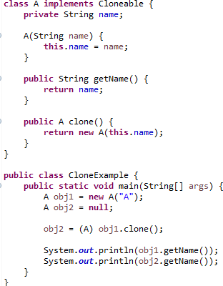
clone Method Example
Output :
A
A
??

Slide 23
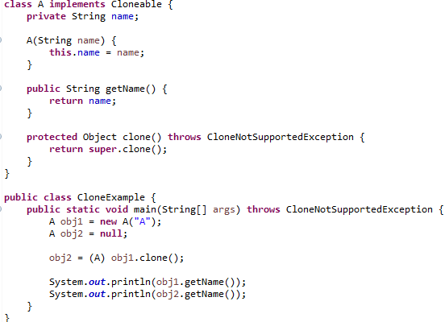
clone Method Example
Output :
A
A

Slide 24
Abstract Classes
Some classes may be defined with incomplete methods definitions (abstract methods).
Such classes are said to be abstract
Such classes cannot be instantiated but must be extended by a concrete class
The concrete class must implement all abstract methods
– If all abstract methods cannot be implemented then the class must also be marked as abstract.

Slide 25
Abstract Classes
Definitions:
An abstract class is a class that contains one or more abstract methods and therefore cannot be instantiated.
Abstract methods are methods that without complete definitions. Instead they are simple placeholders.
A concrete class is a class that contains no abstract methods and therefore can be instantiated.

Slide 26
Tip: An Abstract Class Is a Type
Although an object of an abstract class cannot be created, it is perfectly fine to have a parameter of an abstract class type
This makes it possible to plug in an object of any of its descendent classes
It is also fine to use a variable of an abstract class type, as long is it names objects of its concrete descendent classes only
(Abstract classes can be used as types)

Slide 27
Defining Abstract Class
Defining an abstract class is simple
public abstract class MyClass{
// class constructors
// accessors and mutators
// other methods
Abstract class header
Common fields and methods
Abstract Methods
{} 생략
public abstract returnType myMethod();
}
When defining an abstract method only specify the header
public abstract returnType myMethod();

Slide 28
When to use
Consider using abstract classes if any of these statements apply to your situation:
You want to share code among several closely related classes.
You expect that classes that extend your abstract class have many common methods or fields, or require access modifiers other than public (such as protected and private).
You want to declare non-static or non-final fields. This enables you to define methods that can access and modify the state of the object to which they belong.

Slide 29
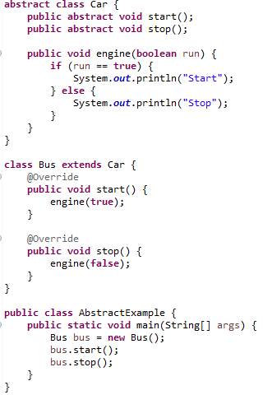
Example
Output :
Start
Stop

Slide 30
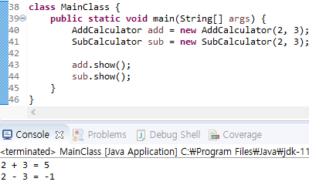
Self Test
Calculator라는 이름으로 추상 클래스 생성
필드로 정수형 num1, num2를 가짐
operator라는 이름의 추상 메소드를 가짐
show라는 이름의 메소드를 가짐 operator 메소드를 호출
Calculator를 상속받는 AddCalculator라는 클래스 생성 및 출력 결과에 맞게 구현
Calculator를 상속받는 SubCalculator라는 클래스 생성 및 출력 결과에 맞게 구현
출력 결과
Override할 때 파라미터도 같아야 하지 않나?
Abstract를 class앞에 or 메소드 앞에 차이?

Slide 31
Exception
An exception represents an error condition that can occur during the normal course of program execution.
When an exception occurs, or is thrown, the normal sequence of flow is terminated. The exception-handling routine is then executed; we say the thrown exception is caught.

Slide 32

try-throw-catch Basics
try {
// some code to attempt
//this code may throw an exception
} catch (Exception e){
//catch the exception if it is thrown
//do whatever you want with it.
}

Slide 33
Catching an Exception
System.out.print(prompt);
try {
try
age = scanner.nextInt( );
} catch (InputMismatchException e){
catch
System.out.println("Invalid Entry. "
+ "Please enter digits only");
}

Slide 34
The finally Block
There are situations where we need to take certain actions regardless of whether an exception is thrown or not.
We place statements that must be executed
regardless of exceptions in the finally block.

Slide 35
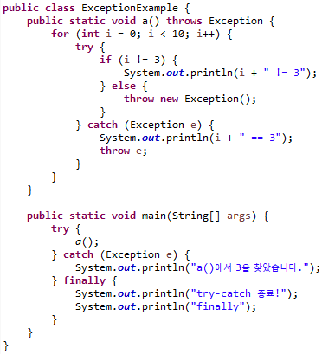
Example
Output :
0 != 3
1 != 3
2 != 3
3 == 3
a()에서 3을 찾았습니다.
try-catch 종료!
finally
구조를 이해하는 좋은 예

Slide 36
Exception Class
Numerous predefined exception classes are included in the standard packages that come with Java
For example:
IOException
NoSuchMethodException FileNotFoundException
Many exception classes must be imported in order to use them
import java.io.IOException;

Slide 37
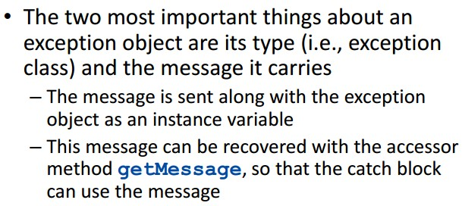
Exception Object

Slide 38
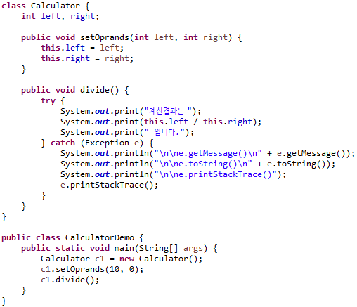
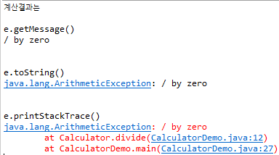
Example

Slide 39

Throwing Exception
We can write a method that throws an exception directly,
i.e., this method is the origin of the exception.
Use the throw reserved to create a new instance of the Exception or its subclasses.
The method header includes the reserved word throws.
public void doWork(int num) throws Exception {
. . .
if (num != val) throw new Exception("Invalid val");
. . .
}

Slide 40
throws keyword
import java.io.IOException;
public class ExceptionExample {
public static void main(String[] args) {
try {
System.in.read();
} catch (IOException e) {
e.printStackTrace();
}
}
}
public class ExceptionExample {
public static void main(String[] args) throws IOException {
System.in.read();
}
}

Slide 41
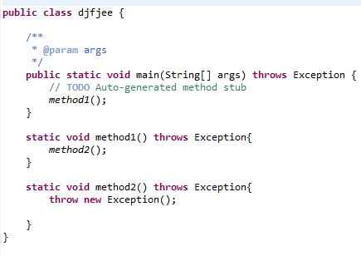
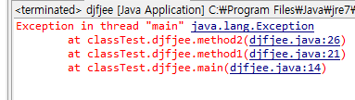
throws keyword
Exception not caught and handled so program crashes
Exception e;
e = new Exception();
throw e;

Slide 42
Q & A

