Slide 1
Object Oriented Programming
Lab #10

Slide 2
Content
Exception
Try – catch – finally block
Thrown & throws
Exception Class
User Define Exception

Slide 3
Exception
An exception represents an error condition that can occur during the normal course of program execution. → Throwing an exception
When an exception occurs, or is thrown, the normal sequence of flow is terminated. The exception-handling routine is then executed; we say the thrown exception is caught.→ Handling the exception

Slide 4

Not Catching Exceptions
Two things occurred in this scenario
Java threw an exception named InputMismatchException
Our program failed to catch the exception resulting in a crash
We can fix this by enclosing our code in a
try - catch block

Slide 5
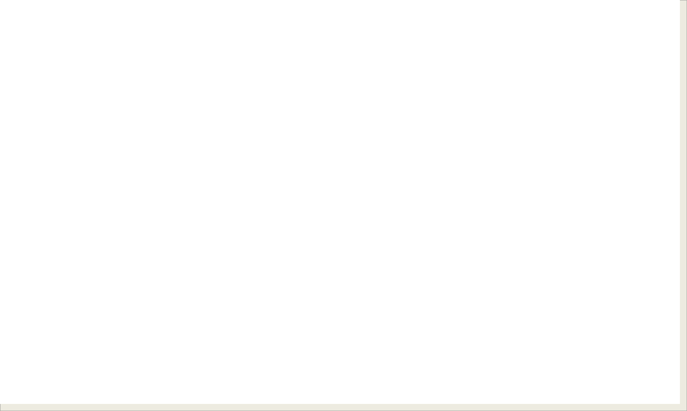
try-throw-catch Basics
try {
// some code to attempt
//this code may throw an exception → throw new someException();
} catch (Exception e){
//catch the exception if it is thrown
//do whatever you want with it.
}

Slide 6
Catching an Exception
System.out.print(prompt);
try {
try
age = scanner.nextInt( );
} catch (InputMismatchException e){
catch
System.out.println("Invalid Entry. "
+ "Please enter digits only");
}

Slide 7
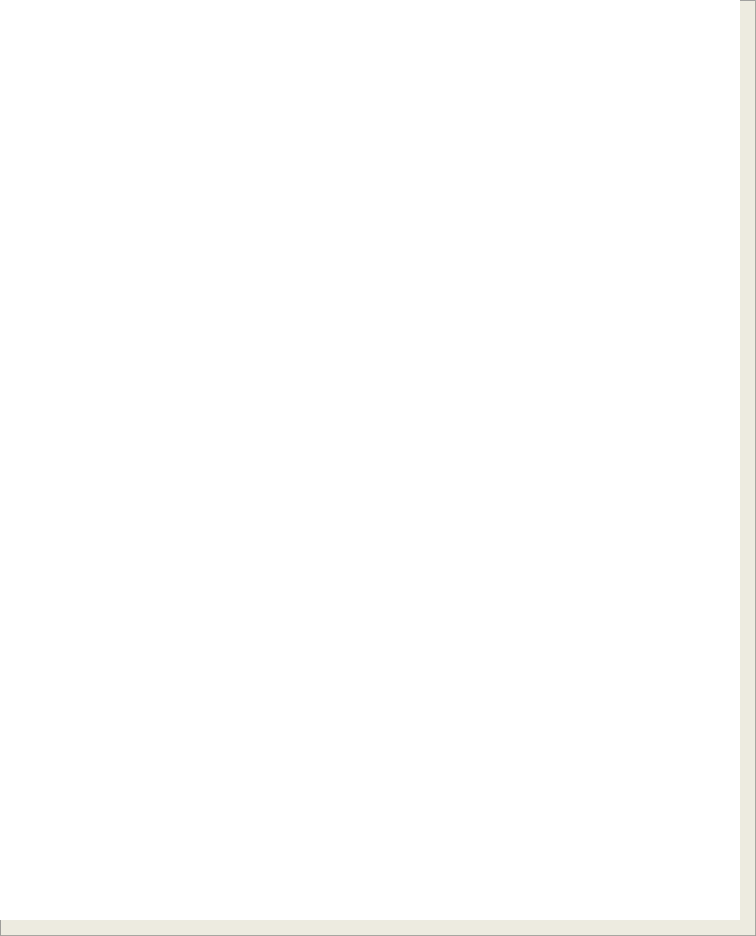


try-catch Control Flow
Exception
No Exception
try {
try {
<t-stmt-1>
<t-stmt-2>
<t-stmt-3>
<t-stmt-4>
. . .
<t-stmt-1>
<t-stmt-2>
<t-stmt-3>
Assume <t-stmt-3>
throws an exception.
All statements in the try block are executed.
<t-stmt-4>
. . .
<t-stmt-n>
Remaining statements in the try block is skipped.
<t-stmt-n>
} catch (Exception e) {
} catch (Exception e) {
<c-stmt-1>
. . .
<c-stmt-m>
<c-stmt-1>
. . .
<c-stmt-m>
Statements in the catch block are executed.
Statements in the catch block are skipped.
}
<next stmt>
}
<next stmt>
And the execution continues to the next statement

Slide 8
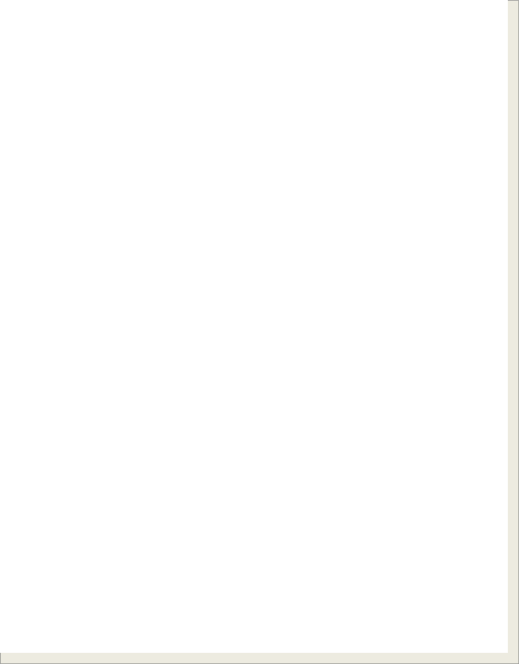
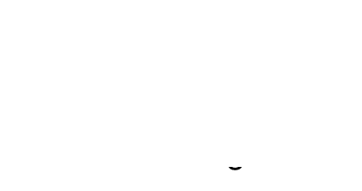

Multiple catch Control Flow
Exception
No Exception
try {
<t-stmt-1>
<t-stmt-2>
<t-stmt-3>
Assume <t-stmt-3> throws an exception and <catch-block-3> is the matching block.
try {
<t-stmt-1>
<t-stmt-2>
<t-stmt-3>
<t-stmt-4>
. . .
All statements in the try block are executed and throw no exceptions.
<t-stmt-4>
. . .
<t-stmt-n>
Remaining statements in the try block is skipped.
<t-stmt-n>
}
}
<catch-block-1>
<catch-block-2>
<catch-block-1>
<catch-block-2>
<catch-block-3>
. . .
<catch-block-m>
Statements in the matching catch block are executed.
All catch blocks are skipped.
<catch-block-3>
. . .
<catch-block-m>
}
}
<next stmt>
<next stmt>

Slide 9
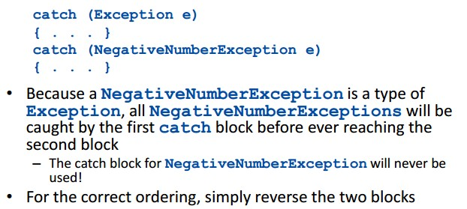
부모클래스는 아래/ 자식클래스는 위에
부모클래스를 위에 두면 아래catch로 가지 않는다
부모가 모두 처리하면 안되나??
-> 자식예외처리에서 코드를 구현하고 실행하고 싶을 때 할 수 없음
Important
When using multiple catch statements always catch the more specific exceptions first
20

Slide 10
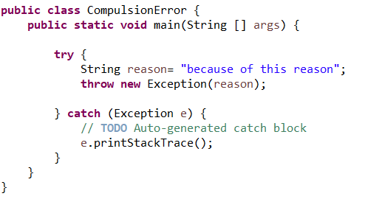

Example

Slide 11

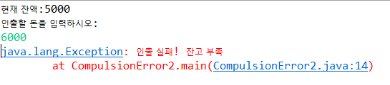
Self Test 1
통장에서 돈을 인출하는 프로그램을 작성하시오.
통장에는 5000원이 들어있습니다.
잔액보다 적은 돈을 인출하면 인출 성공
잔액보다 많은 돈을 인출하면 인출 실패, 에러를 발생 시킨다.
출력결과

Slide 12
The finally Block
There are situations where we need to take certain actions regardless of whether an exception is thrown or not.
We place statements that must be executed
regardless of exceptions in the finally block.

Slide 13
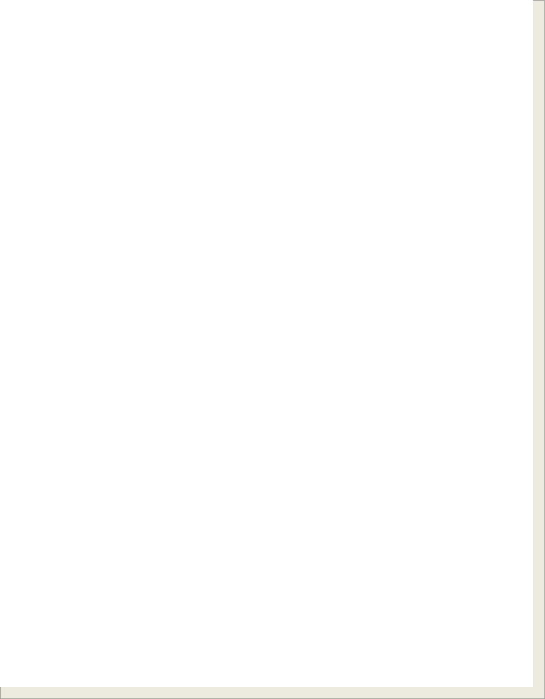
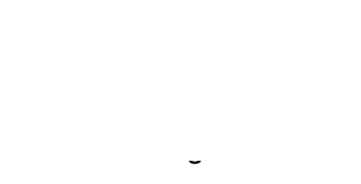


try-catch-finally Control Flow
Exception
No Exception
try {
<t-stmt-1>
. . .
<t-stmt-i>
Assume <t-stmt-i> throws an exception and <catch-block-i> is the matching block.
try {
<t-stmt-1>
. . .
<t-stmt-i>
. . .
<t-stmt-n>
}
<catch-block-1>
. . .
<catch-block-i>
. . .
<catch-block-m>
. . .
<t-stmt-n>
}
<catch-block-1>
. . .
<catch-block-i>
. . .
<catch-block-m>
} finally {
. . .
} finally {
. . .
finally block is
executed.
finally block is executed.
}
}
<next stmt>
<next stmt>

Slide 14



Self Test 2
정수를 입력 받아 짝수이면 “짝” , 홀수이면 “홀” 을 출력하는 프로그램을 작성하라. 사용자가 정수를 입력하지 않는 경우에는 “정수를 입력하지 않았습니다.”를 출력한다. 출력 결과가 나오면 무조건 프로그램을 종료하여라.
try – catch – finally 구문 사용
실행시 에러를 잡는 예외처리 : unchecked exception
출력 결과

Slide 15
Exception Class
Numerous predefined exception classes are included in the standard packages that come with Java
For example:
IOException
NoSuchMethodException FileNotFoundException
Many exception classes must be imported in order to use them
import java.io.IOException;

Slide 16
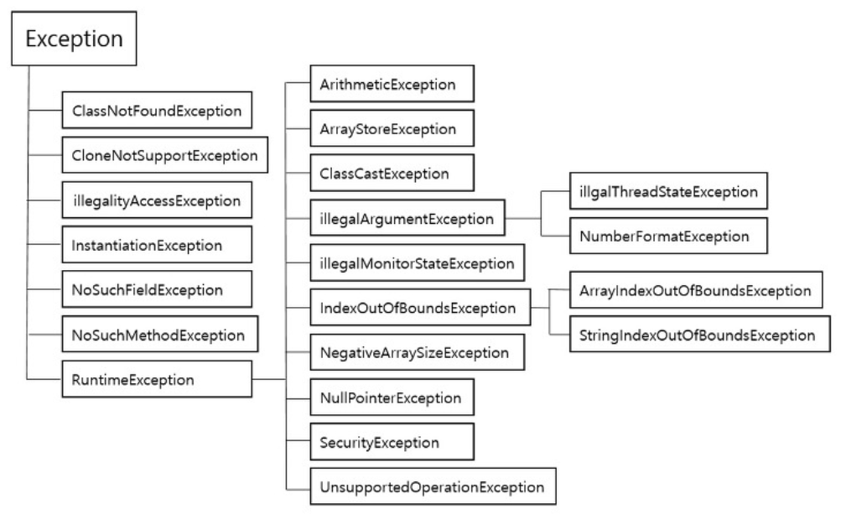
Exception Class
checked exception
-예외처리 필수
-외부의 영향
Unchecked exception
-Try-catch하지 않아도 ok
-개발자의 실수
http://cris.joongbu.ac.kr/course/java/api/java/lang/Exception.html

Slide 17
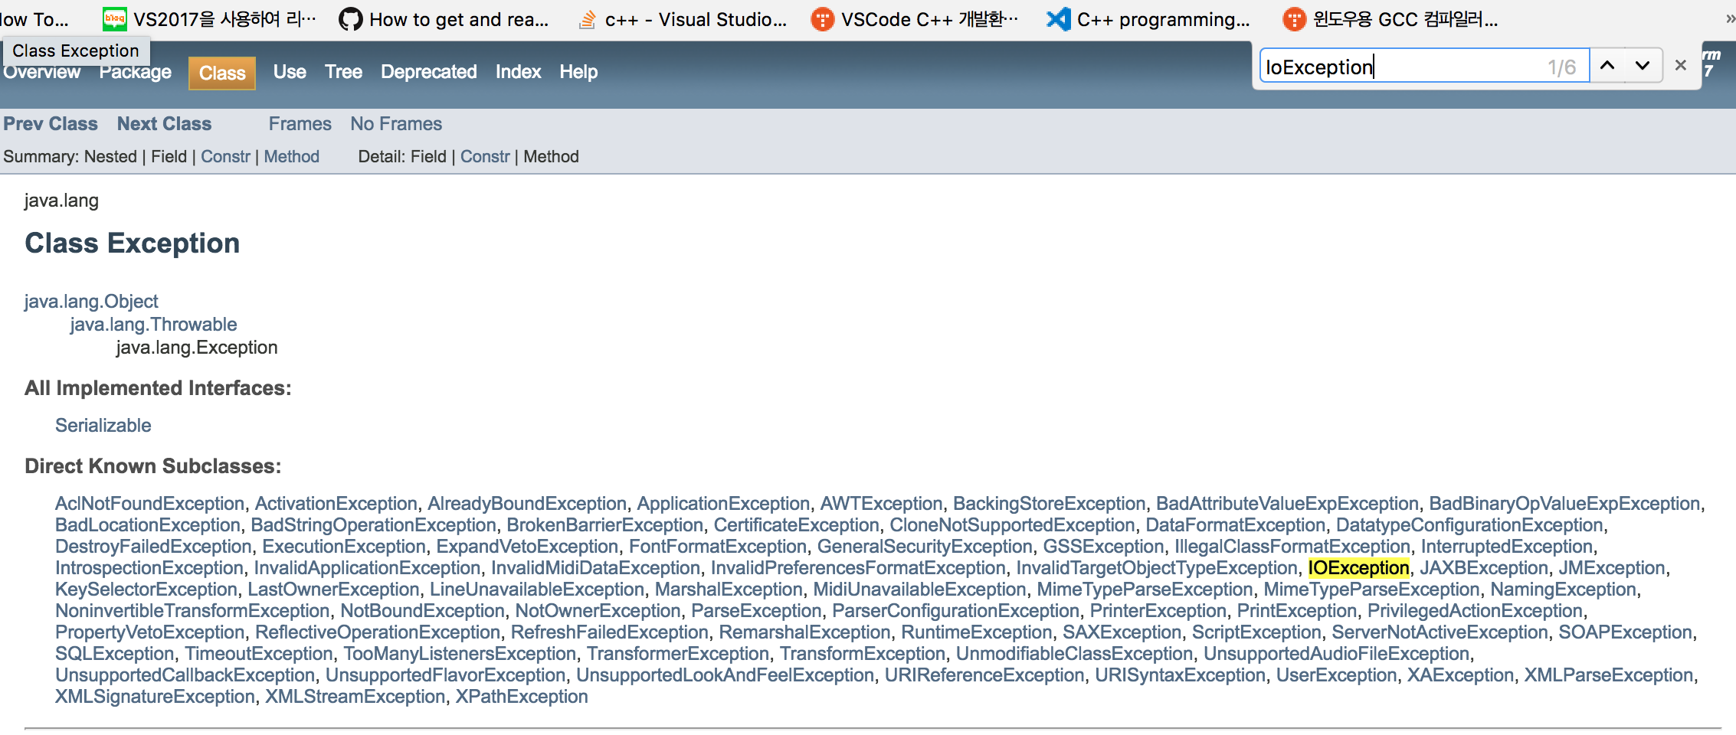
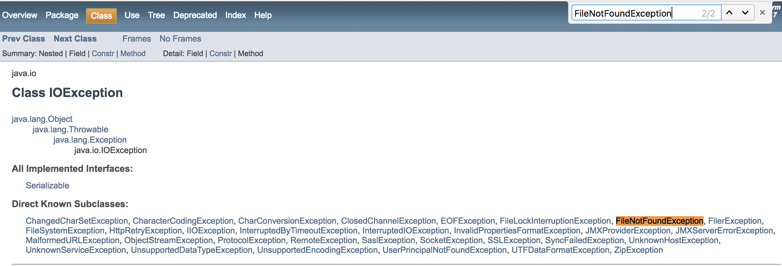
Extends Exception class

Slide 18
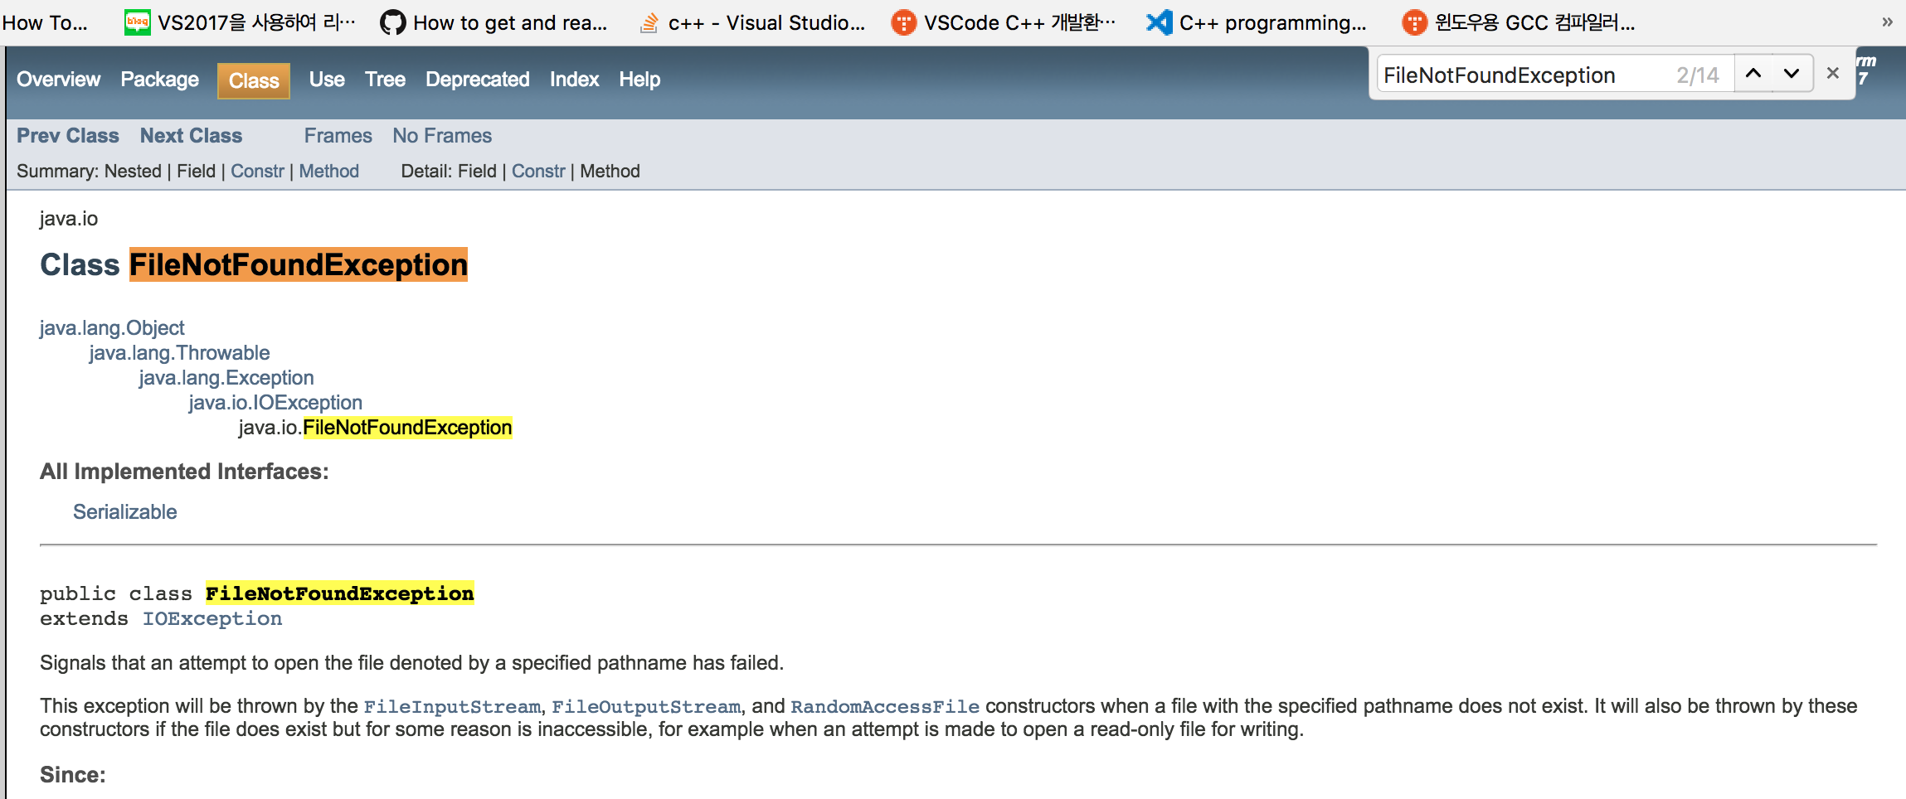
Extends IOException class
It is hierarchical!!

Slide 19
Exception Class
checked
unchecked
http://cris.joongbu.ac.kr/course/java/api/java/lang/Exception.html

Slide 20
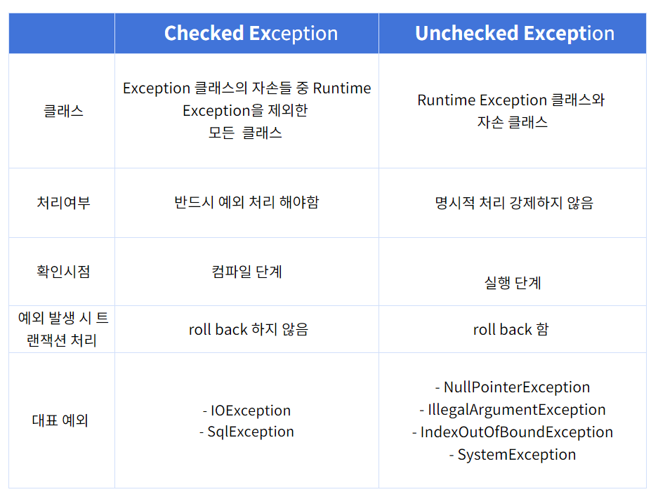
Exception Class(정리)

Slide 21
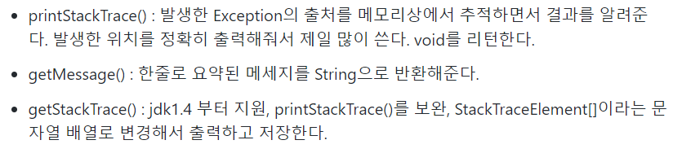
Exception Object Method

Slide 22
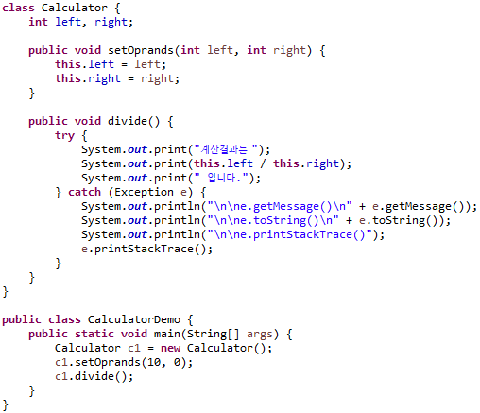
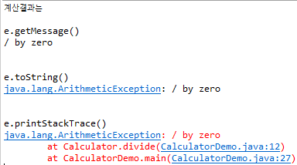
Example

Slide 23
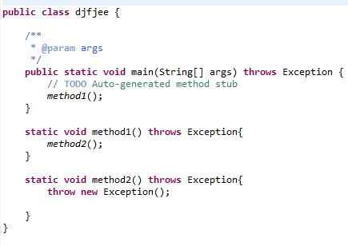
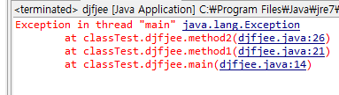
‘throws’ keyword
Throw가 발생하는 곳에서 에러 처리하는 것이 아니라 thorw를 호출하는 곳에서 처리하도록 위임함
Exception not caught and handled so program crashes

Slide 24
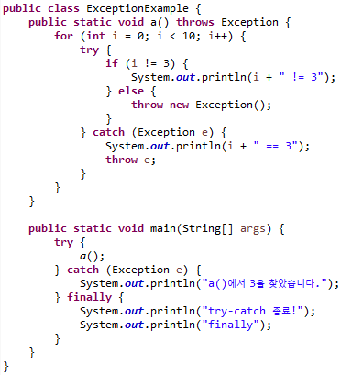
Example
Main a()에서 try-catch로 감싸는 이유??
a()의 catch문에서 throw e로 인해 에러를 메인으로 위임
Output : (빈칸예상)
0 != 3
1 != 3
2 != 3
3 == 3
a()에서 3을 찾았습니다.
try-catch 종료!
finally
Throws vs try-catch
개발자 마음대로 사용

Slide 25
User Define Exception
예외 클래스 정의
Class 예외 클래스 명 extends Exception | RuntimeException{
public 예외 클래스 명(){ //생성자
super(“예외 정보“); //부모 생성자 호출
}
}
예외 발생
throw new 예외 클래스 명(매개변수);
예외 클래스 처리
try-catch (예외가 발생한 메소드에서)
throws(예외가 발생한 메소드를 호출한 다른 메소드에서)
Checked / unchecked

Slide 26
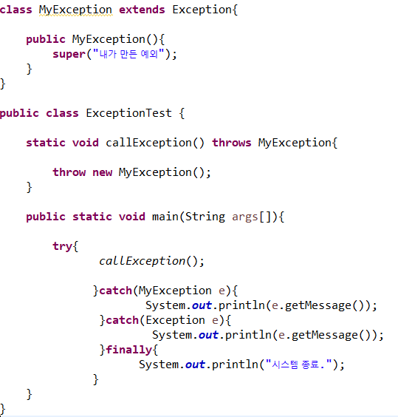
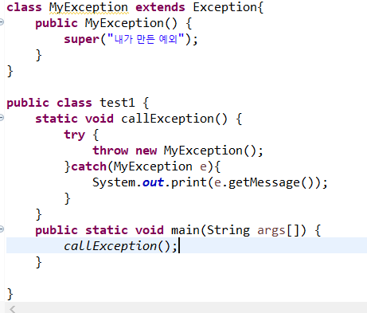

User Define Exception
1)상속
Try-catch로 구현
2)생성자
Thorws로 구현 했기 때문에 main에서 예외가 발생한다 -> 메인에서 try-catch구문 사용
3)예외클래스 처리
메인에서 throw new MyException하지 않는 이유??
-> try – catch 했으니 안해도 ㄱㅊ

