Slide 1
Object Oriented Programming
Lab #11

Slide 2
Content
System.in, System.out, and System.err
setInt()
setOut()
setErr()
The File class
Binary File
The RandomAccessFile Class

Slide 3
System.in, System.out, System.err
The standard streams System.in, System.out, and System.err are automatically available to every Java program.
System.out is used for normal screen output.
System.err is used to output error messages to the screen.
표준스트림 …은 모든 자바프로그램에서 이용가능합니다.
system.out은 일반적으로 화면 출력에 사용됩니다
Err는 에러메세지를 screen에 보여주기 위해 사용됩니다.
System.in(out/err) : Println 클래스를 참조하는 변수

Slide 4
System.in, System.out, System.err
The java.lang.System class contains several useful class fields and methods.
static PrintStream err : This is the "standard" error output stream.
static InputStream in − This is the "standard" input stream.
static PrintStream out − This is the "standard" output stream.
public static void setIn(InputStream inStream)
public static void setOut(PrintStream outStream)
public static void setErr(PrintStream outStream)
표준 에러 output stream이다.
(stream으로 screen에 출력할지 file에 출력할지 아래의 함수로 결정)

Slide 5
System.in, System.out, System.err
Using these methods, any of the three standard streams can be redirected.
For example, instead of appearing on the screen, error messages could be redirected to a file.
PrintStream errStream = null;
try {
errStream = new PrintStream(new
FileOuptputStream("errMessages.txt"));
System.setErr(errStream);
. . . //Set up input stream and read
}

Slide 6
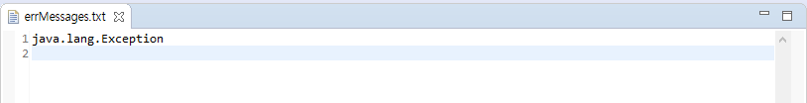
Example
public class SystemErrDemo {
public static void main(String[] args) {
PrintStream errStream = null;
try {
errStream = new PrintStream(new FileOutputStream("errMessages.txt"));
System.setErr(errStream);
throw new Exception();
} catch (Exception e) {
System.err.println(e);
}
}
}
Output:

Slide 7
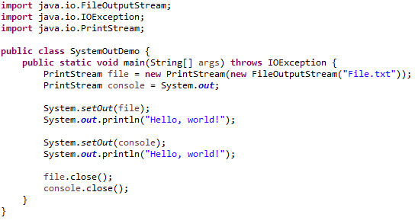
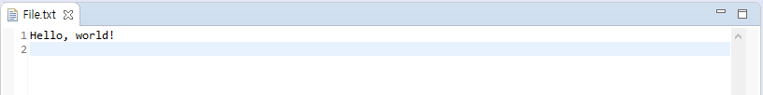
Example
Output:

Slide 8
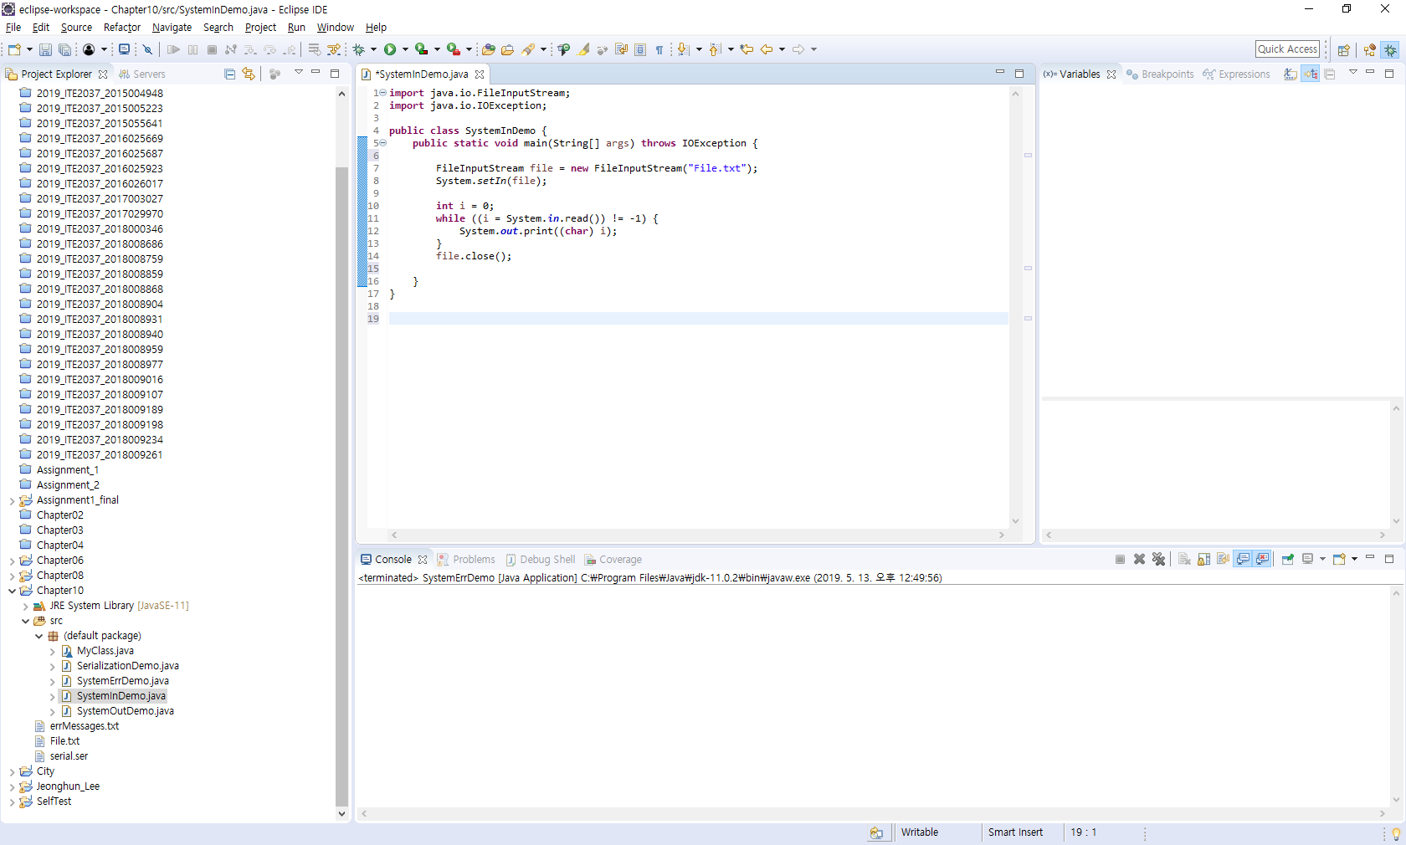
Self Test
Output:
Hello, world!
???

Slide 9
The File Class
The File class is like a wrapper class for file names.
The constructor for the class File takes a name, (known as the abstract name) as a string argument, and produces an object that represents the file with that name.
The File object and methods of the class File can be used to determine information about the file and its properties.
The File is in the java.io.package.
생성자는 파일이름을 argument로 받고, 받은 이름을 나타내는 object를 생성한다
파일 클래스의 메소드는 파일정보를 알려준다

Slide 10
Some Methods in the class File
public File(String pathname)
A constructor. pathname can be either a full or a relative path name (which includes the case of a simple file name). pathname is referred to as the abstract path name.
public boolean exists()
Tests whether there is a file with the abstract path name.
public boolean canRead()
Tests whether the program can read from the file. Returns true if the file named by the abstract path name exists and is readable by the program; otherwise returns false.
public boolean canWrite()
Tests whether the program can write to the file. Returns true if the file named by the abstract path name exists and is writable by the program; otherwise returns false.

Slide 11
Some Methods in the class File
public boolean setReadOnly()
Sets the file represented by the abstract path name to be read only. Returns true if successful; otherwise returns false.
public boolean delete()
Tries to delete the file or directory named by the abstract path name. A directory must be empty to be removed. Returns true if it was able to delete the file or directory. Returns false if it was unable to delete the file or directory.
public boolean createNewFile()throws IOException
Creates a new empty file named by the abstract path name, provided that a file of that name does not already exist. Returns true if successful, and returns false otherwise.

Slide 12
Some Methods in the class File
public String getName()
Returns the last name in the abstract path name (that is, the simple file name). Returns the empty string if the abstract path name is the empty string.
public String getPath()
Returns the abstract path name as a String value.
public boolean isFile()
Returns true if a file exists that is named by the abstract path name and the file is a normal file; otherwise returns false. The meaning of normal is system dependent. Any file created by a Java program is guaranteed to be normal.
public boolean isDirectory()
Returns true if a directory (folder) exists that is named by the abstract path name; otherwise returns false.

Slide 13
Some Methods in the class File
public boolean mkdir()
Makes a directory named by the abstract path name. Will not create parent directories. See mkdirs, which follows. Returns true if successful; otherwise returns false.
public boolean mkdirs()
Makes a directory named by the abstract path name. Will create any necessary but nonexistent parent directories. Returns true if successful; otherwise returns false. Note that if it fails, then some of the parent directories may have been created.
public long length()
Returns the length in bytes of the file named by the abstract path name. If the file does not exist or the abstract path name designates a directory, then the value returned is not specified and may be anything.
만들고자 하는 상위 디렉토리또한 생성

Slide 14
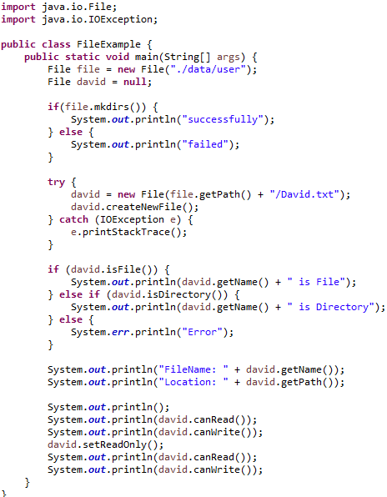
Example
Output:
failed
David.txt is File
FileName: David.txt
Location: .\data\user\David.txt
true
true
true
false

Slide 15
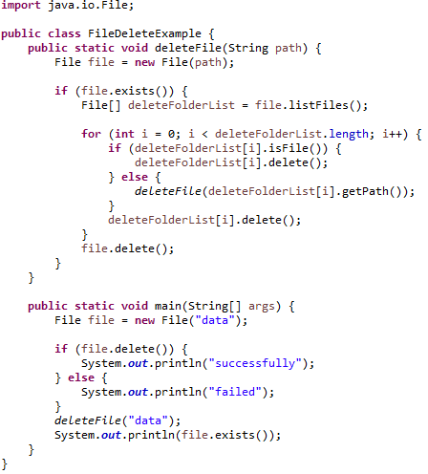
Example
Output:
failed
false
파일 내부의 폴더에 들어가 모든 파일 삭제
디렉터리 안에 파일 모두 삭제한 후 디렉토리 삭제
User, david가 존재

Slide 16
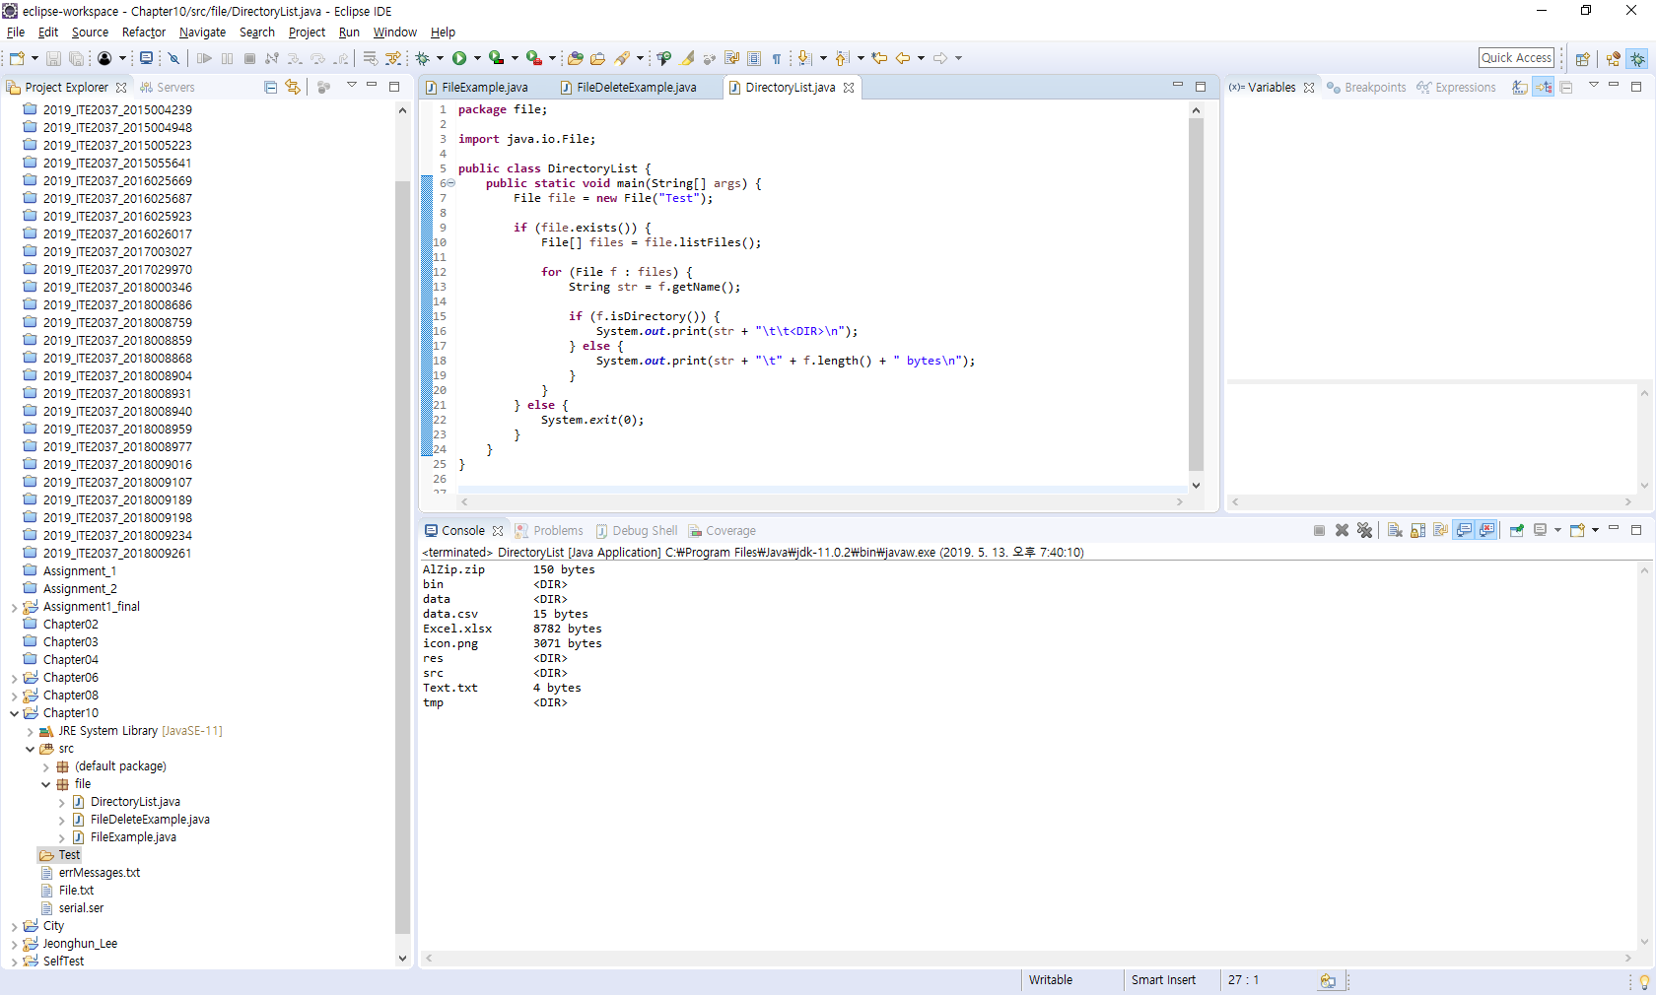
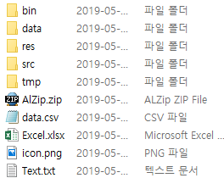
Self Test
???

Slide 17
Binary Files
Binary files store data in the same format used by computer memory to store the values of variables.
No conversion needs to be performed when a value is stored or retrieved from a binary file.
Java binary files, unlike other binary language files, are portable.
A binary file created by a Java program can be moved from one computer to another.
These files can then be read by a Java program, but only by a Java program.
자바 바이너리파일은 다른 컴퓨터에서 사용가능but 자바프로그램에서만 실행

Slide 18
Binary Files
The class ObjectOutputStream is a stream class that can be used to write to a binary file.
An object of this class has methods to write strings, values of primitive types, and objects to a binary file.
A program using ObjectOutputStream needs to import several classes from package java.io:
import java.io.ObjectOutputStream;
import java.io.FileOutStream;
import java.io.IOException;

Slide 19
The Serializable Interface
Binary file로 바꾸는 방법 : serializable
In order to make a class serializable, simply add implements Serializable to the heading of the class definition
public class SomeClass implements Serializable
When a serializable class has instance variables of a class type, then all those classes must be serializable also
A class is not serializable unless the classes for all instance variables are also serializable for all levels of instance variables within classes.

Slide 20
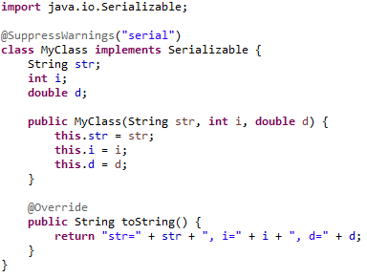
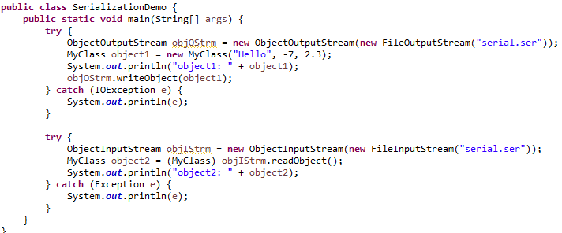
Example
Output:
object1: str=Hello, i=-7, d=2.3
object2: str=Hello, i=-7, d=2.3
직렬화
역직렬화

Slide 21
Serialize the graph
A FileOutputStream is created that refers to a file named "serial", and an ObjectOutputStream is created for that file stream.
invoking writeObject( ) of the class ObjectOutputStream to serialize the object of FileOutputStream.
The object of FileOutputStream is flushed and closed.
ObjectOutputStream is used to create binary representation of Serializable objects

Slide 22
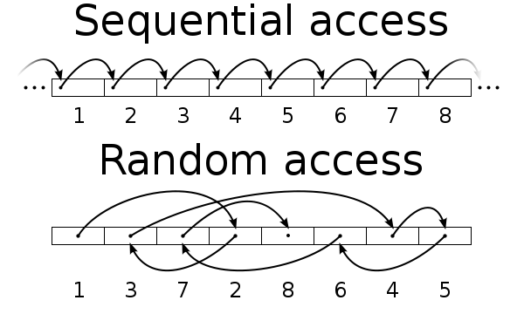
Random Access Files
Random access files are files in which records can be accessed in any order.
Also called direct access files.
More efficient than sequential access files

Slide 23
Random Access Files
The class RandomAccessFile is in the java.io.package.
public RandomAccessFile(String fileName, String mode)
public RandomAccessFile(File fileObject, String mode)
Opens the file, dose not delete data already in the file, but does position the file pointer at the first location.
RandomAccessFile raf;
raf = new RandomAccessFile("input.txt", "rw");
RandomAccessFile raf;
raf = new RandomAccessFile(new File("input.txt"), "rw");

Slide 24
Random Access Files
Table 1: RandomAccessFile Mode
Mode | Remarks
“r” | The file is opened in a read-only mode.
“rw” | The file is opened in a read-write mode. The file is created if it dose not exist.
“rws” | The file is opened in a read-write mode. Any modifications to the file’s content and its metadata are written to the storage device immediately.
“rwd” | The file is opened in a read-write mode. Any modifications to the file’s content are written to the storage device immediately.
e.g. RandomAccessFile raf = new RandomAccessFile(file, ”rw”);

Slide 25
Random Access Files
public long getFilePointer()
Returns the current location of the file pointer. Locations are numbered starting with 0.
public void seek(long location) throws IOException
Moves the file pointer to the specified location.
public long length() throws IOException
Returns the length of the file.
public void setLength(long newLength) throws IOException
Sets the length of this file.

Slide 26
Example
public class RandomAccessFileDemo {
public static void main(String[] args) {
File file = new File("input.txt");
try {
RandomAccessFile raf = new RandomAccessFile(file, "rw");
raf.writeInt(100); // 4 bytes
raf.writeUTF("Hello, world!"); // 2 + 1*13 = 15 bytes
raf.writeUTF("안녕하세요"); // 2 + 3*5 = 17 bytes
System.out.println(raf.length()); // 4 + 15 + 17 = 36 bytes
raf.seek(0);
System.out.println("" + raf.readInt());
raf.seek(4);
System.out.println(raf.readUTF());
raf.seek(19);
System.out.println(raf.readUTF());
raf.close();
} catch (IOException ex) {
ex.printStackTrace();
}
}
}

Slide 27
Q & A

