Slide 1
Object Oriented Programming
Lab #13

Slide 2
Content
ArrayList
Generics

Slide 3
ArrayList class
ArrayList is a class in the standard Java libraries
java.util.ArrayList
An ArrayList is a dynamic data structure.
This means
Items can be added and removed from the list.
The length can grow or shrink as items are added and removed.

Slide 4
ArrayList vs Arrays
A normal array in java is a static data structure, because you stuck with the initial size of your array.
An ArrayList serves the same purpose as an array, except that an ArrayList can change length while the program is running.

Slide 5
ArrayList class
ArrayList<Integer> a =new ArrayList<Integer>()
a.add(10)
a.add(10)
a.add(new Integer(10))
a.add(new Integer(10))
Things to know about ArrayLists.
The base type of an ArrayList must be a class type (or other reference type):
It cannot store primitive types.
Primitive types must be boxed into their Wrapper class before they can be used.
ArrayLists are less efficient than Arrays.

Slide 6
Using ArrayList
To set up an ArrayList, you first have to
import the package from the java.util library:
import java.util.ArrayList;
Specify the base type
ArrayList<BaseType> aList = new ArrayList<BaseType>();
It is possible to specify the initial size of the ArrayList.
ArrayList<String> aList = new ArrayList<String>(20);
하지만 값을 안 넣으면 길이 0

Slide 7
ArrayList Notation
With regular Arrays it is easy to access items at specific indices of the array using [ ].
String str = myArray[i]; myArray[j] = “Hello”;
ArrayLists do not provide the convenient [ ] notation. Instead the
get(index), set(index, object) and add(object) methods may be used.
String[] myArray = {“a”}
String str = myArrayList.get(i); myArrayList.set(j, “Hello”);
q Note: set cannot be used to initialize an item. It can only replace existing items.

Slide 8
ArrayList Notation
To insert items into the ArrayList for the first time you can use the .add() method.
myArrayList.add(“Goodbye”); myArrayList.add(“cruel”);
myArrayList.add(“world.”);
q This adds items sequentially into the ArrayList i.e. 0,1,2…
Goodbye | cruel | world
0 | 1 | 2 | 3 | 4 | …

Slide 9
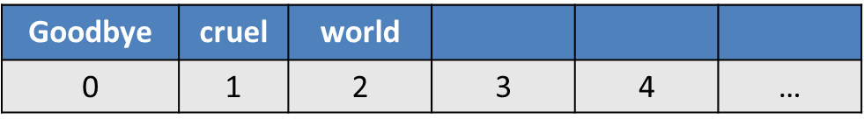
ArrayList Notation
The add() method is overloaded and can accept another parameter. This allows you to insert at a specific index. add(index, object)
myArrayList.add(“Goodbye”); myArrayList.add(“world”); myArrayList.add(1,“cruel.”);
q The items from index 1 are shifted to allow for the word “cruel” to be inserted.
Goodbye | world
0 | 1 | 2 | 3 | 4 | …

Slide 10
ArrayList Notation
The determine the number of elements stored in the ArrayList we can do so by using the .size() method.
System.out.println(myArrayList.size());
3

Slide 11
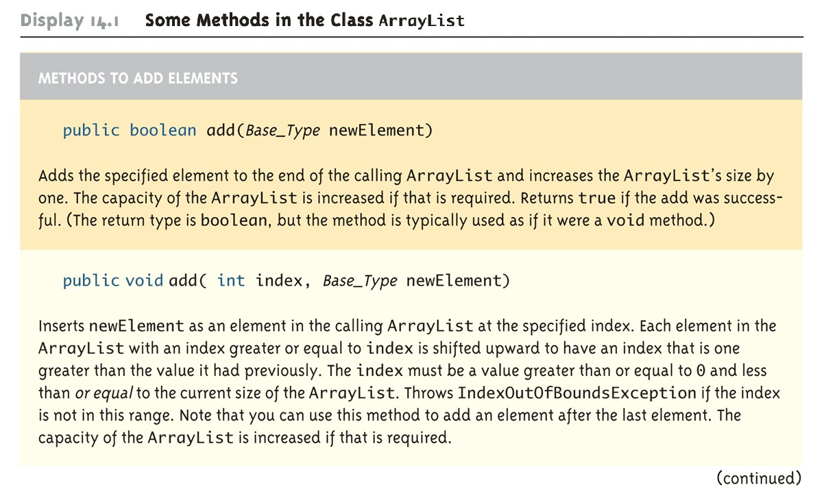
Array list class

Slide 12
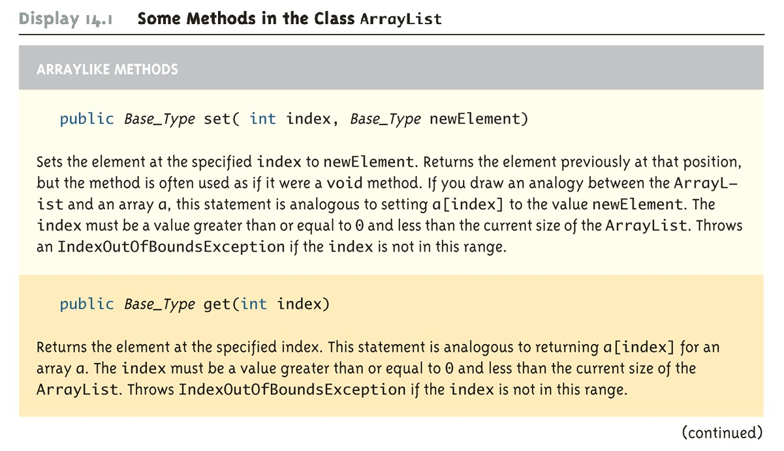
Array list class

Slide 13
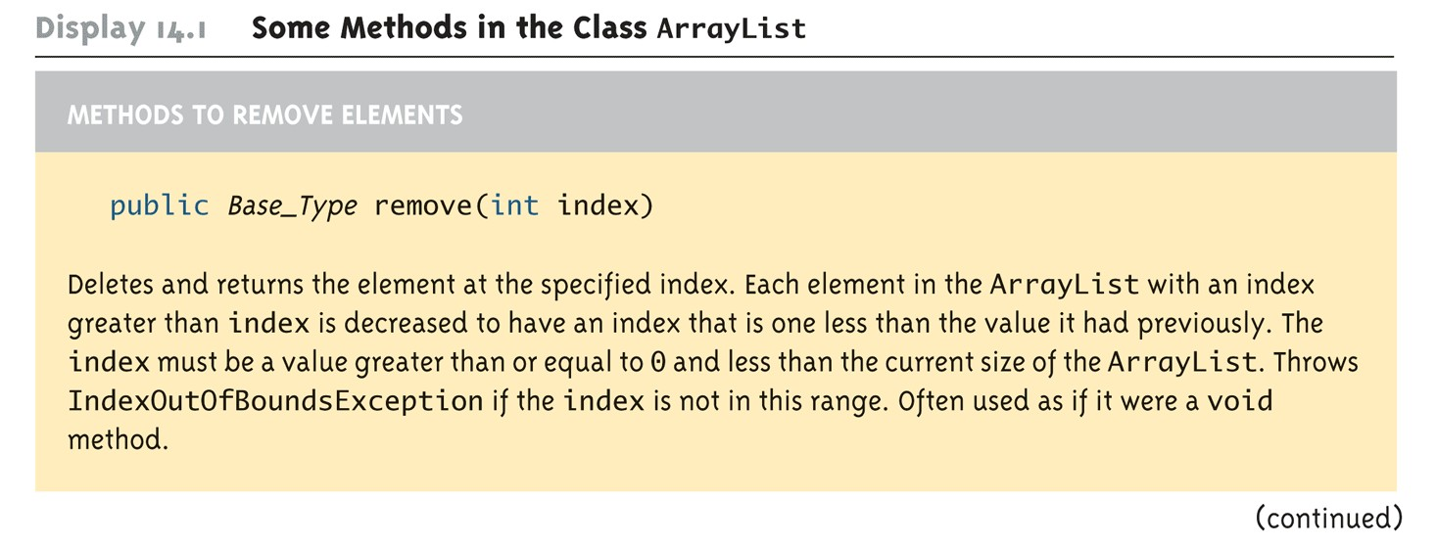
Array list class

Slide 14
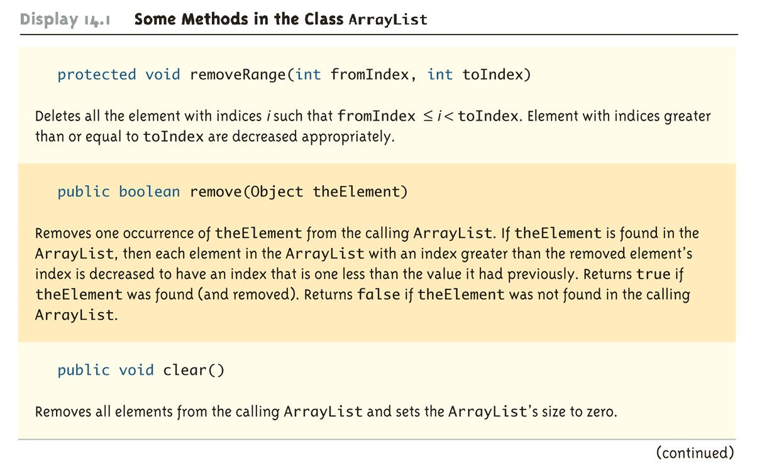
Array list class

Slide 15
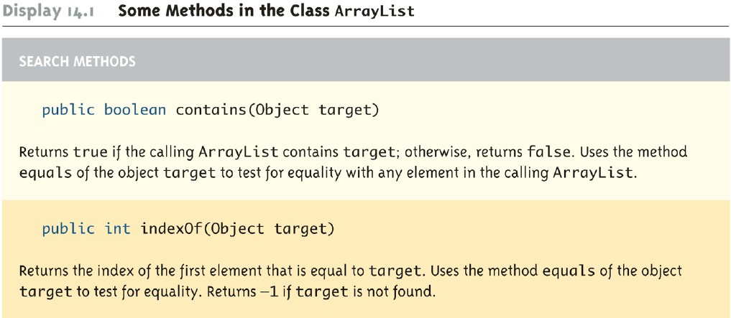
Array list class

Slide 16
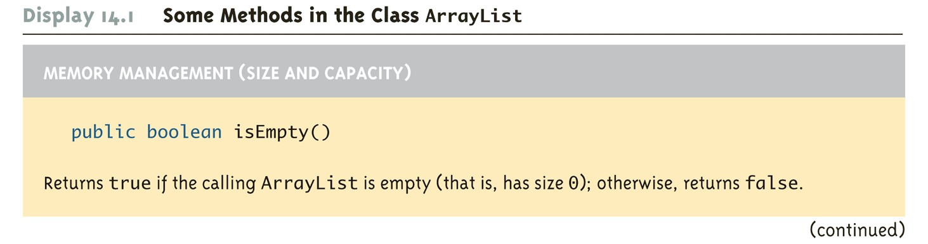

Array list class

Slide 17
For each loop
As with arrays, the For-each loop can be used to cycle through (iterate) all the elements in an collection (like an ArrayList)
for(variable : collection){ Statements;
}

Slide 18
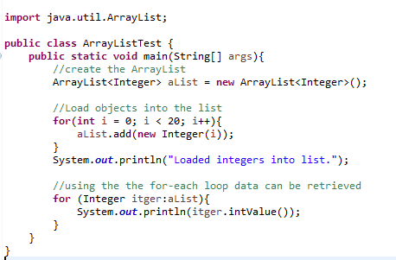
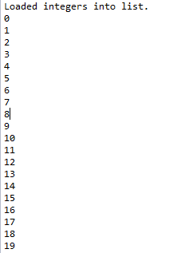
For each loop
Why is the for-each loop not used here?

Slide 19
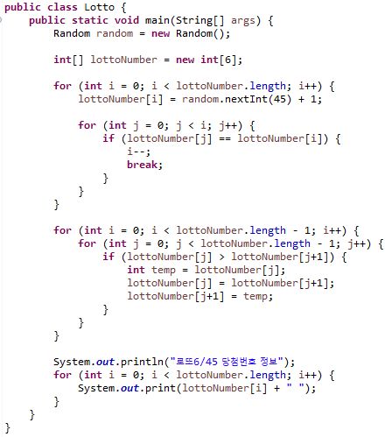
Self Test
ArrayList
Sort
For Each

Slide 20
Iterator interface
An iterator is an object that is used with a collection to provide sequential access to the collection’s elements.
This access allows examination and possible modification of the elements.

Slide 21
ArrayList Iterator
Iterators know how to iterate the internal data structure.
For ArrayLists the iterator knows how to iterate the list.
To use an Iterator you must obtain it from the ArrayList.
Iterator iterator = myArrayList.iterator();
q Obtain an iterator over the ArrayList named myArrayList

Slide 22
ArrayList Iterator
Iterator
Iterators provide methods for traversing the internal structure:
boolean next()
Object hasNext()
void remove()
q Returns the next item from the internal structure
q Returns true if there are more items in the structure
q Removes the current item from the structure.

Slide 23
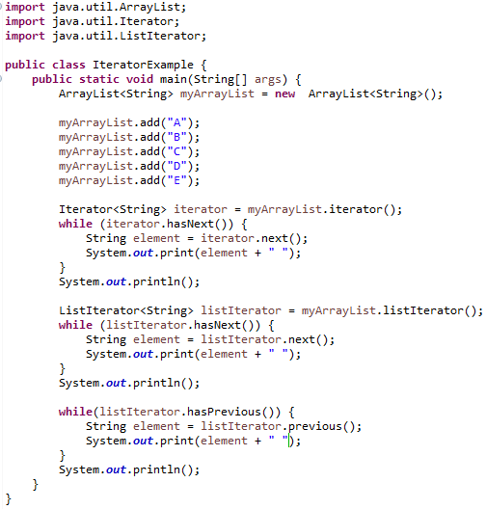
List Iterator example
Output:
A B C D E
A B C D E
E D C B A
현 iterator 기준으로 previous하기 때문에 거꾸로 출력하려면 끝까지 iterator를 보내야함
Iterator를 상속받는 listIterator

Slide 24
Generics
It would be nice if we could write a single sort method that could sort the elements in an Integer array, a String array or an array of any type that supports ordering.
Using Java Generic concept we might write a generic method for sorting an array of objects, then invoke the generic method with Integer arrays, Double arrays, String arrays and so on, to sort the array elements.
A way to re-use the same code with different inputs

Slide 25
Parameterized Classes and Generics
The class ArrayList is a parameterized class
It has a parameter, denoted by Base_Type, that can be replaced by any reference type to obtain a class for ArrayLists with the specified base type
ArrayList<BaseType> aList = new ArrayList<BaseType>();
Starting with version 5.0, Java allows class definitions with parameters for types
These classes that have type parameters are called parameterized class or generic definitions, or simply, generics

Slide 26
Generics Class
A class definition with a type parameter is called a generic class
The type parameter is included in angular brackets after the class name in the class definition heading
The type parameter can be used like other types used in the definition of a class
Public class myClass <T>{
//the generic type is used in here
}
The type plugged in for a type parameter must always be a reference type
– It cannot be a primitive type such as int, double, or char

Slide 27
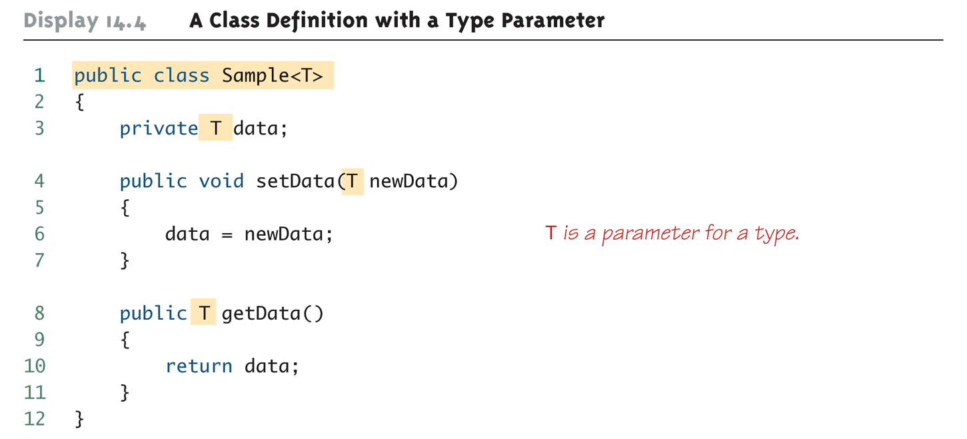
Defining Generic Class

Slide 28
Using Generic Class
To use a generic class you must
Plug the type of the parameter.
This is done by using < >.
e.g. if we would like to create a sample object from previous slide we can do this.
Sample<String> object = new Sample<String>();

Slide 29
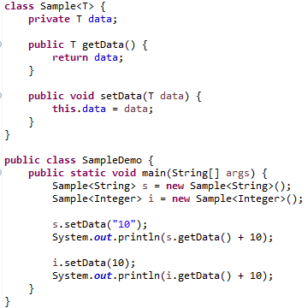
Example
Output:
1010
20

Slide 30
Java Generic Type Naming convention
E – Element (mainly used by Java Collections framework.)
K – Key (Used in Map)
V – Value (Used in Map)
N – Number
T – Type
S,U,V etc. – 2nd, 3rd, 4th types

Slide 31
Multiple generic parameters
It is possible to use multiple generic parameters in a single class. This may be done by listing the parameters.
public class myClass <T, U> {
//the generic types are used in here
}

Slide 32
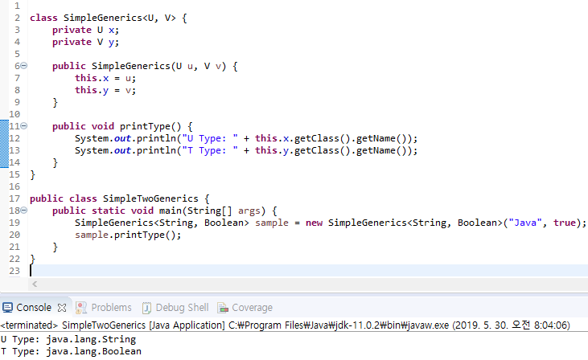
Multiple generic parameters example

Slide 33
Bounds with Generic Class
Public class myClass <T extends Comparable>{
//this forces T to be only Comparable types
}
You may also bind the generic to multiple types however as with regular types you can
Be bound to multiple interfaces
Be bound to only one class
Public class myClass <T extends Employee & Comparable & Iterable >{
//this forces T to be only Comparable types and
//T must be a descendant (sub-class) of Employee
// The extended class (Employee) must be listed first.
}

Slide 34
Bounds with Generic Class example (Part 1 of 2)
class A {
public void printClass() {
System.out.println("A");
}
}
class B extends A {
public void printClass() {
System.out.println("B");
}
}
class BoundExample<T extends A> {
private T refVal;
public BoundExample(T obj) {
this.refVal = obj;
}
public void test() {
this.refVal.printClass();
}
}

Slide 35
Bounds with Generic Class example (Part 2 of 2)
public class BoundsDemo {
public static void main(String[] args) {
BoundExample<A> a = new BoundExample<A>(new A());
a.test();
BoundExample<B> b = new BoundExample<B>(new B());
b.test();
}
}
output:
A
B
New B()가능 -> B출력

Slide 36
Generic Methods
The type parameter must be placed (in angular brackets) after all the modifiers, and before the returned type
q Accepts T array as a parameter and returns type T
public static <T> T getMethod(T[] a)
When one of these generic methods is invoked, the method name is prefaced with the type to be plugged in, enclosed in angular brackets
String s = NonGenClass.<String>getMethod(c);

Slide 37
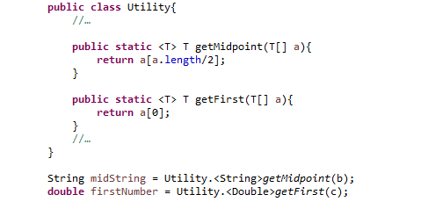
Generics Method sample

Slide 38
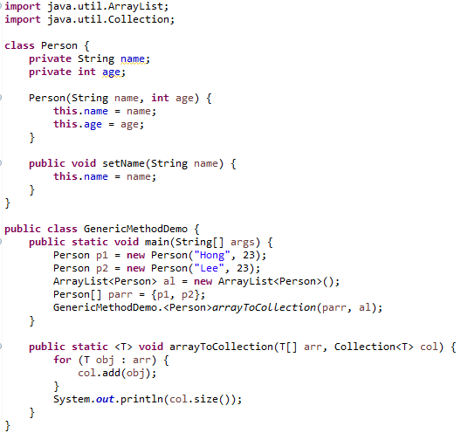
Generics Method Example 2
Output:
2

Slide 39
Q & A

